Slide 1
KAT8-KD RNA-seq: Sex-Combining Validation & Analysis Decision
Parts 7.6 + 7.7 | Sex x Genotype interaction testing & model comparison
Adipose Depot Analysis: iWAT & gWAT
Validation run: 2026-02-18 | Decision: ~ 0 + GroupDepot (unified, no Sex covariate)

Slide 2
Study Design
2 x 2 factorial design: Sex (F, M) x Genotype (CTL, KAT8-KD)
Two adipose depots analyzed separately: iWAT and gWAT
40 samples total, 2 outliers removed (JS_08, JS_28) -> 38 samples
Per depot: 19 samples (after outlier removal)
Group sizes per depot:
CTL Female: 5 | KAT8-KD Female: 4
CTL Male: 5 | KAT8-KD Male: 5
KEY: We have BOTH sexes in every group.
Question: should we account for sex in our statistical model?

Slide 3
The Central Question
Does KAT8 knockdown affect gene expression differently in males versus females?
Why this matters: 1. If YES for most genes: We must analyze males and females separately (splitting would halve our sample size -> less power to detect effects) 2. If NO for most genes: We can include sex as a COVARIATE (this absorbs sex-related noise -> MORE power to detect KD effects) 3. NIH and most journals now require addressing sex as a biological variable (SABV)

Slide 4
Background: What is a Covariate?
A covariate is a variable you ACCOUNT FOR in your statistical model
but are NOT directly interested in testing.
ANALOGY: Imagine measuring the effect of a drug on blood pressure.
- Your variable of interest: Drug vs. Placebo
- A covariate: Patient age (affects blood pressure but isn't what you're testing)
- By accounting for age, you REMOVE age-related noise from the measurement
- This makes it easier to see the true drug effect
In our experiment:
- Variable of interest: KAT8 knockdown effect (Genotype: CTL vs KAT8-KD)
- Covariate: Sex (F vs M) -- affects gene expression but isn't our focus
- By telling the model 'some variance is due to sex,' it can SUBTRACT
that variance and see the genotype effect more clearly
Result: MORE statistical power to detect true KAT8 knockdown effects

Slide 5
Background: Two Possible DESeq2 Models
MODEL A: ~ Genotype (what we had before)
- Compares KAT8-KD vs CTL, ignoring sex entirely
- Any gene expression difference between M and F becomes 'noise'
- The model has to 'see through' this noise to find KD effects
MODEL B: ~ Sex + Genotype (the new model)
- First accounts for M vs F baseline differences (the covariate)
- THEN tests KAT8-KD vs CTL on the sex-adjusted expression
- Less noise -> more statistical power -> more DEGs detected
IMPORTANT: Model B does NOT mean 'analyze males and females separately'
- All samples stay in ONE analysis (maximum sample size)
- Sex is just 'controlled for,' like adjusting for age in clinical studies
BUT: Model B is only valid IF the KD effect is similar in M and F.
If males and females respond completely differently to KD,
we would need to split them. That's what we test next.

Slide 6
Method: Likelihood Ratio Test (LRT)
Testing whether the KD effect depends on sex
Tool: DESeq2 (Bioconductor), run separately per depot
Full model: ~ Sex + Genotype + Sex:Genotype
Reduced model: ~ Sex + Genotype
What is Sex:Genotype (the 'interaction term')?
It captures genes where the KD effect DIFFERS between males and females.
Example: Gene X goes UP in female KD but DOWN in male KD -> strong interaction
Example: Gene Y goes UP equally in both sexes -> NO interaction
The LRT asks: for each gene, does adding the interaction term
significantly improve how well the model fits the data?
If p < 0.05 -> that gene's KD response truly differs between M and F
If p >= 0.05 -> the KD effect is the same in both sexes (what we want!)
We also run 4 complementary analyses to build the full picture:
(1) Pi0 estimation (2) Variance decomposition (3) Sex-stratified concordance (4) Model comparison (Part 7.7)

Slide 7
Background: How to Read a P-value Histogram
When we test thousands of genes, we get one p-value per gene.
Plotting these p-values as a histogram reveals the big picture:
SCENARIO 1: All genes are truly null (no real interaction anywhere)
-> P-values are UNIFORMLY distributed (flat histogram, like a table)
-> Each bar has roughly the same height
SCENARIO 2: Some genes have real interactions
-> There's a SPIKE near p = 0 (real signal produces small p-values)
-> The rest of the histogram stays flat (the true nulls)
What you'll see in our data:
-> Mostly FLAT (most genes have no sex-dependent KD response)
-> Small spike near p = 0 (a few genes do differ between sexes)
-> Red dashed line = expected height if ALL genes were null
-> Bars above the red line near p = 0 = genes with real interaction signal
The flatter the histogram, the more we can trust that
males and females respond similarly to KAT8 knockdown.

Slide 8
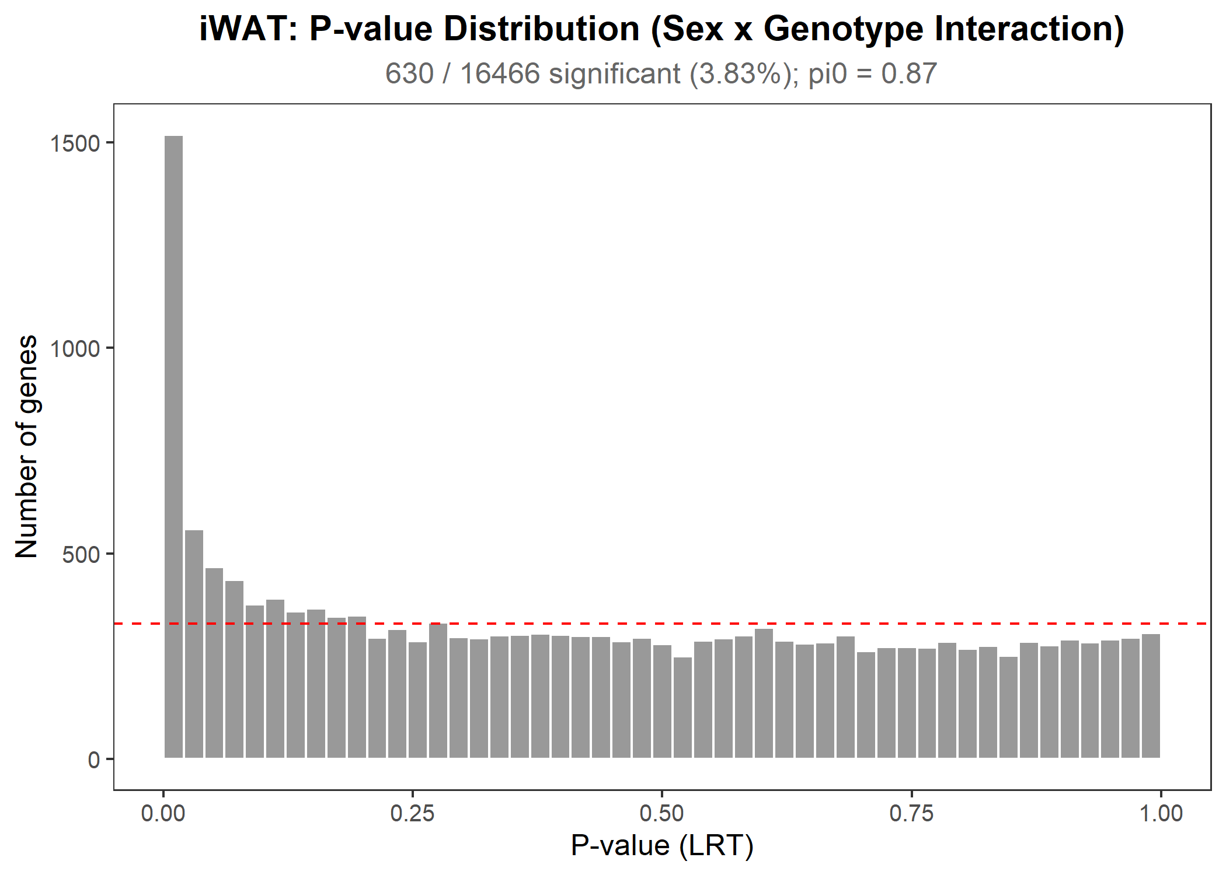
iWAT: LRT Interaction Results
16,466 genes tested (after prefiltering)
630 significant interactions (3.83%, FDR < 0.05)
~96% of genes show NO sex-dependent KD response
How to read the histogram (right):
- Flat distribution = genes with no interaction (null)
- Spike near p=0 = genes with real interaction signal
- Red dashed line = expected count if ALL genes were null
- The histogram is mostly flat -> most genes are null
3.83% is a low interaction rate. For context:
- At FDR < 0.05, we expect ~5% false positives
- So some of these 630 genes are likely false positives
- The true interaction rate is even lower (see pi0 next)

Slide 9
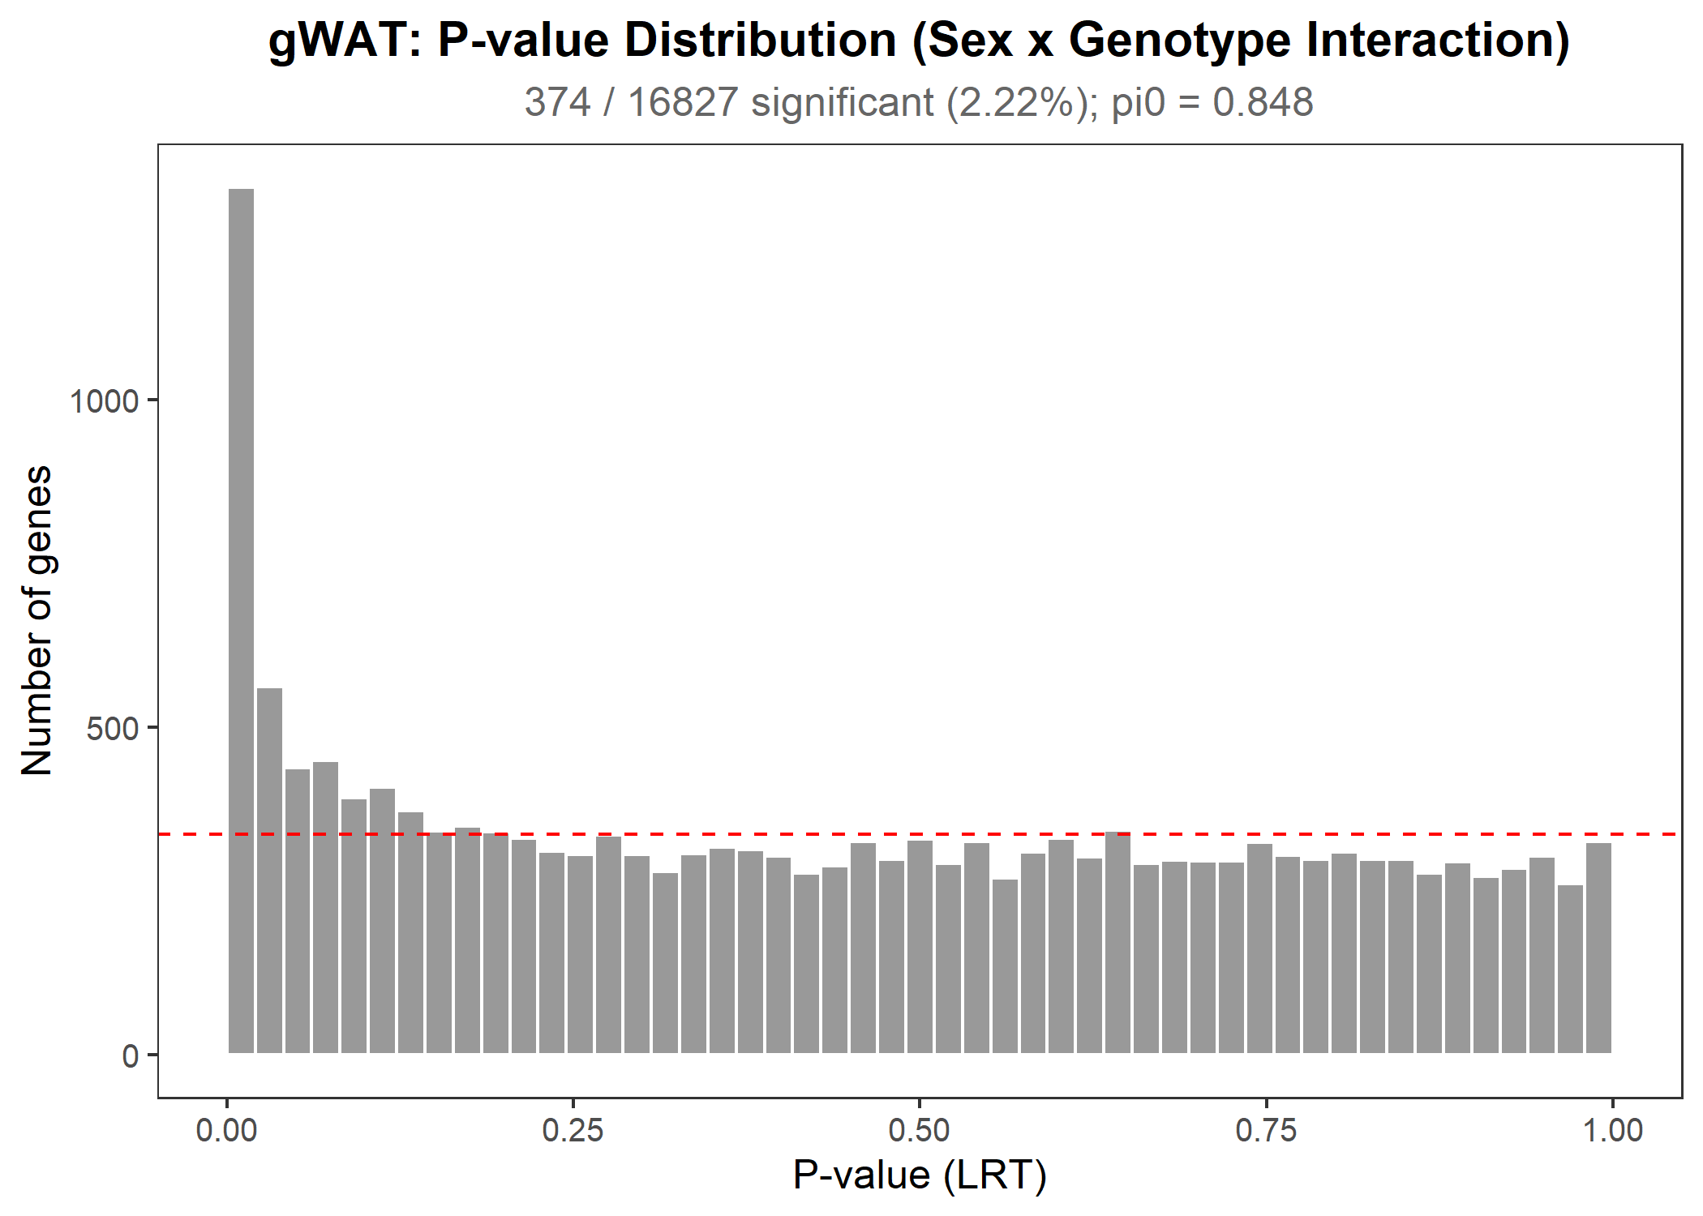
gWAT: LRT Interaction Results
16,827 genes tested (after prefiltering)
374 significant interactions (2.22%, FDR < 0.05)
~98% of genes show NO sex-dependent KD response
Even fewer interaction genes than iWAT (2.2% vs 3.8%),
further supporting sex-independent KD effects.
Why might gWAT have fewer interactions?
- The KD effect is weaker in gWAT overall (fewer DEGs)
- With a weaker main signal, there's less room for
sex-dependent variation to be detected
- This is consistent with what we see in the main analysis:
iWAT shows a stronger KAT8 KD response than gWAT

Slide 10
Background: What is Pi0?
When we test 16,000+ genes, we get a mix of:
- TRUE NULLS: genes where there really is no interaction (what we want!)
- TRUE SIGNALS: genes where the KD effect genuinely differs by sex
- FALSE POSITIVES: genes that look significant by chance
Pi0 (pi-zero) estimates the proportion of TRUE NULLS:
- Pi0 = 0.87 means: 87% of genes genuinely have NO sex-dependent KD response
- The other 13% includes both true interactions AND statistical noise
How is pi0 calculated? (Storey & Tibshirani, 2003)
- If ALL genes were null, p-values would be perfectly uniform
- The method looks at how 'flat' the p-value distribution is away from p=0
- The flat part = true nulls. The spike near p=0 = real signals
Why this matters:
- Pi0 = 0.50 would mean half the genes have sex-dependent effects -> BAD
- Pi0 = 0.95+ would mean almost no genes have sex-dependent effects -> GREAT
- Pi0 = 0.85-0.87 (what we got) -> GOOD: vast majority are sex-independent

Slide 11
Pi0 Results: True Null Proportion
Results:
iWAT: pi0 = 0.8701 -> 87% of genes genuinely have NO interaction
gWAT: pi0 = 0.8483 -> 85% of genes genuinely have NO interaction
What does this mean in plain English?
Imagine lining up all ~16,500 genes in iWAT:
- ~14,350 genes (87%): KAT8 KD has the SAME effect in males and females
- ~2,150 genes (13%): some have real sex-dependent effects, some are noise
Of those 2,150:
- 630 reached statistical significance (FDR < 0.05)
- The rest didn't quite reach significance but may have subtle effects
Bottom line: The vast majority of genes respond identically to KAT8-KD
in both sexes. This strongly supports including sex as a covariate
(rather than splitting the analysis by sex).

Slide 12
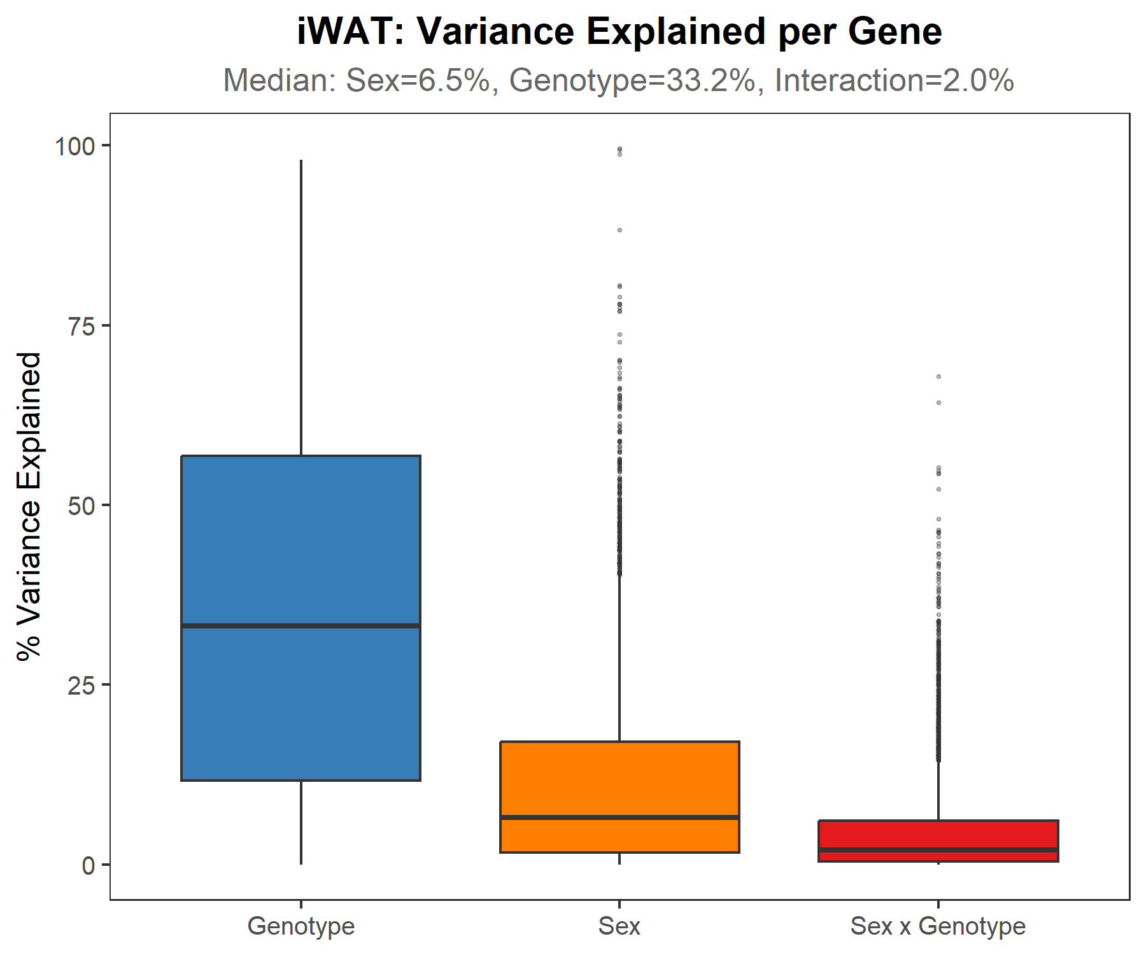
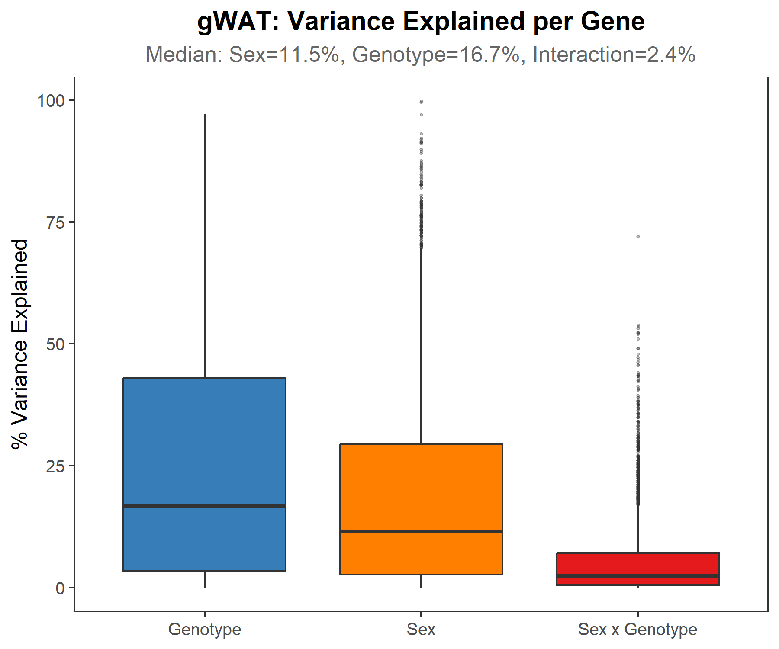
Variance Attribution: What Drives Gene Expression?
For each gene, what fraction of variance comes from Sex, Genotype, or their interaction?
Method: ANOVA on VST-transformed counts:
lm(expression ~ Sex + Genotype + Sex:Genotype)
Term iWAT (median) gWAT (median)
Sex (M vs F) 6.5% 11.5%
Genotype (KD effect) 33.2% 16.7%
Sex x Genotype 2.1% 2.4%
Residual (unexplained) 46.3% 50.1%
iWAT
gWAT
Key takeaway: The interaction term explains only ~2% of variance
vs. 17-33% for the Genotype main effect (8-16x more)
Think of it this way: if gene expression were a pie chart,
the KD effect gets a BIG slice (17-33%),
Sex gets a medium slice (6-12%),
but Sex x KD interaction gets a TINY slice (~2%)

Slide 13
Background: What is Concordance?
Concordance = do males and females AGREE on which genes are affected by KD?
How we test this:
1. Run DESeq2 on FEMALES ONLY -> get a fold change for every gene
2. Run DESeq2 on MALES ONLY -> get a fold change for every gene
3. Plot female fold changes (x-axis) vs male fold changes (y-axis)
4. Compute Pearson correlation (r) -- how well do they match?
Interpreting the scatter plot:
- Points on the diagonal (y = x): perfect agreement (M and F same)
- Points in upper-right quadrant: gene goes UP in both sexes (concordant)
- Points in lower-left quadrant: gene goes DOWN in both sexes (concordant)
- Points in upper-left or lower-right: gene goes UP in one sex but DOWN
in the other (DISCORDANT -- these are the problematic ones)
What r values mean:
r = 1.0: perfect agreement r = 0.7-0.9: strong r = 0.5-0.7: moderate
r < 0.5: poor agreement (males and females respond very differently)

Slide 14
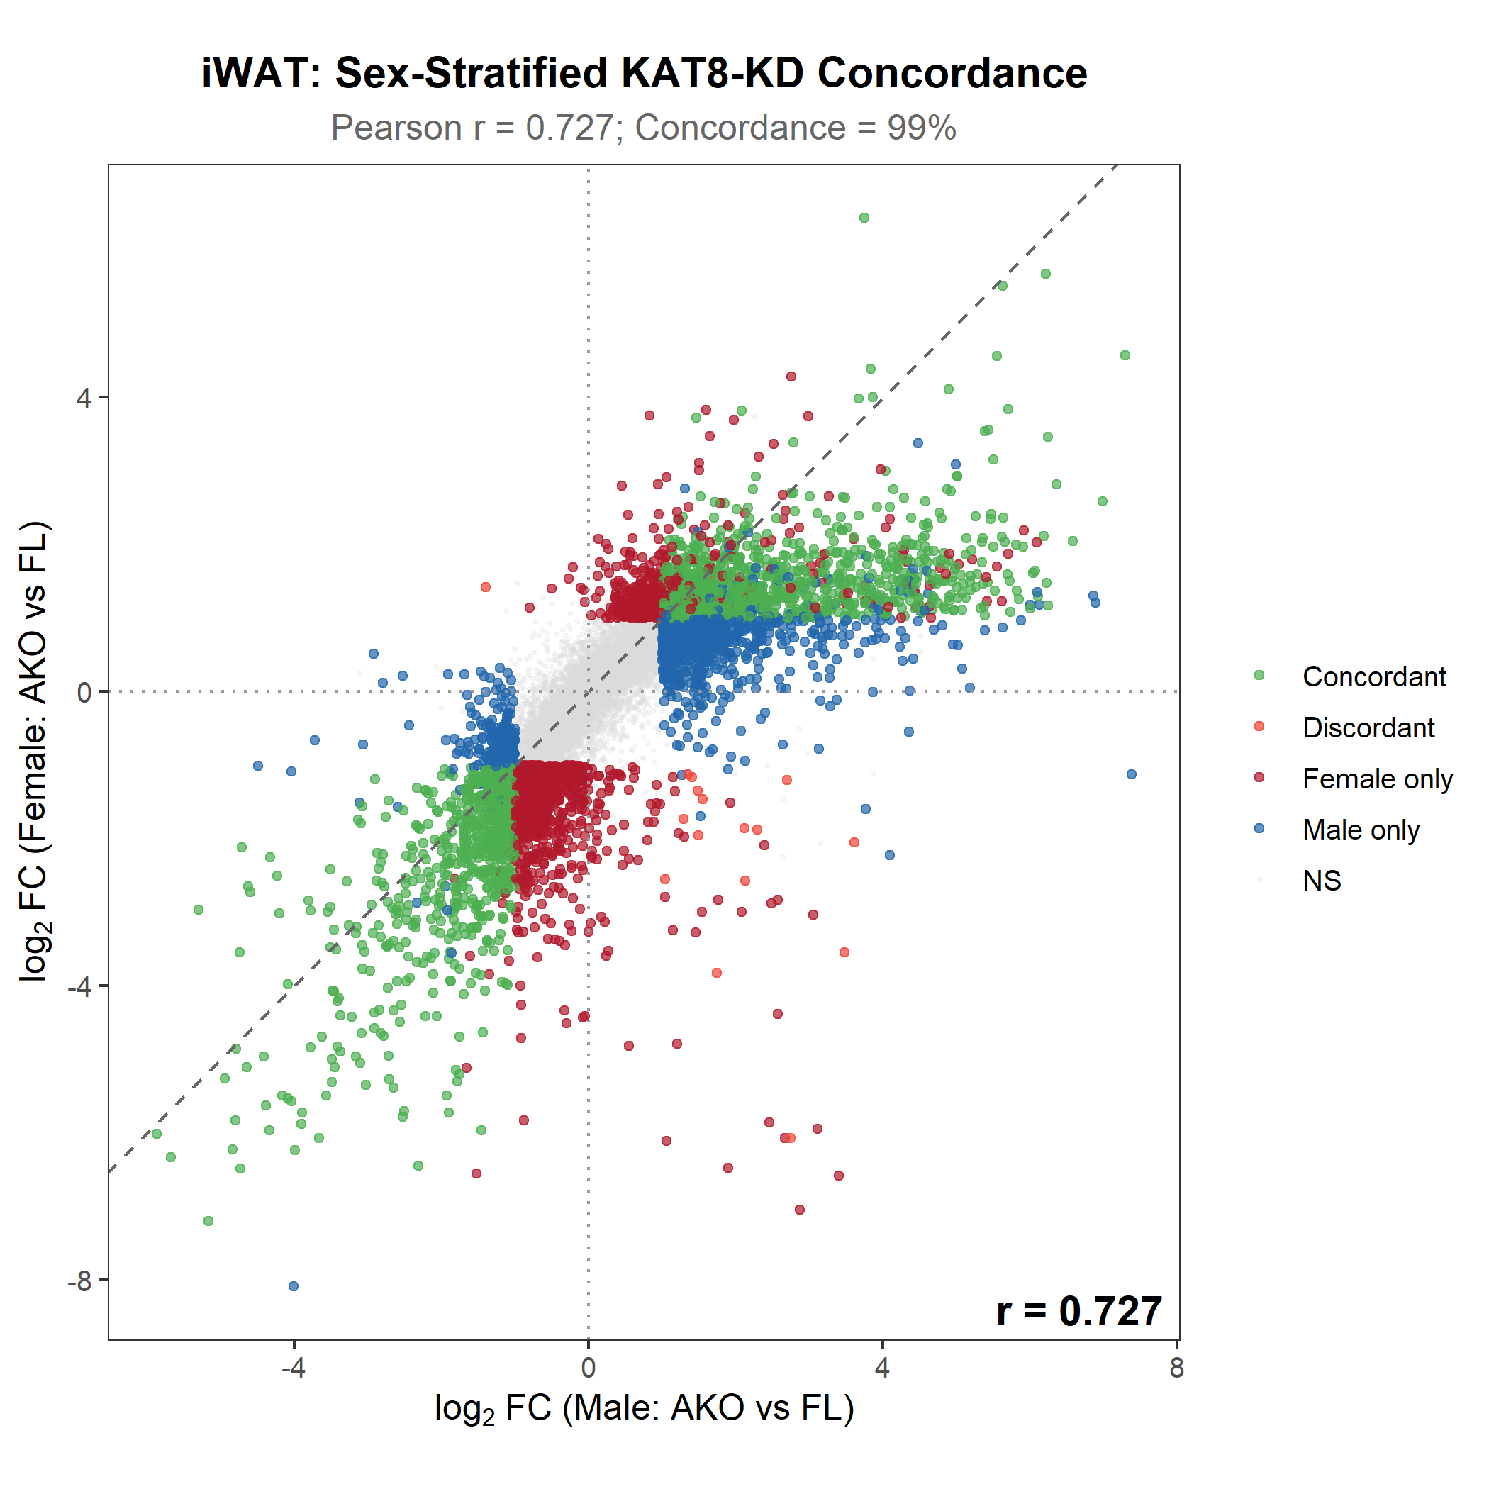
Sex-Stratified Concordance: iWAT
DESeq2 run separately for F-only and M-only, then fold changes correlated
Pearson r = 0.727 (moderate-to-strong concordance)
Directional concordance = 99.0%
What these numbers mean:
r = 0.73: Males and females largely agree on which genes
are affected by KD and how much they change
99.0% directional concordance: Of ALL significant DEGs,
99% go the SAME direction in both sexes. Only 1% are
discordant (up in one sex, down in the other).
Purple dots: significant in BOTH sexes (strongest evidence)
Red dots: significant in F only
Blue dots: significant in M only
Grey dots: not significant in either
Note: r = 0.73 (not 0.99) because with n=4-5 per group,
per-sex analyses are noisy. True concordance is likely higher.

Slide 15
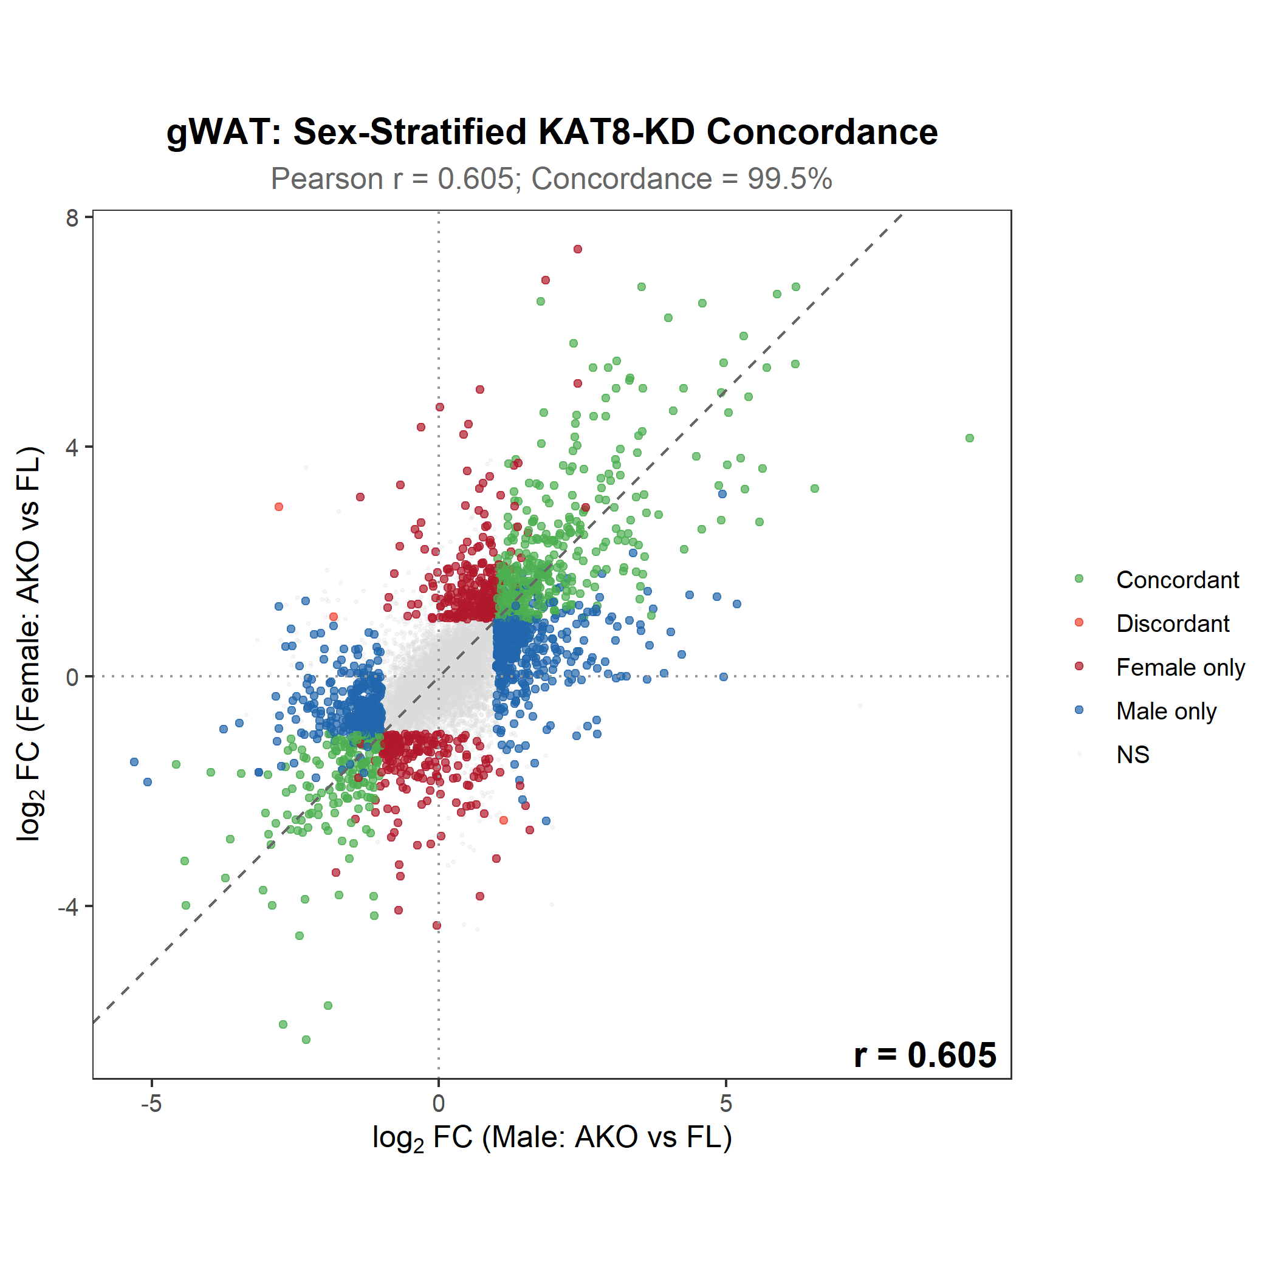
Sex-Stratified Concordance: gWAT
DESeq2 run separately for F-only and M-only, then fold changes correlated
Pearson r = 0.605 (moderate concordance)
Directional concordance = 99.5%
Lower r than iWAT -- why?
Visceral fat (gWAT) has more baseline sex dimorphism than
subcutaneous fat (iWAT). This is well-documented in the
adipose biology literature. Male and female gWAT differ
more at baseline, adding more noise to per-sex analyses.
BUT: 99.5% directional concordance is excellent!
Genes that go up in female gWAT also go up in male gWAT.
The DIRECTION of KD effects is almost perfectly consistent.
The lower r mostly reflects MAGNITUDE differences:
e.g., gene goes up 2-fold in F but 3-fold in M.
This is normal biological variation, not a problem.
Including sex as a covariate handles this optimally.

Slide 16
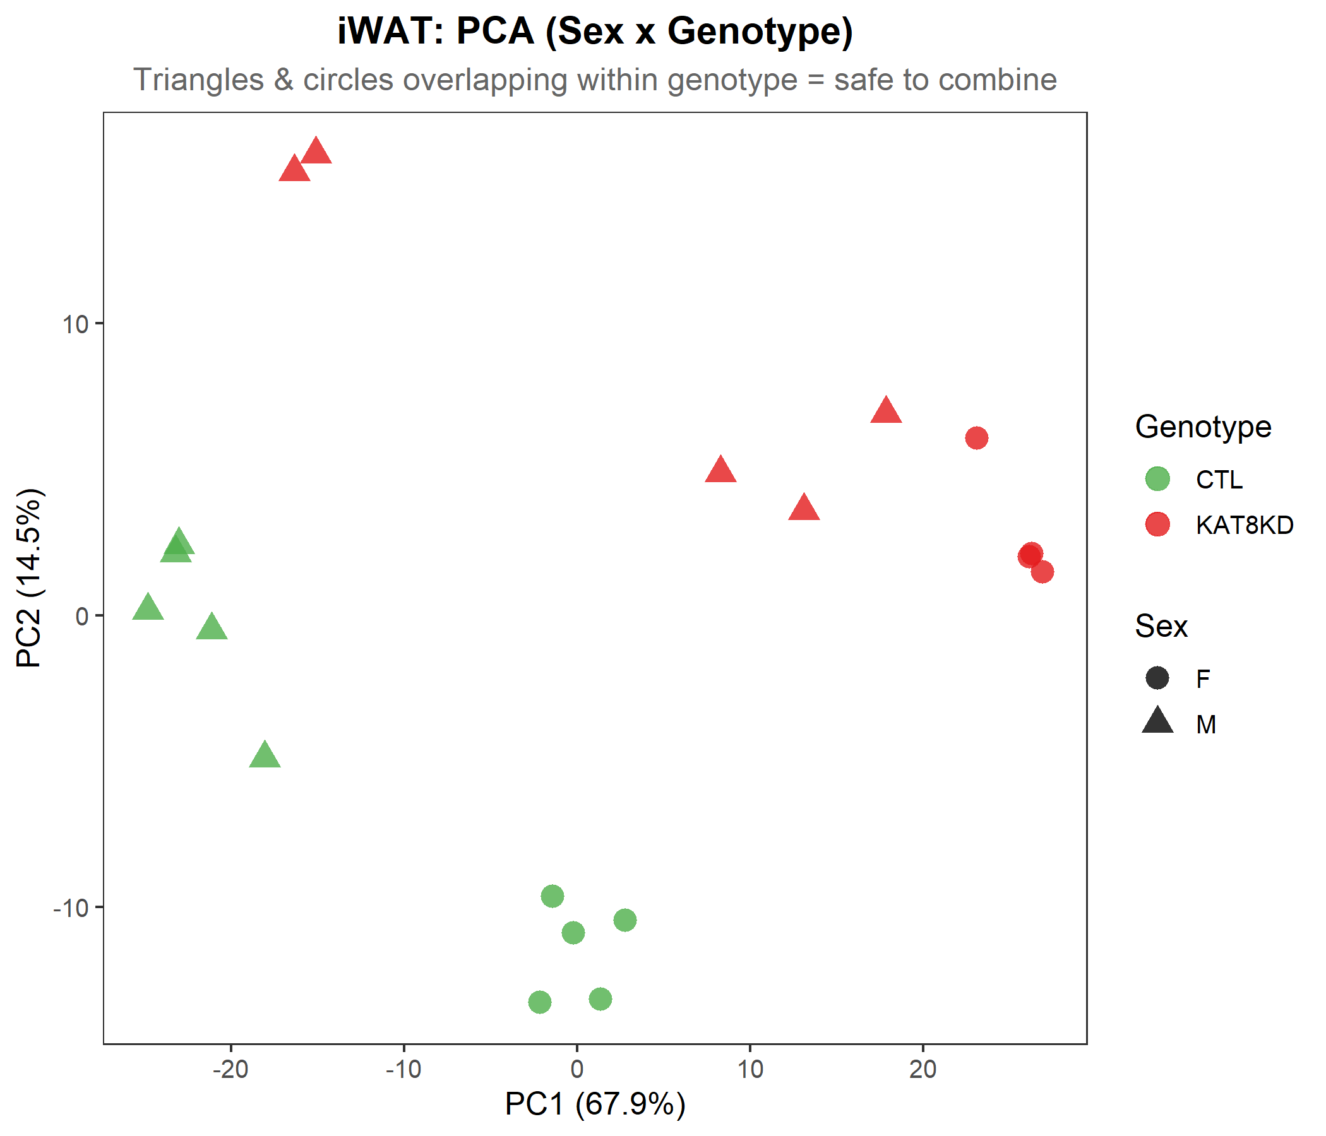
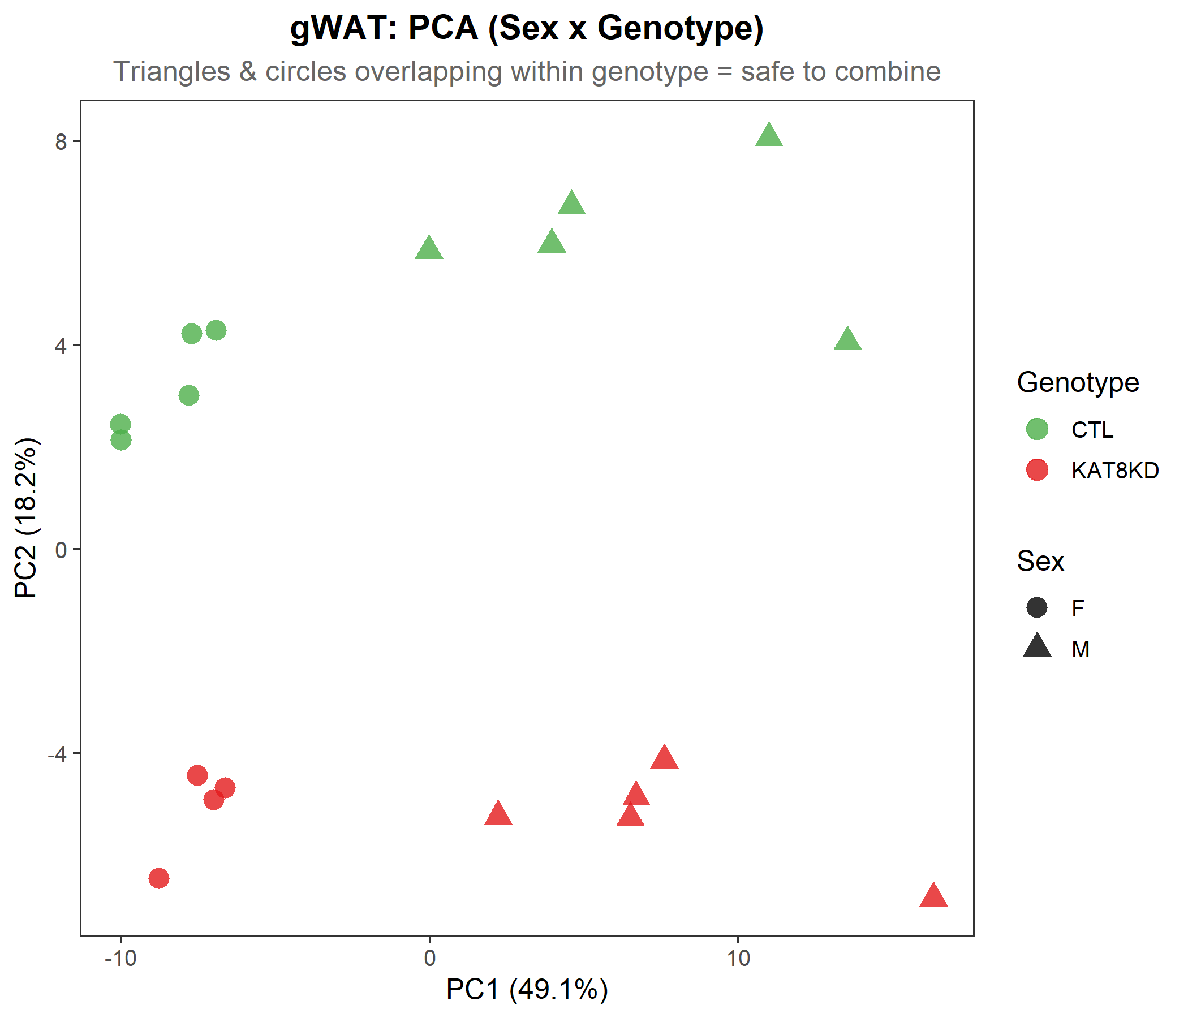
PCA by Sex and Genotype
Principal Component Analysis of top 500 variable genes
How to read this plot:
Color = Genotype (CTL vs KAT8-KD)
Shape = Sex (circle = F, triangle = M)
What to look for:
If M and F of the same genotype cluster together
-> sexes are transcriptionally similar (GOOD)
If M and F of the same genotype separate
-> sex differences dominate (PROBLEMATIC)
What we see: genotype drives separation more than sex,
but male KD samples tend to be slightly more extreme
(further from controls) than female KD samples,
especially in iWAT. This is expected and handled
by the sex covariate in our model.
iWAT
gWAT

Slide 17
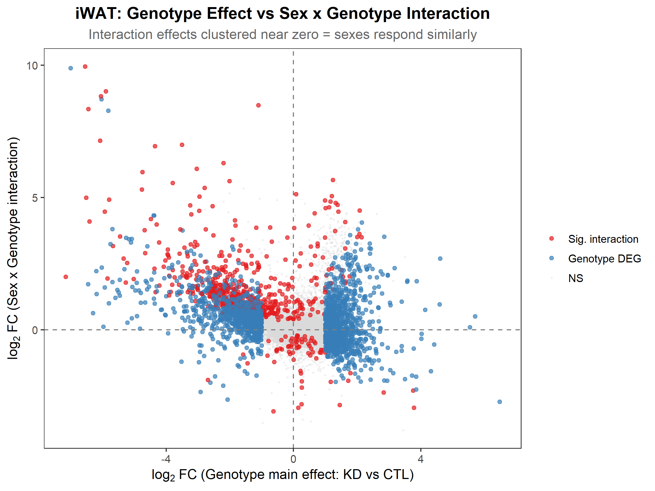
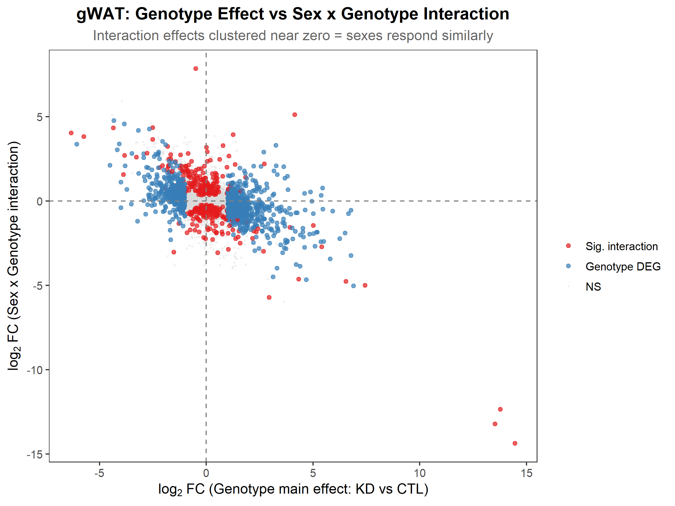
Interaction Effect vs. Genotype Main Effect
This plot directly compares two effects for every gene:
X-axis = Genotype main effect log2FC (how much KD changes the gene)
Y-axis = Interaction log2FC (how much the KD effect DIFFERS by sex)
Red dots: significant interaction genes
Blue dots: significant genotype DEGs (no interaction)
Grey dots: neither significant
What we want to see:
Wide horizontal spread (big genotype effects)
Narrow vertical spread (small interaction effects)
= the KD signal is MUCH bigger than any sex-dependent variation
What we actually see:
Horizontal spread >> vertical spread
Most dots cluster near y = 0 (no interaction)
-> CONFIRMS: genotype effect dominates
iWAT
gWAT

Slide 18
Per-Depot Models: ~ Genotype vs. ~ Sex + Genotype
Part 7.7 Test 3a: At the per-depot level (n ~ 19), adding Sex helps
Per-Depot Comparison | iWAT (n=19) | gWAT (n=19)
~ Genotype (no Sex) | 2,665 DEGs | 1,077 DEGs
~ Sex + Genotype | 3,042 DEGs | 1,131 DEGs
Net DEG change | +377 (+14.1%) | +54 (+5.0%)
Directional concordance | 99.0% | 99.5%
logFC correlation | ~0.999 | ~0.999
At the PER-DEPOT level (n ~ 19), adding Sex gains +14% DEGs in iWAT. Each degree of freedom matters more with fewer samples, so the variance absorbed by Sex outweighs its DF cost. BUT: We use a UNIFIED model (all 38 samples). What happens there? --> Next slide

Slide 19
Unified Models: ~ 0 + GroupDepot vs. ~ Sex + GroupDepot
Part 7.7 Test 3c: At the unified level (n = 38), adding Sex COSTS power
Unified Model Comparison | iWAT contrast | gWAT contrast
~ 0 + GroupDepot (no Sex) | 3,022 DEGs | 1,159 DEGs
~ Sex + GroupDepot | 2,777 DEGs | 1,089 DEGs
Net DEG change | -245 (-8.1%) | -70 (-6.0%)
logFC correlation | 0.939 | 0.967
WHY THE REVERSAL? At n=19 (per-depot), losing 1 DF to Sex = 5.6% of residual evidence lost, but Sex absorbs enough variance to compensate. At n=38 (unified), losing 1 DF = only 2.9% of residual evidence, AND the balanced design already prevents sex from confounding genotype. Result: the DF cost now OUTWEIGHS the variance benefit -> fewer DEGs. DECISION: Use ~ 0 + GroupDepot (the simpler model with MORE power). The two models agree closely (r = 0.94-0.97), so biological conclusions are the same.

Slide 20
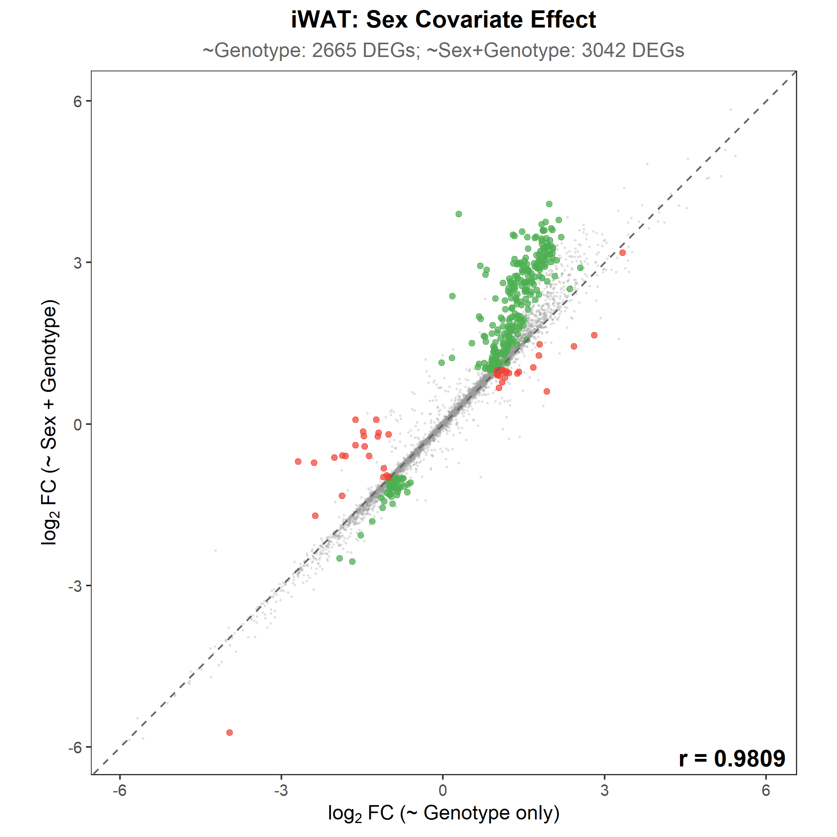
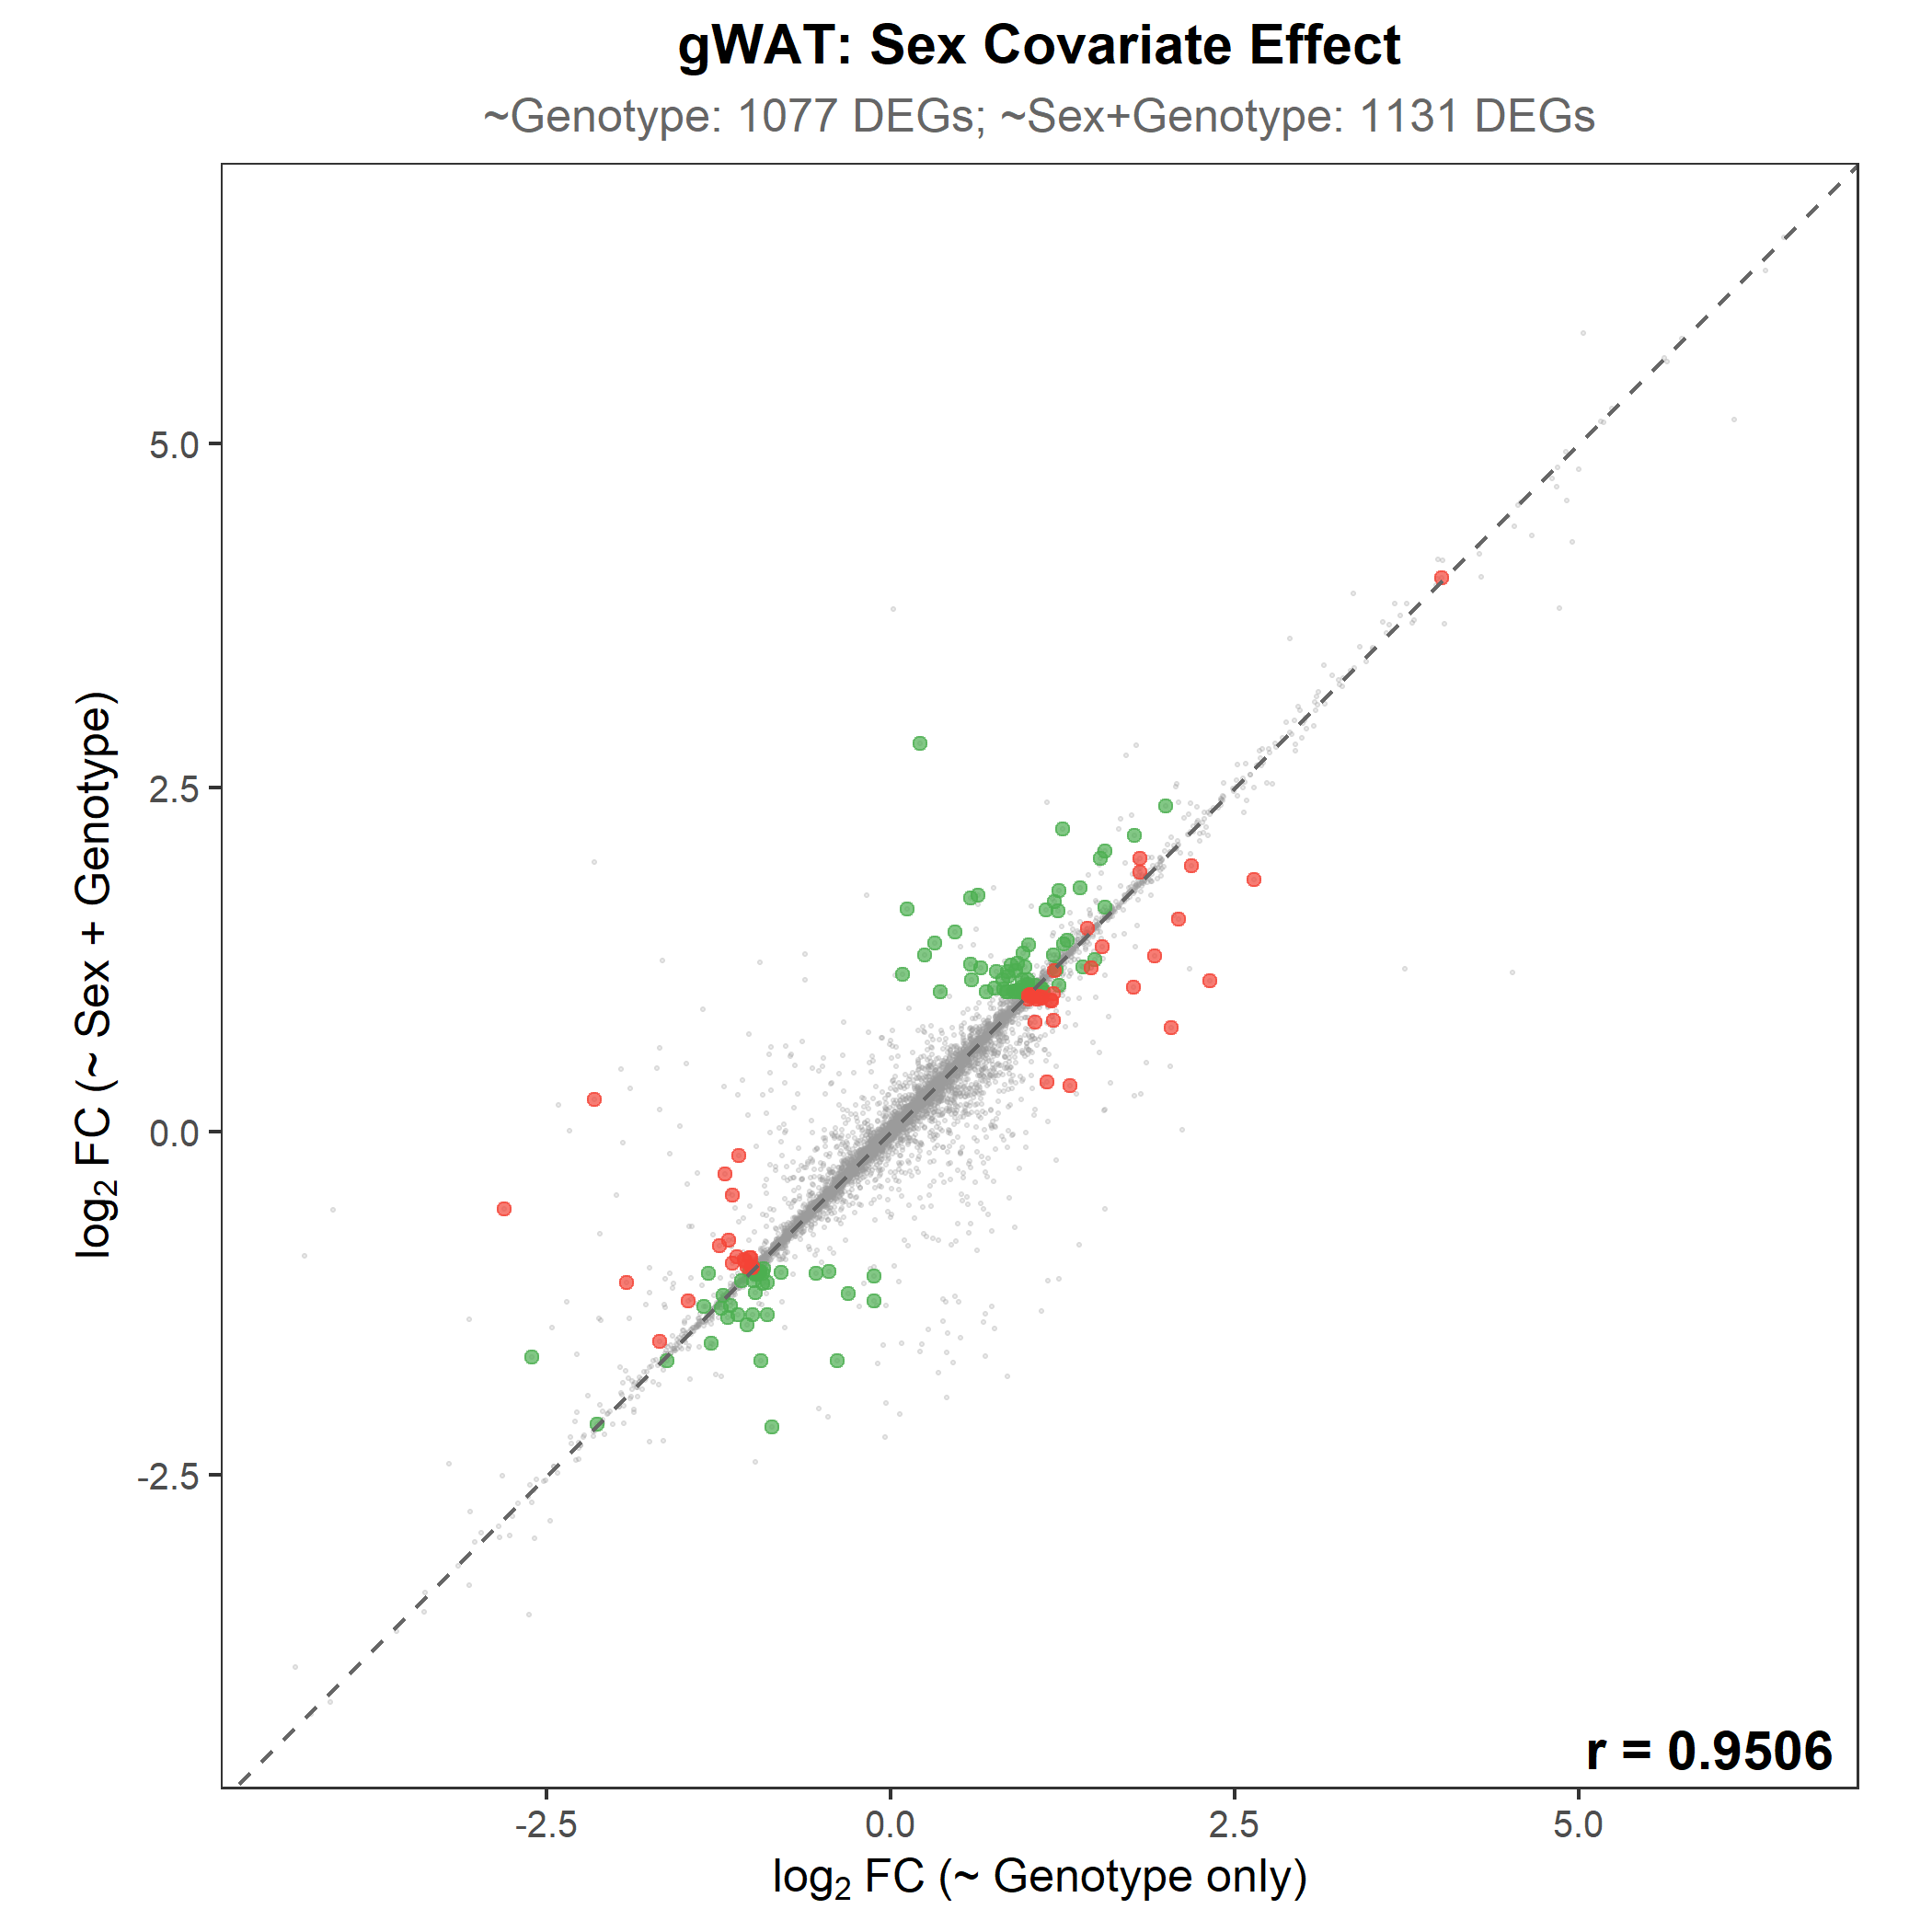
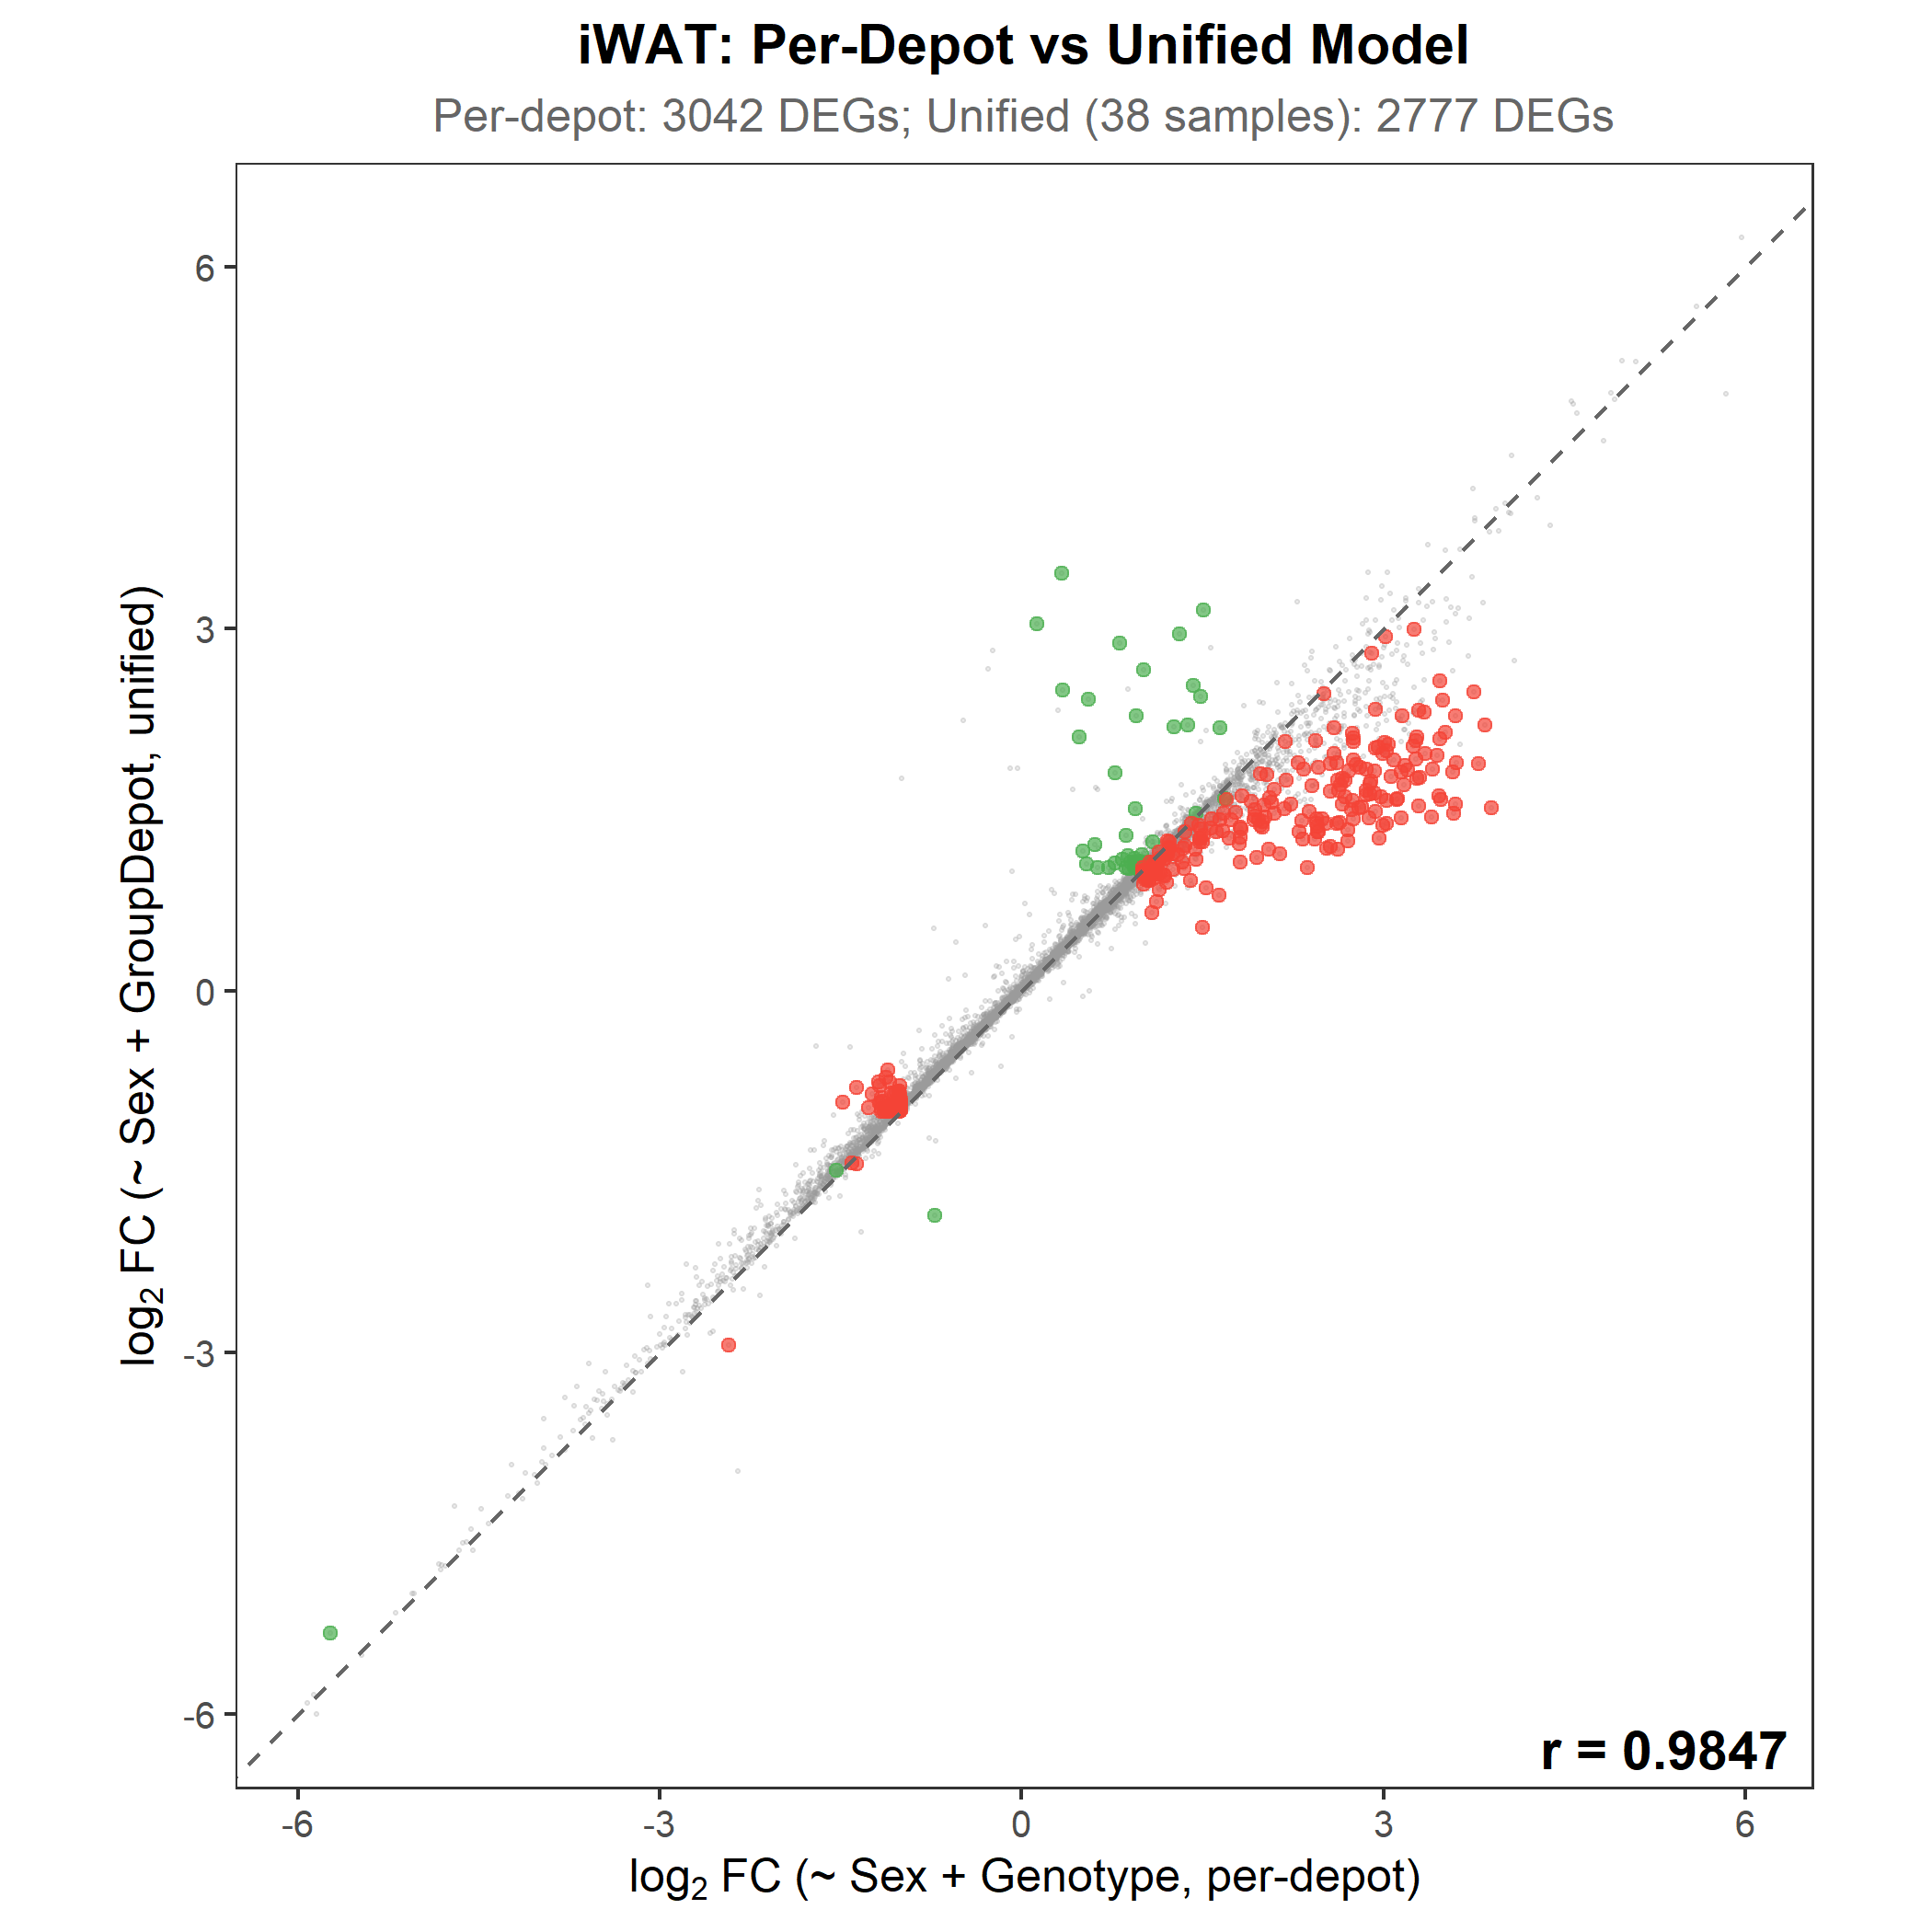
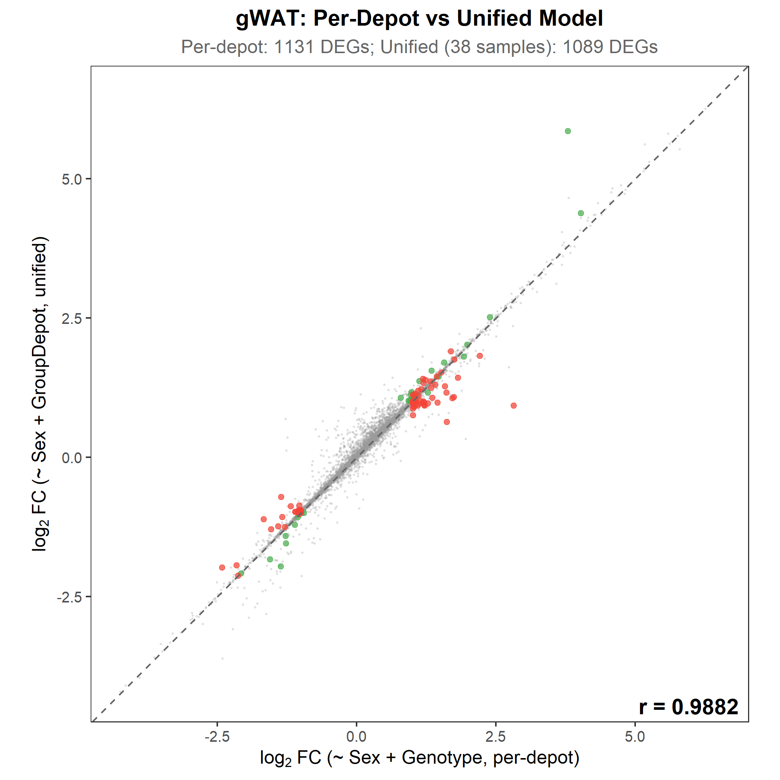
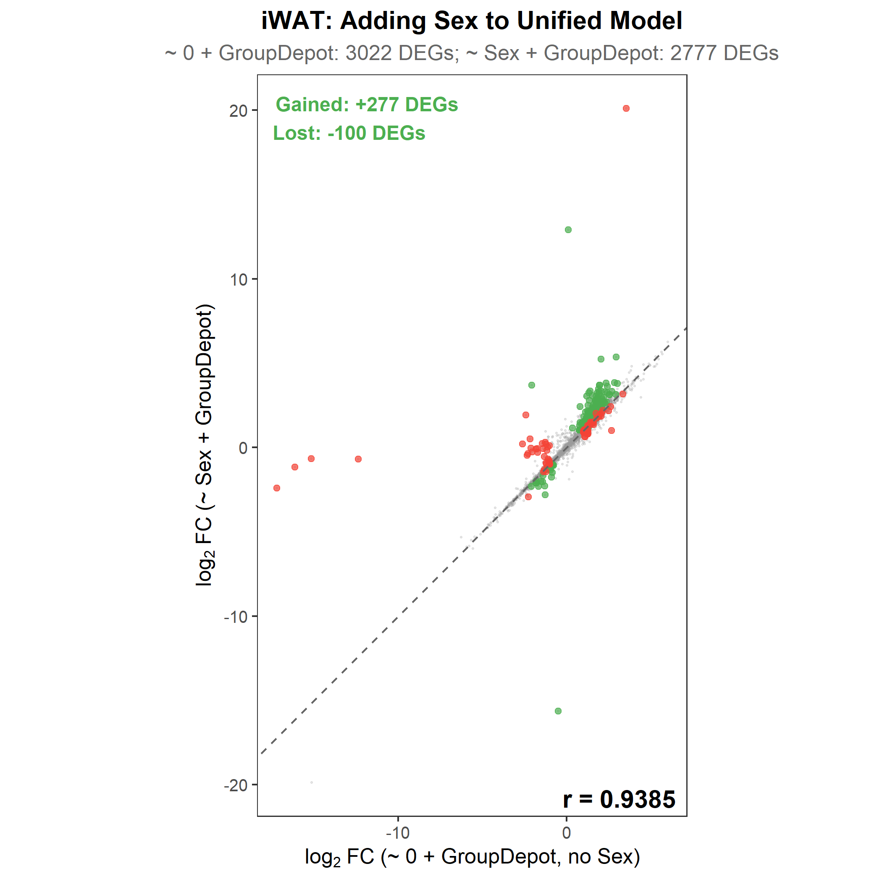
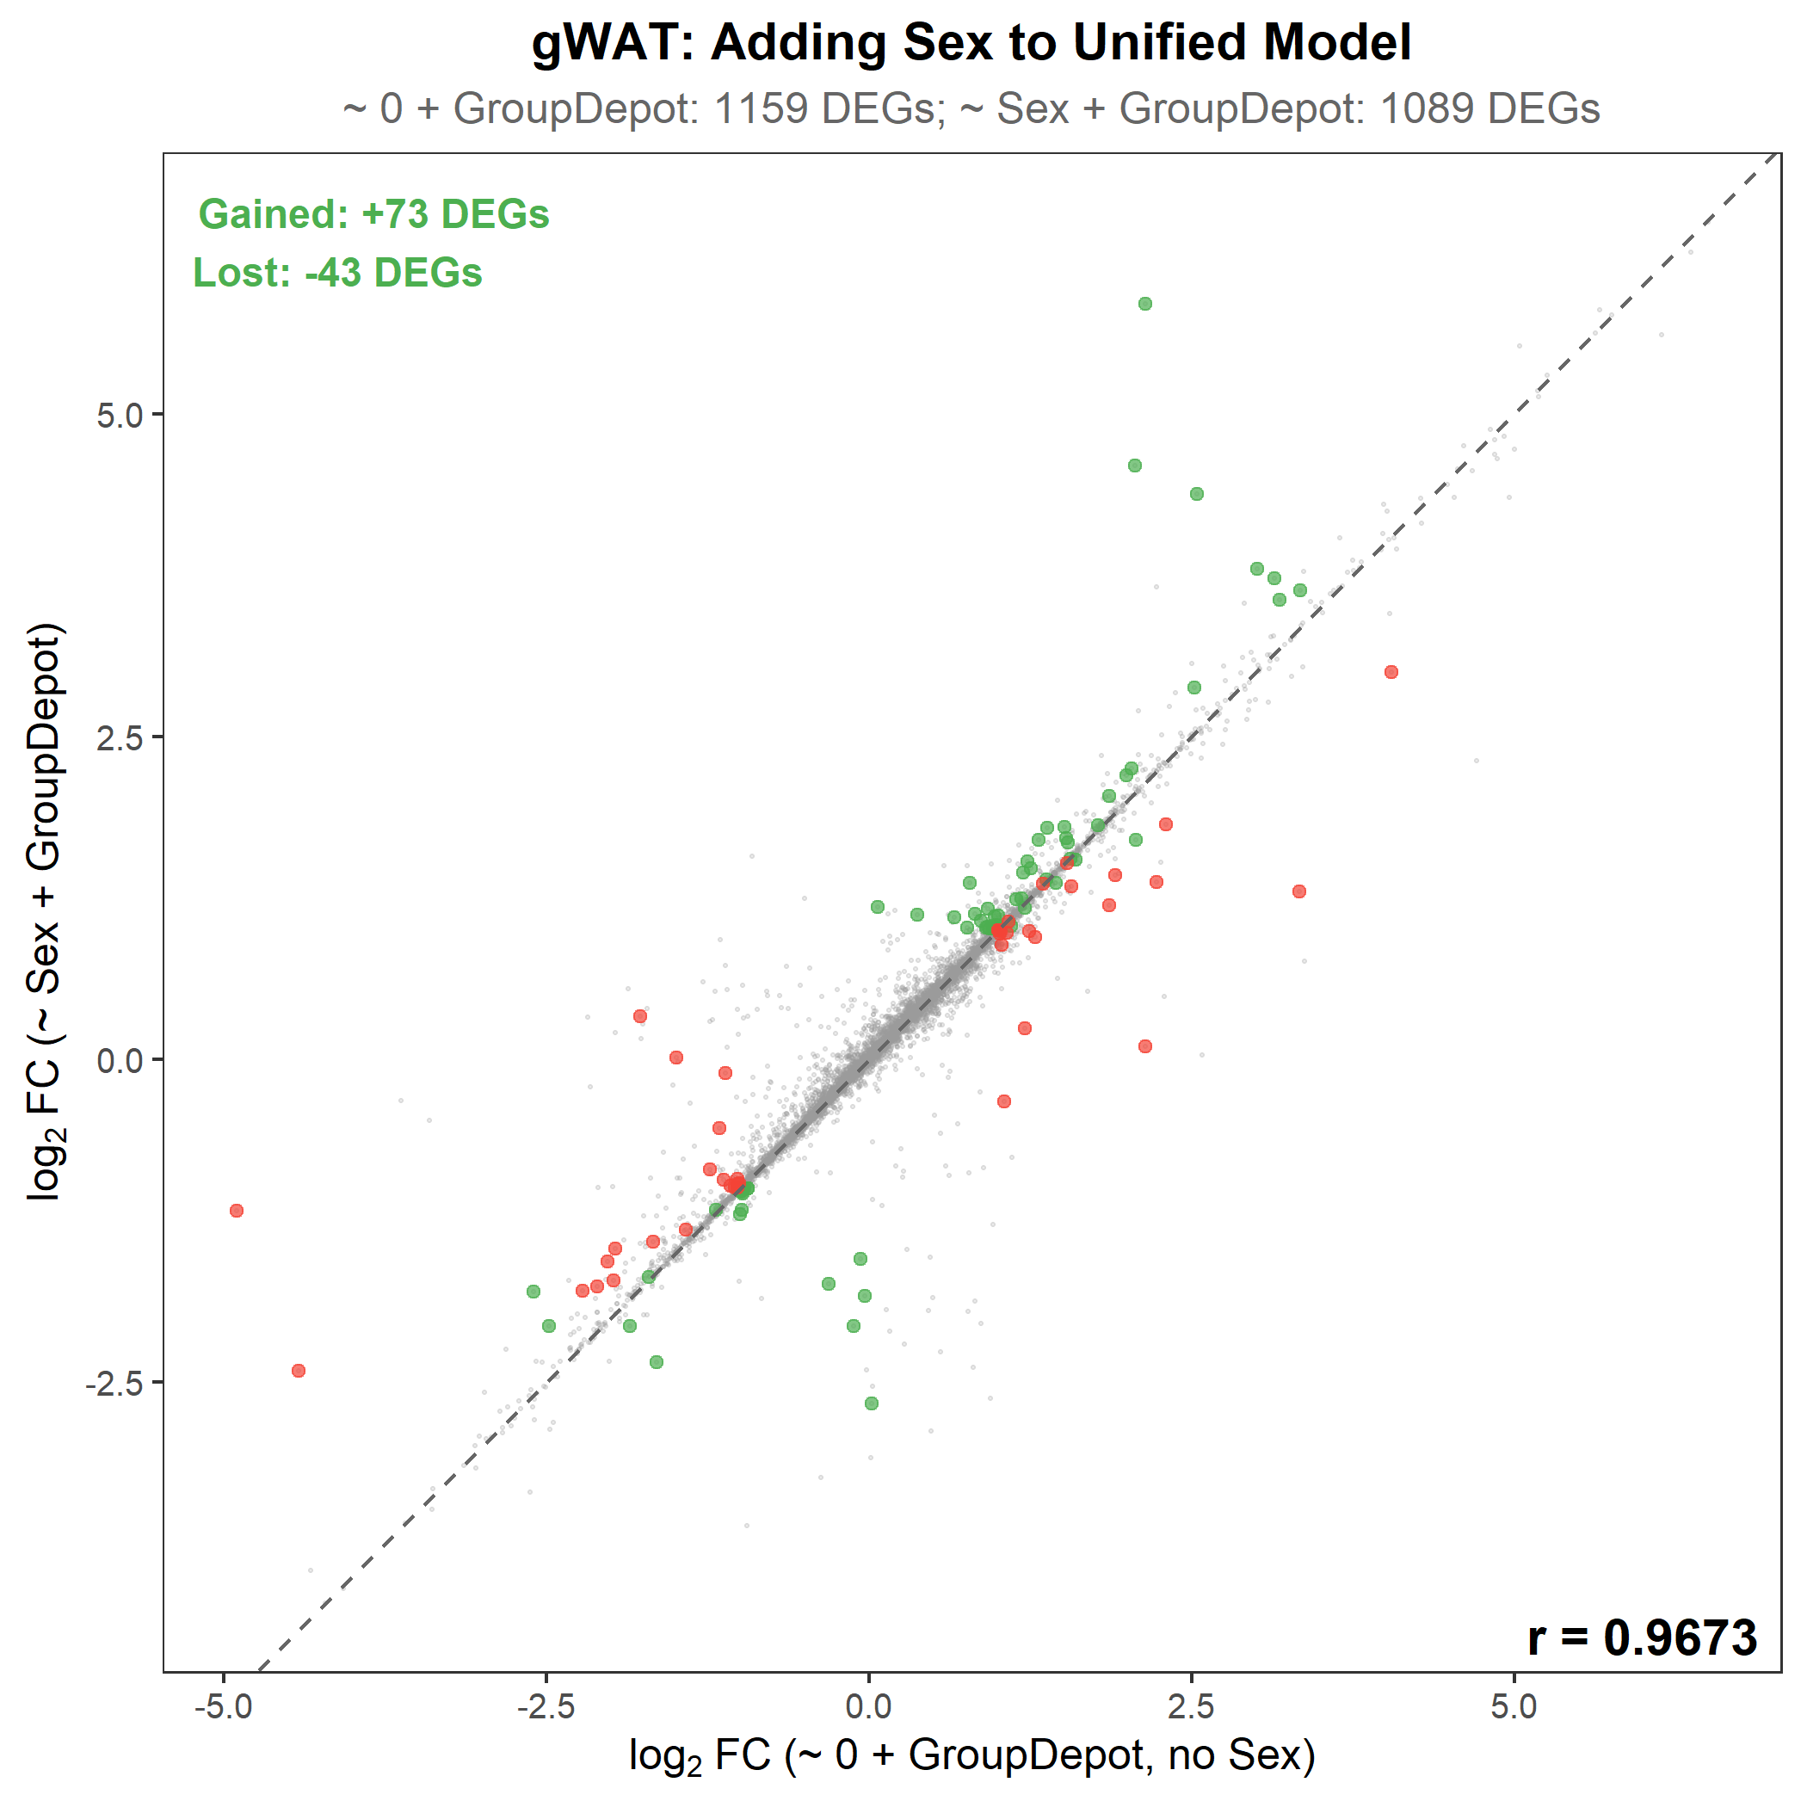
Model Comparison: Scatter Plots (Part 7.7)
logFC near-identity between models confirms biological conclusions are unchanged
3a: ~ Genotype vs ~ Sex + Genotype
3b: Per-depot vs Unified model
Key observations:
- All scatter plots cluster tightly
along the diagonal (y = x)
- Green dots = DEGs gained
- Red dots = DEGs lost
- Per-depot: adding Sex GAINS DEGs
- Unified: adding Sex LOSES DEGs
- logFC estimates nearly identical
regardless of model choice
3c: Unified ~ 0 + GroupDepot vs ~ Sex + GroupDepot (the key comparison)

Slide 21
Summary: All Evidence at a Glance
Metric | iWAT | gWAT
Genes tested | 16,466 | 16,827
Significant interactions (LRT) | 630 (3.83%) | 374 (2.22%)
Pi0 (true null proportion) | 0.87 | 0.85
Median variance: Sex x Genotype | 2.1% | 2.4%
Sex-stratified concordance r | 0.727 | 0.605
Directional concordance | 99.0% | 99.5%
Unified DEGs: ~ 0 + GroupDepot | 3,022 | 1,159
Unified DEGs: ~ Sex + GroupDepot | 2,777 | 1,089
Net change (unified) | -245 (-8.1%) | -70 (-6.0%)
All metrics converge: the KAT8-KD response is overwhelmingly sex-independent. With a balanced design and n=38, the simpler model (~ 0 + GroupDepot) maximizes power.

Slide 22
Conclusion & Analysis Decision
CAN WE POOL SEXES? YES
EVIDENCE:
- Only 2-4% of genes show significant Sex x Genotype interaction
- Pi0 = 0.85-0.87: 85-87% of genes are true nulls (no interaction)
- The interaction term explains only ~2% of variance vs. 17-33% for Genotype
- Sex-stratified concordance: 99%+ directional agreement
- Balanced design: sex CANNOT confound genotype effect
DECISION: Design = ~ 0 + GroupDepot (unified, no Sex covariate)
- All 38 samples in one model, depot-specific KAT8 contrasts extracted
- No Sex covariate needed: balanced design eliminates confounding
- Adding Sex to the unified model COSTS power (-8% iWAT, -6% gWAT DEGs)
- logFC correlation r > 0.94 between +/- Sex models -> same biology
CAVEAT (mention in Discussion if reviewers ask):
- 630 (iWAT) / 374 (gWAT) genes DO show sex-dependent KD responses
- Male KD samples appear more extreme in PCA (especially iWAT)
- gWAT sex-stratified correlation is moderate (r = 0.61)
- These observations warrant follow-up investigation

