Slide 1
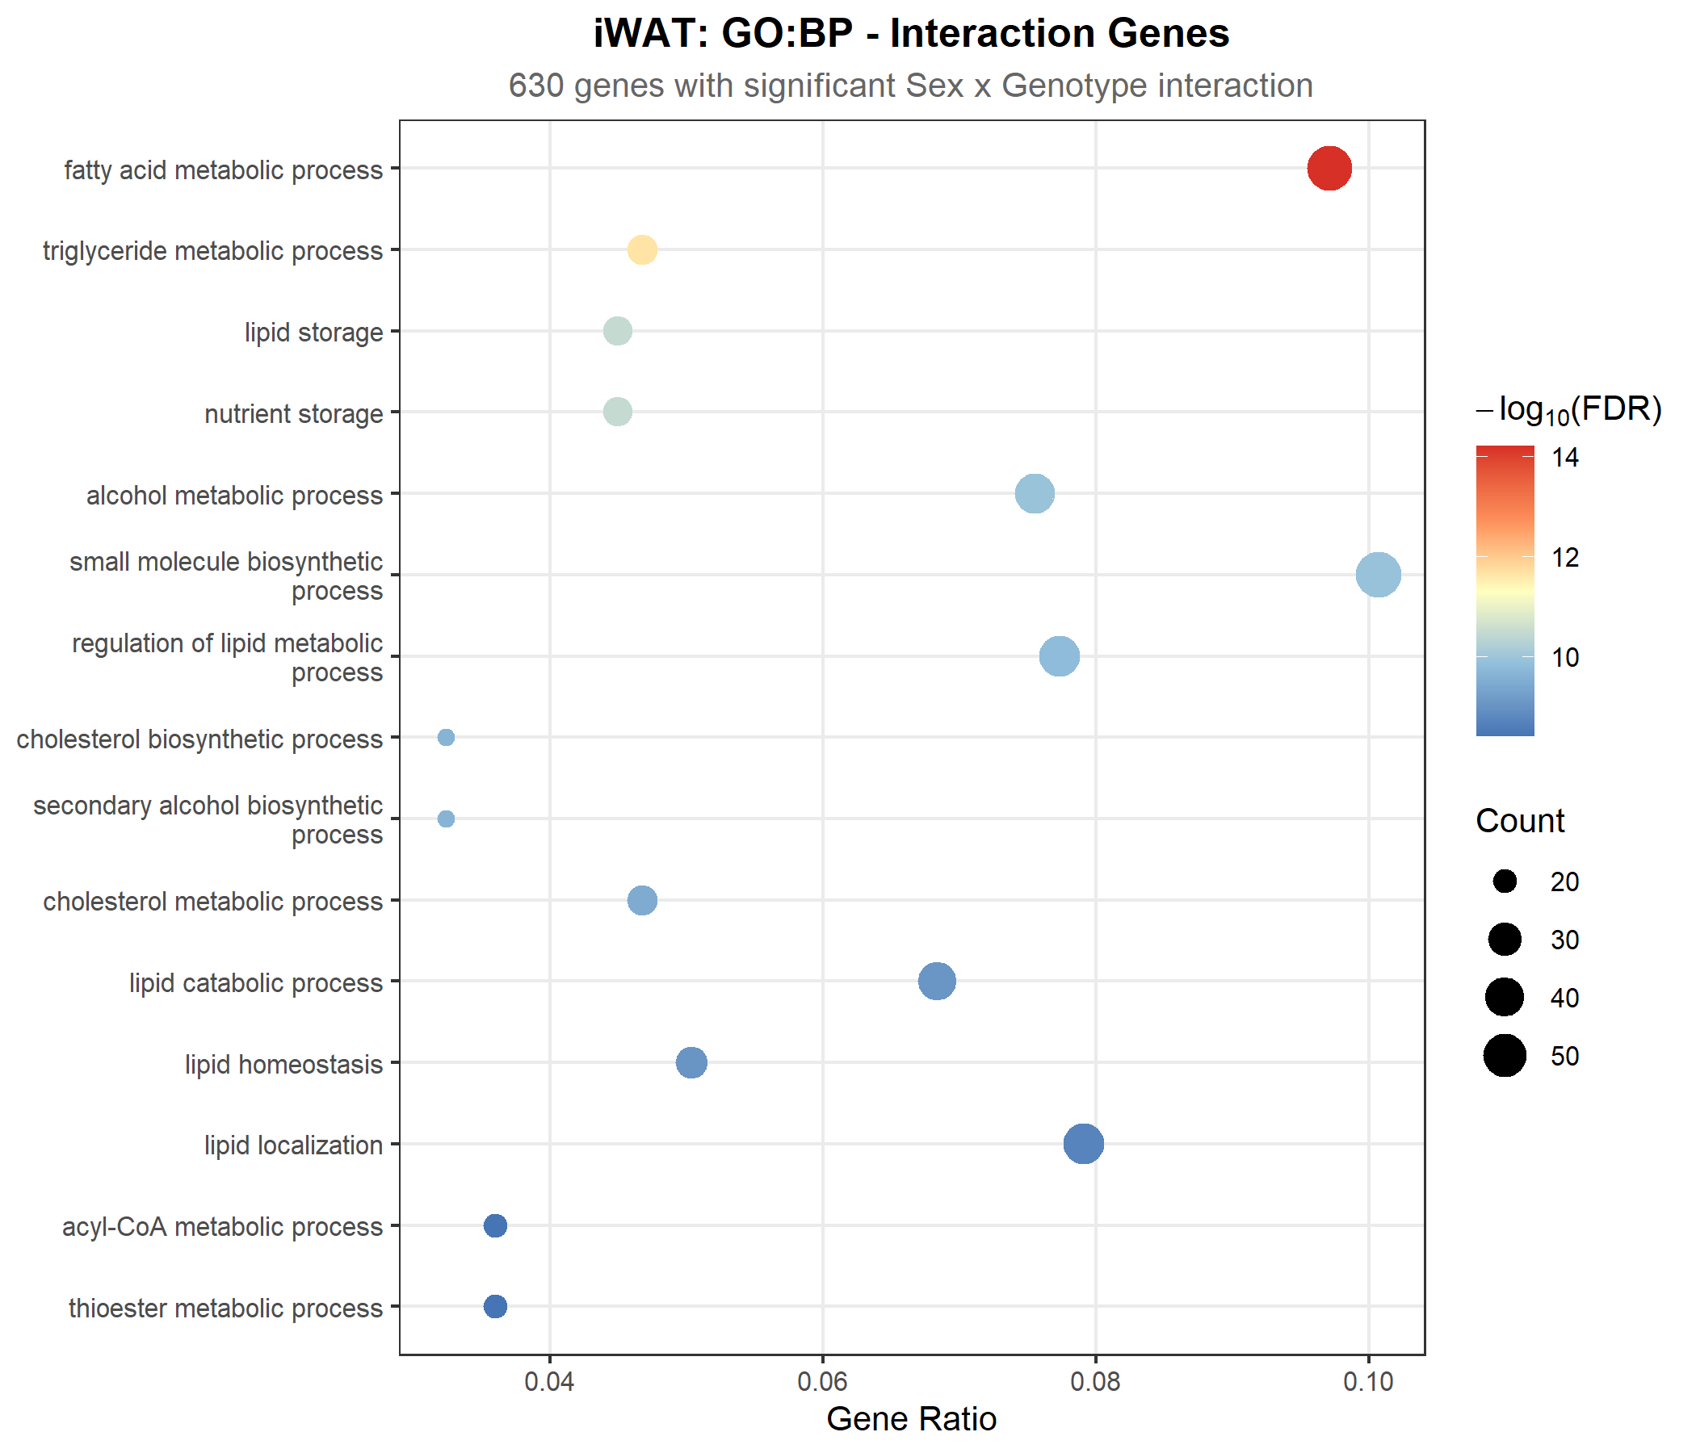
iWAT: Interaction Genes - GO Biological Process Enrichment
What are these 630 interaction genes doing?
ORA (Over-Representation Analysis) on the 630 iWAT genes
with significant Sex x Genotype interaction (FDR < 0.05)
Top enriched GO:BP terms:
- Fatty acid metabolic process (highest gene ratio, most significant)
- Triglyceride / lipid storage / nutrient storage
- Cholesterol biosynthetic & metabolic processes
- Lipid catabolism, homeostasis, localization
- Acyl-CoA / thioester metabolism
Interpretation:
The sex-dependent genes are concentrated in lipid/fat
metabolism -- processes known to be sexually dimorphic
in adipose tissue. This is expected biology, not a
concern for our model. These pathways show sex-based
magnitude differences, not direction reversals.

Slide 2
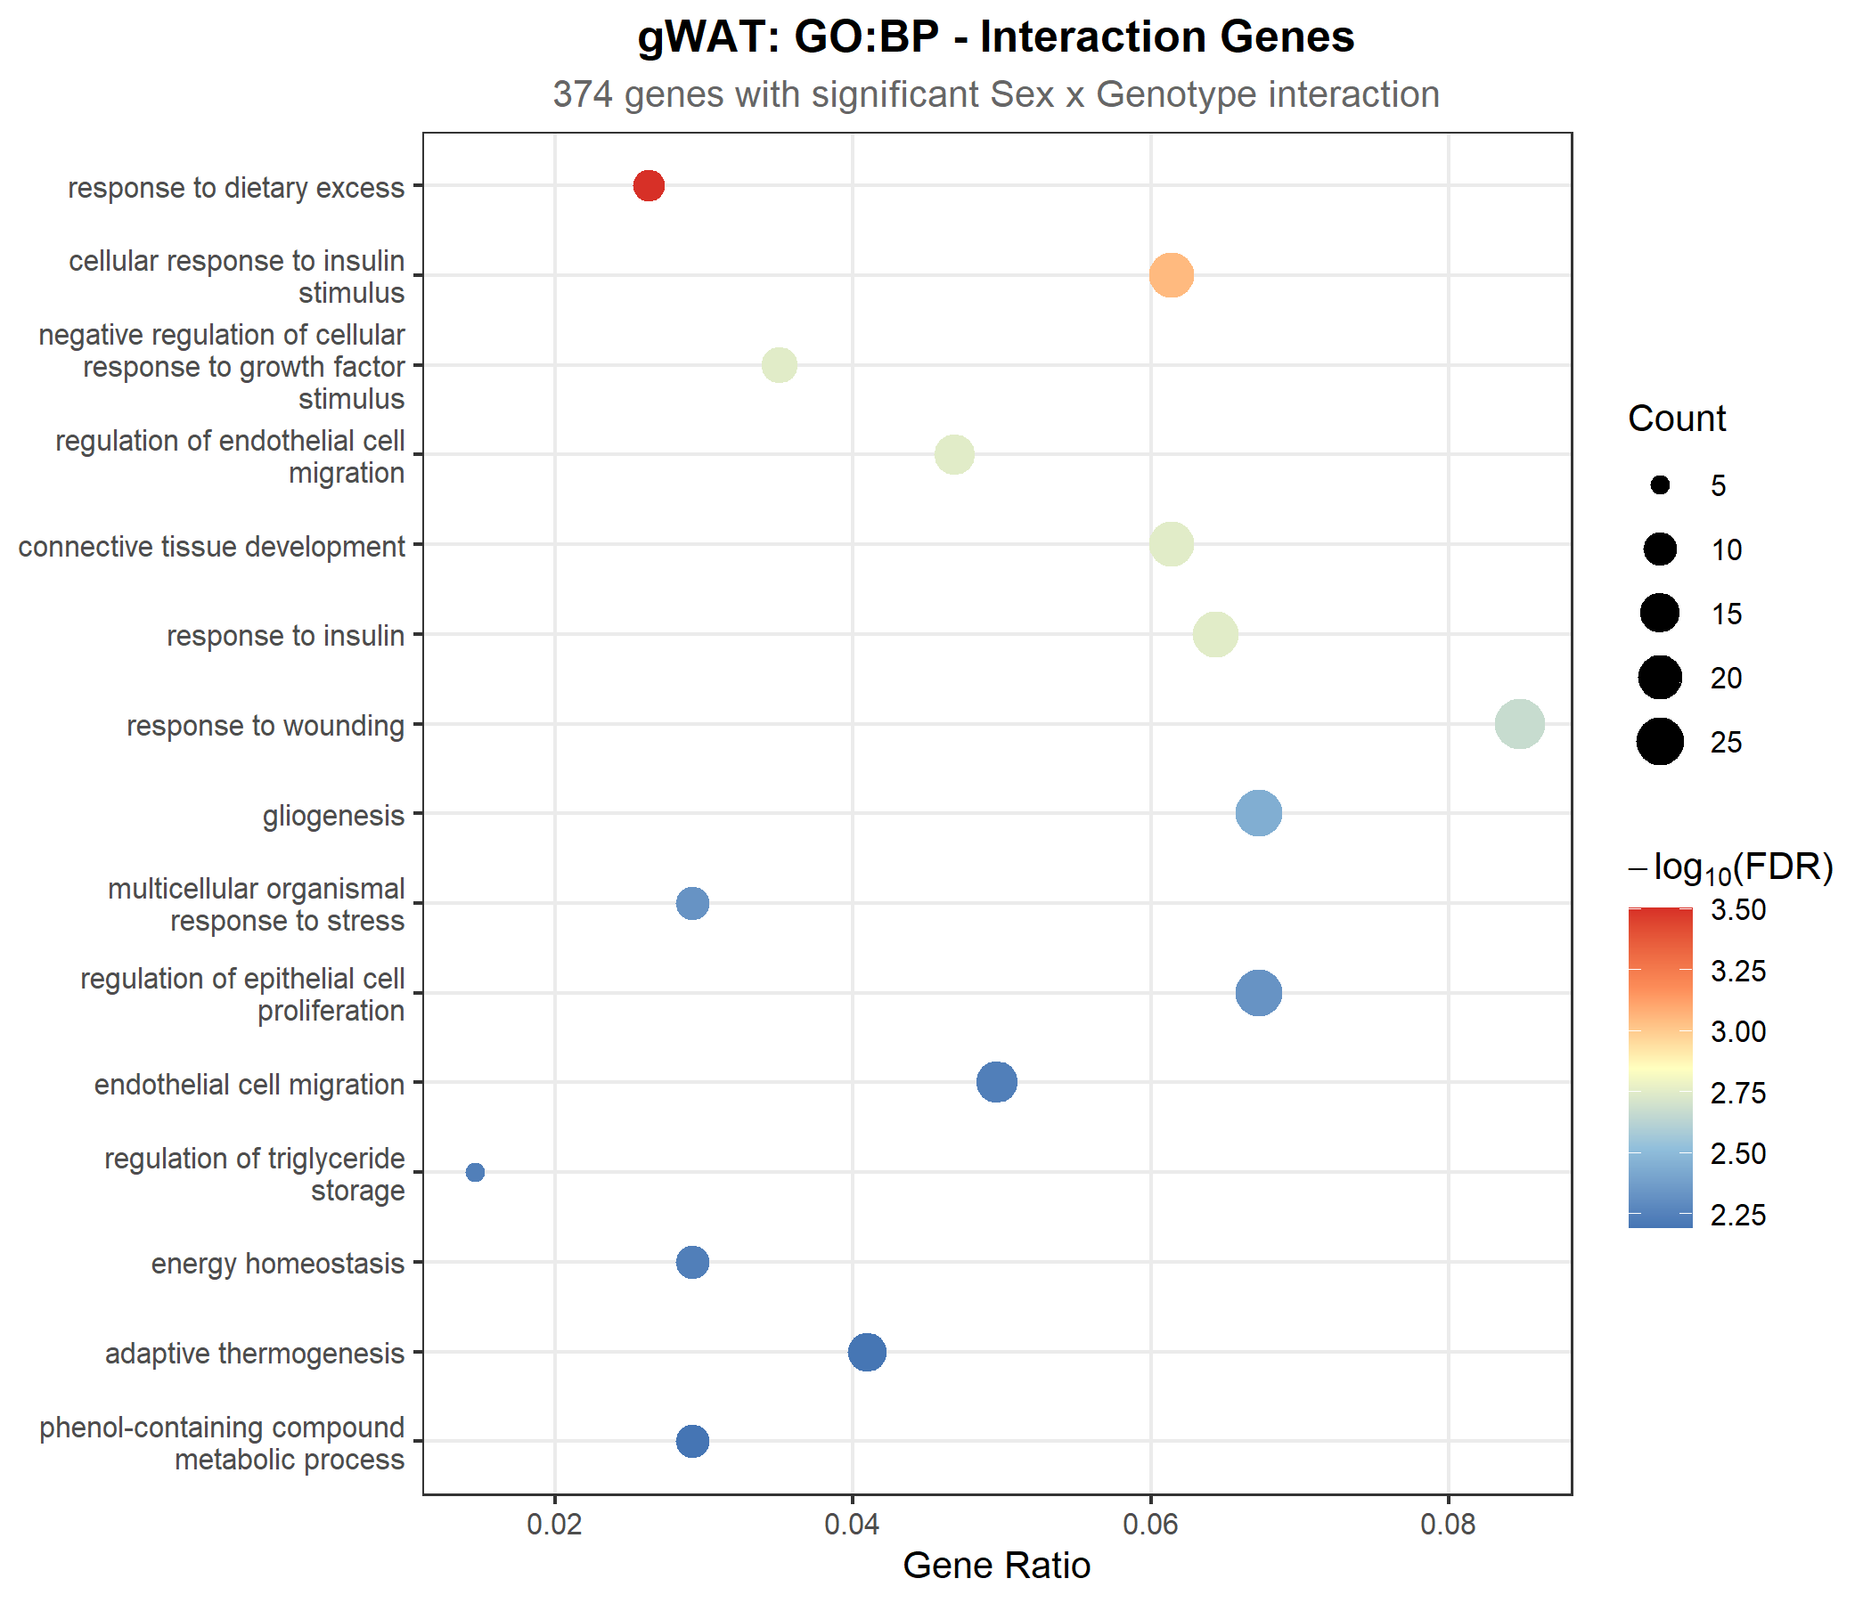
gWAT: Interaction Genes - GO Biological Process Enrichment
What are the 374 gWAT interaction genes doing?
ORA on the 374 gWAT genes with significant
Sex x Genotype interaction (FDR < 0.05)
Top enriched GO:BP terms:
- Response to dietary excess (most significant)
- Cellular response to insulin stimulus
- Connective tissue development
- Response to insulin / wounding
- Gliogenesis, epithelial cell proliferation
- Endothelial cell migration
- Adaptive thermogenesis, energy homeostasis
Interpretation:
gWAT interaction genes enrich for insulin signaling,
tissue remodeling, and metabolic stress responses --
again, processes with known sex dimorphism in visceral
fat. Fewer interaction genes (374 vs 630) and broader
functional categories, consistent with weaker KD signal.

Slide 3
One Line of Code, Layers of Decisions
design = ~ Sex + Genotype + Sex:Genotype
This presentation was created for my dissertation to understand the
depth of decision-making contained in a single line of R code.
Every term in this formula represents a deliberate analytical choice:
~ Sex
Account for baseline M vs F differences as a covariate
Decision: Is sex a nuisance variable or the main effect?
Requires: knowing your experimental design is balanced
+ Genotype
The main effect we care about: KAT8-KD vs CTL
Decision: What is the biological question?
+ Sex:Genotype
The interaction: does KD affect males and females differently?
Decision: Do we NEED this term? Does it improve the model?
This is what the entire Part 7.6 analysis answers.
The 21 slides before this one -- the LRT, pi0, variance decomposition,
concordance analysis, model comparison -- all exist to justify whether
this interaction term belongs in the model or not.
The answer (no, interaction is minimal) then informs the FINAL model:
design = ~ 0 + GroupDepot (unified, interaction term dropped)

