Slide 1



Developing data mining models with application to large datasets
László Kiss
Terminal report presentation 2018.06.18

Slide 2

Introduction
Importance of data mining and analysis
Connection between „real world” and science
Time Series Analysis

Slide 3
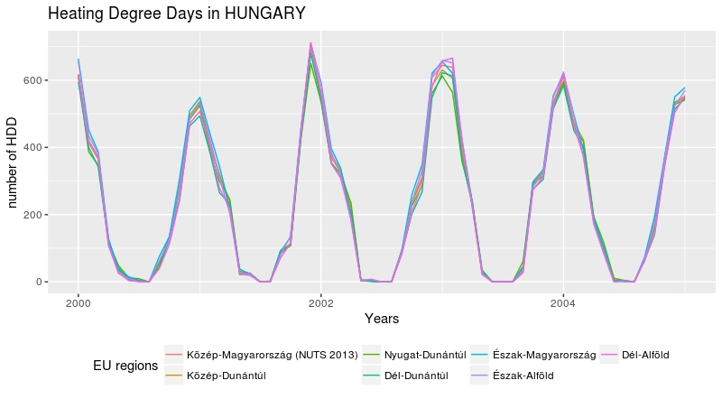
Time Series definition

Slide 4
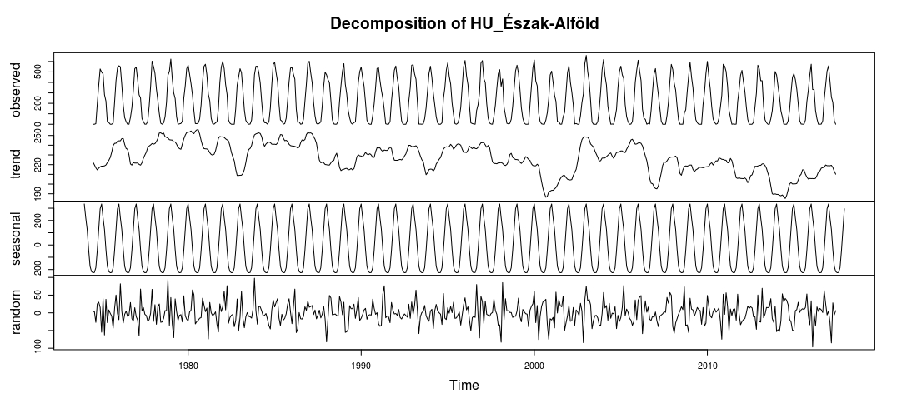
Components of a Time Series

Slide 5
Arima model
ARIMA: Autoregressive integrated moving average
A “stochastic” model that can be used to calculate the probability of a future value

Slide 6
AR and MA models
Autoregressive AR process: Series current values depend on its own previous values
Moving average MR process: The current deviation from mean depends on previous deviations

Slide 7
ARIMA model
Y_{t} → AR filter → Integration filter → MA filter → ε_{t}
AR filter: long term
Integration filter: stochastic trend
MA filter: short term
ε_{t} : white noise error

Slide 8
Ender slide

