Slide 1



Developing data mining models with application to large datasets
László Kiss
Terminal report presentation 2018.06.18

Slide 2

Introduction
Importance of data mining and analysis
Connection between „real world” and science
Time Series Analysis

Slide 3
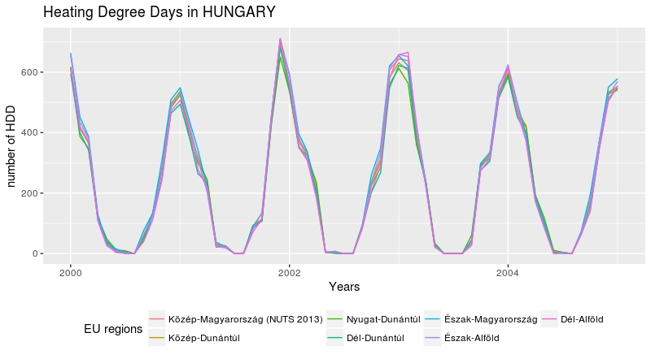
Time Series definition

Slide 4
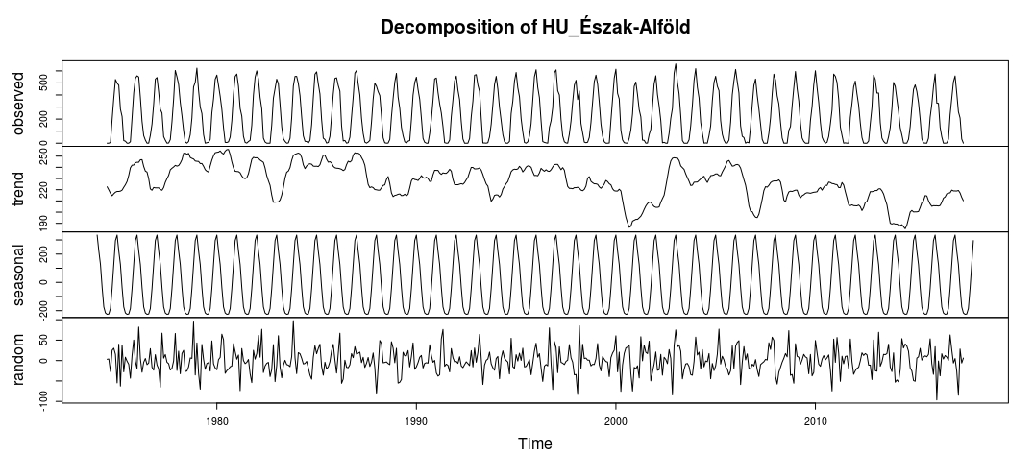
Components of a Time Series

Slide 7
Ender slide

