Slide 1



Application of VAR modeling to a multivariate time series
László Kiss
Complex exam presentation
2019.06.17

Slide 2

Time series definition
A time series is a sequential set of data points, measured typically over successive times. It is mathematically defined as a set of vectors x(t),t = 0,1,2.. where t represents the time and x is a random variable
Examples: economic and industrial datasets, financial data, weather etc.
Univariate time series:
A univariate time series, as the name suggests, is a series with a single time-dependent variable.
Multivariate time series:
A Multivariate time series has more than one time-dependent variable. Each variable depends not only on its past values but also has some dependency on other variables. This dependency is used for forecasting future values

Slide 3
The Vector autoregression model (VAR model)
Stochastic process model which means we have to make sure that variances where we would like to apply our model are constant over time and do not show any trending behaviour.
This model is capable to reveal the linear independences between multiple time series.
VAR models generalize the univariate autoregressive model by allowing for more than one evolving variable.

Slide 4
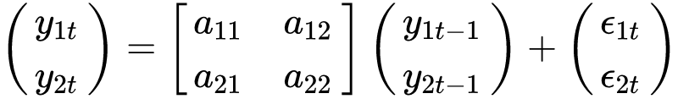
VAR model
For all variables of VAR has an equation defining the evaluation based on
own lagged values
all of the other variables lagged values
error term
A simple VAR model can be written as:

Slide 5
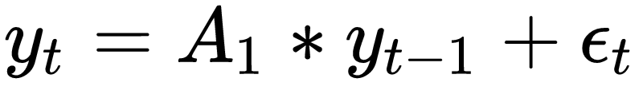
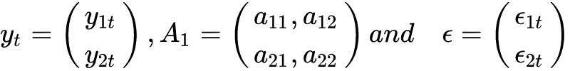
VAR model
Or more compact way:
where

Slide 6
VAR model
This model gives a method to evaluate a set of k variables over the same period of time as a linear function of only their past values.
A p-th order VAR, denoted VAR(p), is:
where the observation y_{t−i} (i periods back) is called the i-th lag of y, c is a k-vector of constants (intercepts), Ai is a time-invariant (k × k)-matrix and et is a k-vector of errors.

Slide 7

VAR model
This model is capable to reveal the dependencies and relationships in multivariate time series
It can described the dynamic behaviour of the data and also provides better forecasting results
It is easy to implement in any development and product environment
Behaviour of this model is very proposing regarding the view of the performance

Slide 8
Stationarity of the VAR(p) model:
Stationarity: A vector process is said covariance stationary if its first and second moments, E[y_{t}] and E[y_{t}y′_{t−j} ] respectively, are independent of the date t
Three conditions are necessary for stationarity of VAR(p)
Absence of mean shifts
The vectors {ε_{t}} are identically distributed, ∀t
Stability condition on F.

Slide 9
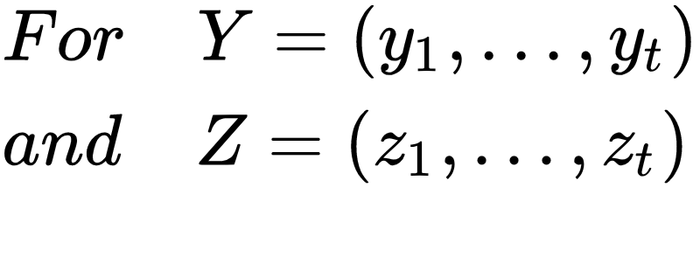
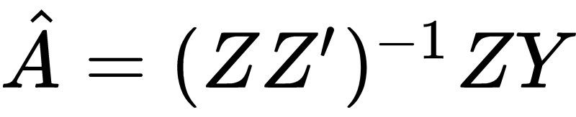
Estimation of the VAR
The estimation of the parameters and the covariance matrix of a simple VAR model is based on next ideas:
with Z as a vector of lagged values of Y.
Possible deterministic terms the least squares estimator of the parameters

Slide 10
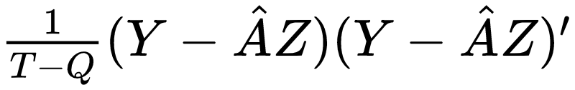
Estimation of the VAR
The covariance matrix is then obtained from
where Q is the number of estimated parameters.

Slide 11
Multivariate time series in telecommunications
In general we collect a very huge amount of data in every event in telecommunication systems.
There are two types of datastructure
The system is recording all of the technical measurement in 24/7 and it is sliced by 5 minutes.
All of the connection between the mobile devices and telco system are recording with all details, called detailed call record.

Slide 12
Multivariate time series in telecommunications
In the physical layer this two data structures stored in json format with more than 600 dimensions, called KPI (Key Performance Indicator)
Based on domain (telco) knowledgement we select about 20 KPI-s from this data structures to analyze for a short and long term.
In first step we would like to reveal the dependency in a technical measurements - like software versions, technical system parameters. We hope we can build a better setup for the mobile network.
In the next slide we can see an example about that.

Slide 13
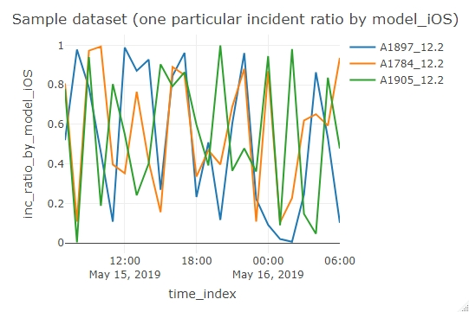

Slide 14
VAR based analytic system
Basic definitions:
Subscriber: the user of the telecommunication networks.
Subscriber incident: physically it is a JSON file generated by rules. This rules examine the KPI-s (Key Performance Indicator ) in describer dataset of calls. The rules contains very simple logic working with thresholds.
Subscriber incident ratio: the number of the incidents divided by number of calls.

Slide 15
VAR based analytic system
Call describer datasets contains more 600 dimensions about the connection between the subscriber devices and radio network.
The examined parameters of the telecommunications are elements of setup of eNodeB-s.
eNodeB is a physical layer of radio network practically means a radio-tower with more cells and antennas.

Slide 16
VAR based analytic system
The purpose of the analysis:
With analysing the relationship between the changing of the subscriber incident ratio and the changing of the parameters of the eNodeB-s we can prepare the further problems.
We can forecast the future values of the subscribers incident ratio, so we can provide an ability to prepare for that events.

Slide 17
Model order selection
The most common approach for model order selection involves selecting a model order that minimizes one or more information criteria evaluated over a range of model orders.
Commonly used information criterion:
Schwarz-Bayes Criterion (Bayesian Information Criterion)
Akaike Information Criterion
Hannan-Quinn Criterion

Slide 18
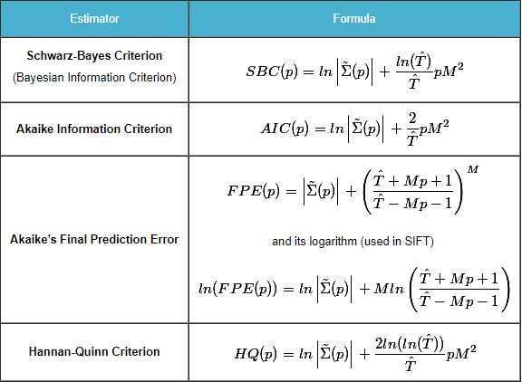
Model order selection
In practice we use the VAR.select from VAR.etp package

Slide 19
Prediction for a sample data set with VAR(2) model

Slide 20
Plans for the future
Reveal and understand the relationships and dependencies not just between two dimensions but more in one occasion.
Build an automatic outlier detection system to feed input parameter to this VAR model.
Involve new methodology and tools to this process.
Methodology: deep learning, isolation forest
Tools: h2o (https://www.h2o.ai/), tensorflow (https://www.tensorflow.org/)

Slide 21
Ender slide

