Slide 1
Solar Wind Correlations
Joseph M Davila
December 2025

Slide 2
Conclusions
The solar wind speed is very predictable when averaged over almost any time scale
There is a significant correlation of solar wind speeds with a time lag equal to the solar rotation rate at the equator

Slide 3
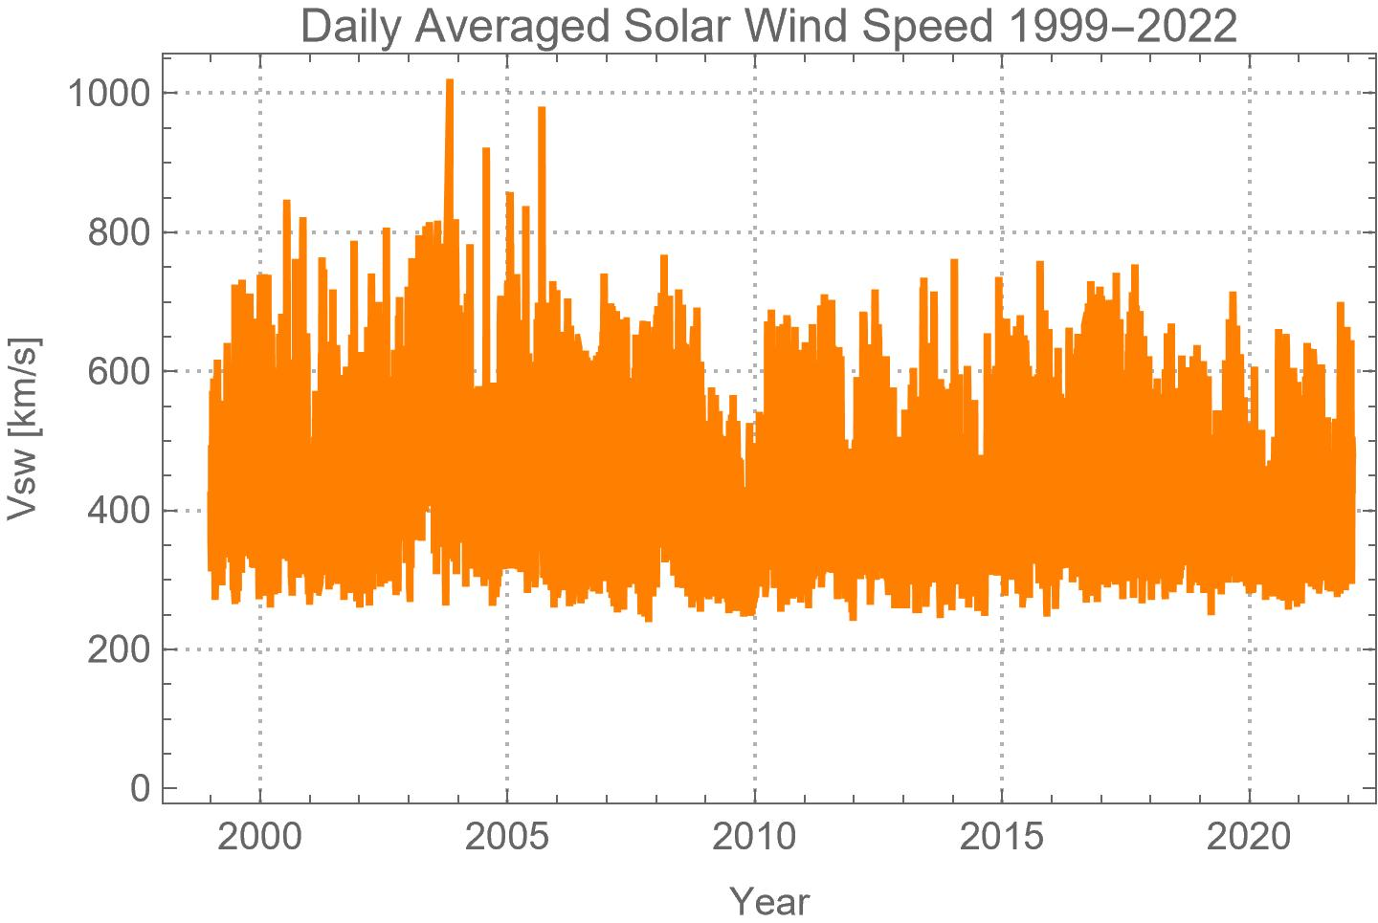
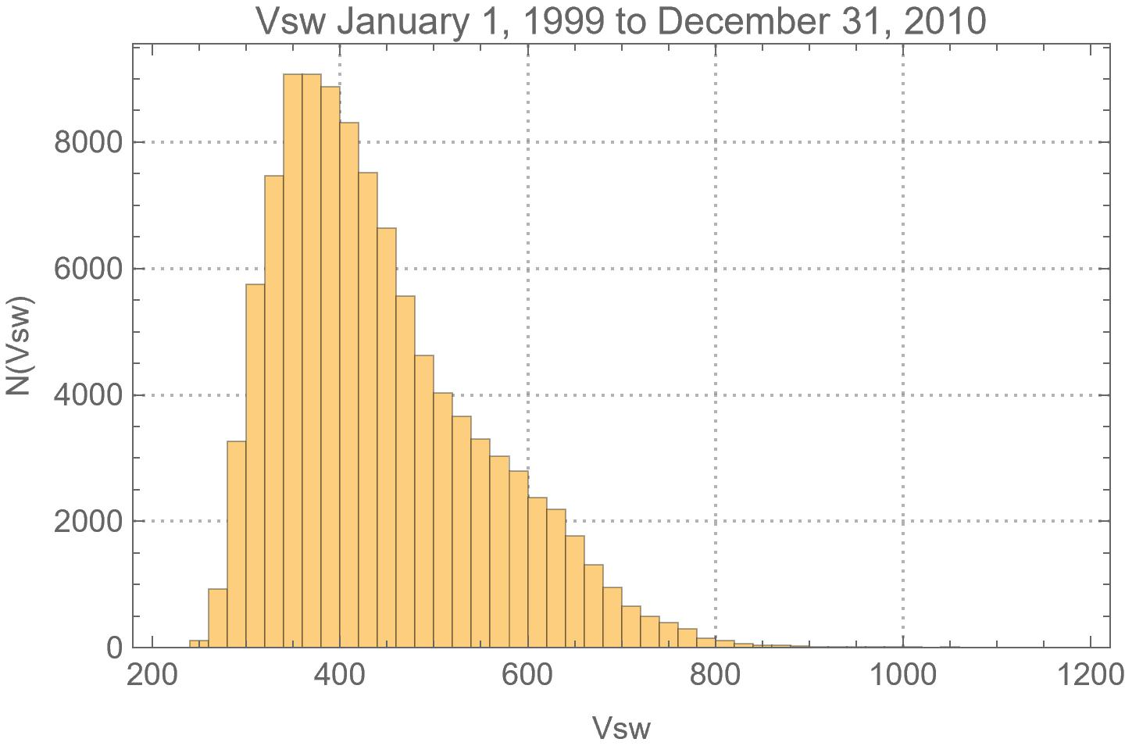
1d Averaged Solar Wind Speed 1999-2022

Slide 4
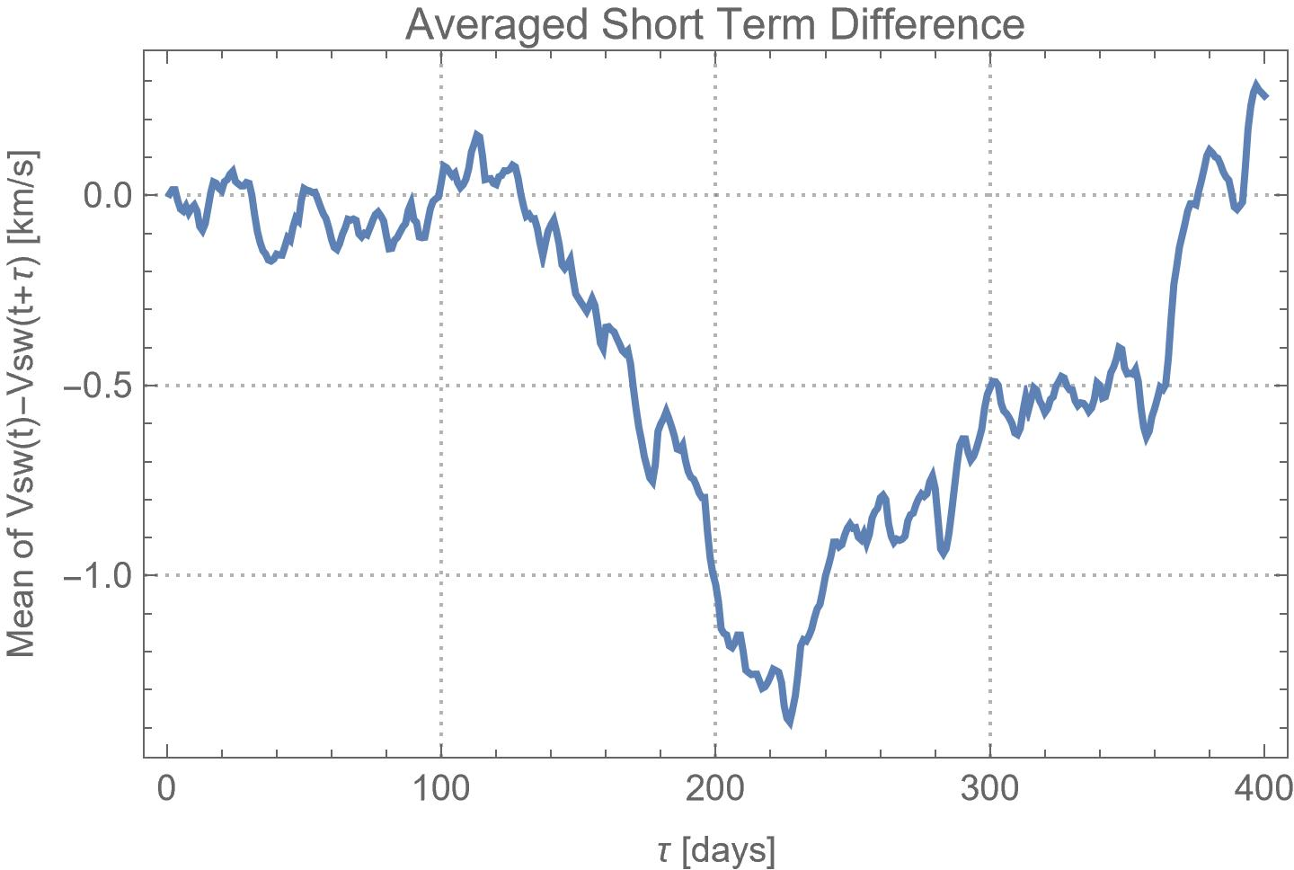
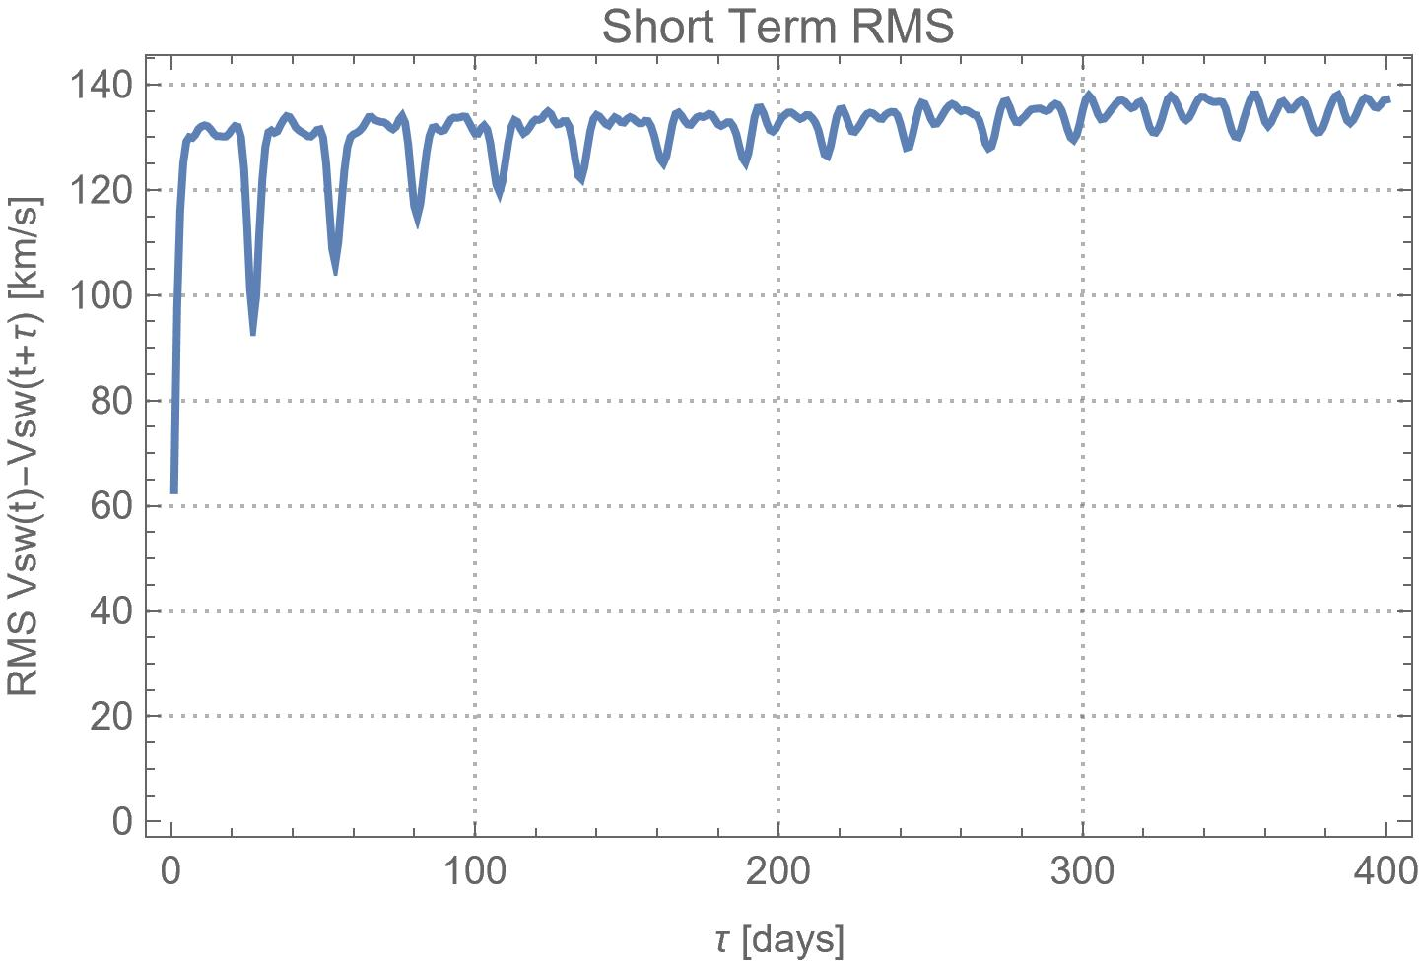
1d Averaged Solar Wind Speed 1999-2022

Slide 5
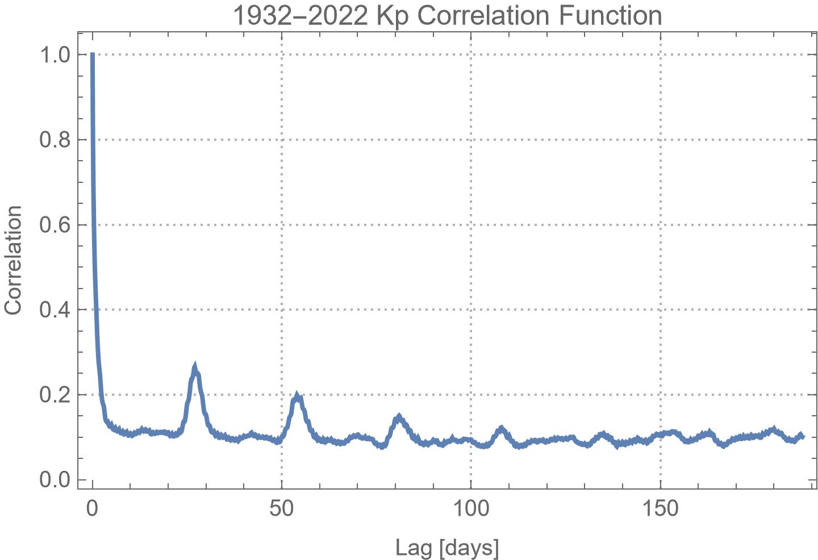
Kp 1932-1922
This correlation function shows the typical exponential(?) decay for short lags, but then exhibits visible bumps at 27, 54, 81, and 108 days. This is the solar rotation period at the equator. This correlation was first recognized long ago, I think by Gauss in global Earth magnetic field measurements.

Slide 6
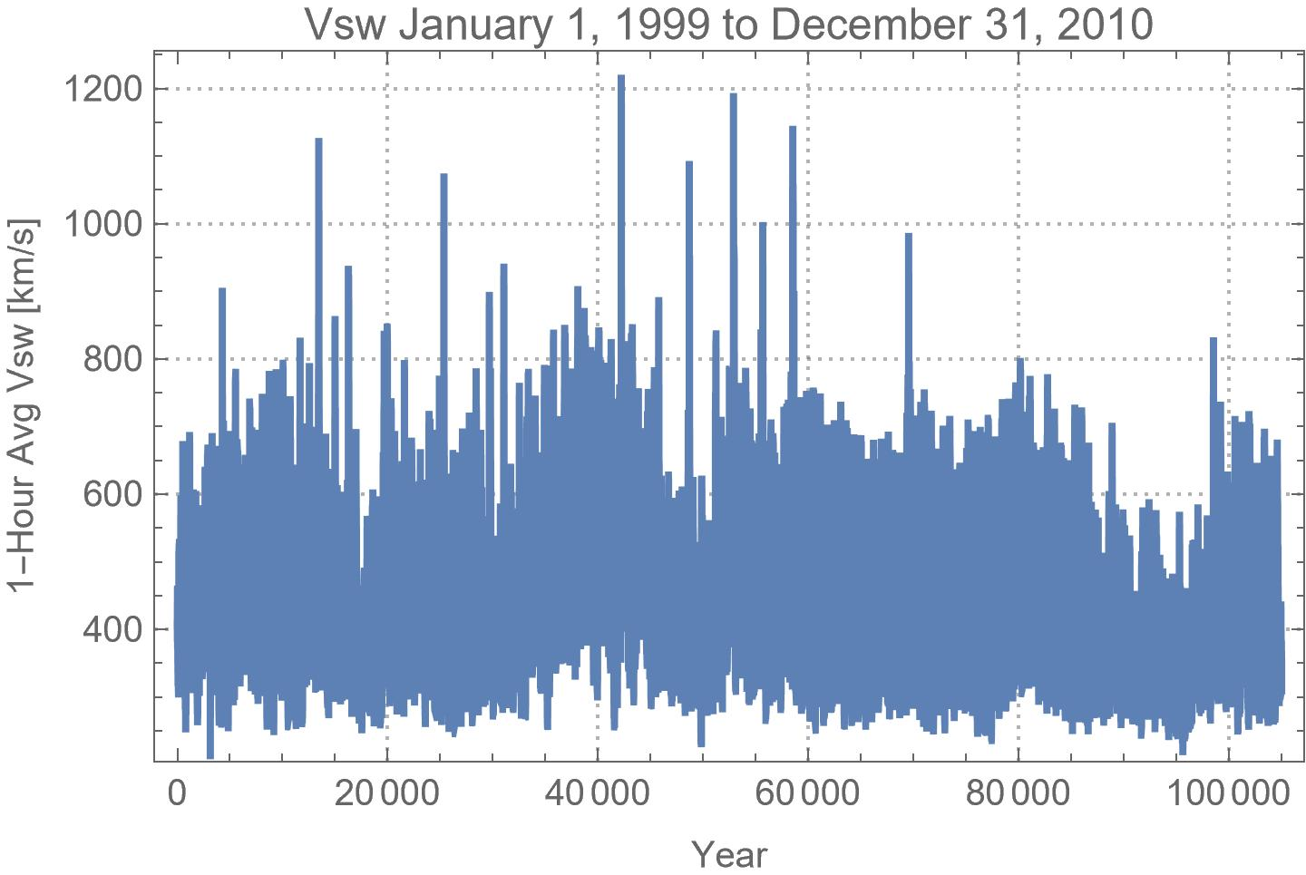
1hr Averaged Solar Wind Speed 1999-2010

Slide 7
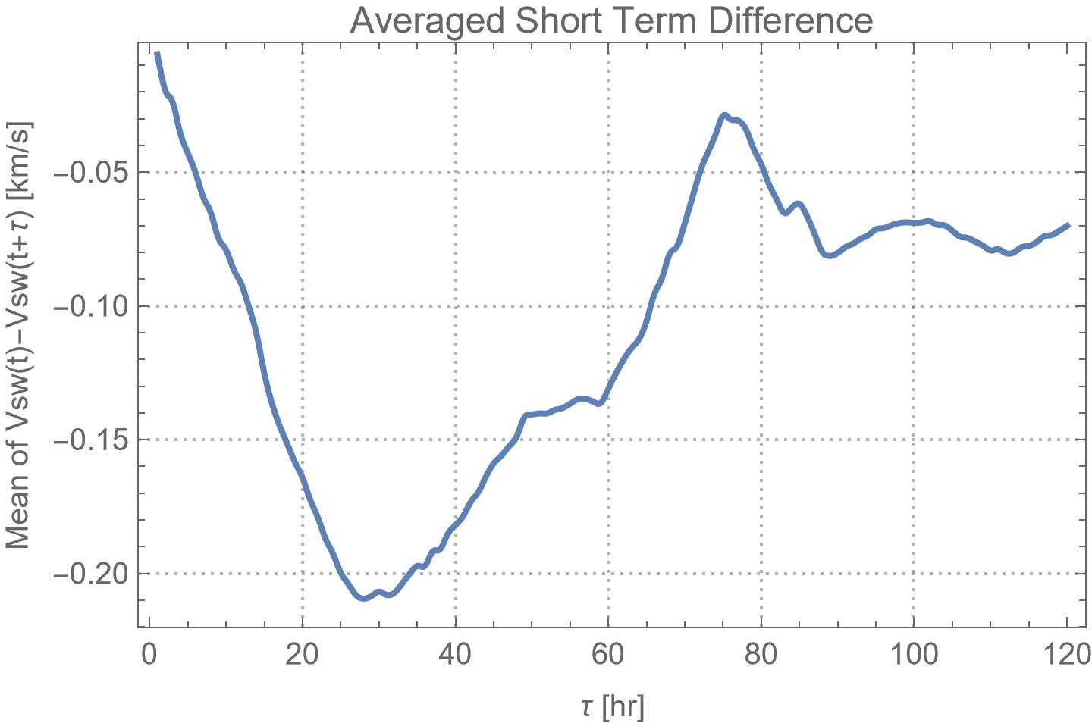
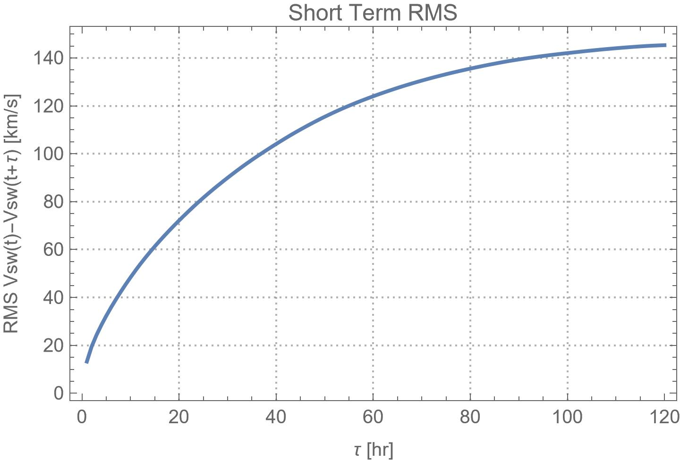
1hr Averaged Solar Wind Speed 1999-2010
5 days

Slide 8
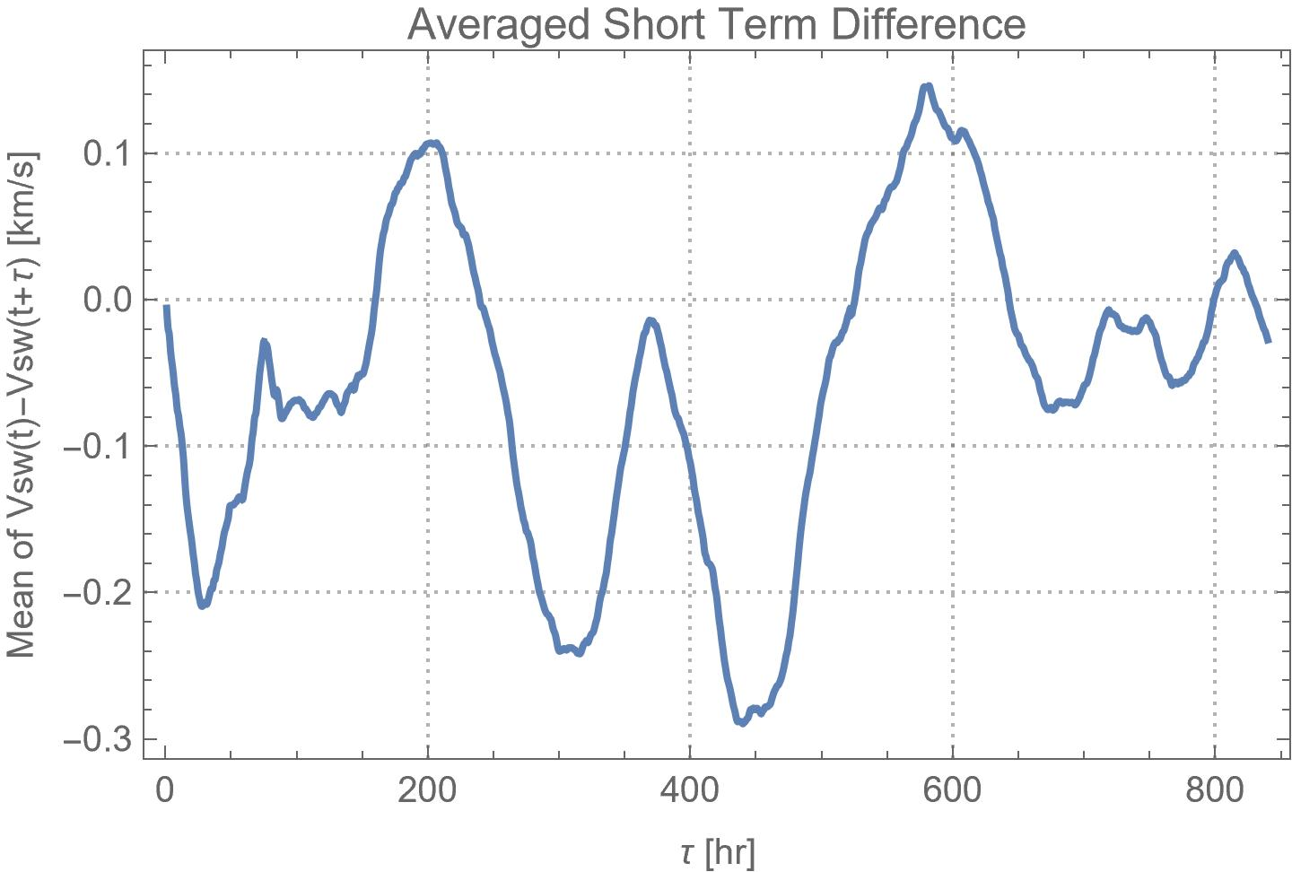
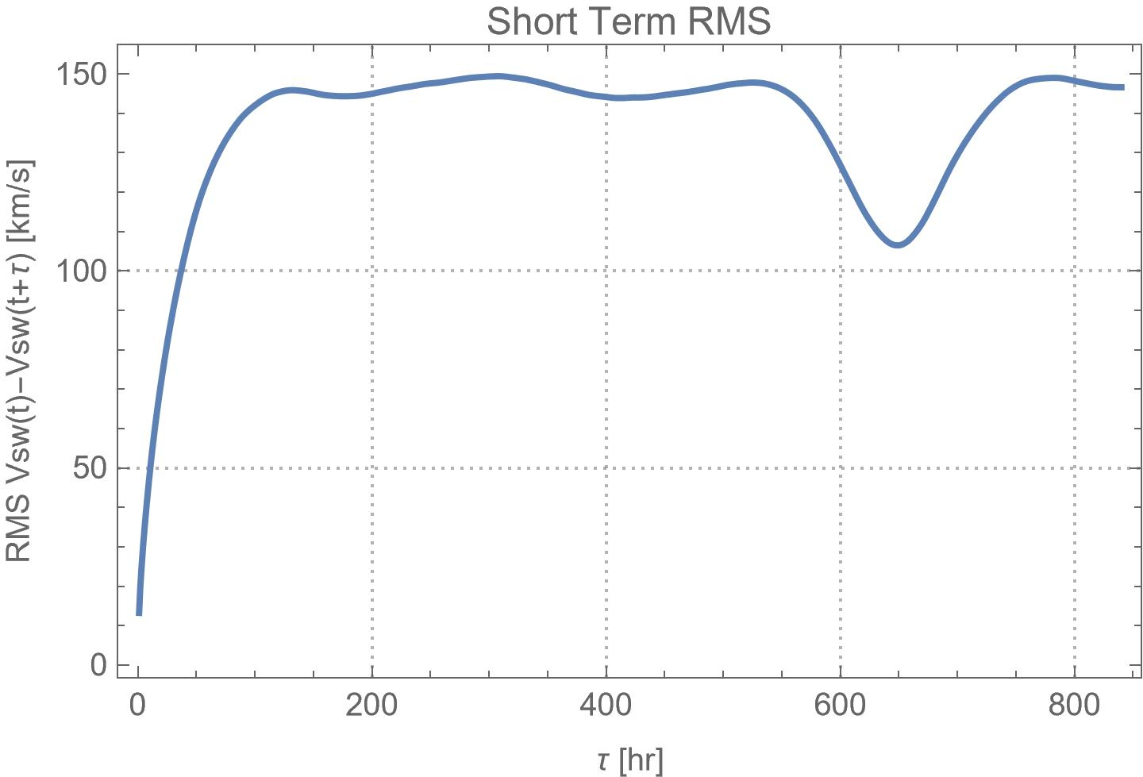
1hr Averaged Solar Wind Speed 1999-2010
35 days

Slide 9
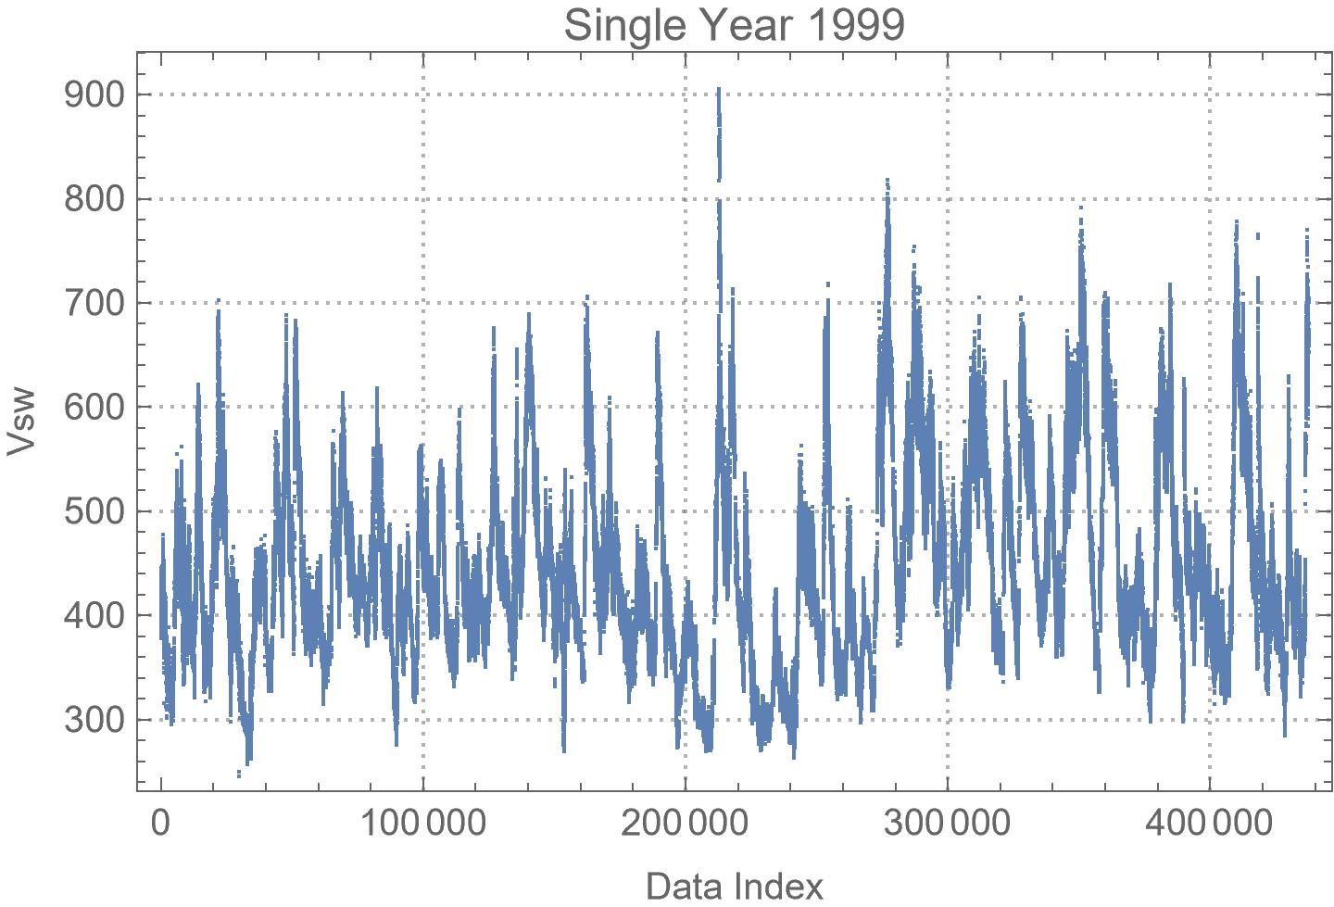
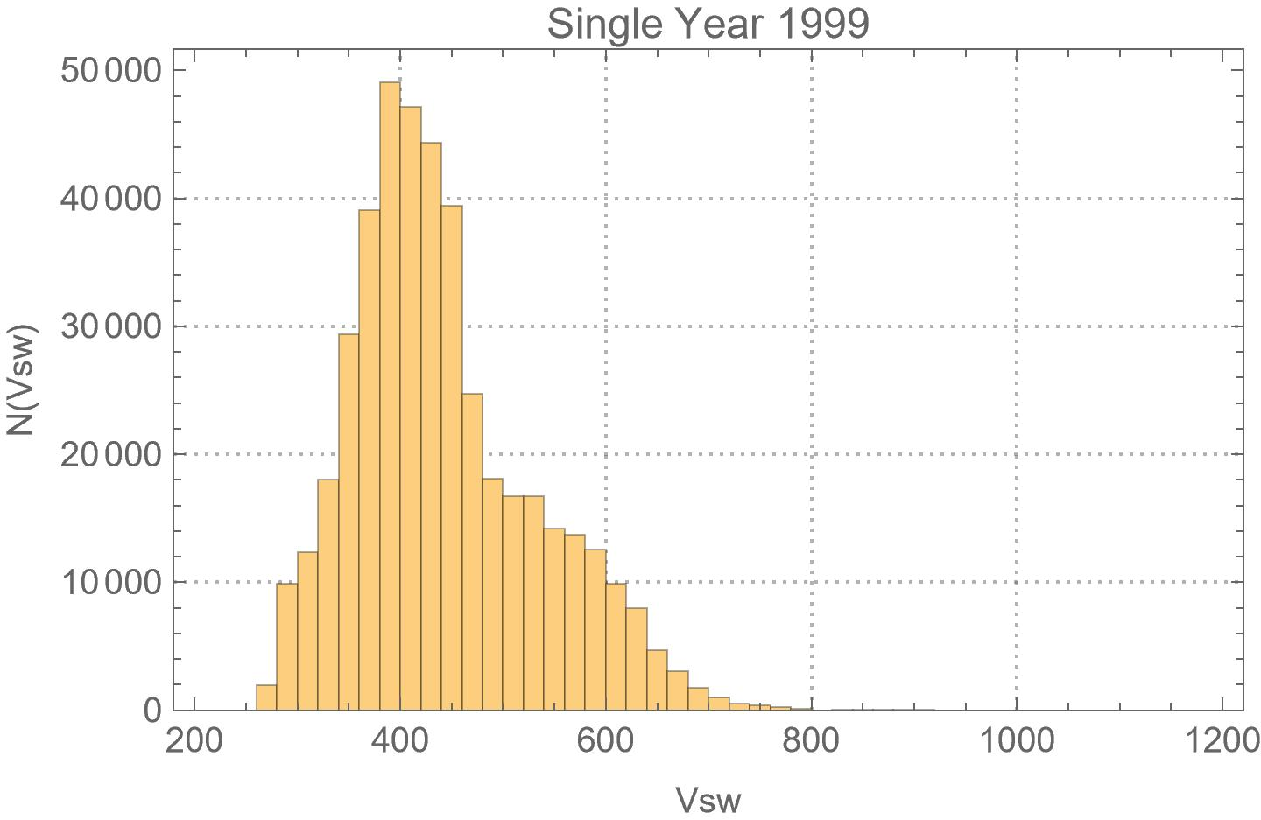
1m Solar Wind Speed 1999

Slide 10
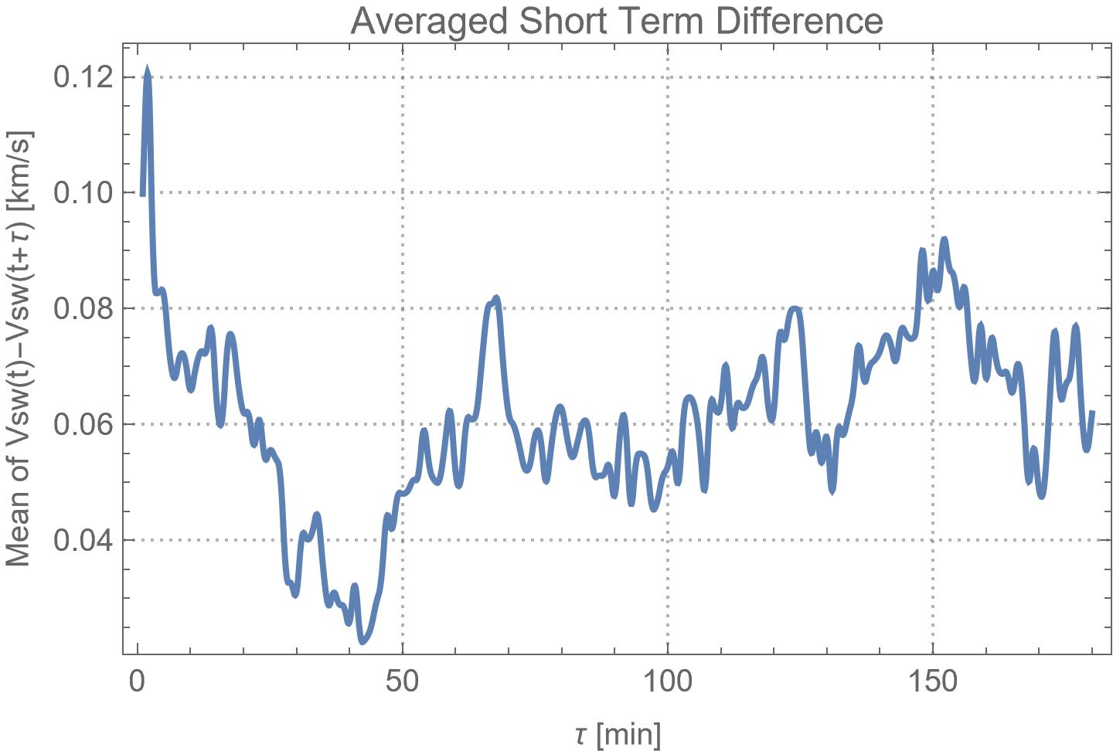
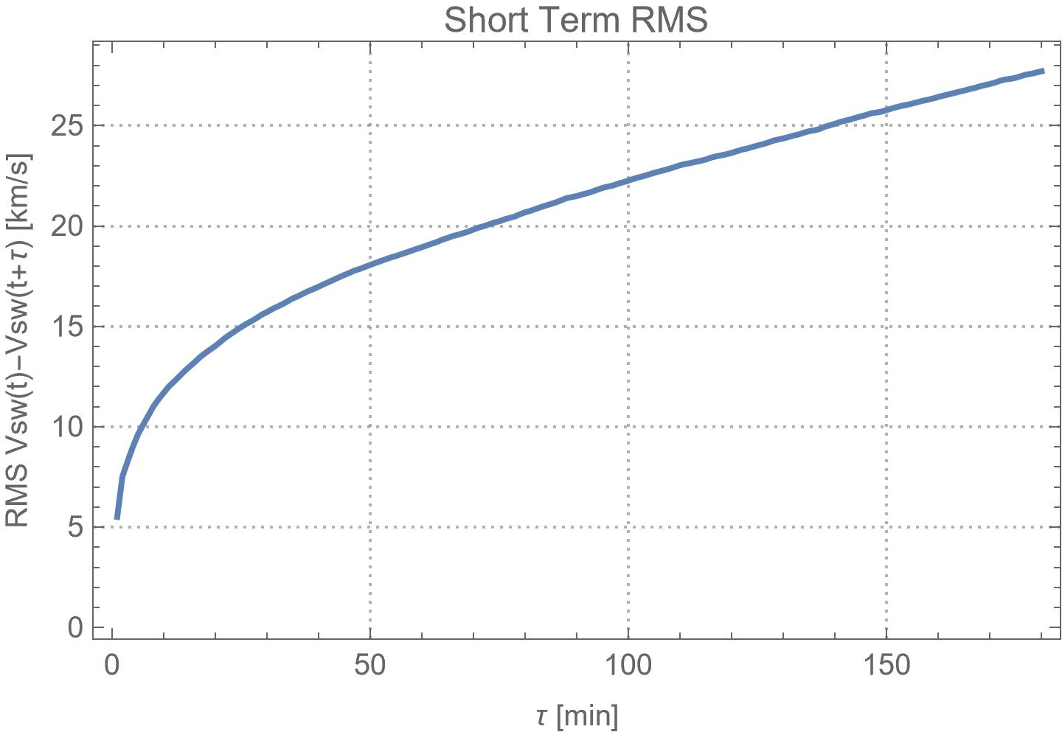
1m Solar Wind Speed 1999
3 hours

Slide 11
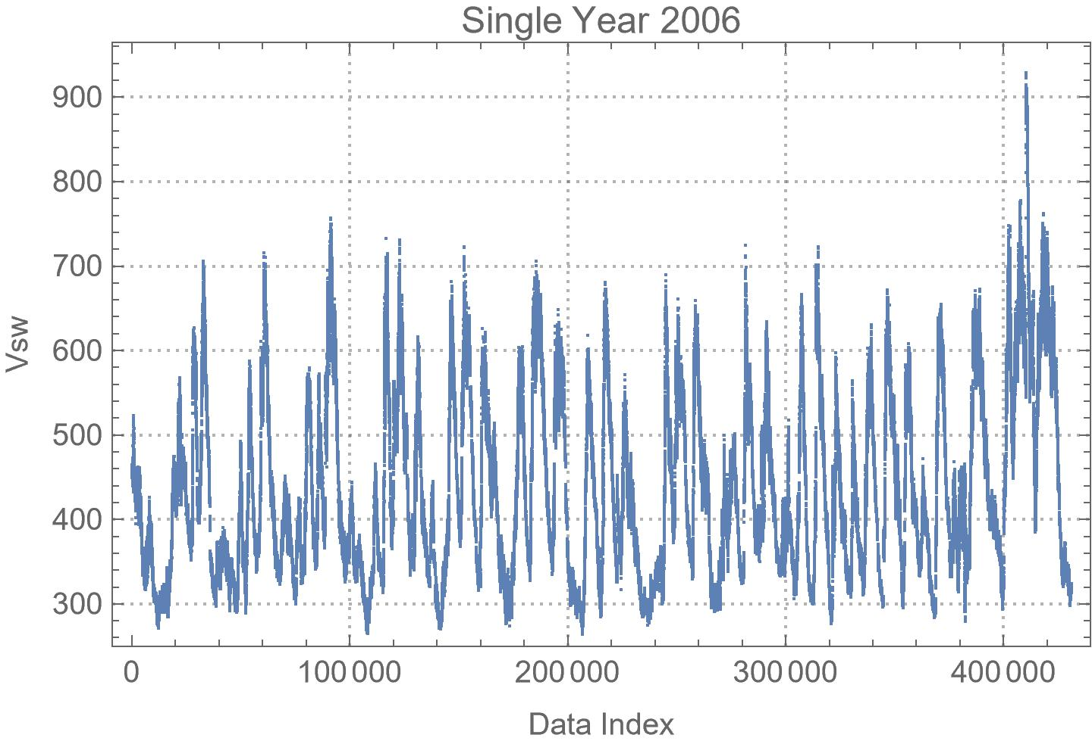
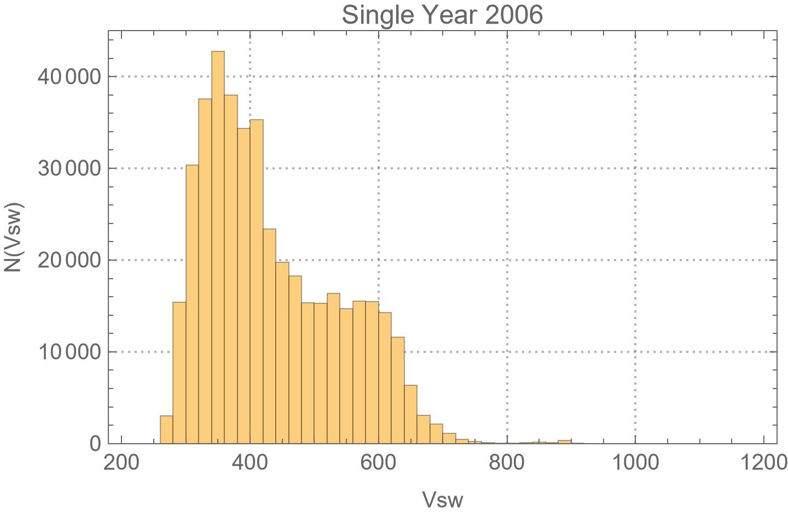
1m Solar Wind Speed 2006

Slide 12
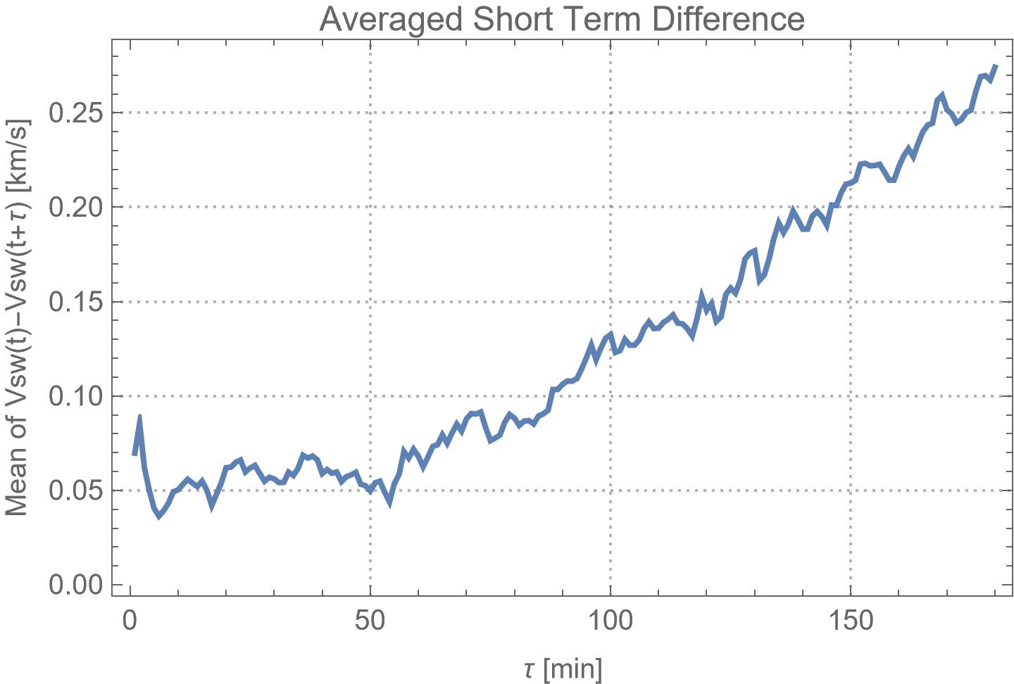
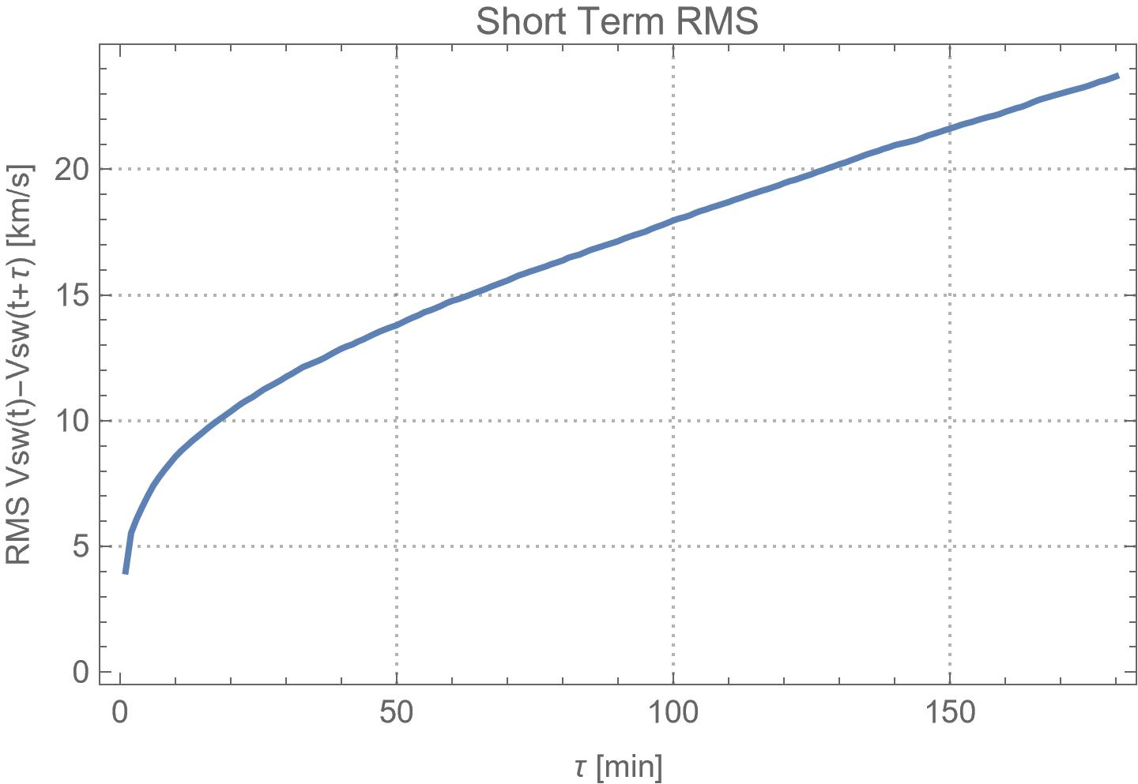
1m Solar Wind Speed 2006
3 hours

