Slide 1
Prediction of geomagnetic disturbance using empirical models
Quantity of interest: 1/ solar wind speed, 2/ Planetary Kp index,

Slide 2
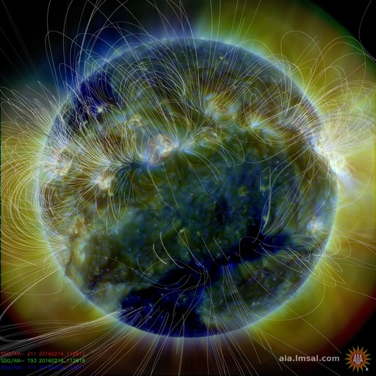
1. Quantity of interest: Solar wind speed
Fast solar wind (750 km/s) is known to originate from coronal holes, which are regions of open magnetic field lines.
Origin of slow solar wind (300–500 km/s) is more debated, it is linked coronal streamers
Solar wind speed is closely related to the information of coronal hole (CH) areas

Slide 3
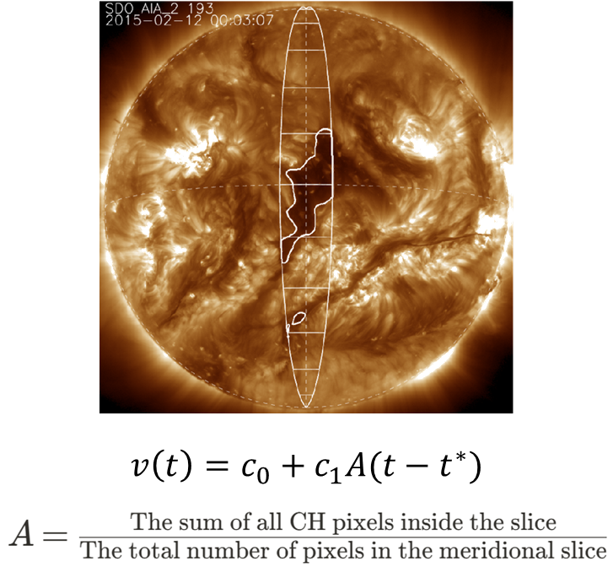
Empirical solar wind forecast (ESWF) model
Rotter, T., Veronig, A.M., Temmer, M. et al. Real-Time Solar Wind Prediction Based on SDO/AIA Coronal Hole Data. Sol Phys 290, 1355–1370 (2015). https://doi.org/10.1007/s11207-015-0680-5
Reiss, M. A., M. Temmer, A. M. Veronig, L. Nikolic, S. Vennerstrom, F. Schöngassner, and S. J. Hofmeister (2016), Verification of high-speed solar wind stream forecasts using operational solar wind models, Space Weather, 14, 495–510, doi:10.1002/2016SW001390.

Slide 4
Datasets
OMNIWEB data provides information about solar wind at L1 point
(https://omniweb.gsfc.nasa.gov/form/dx1.html)
Several EUV solar datasets available, the most used is the SDO/AIA
There exists some ML-ready datasets (SDO-ML), as well as corresponding python script https://github.com/sdoml
https://github.com/SDOML/SDOMLv2 usage of zarr format for compressed N-dimensional arrays

Slide 5
Solar wind speed prediction from AIA 19.3 nm and 21.1nm (WindNet model)
Upendran et al 2020, doi: 10.1029/2020SW002478
Bernoux et al paper makes extensive reference to Upendran paper (it was clearly an inspiration for them).
Input dataset : SDOML, 19.3nm and 21.1 nm
Preprocessing: clipping of values, logarithmic rescaling
Target dataset: daily averaged SW speed measured at L1, obtained with OMNIWEB archive

Slide 6
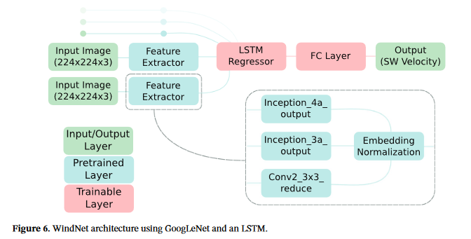
Architecture of WindNet:
Use GoogLeNet as Feature extractor
Temporal encoder using LSTM
There are no decoder, as what is predicted is the SW velocity time series (no probabilistic forecast)
Use nested cross-validation during training
FC = fully connected layer

Slide 7
Open Research statement
Upendran et al 2020, doi: 10.1029/2020SW002478
Model is developed using the Tensorflow package (not PyTorch)
The code and data used in this work is open sourced (model may be found on github: https://github.com/Vishal-Upendran/WindNet).

Slide 8
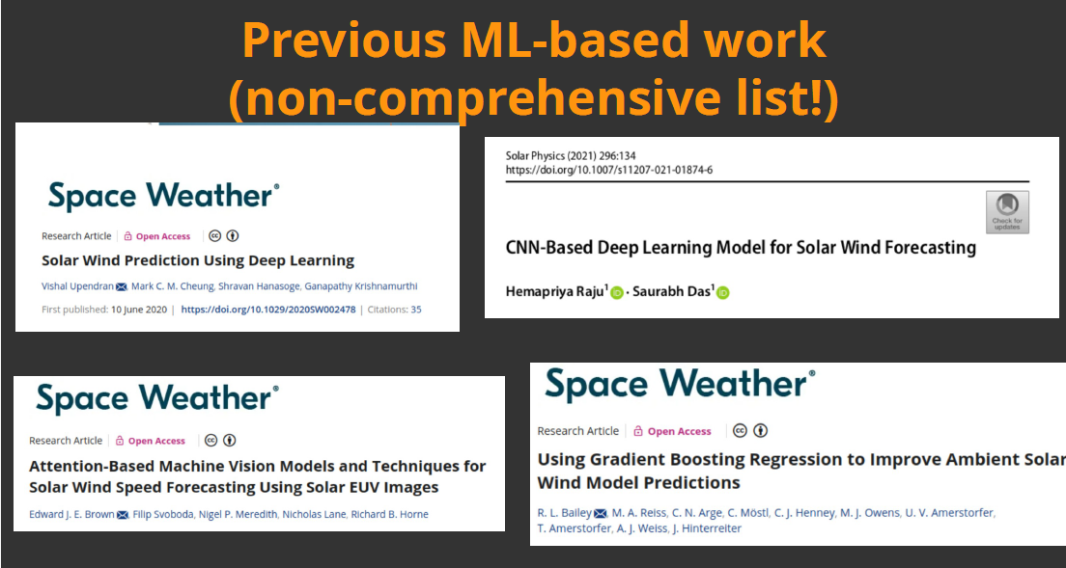

Slide 9
2. Quantity of interest : Kp-index
The ‘planetary’ Kp index is computed from vector measurements of the geomagnetic field from 13 mid-latitude stations
It represents short-term magnetic variations driven by solar wind plasma and interplanetary magnetic field
Zhelavskaya et al. [2019] use solar wind measurements (Bx, By, Bz, Vx, Vy, Vz, etc) at L1 point to predict Kp, by regression
Other work on this: Tan et al, 2028 , Wintoft et al 2017
To improve forecasting time in the future, it is necessary to try and estimate Kp from EUV images.

Slide 10
SERNADE model : Kp prediction from AIA 19.3 nm (Bernoux et al 2022, doi:10.1029/2022JA030868)
Kp prediction using deep learning: SERENADE
Additional preprocessing
Need to enhance contrast -> clip intensity values to (min= 100DN, max= 500 DN)
After clipping, rescale to log10
Linear rescaling between 0 and 1.
Target dataset : Kp index: 27 discrete values ranging from 0 to 9
Available at GFZ Potsdam
https://kp.gfz.de/en/
Prediction of daily maximum, not of three -hourly value of Kp
Up to 5 days in advance prediction
Input: ML-ready SDO/AIA images (Galvez et al 2019): github: https://github.com/SDOML/SDOML
512x512 pixels
Calibrated, corrected for degradation
Corrupted images removed
05/2010-12/2018: 8.5 years of data
Input Dataset
One wavelength: 19.3nm
Recent history: one image every 12hr, for 5 days
Input: image sequences of 10 images

Slide 11
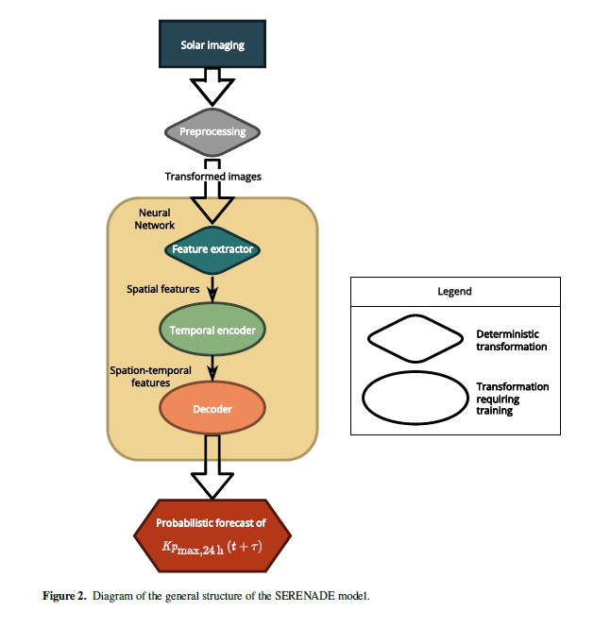
Overview SERENADE model

Slide 12
a) Feature extractor
Torchvision package , developed by Pytorch team: provide pre-trained CNN specialized in classification of samples from ImateNet database.
A pre-trained model is used. GoogLeNet ‘Inception’ model (Szegedy et al , 2014) is chosen amongst several other models
1x512x512 image converted to 3x224x224 to use GoogLeNet
Classification layer was removed -> Feature extractor output is a vector of size 1024.
10 images in a sequence -> vector of size 10x1024 as output

Slide 13
b) Temporal encoder
Input : vector of size 10x1024
Goal: Extract information from the temporal evolution of the features extracted in previous step
Recurrent neural network (RNN) of the type ‘LSTM’ Long-short term memory, with two layers. Same architecture as the one used for studying solar wind speed prediction from AIA images (Upendran et al 2020)
Output : vector of size 1x2048

Slide 14
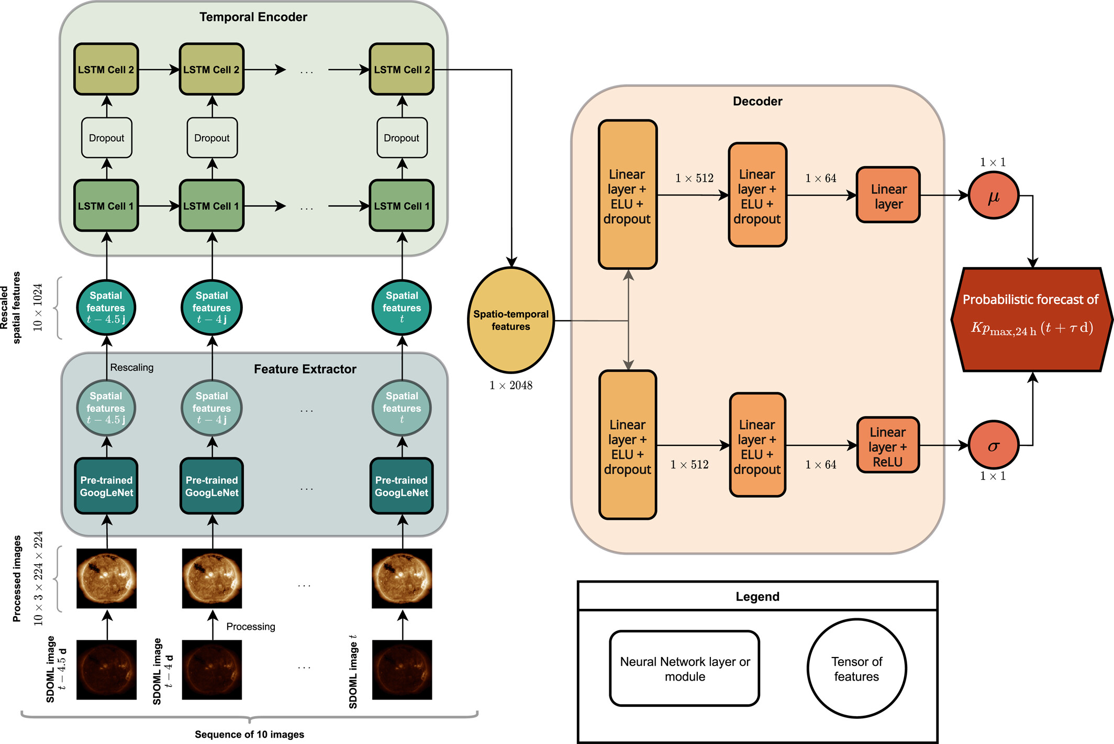
c) Decoder
The whole architecture
Goal: Convert spatio-temporal features (obtained from feature extractor+temporal encoder) into human-understandable prediction
Probabilistic forecast following a normal distribution -> need to estimate the mean and variance of the normal distribution
Multilayer perceptron: three linear (dense) layers of decreasing sizes.

Slide 15
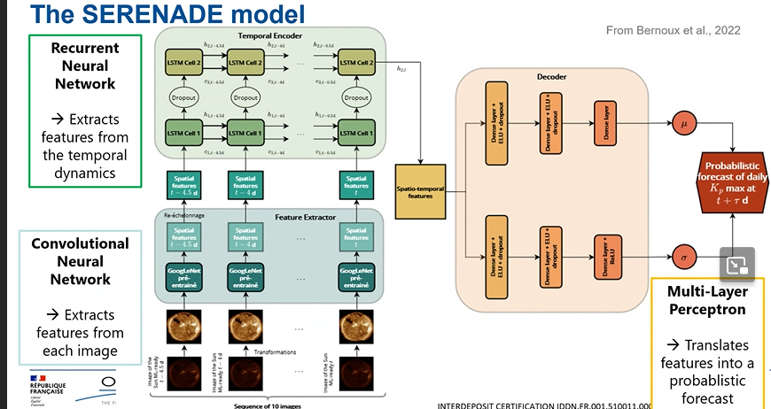
Slide seminar Maria Tahtouh

Slide 16
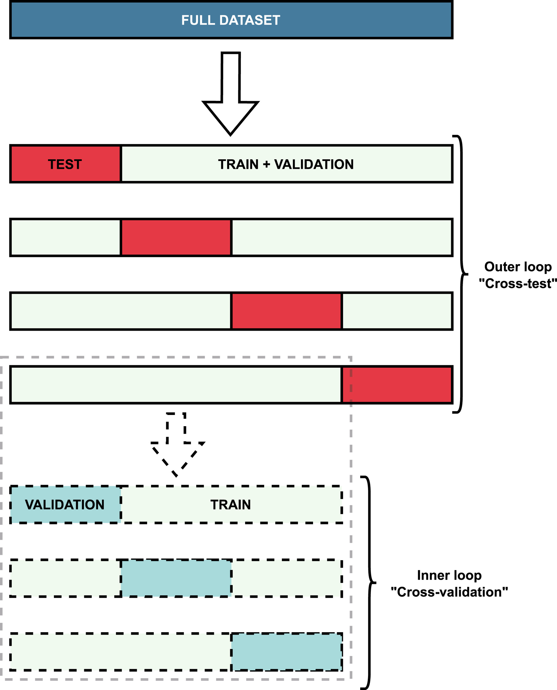
Training with nested cross-validation
Goal: be able to use in an optimal way all the data we have
If we split rigidly into training/validation/test: not enough data for good performance evaluation
In nested cross-validation, every data is used for training/validation/test at different stage

Slide 17
Evaluation of the model
Using benchmark model: climatological model (using mean and std over a large period), persistence model (use last value as prediction for future value) , recurrence model (27 day recurrence)
Evaluation measure: Mean absolute value, RMSE, Pearson correlation
See https://agupubs.onlinelibrary.wiley.com/doi/full/10.1029/2022JA030868 for all the results
Open research statement “We provide the outputs of our model and of the baseline models for the whole period covered by the SDOML data set online: https://zenodo.org/record/6873690 (Bernoux et al., 2022).”
code itself is not available.

Slide 18

Improvements on first results of SERNEADE
1.The same probabilistic models was trained to predict solar wind speed, using an extended dataset ( SDO/AIA+ SOHO/EIT images). This improved the results wrt using only images from Solar cycle 24.-> cfr slides of talk made at ESWW2025: BernouxGuillerme_ESWW2025_CD1.pptx
2. Another member of the team studied the Comparison of Solar Imaging Feature Extraction Methods
Replace pre-trained model with an Variational Auto-encoder, directly trained from the data
=> more consistent (less variable) performance results
Ref:
https://doi.org/10.1029/2024JH000566

