Slide 1
Ecommerce web-scraping llm processing system

Slide 2
AGENDA
Background
Overall themes
Data drill-down
Go forward

Slide 4
BACKGROUND
A/B test windows
Test 1 : Aug 17 to Oct 8 2024 :: PDP traffic split on Web
Internal recs (v1) – 60%
Certona with overrides – 20%
Certona w/o overrides – 20%
Test 2 : Apr 07 to Apr 30 2025 :: PDP traffic split on Web
Internal recs (v1 (warm-start)-v2 hybrid) – 50%
Certona with overrides – 50%
Analysis constraints / Notes
Access : No in-session data, views data
Knowledge Gap : Timelines of Certona change rollouts
Data discrepancy : Mismatches in data between Adobe and GDP
1.7% in sessions, 2.2% in orders, 2% in net revenue
Notes:
App is excluded
Numbers are directionally the same – Adobe has more than us

Slide 5
E-commerce LLM Pipeline
DATA PIPELINE
TECH STACK
Web Scraper
Product Data
LLM Processor
FastAPI\nREST Endpoints

Slide 6
E-commerce LLM Pipeline
DATA Details/Tech Stack
Web Scraping
Playwright + Firefox
Raw Product Data
Title, Price, Description
LLM Processing
Summaries + Highlights by Llama 70b
Persistent Data Storage and Monitor
REST API
JSON, Pandas, Jyputer
FastAPI, Uvicorn, Pydantic
GROQ API
HTTPX + AsyncIO

Slide 7
EMERGING THEMES
Performance(Internal Recs) < Performance(Certona)
Incomparable test results
Opportunities for improvement
Container 1 – Internal recs in 10 positions vs Certona in 5
Container 2 – Internal recs ‘YMAL’ vs Certona ‘Recently Viewed and Related Items’
Potential production issue through experimentation period
High CTRS and RPVs as per funnel, but doesn’t hold at session level
Candidate generation
Generalization between training and inference
Re-evaluate business rules – specifically size coverage, same style conflict rules
Output containers
Alternate fallback strategies / Refined reranking
Using in-session data
3. Potential low data for training

Slide 8
OVERALL metrics
MODEL | # SESSIONS | #RAW PDP VIEWS | #IDENTIFIED PDP VIEWS | #REC CLICKS | #ORDERS | TOTAL REVENUE | NET REVENUE
Certona w overrides | 1349359 | 3500727 | 3389681 | 282547 | 49033 | 10492779 | 8543590
internal recs | 1349367 | 3488990 | 3376514 | 283230 | 48515 | 10341312 | 8413384
 | CTR |  | CVR | RPV |  | Net RPV
Model | #Rec clicks / #Sessions | #Rec clicks / #PDP views | #Orders / #Sessions | Tot Revenue / #Sessions | Tot Revenue / #Order items | Tot Paid Amount / #Sessions | Tot paid Amount / #Order items
Certona w overrides | 20.9% | 8.34% | 3.63% | $7.78 | $213.99 | $6.33 | $174.24
internal recs | 21.0% | 8.39% | 3.60% | $7.66 | $213.16 | $6.24 | $173.42
SESSION
 | CTR | CVR | RPV | Net RPV
Model | #Rec clicks / #~Rec views | #Orders / #Rec clicks | Tot Revenue / #Order items | Tot Paid Amount / #Order items
Certona w overrides | 13.19% | 13.19% | $105.87 | $87.95
Internal recs | 13.22% | 13.22% | $107.46 | $88.53
CTR is at parity => User doesn’t hate what’s shown
CVR and RPV are less, but funnel shows otherwise => Potential external factors
FUNNEL

Slide 9
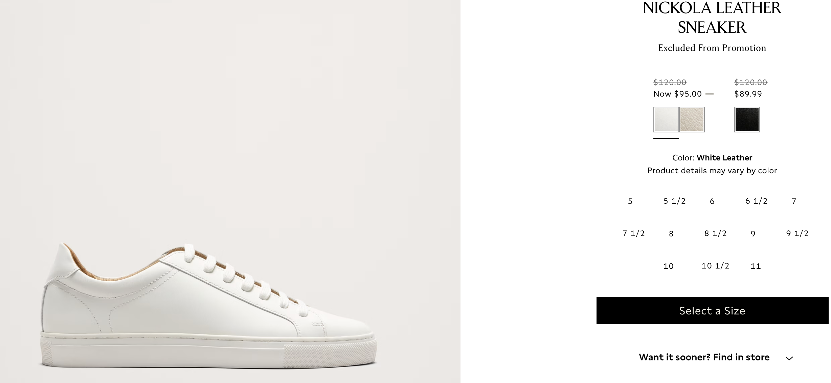
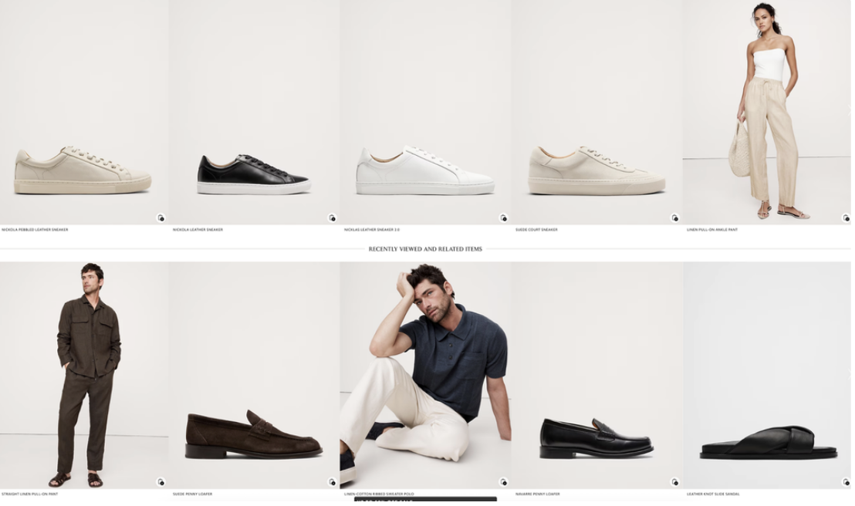
REC POSITION PERFORMACE
PDP VIEWS | 3389681 | 3376514
Container - Position | Num rec clicks |  | CTR (Scaled)
 | Certona | Internal recs | Certona | Internal recs
1 | 165013 | 180448 | 4.87% | 5.34%
1 | 45140 | 41057 | 13.32% | 12.16%
2 | 43495 | 39758 | 12.83% | 11.77%
3 | 29330 | 26968 | 8.65% | 7.99%
4 | 25742 | 21608 | 7.59% | 6.40%
5 | 21226 | 15718 | 6.26% | 4.66%
6 | 21 | 8015 | 0.01% | 2.37%
7 | 19 | 6921 | 0.01% | 2.05%
8 | 15 | 6195 | 0.00% | 1.83%
9 | 9 | 5962 | 0.00% | 1.77%
10 | 16 | 8246 | 0.00% | 2.44%
2 | 115584 | 100790 | 3.41% | 2.99%
1 | 25018 | 20572 | 7.38% | 6.09%
2 | 24846 | 20607 | 7.33% | 6.10%
3 | 17965 | 14313 | 5.30% | 4.24%
4 | 12994 | 12150 | 3.83% | 3.60%
5 | 9906 | 9675 | 2.92% | 2.87%
6 | 5927 | 5023 | 1.75% | 1.49%
7 | 5177 | 4384 | 1.53% | 1.30%
8 | 4293 | 4049 | 1.27% | 1.20%
9 | 4593 | 4121 | 1.35% | 1.22%
10 | 4865 | 5896 | 1.44% | 1.75%

Slide 10
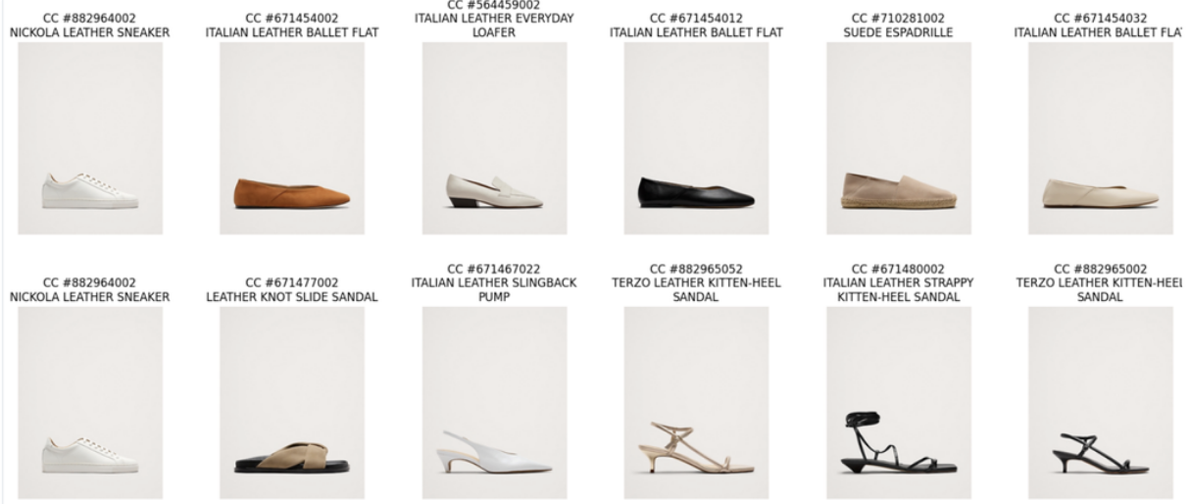
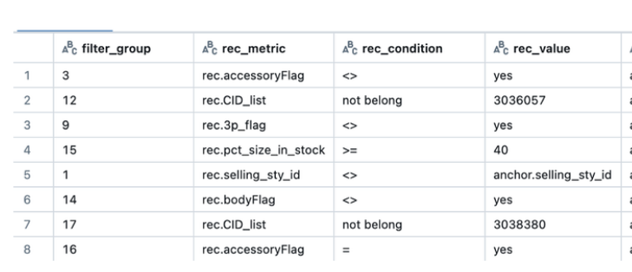
Case study : CERTONA CTR > Internal ctr
Huge difference in Clicks (Internal=68 vs. Certona=235), but not necessarily revenue/purchase
MF and NCF model recommended these good items (Correlational & semantic similarities) but candidate generation drops them !
Why 875974002 and 710314012 are missing?
Eliminated because they belong to MENS department
Why 463541012 and 882964012 are missing?
Eliminated by size coverage and same-style conflict rules.
INTERNAL RECS
CERTONA

Slide 11
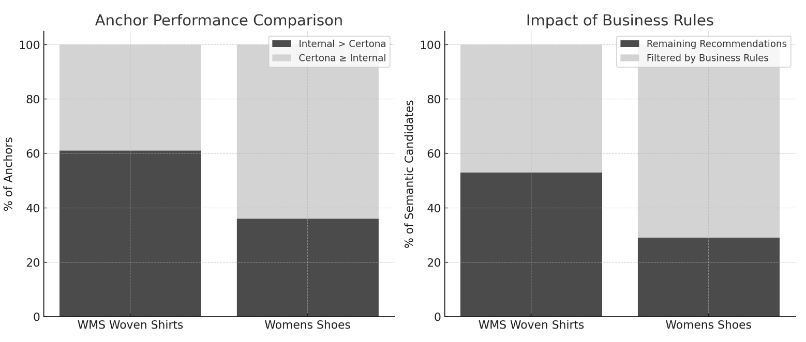
Opportunity : biz rules RE-EVALUATION
Impact of biz rules are substantial, our rules are very different from certona's

Slide 12
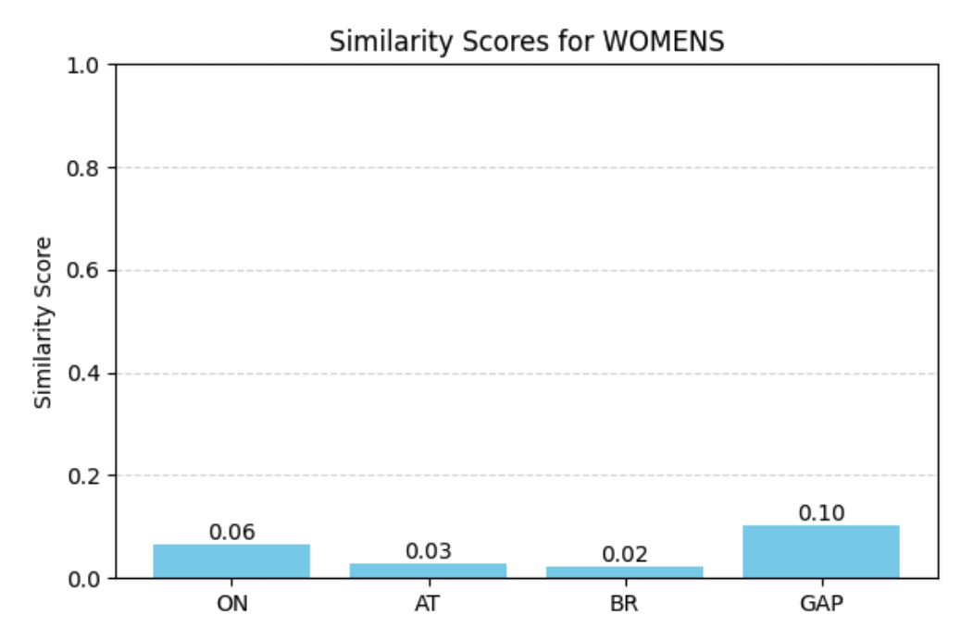
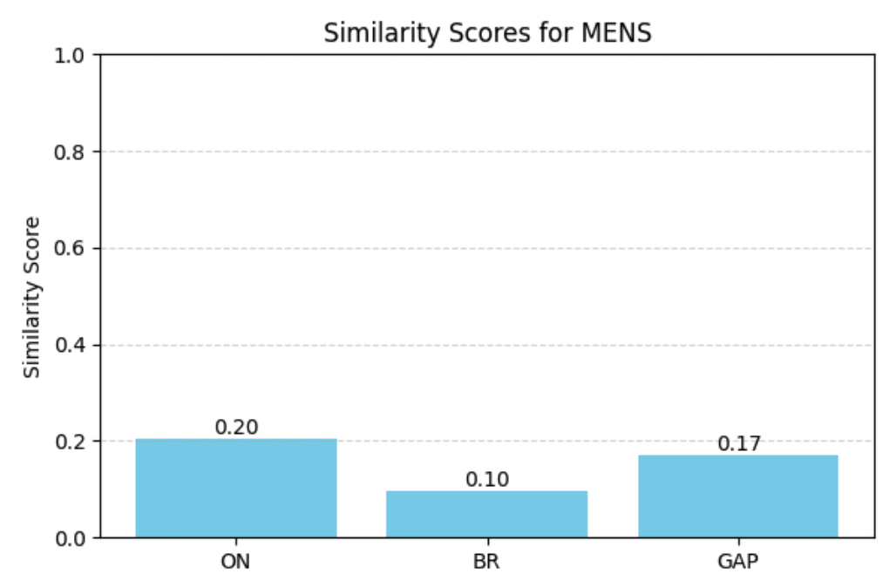
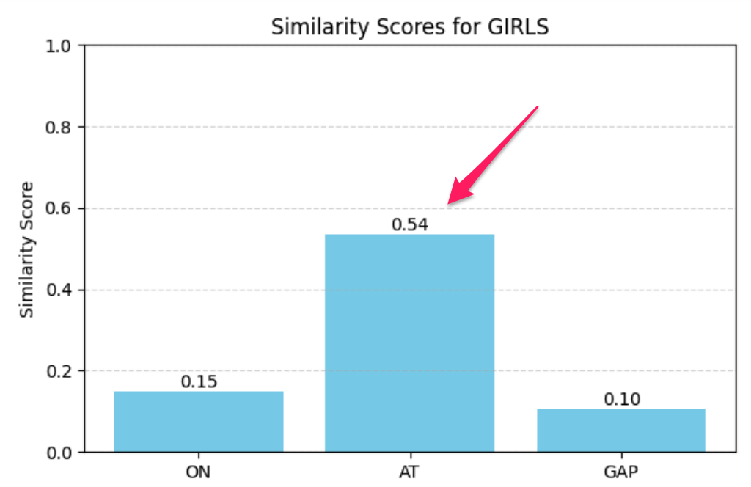
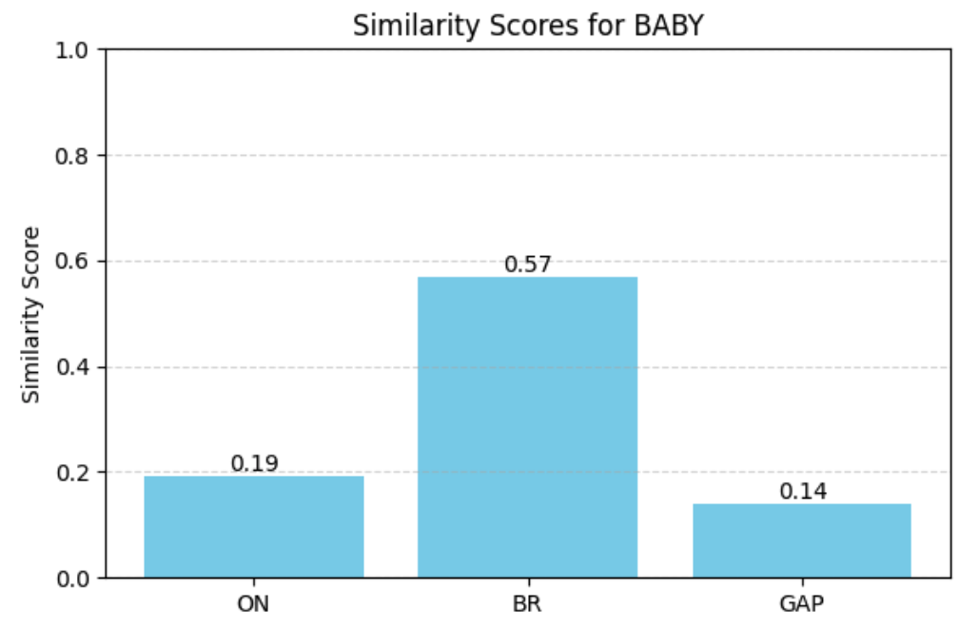
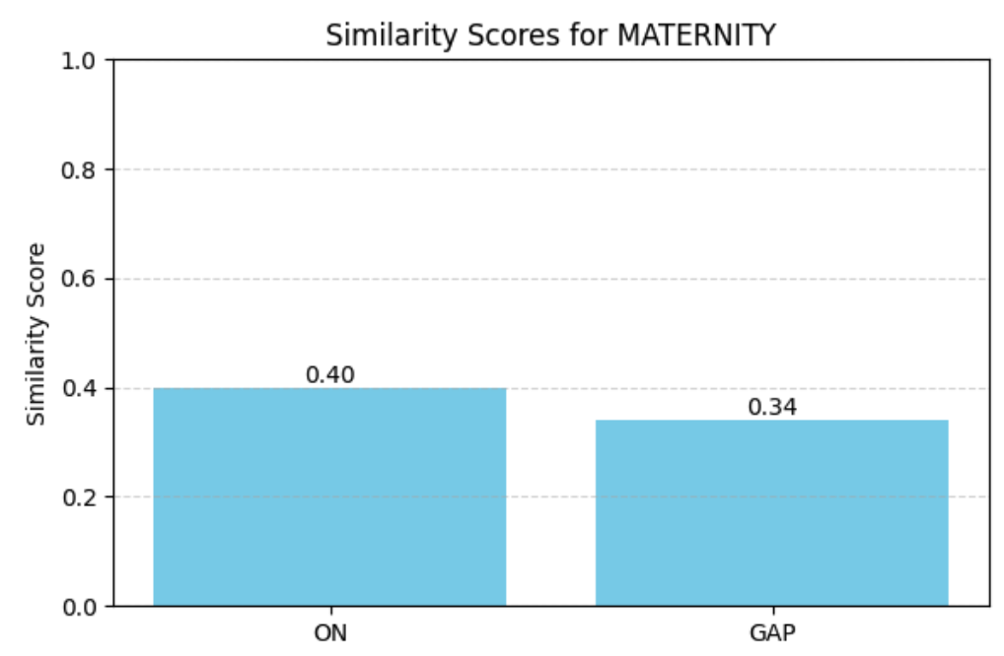
Item representation check
What are we checking here
Deployed BR models look good
Are BR item descriptions too short/general as compared to other brands?
Methodology
Check intra-group embedding similarity scores – higher scores indicate generic descriptions
Deployed AT GIRLS model has this problem
Conclusions
BR MEN and WOMEN look good
We discovered other models with this problem
Code
BR BABY and MATERNITY divisions have the problem but not deployed yet

Slide 13
Thank you

