Slide 1
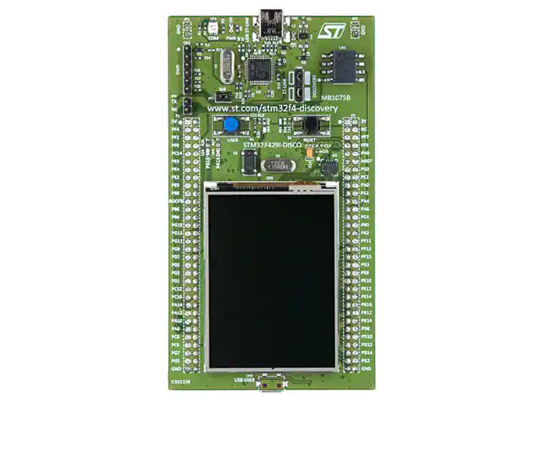
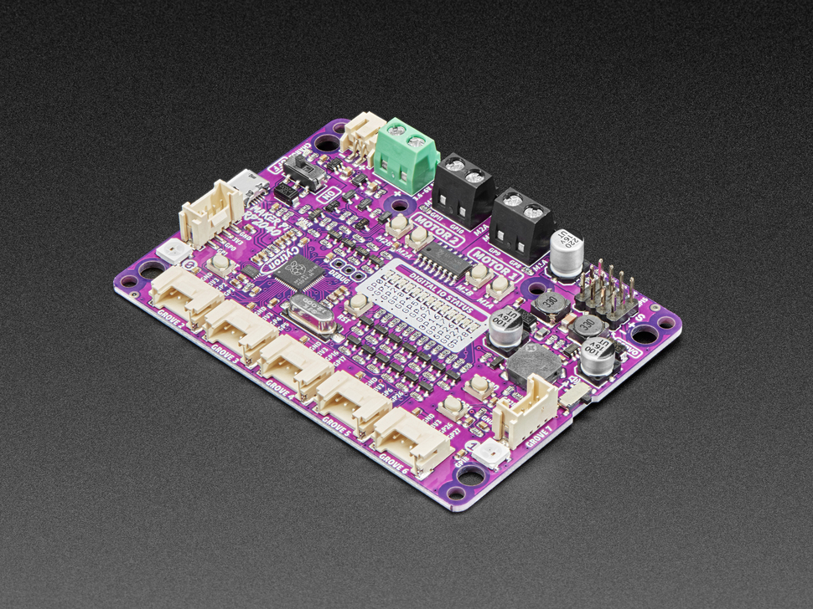
Homework 2 – Board Investigation and Discovery
STM32F429IDISCOVERY Board vs Maker Pi RP2040 - Motor and Robot Controller

Slide 2
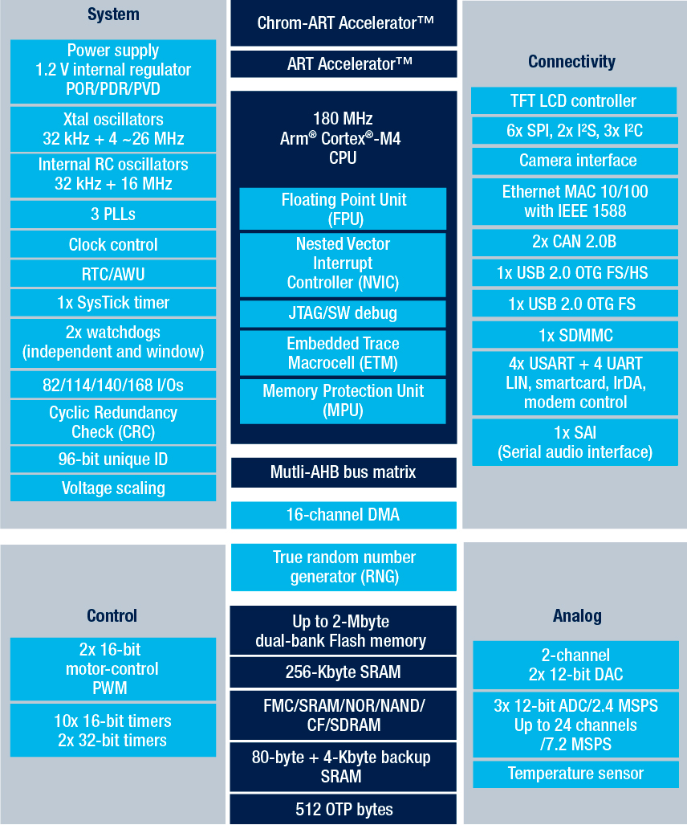
Hardware Diagram - STM32F429IDISCOVERY Board

Slide 3
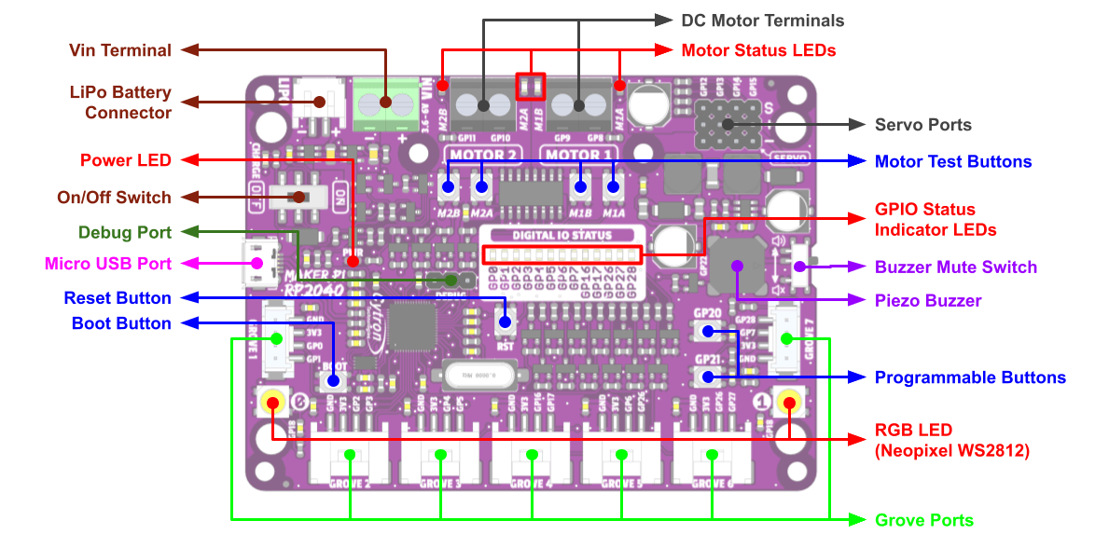
Board Layout - Maker Pi RP2040 - Motor and Robot Controller

Slide 4
How much does each board cost? Are they available?
STM32F429IDISCOVERY Board
Maker Pi RP2040 - Motor and Robot Controller
Digikey PN: 497-16140-ND
Cost: $29.00
Num in stock: 10
Adafruit PN: 5129
Cost: $12.50
Num in stock: 0

Slide 5
What kind of processor is it?
STM32F429ZIT6
RP2040
ARM Cortex-M4
180MHz
Single Core
RISC
32 bit
256K SRAM
2 Mbytes Flash
https://www.st.com/en/microcontrollers-microprocessors/stm32f429zi.html
ARM Cortex-M0+
133 MHz
Dual Core
RISC
32 bit
264K SRAM
0 Mbytes Flash
https://www.raspberrypi.com/documentation/microcontrollers/rp2040.html

Slide 6
How much Flash and RAM does it have? Any other memory types?
STM32F429IDISCOVERY Board
Maker Pi RP2040 - Motor and Robot Controller
64 Mbit SDRAM
2 Mbytes
Supports 64MB external memory
0 SDRAM
2Mbytes Flash
Supports 16 MB external memory

Slide 7
Does it have any special peripherals? List 3-5 that you find interesting.
STM32F429IDISCOVERY Board
Maker Pi RP2040 - Motor and Robot Controller
Has an ST MEMS motion sensor 3-axis digital output gyroscope
2.4” QVGA TFT LCD
“Extension header for LQFP144 I/Os for a quick connection to the prototyping board and an easy probing”
This is a board optimized for debugging
It has 4 Servo motors
It also has 2 DC motors with quick test buttons
There are 13 status LEDs for GPIO pins
Piezo buzzer with mute switch
7 grove ports (flexible I/O)
This is the Las Vegas of boards

Slide 8
If it has an ADC, what are the features?
STM32F429IDISCOVERY Board
Maker Pi RP2040 - Motor and Robot Controller
3×12-bit, 2.4 MSPS ADC: up to 24 channels and 7.2 MSPS in triple interleaved mode
N/A

Slide 9
Look at one application note for this board
STM32F429IDISCOVERY Board
Maker Pi RP2040 - Motor and Robot Controller
Looked at: EMC design guide for STM8, STM32 and Legacy MCUs
https://www.st.com/resource/en/application_note/an1709-emc-design-guide-for-stm8-stm32-and-legacy-mcus-stmicroelectronics.pdf
So far unable to find application notes for this board

Slide 10
Sources:
STM32F429IDISCOVERY Board
https://www.st.com/content/ccc/resource/technical/document/data_brief/ff/c1/b6/02/c3/b4/49/cb/DM00094498.pdf/files/DM00094498.pdf/jcr:content/translations/en.DM00094498.pdf
https://www.st.com/en/microcontrollers-microprocessors/stm32f429ii.html#documentation
https://www.st.com/en/microcontrollers-microprocessors/stm32f429ii.html#
https://www.st.com/en/microcontrollers-microprocessors/stm32f429zi.html
Maker Pi RP2040 - Motor and Robot Controller
https://www.adafruit.com/product/5129
https://www.raspberrypi.com/documentation/microcontrollers/rp2040.html
https://docs.google.com/document/d/1DJASwxgbattM37V4AIlJVR4pxukq0up25LppA8-z_AY/edit
https://www.cytron.io/p-maker-pi-rp2040-simplifying-robotics-with-raspberry-pi-rp2040

