Slide 1



EPC
eNodeB
eNodeB
E-UTRAN

Slide 2

UE
eNodeB
Reference Signal, PSS, SSS
Cell Configuration
MIB, SIB 1, SIB2, …
PRACH Preamble
Random Access
PRACH Preamble Response
RRC Connection Request
RRC Setup
RRC Connection Setup
RRC Connection Setup Complete

Slide 3

UE
eNodeB
Reference Signal, PSS, SSS
Cell Configuration
MIB, SIB 1, SIB2, …
PRACH Preamble
Random Access
PRACH Preamble Response
RRC Connection Request
RRC Setup

Slide 4
UE
eNodeB
Reference Signal, PSS, SSS
Cell Configuration
MIB, SIB 1, SIB2, …
PRACH Preamble
Random Access
PRACH Preamble Response
RRC Connection Request
RRC Setup
RRC Connection Setup
RRC Connection Setup Complete

Slide 5
UE
eNodeB
Reference Signal, PSS, SSS
Cell Configuration
MIB, SIB 1, SIB2, …
PRACH Preamble
Random Access
PRACH Preamble Response
RRC Connection Request
RRC Setup
RRC Connection Setup
RRC Connection Setup Complete

Slide 6
UE
eNodeB
Reference Signal, PSS, SSS
Cell Configuration
MIB, SIB 1, SIB2, …
PRACH Preamble
Random Access
PRACH Preamble Response
RRC Connection Request
RRC Setup
RRC Connection Setup
RRC Connection Setup Complete

Slide 7
B samples of binomial distribution
NR of admitted UEs

Slide 8
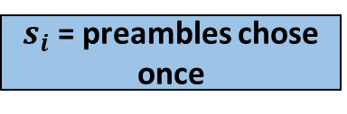
B samples of binomial distribution
NR of admitted UEs
B samples of uniform distribution
$s_{i}$ = preambles chose once

Slide 9

B samples of binomial distribution
NR of admitted UEs
B samples of uniform distribution
$s_{i}$ = preambles chose once
B -= $s_{i}$
ACB

Slide 10

$[B<b^{ε} or t_{i}≥t$]
B samples of binomial distribution
NR of admitted UEs
B samples of uniform distribution
$s_{i}$ = preambles chose once
B -= $s_{i}$
ACB

Slide 11

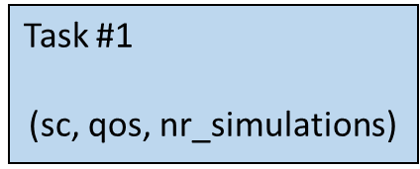
Task #3
(sc, qos, nr_simulations)
Worker #1
Task #2
(sc, qos, nr_simulations)
Task #1
(sc, qos, nr_simulations)
Process Pool
Task #3
(sc, qos, nr_simulations)
Task #2
(sc, qos, nr_simulations)
Worker #2
Task #1
(sc, qos, nr_simulations)
Results

