Slide 1
Seminar Seminar: Distributed Computer Systems SS23
On the Reliability of LTE Random Access: Performance Bounds for Machine-to-Machine Burst Resolution Time

Slide 2
Table of Contents
LTE Networks
RACH as Bottleneck
RACH Procedure in Detail
Access Class Barring
Analysis
Simulation

Slide 3
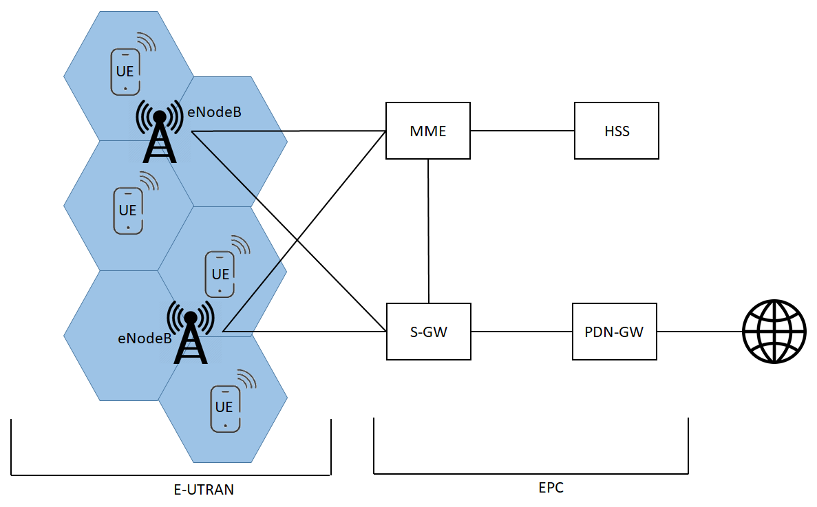
LTE Networks

Slide 4


RACH Procedure as Bottleneck

Slide 5

RACH Procedure as Bottleneck

Slide 6
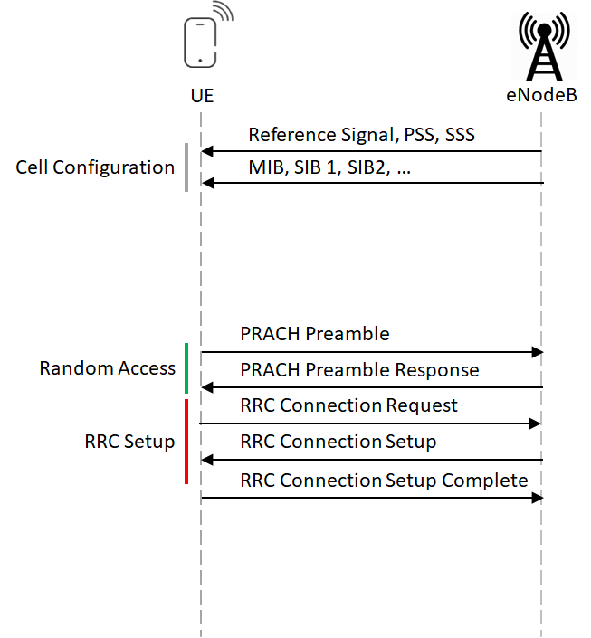
RACH Procedure in Detail

Slide 7
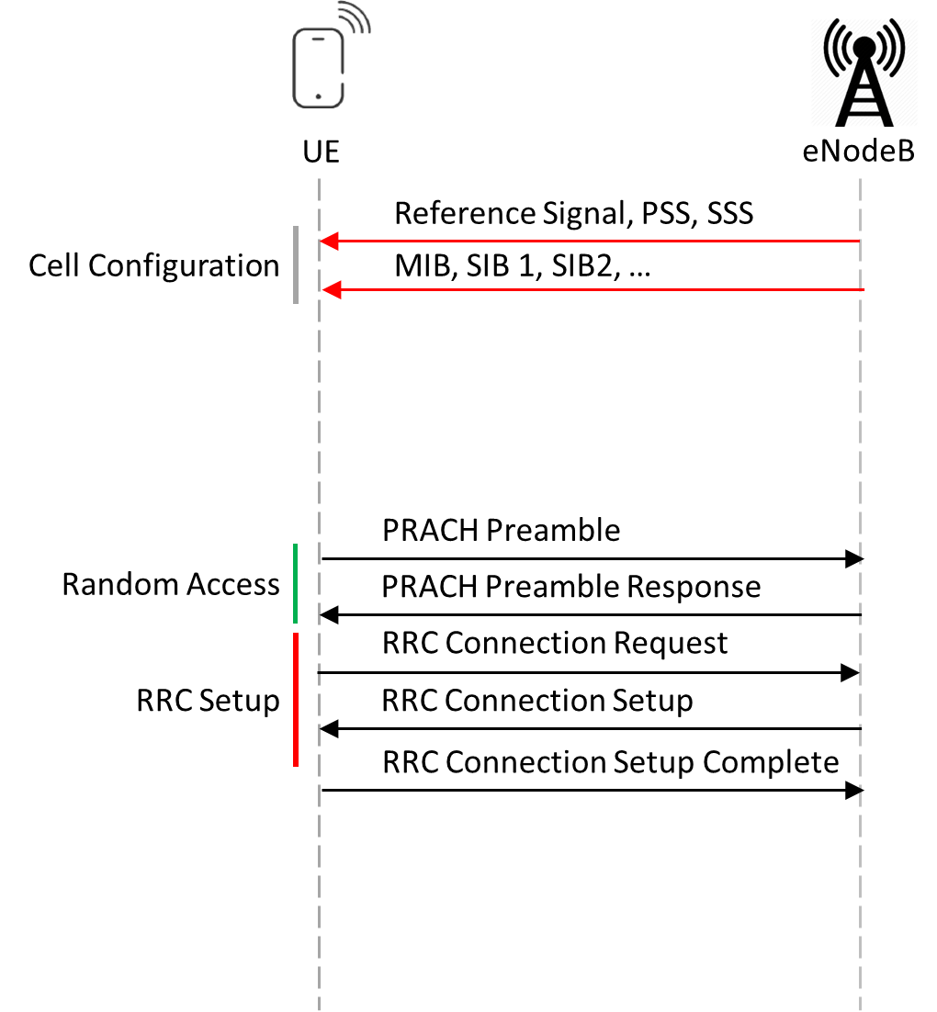
RACH Procedure
Objectives of UE:
Synchronization
Sending signal power
Cell Configuration

Slide 8
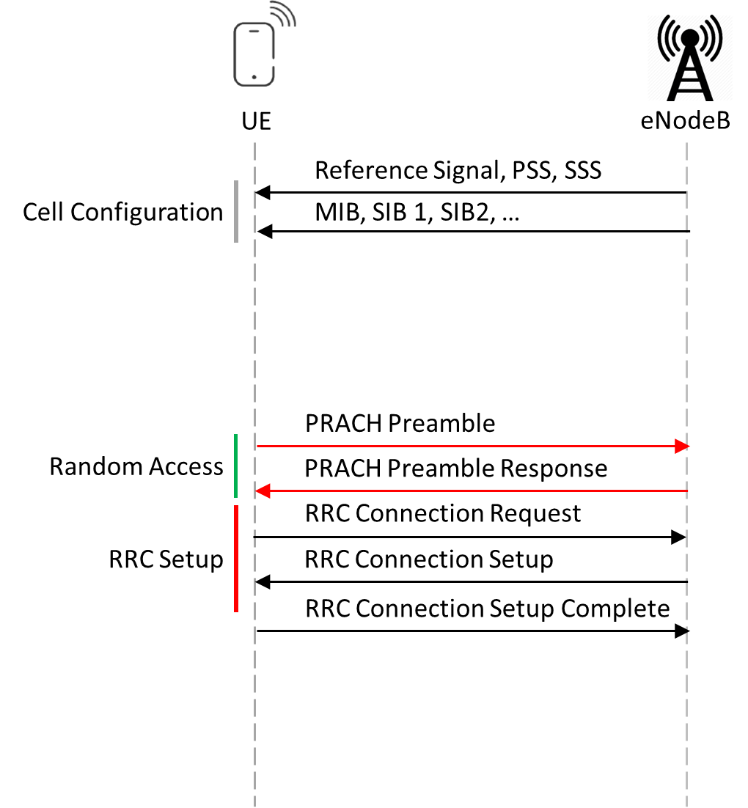
RACH Procedure
UE:
Send one of M Preambles on PRACH
eNodeB:
Reply containing UL Grant on PRACH

Slide 9
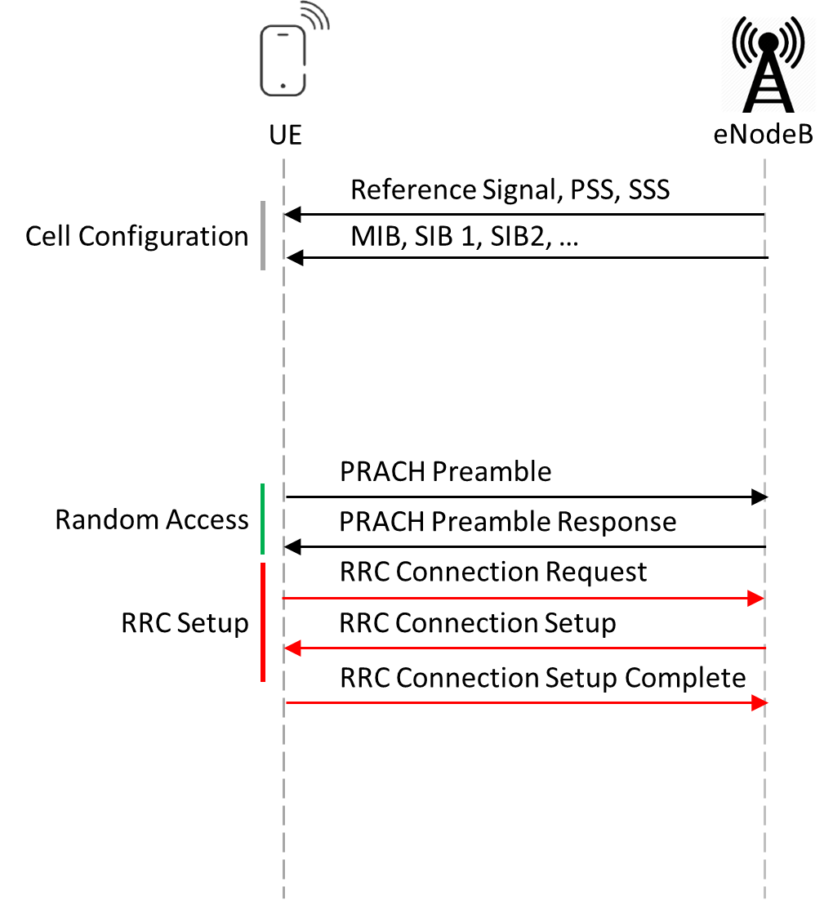
RACH Procedure
Objective:
Exchange UE specific Data
Uses granted Resources
→ UE is signed up at eNodeB

Slide 10
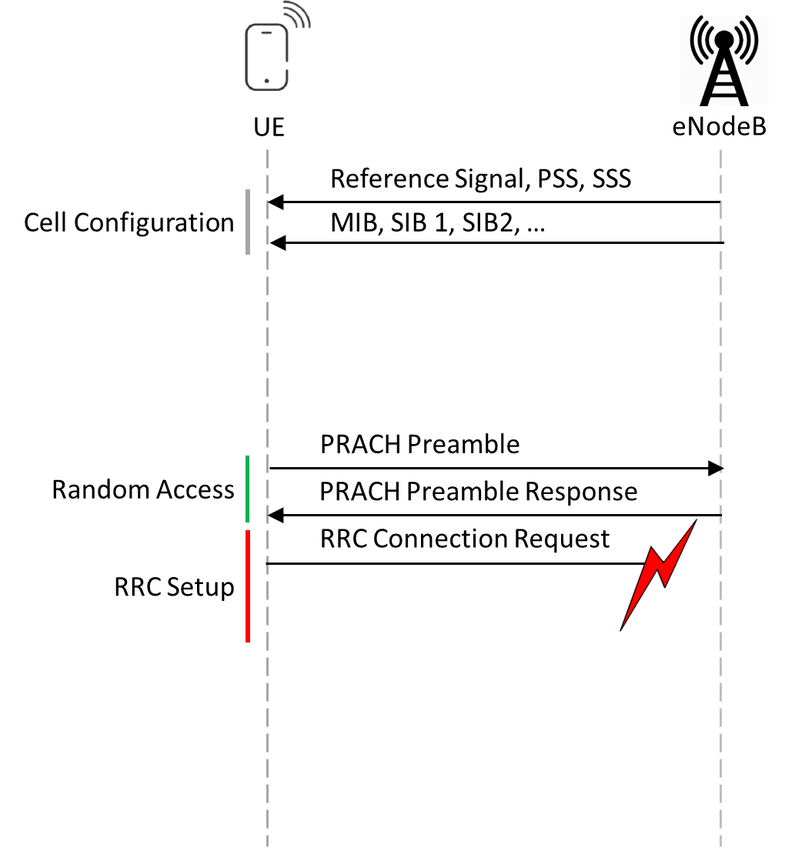
RACH Procedure
Preamble:
Contains no UE specific Data
→ Will collide constructivly
Preamble Response:
Assigns Grant to multiple Ues
Connection Request:
Contains UE specific Data
Will collide destructivly

Slide 11
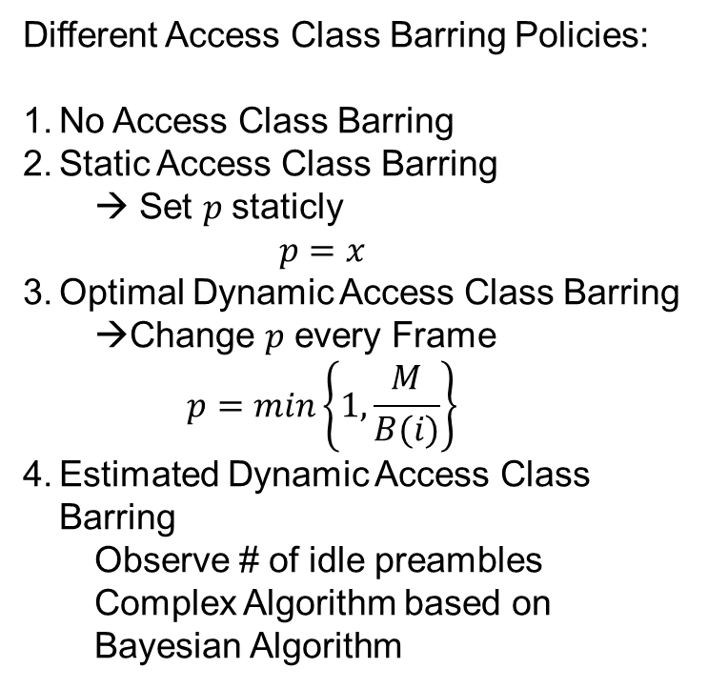
Access Class Barring
< LTE SIB2 >
sib2
ac-BarringInfo
...1 .... ac-BarringForEmergency: True
ac-BarringForMO-Signalling
ac-BarringFactor: p00 (0)
ac-BarringTime: s4 (0)
ac-BarringForSpecialAC: 10000 (bitmap)
ac-BarringForMO-Data
ac-BarringFactor: p00 (0)
ac-BarringTime: s4 (0)
ac-BarringForSpecialAC: 00000 (bitmap)
....
ssac-BarringForMMTEL-Voice-r9
ac-BarringFactor: p00 (0)
ac-BarringTime: s4 (0)
ac-BarringForSpecialAC: 00000 (bitmap)
ssac-BarringForMMTEL-Video-r9
ac-BarringFactor: p00 (0)
ac-BarringTime: s4 (0)
ac-BarringForSpecialAC: 00000 (bitmap)
Different Access Class Barring Policies:
No Access Class Barring
Static Access Class Barring
→ Set $p$staticly
$$p=x$$
Optimal Dynamic Access Class Barring
Change $p$ every Frame
$$p=min\left\{1, \frac{M}{B(i)}\right\}$$
Estimated Dynamic Access Class Barring
Observe # of idle preambles
Complex Algorithm based on Bayesian Algorithm

Slide 12
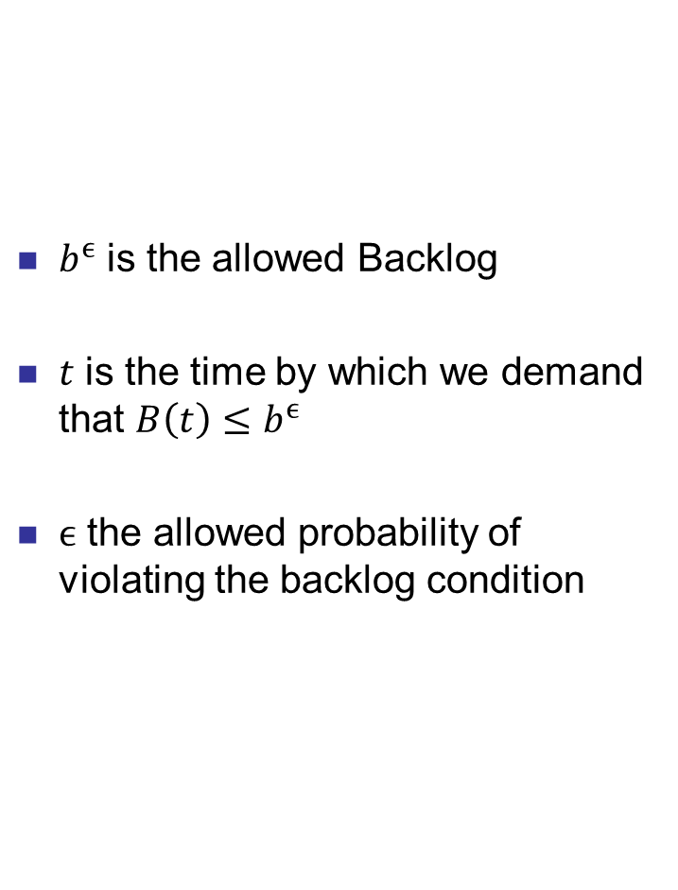

Analysis Quality of Service
$$qos=(b^{ϵ}, t,ϵ)$$
$b^{ϵ}$ is the allowed Backlog
$t$ is the time by which we demand that $B\left(t\right)≤b^{ϵ}$
$ϵ$ the allowed probability of violating the backlog condition

Slide 13
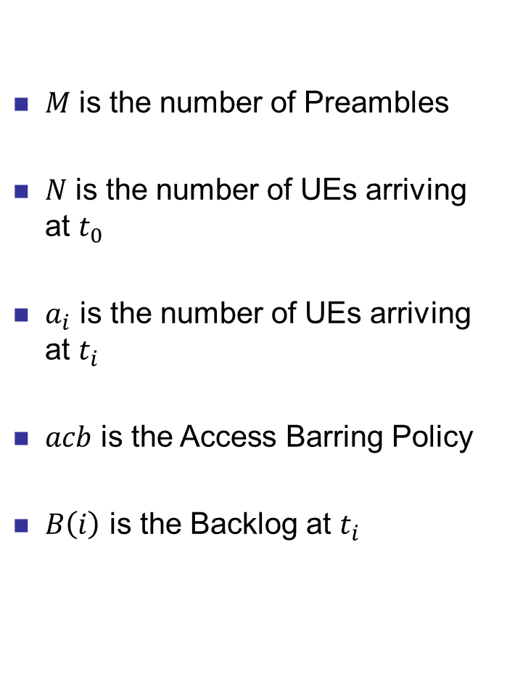

Analysis System Characteristics
$$sc=(N, M, a_{i}, acb)$$
$M$ is the number of Preambles
$N$ is the number of UEs arriving at $t_{0}$
$a_{i}$ is the number of UEs arriving at $t_{i}$
$acb$ is the Access Barring Policy
$B\left(i\right)$ is the Backlog at $t_{i}$

Slide 14

Recursive Analysis
$$s_{i,m}= \left\{\begin{aligned}1 if chosen by 1 UE \\ 0 else \end{aligned}\right.$$
$$B\left(i+1\right)=max⁡\{0, B\left(i\right)+a_{i}−s_i\}$$
Enables recursive calculations of Backlog
Access Barring Policies can be applied every step
Slow

Slide 15
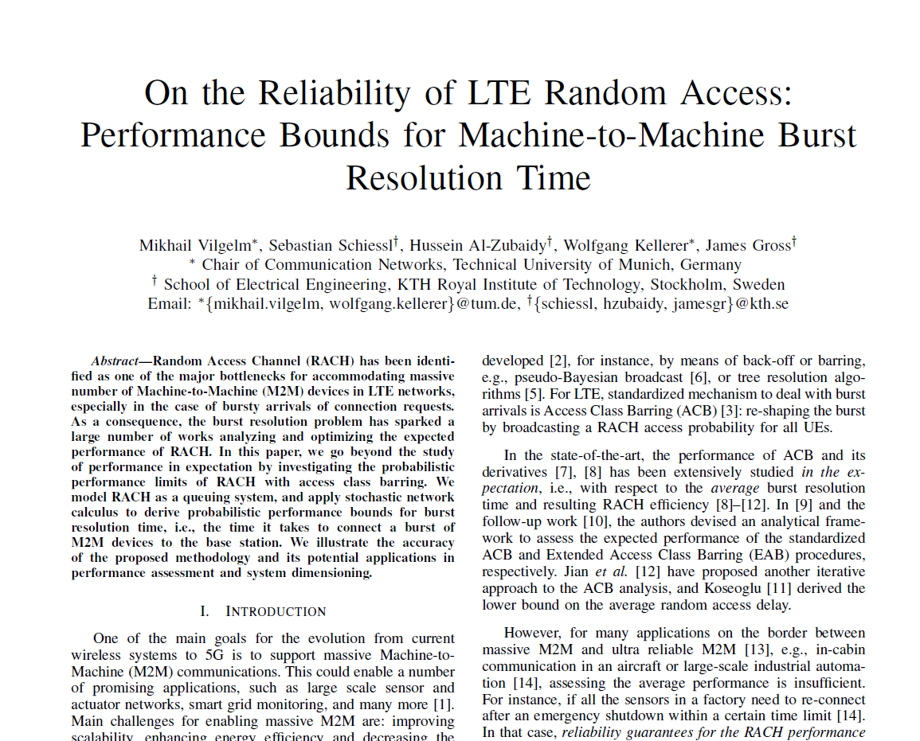
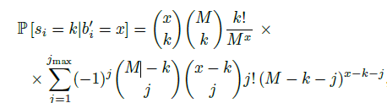
Probabilistic Analysis
Model Backlog Probability distribution with Moment Generating Functions
Fast Analysis
Compute satisfiable QoS Requirements
Dimension LTE Networks
Compare different Access Barring Policies

Slide 16
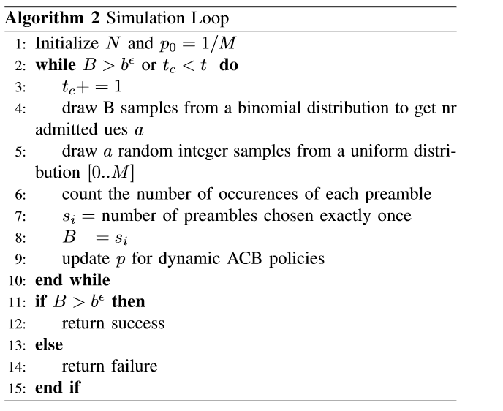
Simulation
FIXME: improve vis

Slide 17
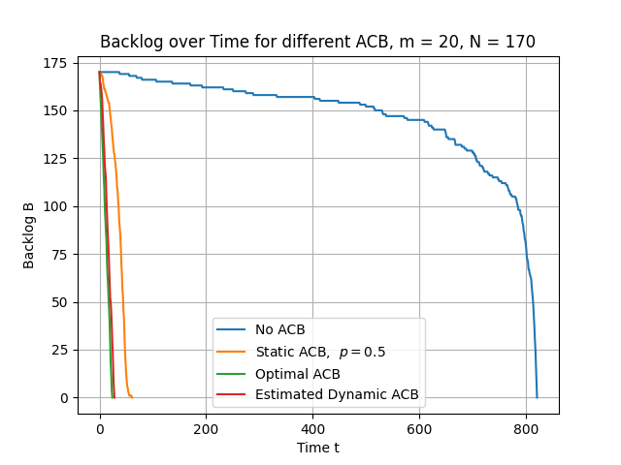
Simulation Result: Backlog over Time
FIXME: REMOVE NO ACB ON NEXT SLIDE

Slide 18
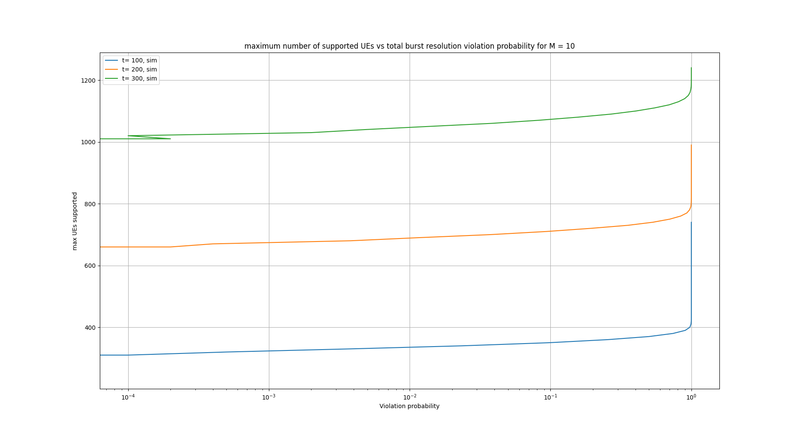
Simulation Results

