Slide 1
Finding The Right Bud
EDA 1 | Group 3 - 2023 Lani Lewis & Todd Garner SMU

Slide 2
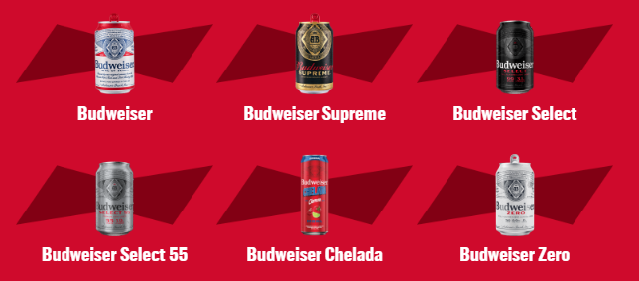
Budweiser Beer
“Budweiser is a medium-bodied, flavorful, crips American-style lager.”
5% Alcohol by Volume (ABV)
12% International Bitterness Units (IBU)
https://us.budweiser.com/
https://worldfood.guide/list/list_of_beers_in_america_by_alcohol_content_abv/

Slide 3
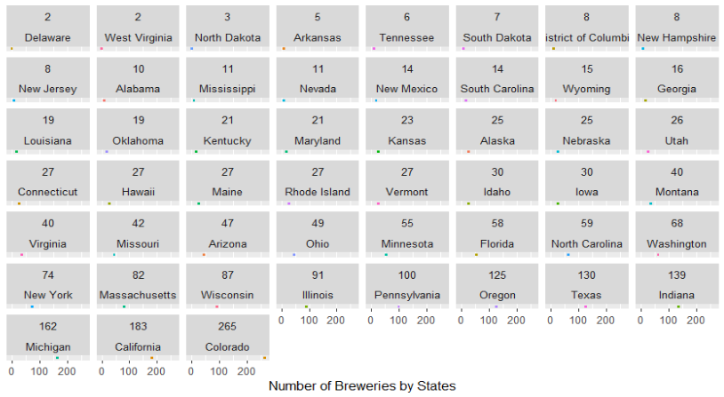
Understanding Overall State Expansion
Notes:
See if there are any other options

Slide 4
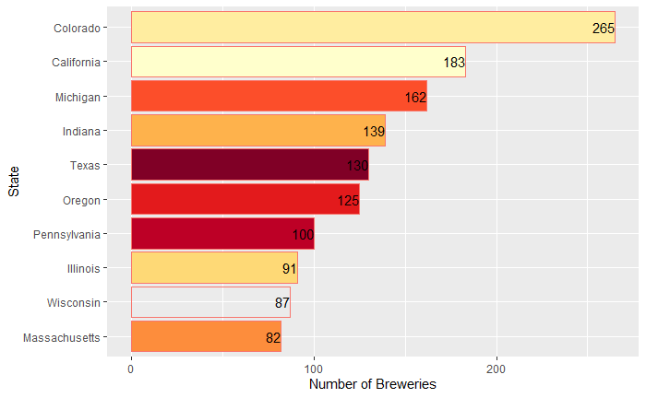
Top Ten States with the Highest Brewery Count
Notes:
Change this chart to have red as the color

Slide 5
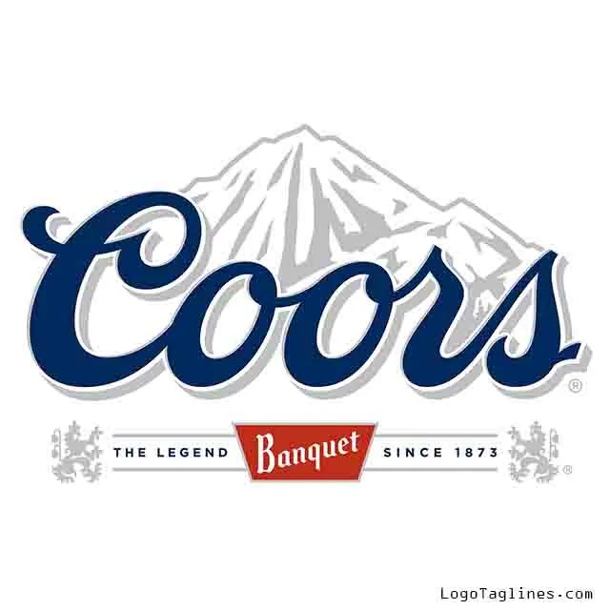
Colorado Beer History

Slide 6







Colorado Beer History

Slide 7
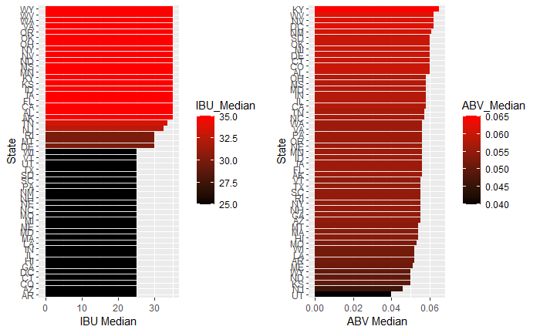
Median Values for IBU & ABV by State
Notes:
Fix graph…and colors these all have the same value from us adding the median into missing values Lani is working on a fix…

Slide 8
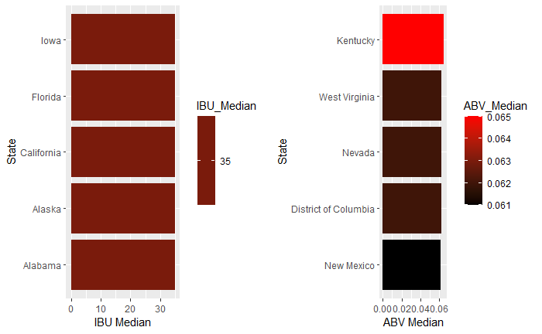
Top Five States by IBU & ABV
Notes:
This graph needs to be fixed. Change colors and arrange from small to big or visa versa

Slide 9
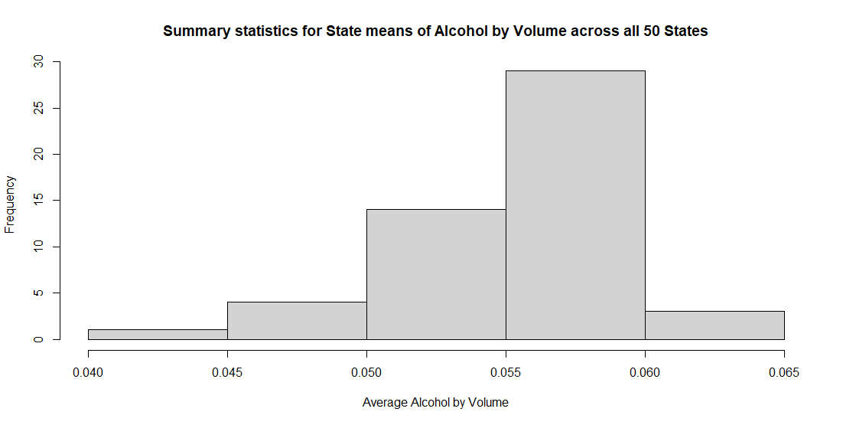
Summary Statistics and Distribution by ABV
MIN: 0.10%
MAX: 12.8%
MEAN: 5.977%
MEDIAN: 5.7%
Notes:
Can we make this have colors that match the next chart?

Slide 10
Median ABV values by State
KY Stats: ABV: 6.5% IBU: 35

Slide 11
Median IBU values by State

Slide 12
MAX ABV & MAX IBU
MAX ABV: 12.8%
Type: 52 Lee Hill Series Vol. 5
Location: Boulder, CO
MAX IBU: 138
Type: 375 Bitter Bitch Imperial IPA
Location: Astoria, OR

Slide 13
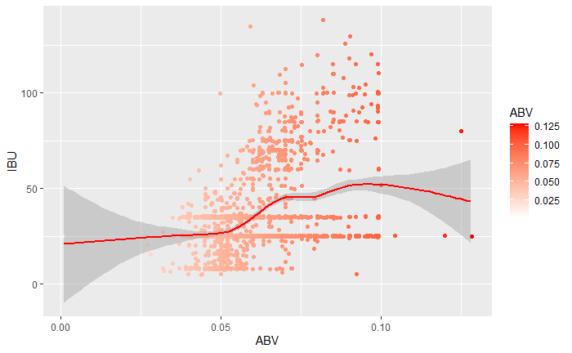
Relationship Between ABV & IBU with the Entire Dataset

Slide 14
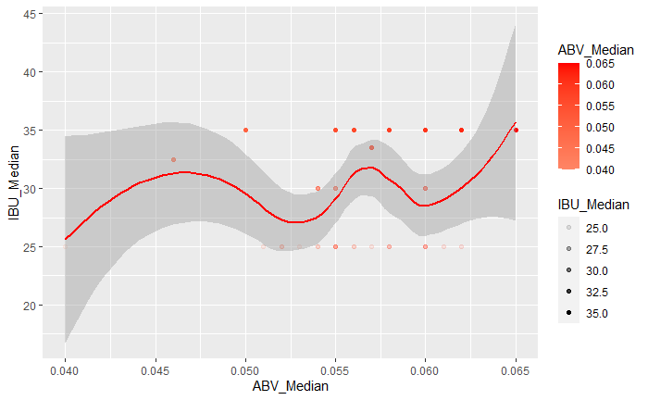
Relationship Between Median ABV & IBU with a Sample
Notes:
Fix chart to fill by beer type verses state to prove if there is any correlation and see if we can make a red line rather then blue
Make the title shorter for chart (K.I.S.)

Slide 15
Probability of Selecting a Beer Similar to Budweiser
Confusion Matrix and Statistics
class4 Ale IPA
Ale 923 78
IPA 53 480
Accuracy : 0.9146
95% CI : (0.8995, 0.9281)
No Information Rate : 0.6362
P-Value [Acc > NIR] : <2e-16
Kappa : 0.8137
Mcnemar's Test P-Value : 0.036
Sensitivity : 0.9457
Specificity : 0.8602
Pos Pred Value : 0.9221
Neg Pred Value : 0.9006
Prevalence : 0.6362
Detection Rate : 0.6017
Detection Prevalence : 0.6525
Balanced Accuracy : 0.9030
'Positive' Class : Ale
40% Chance
Style: Gose

Slide 16
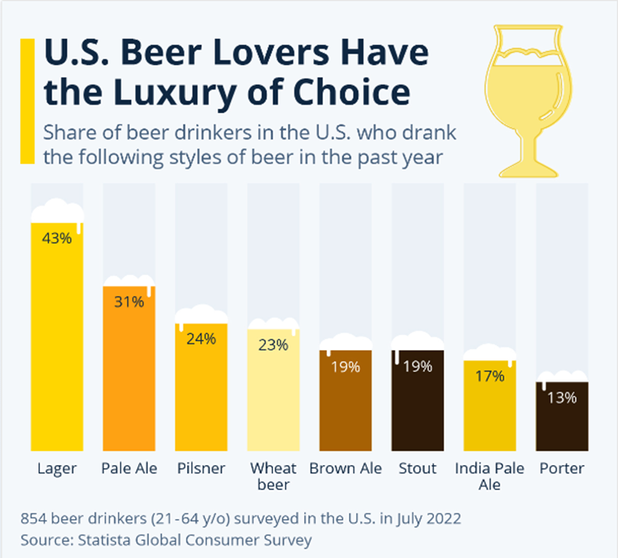
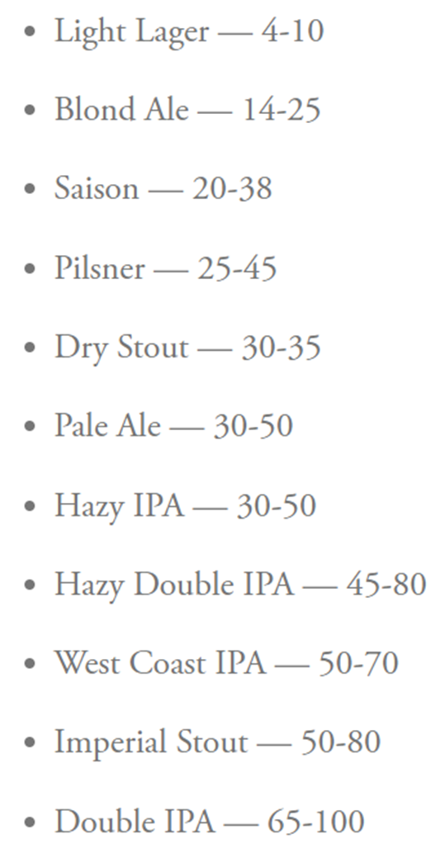
US Beer Type of Choice
IBU By Beer Type
https://www.statista.com/chart/28572/popularity-of-beer-styles-in-the-us/
https://www.firestonebeer.com/what-really-is-ibu/

Slide 17
Supplemental Information
Missing Values

Slide 18
Addressing Missing Data
2,410 observations
62 missing ABV values
1,005 missing IBU values

Slide 19
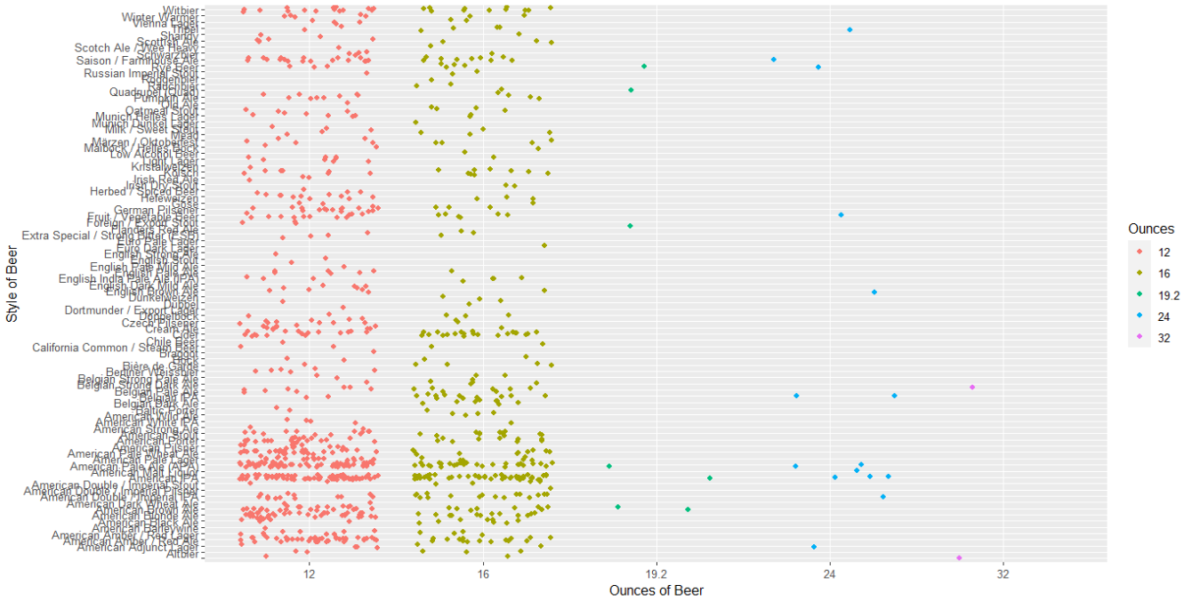
Missing Data

Slide 20
Thank You For Your Business!
Lani Lewis - lanil@mail.smu.edu
& Todd Garner - toddg@mail.smu.edu
Git Repo:

