Slide 1
Finding The Right Bud
EDA 1 - 2023 Lani Lewis SMU

Slide 2
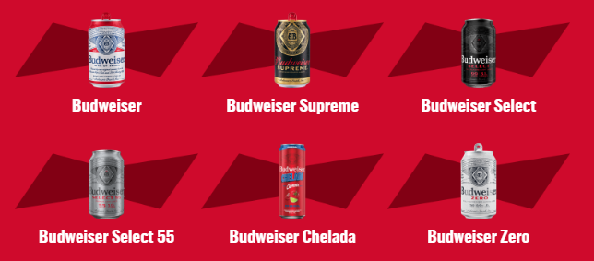
Budweiser Beer
“Budweiser is a medium-bodied, flavorful, crips American-style lager.”
5% Alcohol by Volume (ABV)
12% International Bitterness Units (IBU)
https://us.budweiser.com/
https://worldfood.guide/list/list_of_beers_in_america_by_alcohol_content_abv/

Slide 3
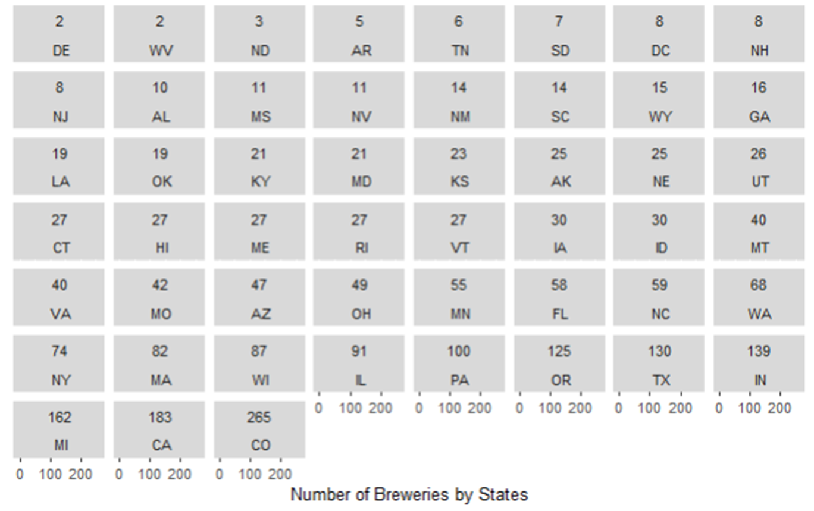
Understanding State Expansion

Slide 4
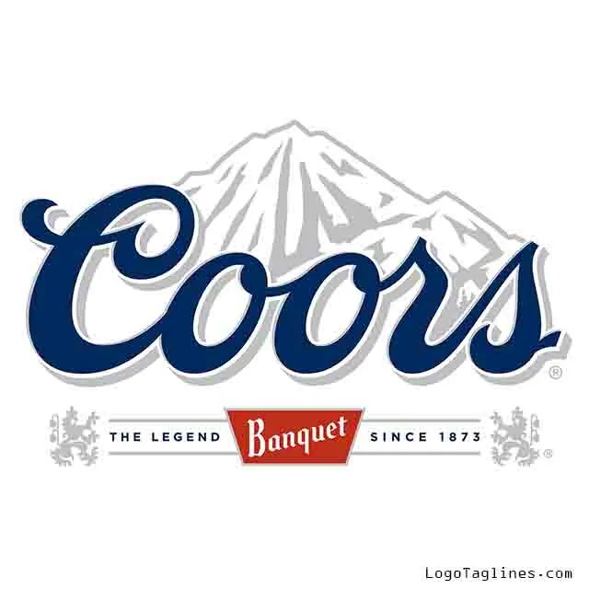







Colorado Beer History

Slide 5
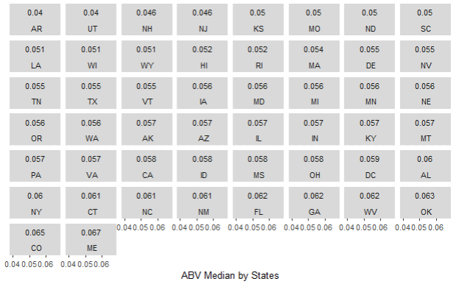
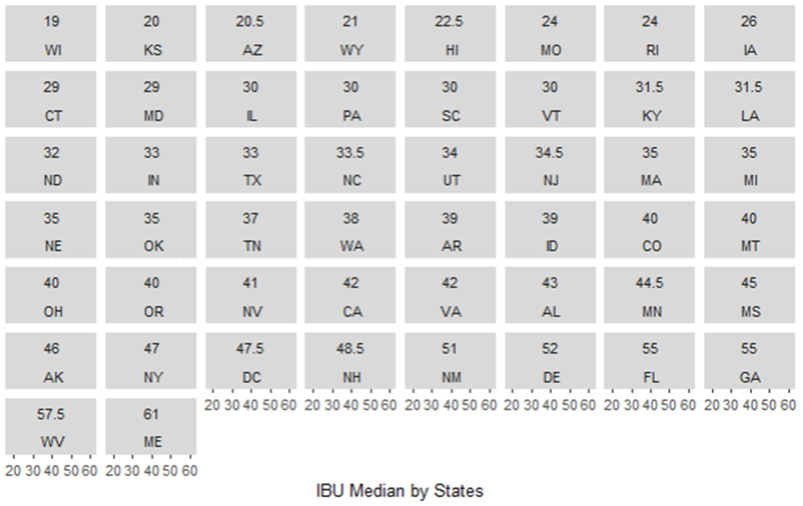
Maine Highest ABV or IBU Median

Slide 6
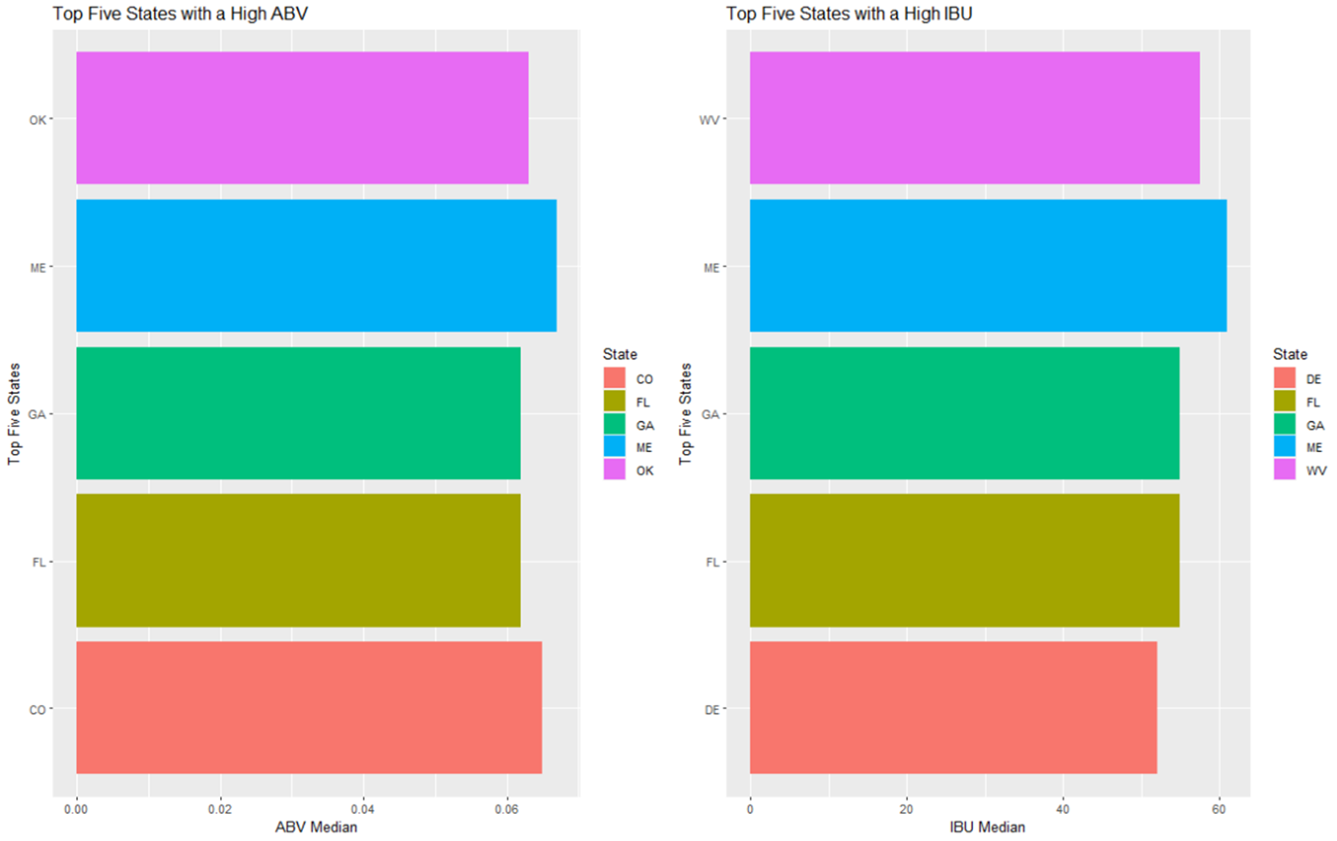
Top Five States by ABV or IBU

Slide 7
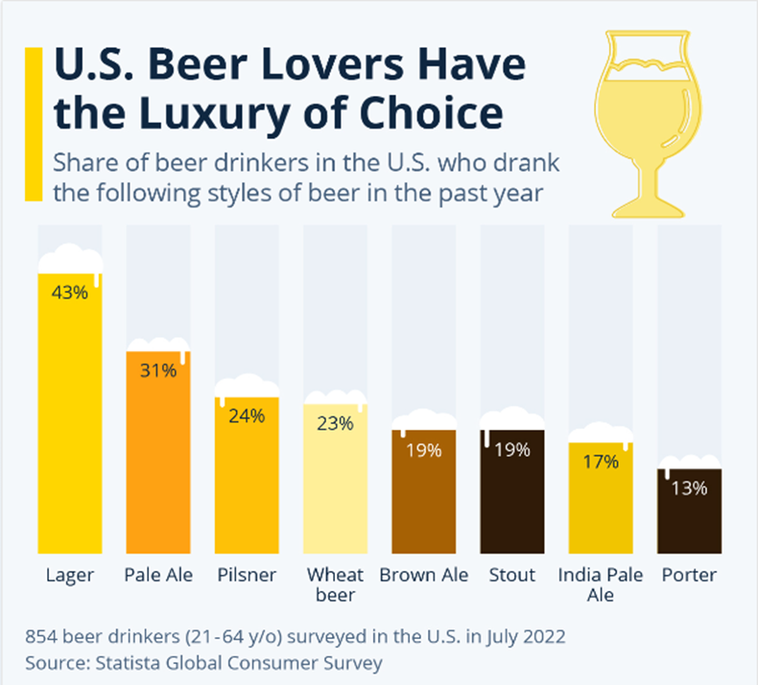
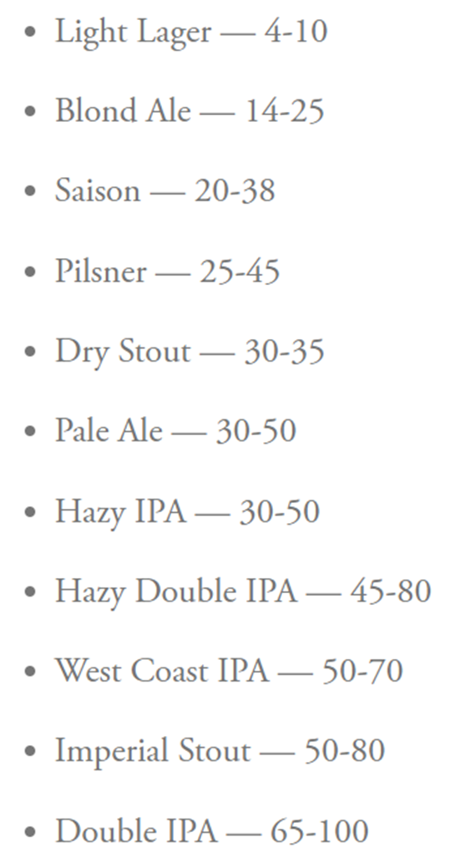
US Beer Type of Choice
IBU By Beer Type
https://www.statista.com/chart/28572/popularity-of-beer-styles-in-the-us/
https://www.firestonebeer.com/what-really-is-ibu/

Slide 8
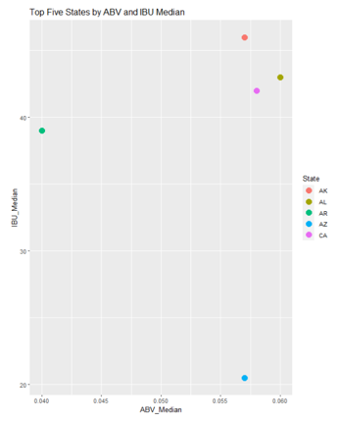
Top Five States by ABV and IBU

Slide 9
Thank You

