Slide 1
Finding The Right Bud
EDA 1 - 2023 Lani Lewis & Todd Garner SMU

Slide 2
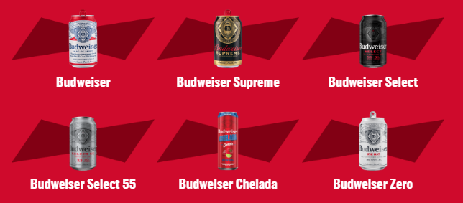
Budweiser Beer
“Budweiser is a medium-bodied, flavorful, crips American-style lager.”
5% Alcohol by Volume (ABV)
12% International Bitterness Units (IBU)
https://us.budweiser.com/
https://worldfood.guide/list/list_of_beers_in_america_by_alcohol_content_abv/

Slide 3
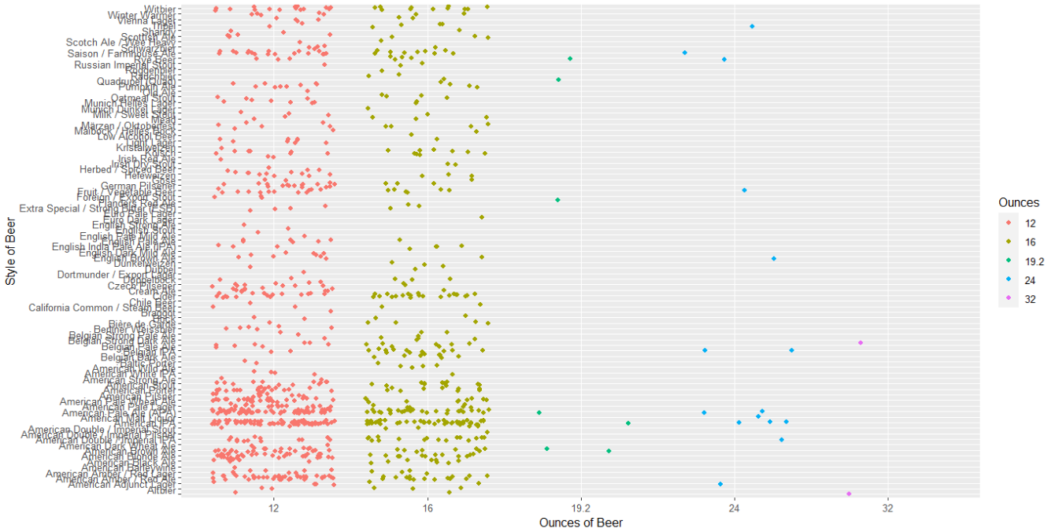
Missing Data

Slide 4
Addressing Missing Data
2,410 observations
62 missing ABV values
1,005 missing IBU values

Slide 5
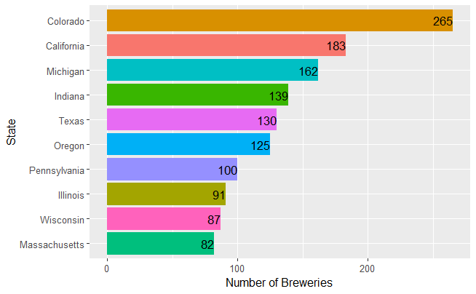
Top Ten States with the Highest Brewery Count
Notes:
Change this chart to have red as the color

Slide 6
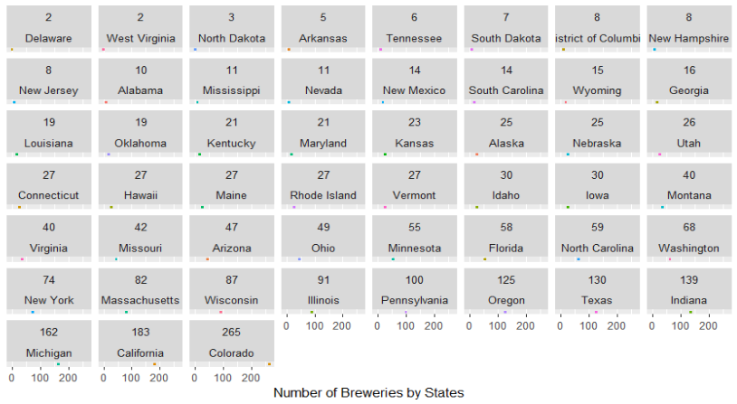
Understanding State Expansion
Notes:
See if there are any other options

Slide 7
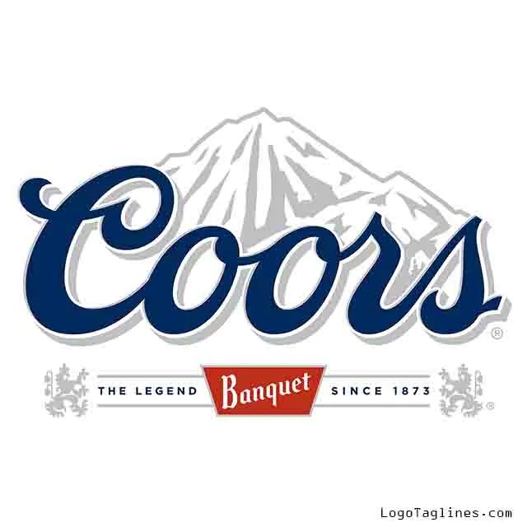
Colorado Beer History

Slide 8


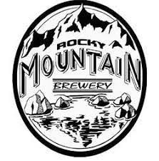




Colorado Beer History

Slide 9
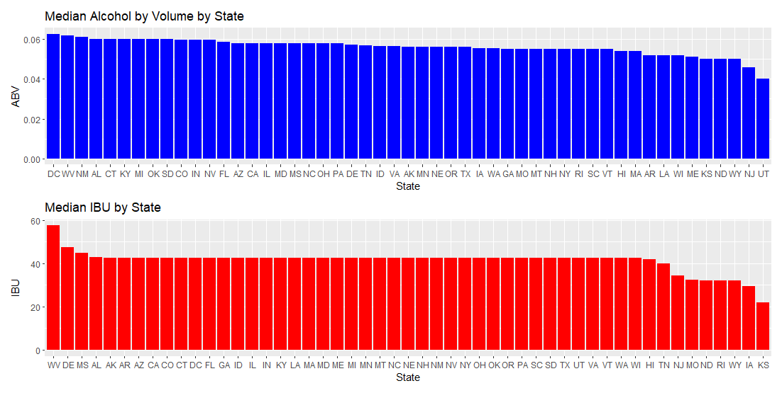
Median Values for ABV & IBU by State
Notes:
Fix graph…and colors these all have the same value from us adding the median into missing values Lani is working on a fix…

Slide 10
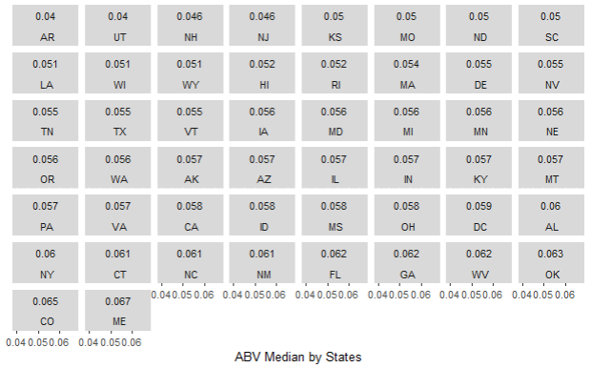
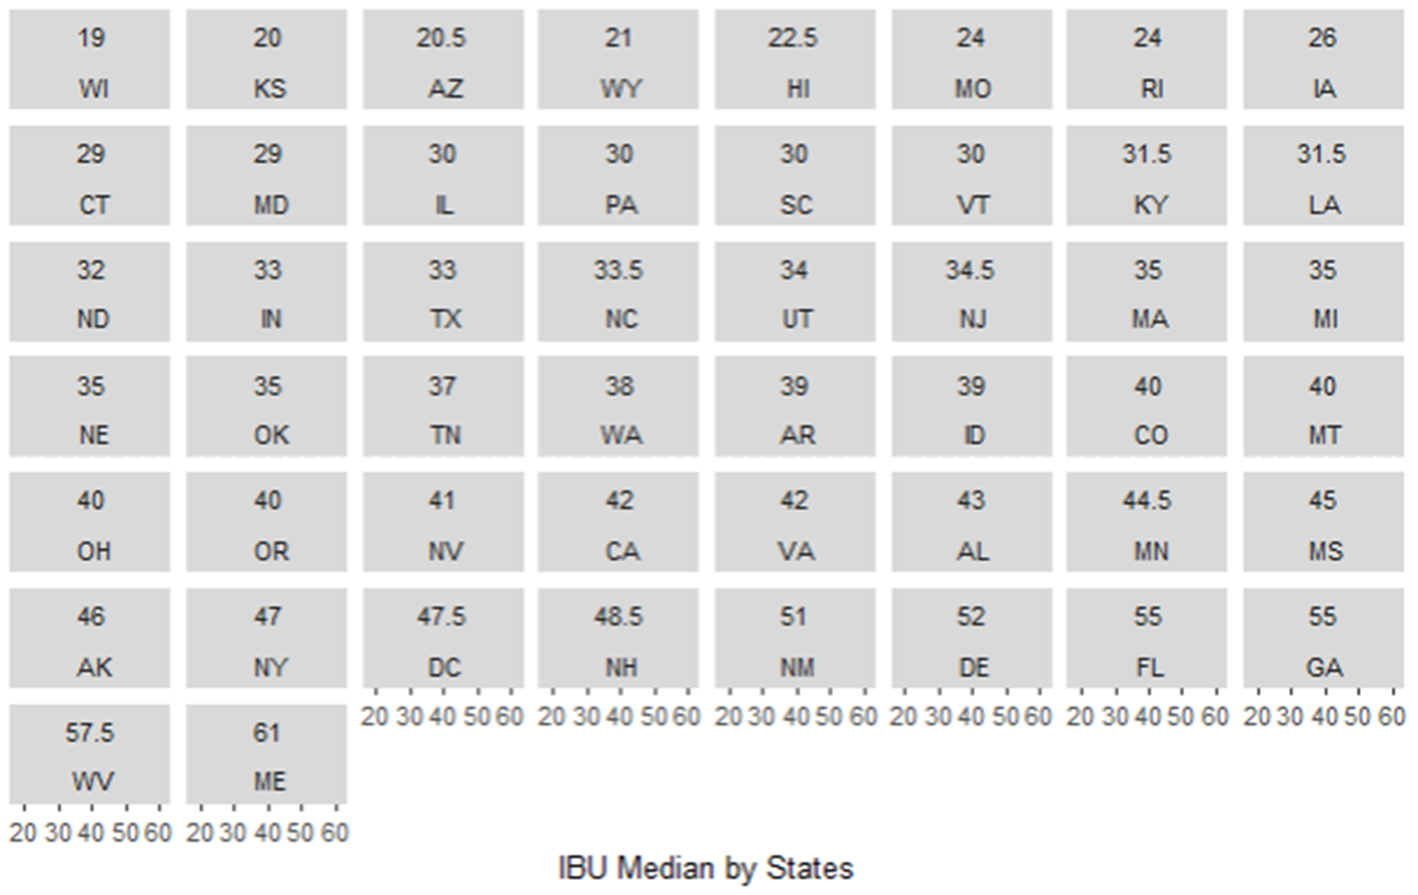
ABV or IBU Medians by State

Slide 11
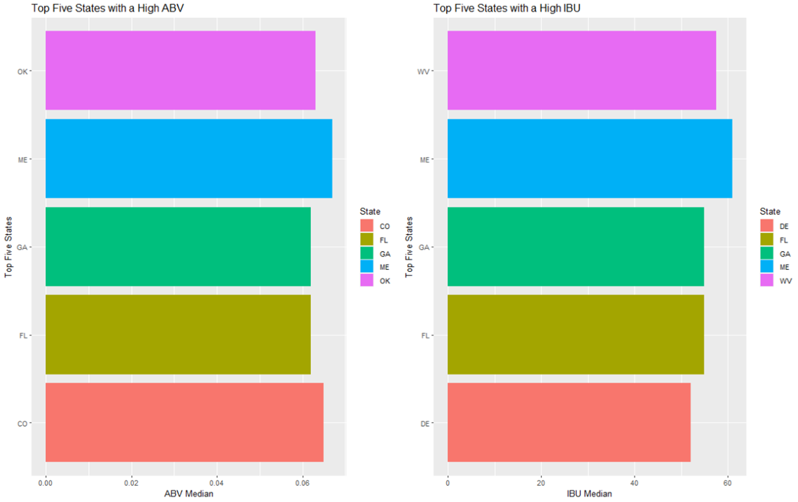
Top Five States by ABV or IBU
Notes:
This graph needs to be fixed. Change colors and arrange from small to big or visa versa

Slide 12
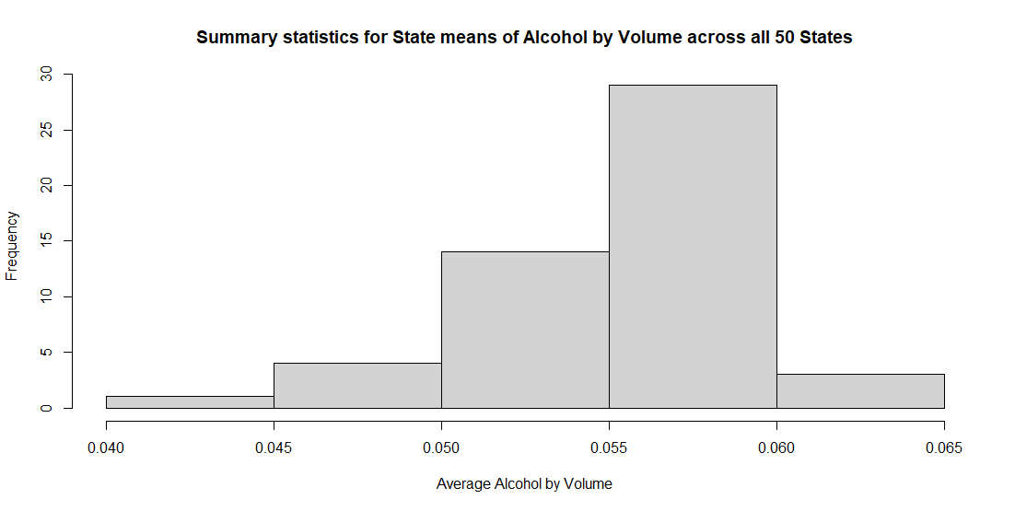
Summary Statistics and Distribution by ABV
MIN: 0.10%
MAX: 12.8%
MEAN: 5.977%
MEDIAN: 5.7%
Notes:
Can we make this have colors that match the next chart?

Slide 13
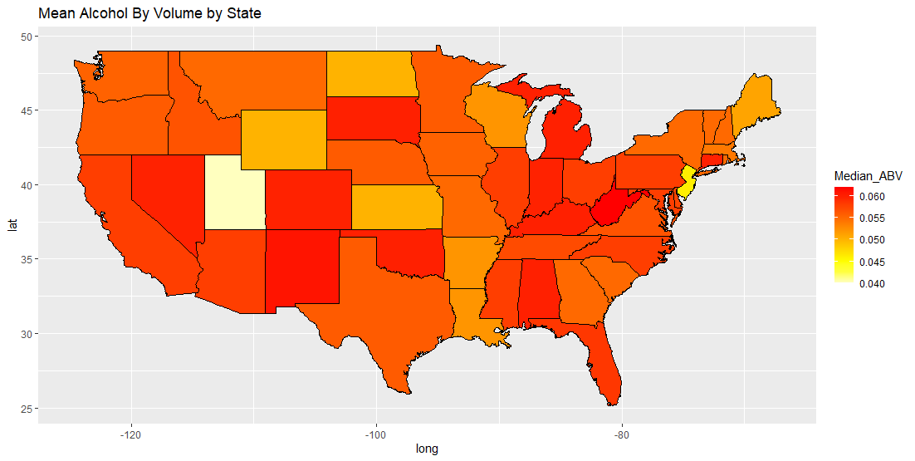
Mean Alcohol by Volume by State
Notes:
Correct this whole powerpoint slide we have Median and Mean on this one slide which one is it.

Slide 14
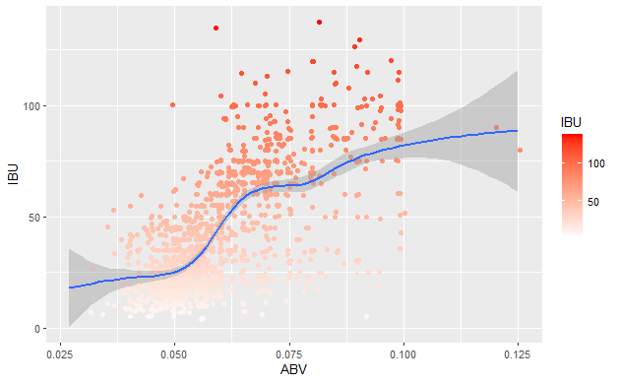
Relationship Between ABV & IBU with the Entire Dataset
Notes:
Fix chart to fill by beer type verses state to prove if there is any correlation and see if we can make a red line rather then blue
Make the title shorter for chart (K.I.S.)

Slide 15
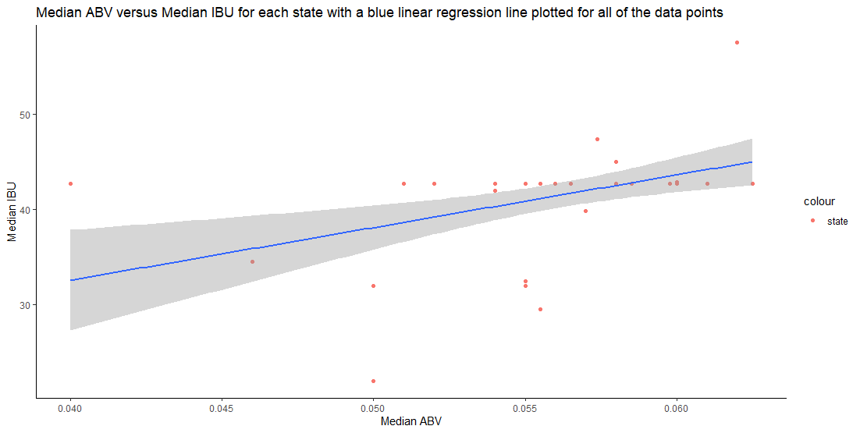
Relationship Between Median Sample Data of ABV & IBU
Notes:
Fix chart to fill by beer type verses state to prove if there is any correlation and see if we can make a red line rather then blue
Make the title shorter for chart (K.I.S.)

Slide 16
MAX ABV & MAX IBU
MAX ABV: 12.8%
Type: 52 Lee Hill Series Vol. 5
Location: Boulder, CO
MAX IBU: 138
Type: 375 Bitter Bitch Imperial IPA
Location: Astoria, OR

Slide 17
Probability of Selecting a Beer Similar to Budweiser
37% Chance
Style: Cream Ale

Slide 18
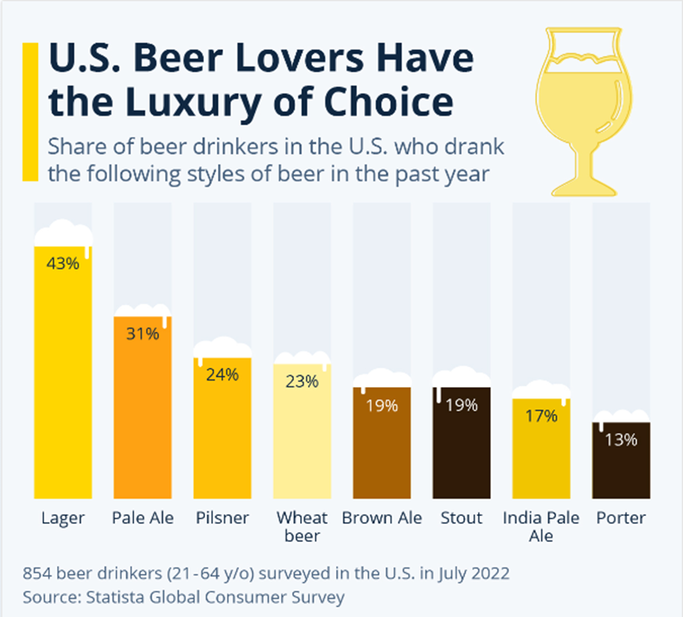
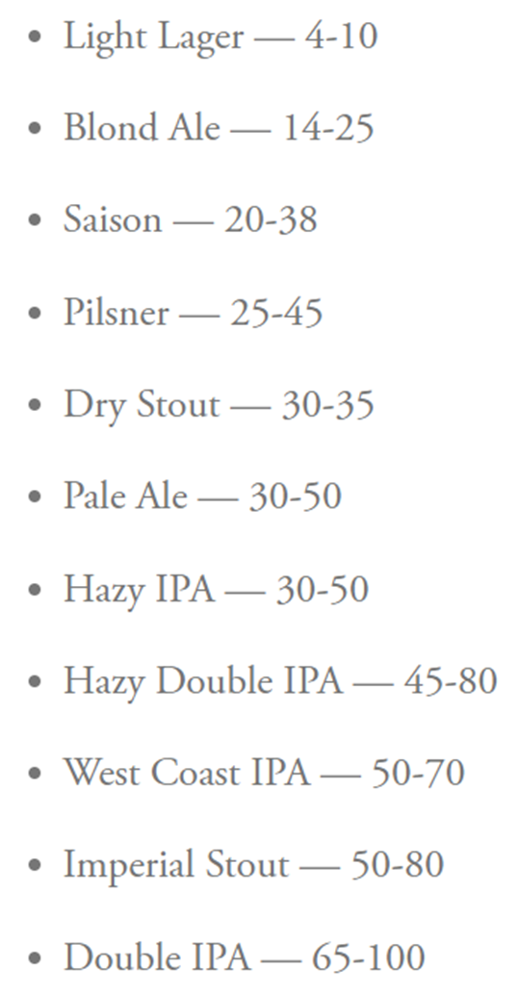
US Beer Type of Choice
IBU By Beer Type
https://www.statista.com/chart/28572/popularity-of-beer-styles-in-the-us/
https://www.firestonebeer.com/what-really-is-ibu/

Slide 19
Thank You For Your Business!
Lani Lewis - lanil@mail.smu.edu
& Todd Garner - toddg@mail.smu.edu
Git Repo:

