Slide 1


TimeSeries
Kenya Roy & Lani Lewis
SMU | 2024

Slide 2

EDA
Merge Data
Remove NA >50%
Split Data
Aggregate Date (Trend)

Slide 3
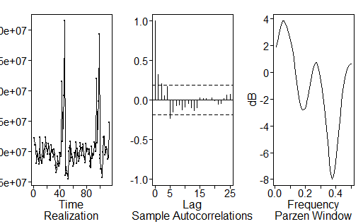
TSWGE PLOTS

Slide 4
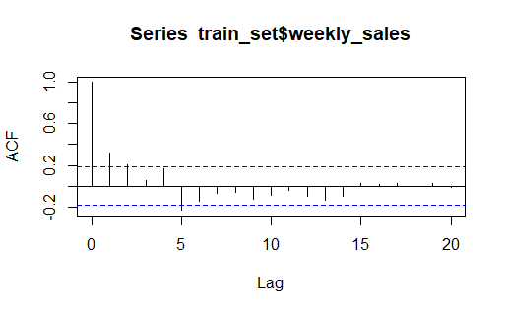
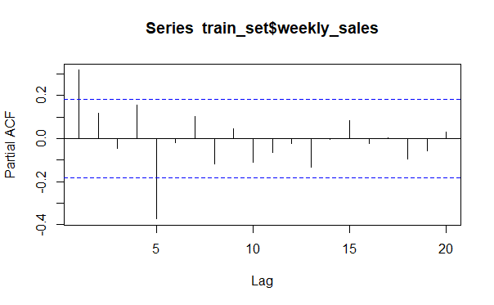
TSWGE PLOTS

Slide 5

Dickey-Fuller Test for Stationarity

Slide 6
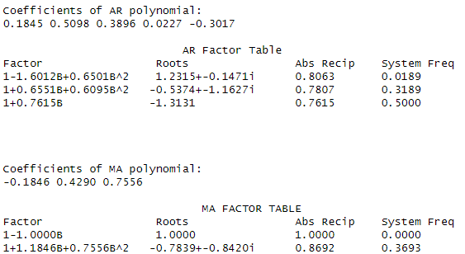
ARMA(5,3) MODEL | Factor Table
est.arma.wge

Slide 7
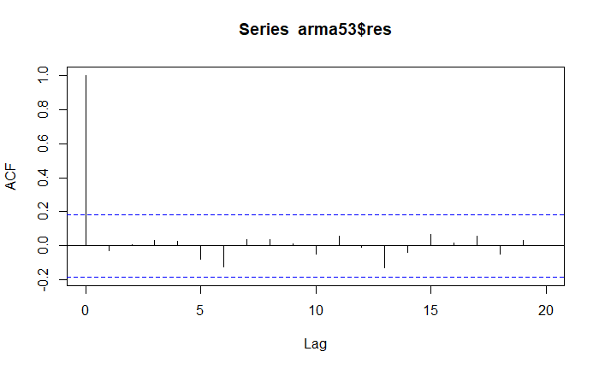
ARMA(5,3) MODEL | Residual White Noise

Slide 8
ARMA(5,3) MODEL | Ljung Box Check
p-value 0.8608568
PASS
p-value 0.9770763

Slide 9
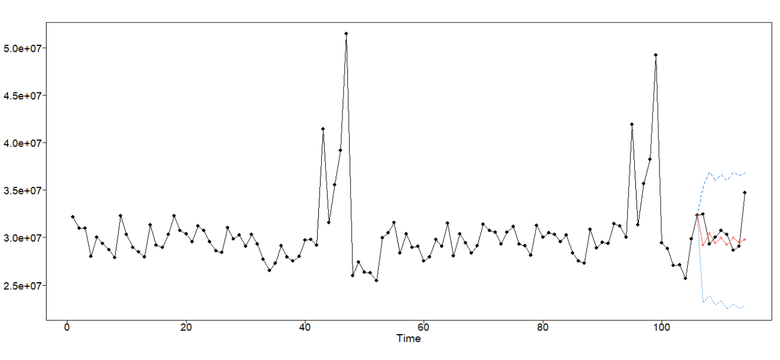
ARMA(5,3) MODEL
ASE: 1.757819e+12

