Slide 1
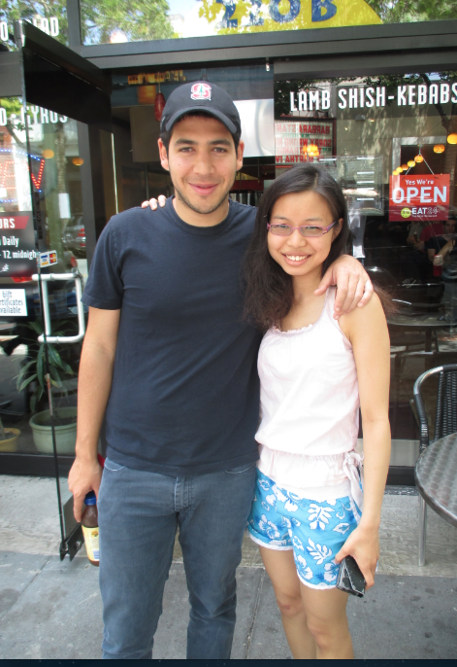
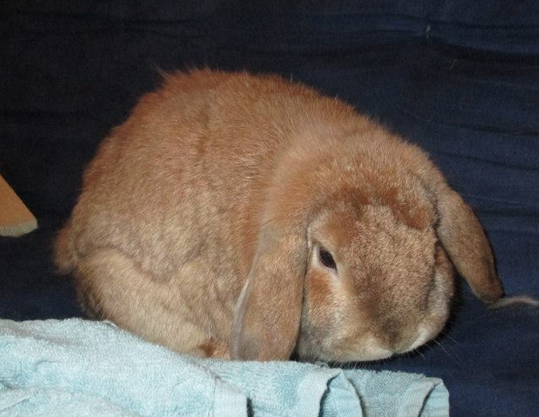
Mao the bunny
Lay Kuan Loh
Former software engineer
Former intern at Northwestern EPS
Graduate Student at Carnegie Mellon
Started June 30, 2014

Slide 2
Past Research
Cluster Analysis on Volcanic Vents
Making software for seismic wave analysis more user friendly
Picking out seismic events
Storing Data
Microsoft excel
SQL
Matlab Data
Programming languages used for research
Matlab
Python
Obspy to download data from IRIS
Currently
Making other peoples’ work more rigorous by writing proofs
Researching how to get around a new city..

