Slide 1
Installing Common Programs
Lay Kuan Loh
Suzan van der Lee
August 3, 2014

Slide 2
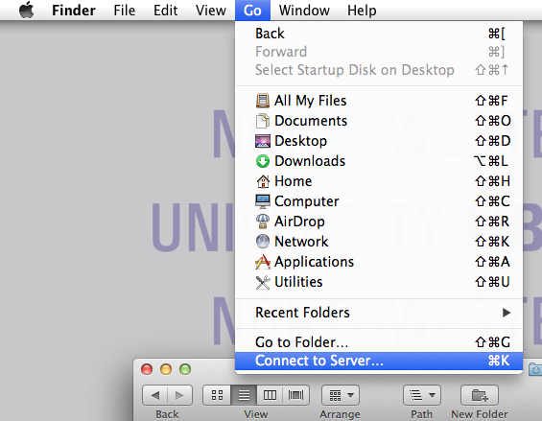
What if you lose connection to the Volumes/USArray folder
Finder >> Go >> Connect to Server >>
Connect to default server

Slide 3
Contents
Configuring the UNIX system
JPlotResp
Installing JPlotResp
Using PlotResp
Python
Introduction
Installing Python
Obspy
Introduction
Installing Obspy
Uninstalling programs
Notes:
I’m suggesting to replace the SAC part with something else that’s not already on the system, such as JEvalresp (or another software downloadable from IRIS) – but I still need to check out the system.

Slide 4
Configuring the UNIX system
The default Bourne Again Unix shell reads the .bashrc (or .profile) file when starting and execute commands contained in them
Shell commands
set aliases
Set new environment variables
Profile file
Search for file name
http://superuser.com/questions/49289/what-is-the-bashrc-file
Notes:
edited this a bit

Slide 5
JPlotResp
Manual: http://www.isti.com/JPlotResp/JPlotResp.html
Fetches and plots data from web-service servers
Plots the response information
Download it from: http://www.isti.com/JPlotResp/
Notes:
Obspy also has a library that does very similar things

Slide 6
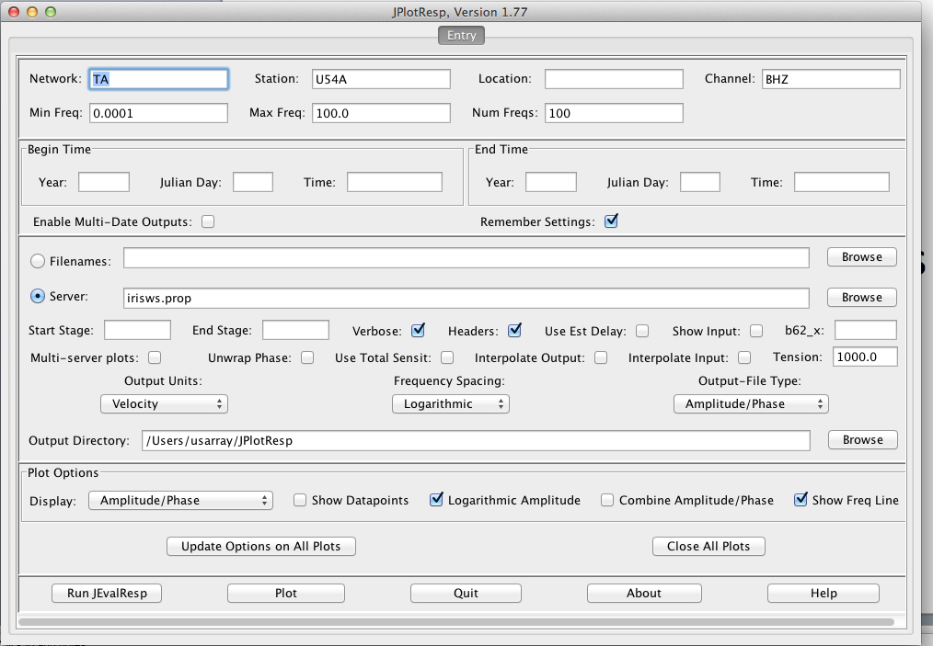
User interface

Slide 7
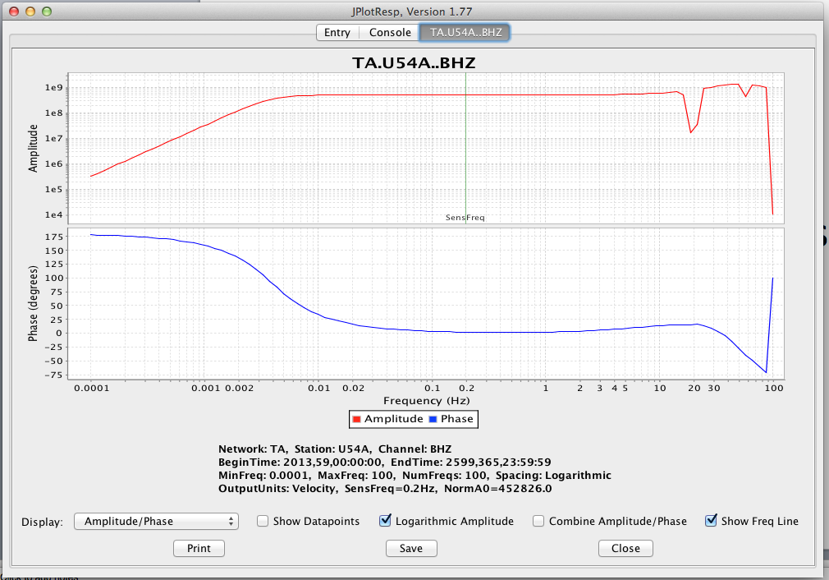
Response plot

Slide 8
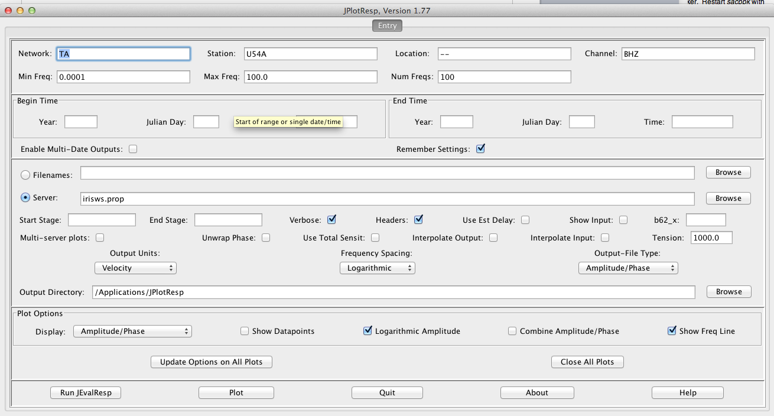
Bug?

Slide 9
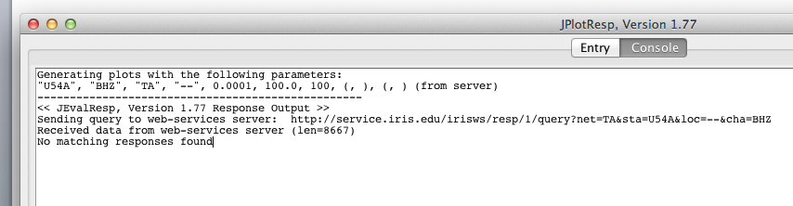
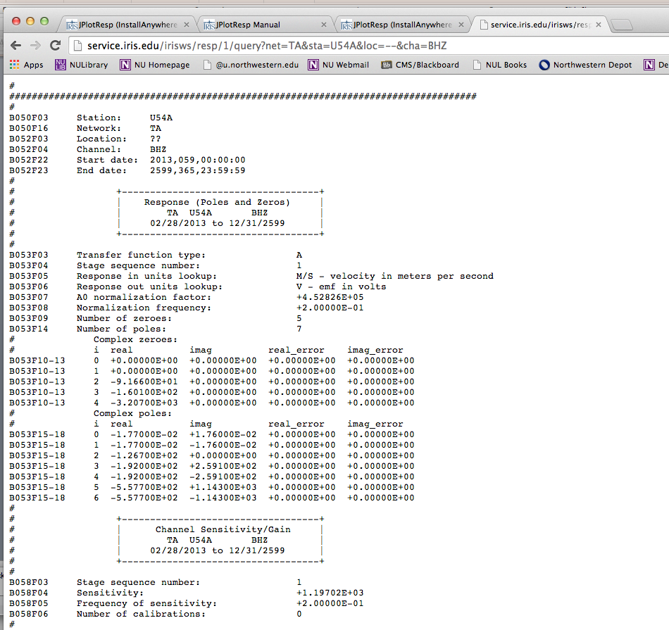

Slide 10
Links to other IRIS Software packages
http://www.iris.edu/ds/nodes/dmc/software/
https://seiscode.iris.washington.edu/

Slide 11
Python
General purpose language
High-level
Commonly used for teaching intro CS classes
Open source
Scripting allowed
Notes:
Session about it later

Slide 12
Installing Python -- Tips
Easy way: https://store.enthought.com/downloads/
Hard way:http://aimbat.readthedocs.org/en/latest/docfiles/install_dependencies.html
Note: Python is already installed on the cluster computers
Notes:
You will need to explain that python is already installed for the short course, and that this slide is helpful for when they go back to their own computers.

Slide 13
Obspy
Python library made for processing seismic data
Very useful if you ever need to develop code for seismology research
https://github.com/obspy/obspy/wiki
Notes:
Obspy should

Slide 14
Installing Obspy -- Tips
Macports seems the best way:
https://github.com/obspy/obspy/wiki/Installation-on-Mac-OS-X-using-Macports
Notes:
Same here

Slide 15
Uninstalling programs
Check if the program exists first
which <name-of-program>
Sudo rm <path-to-program>
Repeat until which <name-of-program> shows up nothing in terminal
Delete path to scripts in bash file, if appropriate

