Slide 1
Installing Common Programs
Lay Kuan Loh
Suzan van der Lee
August 3, 2014

Slide 2
Contents
Configuring the UNIX system
JEvalPlot
Installing JEvalPlot
Using JEvalPlot
Python
Introduction
Installing Python
Obspy
Introduction
Installing Obspy
Uninstalling programs
Notes:
Practicing with JEvalPlot

Slide 3
Configuring the UNIX system
The default Bourne Again Unix shell reads the .bashrc (or .profile) file when starting and execute commands contained in them
Shell commands
set aliases
Alias ll = ‘ls -a’ in bashrc file
Alias rmf = ‘rm -rf’ in bashrc file
Set new environment variables
Profile file
Search for file name
http://superuser.com/questions/49289/what-is-the-bashrc-file
Notes:
edited this a bit

Slide 4
JEvalPlot
Manual: http://www.isti.com/JPlotResp/JPlotResp.html
Fetches and plots data from web-service servers
Plots the response information
Notes:
Obspy also has a library that does very similar things.
Automatically installs JEvalResp as well, so by getting JEvalPlot, but get both
Easy to install as it was made by software engineers, not grad students

Slide 5
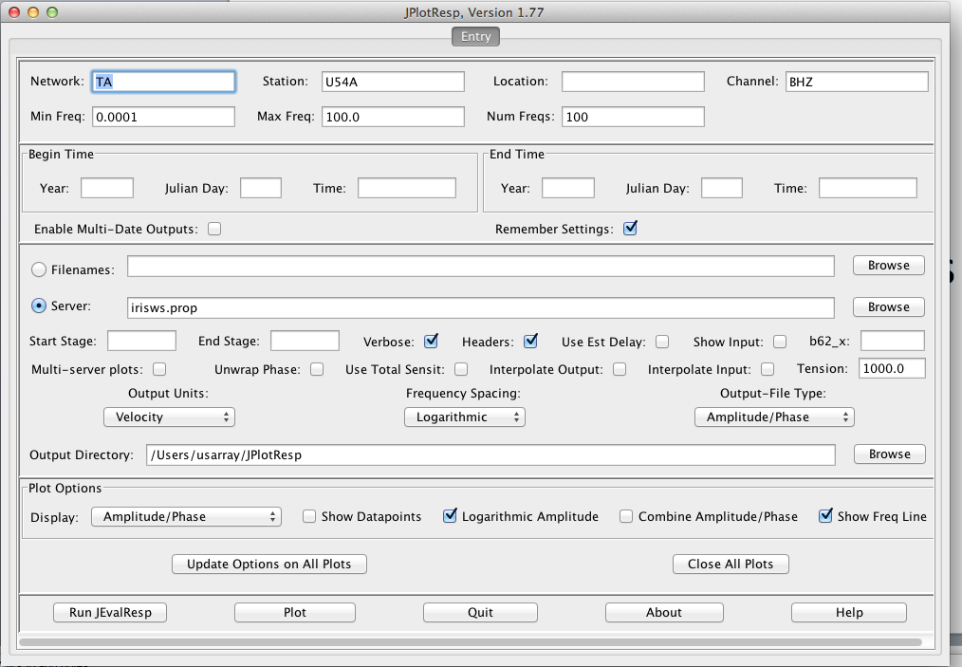
User interface
Network: TA
Station: US4A

Slide 6
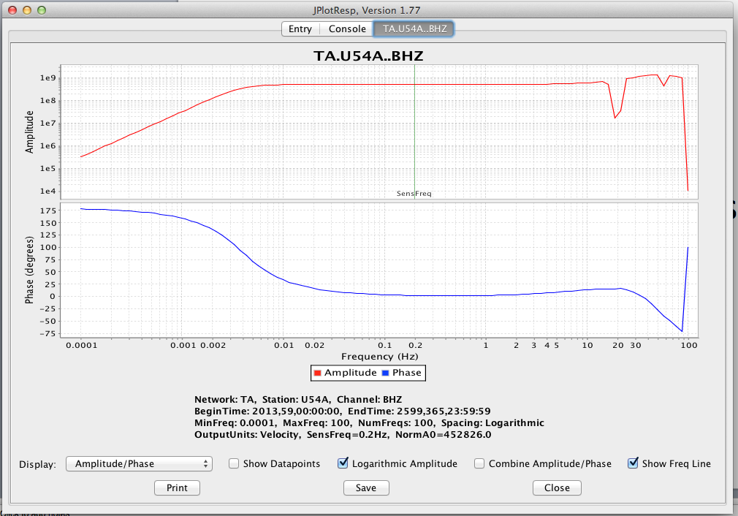
Response plot

Slide 7
Bug
What happens if you put ‘- -’ into the “Location” box?

Slide 8
Python
General purpose language
High-level
Commonly used for teaching intro CS classes
Open source
Scripting allowed
Notes:
Session about it later

Slide 9
Installing Python -- Tips
Easy way: https://store.enthought.com/downloads/
Hard way:http://aimbat.readthedocs.org/en/latest/docfiles/install_dependencies.html
Note: Python is already installed on the cluster computers
Notes:
Python is already installed for the short course, and that this slide is helpful for when they go back to their own computers.

Slide 10
Obspy
Python library made for processing seismic data
Very useful if you ever need to develop code for seismology research
https://github.com/obspy/obspy/wiki
Notes:
Obspy should

Slide 11
Installing Obspy -- Tips
Macports seems the best way:
https://github.com/obspy/obspy/wiki/Installation-on-Mac-OS-X-using-Macports
Notes:
Same here

Slide 12
Uninstalling programs
Check if the program exists first
which <name-of-program>
Sudo rm <path-to-program>
Repeat until which <name-of-program> shows up nothing in terminal
Delete path to scripts in bash file, if appropriate

Slide 13
Links to other IRIS Software packages
http://www.iris.edu/ds/nodes/dmc/software/
https://seiscode.iris.washington.edu/
Exercise:
Choose one an try and install/use it
Notes:
Too much time? Github

