Slide 1
Good Coding Practices
Lay Kuan Loh
August 4, 2014

Slide 2
Contents
Admin
My background
Goals of this session
Version Control
Github
Dropbox
Harddrives
Writing code
Writing your own code
Working on code with collaborators
Joining a project where someone left off
Find out how to do something
Looking for information you need
Using the fruits of other peoples’ labor
Developing your own tool
When to do it
What to keep in mind

Slide 3
Admin

Slide 4
Where I’m coming from
Undergraduate (Stanford)
Major in Math
Minor in Computer Science
No exposure to coding before undergrad
Research
Undergraduate research in computational geophysics
Internship, Northwestern Earth and Planetary Sciences
Industry
9 months as a software engineer at a Silicon Valley startup
http://www.dwellers.com/
http://mathcrunch.com/
Current (Carnegie Mellon)
Graduate student (started Jun 30, 2014)
Electrical and Computer Engineering

Slide 5
Takeaway points
Writing easily maintained code
Getting unstuck when you hit a problem

Slide 6
Version Control

Slide 7


Slide 8
Github
Good
Useful for collaborators
Showcase non-confidential work online
Get it online, anywhere
Bad
Limited allowance for privacy – free private account with .edu email for two years
Steep learning curve

Slide 9
Demo
Downloading and installing Git
Creating a repository
Cloning a repository
Making commits
Reverting a commit
Making and pushing a branch
Merging a branch with master
Dealing with merge conflicts
https://github.com/pysmo/aimbat-docs/wiki/Introduction-to-Github

Slide 10
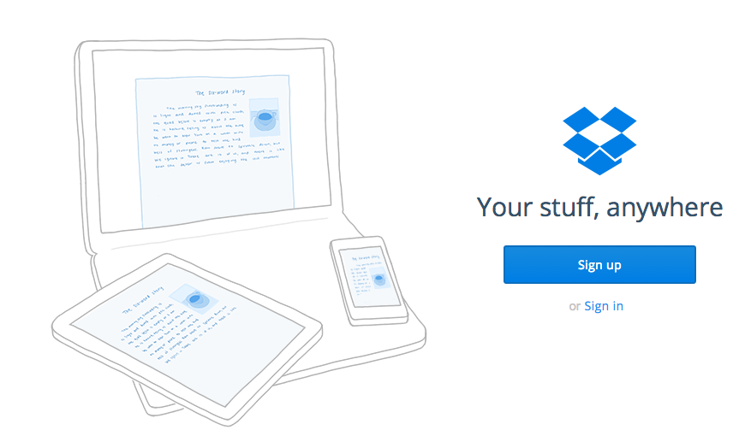
Dropbox

Slide 11
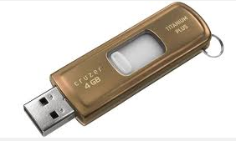
Hard drives
Good
Very cheap storage
Bad
Inconvenient to backup
Better for archived projects, not projects actively being developed
Not on a cloud, but a physical device

Slide 12
Coding Practices

Slide 13
Writing your own code … Comments
Describe the process, not the code

Slide 14
// step through the loop 100 times
// duh!
for (i = 1; i <= 100; i++) {
…
…
…
}

Slide 15
// increment along the surface (x axis)
// summing each point’s contribution
for (i = 1; i <= 100; i++)
{
…
…
…
}

Slide 16
Write a header block
/******************************************/
/* 2-dimensional channel flow program */
/* for channels with free upper surface */
/* */
/* Original by JD West, 01/08/2006 */
/* Modified 02/11/2007 to increase resolution */
/******************************************/

Slide 17
Use Descriptive Variable Names
// increment along the surface (x axis)
// summing each point’s contribution
for (iLength = 1; iLength <= 100; iLength++)
{
…
…
…
}

Slide 18
No magic (numbers)
// increment along the surface (x axis)
// summing each point’s contribution
for (i = 1; i <= 27; i++)
{
…
…
…
}

Slide 19
No magic (numbers)
// increment along the surface (x axis)
// summing each point’s contribution
for (iLength = 1; iLength <= iMax; iLength++)
{
…
…
…
}

Slide 20
Or, use an external file
// Declarations
int iLength; // x-axis increment
int iMax; // total increments
double dVelocity[5001]; // array of velocities
…
// Read and set Initial Values from a file
…
…

Slide 21
Use descriptive file names
Naming your script “test.csh” means
“I will never be able to reuse this code.”

Slide 22
Pretend you are in a programming team
Write your code as if someone else will have to understand and modify it

Slide 23
Working with someone else
Don’t try to understand everything in one go
Identify one place you need to begin work on
Ask the person who worked on it to explain what was going on in that part, then start!

Slide 24
Taking over someone’s project
Comment/uncomment out bits of their code
See what part of the code controls the functionality

Slide 25
Solving Problems

Slide 26
What if you hit a problem?
Coding problem
chances are someone else has a similar problem, and a solution exists
Google it. How would you phrase that question to a human?
Who does research in that general area?
Look at their papers for something similar you can adapt
How would you do it manually?
Describe the steps, then code it up

Slide 27
How to ask good questions online
Choose where to ask
Stack Oveflow vs Stack Exchange
Search the web
Project mailing lists
Meaningful specific subject headers
Questions in readable data formats
Have your contact info readily availabl

Slide 28
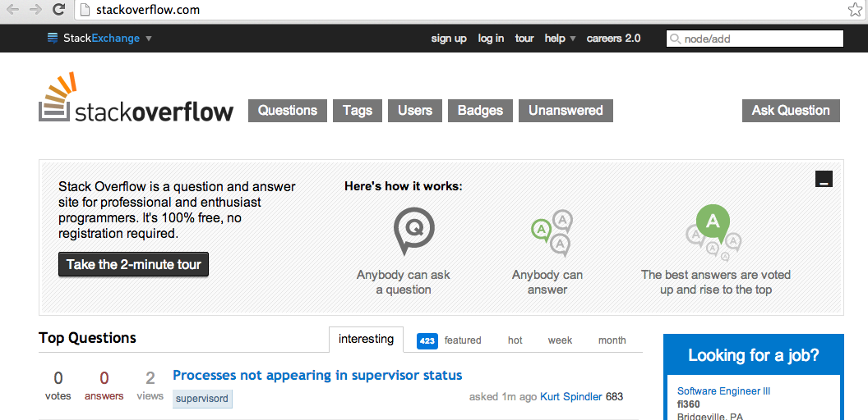
Stack Overflow

Slide 29
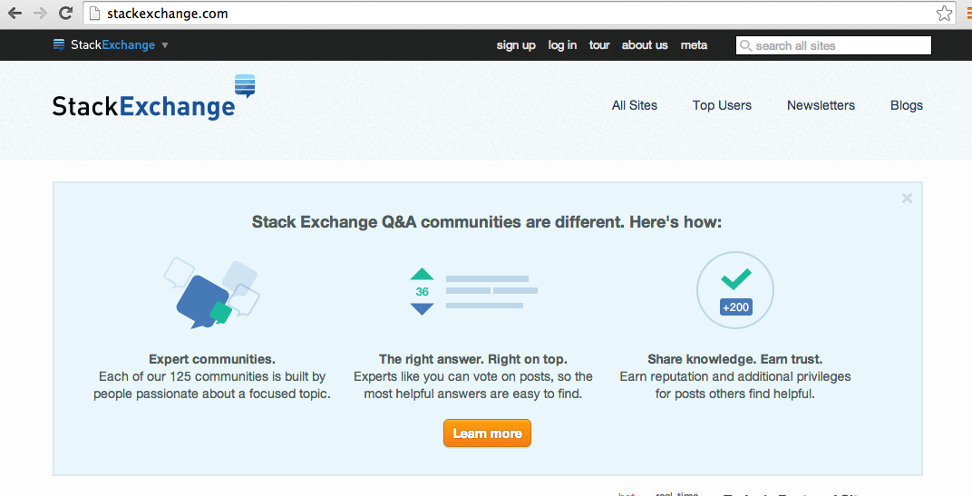
Stack Exchange

Slide 30
Do not reinvent the wheel
Do not write your own code for a function, unless there is absolutely no choice
If a solution is available on the internet, use it. If it popped up in Google, its probably been rigorously tested by many more people than code you would write yourself

Slide 31
Developing Your Own Tool

Slide 32

When to develop your own tool
When you really need it, and no one else has done anything remotely similar you can adapt
When there’s a clear need for it

Slide 33
Things to keep in mind
Operating System compatibility
Who are your users?
What OS do they mainly use?
Beta Testing
People in your department, who haven’t used it yet
People with only a basic knowledge of computer science
Documentation
Write good documentation if you want other people to use your program
If its hard for them to understand what your code does, it would be easier for them to write it themselves

Slide 34
Why Unit Testing
Ensure functionality of a program
Important for software meant for a large user base/multiple collaborators
Defend your research results

Slide 35
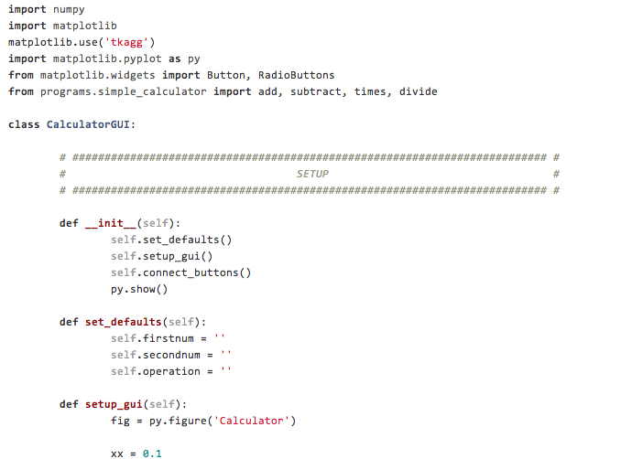
GUI

Slide 36
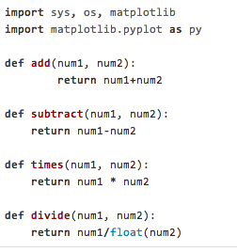
Model

Slide 37
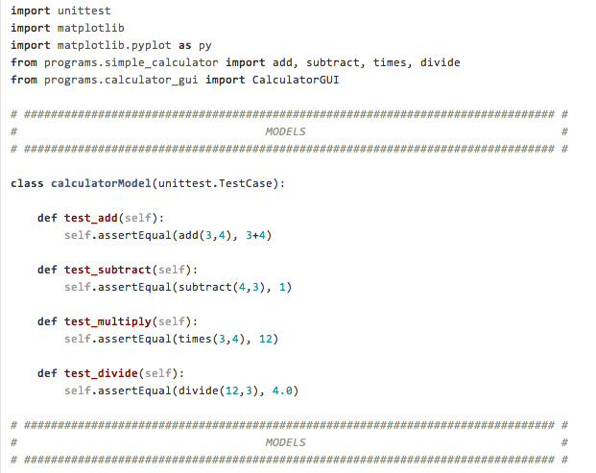
Unit tests

Slide 38
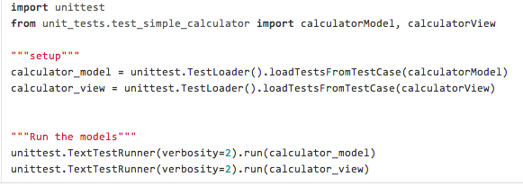
Running unit tests

