Slide 1
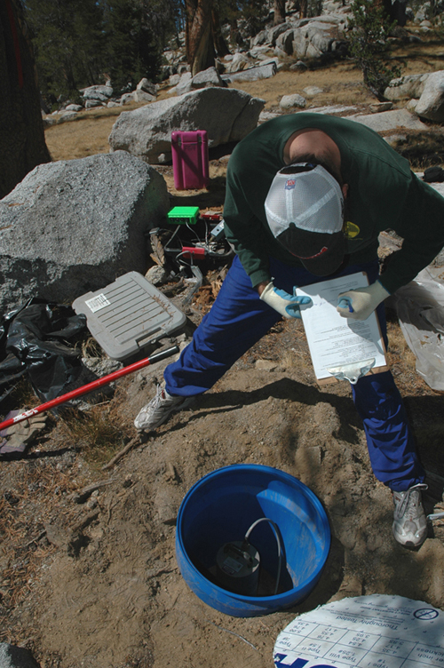
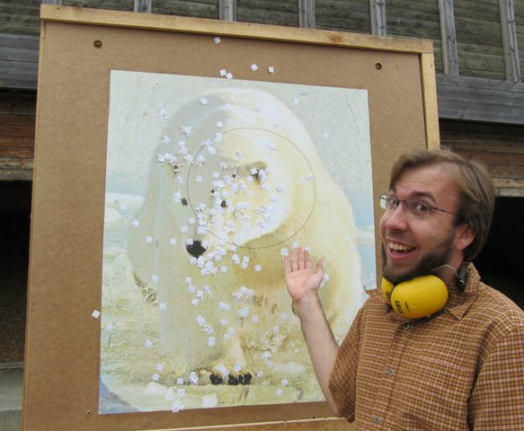
Andy Frassetto
“Swiss Army Knife” at IRIS HQ for ~3 years
2011 Univ. Copenhagen (Scandinavian Post-doc/Vacation)
Ph.D. 2009 Univ. Arizona w/George Zandt and Susan Beck
B.S. 2004 Univ. South Carolina

Slide 2
SOD
local filing system/processing
netdc/breqfast
webservices
Community software (e.g. PQLX)
Homegrown codes (typically MATLAB)
Products (past: RFs, SKS splits, present: visualizations, sensor orientations, spectral measurements
2014 Goals: squeeze some Python into my brain

