Slide 1
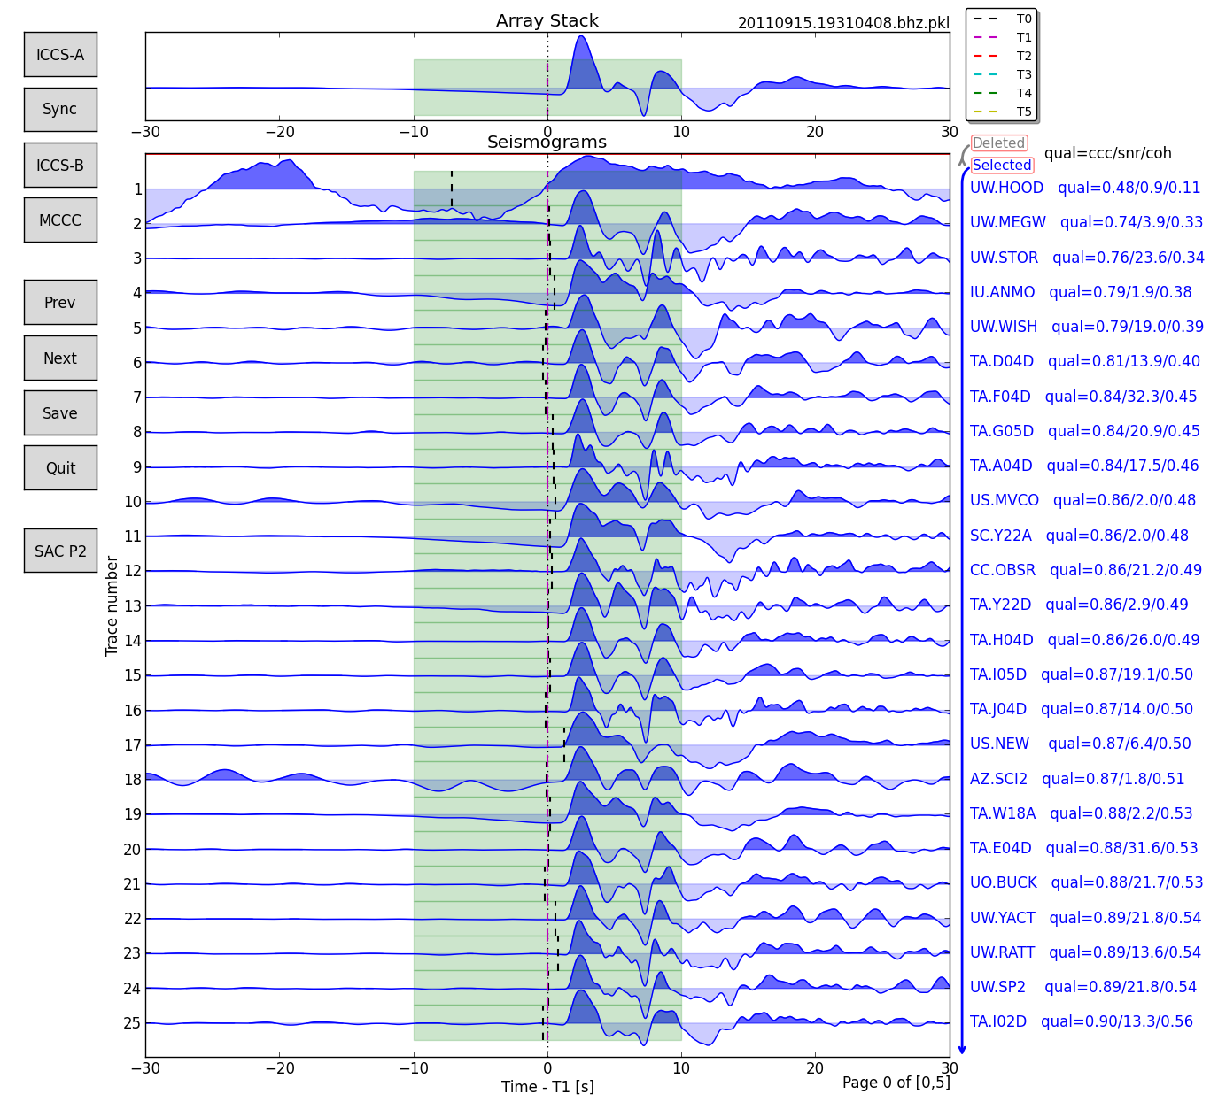
AIMBAT
Lay Kuan Loh
Suzan van der Lee
August 4, 2014

Slide 2
Contents
Introduction to AIMBAT
Installing dependencies
Installing AIMBAT
Picking Travel Wave Arrival Times

Slide 3
Introduction to AIMBAT

Slide 4
AIMBAT
Python tool for measuring teleseismic arrival times for large seismic arrays
Aligns seismograms by ICCS (iterative cross-correlation and stack)
Picks arrival times by Multi-channel cross-correlation
GUI for user to fine-tune arrival times

Slide 5
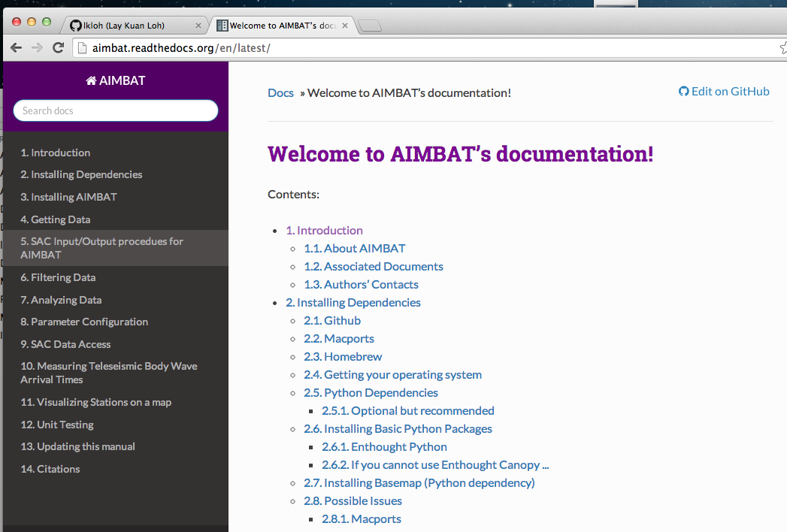

Slide 6
Installing Dependencies

Slide 7
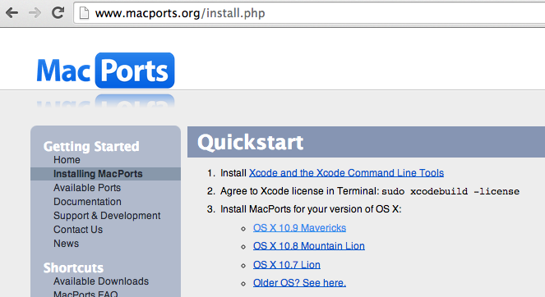
Package Manager - Macports

Slide 8
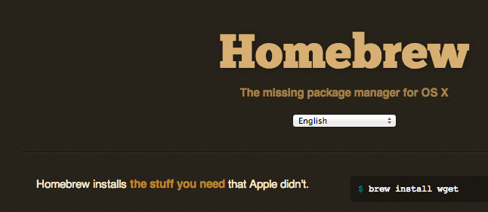
Package Manager - Homebrew

Slide 9

Enthought Canopy (Python)

Slide 10
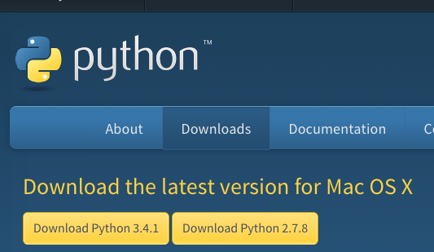

Slide 11
Python Packages
Numpy
Scipy
Matplotlib

Slide 12
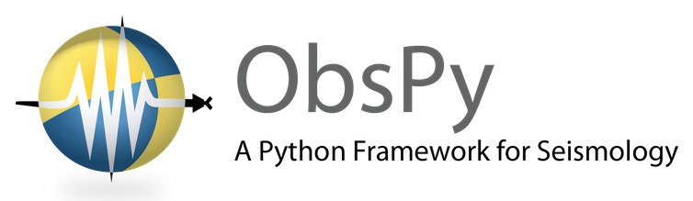
Obspy
Python library for rapid development in seismology

Slide 13
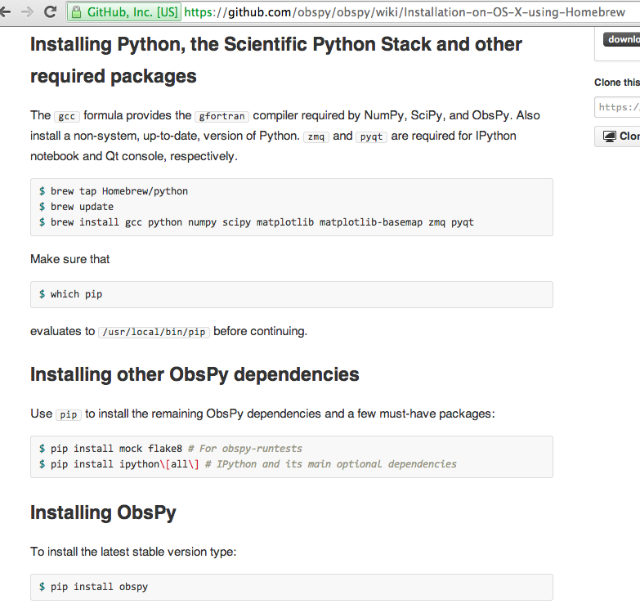

Slide 14
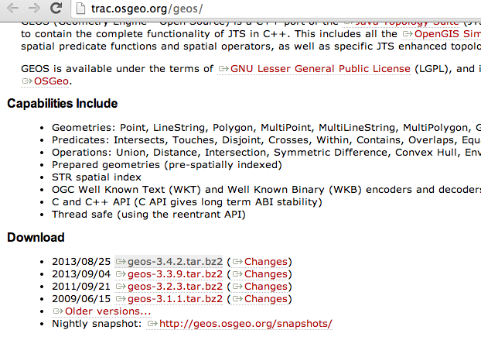
Python -Geos

Slide 15
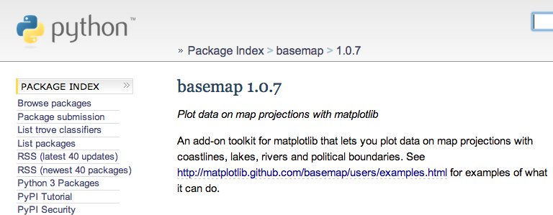
Python - Basemap

Slide 16
Installing AIMBAT

Slide 17
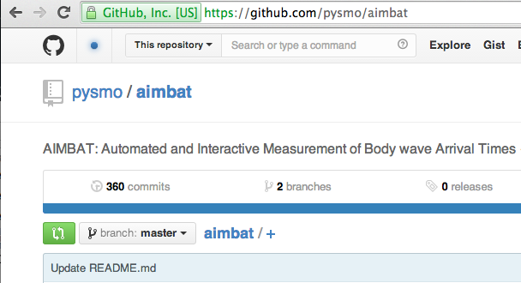
Installing AIMBAT
Install pysmo.sac

Slide 18
.bash_profile
Ls –a
Vi .bash_profile

Slide 19
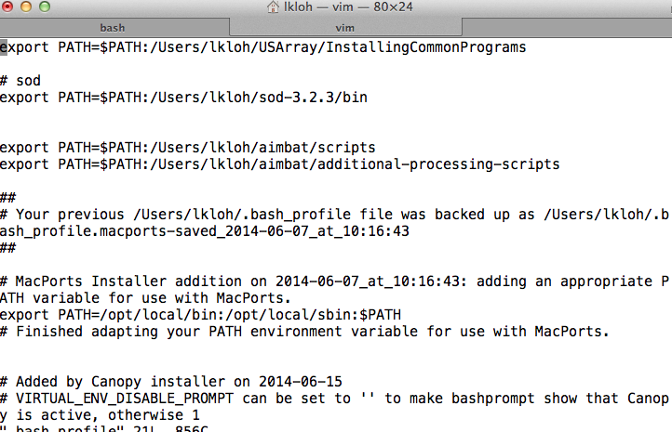

Slide 20
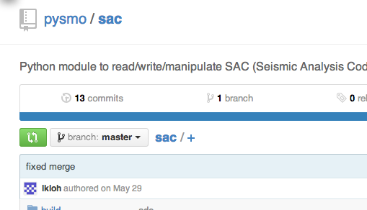
Installing AIMBAT
Install pysmo.sac

Slide 21
Getting Data

Slide 22
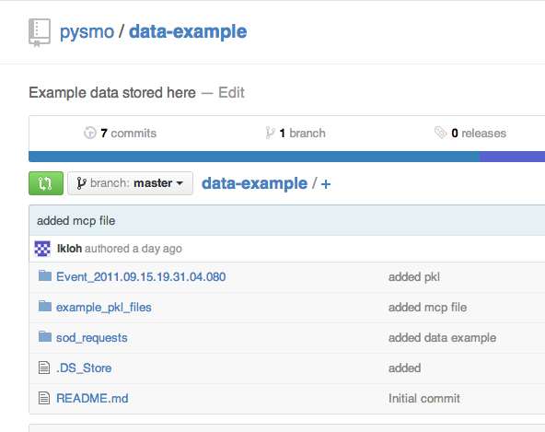

Slide 23

Automates data selection, downloading, routine processing

Slide 24
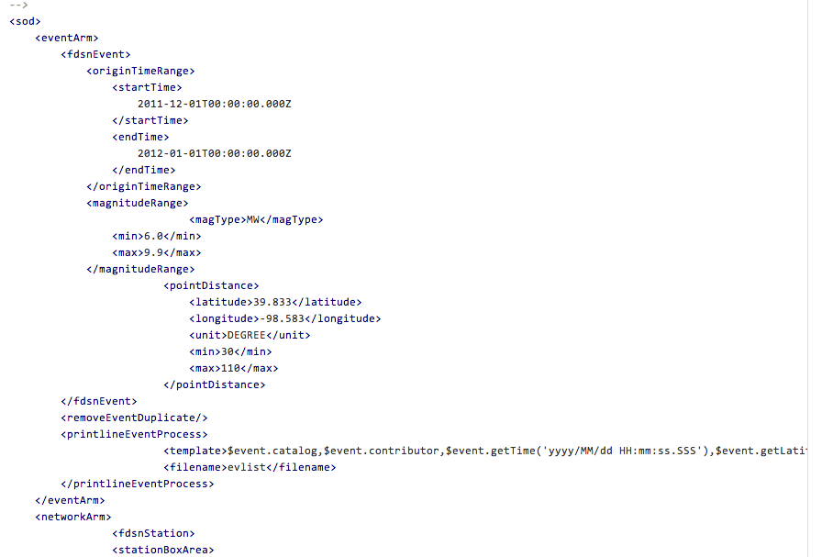

Slide 25
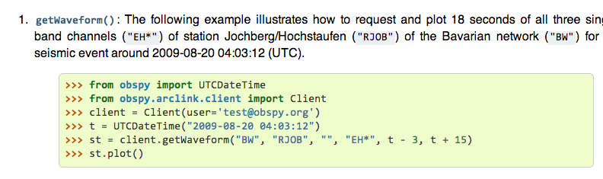
Obspy – download IRIS data

Slide 26
Picking Travel Wave Arrival Times

Slide 27
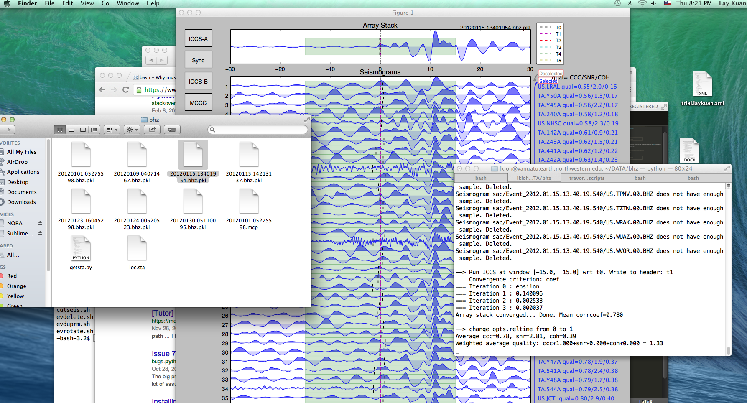
Ttpick.py

Slide 28
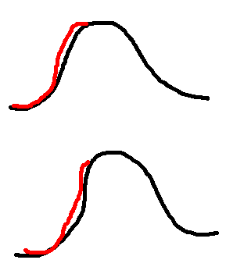
Aligning Seismograms

Slide 29
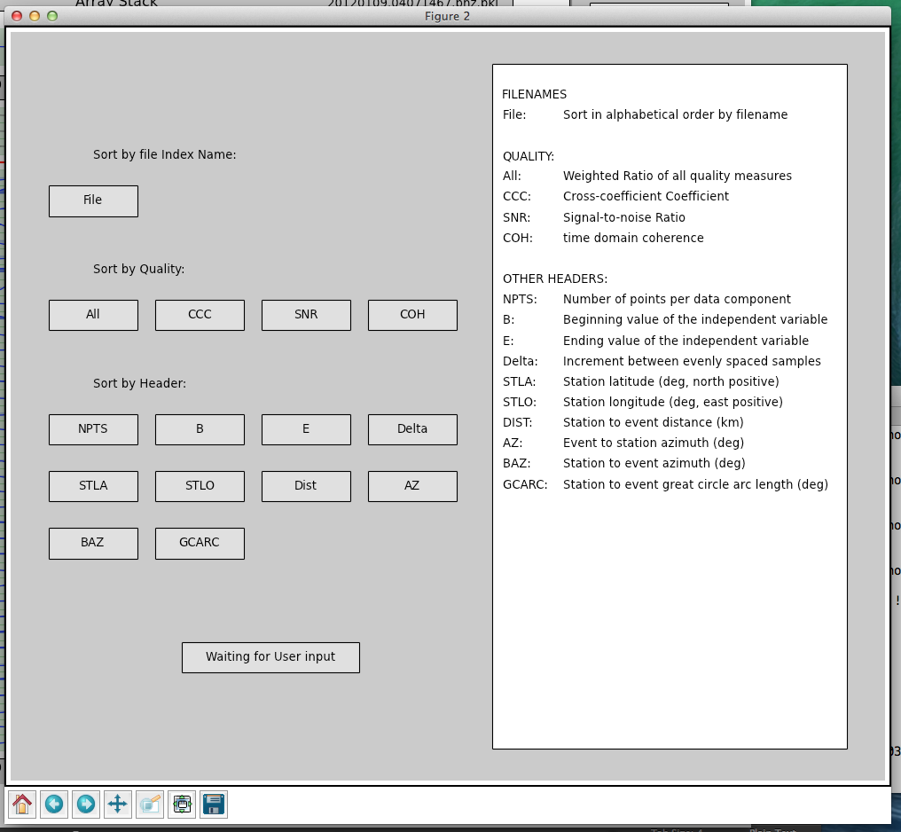

Slide 30
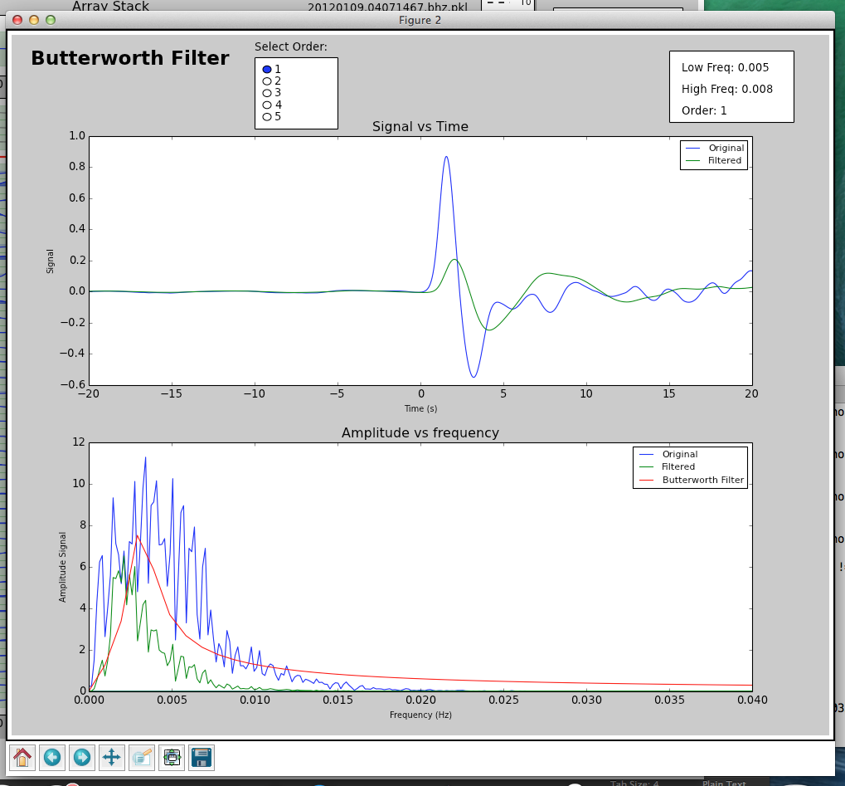

Slide 31
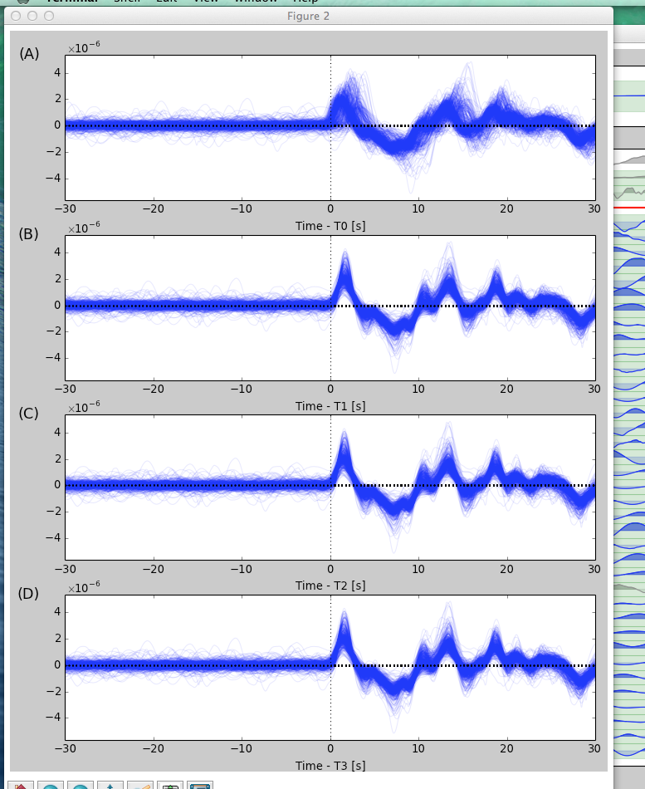

Slide 32


