Slide 1
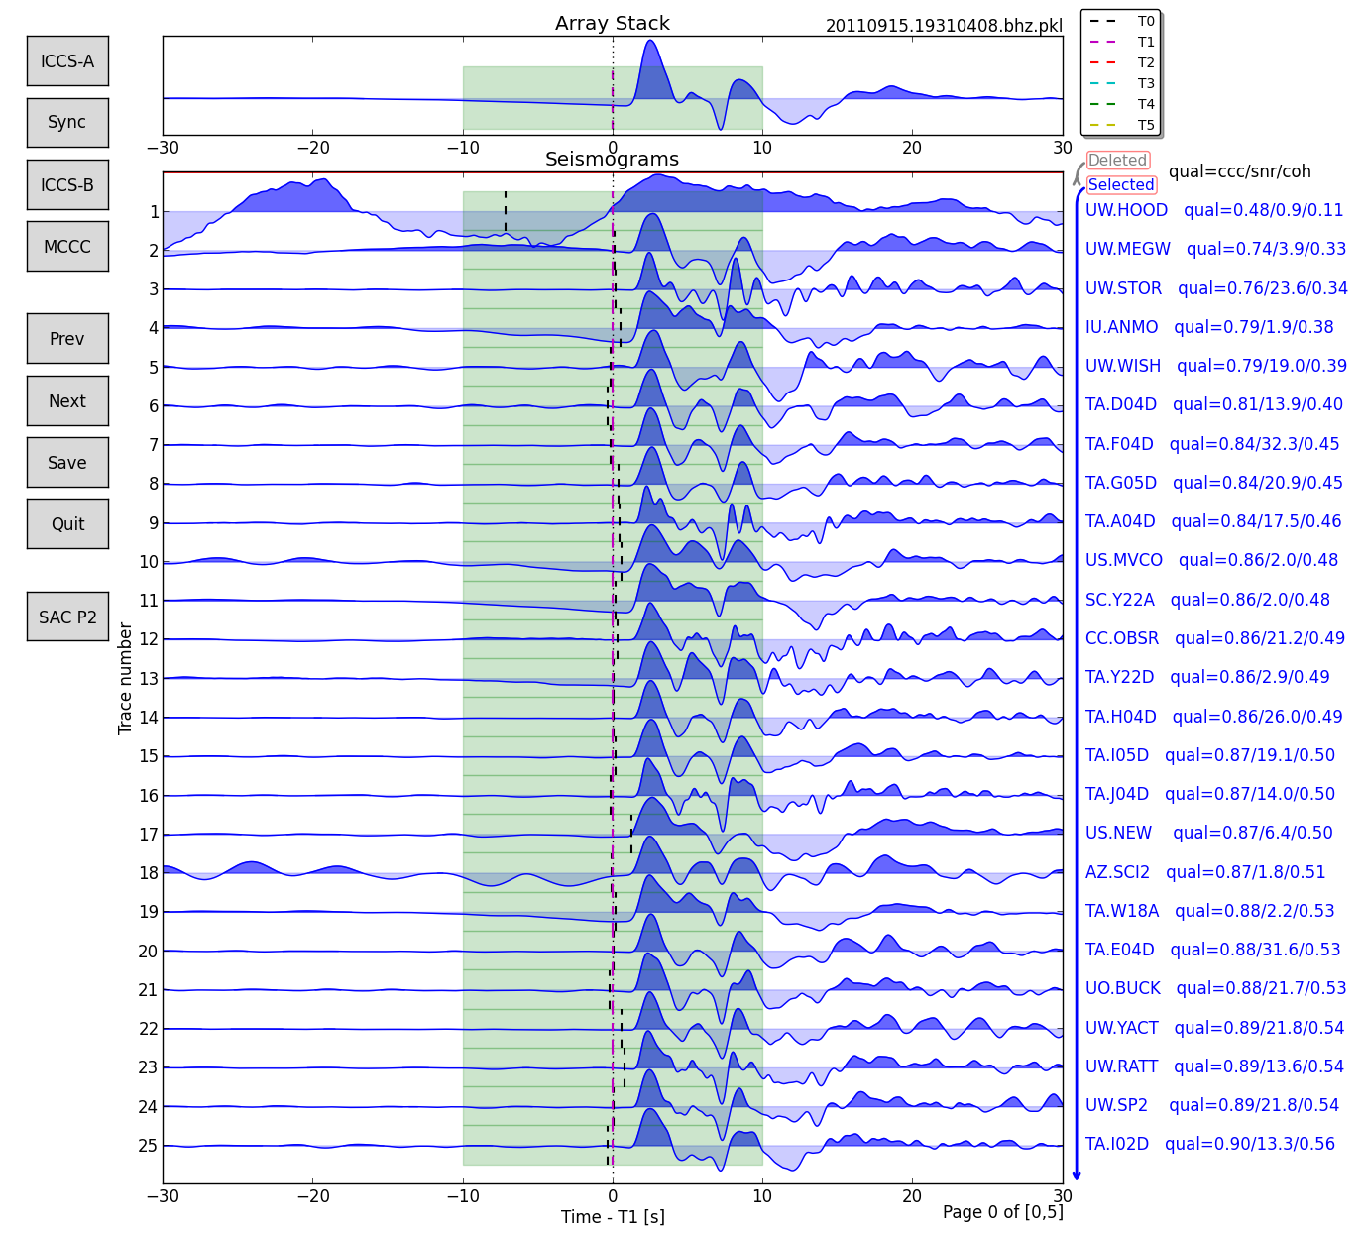
AIMBAT
Lay Kuan Loh
Suzan van der Lee
August 4, 2014

Slide 2
Contents
Introduction to AIMBAT
Installing dependencies
Installing AIMBAT
Picking Travel Wave Arrival Times

Slide 3
Introduction to AIMBAT

Slide 4
AIMBAT
Python tool for measuring teleseismic arrival times for large seismic arrays
Aligns seismograms by ICCS (iterative cross-correlation and stack)
Picks arrival times by Multi-channel cross-correlation
GUI for user to fine-tune arrival times

Slide 5
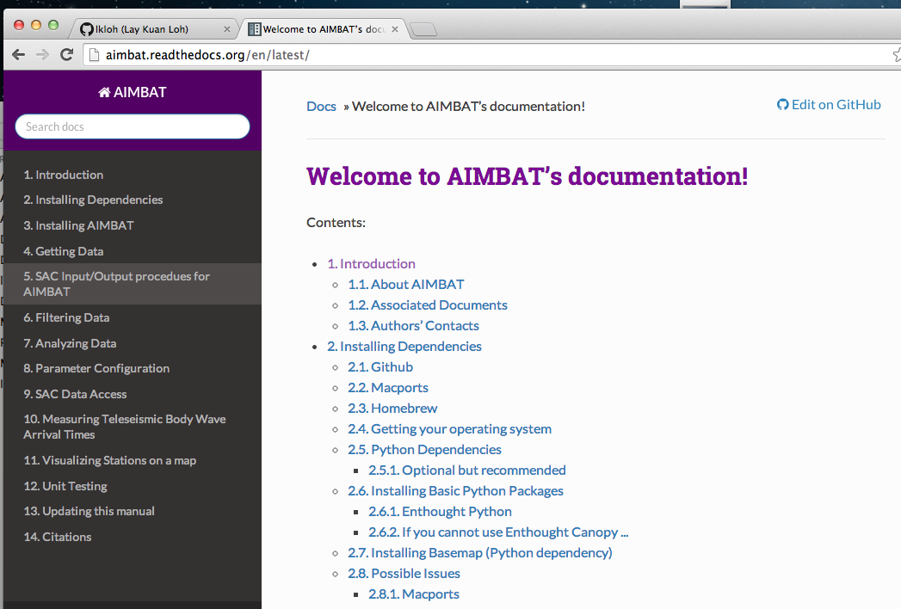

Slide 6
Installing Dependencies

Slide 7
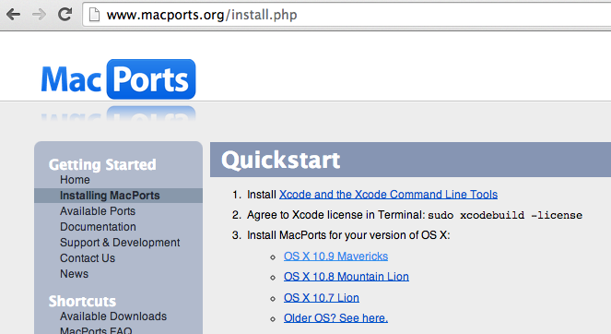
Package Manager - Macports

Slide 8
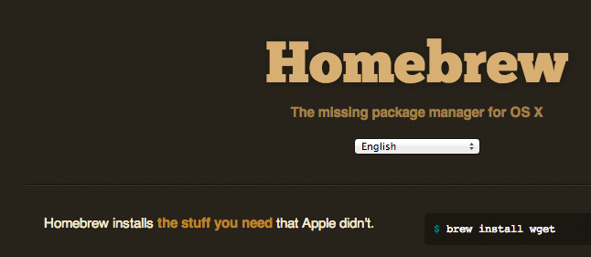
Package Manager - Homebrew

Slide 9

Enthought Canopy (Python)

Slide 10
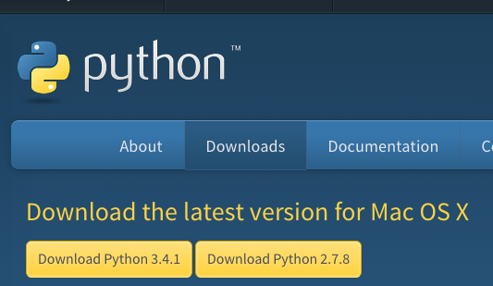

Slide 11
Python Packages
Numpy
Scipy
Matplotlib

Slide 12
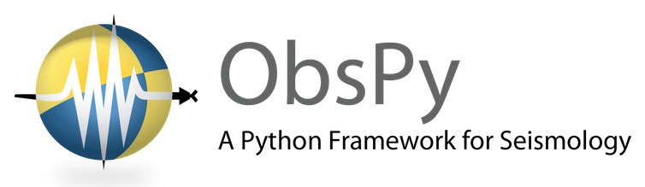
Obspy
Python library for rapid development in seismology

Slide 13
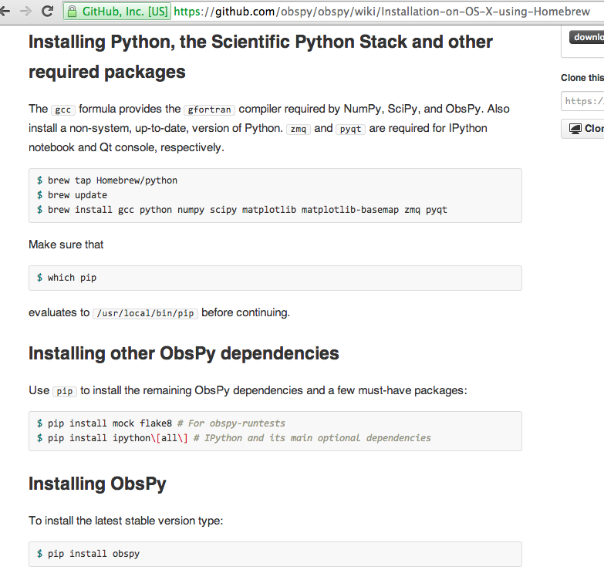

Slide 14
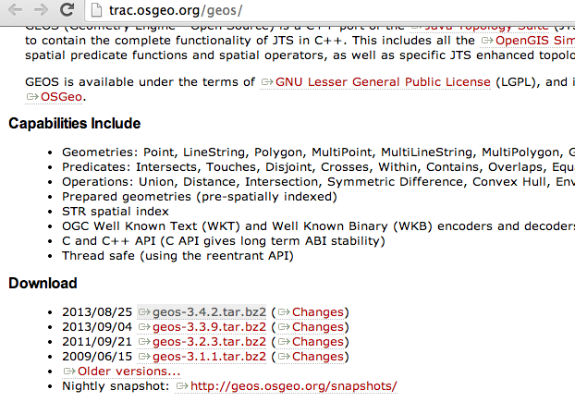
Python -Geos

Slide 15
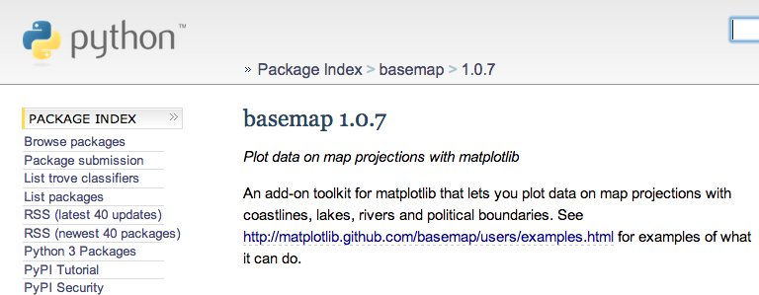
Python - Basemap

Slide 16
Installing AIMBAT

Slide 17
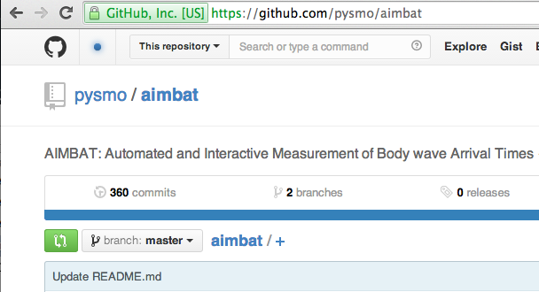
Installing AIMBAT
Install pysmo.sac

Slide 18
.bash_profile
Ls –a
Vi .bash_profile

Slide 19
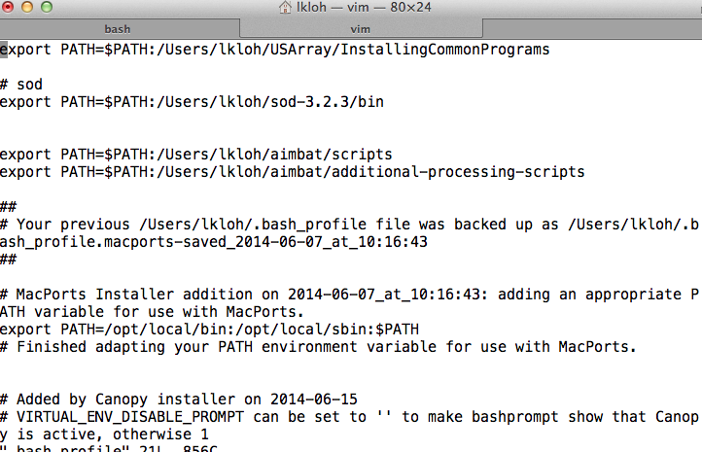

Slide 20
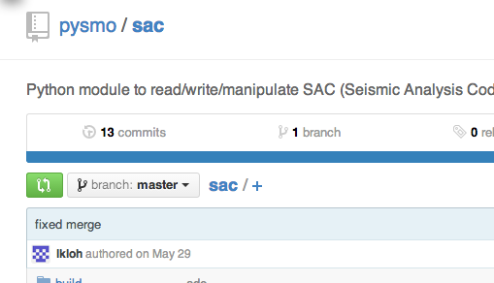
Installing AIMBAT
Install pysmo.sac

Slide 21
Getting Data

Slide 22
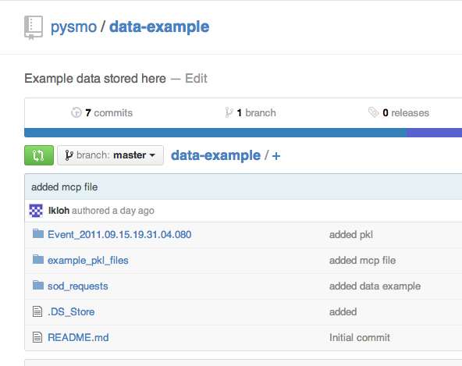

Slide 23

Automates data selection, downloading, routine processing

Slide 24
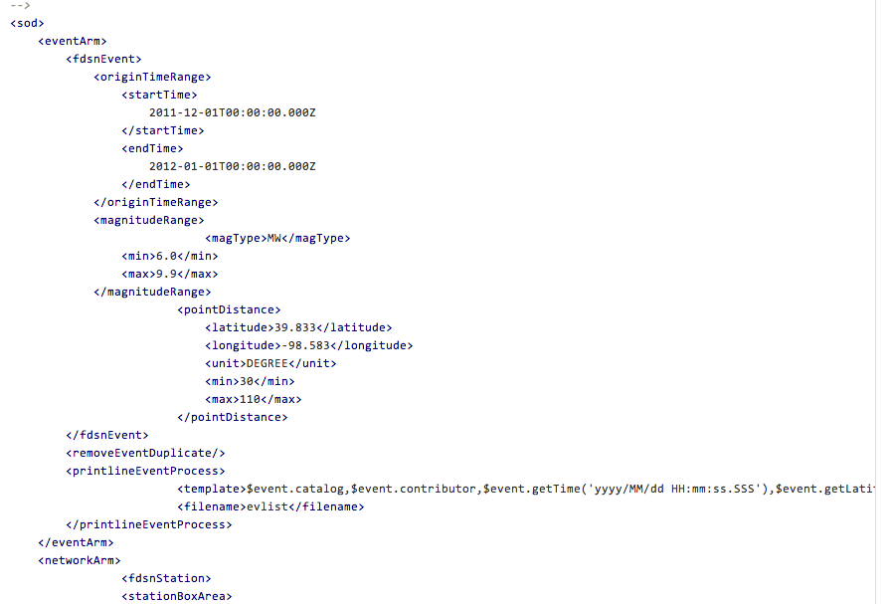

Slide 25
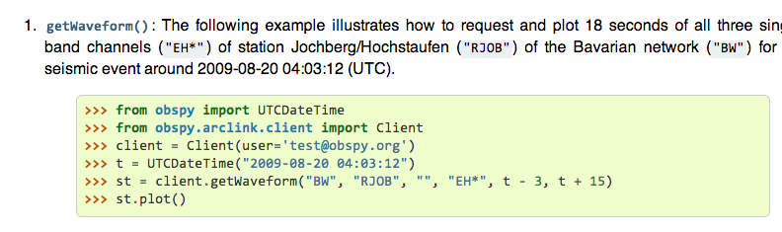
Obspy – download IRIS data

Slide 26
Picking Travel Wave Arrival Times

Slide 27
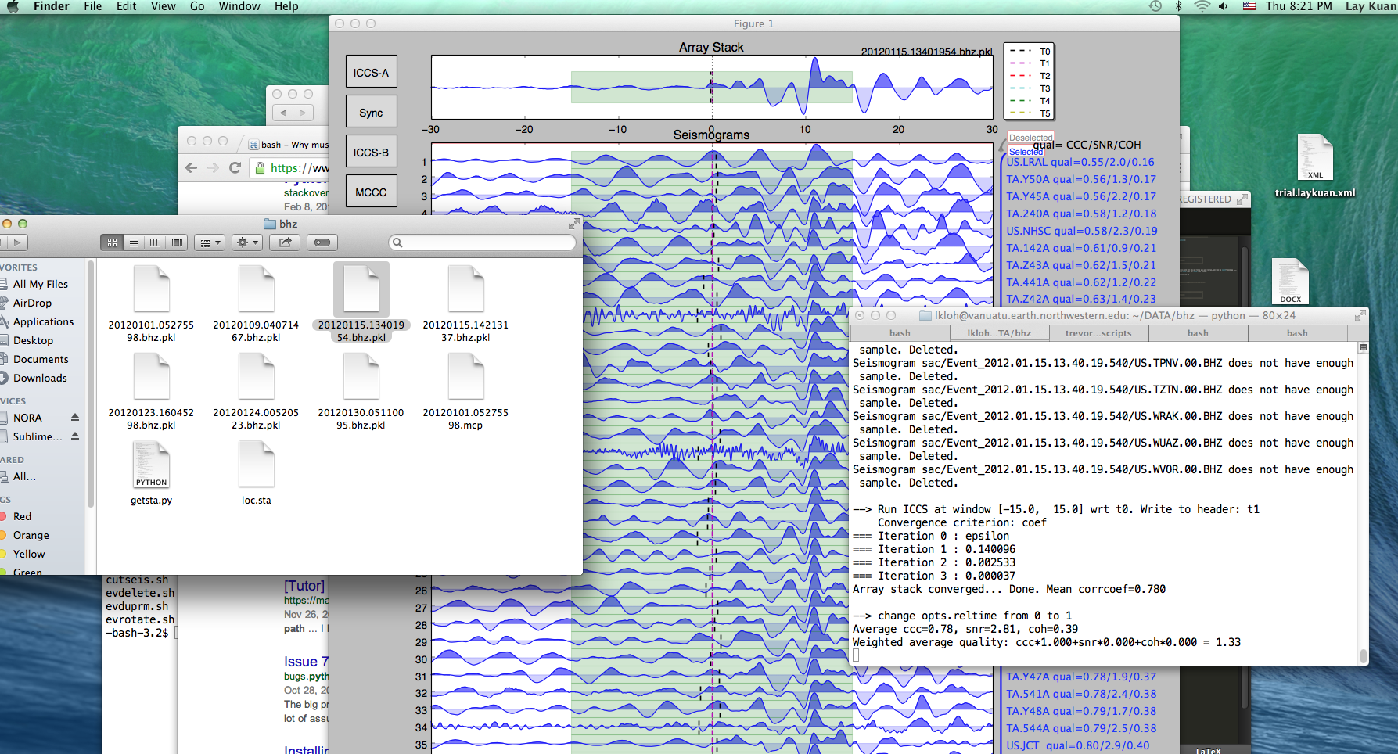
Ttpick.py

Slide 28
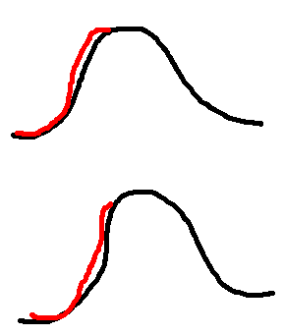
Aligning Seismograms

Slide 29
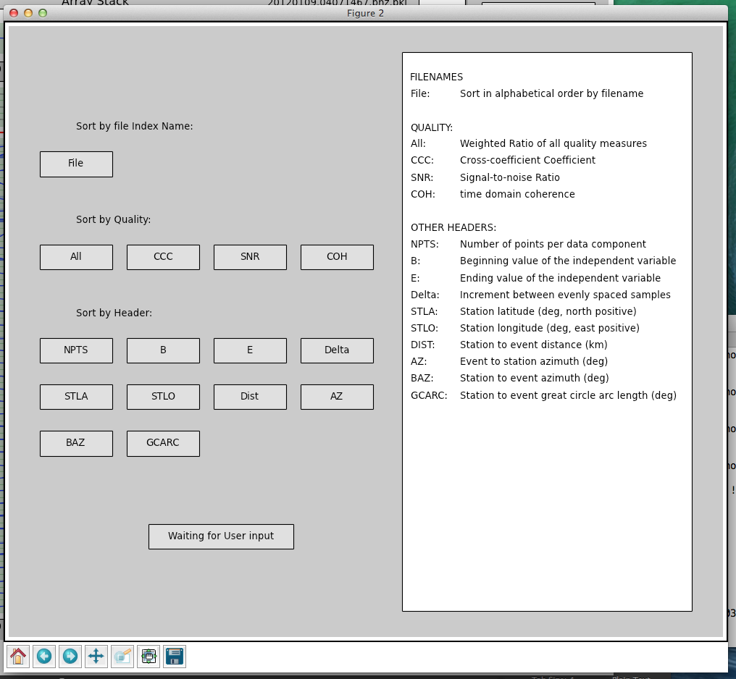

Slide 30
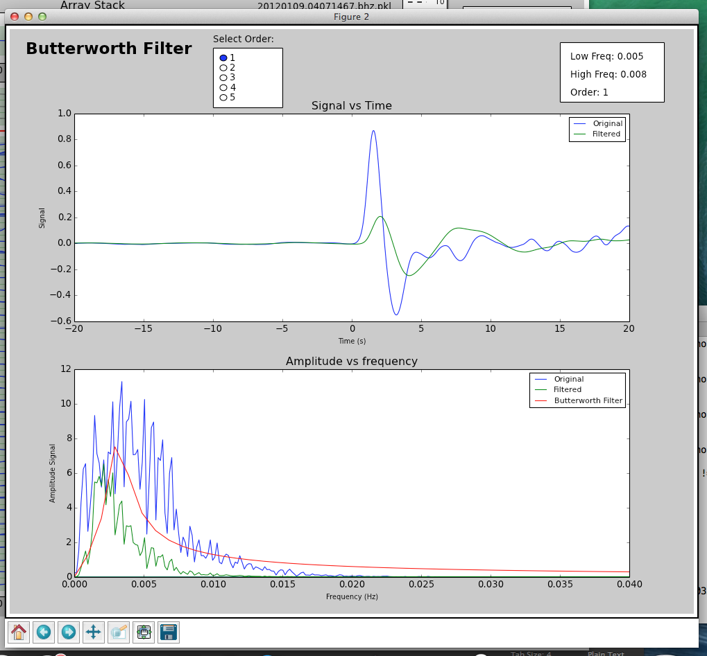

Slide 31
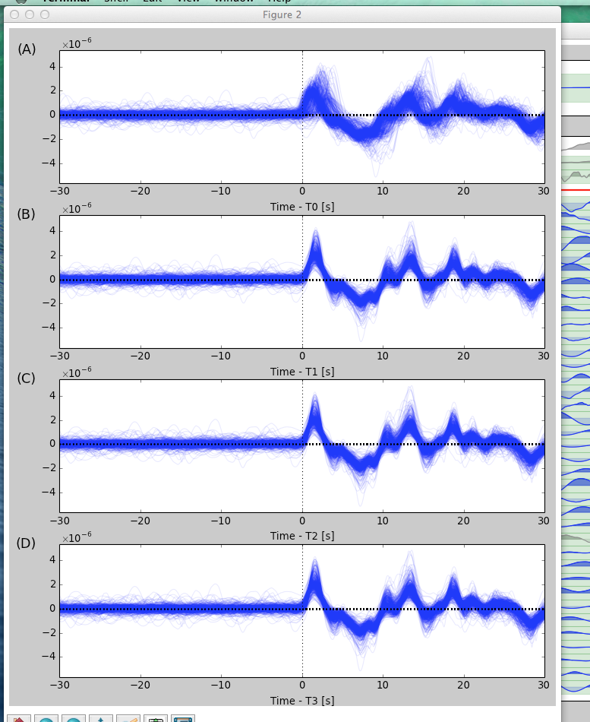

Slide 32


Slide 33
Documentation

Slide 34
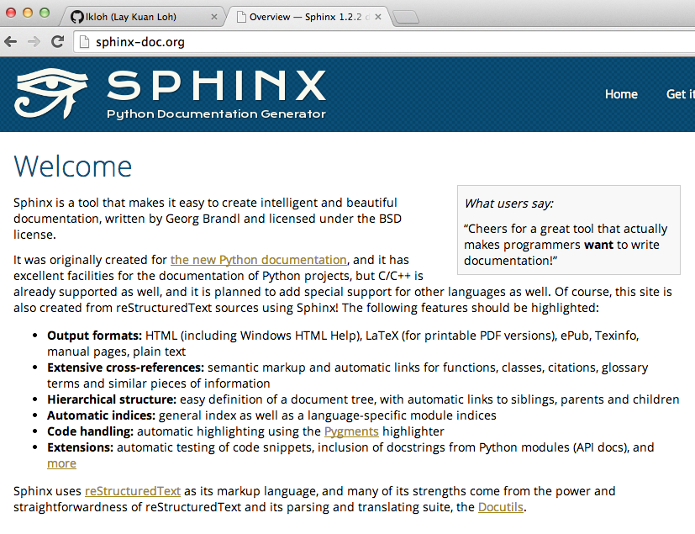

Slide 35
