Slide 1
Good Coding Practices
Lay Kuan Loh
August 4, 2014
Notes:
Talking about what to watch out for when coding, especially in the context of writing software meant for other users

Slide 2
Contents
Admin
My background
Goals of this session
Version Control
Github
Writing code
Writing your own code
Working on code with collaborators
Joining a project where someone left off
Find out how to do something
Looking for information you need
Using the fruits of other peoples’ labor
Developing your own tool
When to do it
What to keep in mind
Writing Documentation
Sphinx
LaTeX
Notes:
Version control, so if something stops working you can go back and revert to the last working state
What to look out for when writing code
How to ask the right questions (when programming), extended to other areas
good practices for writing software
Documentation and how to write it. Try and put it online if possible. Make sure it can be updated easily

Slide 3
Admin

Slide 4
Where I’m coming from
Undergraduate (Stanford)
Major in Math
Minor in Computer Science
No exposure to coding before undergrad
Research
Undergraduate research in computational geophysics
Internship, Northwestern Earth and Planetary Sciences
Industry
9 months as a software engineer at a Silicon Valley startup
http://www.dwellers.com/
http://mathcrunch.com/
Current (Carnegie Mellon)
Graduate student (started Jun 30, 2014)
Electrical and Computer Engineering
Notes:
Did not have much formal schooling in coding, mainly learnt by looking at other people’s code, googling, and asking people
Done research in earth science needing computational tools
Worked on several large collaborative coding projects as a software engineer while on a gap year between undergrad and grad school
Now graduate student in electrical and computer engineering.

Slide 5
Takeaway points
Writing easily maintained code
Getting unstuck when you hit a problem
Notes:
What to try and remember from this session

Slide 6
Version Control

Slide 7

Github
Good
Useful for collaborators
Showcase non-confidential work online
Get it online, anywhere
Bad
Limited allowance for privacy – free private account with .edu email for two years
Steep learning curve
Notes:
Good for sharing code and building a portfolio.
Convenient as it is hosted on a cloud, can get it anyway just by logging into your account
Bad: troublesome to learn,
Problematic if code needs to be private – need to pay
Code is so hard to read, if you make it public but add no documentation, may be ok

Slide 8
Demo
Downloading and installing Git
Creating a repository
Cloning a repository
Making commits
Reverting a commit
Making and pushing a branch
Merging a branch with master
Dealing with merge conflicts
https://github.com/pysmo/aimbat-docs/wiki/Introduction-to-Github
Notes:
Demonstration
Make a github account and follow along
Wrote up important points covered in the link

Slide 9
Coding Practices
Notes:
John West’s slides used for this part
He was an engineer for a while too
Pull up the code in unit_test_demo (can be opened with plain text editor)

Slide 10
Writing your own code … Comments
Describe the process, not the code
Notes:
What does that bit of code do?

Slide 11
// step through the loop 100 times
// duh!
for (i = 1; i <= 100; i++) {
…
…
…
}

Slide 12
// increment along the surface (x axis)
// summing each point’s contribution
for (i = 1; i <= 100; i++)
{
…
…
…
}
Notes:
Describe what is it doing, so someone later looking through the code can understand what its doing
Don’t need to describe the mechanics of the code unless its unusually complicated

Slide 13
Write a header block
/******************************************/
/* 2-dimensional channel flow program */
/* for channels with free upper surface */
/* */
/* Original by JD West, 01/08/2006 */
/* Modified 02/11/2007 to increase resolution */
/******************************************/
Notes:
Breaks up the code nicely

Slide 14
Use Descriptive Variable Names
// increment along the surface (x axis)
// summing each point’s contribution
for (iLength = 1; iLength <= 100; iLength++)
{
…
…
…
}

Slide 15
No magic (numbers)
// increment along the surface (x axis)
// summing each point’s contribution
for (i = 1; i <= 27; i++)
{
…
…
…
}
Notes:
What is 27? what if you use it in lots of other places and need to change it later? Hard to catch everything you used it
May forget what 27 represented

Slide 16
No magic (numbers)
// increment along the surface (x axis)
// summing each point’s contribution
for (iLength = 1; iLength <= iMax; iLength++)
{
…
…
…
}

Slide 17
Or, use an external file
// Declarations
int iLength; // x-axis increment
int iMax; // total increments
double dVelocity[5001]; // array of velocities
…
// Read and set Initial Values from a file
…
…
Notes:
Declare constants in one file and source the file

Slide 18
Use descriptive file names
Naming your script “test.csh” means
“I will never be able to reuse this code.”
Notes:
Name the file what it is used for

Slide 19
Pretend you are in a programming team
Write your code as if someone else will have to understand and modify it
Notes:
“Someone else” may be you in 6 months or 6 years

Slide 20
Working with someone else
Don’t try to understand everything in one go
Ask them to explain the important parts affecting the functionality you will work on
Identify one place you need to begin work on
Play with the code a bit
Comment out things to see what part of the code controls which bit of functionality
Notes:
No point trying to understand all of the code, will probably just confuse you
Programmers should try to ensure modularity in code – isolate different parts from each other as much as possible

Slide 21
Solving Problems

Slide 22
What if you hit a problem?
Coding problem
Chances are someone else has a similar problem, and a solution exists
Google it. How would you phrase that question to a human?
Who does research in that general area?
Look at their papers for something similar you can adapt
How would you do it manually?
Describe the steps, then code it up
Notes:
Some things to think about

Slide 23
How to ask good questions online
Choose where to ask
Stack Overflow vs Stack Exchange
Search the web
Project mailing lists
Meaningful specific subject headers
Questions in readable data formats
Have your contact info readily available
Notes:
Stack overflow: community for programmers to ask each other questions
Stack exchange for other types of fields like geology/math/physics, etc
Started by the same group of people who began with stack overflow and expanded into stack exchange

Slide 24
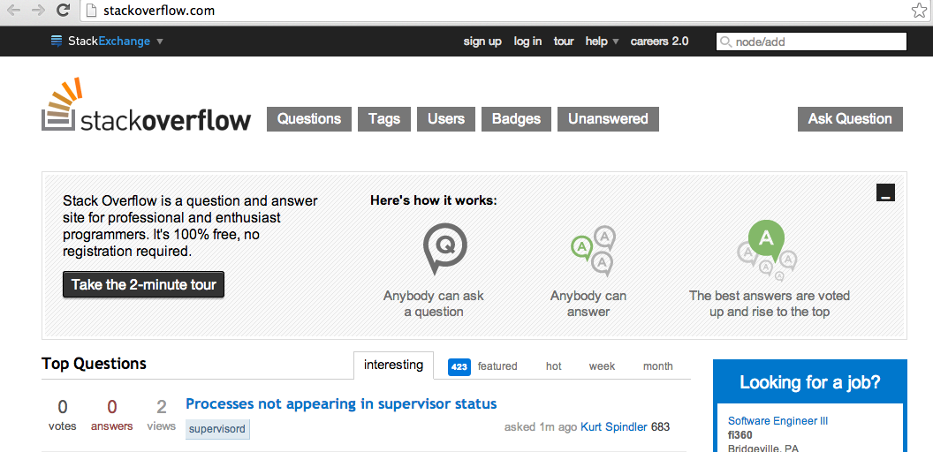
Stack Overflow
Notes:
Quality control by allowing users to rate the quality of an answer/question
Deters internet trolls

Slide 25
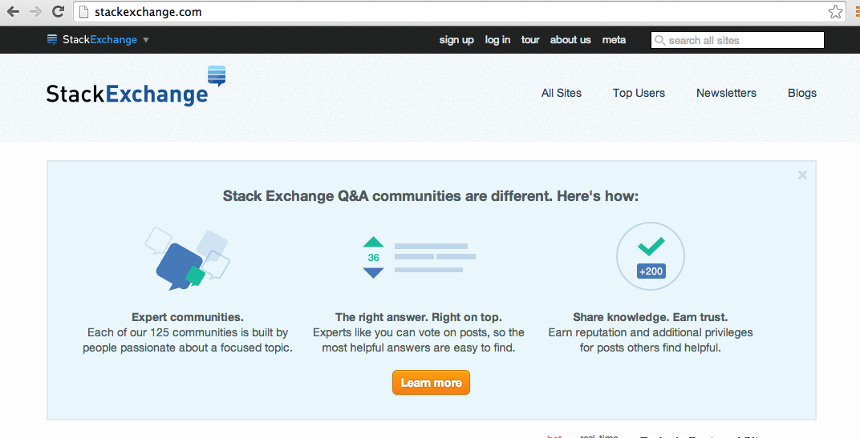
Stack Exchange
Notes:
Find your relevant community!
Problems with seismology; email the authors directly, since this is a small field and only a few people are producing the programs

Slide 26
Do not reinvent the wheel
Do not write your own code for a function, unless there is absolutely no choice
If a solution is available, written by someone else
Probably been rigorously tested by many more people
Notes:
More explicit: for software bugs or your own programming bugs?
There are always bugs in other peoples’ codes, so report it if you find them! Makes it better for everyone else also

Slide 27
Developing Your Own Tool

Slide 28

When to develop your own tool
When you really need it
No one else has done anything remotely similar you can adapt
There’s a clear need for it by other people
Notes:
Refer to Emily’s talk (introduced yesterday)

Slide 29
Things to keep in mind
Operating System compatibility
Who are your users?
What OS do they mainly use?
Beta Testing
People in your department, who haven’t used it yet
People with only a basic knowledge of computer science
Documentation
Write good documentation if you want other people to use your program
If its hard for them to understand what your code does, it would be easier for them to write it themselves
Versions of software dependencies
What works on a higher version may be broken on a previous version
Features in a lower version may be deprecated in a higher version
Notes:
Seismologists tend to use macs/linux, so test on these two rigorously
Make sure its intuitive to use .
Write good documentation. Later will introduce you to Sphinx for documentation
Software shipped out is always evolving. If something is popular enough, best to keep upgrading it/testing it when its dependencies get an upgrade too

Slide 30
What is unit testing?
Test cases for a program you wrote to check that it works as expected
Sometimes while working on something else/fixing it, you break another feature
This defends against it!
Test MVC
Model
View
Controller
Notes:
Give example, go through the lines

Slide 31
Why Unit Testing
Ensure functionality of a program
Important for software meant for a large user base/multiple collaborators
Defend your research results
Finds problems early
Reduces uncertainty

Slide 32
Documentation

Slide 33
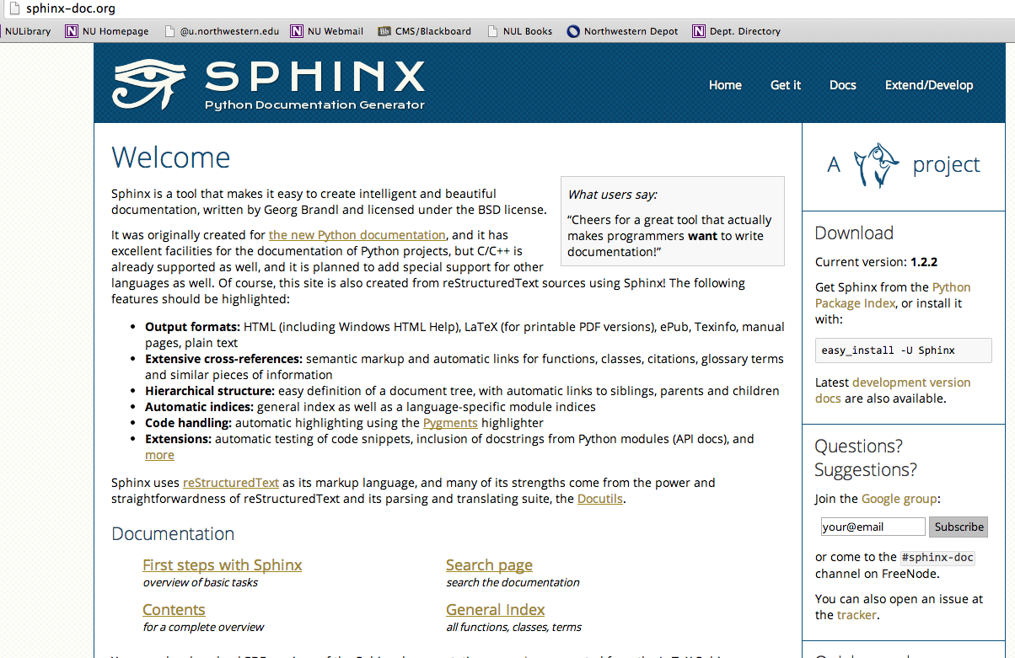
Notes:
How to install

Slide 34
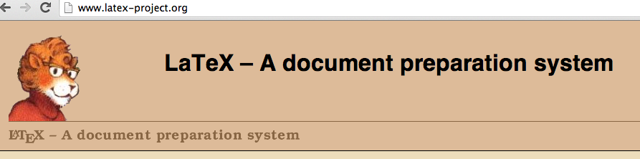
Full version (very large): http://www.tug.org/mactex/
Smaller version: http://www.tug.org/mactex/morepackages.html
Notes:
Don’t really need full version

