Slide 1

PODHIGAI COLLEGE OF ENGINEERING & TECHNOLOGY
NAME | LOKESH K
REG NO | 51182114021
DEPT | BE- CSE
PROJECT SUBMISSION

Slide 2

KEYLOGGERS
AND
SECURITY

Slide 3
OUTLINE :
➤ Problem Statement ➤ Proposed System ➤System Development Approach ➤ Algorithm & Deployment ➤ Result ➤ Conclusion ➤ Future Scope ➤ References

Slide 4
PROBLEM STATEMENT :
✔ It’s challenging to covertly install a hardware keylogger on another person’s device. ✔ To tackle this issue, We aretherefore using a software keylogger that can be remotely installed one person’s PC to resolve this problem. ✔ Without the device owner’s knowledge, the keylogger would be running in the background.

Slide 5
Proposed System / SOLUTION:
✓ A Keylogger is a form of software which is used to track or log the all the keys that a user strikes on their keyboard, usually in secret so that the user of the system doesn’t know that their actions are being monitored. It is otherwise known as keyboard capturer. ✓ The solution to the above existing problem is that we can create software keyloggers instead of hardware keyloggers.

Slide 6
✔ The proposed model provides a solution that reducestrouble installing the keylogger to the target System.
✔ Because keylogger software can be installed remotely and does not need any physical access of the target system.
✔ He designed software is powerful enough to be installed targeted system itself

Slide 7
✓ When a user clicks, for example malicious link sent to him through mail or any social network media. ✔ Finally captures all the user’s keystrokes when logged into the system.
✔ It saves the logs to a folder or sends the log directly to a third party’s email address celebration.

Slide 8
System Development Approach:
✔ It is important to notice that a user-space keylogger can easily depend on documented sets of unprivileged APIs commonly available on modern operating systems (Oss). ✓ This is not the case for a keylogger implemented as a kernel module. In kernel space, the programmer must rely on kernel-level to intercept all the messages dispatched by the keyboard driver.

Slide 9
✓ Furthermore, a keylogger implemented as a user-space process is much easier to deploy since no special permission is required. ✓ Anti-hook technique is based on the fact that each processes either hidden or on display uses hooks APIs for the purpose III. Of hooking. ✔ So if we become able to scan all the processes and static executable and DLLs and detect the suspicious processes or files, which uses hooks.

Slide 10
✓ Then we can get the complete detail about that particular fle or process. We can also terminate its execution or existence to secure the system. ✓ This paper focuses the anti-hook technique by keeping in view the Key loggers development process so that personal privacy and security can be ensured.

Slide 11
API Technology is used in Software Development Approach.
✓ API- Application Programming Interface ✔ User mode keyloggers use a Windows application programming interface (API) to intercept keyboard and mouse movements. ✔ GetAsyncKeyState or GetKeyState API functions might also be captured. These keyloggers require the attacker to actively monitor each key press.

Slide 12
Algorithm & Deployment:
Start the Process:
A. The program will wait for all the system processes to initialize. B. The keylogger daemon is initialized and the process will be gauged in scale of time. C. A log f le is created for the current session to log all the keystrokes and maintain a record.

Slide 13
D. If no event occurs, keylogger continues listening to the strokes. E. If an event occurs, the keylogger classif es the type of keystroke that has occurred- special key which are commands or normal text input. F. If a special key that gives a command has been entered then it is compared with a value in a dictionary and recorded in the log file.

Slide 14
G. If a normal text i.e. Anything in the range of ASCII characters has been inputted, the ASCII code is converted to its respective character and this is exported to the log file. H. The inputs along with their timestamps are recorded in the log file. I. Stop the Process

Slide 15
DEPLOYMENT :
✓ A keylogger or keystroke logger/keyboard capturing is a form of malware or hardware that keeps track of and records your keystrokes as you type. It takes the information and sends it to a hacker using a command-and-control (C&C) server.

Slide 16
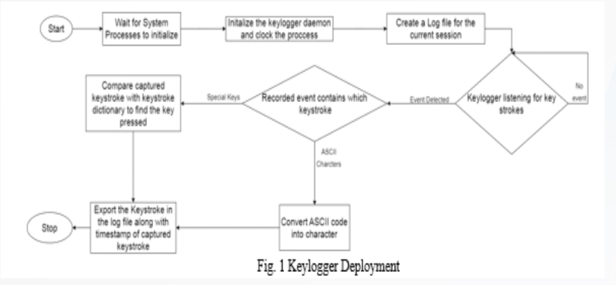

Slide 17
RESULT :
✓ Keystroke technology is a software that tracks and collects data on employees’ computer use. It tracks each and every keystroke an employee types on their computer and is one of a few tools companies have to more closely monitor exactly how staff spend the hours they are expected to work

Slide 18
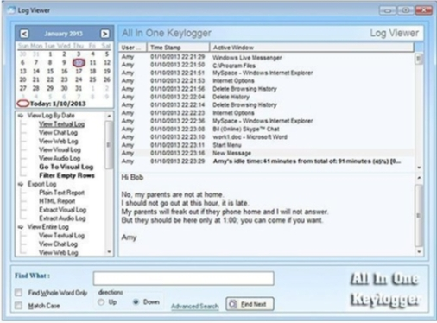

Slide 19
Conclusion:
• Keyloggers are a potent threat to both individuals and enterprises, with the potential to cause significant harm if left undetected.
• Understanding the nature of keyloggers, their methods of infltration, and the dangers they pose is crucial for maintaining a secure digital environment.

Slide 20
Future Scope:
➤ personally identifiable information. ➤ login credentials. ➤ emails. ➤ banking info. ➤ sensitive enterprise data. ➤ Etc...

Slide 21
References:
➤ https://www.ntiva.com/cyber-security-services/ ➤ geeksforgeeks.org/cryptography-introduction/ ➤ https://sec.okta.com/articles/2020/12/password -spraying-attacks-and-how-prevent-them ➤ https://info-savvy.com/password-attacks/ ➤ https://www.linkedin.com/pulse/common- security-attacks-cyber-mobile-atms-wif iiot-niteen -lall

Slide 22
➤h t t ps://searchsecurity.techtarget.com/def hition/keylogg er ➤ https://www.veracode.com/security/keylogger ➤ AntiHook Shield against the Software Keyloggers. Aslam at el. (2004) ➤ Google, Chrome, Books, Libraries, Etc....

Slide 23
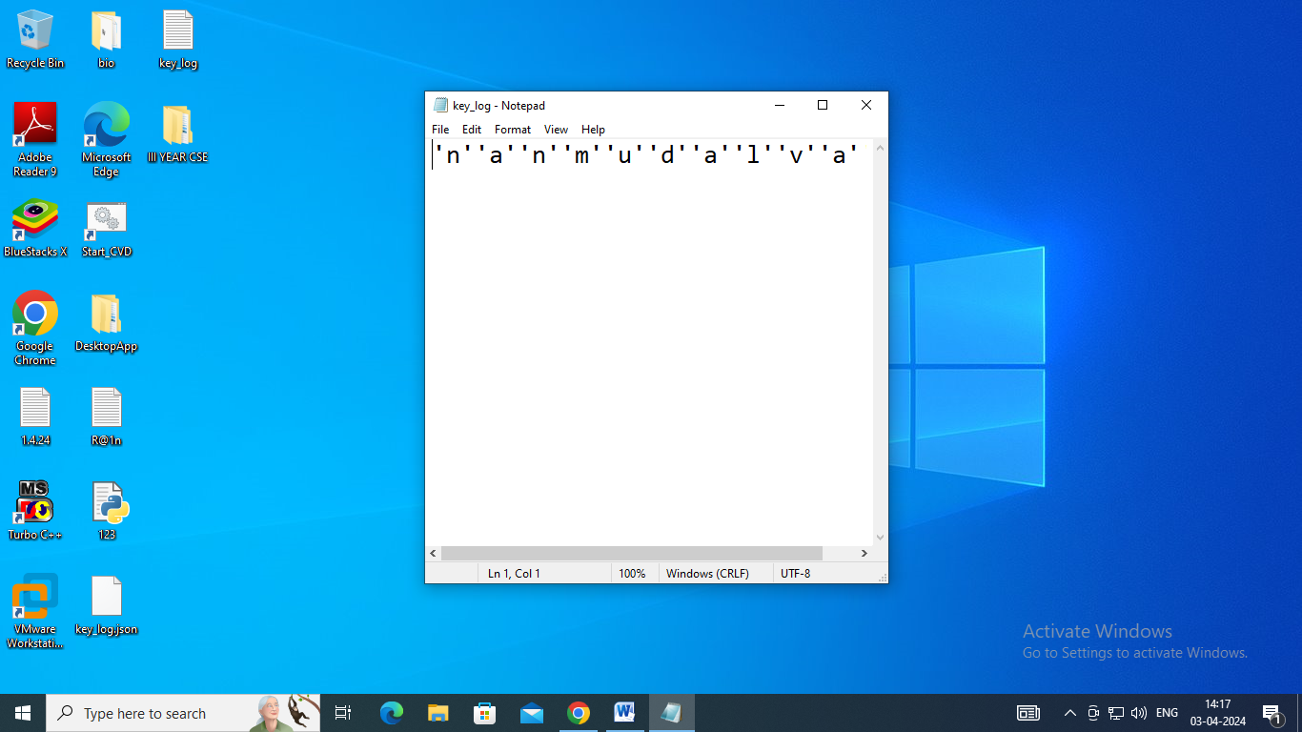

Slide 24
THANK YOU

