Slide 1


Introduction to utilizing the power of Nvidia GPUs

Slide 2
Agenda
1. Introduction
1.1 The Benefits of using GPUs
1.2 Performance Demo
1.3 Cuda, short overview
2. Programming Model
3. Implementation
3.1 Kernels
3.2 Thread hierarchy
3.3 Heterogeneous programming
4. Usage
4.1 Installation
4.2 IDEs & Tools
5. Demo

Slide 3
Introduction

Slide 4
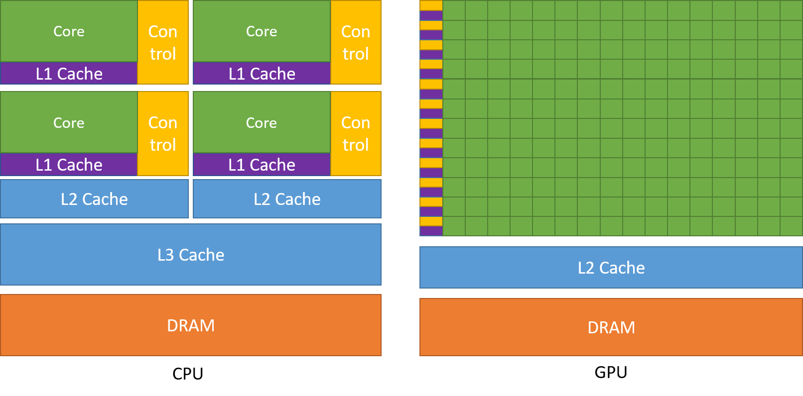
The Benefits of using GPUs

Slide 5
Performance Demo
Results:
Matrix size: 3440 x 3440
C++: 22.7181 seconds
Cuda: 0.563215 seconds
=> 3934% Performance increase!

Slide 6
Cuda – Short Overview
Introduced in 2006
General purpose parallel computing plattform
Only available for Nvidia GPUs
Use Cases:
    Machine Learning
    Computational Chemistry
    Bioinformatics
    Computational Fluid Dynamics
    Data Science
    Weather and Climate

Slide 7
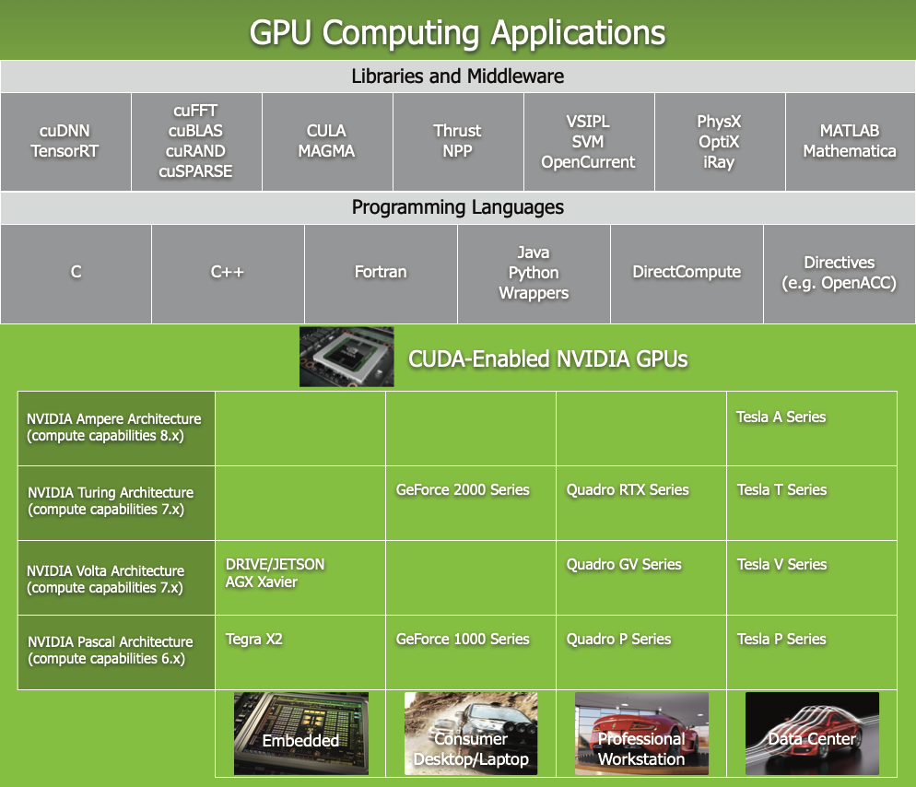

Slide 8
Programming model

Slide 9
Programming model
Problem
Sub-Problem
Sub-Problem
Sub-Problem
Sub-Problem
Sub-Problem
Sub-Problem
Sub-Problem
Sub-Problem
Sub-Problem
Sub-Problem
Sub-Problem
Sub-Problem
Sub-Problem
Sub-Problem
Sub-Problem
Sub-Problem
Sub-Problem
Sub-Problem
Sub-Problem
Sub-Problem
Sub-Problem
Sub-Problem
Sub-Problem
Sub-Problem
Multithreaded Cuda Programm
Block 0
Block 1
Block 2
Block 3
Block 4
Block 5
Block 6
Block 7
Block 8
Block 9
Block 10
Block 11
Block 12
Block 13
Block 14
Block 15
Block 16
Block 17
Block 18
Block 19
Block 20
Block 21
GPU with 2 SMs
GPU with 4 SMs
SM 0
SM 1
SM 0
SM 1
SM 2
SM 3
Block 1
Block 2
Block 1
Block 2
Block 3
Block 4
Block 3
Block 4
Block 5
Block 6
Block 7
Block 8
Block 5
Block 6
Block 9
Block 10
Block 11
Block 12

Slide 10
Implementation

Slide 11


Kernels
Kernel represents smallest possible sub-Problem
C++ function
Gets executed N times by N different Cuda threads
Defined by the __global__ declaration specifier:
Execution configuration syntax:

Slide 12

Thread hierarchy
Each thread gets a unique threadID
    accessed by build-in variables:
int I = threadIdx.x
ThreadID is a 3 component Vector
    Thread identification using up to 3-dimensional indices
    Threads are arranged in blocks of threads
        Thread Blocks

Slide 13
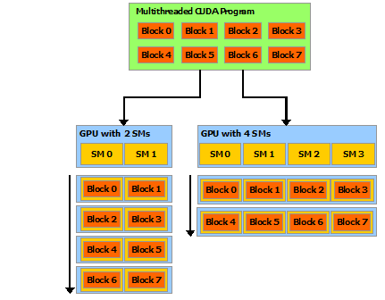
Thread hierarchy
Number of Threads per Block is set by user
Calculate blockSize and number of Blocks!

Slide 14
Thread hierarchy
RTX 2070super:
40 Streaming Multiprocessors (Sms)
2560 Cuda Cores / Shading Units
BlockSize = CudaCores / Sms
blockSize = 2560 / 40 = 64
NumberOfBlocks = (N + blockSize – 1) / blockSize
N = total number of Threads needed to solve the Problem
numBlocks = (10000 + 64 – 1) / 64 ≈ 158

Slide 15
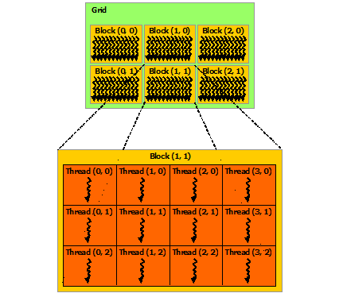
Thread hierarchy
Blocks get organized in a Grid
Configuration specified by the Execution Configuration Syntax

Slide 16
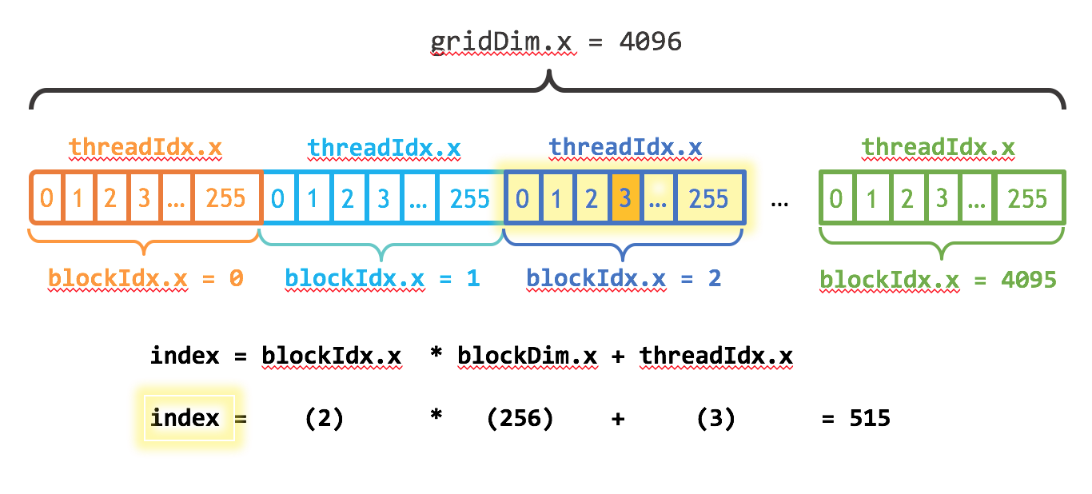
Thread hierarchy
BlockDim = number of threads in current block
BlockIdx = ID of current block
GridDim = number of threads in currend Grid

Slide 17
Heterogeneous Programming
Cuda Programming Model assumes:
    Cuda Threads get executed on a physically seperate device
    Both devices maintain their own seperate memory Spaces
        Host memory & device memory
Memory needs to be allocated on both Devices
Data needs to be transferred between both devices

Slide 18
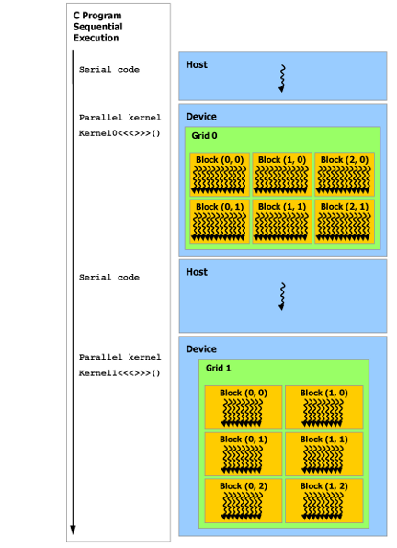
Heterogeneous Programming

Slide 19
Usage

Slide 20
Installation
Download & Install the CUDA TOOLKIT
https://developer.nvidia.com/cuda-downloads
Prerequirements:
    Cuda Capable GPU: https://developer.nvidia.com/cuda-gpus
    You can code and compile Cuda Kernels without a Nvidia GPU
    Cuda is also available in cloud services:
      Amazon AWS
      Microsoft Azure
      ...

Slide 21
IDEs & Tools
IDEs:
    Nsight Studio (eclipse based)
    Clion (doesn’t include debugging functionality)
    Visual Studio
Tools:
  Nvidia Visual Profiler: Performance analysis for Cuda Kernels

Slide 22
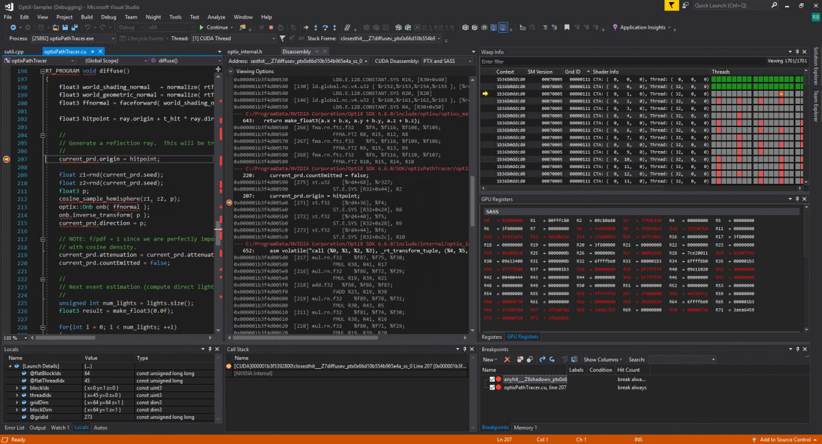
IDEs & Tools

Slide 23
Demo

Slide 24
More Info

Slide 25
More Info
Nvidia Cuda Zone:https://developer.nvidia.com/cuda-zone
Nvidia developer Programm
Programming Guide:https://docs.nvidia.com/cuda/cuda-c-programming-guide/index.html

