Slide 1
E-commerce Sales & Profit Dashboard
End-to-End Data Analysis using Python (Jupyter Notebook) and Power BI
Dataset: Superstore

Slide 2
Project Objective
Analyze sales and profit performance of an e-commerce business
  Identify monthly trends and seasonality
  Evaluate category, sub-category, and regional performance
  Build an interactive dashboard for business insights

Slide 3
Tools & Technologies
Python (Jupyter Notebook) – data cleaning and analysis
  Pandas & Matplotlib – calculations and visualizations
  Power BI – dashboard creation and DAX measures
  Python Script integration for advanced analytics

Slide 4
Key Business Metrics
Total Sales: 2.30M
  Total Profit: 286.40K
  Total Orders: 5K
  Profit Margin: 12.47%

Slide 5
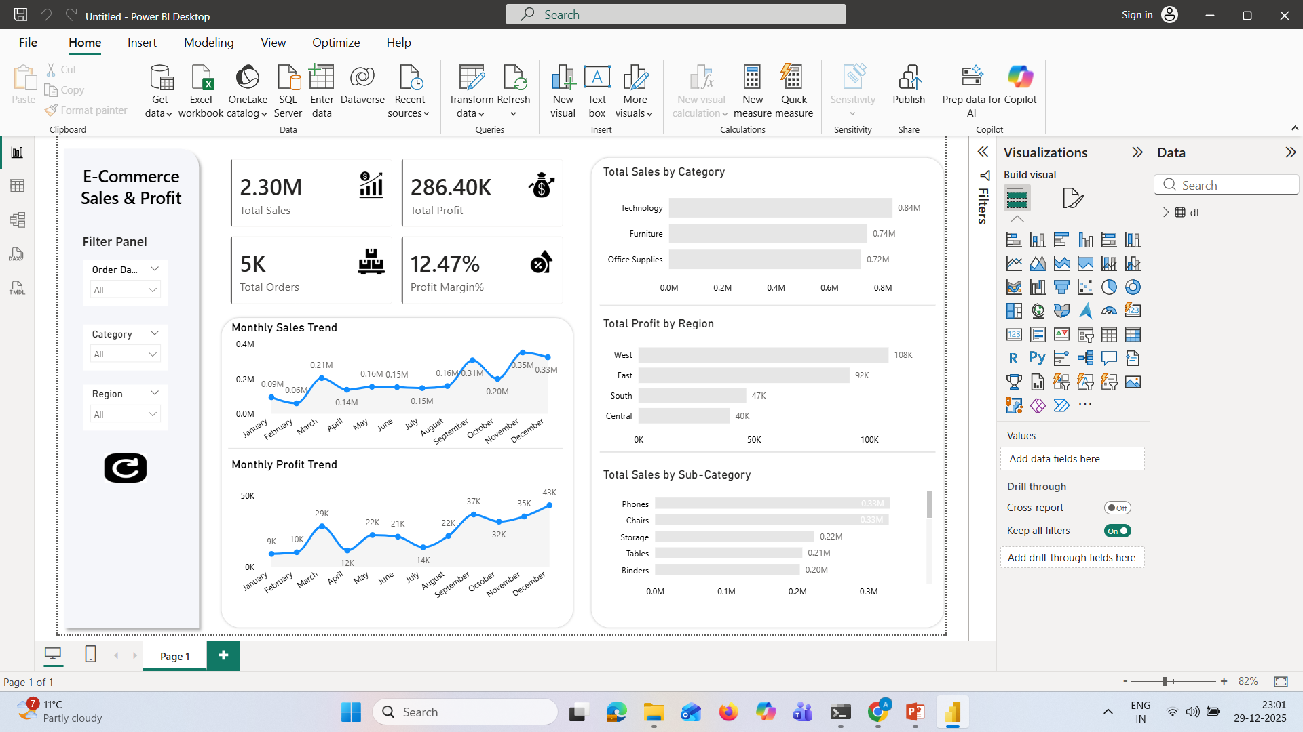
Power BI Dashboard Overview

Slide 6
Key Insights
Sales peak during November and December
  Technology category generates the highest sales
  West region is the most profitable
  Consumer segment contributes maximum revenue

Slide 7
Conclusion
Dashboard provides a clear view of sales and profitability
  Supports data-driven business decisions
  Scalable approach for real-world e-commerce datasets

