Slide 1
Rat STN cell reduction
Reduction of the Gillies (2006) model according to reduction method Marasco et al. 2012/2013

Slide 2
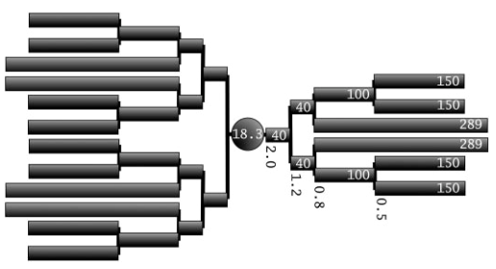
Indices
8
6
4
9
7
2
4
6
10
5
2
12
0
7
1
5
13
11
1
18
16
8
14
10
19
3
3
11
17
9
20
15
22
23
21
tree_index = 0
tree_index = 1

Slide 3
Lengths & nseg
6
4
2
0
40
80
180
220
330
369
6
12
2
4
6
12
2
2
6
1
6
2
12
6
4
2
6
4
12
2
6
6
2
2
6
12
4
12
2
6
6
4
Total nseg = 189

Slide 4
Diameter
0.49
0.77
1.23
0.49
0.77
1.95
0.77
0.49
0.77
1.23
0
0.49
3.1
1.95
0.77
0.77
diameter scale factors
Note: diameters are symmetrical (3 same trees)

Slide 5
Strahler numbers
3
2
1
2
4
1
3
1
1
1
3
2
1
2

Slide 6
L/lambda(f=100)
0.801
1.735
0.306
0.149
1.735
1.737
0.024
1.737
1.735
1.735

