Slide 1
Rat STN cell reduction
Reduction of the Gillies (2006) model according to reduction method Marasco et al. 2012/2013

Slide 2
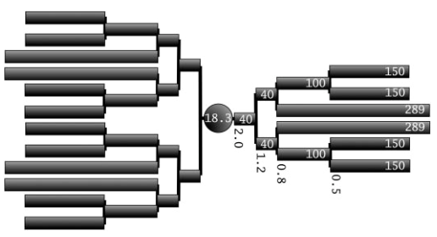
3
2
1
2
4
1
3
1
1
1
3
2
1
2

