Slide 1
CSIS10C C Introduction
Fundamentals of
Modern Software Development

Slide 2
Agenda
The Arduino
Software Development
Tool Chains
Command Line
Tools
  git
  gcc
  make
  avrdude
  environments

Slide 3
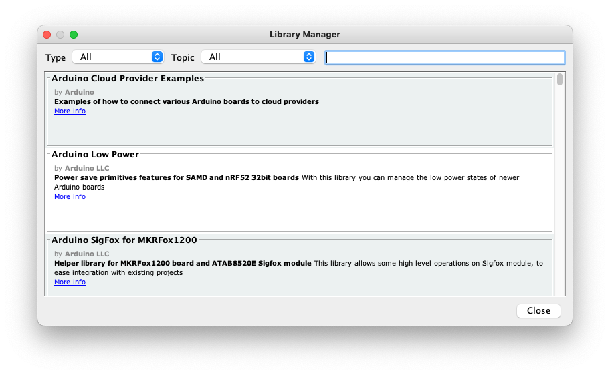
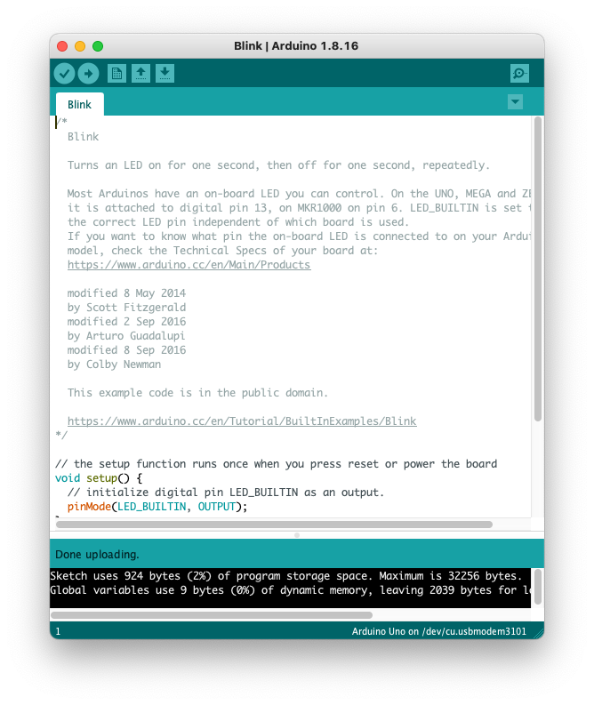
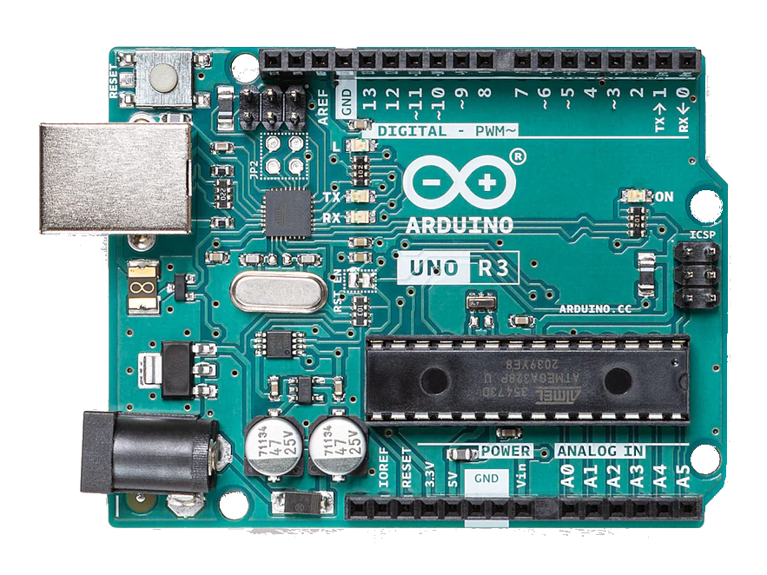
Three Components of the Arduino
Hardware – Arduino Uno
Application – Arduino IDE
Language/Library – C++/ Arduino Libraries

Slide 4
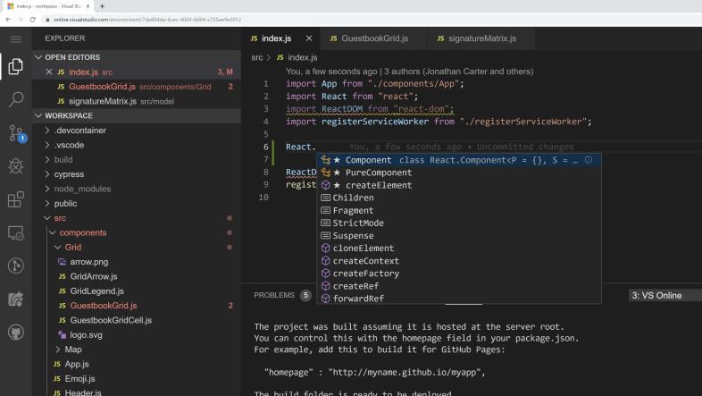
Software Development
Modern software development => Integrated Development Environment (IDE)
Values of an IDE:
  Automation
  Abstraction
  All-in-One
Issues of an IDE
  Single point of failure
  Hides critical details
  Complex tool
Arduino is a good IDE for learning C++ and embedded microcontrollers…same issues of an IDE
We’ll use same tools, however…via the command line to better understand the process

Slide 5
Software Development
Embedded microcontroller software development tasks:
  Editing
  Compiling
  Linking
  Create an executable
  Upload the executable
The Arduino IDE provides all these tasks
We’ll break down the tasks and execute them separately to gain a better understanding of what is required

Slide 6
Tool Chains
What do we call the set of individual tools?
A tool chain
A tool chain is a set of tools, usually executed on the command line in order to create an application
Tool chains are based on a specific language, operating environment and application
Tools in chain…compilers, linkers, debuggers, programmers

Slide 7
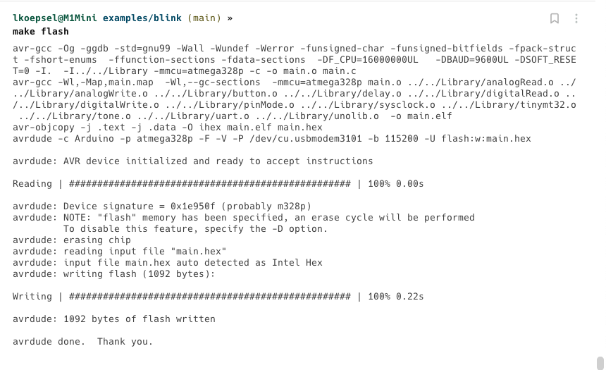
Using the C Tool Chain

Slide 8
Command Line
Command line is the simplest interface and the one closest to the fundamentals of the operating system
As such, the most common method for implementing a tool chain and it is easy to automate
Command line applications:
  Windows – cmd.exe, Windows Terminal,
  Linux – terminator, konsole, tilda, many programs
  macOS – Terminal, iTerm, warp
Common commands
  pwd - present working directory
  ls – list files in directory
  cd – change directory
  rm – rm file or directory

Slide 9
Tools
  git – software version control
  gcc – compiler, linker and loader
  make – automation tool
  avrdude – AVR upload tool (programmer)
  environments – a term for your specific operating system, hardware and tool set

Slide 10
git – software version control
git
  Provides the ability to ”roll-back” changes if a problem is found
  Allows many people to work on the same code then merge each other’s work
  An industry standard for software distribution
Installation
  sudo apt install git (Linux, WSL)
  brew install git (macOS)
  git-version-xx.exe (Windows) https://gitforwindows.org
Primary commands
  git init – initialize a directory to be tracked by git
  git status – show changed and uncommitted files
  git add –A – stage all changed and uncommitted files
  git commit –m “text” – commit all files and update the tracking number

Slide 11
gcc – compiler, linker and loader
gcc
  The gnu compiler, works on many languages, C, C++… https://gcc.gnu.org
  Well known and well maintained free set of compiler tools
  The version specific to the Uno’s ATmega328P chip is called avr-gcc
Installation
  sudo apt install avr-gcc (Linux, WSL)
  brew install avr-gcc (macOS)
  Download latest https://blog.zakkemble.net/avr-gcc-builds/
Primary commands (compile, link and load)
  avr-gcc -Os -DF_CPU=16000000UL -mmcu=atmega328p -c -o main.o main.c
  avr-gcc -mmcu=atmega328p main.o -o main
  avr-objcopy -O ihex -R .eeprom main main.hex

Slide 12
make – automation tool
make
  The compile/link/load commands can be complex
  make allows the commands to be in a file and executed based on parameters
  The first step in automating the tool chain
Installation
  sudo apt install make (Linux, WSL)
  brew install make (macOS)
  Download latest https://blog.zakkemble.net/avr-gcc-builds/
Primary commands
  make – compile, link and load (CLL) the file into a hex file for upload to Uno
  make flash – upload hex file to Uno, recompile/link/load if files have changed
  make clean – delete all non-source files for a complete new CLL

Slide 13
avrdude – AVR upload tool
avrdude
  Standard method of uploading files to AVR microcontrollers
  Used by Arduino
  Seeing a resurgence in development
Installation
  sudo apt install avrdude (Linux, WSL)
  brew install avrdude (macOS)
  Download latest https://blog.zakkemble.net/avr-gcc-builds/
Primary command
  avrdude -F -V -c arduino -p ATMEGA328P -P /dev/ttyACM0 -b 115200 -U flash:w:main.hex
  Requires specific environment to be setup based on users operating system, hardware and microcontroller board (env.make)

Slide 14
environments – your specific OS, hardware and tool set
Similar function to Arduino -> Tools -> Port and -> Board
env.make:
# Arduino UNO and compatible boards
MCU = atmega328p
SERIAL = /dev/cu.usbserial-01D5BFFC
F_CPU = 16000000UL
BAUD = 9600UL
SOFT_RESET = 0
LIBDIR = ../../Library
PROGRAMMER_TYPE = Arduino
PROGRAMMER_ARGS = -F -V -P $(SERIAL) -b 115200
Typical SERIAL definitions:
  Linux: /dev/ttyACM0, /dev/ttyUSB
  macOS: /dev/usbserial-01D5BFFC
  Windows: COM3, COM4

Slide 15
C Reference Material
Book: “The C Programming Language” Kernighan and Ritchie
Second Edition
  The original C programming book
  Still very, very good for learning C
AVR-libc contains the C Library Reference material
  https://avr-libc.nongnu.org
  https://avr-libc.nongnu.org/user-manual/index.html
C Tutorial Websites
  https://www.tutorialspoint.com/cprogramming/index.htm
  https://www.guru99.com/c-programming-tutorial.html

Slide 16
Next Steps
Install Arduino IDE and test your system with your Uno (and get your serial port number!)
Install git, make, and the AVR tool chain per:
https://www.wellys.com/posts/avr_c_gettingstarted/
For your OS, work the exercises of:
  Using gcc and avrdude to upload blink to Uno
  Using make to automate the uploading
Use git to clone the Lab repository on your system
  https://github.com/lkoepsel/Labs_10C_Class

