Slide 1
CSIS10C
Lecture 3 – Basic Electronics

Slide 2
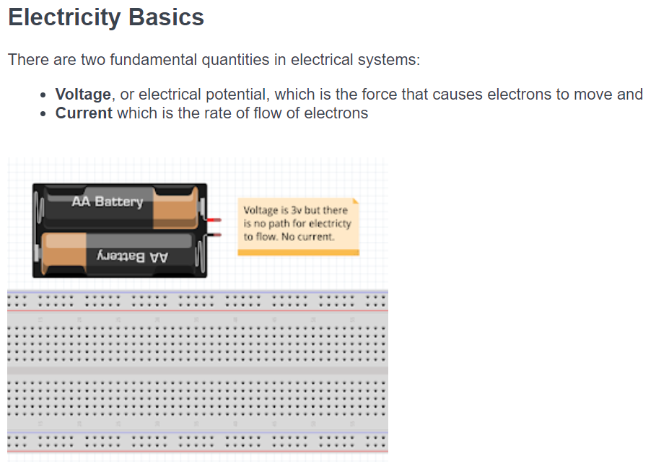


Slide 3
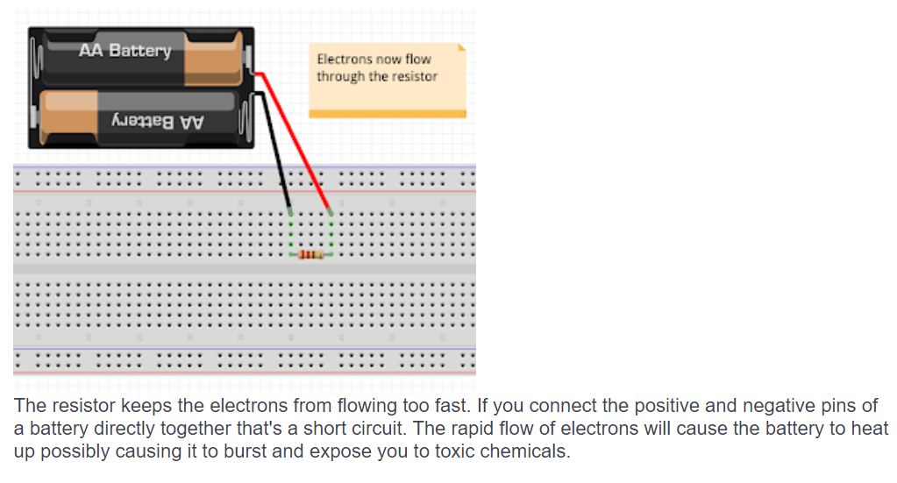
Electrons can flow through air but it takes tremendous voltage (or high voltage) to do that. Electrons flow easily through wire. Giving electrons a path allows them to flow.

Slide 4
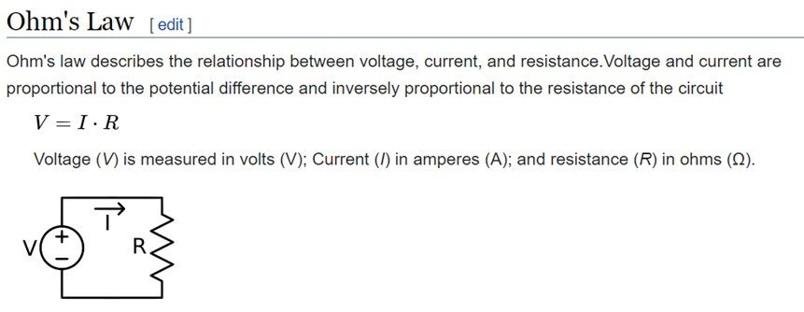

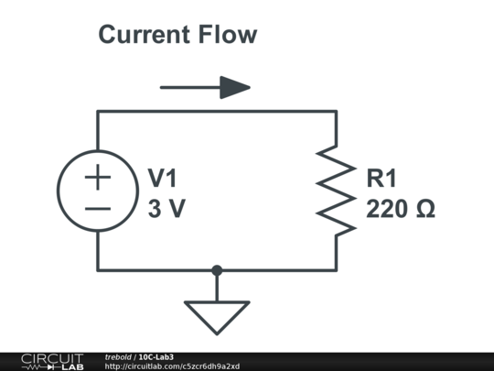
In circuit at right
Voltage = Current Flow x Resistance
3V = Current Flow x 220 Ohms
Current Flow = 3V/ 220 Ohms
Current Flow = .0136 Amps
(or 13.6 milliAmps)

Slide 5
Schematic Symbols
Schematics are drawings that make it easy to show someone else a circuit without having to take a picture of a breadboard. In a schematic each circuit element has a symbol that's usually easy to draw by hand.
Voltage
source
Resistor
Ground (0V) or Reference Node

Slide 6
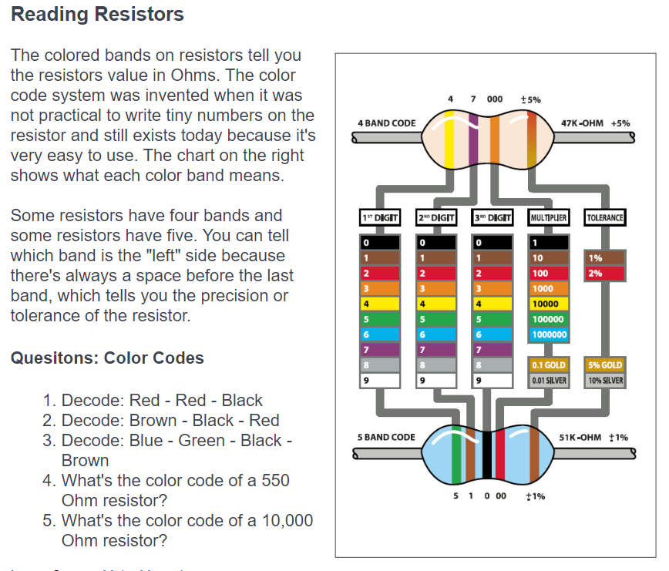

Slide 7
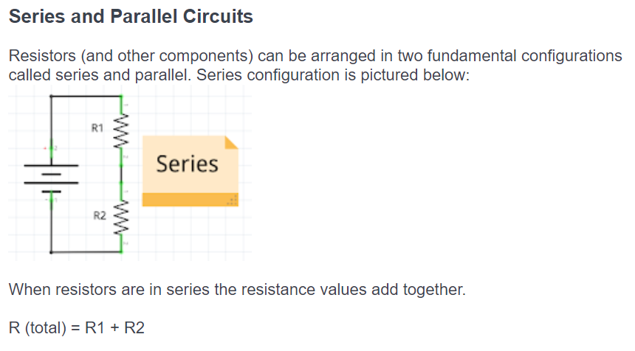

Slide 8
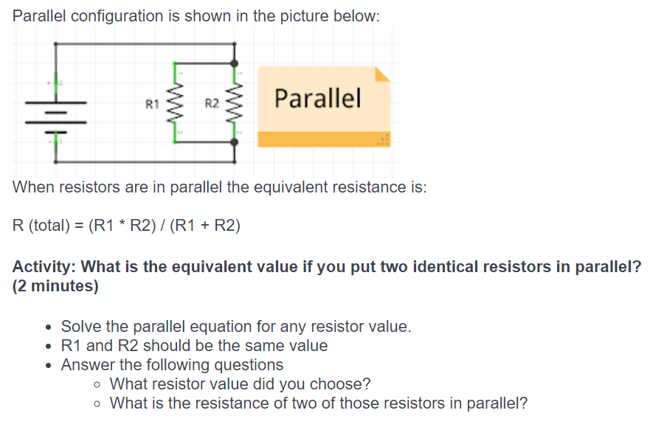

Slide 9
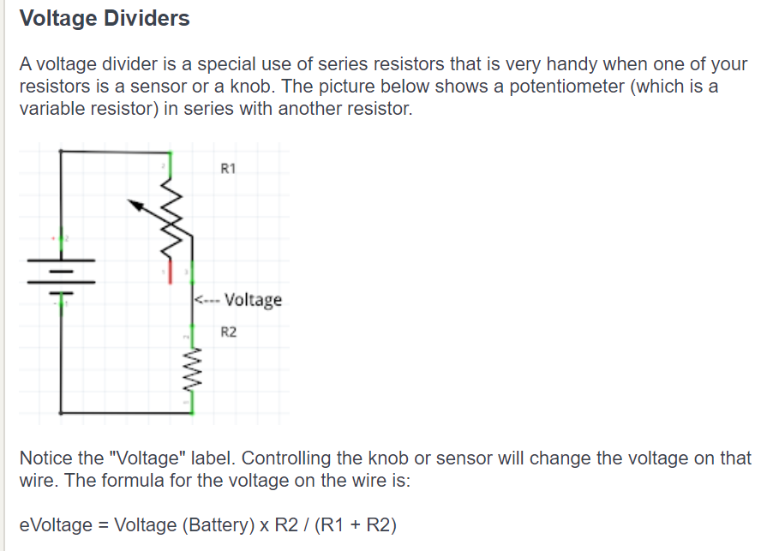

Slide 10
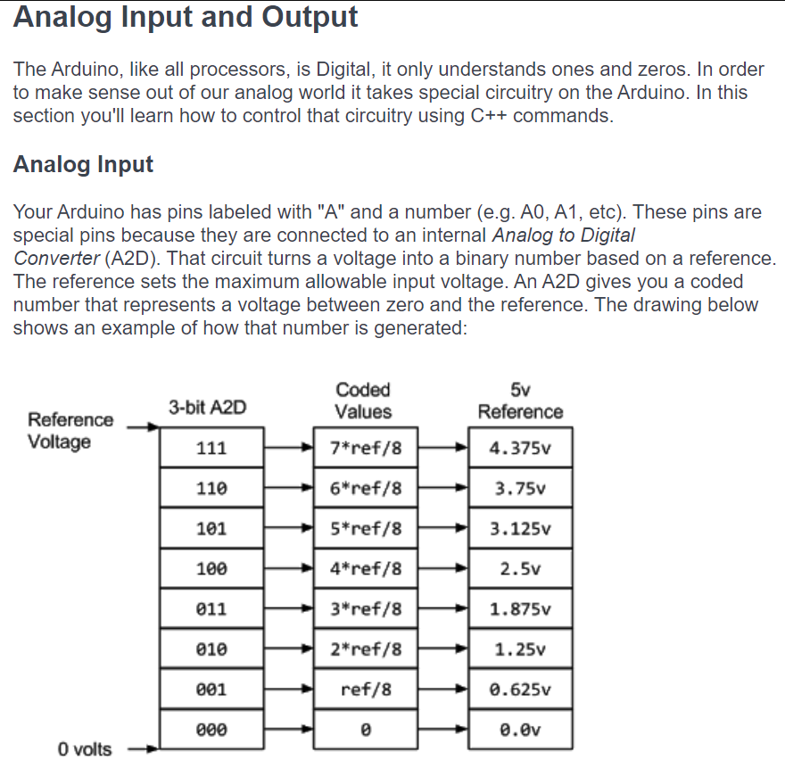

Slide 11
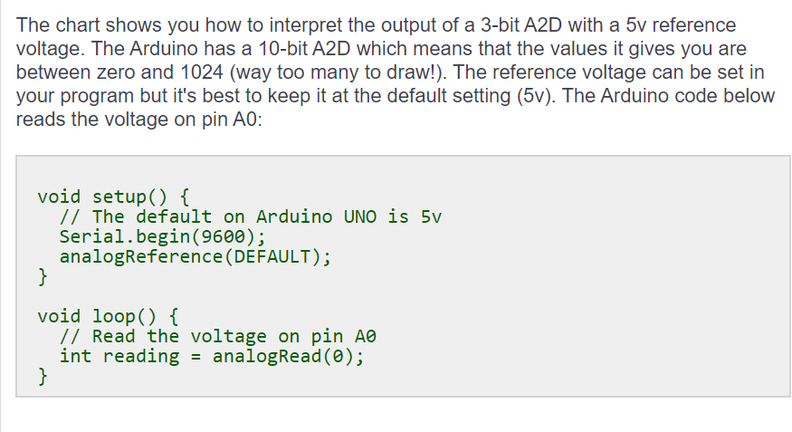
If we print out reading we should see a number about 675.

Slide 12
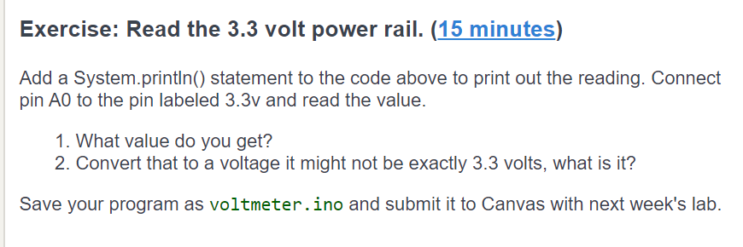
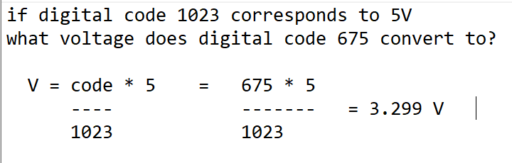

Slide 13
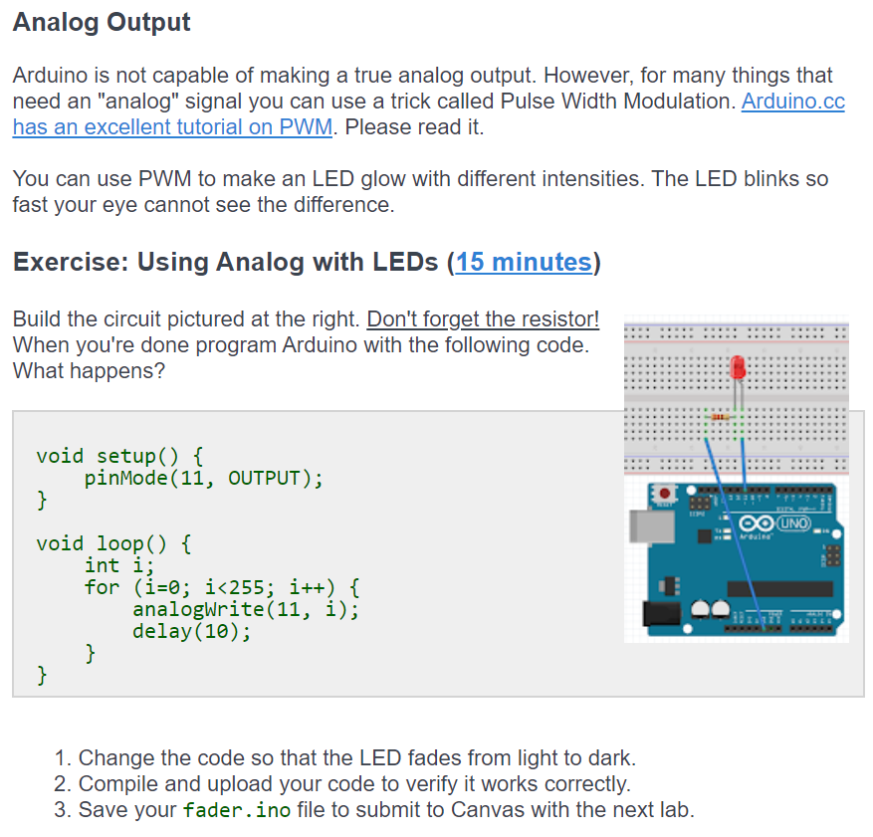

Slide 14
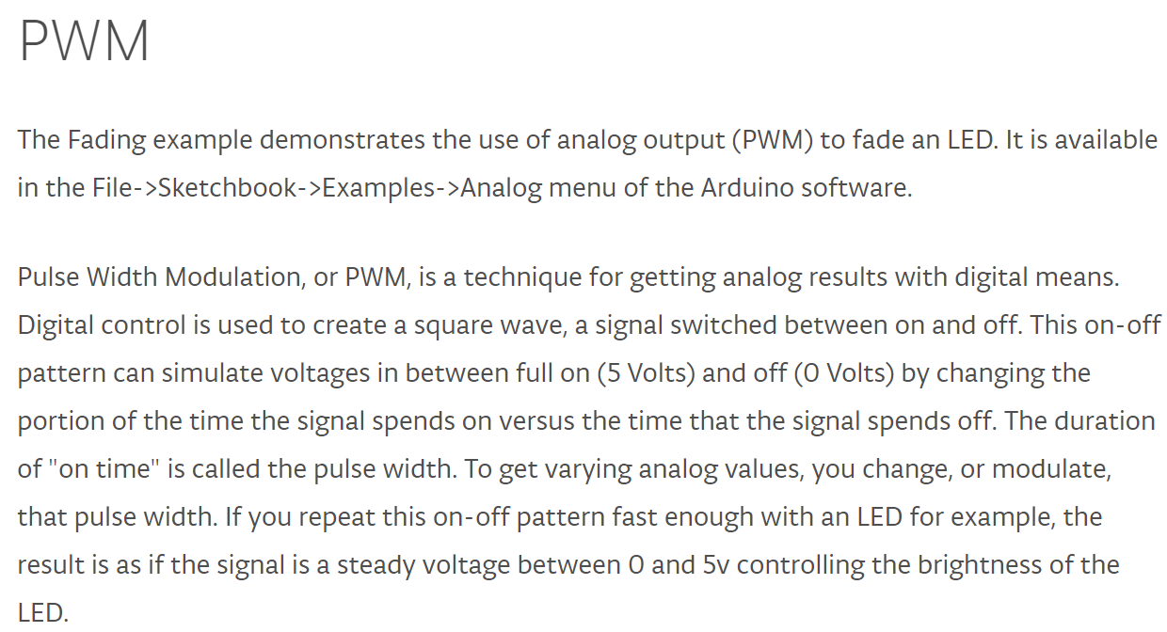
How Pulse Width Modulation works

Slide 15
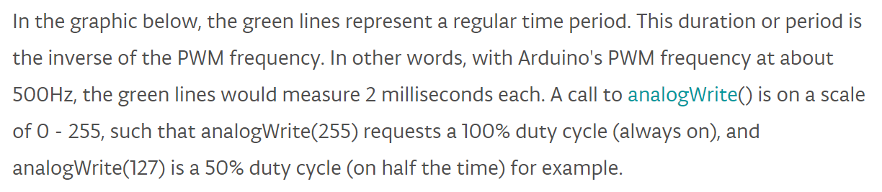
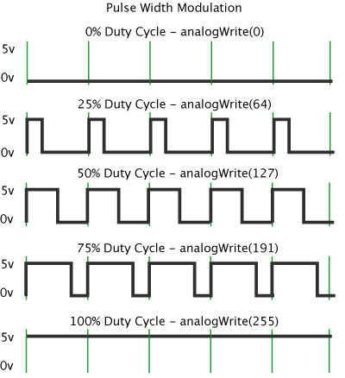
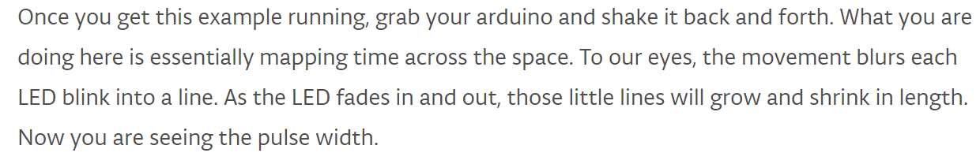

Slide 17
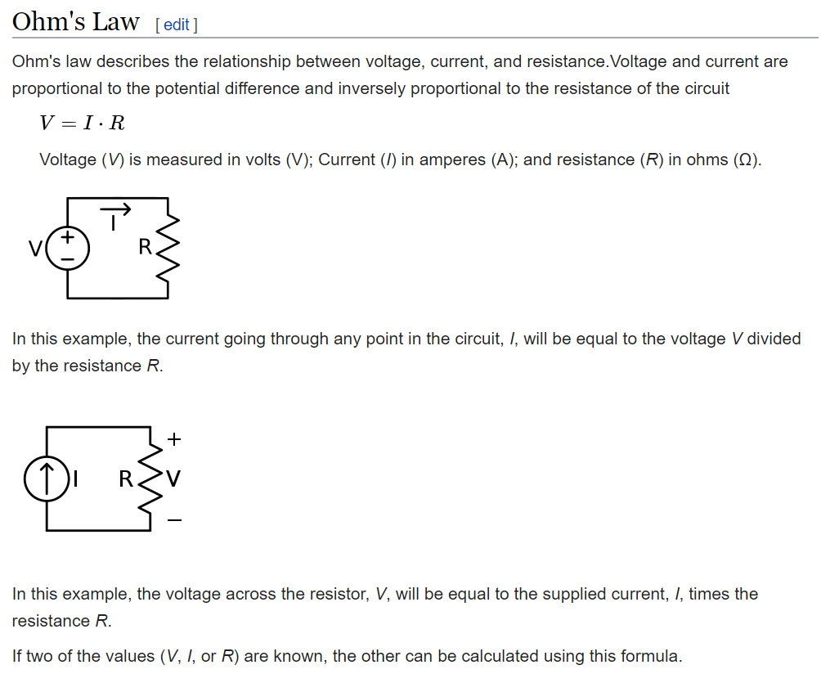

Slide 18
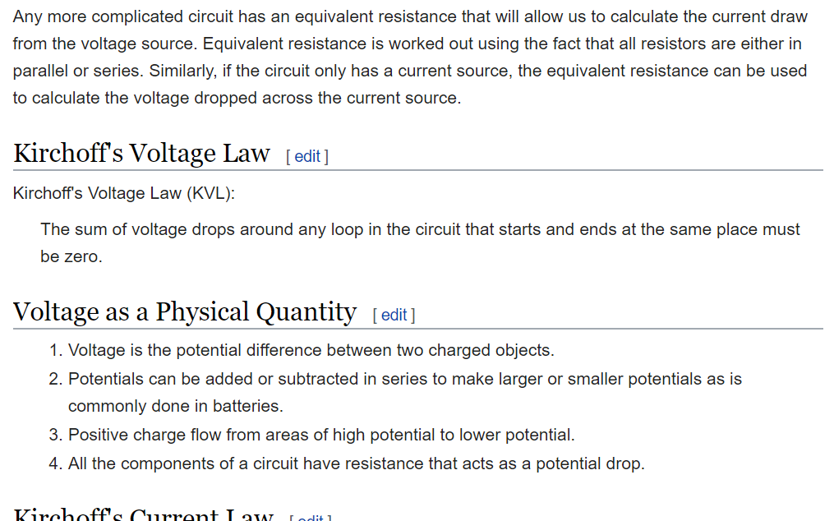

Slide 19
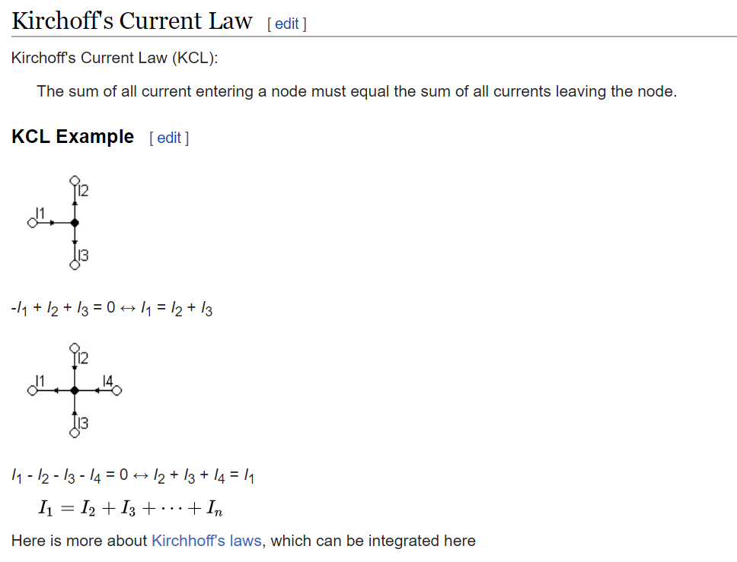

Slide 20
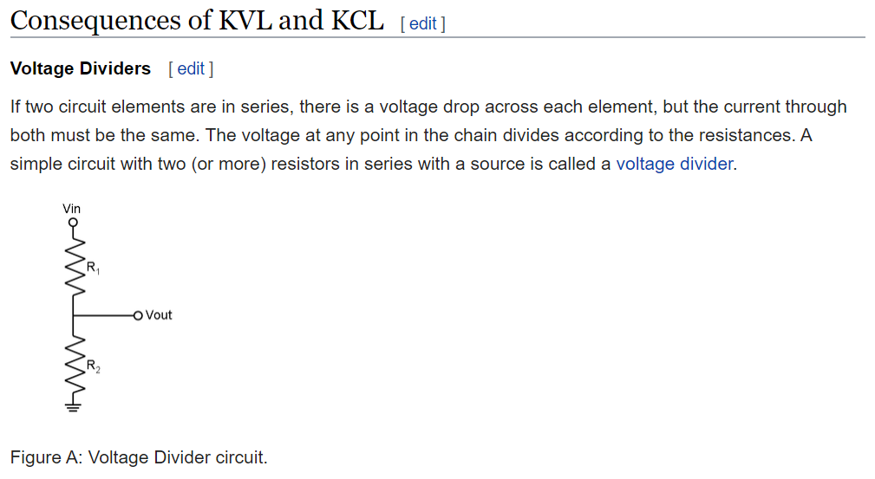

Slide 21
