Slide 1
CSIS10C Lab 2b
Arduino Uno,
LEDs, Pushbuttons,
and Finite State Machines

Slide 2
Agenda
Part A
Serial I/O and LEDs
Debugging with Serial I/O
Setting up a State Machine based on Serial I/O
Part B
Programming a Finite State Machine
Reading a Pushbutton
  Using pushbuttons to change flashing rate
  Counting button presses
Challenge -- Programming Arduino Finite State Machine
Concepts
Finite State Machines
Serial Input/Output
Digital Output: LEDs
Digital Input: Pushbuttons
Techniques
Debugging
Code blocks
Incremental changes
Editing

Slide 3
Lab 2B Part 1
In this first part of Lab 2B, we will
  Learn about finite state machines
  Learn how to use the Serial Monitor
  Determine how to use LEDs in your projects
  Use the serial port to debug our program
  Setup a finite state machine

Slide 4
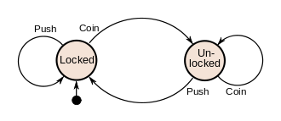
Finite State Machines
A deep topic in computer architectures, robotics
You can use a special variable (called a “state” variable)
  Keep track of which state your program is in
  Each state offers different input / output behavior
  Pressing a button changes the state of the machine.
  See https://en.wikipedia.org/wiki/Finite-state_machine
Example

Slide 5
Example -- Combination lock FSM
Input = 1
State 0
√
Input = 0
State 1
State 2
Input = 1
State 3
Input = 1
State 4
Input = 0
State 5
Input = 0
√
√
√
√
√
Input = 1
Input = 0
Input = 0
Input = 1
Input = 0
State 6
Input = 1
Success – Unlocked!

Slide 6
Example Coding a FSM: Psuedocode
Get input
If state 0
if input = 0
perform state 0, input 0 activities
if input = 1
perform state 0, input 1 activities
clear input
If state 1
if input = 0
perform state 1, input 0 activities
if input = 1
perform state 1, input 1 activities
clear input...

Slide 7
Introduction to Serial I/O
In computing input/output or I/O (or informally IO) is communication between a computer and other devices
Serial I/O is how we get Arduino to communicate with our PC
All Arduino boards have at least one serial port
A serial port is a connector by which a device that sends data one bit at a time may be connected to a computer
One way to transmit data through the serial port is with a USB cable
Like data is stored in a computer using binary numbers, data is transmitted in binary

Slide 8
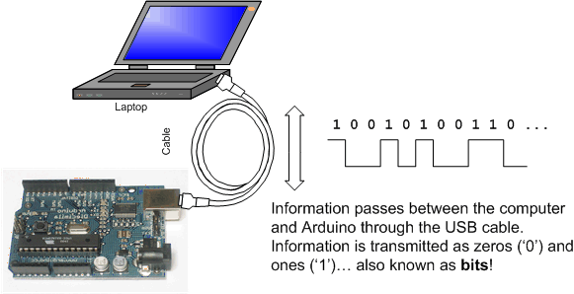
Serial Data Transmission between an Arduino and PC

Slide 9
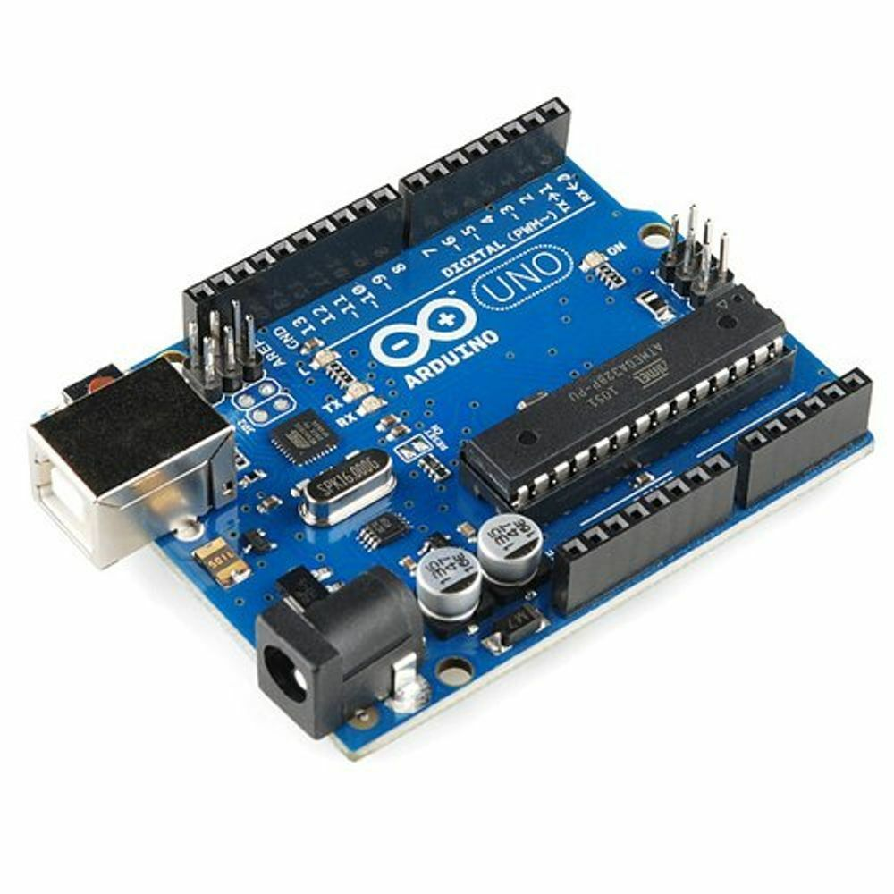
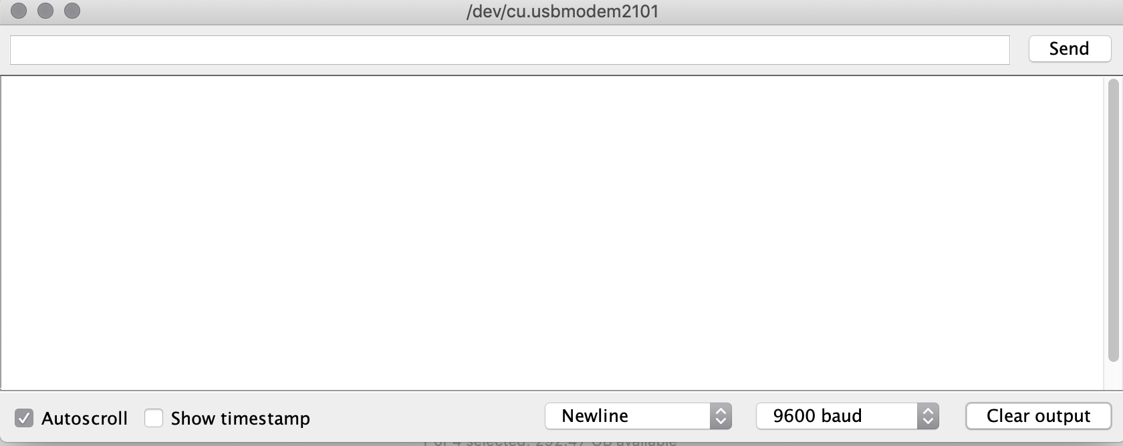
Serial Monitor
A serial program allows our computer to display messages sent by the Arduino board
Windows: PuTTY, Arduino Serial
Linux: minicom, serial, Arduino Serial
macOS: minicom, Serial, Arduino Serial
Arduino Serial

Slide 10
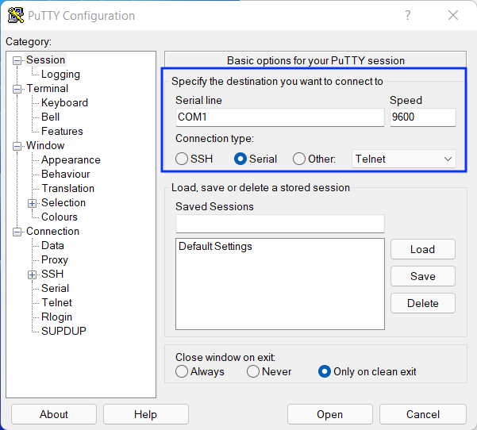
Serial Monitor Setup
The basis of communication with the Arduino Uno is:
9600 baud
8 bits, no parity, 1 stop bit
Specify serial port…COM3, /dev/tty… etc
Here are examples of how to set common serial programs
minicom -b 9600 -D /dev/cu.usbmodem3101
Arduino Serial 9600 baud, No newline

Slide 11
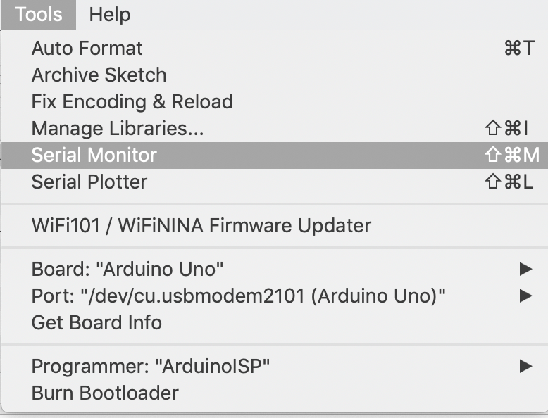
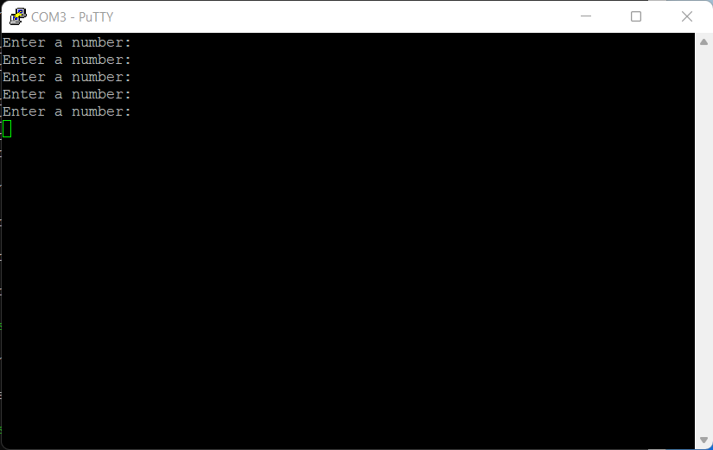
Serial I/O Setup
To get started, we open the serial monitor by:
  pressing the special button or using the menus on the Arduino
  Or
  Running minicom in a terminal window, macOS and Linux
  Or
  Running PuTTY or Serial in Windows or macOS
Arduino IDE
Windows PuTTY

Slide 12
AVR-libC: The C Library for the AVR family
The Arduino Uno uses an AVR ATmega328P microcontroller
The AVR Libc package provides a subset of the standard C library for AVR microcontrollers. In addition, the library provides the basic startup code needed by most applications.
http://www.nongnu.org/avr-libc/
We’ll incorporate AVR Libc in functions starting with serial I/O
This allows us to use Standard C functions such as puts(), getchar() and fprint() instead of the Arduino class Serial.print()

Slide 13
AVR Libc: stdio.h standard IO faculties http://www.nongnu.org/avr-libc/user-manual/group__avr__stdio.html
To use the Standard C functions, you must have the following 3 elements (in bold) in your code:
(near the top of the file)
#include <stdio.h>
  Provides the Standard C I/O functions
#include "uart.h”
  Identifies the UART polling routines as streams, stdin and stdout
(in main())
init_serial;
  This sets up the code to use the Uno serial hardware in a polling fashion (slow, 9600 baud)
  init_serial is a macro so () are not used at the end
Review serialio in the examples folder as a simple implementation

Slide 14
Standard C I/O functions http://www.nongnu.org/avr-libc/user-manual/group__avr__stdio.html
getchar() - function reads a character from stdin. It returns the character, or EOF in case end-of-file was encountered or an error occurred.
  EX: input = getchar();
printf(string, variables) - outputs values to stdout under control of a format string passed in fmt (see vprintf for all formatting options)
  EX: printf(“This is your input %d\n”, input);
puts(string) - write the string to stdout.
  EX: puts("Serial I/O Test");

Slide 15
Example Code: serialio
#include <stdio.h>
#include "uart.h"
int main(void) {
init_serial;
char input;
puts("Enter a number");
while((input = getchar())!= EOF) {
printf("You entered %c\n", input);
}
return 0;
}
Adapted from K&R The C Programming Language V3 page 17

Slide 16
First Exercise: 1_serial
Objective(s):
  Demonstrate the ability to compile/link/load a program on the Uno
  Demonstrate the ability to use a serial monitor with the Uno
Steps
Go to folder 2B and open folder 1_serial
The program main.c is already complete and ready to use
Compile and upload it to the Arduino (make flash)
Open your serial program (Arduino Serial Monitor, PuTTY, minicom)
Enter numbers and confirm they are printed back out

Slide 17
Technique: Debugging using the Serial Port
Many times, we’re not sure of why a program isn’t working correctly
One way to debug the program is to insert print statements which show where the program is and possible variable values
This along with hand walking your code allows you to determine where the program is failing
Debugging with print statements is the first step to good debugging technique

Slide 18
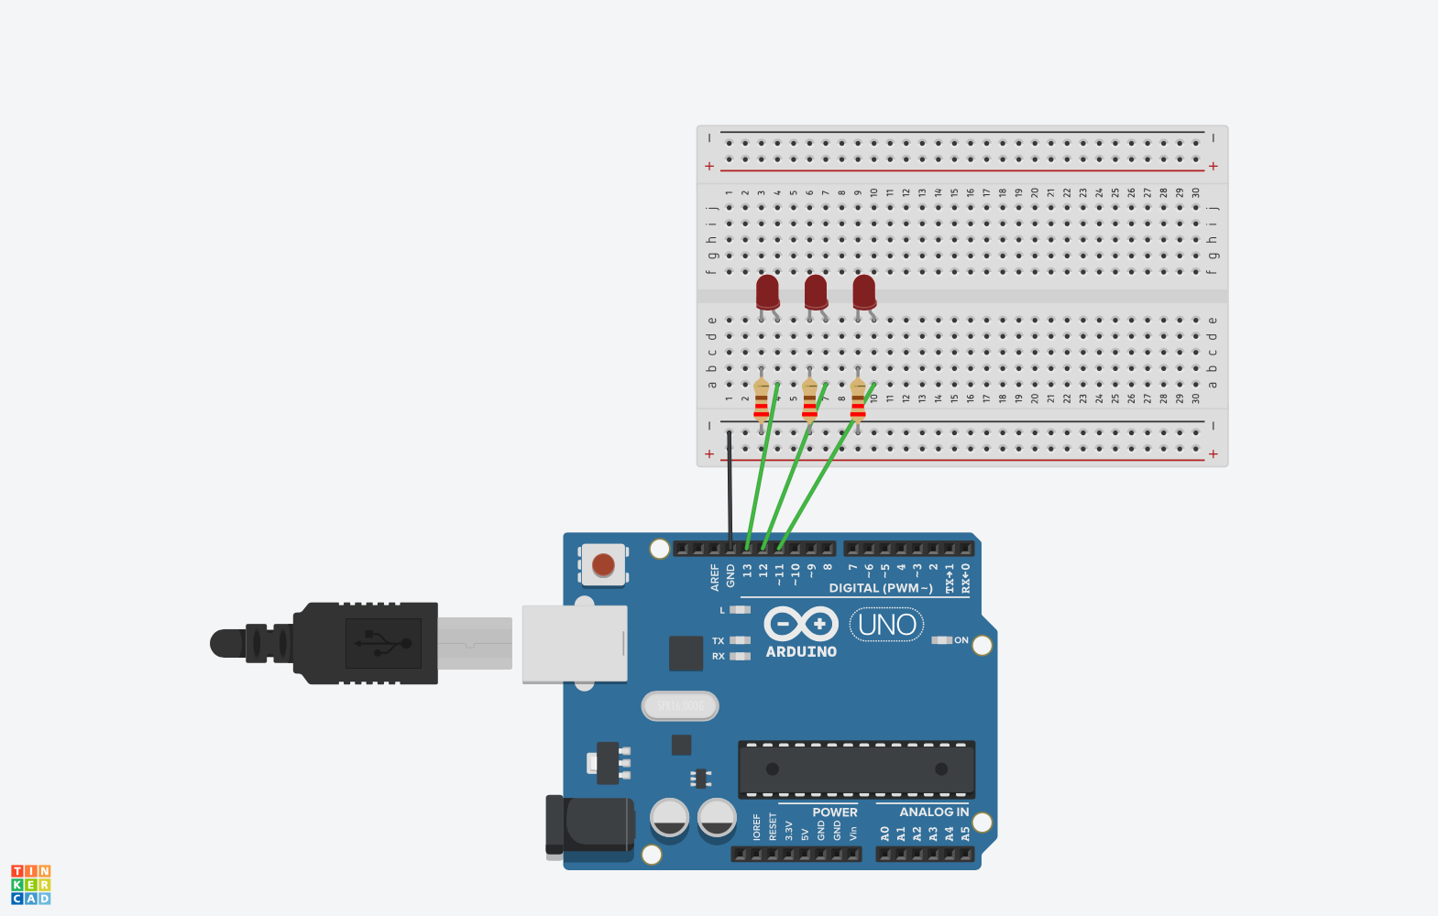
Wire up the Arduino with 3 LEDs
(When you finish today’s lab, DON’T dismantle your circuit!)
Lab 2B – Exercise 2
Long wires
If you have issues, review https://sites.google.com/a/cabrillo.edu/cs-11m/schedule/memory Exercise 1

Slide 19
Technique: Code Blocks
Develop your code in blocks that have specific tasks (turn on a set of LEDs, input a number via the serial port etc)
Title the block with a comment, so you know exactly what it does:
  // Display binary 7 on 3 LEDs
Then copy and paste the blocks as appropriate
You might need to update certain values, such as changing a test from a 0 to a 1 or change the display of a number from 3 to a 4
We will begin to turn code blocks into functions in the next few weeks
In the meantime, there will be a lot of code repetition, however if the block is properly debugged prior to copying, it will reduce the amount of work writing your code

Slide 20
Numbers in C
Using the Serial monitor and getchar(), provides a number in ASCII format and it will need to be changed to a decimal number.
ASCII is a standard format for text. Notice that ASCII numbers are sequential. https://www.ascii-code.com
To convert an ASCII number to decimal:
int number = getchar() – ‘0’;
Binary number use only 0 and 1 to represent a number
https://www.exploringbinary.com/decimal-binary-conversion-table/
For our purposes:
Decimal | 0 | 1 | 2 | 3 | 4 | 5 | 6 | 7
Binary | 000 | 001 | 010 | 011 | 100 | 101 | 110 | 111

Slide 21
Second Exercise: 2_binary
Objective(s):
  Demonstrate the ability to input data to the Uno
  Demonstrate the ability to program decision-making
  Demonstrate the ability to copy/edit code blocks to decrease development time
Steps
Open folder 2_binary
The program main.c is partially complete. The 3 LEDs need to show the correct binary display for each number, 0-7 entered.
Numbers 0 and 1 are correct, following the existing code, and add additional blocks for 2-7.
Compile and upload it to the Arduino (make flash)
Open your serial program (Arduino Serial Monitor, PuTTY, minicom)
You should be able to enter a number 0-7 on the keyboard and the binary equivalent will be displayed on the LEDs.

Slide 22
Thoughts on Coding
Don’t try to simplify the code too soon. Its best to write the code as clear as possible, then if, desired, simplify the code.
For example: this state machine, there are two decisions:
  What state?
  if state == 0 {
  do something }
  if state == 1 {
  do something }
  What is the next input?
  if num == 0 {
  do something }
  else if num == 1 {
  do something }
3. Put it together:
  if state == 0 {
  if num == 0 {
  do something }
  if num == 1 {
  do something }
  }
  if state == 1 {…
  If state == 2 {…

Slide 23
Third Exercise: 3_serial_state
Make a Finite State Machine
Objective(s):
  Demonstrate the ability to program a finite state machine
Steps
Open folder 3_serial_state
Use the pseudo-code FSM example to create a C version of the FSM lock
The program main.c is partially complete. It contains sufficient code to help you understand how to convert the pseudocode into C.
Compile and upload it to the Arduino (make flash)
Open your serial program (Arduino Serial Monitor, PuTTY, minicom)
You should be able to enter a number 0 or 1 and move through the finite state machine.

Slide 24
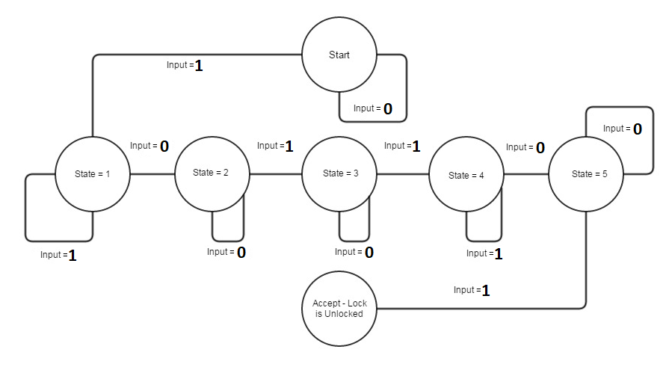
State Definitions
Exercise 3 – continued…
Now test your state machine – verify the state changes correctly based on the console input. Note that you will need to change your code in the “if” statements to match the inputs above.

Slide 25
Lab 2B Part 2
In this second part of Lab 2B we will
  Experiment with pushbutton switches
  Add switches to change the state of our state machine
  Notice how pushbutton presses are sometimes ignored
  Improve performance using hardware interrupts

Slide 26
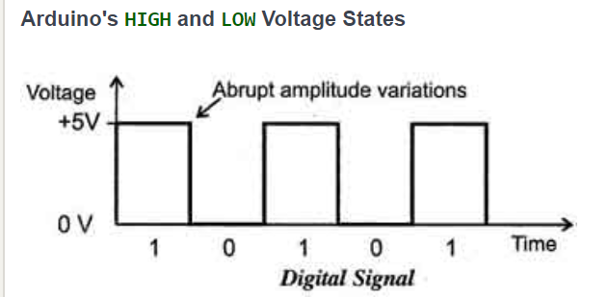
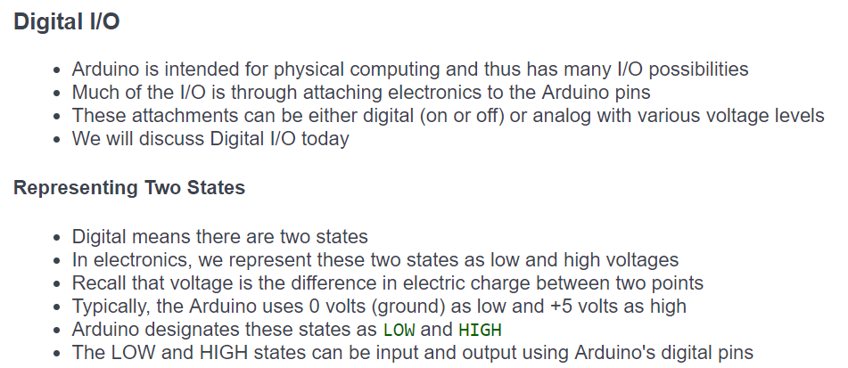
Adding Pushbuttons to your project –
Arduino Digital I/O

Slide 27
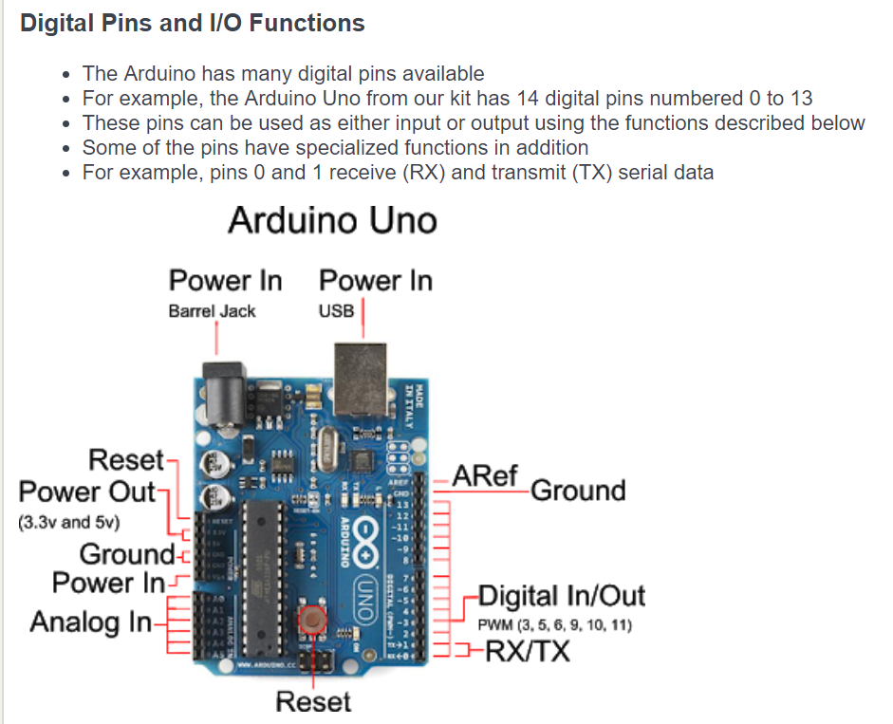


Slide 28
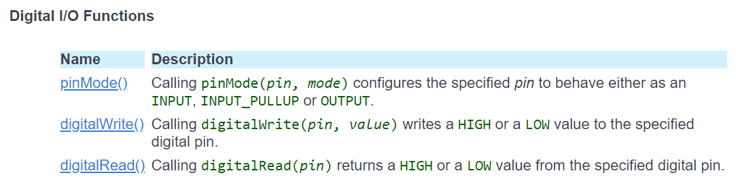
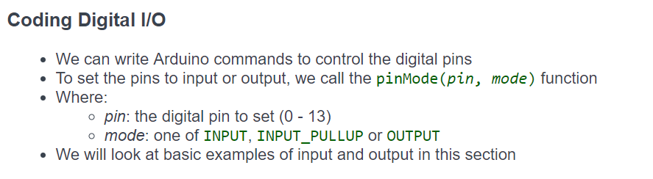

Slide 29
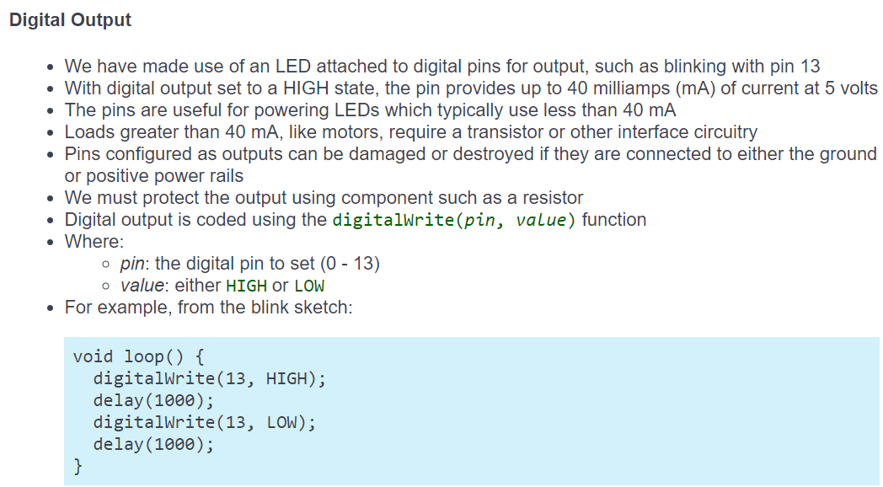

Slide 30
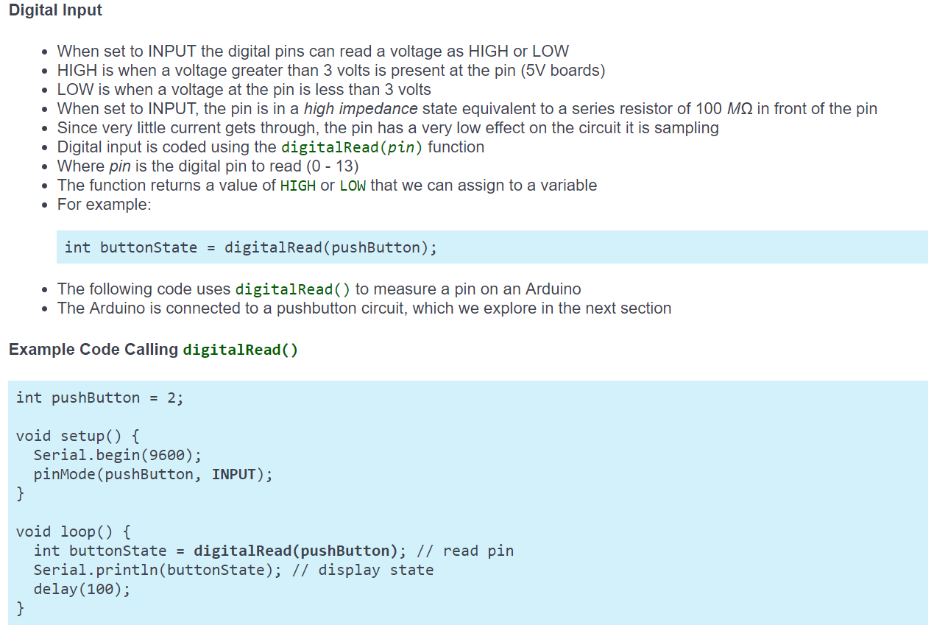

Slide 31
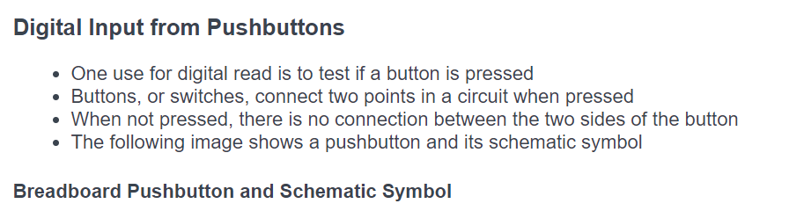
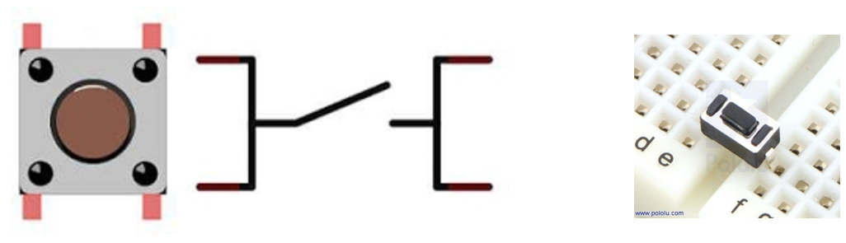
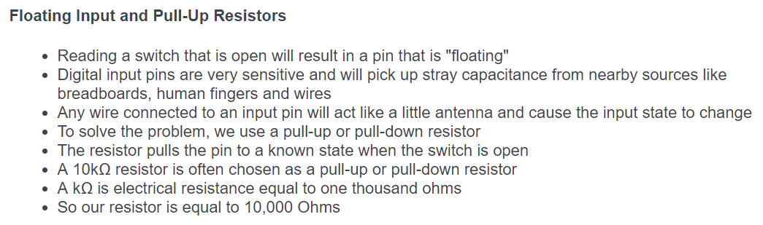

Slide 32

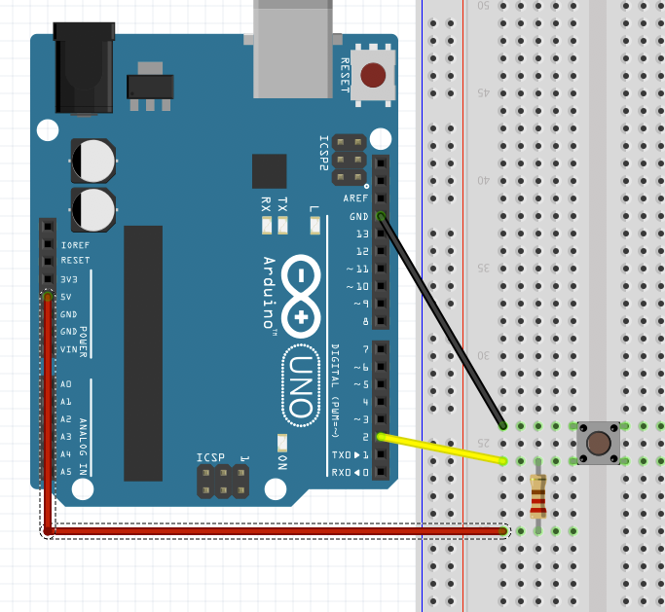
Implement a Digital Read with a Pushbutton
Wire up the circuit to the left.
One pole of the button is connected to pin 2 then 5V, forcing the pin HIGH by default
The other side of the pin is connected to GND.
When the button is pressed, the metal contacts close and force the pin to ground.
The code to test for button presses is shown on below.
This works but there is a better way that doesn’t need a resistor…read on.

Slide 33
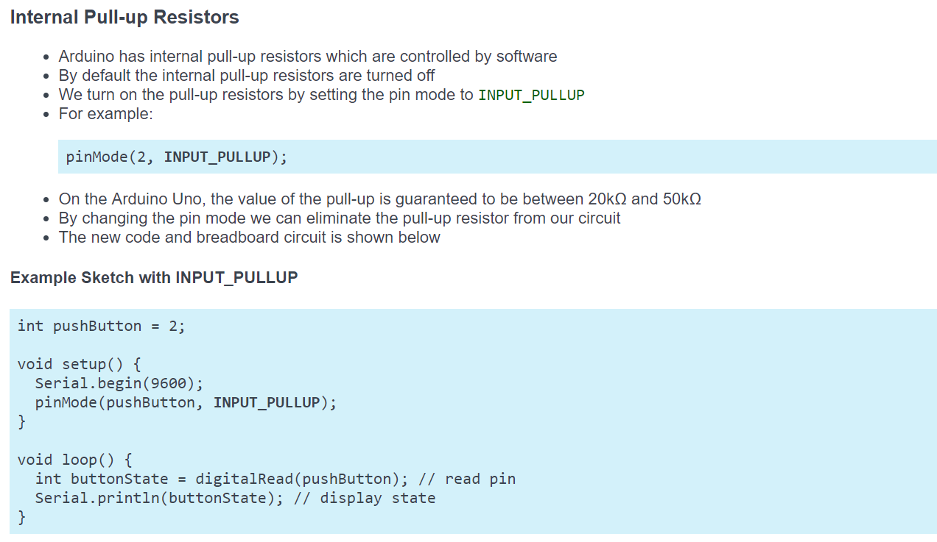
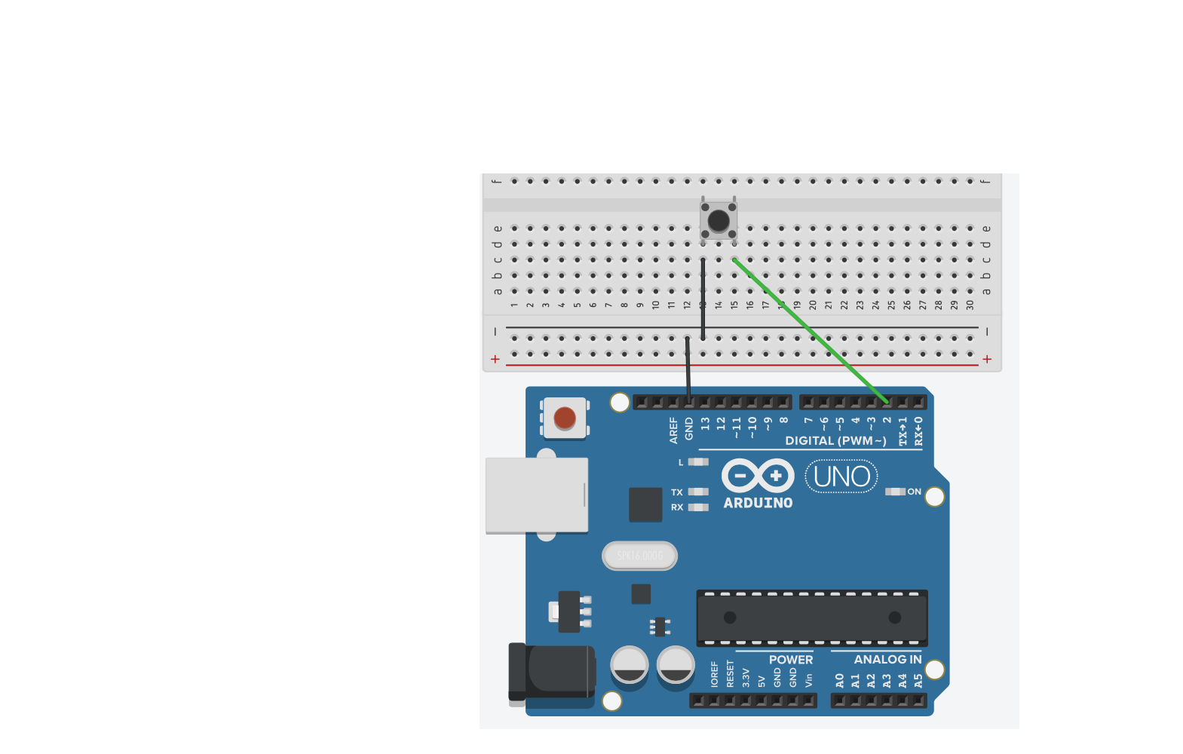

Slide 34
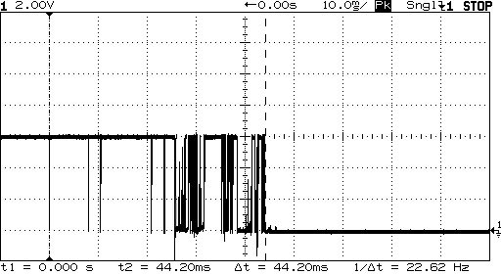
Another issue with switches – “bounce”
Electrical/mechanical contacts during switching are often erratic
We can work around this by adding a small delay to our loop function after every switch read
You may need to wait up to 1/10 or ¼ of a second
If you have two switches, a single delay after reading both switches should suffice.

Slide 35
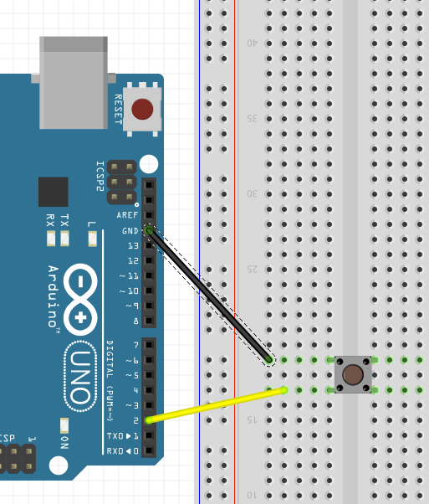
Lab 2B – Exercise 4 – Counting Button Presses
Do NOT REMOVE your LEDs
Start with the Arduino unplugged.
Make the circuit as shown.

Slide 36
Fourth Exercise: 4_button
Objective(s):
  Demonstrate the ability to read the state of a button
Steps
Open folder 4_button
The code is complete. Compile and upload it to the Arduino (make flash)
Open your preferred serial monitor.
What is the value of the button when pressed and not pressed?

Slide 37
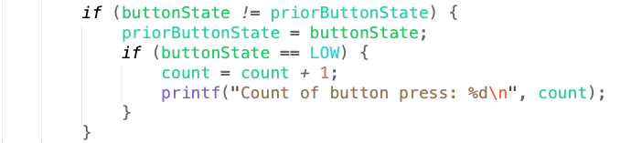
Fourth Exercise: 4_button continued
Counting button presses
Continue with 4_button from the previous page.
Add two new variables after the pinMode line: (type in)
Replace the printf(“ButtonState…) with the following code:
Change the delay value from 1000 to 1.
Compile and upload your code to verify it works correctly.
When you open the serial monitor, you should see a count of every button press.

Slide 38
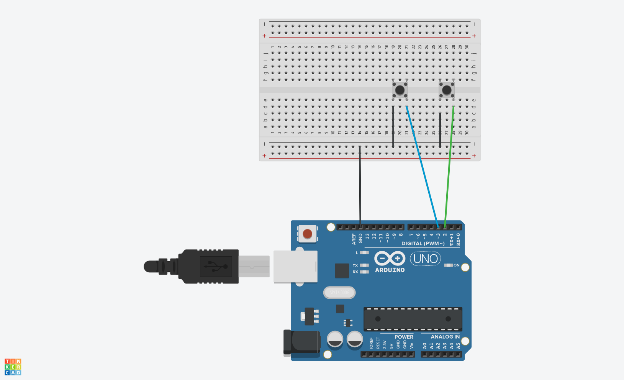
Two Button Counter

Slide 39
Fifth Exercise: 5_twobutton
Objective(s):
  Demonstrate the ability to evolve code
Steps
Open folder 4_button main.c, select all of the contents and copy
Open folder 5_twobutton main.c. The file is empty, paste the copy contents into the file.
Open your preferred serial monitor.
What is the value of the button when pressed and not pressed?

Slide 40
Fifth Exercise: 5_twobutton continued
Add a second switch right next to first switch
Add a second pushbutton connected to pin 3
Rename the following variables
  count → count0
  pushButton → pushButton0 (still equals pin 2 but pressing means input 0 )
  buttonState → buttonState0
  priorButtonState → priorButtonState0
  TEST THESE CHANGES BEFORE ADDING CODE FOR PIN 3!
Declare new variables with same name as above but with 1 instead of 0
  Assign pushButton1 to pin 3
  Pressing the second pushbutton means input 1
Add printf() statements so the program prints the count for 0 and 1 presses. If errors, debug!
Make sure only pressing a button (0 or 1) increases the counter
  Button releases should be ignored!

Slide 41
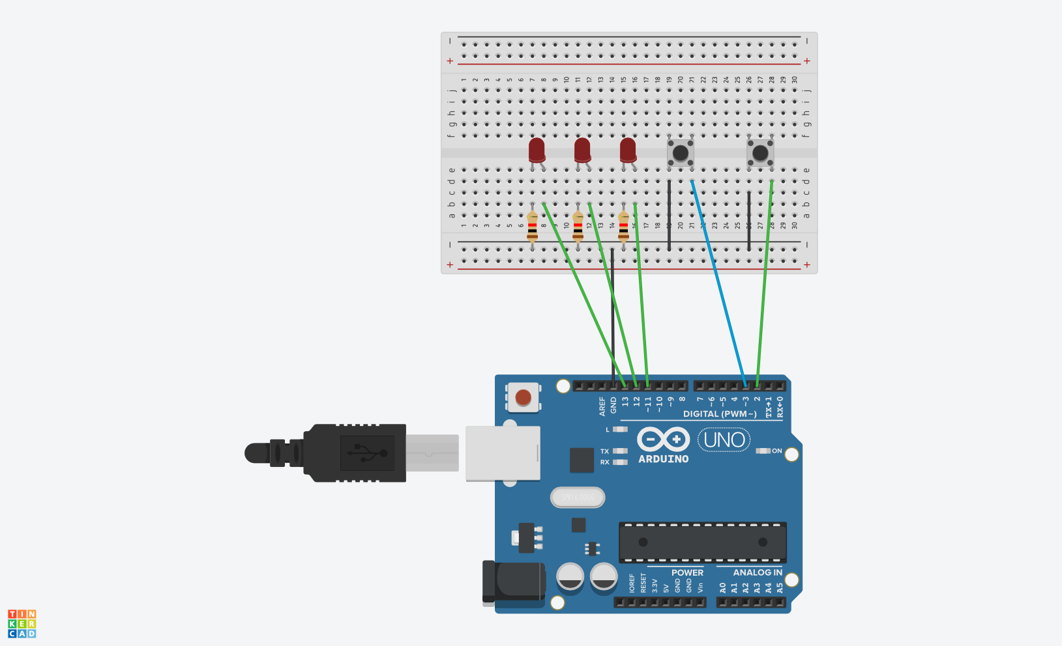
Finite State Machine

Slide 42
Assemble the full FSM!

Slide 43
Sixth Exercise: 6_FSM_lock
Objective(s):
  Demonstrate the ability to evolve code into a new application
Steps
Use the programs 2_binary, 3_serial_state and 5_twobutton to create a new program, 6_FSM_lock
Think of 3_serial_state as the structure for your finite state machine.
Use 2_binary to guide you as to how to light up the LEDs. Have the LEDs indicate the state of the FSM.
Use 5_twobutton to guide you as to how to process button presses. Button 0 and 1 are the buttons which change state.
Compile, link and load on to the UNO and debug.
Are you able to use the sequence 101101 to unlock the lock?

Slide 44
Technique: Hints for full FSM Code
Remove extraneous code like the counting code to keep debugging simple
Make incremental changes and test each increment to ensure the program continues to work as expected
If something doesn’t appear to be working, use printf() to help debug
Use both Serial Monitor and LEDs while developing code then once working well, remove the Serial commands using only LEDs to show state
Blink all three LED’s multiple times on Unlock Success

Slide 45
Optional: Need for interrupts
You may find that your FSM doesn’t seem to respond if you press the button too early or late. Timing is critical because most of the time the FSM is waiting for the LED to change on or off (longDelay or shortDelay).
You can fix this with a new technique called hardware interrupts
With this feature you can interrupt the delay statements to allow quick response (interrupt) to button presses (hardware).
With interrupts, you can also fine-tune your software to allow for better debouncing of the button. See this link for more information:
https://hackaday.com/2015/12/10/embed-with-elliot-debounce-your-noisy-buttons-part-ii/
Ultimately, by using an interrupt and debouncing, the code for the Finite State Machine can be made much more simple

Slide 46
sysclock and button functionality
Instead of using the Arduino ISR capability, this framework has new functionality:
  sysclock – a Timer/Clock 1 interrupt which happens every 1ms, this period can be adjusted by changing the scalar SCALAR1 in the sysclock.h file. It can be changed to a divide by 8, 64, 256 or 1024, which in turn would provide a period of 8ms, 64ms, 256ms or 1.024secs. For the buttons application, you will want to scan the buttons every 8ms so SCALAR1 = SCALAR01_8
  Buttons[i] is a struct which uses buttons[i].uno to identify which pin on the Uno is attached to a button and buttons[i].pressed to determine if the button has been pressed. This allows code that looks like this:
  uint8_t i = 0;
  buttons[i].uno = 10;
  pinMode(buttons[i].uno, INPUT_PULLUP);
  /* loop for checking buttons */
  if (buttons[0].pressed) { …code for button 0…}

Slide 47
Lab 2B – Exercise 7 – Add interrupt handling to Combo Lock FSM
Additional Notes:
Add two instances of buttons[] by i=0 and i=1
Notice from the code in the previous exercise 6_FSM_lock that you may delete all the code which checks the button states, prior button states, and so on. This simplifies your program a lot.
As the button press check happens every 8ms, this is quite slow for the microcontroller. This creates a race-condition in the code, when you wish to check a button being pressed twice in a row. (This is not the same thing as a debounce.)
To resolve this issue, clear the button in the same section of code where you check for the button press, to ensure the press has been cleared.
  if (buttons[0].pressed) {
  /* code when button has been pressed */
  state = 0;
  buttons[0].pressed = 0;
  }

Slide 48
Optional Exercise: 7_FSM_ISR
Objective(s):
  Demonstrate the ability to simplify the code by adding an ISR
Steps
Use the program, 6_FSM_lock
Replace the button priorState code with a far more simple:
  if (buttons[0].pressed) { state code }
Make sure you resolve the possible race-condition
Compile, link and load on to the UNO and debug.
Are you able to use the sequence 101101 to unlock the lock?

Slide 49
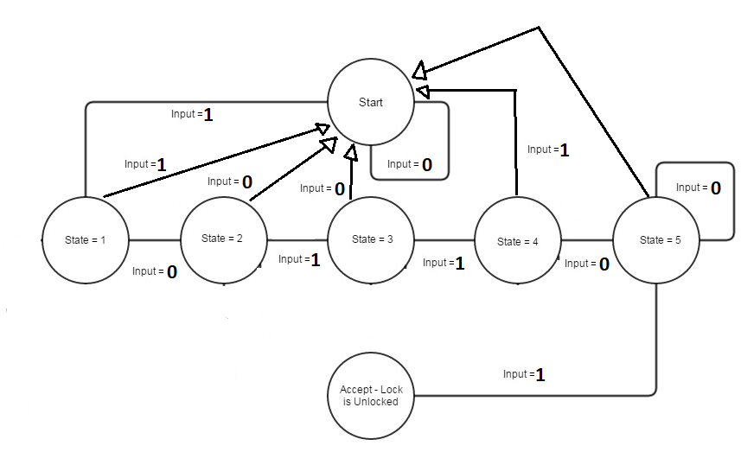
Challenge – Modify your state machine response so pressing the wrong button resets to state 0 (Start)
Lab 2B – OPTIONAL
We are going to construct the following FSM in lab 2B
  Requires a second pushbutton (1 and 2)
  State S0 –
    Perfoms the SOS pattern
    Button 2 increases all delays x2
    Button 1 advances to S1
  State S1 –
    Performs the Railroad pattern
    Button 2 divides all delays by 2
    Button 1 advances to S2
  State S2 –
    Performs a random “coin” toss
      Lights one LED at random
    Button 2 does another coin flip
    Button 1 advances to S0

