Slide 1
Deep learning introduction
Benjamin Chatain
Leo Kolezhuk

Slide 2
Classification Dataset
Macular patches of size 224 x 224 representing the 2 stages of the degeneration and a set of non degenerated patches
The purpose of the classification will be to separate the negative and the positives patches, identify the stage of degeneration.

Slide 3
Classification Strategy
Transfer learning approach
Alex net
Change of last layers to (fully connected layer, soft max layer, classification layer)
Adapting the dataset size in order to match the input type of the net
Determine optimal weight learning rates, bias learning rates
Evaluate the influence of the number of epochs

Slide 4
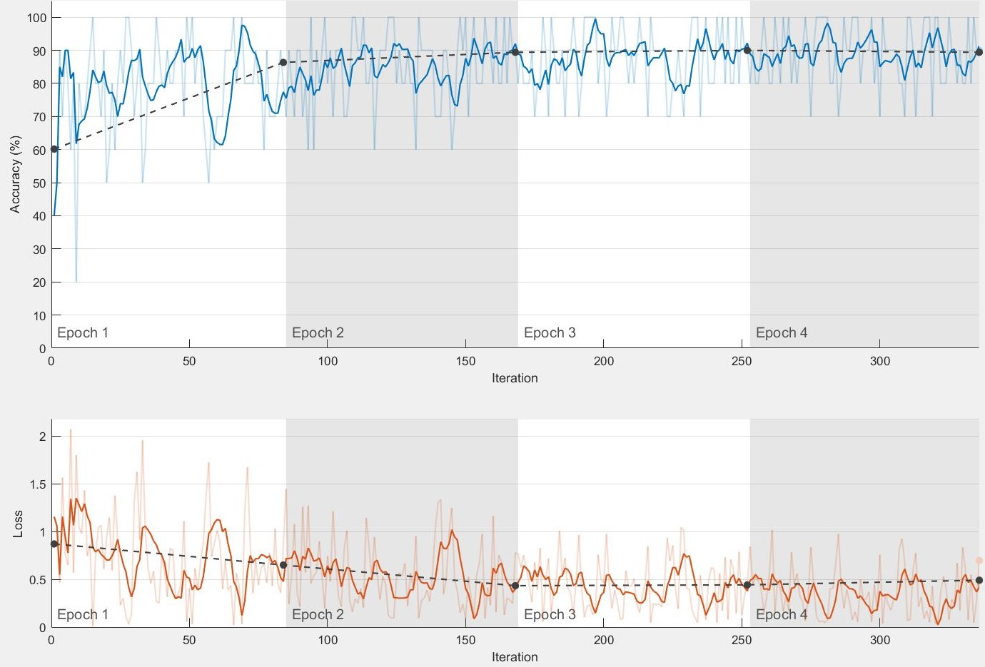
Results
Validation dataset accuracy – 89.42%

Slide 5
Segmentation Dataset
Dataset for retinal vessel segmentation has been divided directly into a training and testing sub datasets.
The training dataset consists of 120 000 negative samples and 60 000 positive samples.
The characteristic positive or negative depends if the unique center pixel of the sample is part of a vessel.
The testing dataset is composed of 20 retinal images, with their corresponding masks and ground truth segmentation.

Slide 6
Segmentation Strategy
Transfer learning approach
Alex net
Change of last layers to (fully connected layer, soft max layer, classification layer)
Adapting the dataset size in order to match the input type of the net (from 30 x 30 to 227 x 227 pixels)
Evaluate the influence of the number of epochs

Slide 7
Segmentation Strategy
Resizing of the images, masks and labels to match the net requirements
Extraction of patches of the test set images
Pass every patch through the trained net in order to determine its label
Segment the image based on the output of the net for all of the patches taking into account the central pixel of each of them

Slide 8
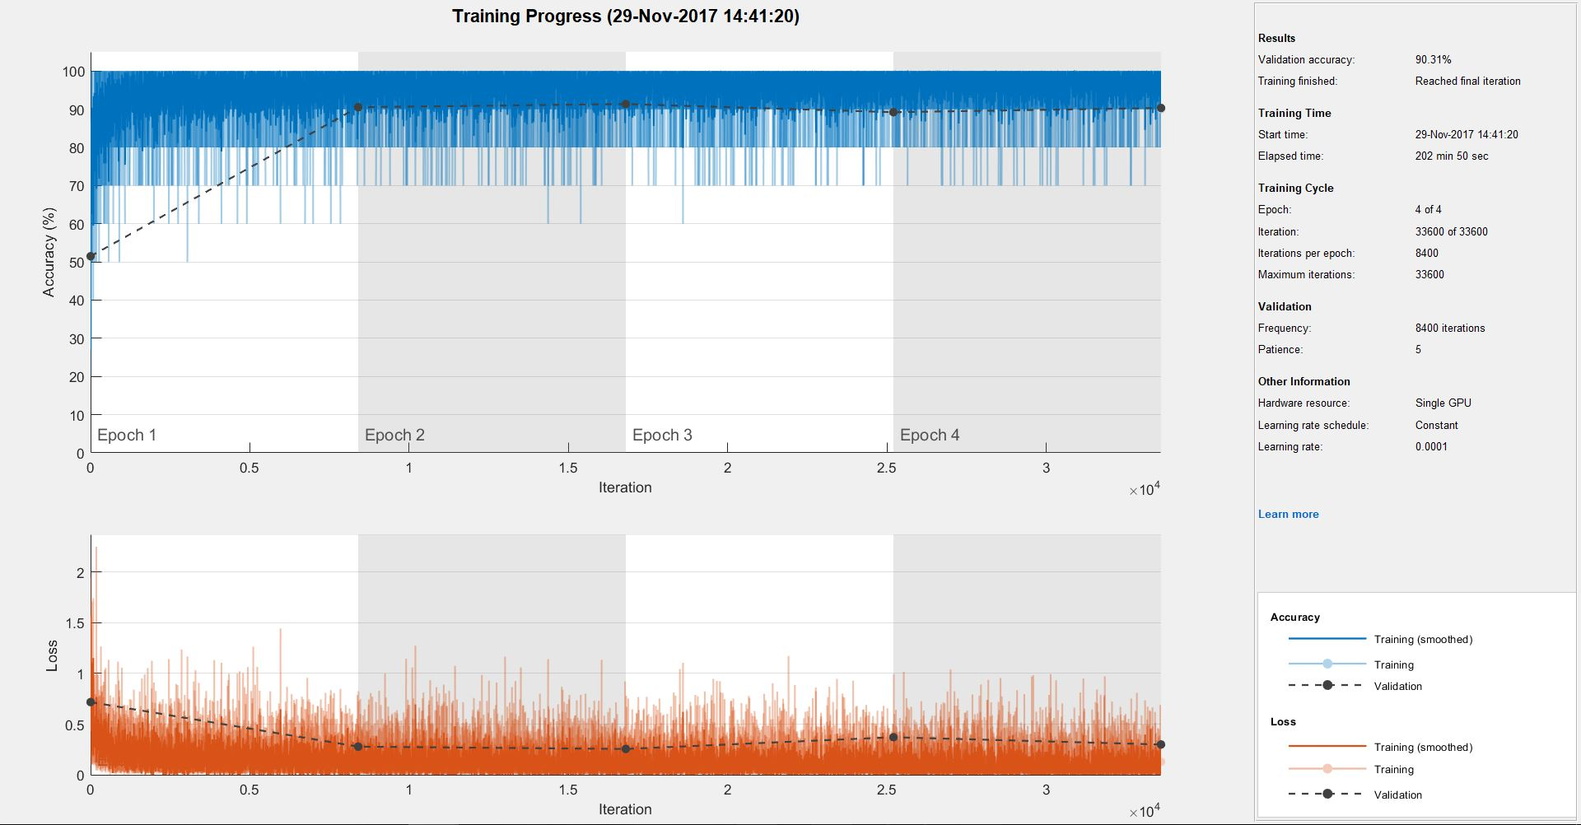
Segmentation Results
Validation set accuracy – 96.79%

Slide 9
Conclusion
The proposed approach has proven to provide satisfying results for the problem of classification.
However for the problem of segmentation of retinal vessel images problems have been encountered due to the size of the processed data
In conclusion, even taking into account the lack of computational power, we were surprised by the obtained results
Using a pretrained ALEXnet neural network is not always an optimal solution

