Slide 1
Chapter 1
The Semantic Web Vision
Grigoris Antoniou
Frank van Harmelen
Chapter 1
A Semantic Web Primer

Slide 2
Lecture Outline
Today’s Web
The Semantic Web Impact
Semantic Web Technologies
A Layered Approach
Chapter 1
A Semantic Web Primer

Slide 3
Today’s Web
Most of today’s Web content is suitable for human consumption
  Even Web content that is generated automatically from databases is usually presented without the original structural information found in databases
Typical Web uses today people’s
  seeking and making use of information, searching for and getting in touch with other people, reviewing catalogs of online stores and ordering products by filling out forms
Chapter 1
A Semantic Web Primer

Slide 4
Keyword-Based Search Engines
Current Web activities are not particularly well supported by software tools
  Except for keyword-based search engines (e.g. Google, AltaVista, Yahoo)
The Web would not have been the huge success it was, were it not for search engines
Chapter 1
A Semantic Web Primer

Slide 5
Problems of Keyword-Based
Search Engines
High recall, low precision.
Low or no recall
Results are highly sensitive to vocabulary
Results are single Web pages
Human involvement is necessary to interpret and combine results
Results of Web searches are not readily accessible by other software tools
Chapter 1
A Semantic Web Primer

Slide 6
The Key Problem of Today’s Web
The meaning of Web content is not machine-accessible: lack of semantics
It is simply difficult to distinguish the meaning between these two sentences:
I am a professor of computer science.
I am a professor of computer science,
you may think. Well, . . .
Chapter 1
A Semantic Web Primer

Slide 7
The Semantic Web Approach
Represent Web content in a form that is more easily machine-processable.
Use intelligent techniques to take advantage of these representations.
The Semantic Web will gradually evolve out of the existing Web, it is not a competition to the current WWW
Chapter 1
A Semantic Web Primer

Slide 8
Lecture Outline
Today’s Web
The Semantic Web Impact
Semantic Web Technologies
A Layered Approach
Chapter 1
A Semantic Web Primer

Slide 9
The Semantic Web Impact – Knowledge Management
Knowledge management concerns itself with acquiring, accessing, and maintaining knowledge within an organization
Key activity of large businesses: internal knowledge as an intellectual asset
It is particularly important for international, geographically dispersed organizations
Most information is currently available in a weakly structured form (e.g. text, audio, video)
Chapter 1
A Semantic Web Primer

Slide 10
Limitations of Current Knowledge Management Technologies
Searching information
  Keyword-based search engines
Extracting information
  human involvement necessary for browsing, retrieving, interpreting, combining
Maintaining information
  inconsistencies in terminology, outdated information.
Viewing information
  Impossible to define views on Web knowledge
Chapter 1
A Semantic Web Primer

Slide 11
Semantic Web Enabled Knowledge Management
Knowledge will be organized in conceptual spaces according to its meaning.
Automated tools for maintenance and knowledge discovery
Semantic query answering
Query answering over several documents
Defining who may view certain parts of information (even parts of documents) will be possible.
Chapter 1
A Semantic Web Primer

Slide 12
The Semantic Web Impact –
B2C Electronic Commmerce
A typical scenario: user visits one or several online shops, browses their offers, selects and orders products.
Ideally humans would visit all, or all major online stores; but too time consuming
Shopbots are a useful tool
Chapter 1
A Semantic Web Primer

Slide 13
Limitations of Shopbots
They rely on wrappers: extensive programming required
Wrappers need to be reprogrammed when an online store changes its outfit
Wrappers extract information based on textual analysis
  Error-prone
  Limited information extracted
Chapter 1
A Semantic Web Primer

Slide 14
Semantic Web Enabled B2C
Electronic Commerce
Software agents that can interpret the product information and the terms of service.
  Pricing and product information, delivery and privacy policies will be interpreted and compared to the user requirements.
Information about the reputation of shops
Sophisticated shopping agents will be able to conduct automated negotiations
Chapter 1
A Semantic Web Primer

Slide 15
The Semantic Web Impact –
B2B Electronic Commerce
Greatest economic promise
Currently relies mostly on EDI
  Isolated technology, understood only by experts
  Difficult to program and maintain, error-prone
  Each B2B communication requires separate programming
Web appears to be perfect infrastructure
  But B2B not well supported by Web standards
Chapter 1
A Semantic Web Primer

Slide 16
Semantic Web Enabled B2B Electronic Commerce
Businesses enter partnerships without much overhead
Differences in terminology will be resolved using standard abstract domain models
Data will be interchanged using translation services.
Auctioning, negotiations, and drafting contracts will be carried out automatically (or semi-automatically) by software agents
Chapter 1
A Semantic Web Primer

Slide 17
Wikis
Collections of web pages that allow users to add content via a browser interface
Wiki systems allow for collaborative knowledge
Users are free to add and change information without ownership of content, access restrictions, or rigid workflows
Chapter 1
A Semantic Web Primer

Slide 18
Some Uses of Wikis
Development of bodies of knowledge in a community effort, with contributions from a wide range of users (e.g. Wikipedia)
Knowledge management of an activity or a project (e.g. brainstorming and exchanging ideas, coordinating activities, exchanging records of meetings)
Chapter 1
A Semantic Web Primer

Slide 19
Semantic Web Enabled Wikis
The inherent structure of a wiki, given by the linking between pages, gets accessible to machines beyond mere navigation
Structured text and untyped hyperlinks are enriched by semantic annotations referring to an underlying model of the knowledge captured by the wiki
  e.g. a hyperlink from Knossos to Heraklion could be annotated with information is located in. This information could then be used for context-specific presentations of pages, advanced querying, and consistency verification
Chapter 1
A Semantic Web Primer

Slide 20
Lecture Outline
Today’s Web
The Semantic Web Impact
Semantic Web Technologies
A Layered Approach
Chapter 1
A Semantic Web Primer

Slide 21
Semantic Web Technologies
Explicit Metadata
Ontologies
Logic and Inference
Agents
Chapter 1
A Semantic Web Primer

Slide 22
On HTML
Web content is currently formatted for human readers rather than programs
HTML is the predominant language in which Web pages are written (directly or using tools)
Vocabulary describes presentation
Chapter 1
A Semantic Web Primer

Slide 23
An HTML Example
<h1>Agilitas Physiotherapy Centre</h1>
Welcome to the home page of the Agilitas Physiotherapy Centre. Do
you feel pain? Have you had an injury? Let our staff Lisa Davenport,
Kelly Townsend (our lovely secretary) and Steve Matthews take care
of your body and soul.
<h2>Consultation hours</h2>
Mon 11am - 7pm<br>
Tue 11am - 7pm<br>
Wed 3pm - 7pm<br>
Thu 11am - 7pm<br>
Fri 11am - 3pm<p>
But note that we do not offer consultation during the weeks of the
<a href=". . .">State Of Origin</a> games.
Chapter 1
A Semantic Web Primer

Slide 24
Problems with HTML
Humans have no problem with this
Machines (software agents) do:
  How distinguish therapists from the secretary,
  How determine exact consultation hours
  They would have to follow the link to the State Of Origin games to find when they take place.
Chapter 1
A Semantic Web Primer

Slide 25
A Better Representation
<company>
<treatmentOffered>Physiotherapy</treatmentOffered>
<companyName>Agilitas Physiotherapy Centre</companyName>
<staff>
<therapist>Lisa Davenport</therapist>
<therapist>Steve Matthews</therapist>
<secretary>Kelly Townsend</secretary>
</staff>
</company>
Chapter 1
A Semantic Web Primer

Slide 26
Explicit Metadata
This representation is far more easily processable by machines
Metadata: data about data
  Metadata capture part of the meaning of data
Semantic Web does not rely on text-based manipulation, but rather on machine-processable metadata
Chapter 1
A Semantic Web Primer

Slide 27
Ontologies
The term ontology originates from philosophy
The study of the nature of existence
Different meaning from computer science
An ontology is an explicit and formal specification of a conceptualization
Chapter 1
A Semantic Web Primer

Slide 28
Typical Components of Ontologies
Terms denote important concepts (classes of objects) of the domain
  e.g. professors, staff, students, courses, departments
Relationships between these terms: typically class hierarchies
  a class C to be a subclass of another class C' if every object in C is also included in C'
  e.g. all professors are staff members
Chapter 1
A Semantic Web Primer

Slide 29
Further Components of Ontologies
Properties:
  e.g. X teaches Y
Value restrictions
  e.g. only faculty members can teach courses
Disjointness statements
  e.g. faculty and general staff are disjoint
Logical relationships between objects
  e.g. every department must include at least 10 faculty
Chapter 1
A Semantic Web Primer

Slide 30
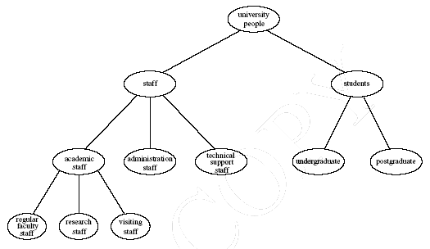
Example of a Class Hierarchy
Chapter 1
A Semantic Web Primer

Slide 31
The Role of Ontologies on the Web
Ontologies provide a shared understanding of a domain: semantic interoperability
  overcome differences in terminology
  mappings between ontologies
Ontologies are useful for the organization and navigation of Web sites
Chapter 1
A Semantic Web Primer

Slide 32
The Role of Ontologies in Web Search
Ontologies are useful for improving the accuracy of Web searches
  search engines can look for pages that refer to a precise concept in an ontology
Web searches can exploit generalization/ specialization information
  If a query fails to find any relevant documents, the search engine may suggest to the user a more general query.
  If too many answers are retrieved, the search engine may suggest to the user some specializations.
Chapter 1
A Semantic Web Primer

Slide 33
Web Ontology Languages
RDF Schema
RDF is a data model for objects and relations between them
RDF Schema is a vocabulary description language
Describes properties and classes of RDF resources
Provides semantics for generalization hierarchies of properties and classes
Chapter 1
A Semantic Web Primer

Slide 34
Web Ontology Languages (2)
OWL
A richer ontology language
relations between classes
  e.g., disjointness
cardinality
  e.g. “exactly one”
richer typing of properties
characteristics of properties (e.g., symmetry)
Chapter 1
A Semantic Web Primer

Slide 35
Logic and Inference
Logic is the discipline that studies the principles of reasoning
Formal languages for expressing knowledge
Well-understood formal semantics
  Declarative knowledge: we describe what holds without caring about how it can be deduced
Automated reasoners can deduce (infer) conclusions from the given knowledge
Chapter 1
A Semantic Web Primer

Slide 36
An Inference Example
prof(X) → faculty(X)
faculty(X) → staff(X)
prof(michael)
We can deduce the following conclusions:
faculty(michael)
staff(michael)
prof(X) → staff(X)
Chapter 1
A Semantic Web Primer

Slide 37
Logic versus Ontologies
The previous example involves knowledge typically found in ontologies
  Logic can be used to uncover ontological knowledge that is implicitly given
  It can also help uncover unexpected relationships and inconsistencies
Logic is more general than ontologies
  It can also be used by intelligent agents for making decisions and selecting courses of action
Chapter 1
A Semantic Web Primer

Slide 38
Tradeoff between Expressive Power and Computational Complexity
The more expressive a logic is, the more computationally expensive it becomes to draw conclusions
  Drawing certain conclusions may become impossible if non-computability barriers are encountered.
Our previous examples involved rules “If conditions, then conclusion,” and only finitely many objects
  This subset of logic is tractable and is supported by efficient reasoning tools
Chapter 1
A Semantic Web Primer

Slide 39
Inference and Explanations
Explanations: the series of inference steps can be retraced
They increase users’ confidence in Semantic Web agents: “Oh yeah?” button
Activities between agents: create or validate proofs
Chapter 1
A Semantic Web Primer

Slide 40
Typical Explanation Procedure
Facts will typically be traced to some Web addresses
  The trust of the Web address will be verifiable by agents
Rules may be a part of a shared commerce ontology or the policy of the online shop
Chapter 1
A Semantic Web Primer

Slide 41
Software Agents
Software agents work autonomously and proactively
  They evolved out of object oriented and compontent-based programming
A personal agent on the Semantic Web will:
  receive some tasks and preferences from the person
  seek information from Web sources, communicate with other agents
  compare information about user requirements and preferences, make certain choices
  give answers to the user
Chapter 1
A Semantic Web Primer

Slide 42
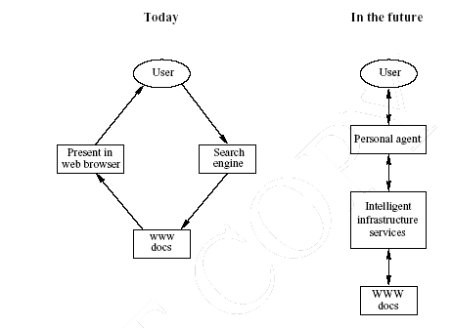
Intelligent Personal Agents
Chapter 1
A Semantic Web Primer

Slide 43
Semantic Web Agent Technologies
Metadata
  Identify and extract information from Web sources
Ontologies
  Web searches, interpret retrieved information
  Communicate with other agents
Logic
  Process retrieved information, draw conclusions
Chapter 1
A Semantic Web Primer

Slide 44
Semantic Web Agent Technologies (2)
Further technologies (orthogonal to the Semantic Web technologies)
  Agent communication languages
  Formal representation of beliefs, desires, and intentions of agents
  Creation and maintenance of user models.
Chapter 1
A Semantic Web Primer

Slide 45
Lecture Outline
Today’s Web
The Semantic Web Impact
Semantic Web Technologies
A Layered Approach
Chapter 1
A Semantic Web Primer

Slide 46
A Layered Approach
The development of the Semantic Web proceeds in steps
  Each step building a layer on top of another
Principles:
Downward compatibility
Upward partial understanding
Chapter 1
A Semantic Web Primer

Slide 47
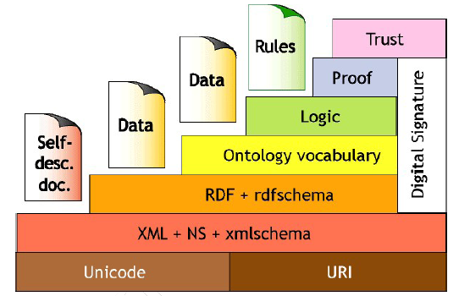
The Semantic Web Layer Tower
Chapter 1
A Semantic Web Primer

Slide 48
An Alternative Layer Stack
Takes recent developments into account
The main differences are:
The ontology layer is instantiated with two alternatives: the current standard Web ontology language, OWL, and a rule-based language
DLP is the intersection of OWL and Horn logic, and serves as a common foundation
The Semantic Web Architecture is currently being debated and may be subject to refinements and modifications in the future.
Chapter 1
A Semantic Web Primer

Slide 49
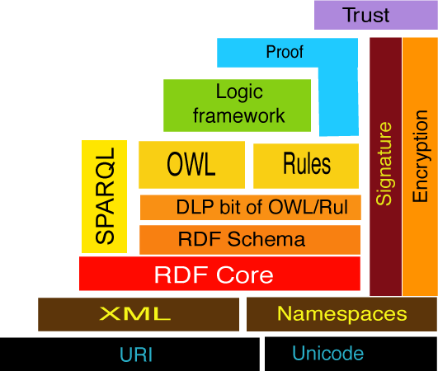
Alternative Semantic Web Stack
Chapter 1
A Semantic Web Primer

Slide 50
Semantic Web Layers
XML layer
  Syntactic basis
RDF layer
  RDF basic data model for facts
  RDF Schema simple ontology language
Ontology layer
  More expressive languages than RDF Schema
  Current Web standard: OWL
Chapter 1
A Semantic Web Primer

Slide 51
Semantic Web Layers (2)
Logic layer
  enhance ontology languages further
  application-specific declarative knowledge
Proof layer
  Proof generation, exchange, validation
Trust layer
  Digital signatures
  recommendations, rating agencies ….
Chapter 1
A Semantic Web Primer

Slide 52
Book Outline
Structured Web Documents in XML
Describing Web Resources in RDF
Web Ontology Language: OWL
Logic and Inference: Rules
Applications
Ontology Engineering
Conclusion and Outlook
Chapter 1
A Semantic Web Primer

