Slide 1
Ctags
Source code indexer

Slide 2
What does it do?
Indexes source code for fast lookups of methods, variables, structs, macros, …
But LXR does this…
Ctags can be used directly in vim or emacs
Don’t need to switch to a browser
Faster

Slide 3
How to install
aptitude install ctags (installs exuberant ctags)
Run “ctags –R” while in the linux kernel source directory
Creates a file called “tags” in the source directory
Running “ctags –R <source dir>” creates an index of <source dir>, but creates the file in the pwd

Slide 4
Basic Commands
Vim –t <tag>
Jumps to first match of tag
In normal mode
:tjump <tag> or :tjump /<pattern>
Search for tag or pattern, allow user to select from matches
:tag <tag> or :tag /<pattern>
Search for tag or pattern, jump to first match

Slide 5
More Commands
In normal mode
:tags
Display current tag stack
:pop
Pop top tag from stack, go to tag on top of stack

Slide 6
Basic Key Mappings
In normal mode
g Ctrl-] :tjump <word under cursor>
Allow user to select match for tag under cursor
Ctrl-] :tag <word under cursor>
Jump to first match of tag under cursor
Ctrl-T :pop
Pop top tag from stack, go to new tag on top of stack

Slide 7
Window Key Mappings
Ctrl-W g ] :stjump <word under cursor>
Split window, and allow user to select match of tag
Ctrl-W ] :stag <word under cursor>
Split window, go to first match of tag
Ctrl-W g } :ptjump
Open preview window, allow user to select match of tag
Ctrl-W } :ptag <word under cursor>
Open preview window, go to first match of tag

Slide 8
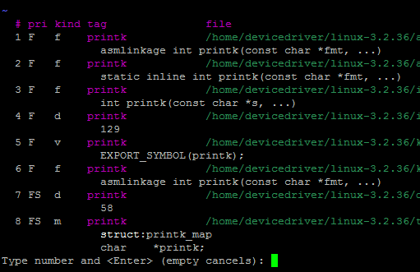

Slide 9
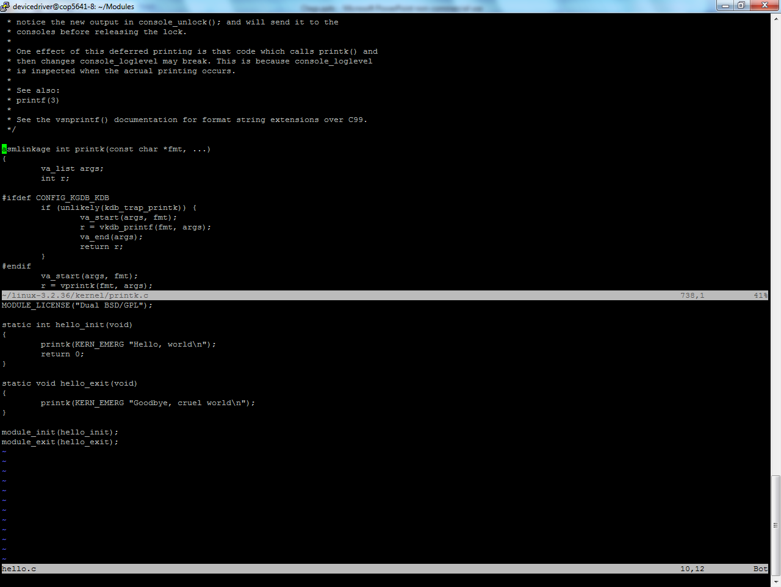

Slide 10
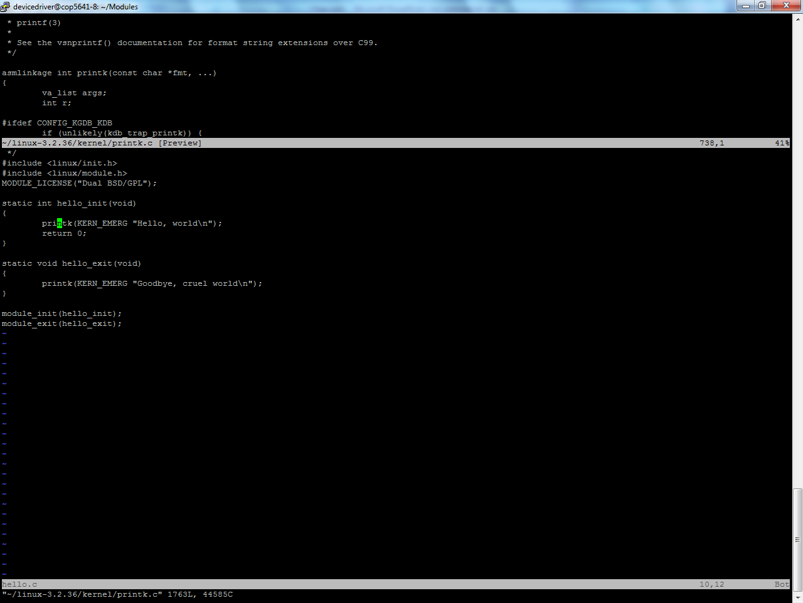

Slide 11
Other notes
Vim looks for tags file in tags option, or, if it doesn’t exist, for the tags file in its pwd
:set tags=<tags file>
Add to .vimrc if lazy
ctags --list-kinds=c, list kinds of tags for c language

Slide 12
More Notes
Ctrl-] and g Ctrl-] open result in current window
If current buffer in vim isn’t saved, vim complains
Auto save buffer on buffer switch with
:set autowrite, or tell vim to ignore unsaved buffers with :set hidden (be careful doing :q! with this option)
Or just save the file

Slide 13
References
http://vim.wikia.com/wiki/Browsing_programs_with_tags
http://ctags.sourceforge.net/ctags.html

