Slide 1


Real-time Aspect Sentiment Quad Predictions for Vietnamese Youtube Comments
Nhóm 12:
Nguyễn Ngọc Lương - 21522311
Nguyễn Phúc Hào - 21522047
Lê Hữu Tài - 21522562

Slide 2




Table of contents
01
04
Introduction
Result
02
05
Data
Spark Streaming
03
06
Method & Model
Conclusion & Future Work

Slide 3


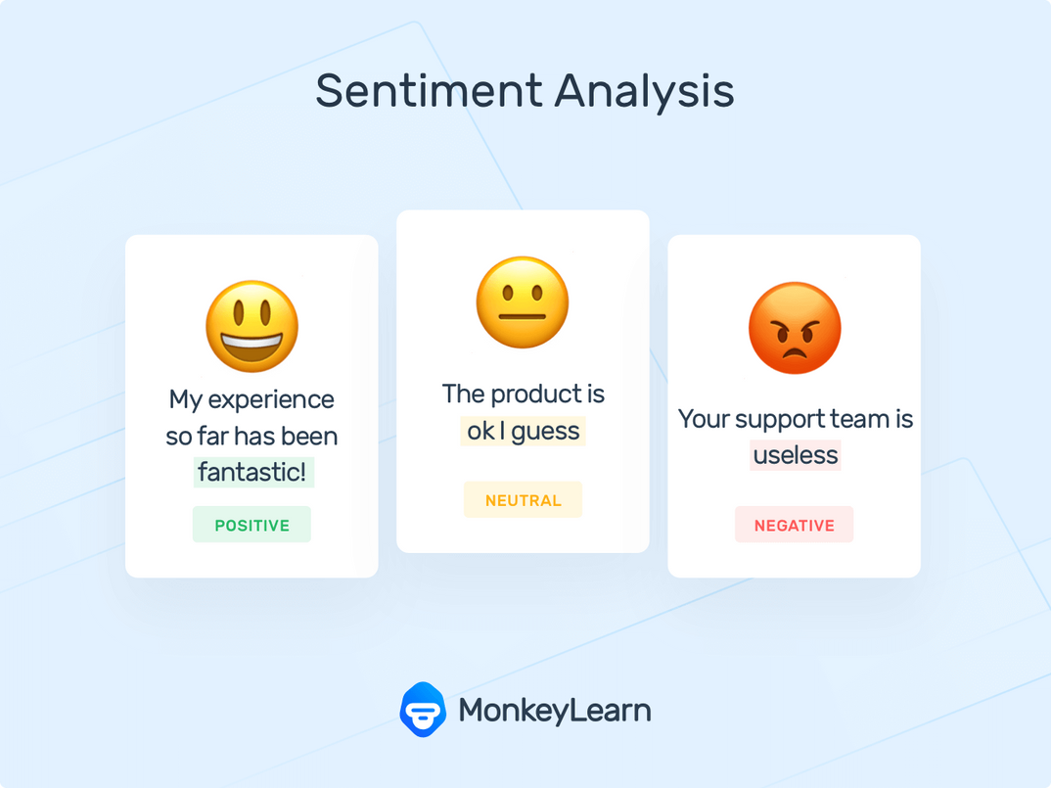


Introduction

Slide 4
Introduction
🔉
🎤
🎧
🎶
🔊

Slide 5

RELATED WORK
> Global datasets:
- SemEval-2014 Task 4: Aspect Based Sentiment Analysis (Pontiki et al., SemEval 2014)
- SemEval-2015 Task 12: Aspect Based Sentiment Analysis (Pontiki et al., SemEval 2015)
- SemEval-2016 Task 5: Aspect Based Sentiment Analysis (Pontiki et al., SemEval 2016)
- Target aspect sentiment detection (TASD) (Wan et al. (2020)
- Peng et al. (2020) propose the aspect sentiment triplet extraction (ASTE) (Xu et al., 2020; Huang et al., 2021; Mao et al., 2021…)
- Aspect Sentiment Quad Prediction as Paraphrase Generation (Wenxuan Zhang, Yang Deng, Xin Li, Yifei Yuan, Lidong Bing, Wai Lam)
> Vietnamese datasets:
- VLSP 2018 - Aspect Based Sentiment Analysis (VABSA 2018) (published by H. T. Nguyen et al.)
- UIT-ViSFD (Vietnamese Aspect-Based Sentiment Analysis Dataset) (Introduced by Phan et al. in SA2SL: From Aspect-Based Sentiment Analysis to Social Listening System for Business Intelligence)
- Span Detection for Aspect-Based Sentiment Analysis in Vietnamese (Thanh et al., PACLIC 2021)
- A dataset for internal circulation only made by Duy el al. in 2024 for their subject

Slide 6


DATA
> Python library
> Google for developer: Youtube data API
> Source: youtube.com
Character-Outlook | Comments about the person outlook
Character - Voice | Comments about the person voice (mostly is show candidate)
Character - Overall | Comments describe other aspects of the person (style, character…)
Show | Comments that concern to the show
Song | Comments refer to the music, the melody, the song
Examiner | Comments about the examiner and coach that appear ịn the show
Others | Spam comments
> Dataset contains 8405 Vietnamese comments and was annotated manually for quad predictions : aspect category, polarity sentiment, aspect term,
and opinion term
> For sentiment classification, we divided it into 3 labels: POSITIVE, NEGATIVE, NEUTRAL

Slide 7

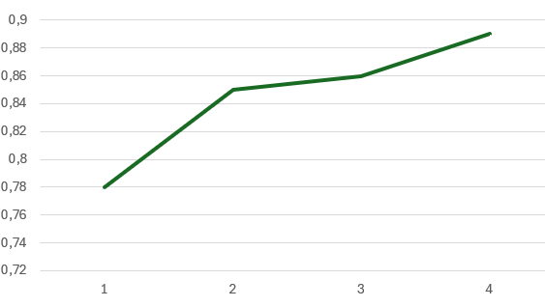
ANNOTATION PROCESS
Training phrase:
we randomly take 100 comments to annotate, then we calculate Cohen’s Kappa score for those annotated rreviews. And those comment are instruction for chatGPT to annotate
Anotating phrase :
The rest of the data was split into 3 parts and each member will be a supervisor for each part.
Finallly, the dataset was split into 4 parts: train, dev, test, stream

Slide 8

Set | Reviews | Avg aspect/review | Positive | Negative | Neutral | Total sentiment
Train | 7000 | 1.2551 | 4737 | 1364 | 2685 | 8786
Dev | 500 | 1.2760 | 350 | 108 | 180 | 638
Test | 500 | 1.2240 | 322 | 89 | 201 | 612
Stream | 405 | 1.2839 | 282 | 79 | 159 | 520
STATISTICS

Slide 9

Aspect and sentiment distribution in dataset
Set | Character - Overall | Character - Voice | Character - Outlook | Examiner | Show | Song | Others
Total | 3492 | 801 | 158 | 399 | 1587 | 1770 | 2338
Positive | 2357 | 518 | 100 | 135 | 937 | 638 | 0
Negative | 688 | 212 | 35 | 95 | 453 | 612 | 0
Neutral | 447 | 71 | 23 | 69 | 197 | 520 | 2338
STATISTICS

Slide 10
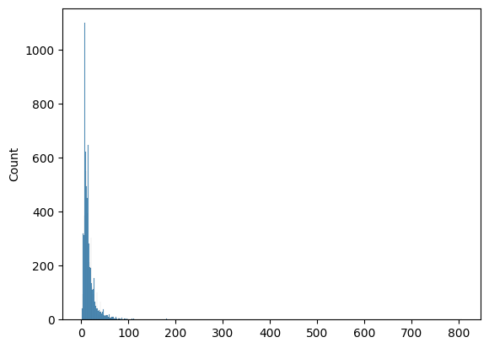
- Remove HTML
- Remove unnecessary, duplication characters
- Convert unicode, normalize teencode, emoji
https://www.example.com ❌
Đỉnhhhhh ❌
Đỉnh ✅
Ko ❌
Không ✅
DATA PREPROCESSING
- Padding is used with a maximum length of 128, which is chosen based on the word length distribution chart of the dataset shown in figure.
Sentence length distribution of the dataset

Slide 11
Paraphrase Generation Method:
{Aspect category} là {Sentiment polarity} bởi vì {Aspect Term} là {Opinion term}
Sentiment Polarity(p):
tuyệt if p = POS
tạm if p = NEU
tệ if p = NEG
Input – 1 | Rap Việt hay hơn nhiều đúng không mọi người
Label – 1 Target – 1 | (c, a, o, p) (Show, Rap Việt, hay hơn nhiều, POS) Sh﻿ow là tuyệt bởi vì Rap V﻿iệt là hay hơn nhiều
Input – 2 | Đêm chung kết chất lượng hơn bên RV một ngàn lần
Label – 2 Target – 2 | (c, a, o, p) (Sho﻿w, Đêm chung kết, chất lượng hơn bên RV, POS) Show là tuyệ﻿t bởi vì Đêm chung kế﻿t là chất lượng hơn bên RV
Method

Slide 12




MODEL

Slide 13


RESULT
 | Precision | Recall | F1-macro
ViT5 | 0.2710 | 0.2496 | 0.2598
BARTpho | 0.2722 | 0.2232 | 0.2453
byT5 | 0.2790 | 0.2626 | 0.2706

Slide 14
RESULT
Aspect Category Detection F1-macro
 | ViT5 | BARTpho | byT5
Character - Outlook | 0.44 | 0.44 | 0.40
Character - Voice | 0.61 | 0.50 | 0.57
Character - Overall | 0.69 | 0.65 | 0.71
Show | 0.71 | 0.60 | 0.66
Song | 0.72 | 0.60 | 0.70
Examiner | 0.45 | 0.42 | 0.61
Others | 0.65 | 0.61 | 0.68

Slide 15



RESULT
F1-score macro is used due to the high imbalance of the dataset
Sentiment Classification F1-macro
 | ViT5 | BARTpho | byT5
Negative | 0.52 | 0.45 | 0.50
Positive | 0.80 | 0.67 | 0.79
Neutral | 0.70 | 0.66 | 0.71

Slide 16
ERROR ANALYSIS
Comments | Aspect category Aspect term |  | Sentiment polarity Opinion term
Chung kết king of the rap chất hơn rap viet | Others NULL neutral NULL |  | Show Chung kết king of the rap positive Chất hơn
Chương trình sẽ hay hơn khi để một MC khác dẫn chương trình quá tệ và nhạt | Character - Overall MC positive quá tệ và nhạt |  | Character - Overall MC negative quá tệ và nhạt
Chị kiều keo ghê | Character - Overall NULL positive keo ghê |  | Character - Overall Chị kiều positive keo ghê
Không hiểu bà Lona đang rap cái gì luôn ấy được vào vòng trong t cũng chịu | Character - Overall Lona negative đang rap cái gì |  | Character - Overall Lona negative Không hiểu

Slide 17
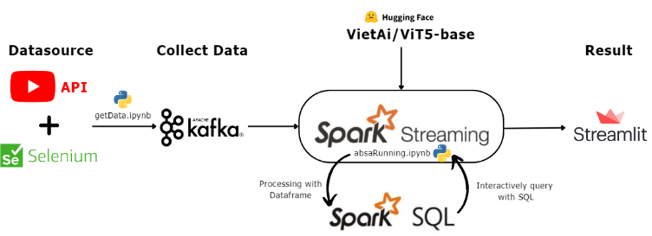
SPARK STREAMING
Our system is divided into two parts: real-time data collecting and real-time analysis.
The end-to-end system’s architecture using Spark Streaming

Slide 18
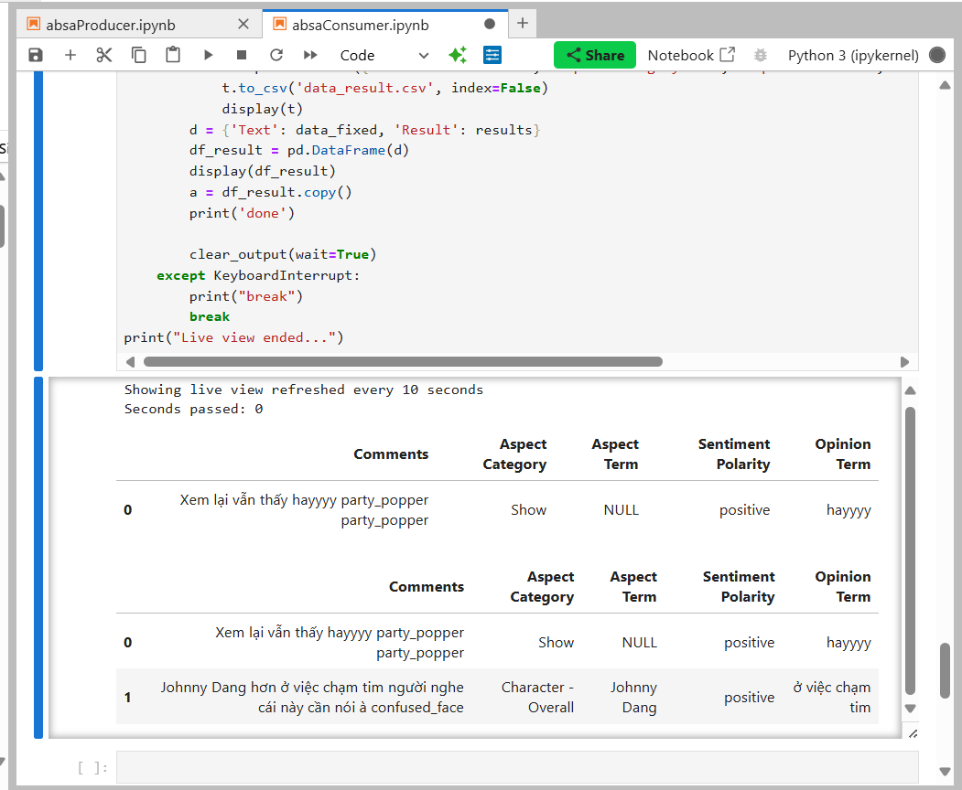
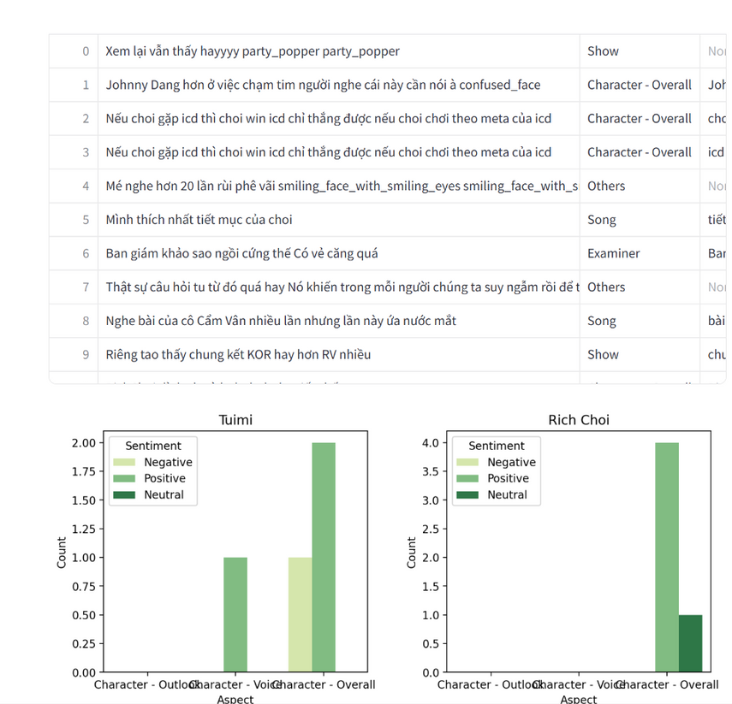
SPARK STREAMING
Consumer results
Real time candidate statistics Streamlit demo

Slide 19
UPDATE
Since the last report, our team have shortened Aspect term and Opinion term, achieved 4-5% better performance.
We have added Spark Streaming section to process live data.

Slide 20
Conclusion and Future Work
Conclusion
- We have presented a new dataset for ABSA-quad base on a dataset that internal circulation only.
- We applied the Paraphrase Generation method to this dataset, with the aim of predicting a quad that includes all 4 elements in one shot. We deployed 3 models ViT5, BARTPho and byT5 to our dataset and received an acceptable result.
Future Work
- Continue expand our dataset. Althought using GPT for annotating but we only annotate 20% of the collected data.
- Learn more about others approach and models for ABSA and ABSA-quad goalto develop a system capable of automatically collecting, preprocessing, analyzing comments, and visualizing results .
- We aim to further research Aspect SentimentQuad Prediction (ASQP), explore multimodal ABSA, and experiment with models like LLAMA tocreate a robust Social Listening system.

