Slide 1
Chest Abnormalities Detection
on VinBigAI chest X-Ray dataset
Môn học: Xử lý ảnh y khoa - DS312.O21
GVHD: TS. Nguyễn Tất Bảo Thiện
Đỗ Phú Duy – 21520205
Trần Nguyên Mẫn – 21522325
Nguyễn Phúc Hào – 21522047
Phan Lê Chí Trung – 21522725
Nguyễn Ngọc Lương – 21522311

Slide 2

Outline
I/ Introduction
II/ Related Work
III/ Dataset
IV/ Preprocessing methods
V/ Proposed models
VI/ Experiments
VII/ Conclusion and
Future Work

Slide 3
I/ Introduction
The rapid and accurate diagnosis of chest abnormalities is crucial, as some diseases may cause death within a very short time.
Medical imaging is usually the first radiological examination for clinical diagnosis.
Indeed, chest X-rays have remarkable advantages
low cost
fast imaging speed
small amounts of radiation

Slide 4
I/ Introduction
Currently, chest X-rays are mainly read manually by professional radiologists, who are primarily limited by their experience, efficiency, and the complexity of the image itself.
With the development of artificial intelligence, it does give us some significant advantages
relieve the working pressure of radiologists
increase the diagnosis speed and improve sensitivity to subtle abnormalities

Slide 5
I/ Introduction
This study is devoted to the multi-label and instance-level anomaly classification of chest X-rays.
Using a dataset of 15,000 scans along with the corresponding label annotated by experienced radiologists, we have applied different networks for training and comparing.

Slide 6
II/ Related works
Comparison of Deep Learning Approaches for Multi-Label Chest X-Ray Classification: compares deep learning architectures (DenseNet, ResNet, etc.) and training strategies for multi-label chest X-ray classification, analyzing the impact of data and image quality.
SwinCheX: Multi-label classification on chest X-ray images with transformers: proposes a novel transformer-based model (Swin Transformer) for multi-label chest X-ray classification, achieving superior results on ChestX-ray14 and advocating for a standardized evaluation approach.

Slide 7
II/ Related works
A systematic literature review on deep learning approaches for pneumonia detection using chest X-ray images: provides a comprehensive review of deep learning approaches for pneumonia detection in chest X-ray images. It discusses various CNN architectures, data augmentation techniques, transfer learning, and ensemble methods used for this task.
Detection of COVID-19 from CT and Chest X-ray Images Using Deep Learning Models: reviews deep learning for COVID-19 detection in CT scans and chest X-rays, exploring architectures, data augmentation, and limitations of existing methods.

Slide 8
III/ Dataset
1. Data source
The dataset was provided by two hospitals in Vietnam: the Hospital 108 and the Hanoi Medical University Hospital
This dataset is for the Kaggle competition - VinBigData Chest X-ray Abnormalities Detection
Data link: https://www.kaggle.com/c/vinbigdata-chest-xray abnormalities-detection/data

Slide 9
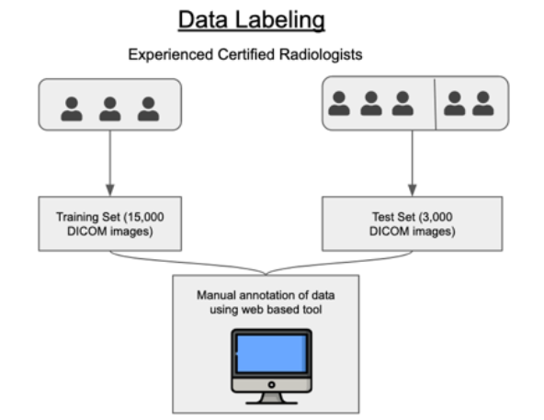
III/ Dataset
2. Annotation Process
All images were labeled for the presence of 14 critical radiographic findings.
Each scan in the training set was independently labeled by 3 radiologists while each scan in the test set was labeled by consensus of 5 radiologists.

Slide 10

III/ Dataset
3. Data statistics
0. Aortic enlargement | 8. Nodule/Mass
1. Atelectasis | 9. Other lesion
2. Calcification | 10. Pleural effusion
3. Cardiomegaly | 11. Pleural thickening
4. Consolidation | 12. Pneumothorax
5. Interstitial Lung Disease (ILD) | 13. Pulmonary fibrosis
6. Infiltration | 14. No finding
7. Lung Opacity
15 labels

Slide 11
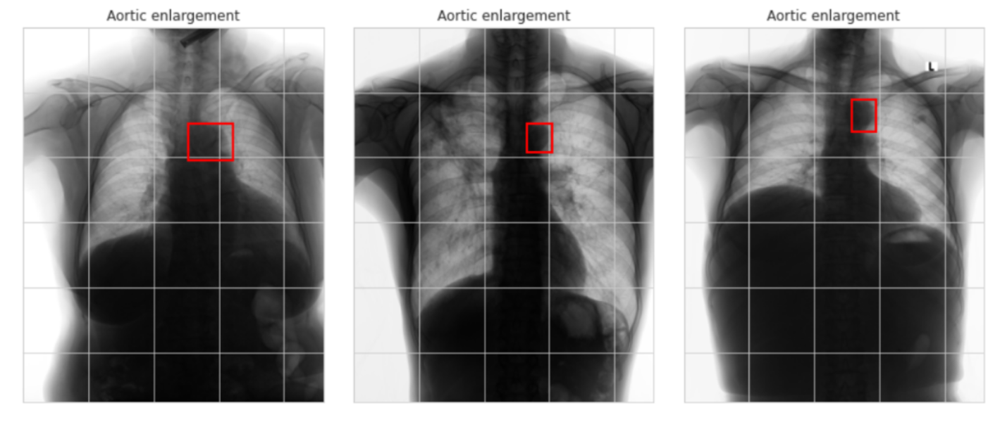
III/ Dataset
3. Data statistics

Slide 12
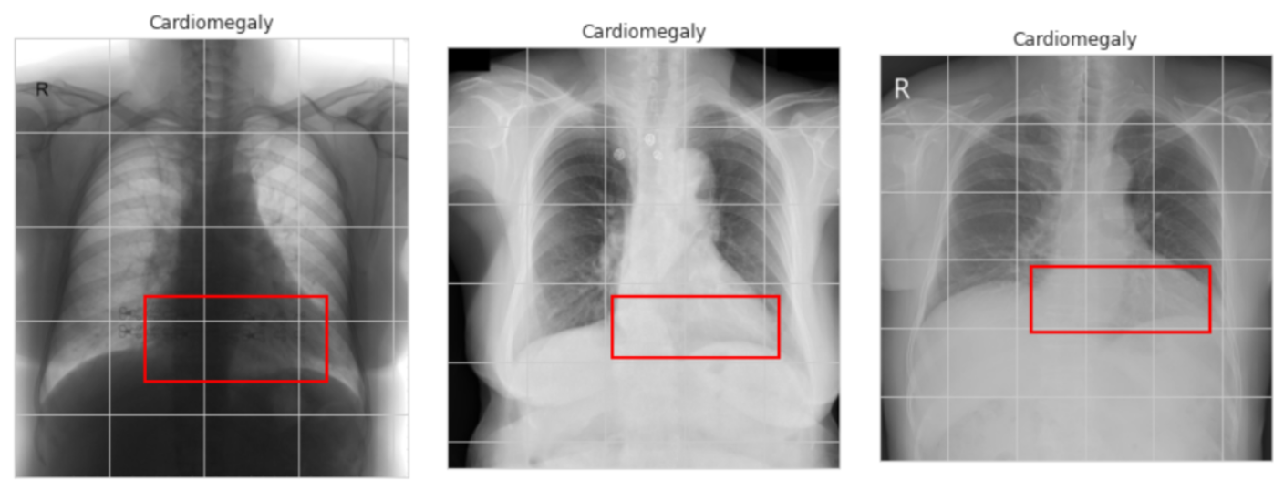
III/ Dataset
3. Data statistics

Slide 13
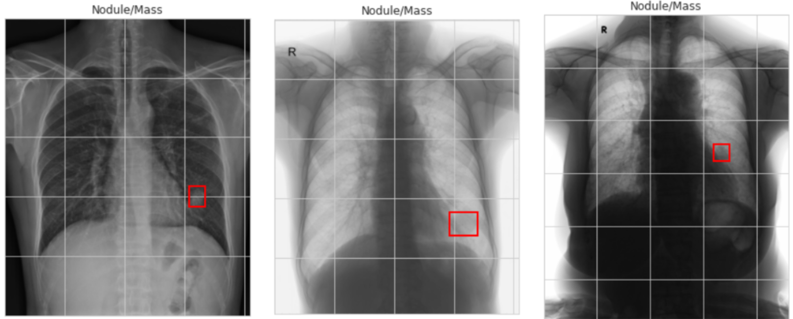
III/ Dataset
3. Data statistics

Slide 14
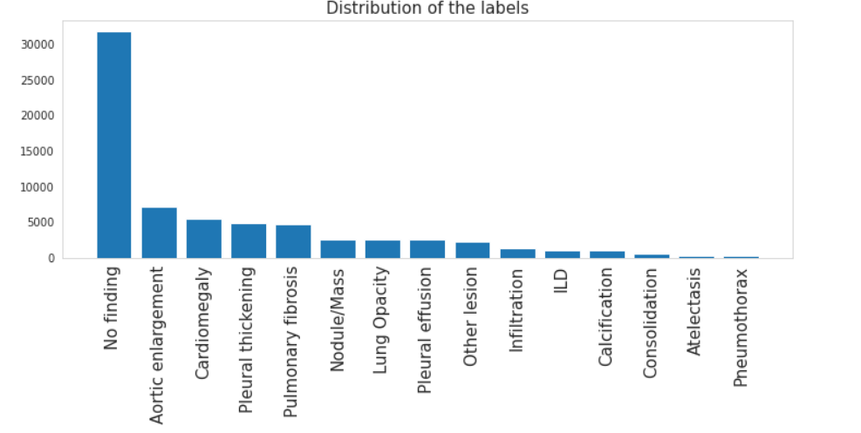
III/ Dataset
3. Data statistics
The training set comprises 15,000 postero-anterior (PA) CXR scans in DICOM format, which were de-identified to protect patient privacy. The distribution of the labels of the dataset is shown in Figure.

Slide 15
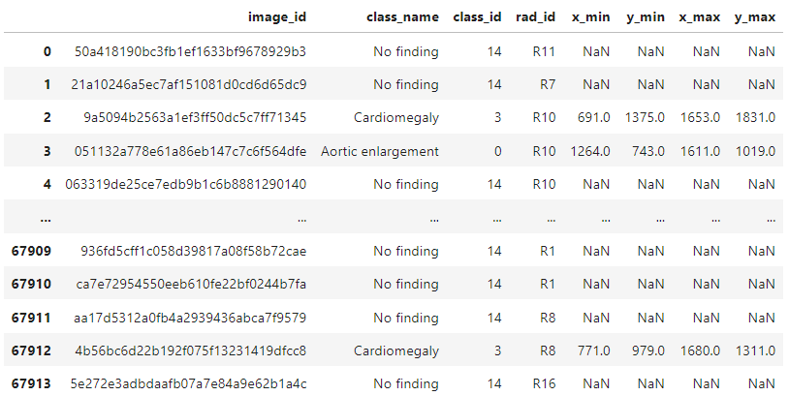
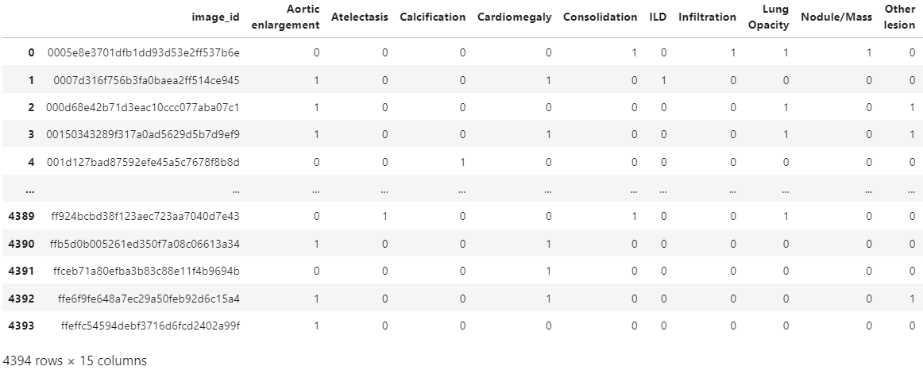
III/ Dataset
3. Data statistics
Grouped data by image_id
Deleted column ‘No finding’

Slide 16
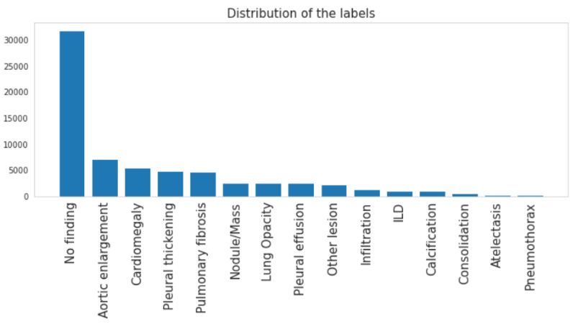
Distribution of the labels before deleting ‘No finding’

Slide 17
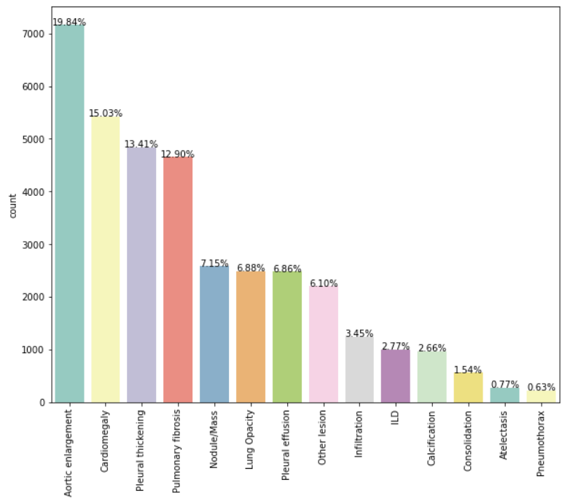
Distribution of the labels after deleting ‘No finding’

Slide 18
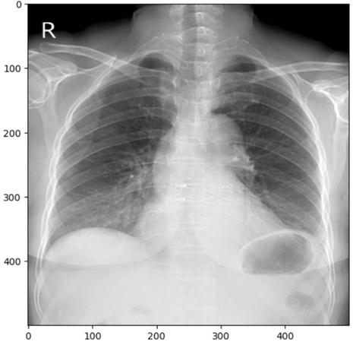
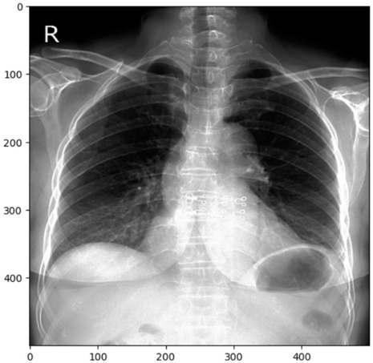
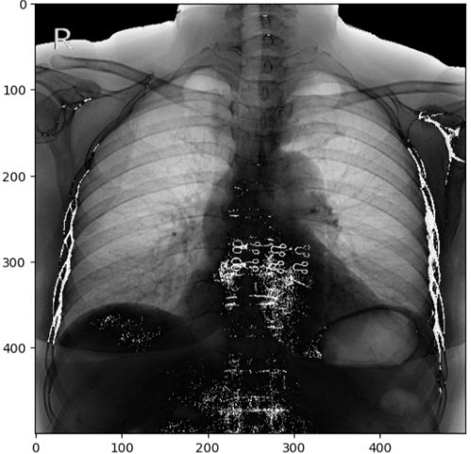
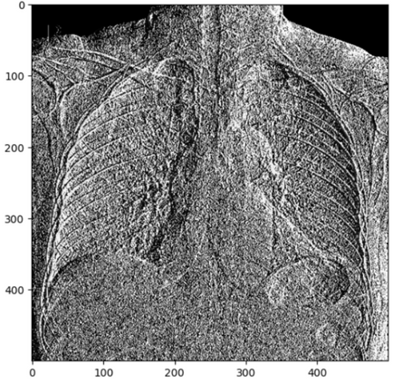
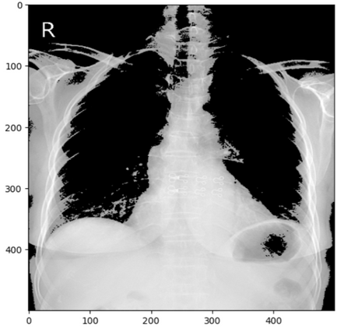
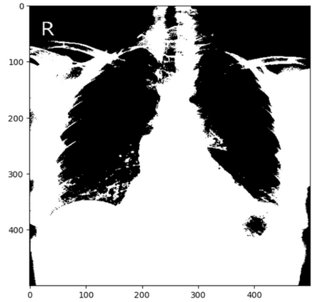
IV/ Preprocessing methods
No preprocess
Exposure + Histogram
Laplace Gaussian
Sobel
Noisy threshold
Less noisy threshold

Slide 19
V/ Proposed models
1. Swin transformer
A vision Transformer uses non-overlapping windows that shift between layers, which allows the model to efficiently capture both local and global visual features by processing image patches within windows and then shifting these windows to capture cross-window connections.
Scalable and suitable for a wide range of vision applications, from image classification to object detection and segmentation

Slide 20
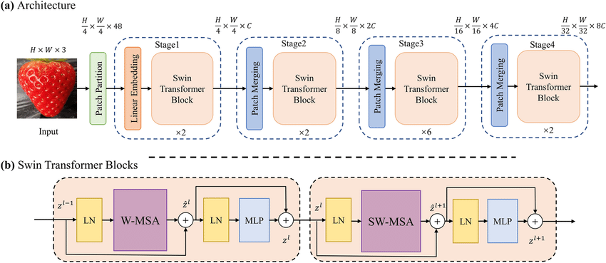
V/ Proposed models
1. Swin transformer

Slide 21
V/ Proposed models
2. UNet transformer
Transformer-based architecture for medical image segmentation that utilizes a pure transformer as the encoder to learn sequence representations of the input volume -- effectively capturing the global multi-scale information.
The transformer encoder is directly connected to a decoder via skip connections at different resolutions like a U-Net to compute the final semantic segmentation output.

Slide 22
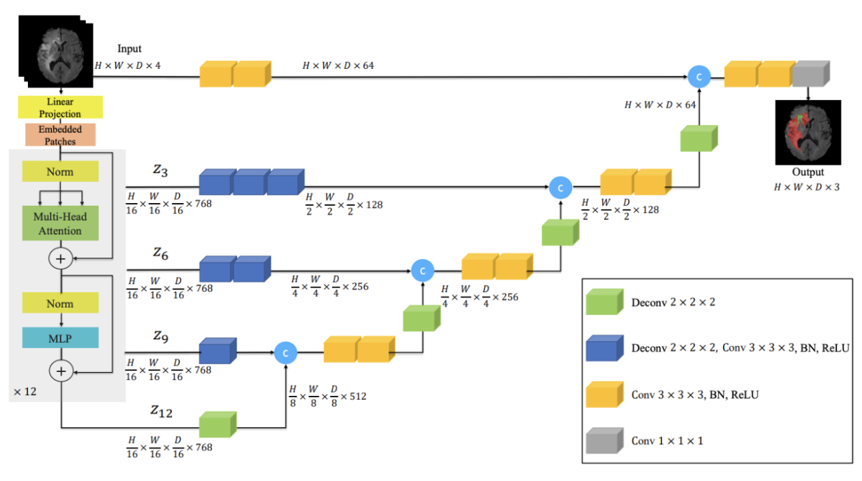
V/ Proposed models
2. UNet transformer
Overview of the UNETR architecture. We extract sequence representations of different layers in the transformer and merge them with the decoder via skip connections. Output size demonstrated for patch dimension N = 16 and embedding size C = 768

Slide 23
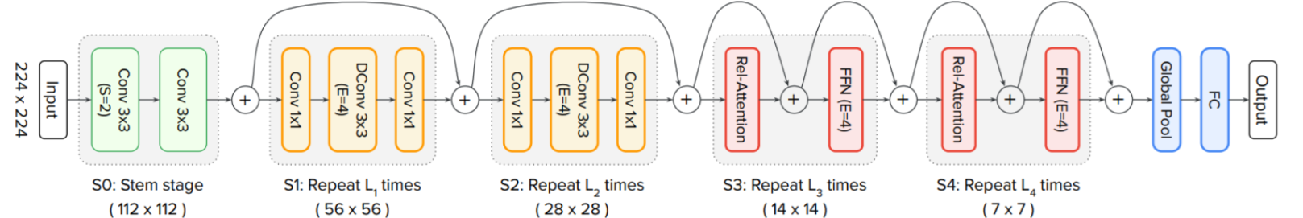
V/ Proposed models
3. CoAtNet
The neural network architecture that combines the strengths of Convolutional Neural Networks (CNNs) and Transformers. It is designed to leverage the local feature extraction capabilities of CNNs and the global context modeling power of Transformers to achieve superior performance in computer vision tasks.
Overview of the proposed CoAtNet

Slide 24
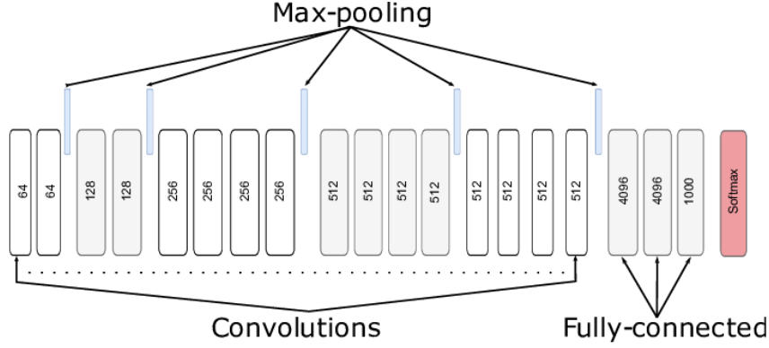
V/ Proposed models
4. VGG-19
VGG-19 is renowned for its depth and simplicity, and it played a pivotal role in the advancement of deep learning for image recognition. Its architecture consists of 19 layers, including 16 convolutional layers, 3 fully connected (FC) layers, and 5 max-pooling layers. The final layer is a softmax layer.
Overview of the proposed VGG-19

Slide 25
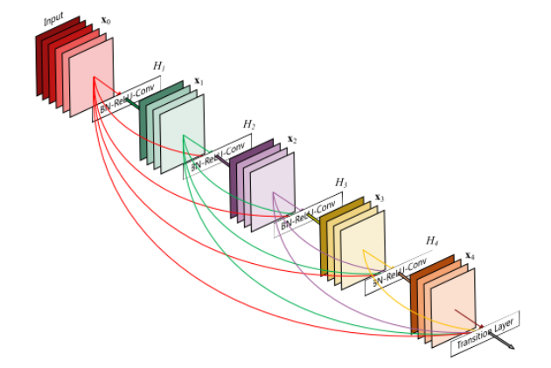
V/ Proposed models
5. DenseNet
A DenseNet is a type of convolutional neural network that utilises dense connections between layers, through Dense Blocks, where we connect all layers (with matching feature-map sizes) directly with each other.
The input of a layer inside DenseNet is the concatenation of feature maps from previous layers.
The DenseNet architecture

Slide 26
VI/ Experiments
1. Experiment Settings
Apply five models under five different preprocessing techniques to examine the impact of each method on models’ ability to learn and classify diseases.
Settings:
Optimizer: Adam with a 3e-5 learning rate
Batch size: 8
Epoch: 10
Loss function: BCEWithLogitsLoss

Slide 27
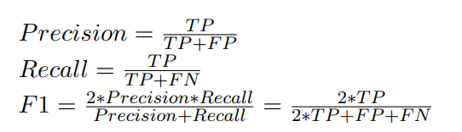
VI/ Experiments
2. Evaluation Metrics
F1-score macro, which is the harmonic mean of precision and recall, is used because of the imbalance of the labels in the dataset.
The formula of F1-score is as follow with TP, FP, and FN denoted for True Positive, False Positive and False Negative respectively:

Slide 28
VI/ Experiments
3. Results and Discussion
 | F1-scores | Precision | Recall | Accuracy
SwinTran | 0.3657 | 0.5332 | 0.3703 | 0.7872
UNetr | 0.3609 | 0.5887 | 0.3196 | 0.8250
CoAtNet | 0.2177 | 0.4025 | 0.2032 | 0.8049
VGG19 | 0.3617 | 0.4642 | 0.3432 | 0.8058
DenseNet | 0.1560 | 0.1811 | 0.1563 | 0.7914

Slide 29
VI/ Experiments
4. Analyzing the effectiveness of image preprocessing
 | SwinTran | Unetr | CoAtNet | VGG19 | DenseNet
No preprocess | 0.3657 | 0.3609 | 0.2177 | 0.3617 | 0.1564
Exposure + Hist | 0.3783 | 0.3428 | 0.2175 | 0.3672 | 0.1582
Laplace Gaussian | 0.3941 | 0.3625 | 0.2384 | 0.2164 | 0.1485
Sobel | 0.3611 | 0.3436 | 0.2244 | 0.2550 | 0.1386
Thresholding - noisy | 0.1476 | 0.1043 | 0.1494 | 0.1494 | 0.1043
Thresholding - less noisy | 0.1494 | 0.1043 | 0.1472 | 0.1494 | 0.1043

Slide 30
 | SwinTran |  | VGG19
 | NoPrep | LapGau | NoPrep | ExHist
Aortic enlargement | 0.85 | 0.85 | 0.85 | 0.84
Atelectasis | 0.25 | 0.23 | 0.00 | 0.10
Calcification | 0.03 | 0.03 | 0.07 | 0.03
Cardiomegaly | 0.71 | 0.74 | 0.78 | 0.75
Consolidation | 0.06 | 0.11 | 0.25 | 0.25
Interstitial Lung Disease (ILD) | 0.43 | 0.34 | 0.09 | 0.16
Infiltration | 0.03 | 0.30 | 0.29 | 0.25
Lung Opacity | 0.52 | 0.54 | 0.46 | 0.40
Nodule/Mass | 0.12 | 0.15 | 0.15 | 0.24
Other lesion | 0.45 | 0.43 | 0.35 | 0.35
Pleural effusion | 0.54 | 0.60 | 0.54 | 0.54
Pleural thickening | 0.55 | 0.60 | 0.64 | 0.67
Pneumothorax | 0.00 | 0.00 | 0.00 | 0.00
Pulmonary fibrosis | 0.58 | 0.59 | 0.57 | 0.56

Slide 31
SwinTran | Original | LapGau | Hist | Sobel
Aortic enlargement | 0.85 | 0.85 | 0.85 | 0.83
Atelectasis | 0.25 | 0.23 | 0.31 | 0.22
Calcification | 0.03 | 0.03 | 0.07 | 0.00
Cardiomegaly | 0.71 | 0.74 | 0.75 | 0.69
Consolidation | 0.06 | 0.11 | 0.00 | 0.00
Interstitial Lung Disease (ILD) | 0.43 | 0.34 | 0.37 | 0.33
Infiltration | 0.03 | 0.30 | 0.22 | 0.24
Lung Opacity | 0.52 | 0.54 | 0.51 | 0.51
Nodule/Mass | 0.12 | 0.15 | 0.19 | 0.03
Other lesion | 0.45 | 0.43 | 0.44 | 0.41
Pleural effusion | 0.54 | 0.60 | 0.49 | 0.44
Pleural thickening | 0.55 | 0.60 | 0.48 | 0.59
Pneumothorax | 0.00 | 0.00 | 0.00 | 0.15
Pulmonary fibrosis | 0.58 | 0.59 | 0.63 | 0.62

Slide 32
VII/ Conclusion & Future work
In this report, we conduct some experiments with medical image preprocessing and deep learning approach which is neural network architectures selection.
Swin Transformer achieves highest F1-macro score of 0.3657 on the test set for chest X-ray abnormalities detection task without using any preprocessing technique. This result can be accepted because of the variety of the labels from the dataset.
We also compare the impact of each preprocessing method on the models and find out that Laplace Gaussian is suitable with SwinTran, UNetr and CoAtNet, while Exposure + Histogram is more compatible with VGG19 and DenseNet. Swin Transformer with Laplace Gaussian and VGG19 with Exposure + Histogram has the best performance with an F1-macro score of 0.3941 and 0.3672, respectively.

Slide 33
VII/ Conclusion & Future work
We would like to conduct follow-up research to improve performance by:
Acquiring more diverse chest X-ray images to enhance the robustness of the model including low-quality images, images with rare diseases,... This will enable the model to better generalize to real-world scenarios and improve its ability to handle unseen data.
Investigating instance segmentation techniques to identify and segment individual abnormalities within chest X-ray images. This would allow for more precise localization and quantification of abnormalities, potentially aiding in clinical decision-making.

Slide 34
Thank you for listening
Q&A?

Slide 35
Chest X-Ray Abnormalities
Detection on VinBigAI dataset
Môn học: Xử lý ảnh y khoa - DS312.O21
GVHD: TS. Nguyễn Tất Bảo Thiện
Đỗ Phú Duy – 21520205
Trần Nguyên Mẫn – 21522325
Nguyễn Phúc Hào – 21522047
Phan Lê Chí Trung – 21522725
Nguyễn Ngọc Lương – 21522311

