Slide 1
This is a test

Slide 2
Background
Motivation
FNs’ distribution Analysis
Case study
Conclusions

Slide 3
Background
WFS model
Purpose: generate alerts which surveil for key compliance Regulatory and Financial Crimes risk.
Model consists of key indicators(KIs) developed by Ai ML CoE to generate alerts for compliance risk such as Complaints, Cheating&Illegality, Rumor, Secrecy.
Alerts produced by the model’s Kis will first be reviewed by the Compliance Central Review Teams (CRT) and then escalated to the appropriate party if deemed necessary.
Motivation
Monitor and maintain model
Recall estimation
Random sampling, stratified sampling(BTL sampling): (1) low risk area/high risk area. (2) divide the BTL area into 10 equal bins, randomly sample from each bin.
SME team: upper limit of 2000 annotations.

Slide 4
Background
WFS model
Purpose: generate alerts which surveil for key compliance Regulatory and Financial Crimes risk.
Model consists of key indicators(KIs) developed by Ai ML CoE to generate alerts for compliance risk such as Complaints, Cheating&Illegality, Rumor, Secrecy.
Alerts produced by the model’s Kis will first be reviewed by the Compliance Central Review Teams (CRT) and then escalated to the appropriate party if deemed necessary.
Motivation
Monitor and maintain model
Recall estimation
Random sampling
stratified sampling(BTL sampling): (1) low risk area/high risk area. (2) divide the BTL area into 10 equal bins, randomly sample from each bin.
Assumption: zero FNs at low risk area or zero FNs around low probability score bins.
SME team: upper limit of 2000 annotations.

Slide 5
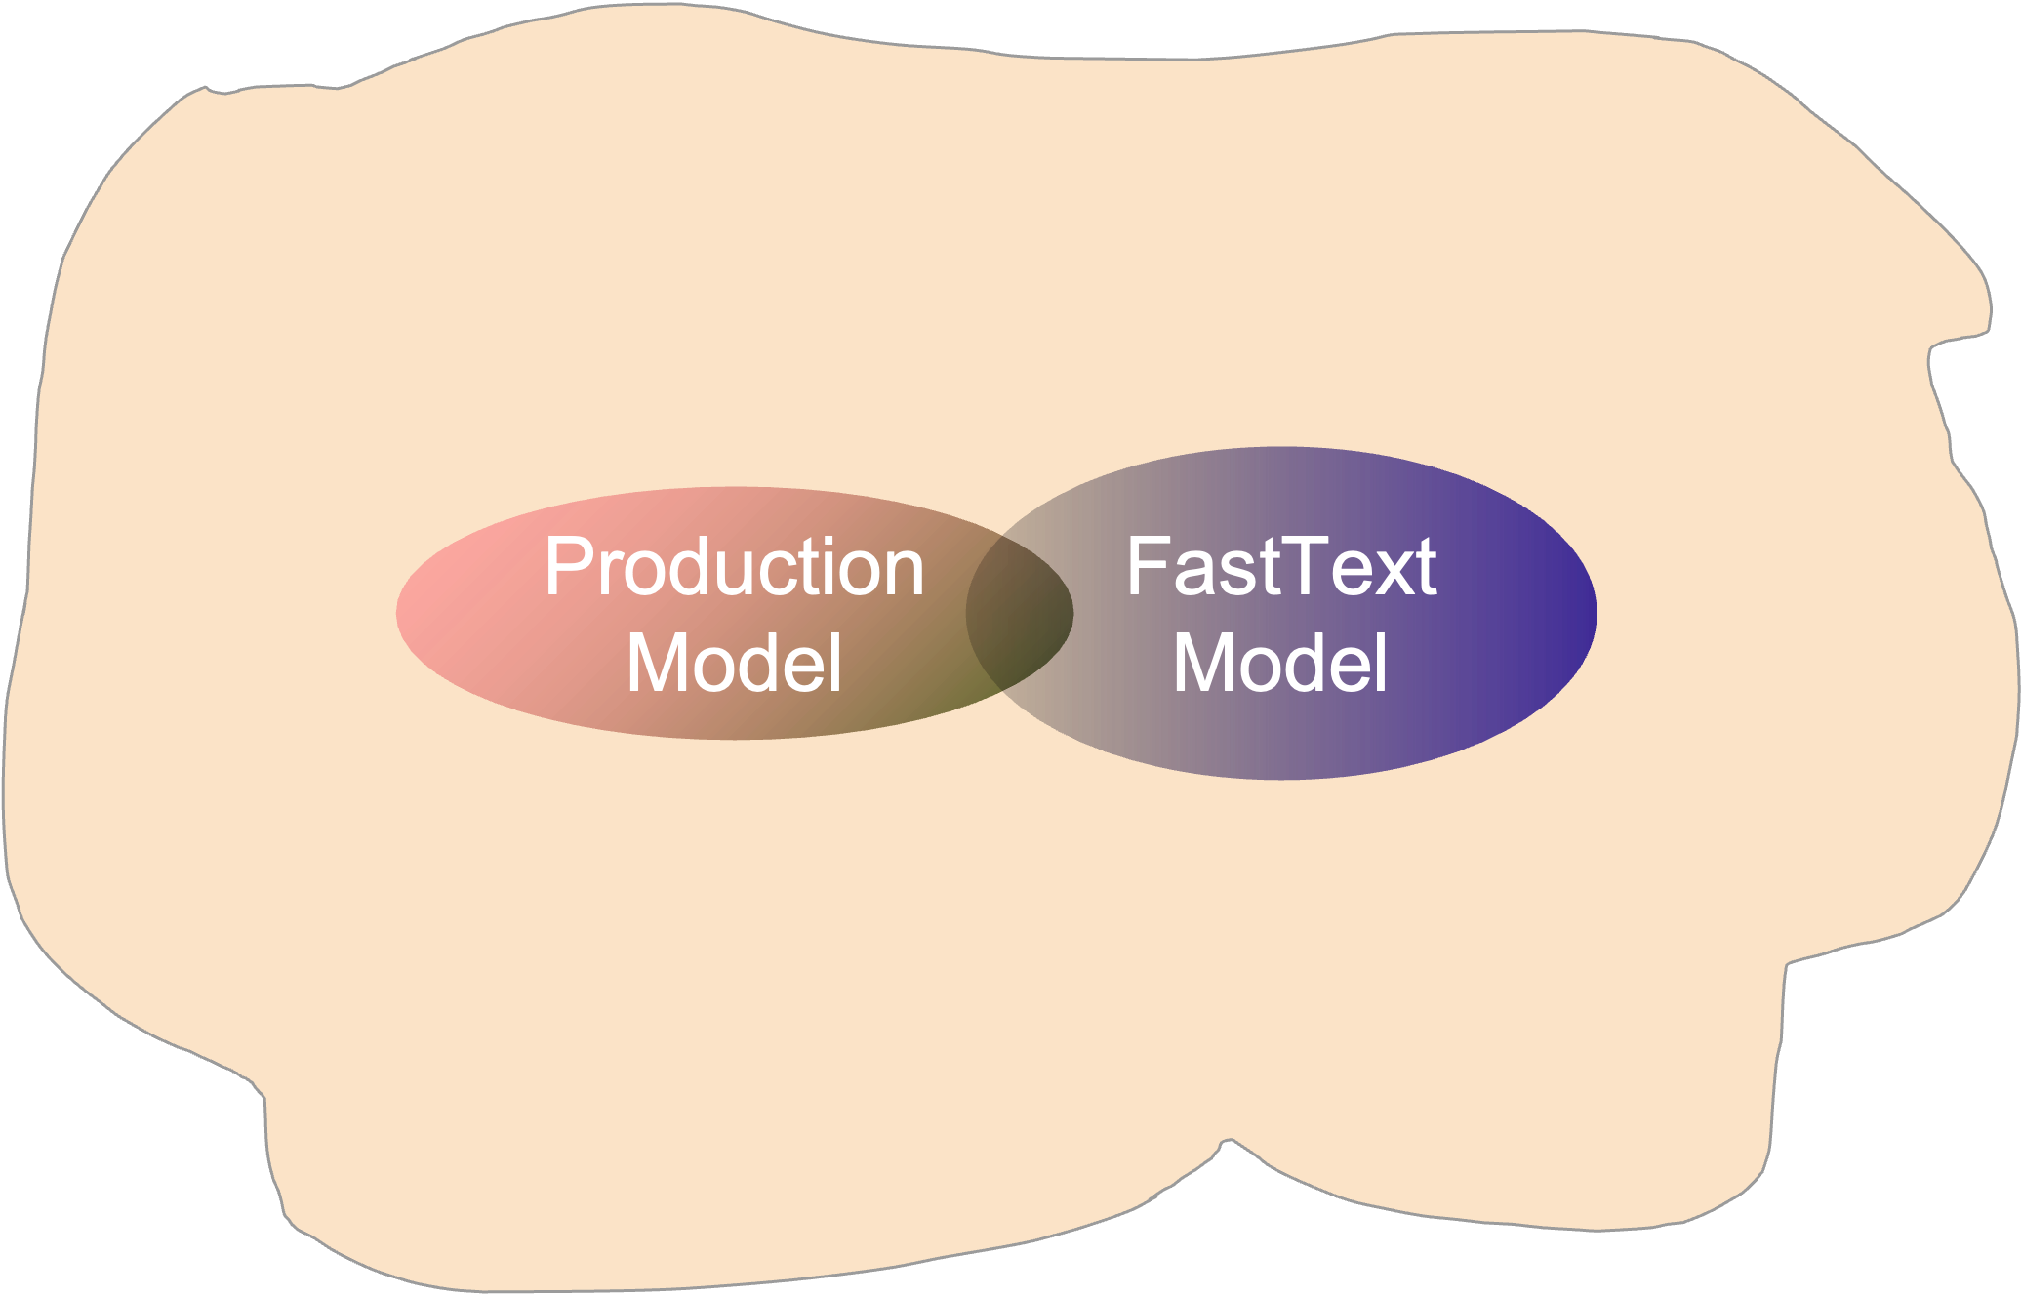

Slide 6
Majorities FNs
0.95 threshold
0.85 threshold
A few FNs
0.95 threshold
Probability
A few FNs
0.50 threshold
0.85 threshold
Zero FNs
A few FNs
0.50 threshold
Majorities FNs

Slide 7





# of FNs
# of FNs
# of Sentences
# of Sentences
Threshold
Threshold
Not Sampleable
Sampleable
Not Sampleable
Count
Count
$$0$$
$$0.5$$
$$T$$
$$0$$
$$T$$
Probability Score
Probability Score

Slide 8
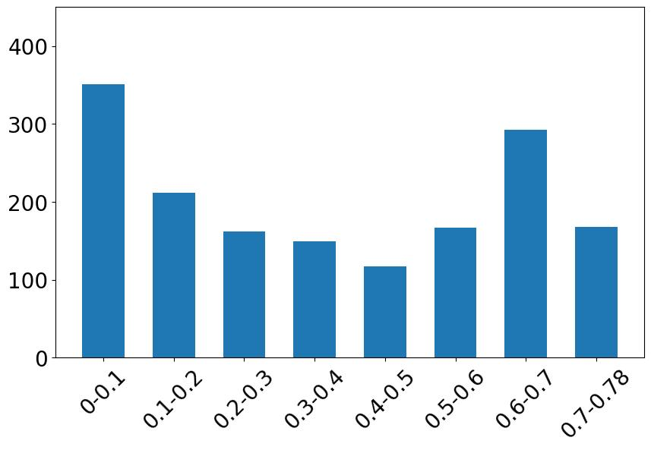
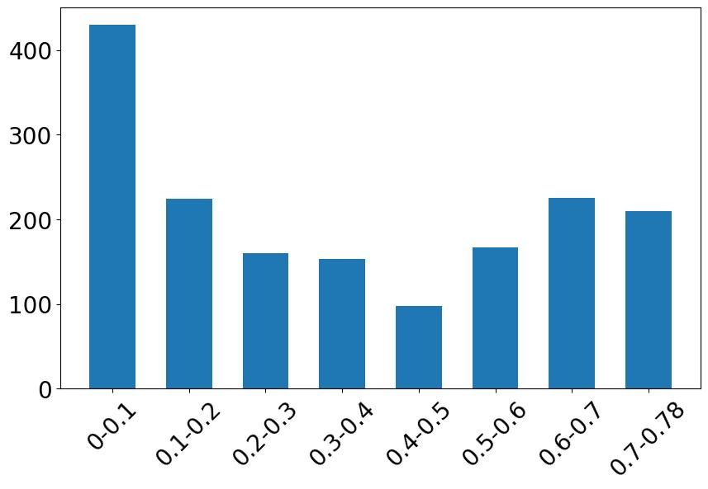
XGboost
CV
Threshold=0.81
F-score = 0.70
Tfidf
Threshold= 0.81
F-score = 0.71
0.7-0.81
0.7-0.81

Slide 9
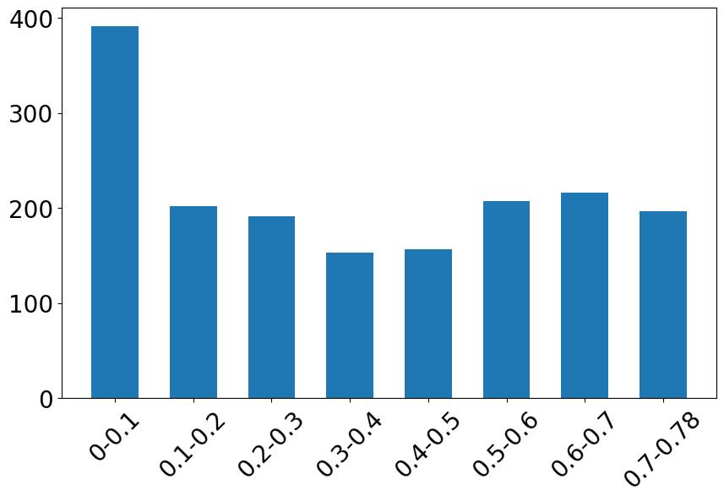
Tfidf + SelectKBest + LR
F-score=0.647
Threshold = 0.78

Slide 10
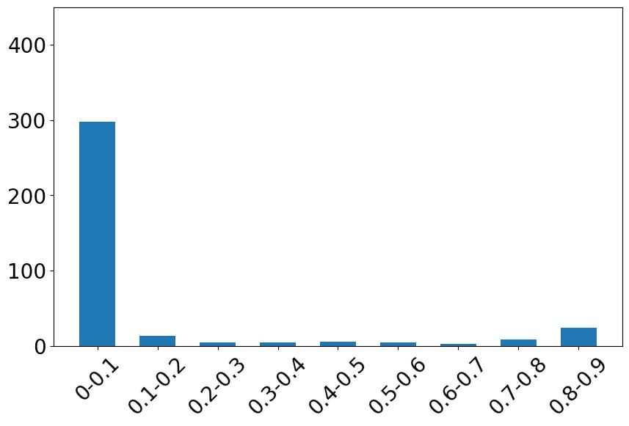
FinBert
Pretrained BERT on Financial Corpus
F1-score = 0.79
Threshold = 0.90
FNs distribution
Probability

