Slide 1
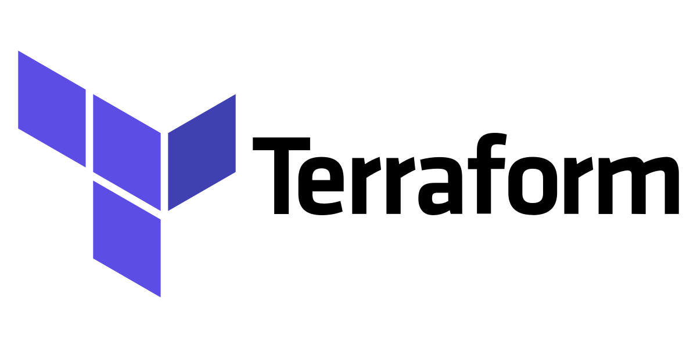

Slide 2
What is Terraform
Why Terraform
Automate and manage your infrastructure / platform / services
It's open source
declarative
Tool for infrastructure provisioning.
Manage any infrastructure
Track your infrastructure
Automate changes
Standardize configurations
Collaborate
Notes:
Terraform is an infrastructure as code tool that let you define your desired infrastructure in human readable configuration file that you can version, reuse and share
Declarative = define what end result you want. no need to define every step of how it's done.
Why
There are thousands of providers(plugins) available for most of the platforms and services, In case of unavailability of provider , you can create your own one.
TF keep track of your real infra in a state file. which acts as a source of truth for your environment.
as TF configuration files are declarative, you do not need to write step by step instructions.
TF supports reusable configuration components called modules that define configurable collection of infra, it save lot of time and encourage the best practices.
Configurations are written in file so easy to manage in VCS and collaborate.

Slide 3
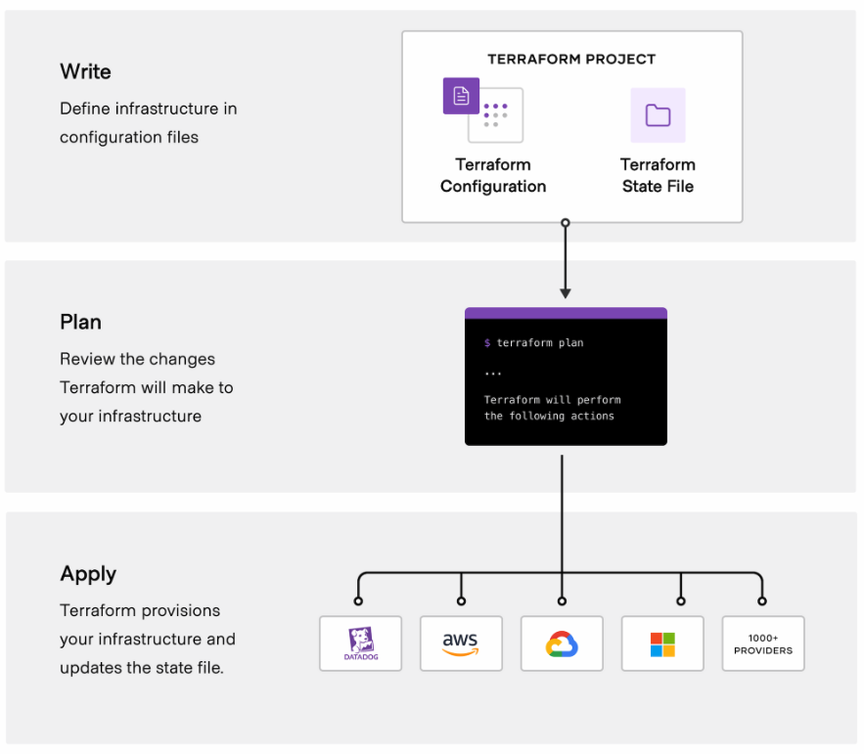
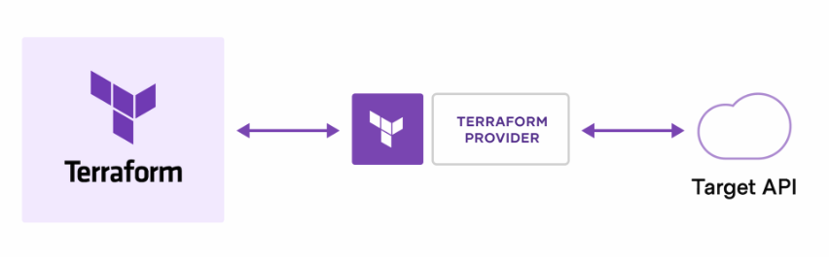
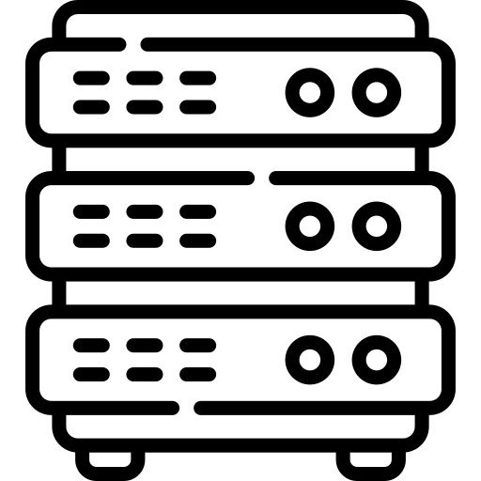


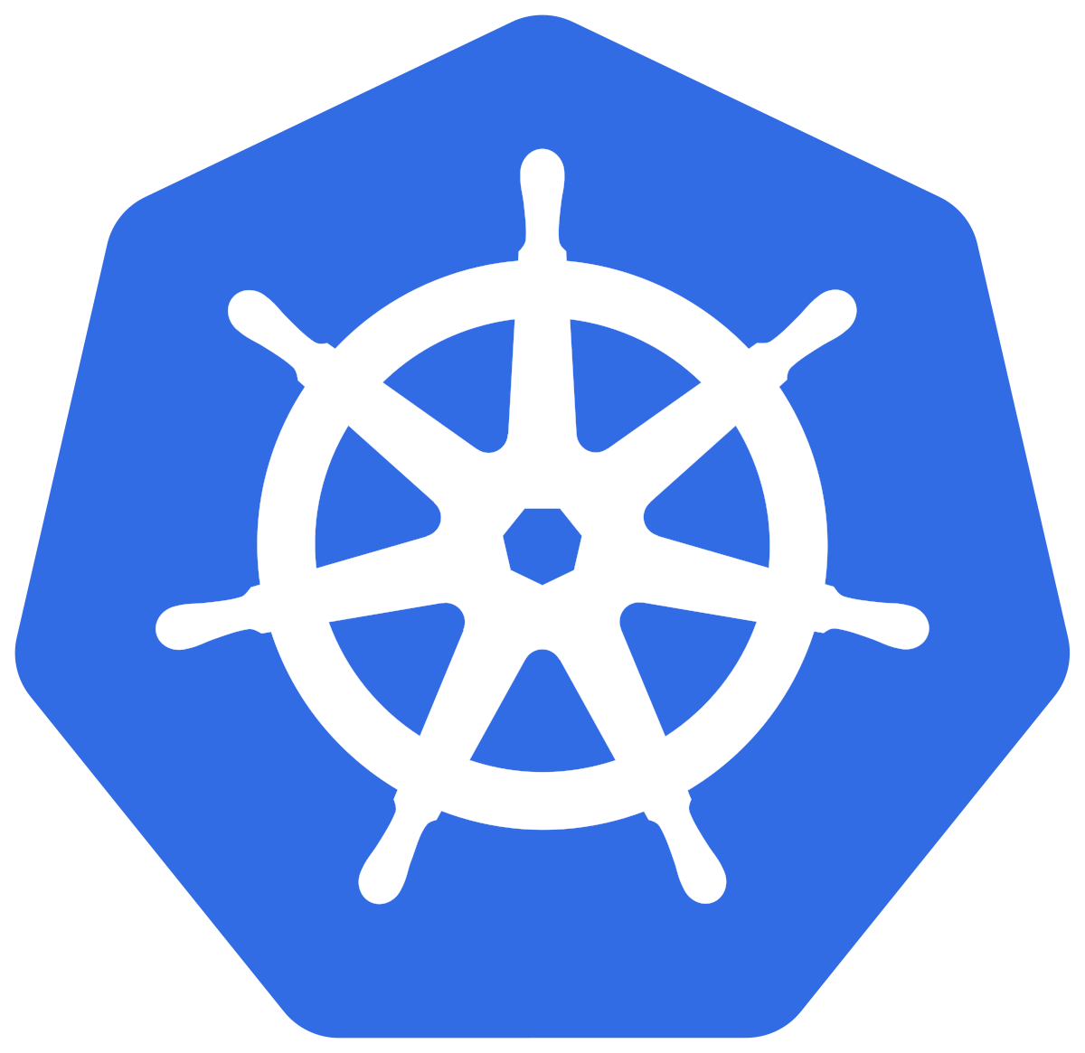




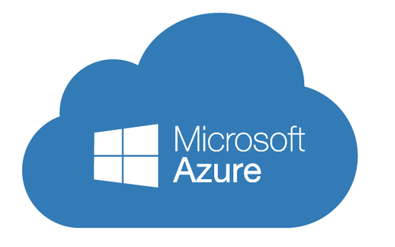
How It work ?
Terraform creates and manage resources through their APIs.
Providers enable Terraform to work with virtually any platform or service via API.
More than 1700 providers.
Physical Machines
VMWare
AWS
Kubernetes
GitHub
GCP
Oracle Cloud
Grafana
Azure
BigIP
auth0
Artifactory
Terraform Providers
Notes:
Provider in terraform is a connection that allows terraform to manage infrastructure using pre defined interface.
Providers are not part of the main Terraform source code. They are separate binaries that live in their own repos

Slide 4
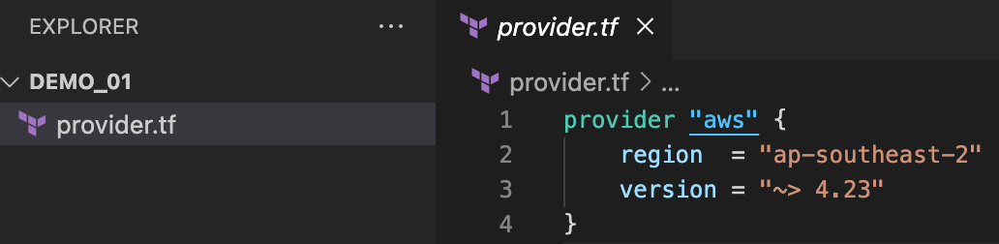
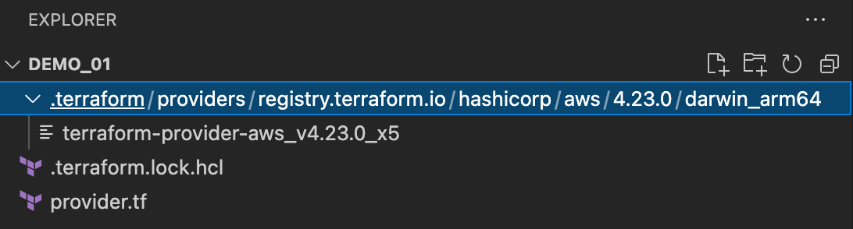
Providers
Terraform init process download the all defined providers.
You should use the version constraint to avoid the breaking changes.
terraform init

Slide 5
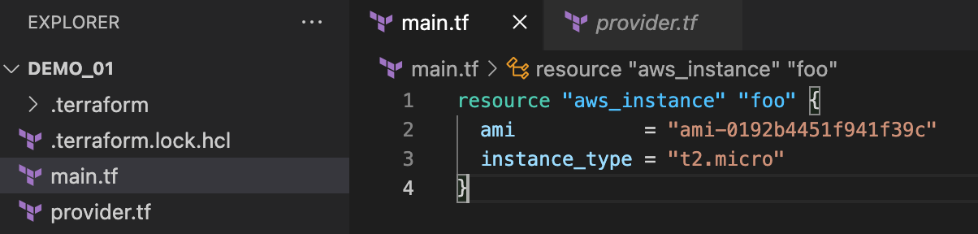
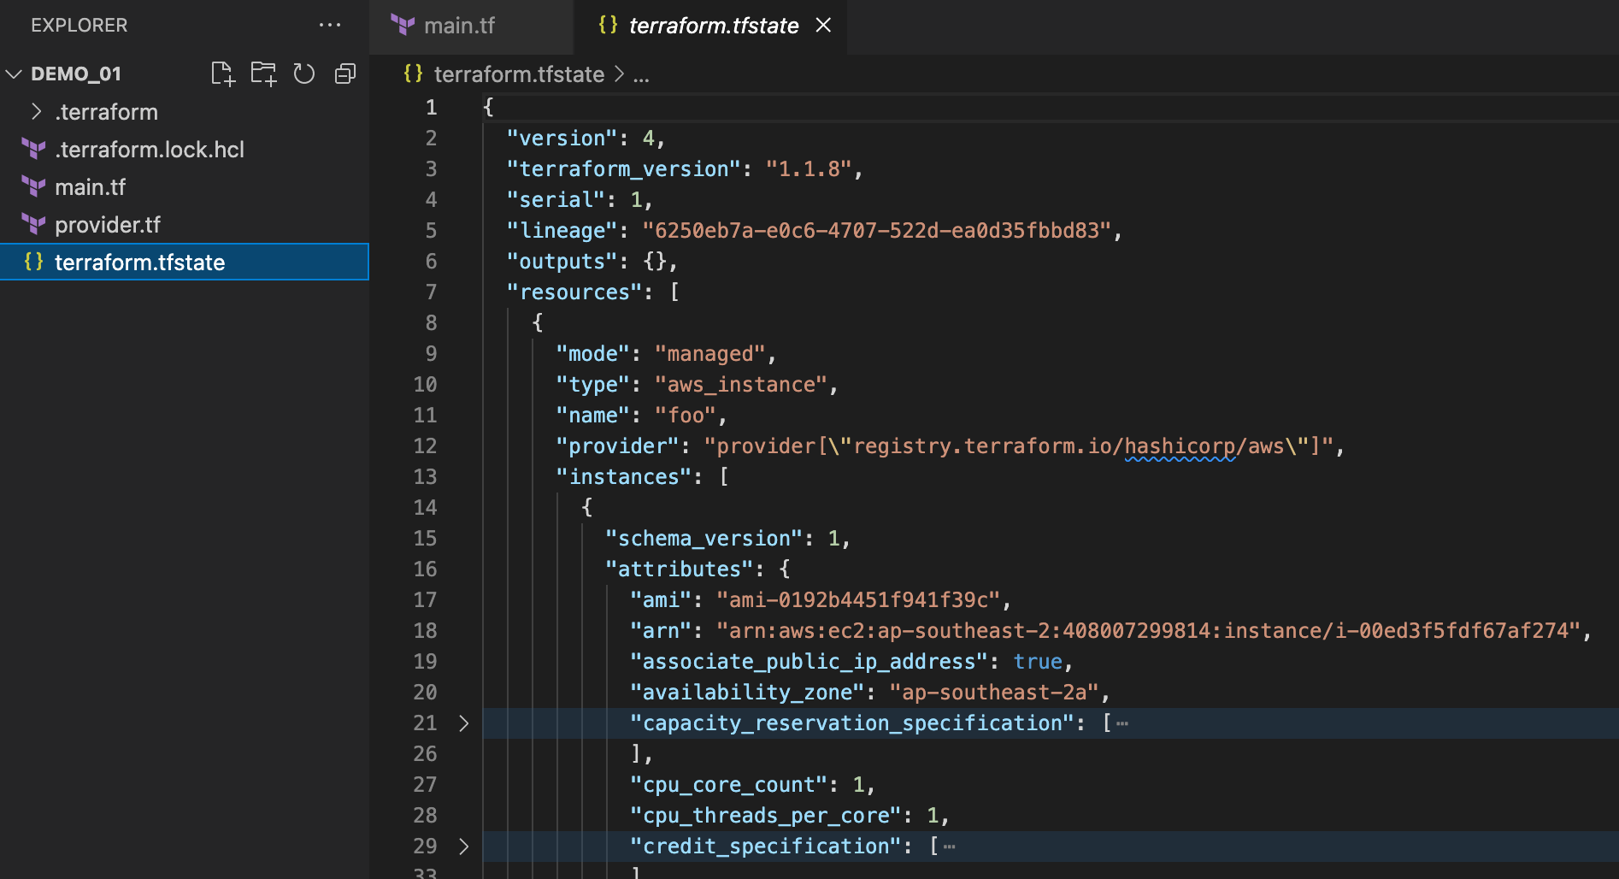
Resources
Resources in TF represent a thing in the real world.
Resource block allow you to define how you want to create something in real world.
Terraform plan
Terraform apply

Slide 6
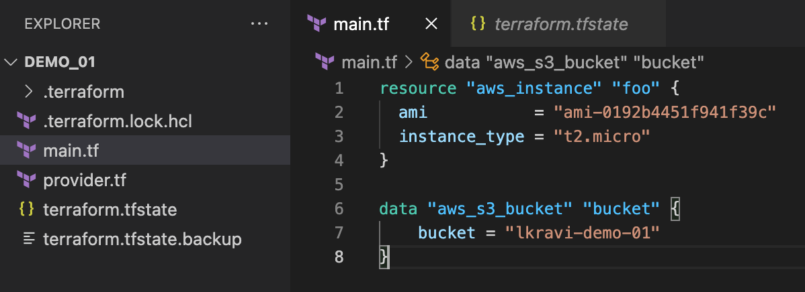
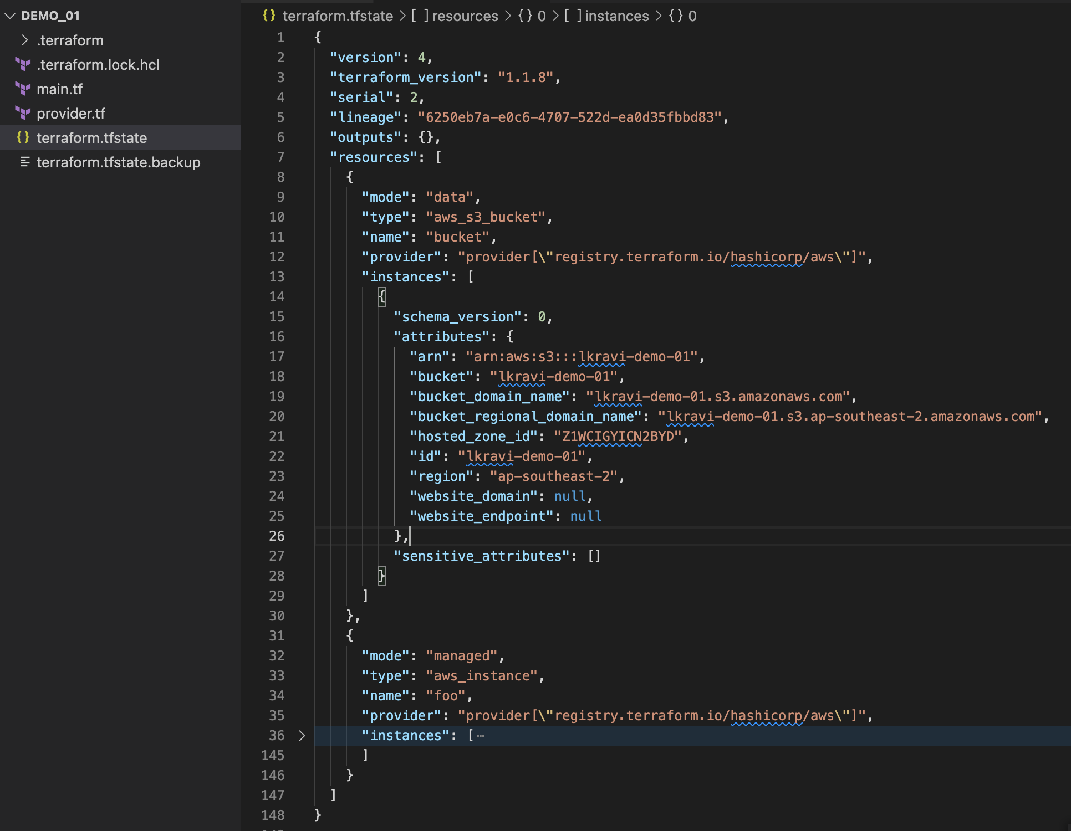
Data Sources
Data Source in TF is used to fetch data from a resource that is not managed by the current Terraform project.
Readonly resource.

Slide 7
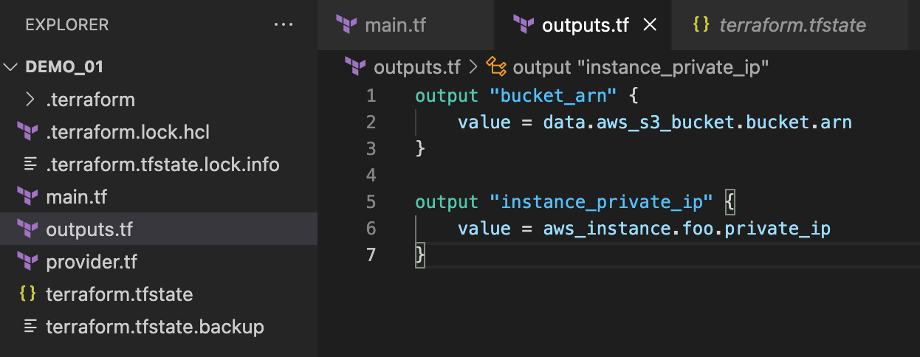
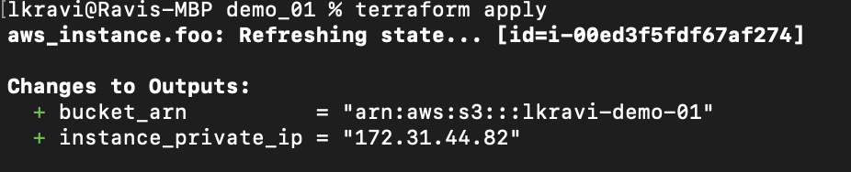
Outputs
Output values make information about your infrastructure available on the command line, and can expose information for other Terraform configurations to use. Output values are similar to return values in programming languages.
Notes:
Output values are like function return values.

Slide 8
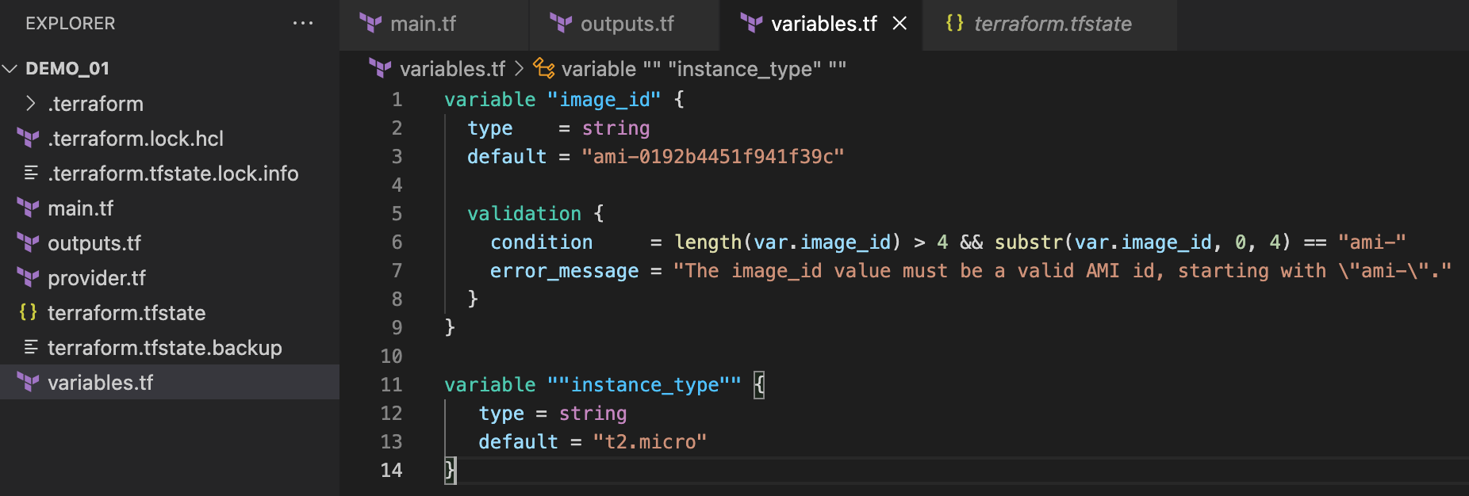
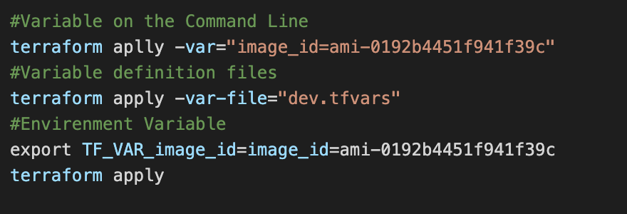
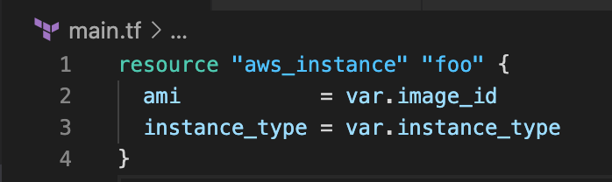
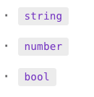
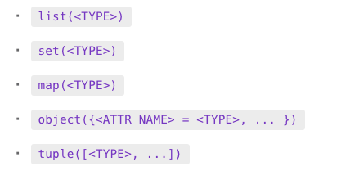
Variables
Passing dynamic values to use in runtime
Variable Definition Precedence
Type Constraints
Environment variables
The terraform.tfvars file, if present.
The terraform.tfvars.json file, if present.
Any *.auto.tfvars or *.auto.tfvars.json files,
Any -var and -var-file options on the command line
Notes:
Input variables are like function arguments.

Slide 9
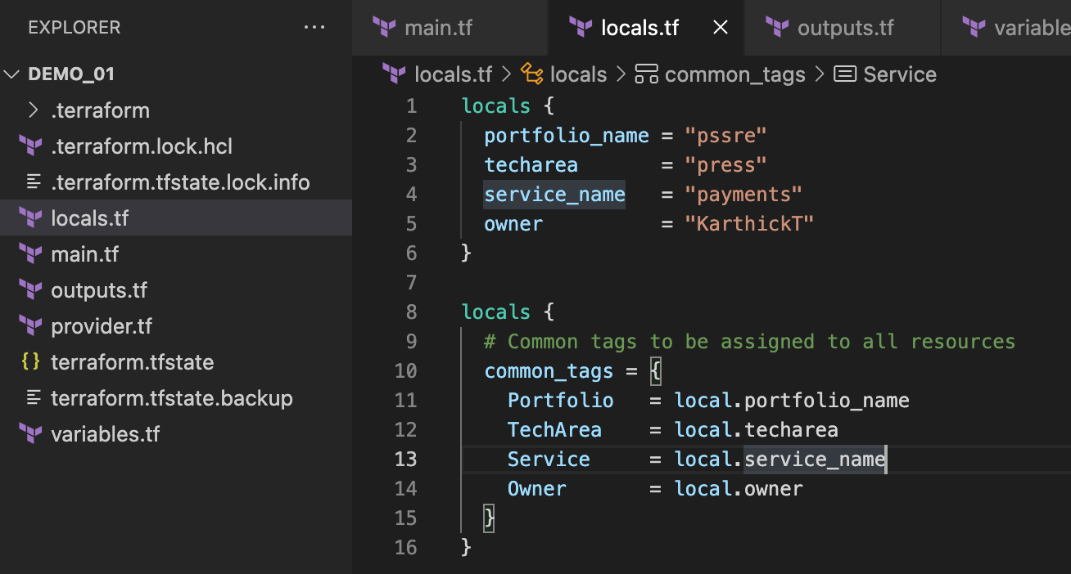
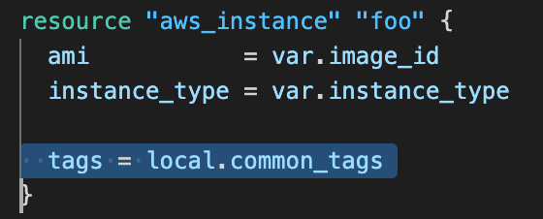
Locals
A Local value assigns a name to an expression, so you can use that multiple times without repeating the expression.
Notes:
Local values are like a function's temporary local variables.

Slide 10
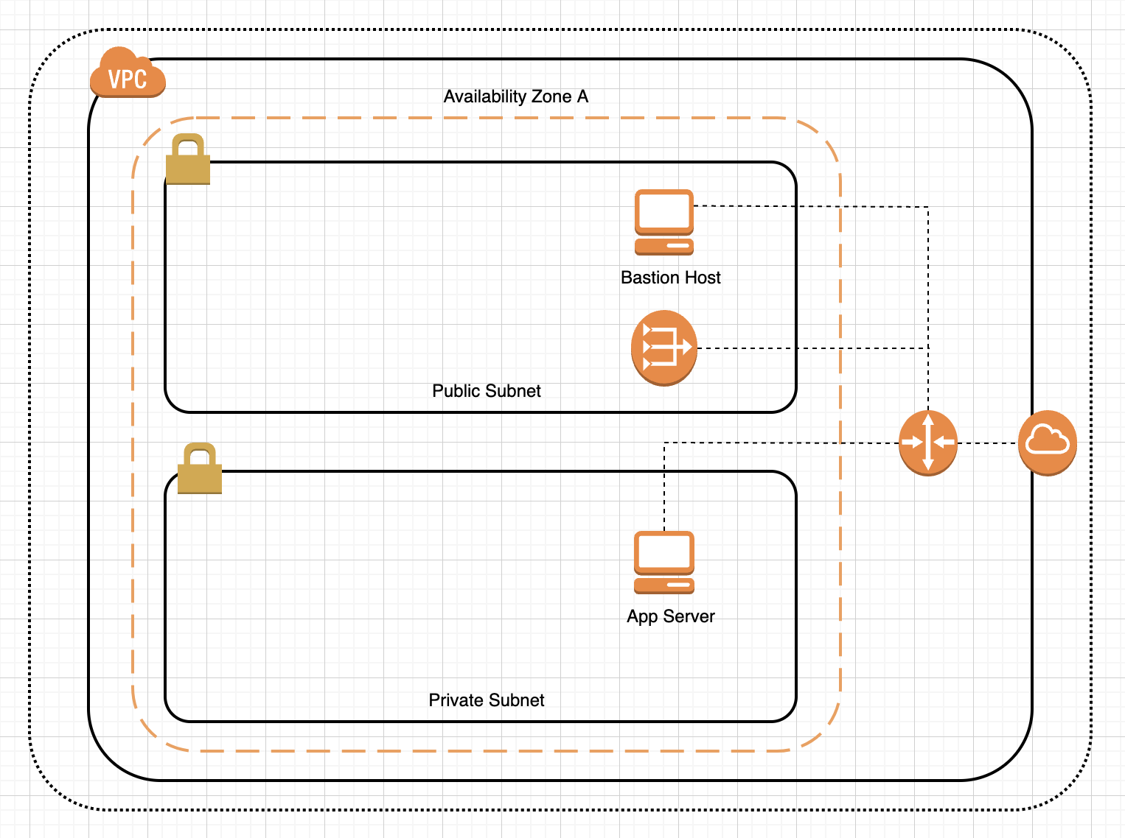

Let's see some scenarios.
I'm Sam, I'm tasked with creating cloud infrastructure for this architecture.

Slide 11
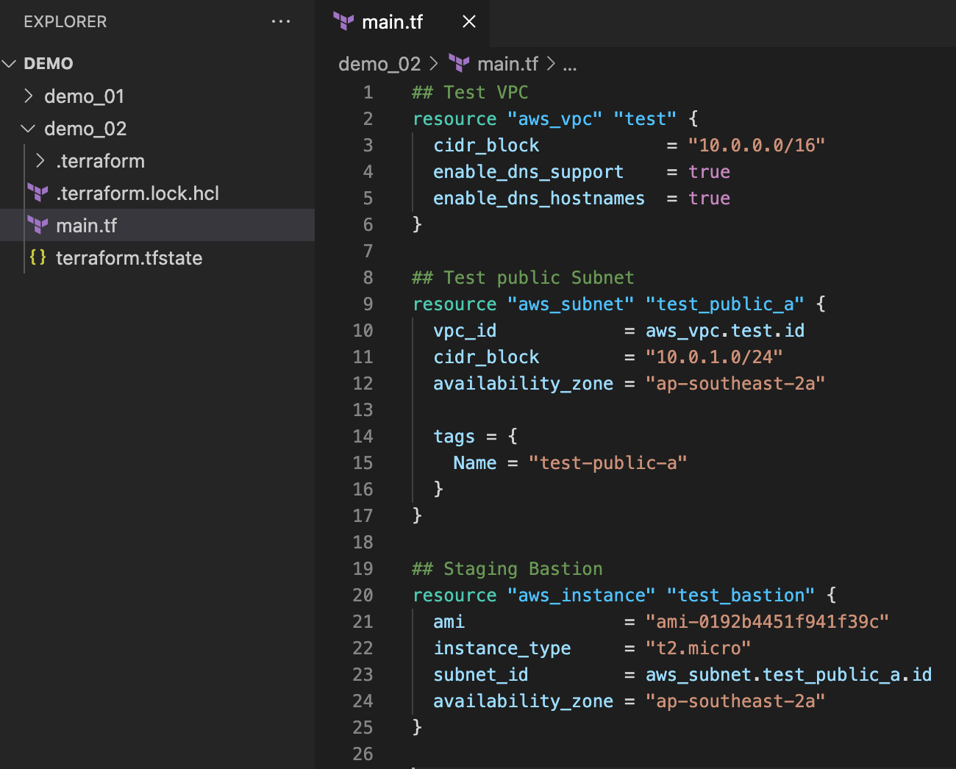
Sam start trying things out in staging environment.
Created test VPC, Subnet & Bastion host

Slide 12
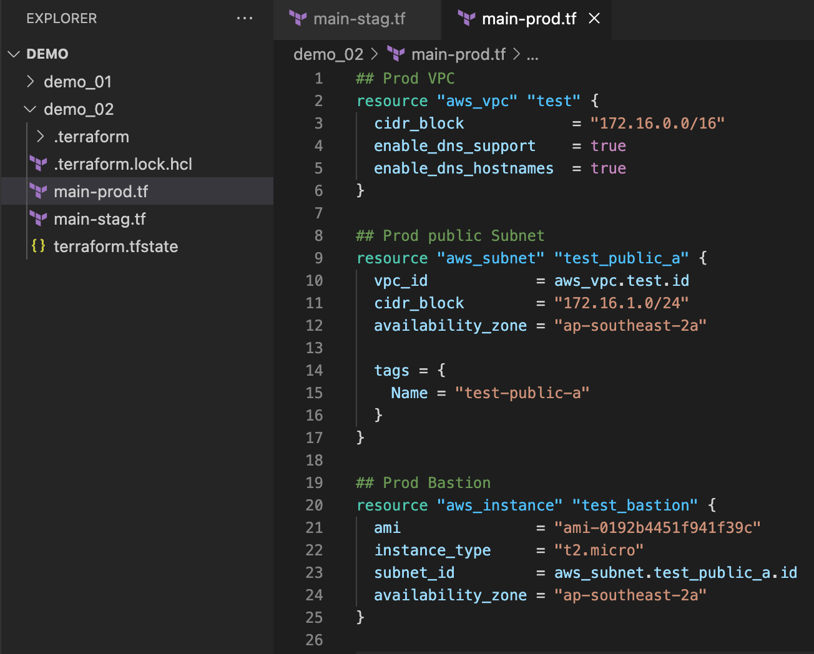
Sam's got instructions to create prod bastion host as well.
He decided to get a copy from staging tf file and do the required changes.

Slide 13
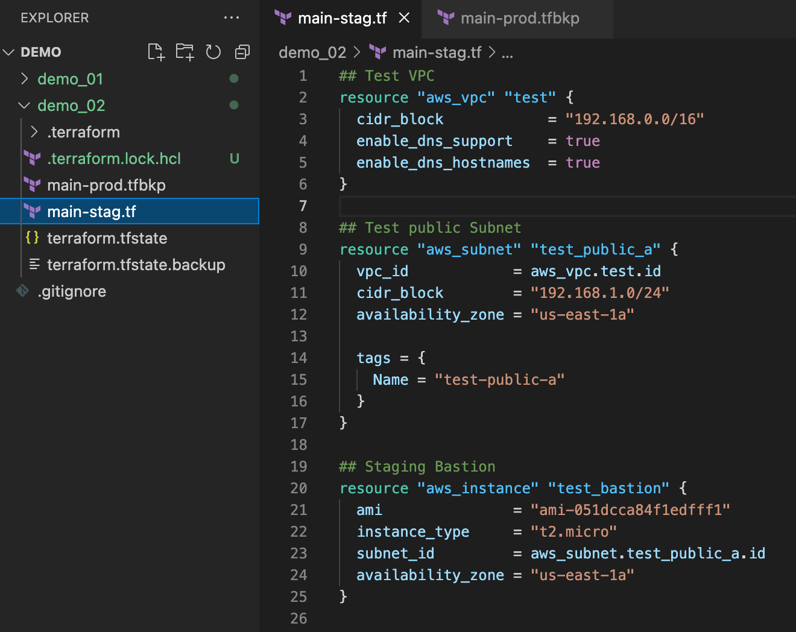
Sam got requirement to change staging VPC CIDR from 10.0.0.0/16 to 192.168.0.0/16
He doesn't want any changes on prod so he decided to backup prod configuration file.

Slide 14

Whoops ! Looks like I lost my prod env.
What the issues we have in current design.
Sharing state file for multiple Env.
All configs in single file
Hard coded configs
Local state file
Notes:
can't manage environments separately
Duplicate Defs, difficult to maintain (DRY)

Slide 15
sprint #2
Let's do following Improvements
Separate state for each Env
Refactor configs to multiple files
Use variables

Slide 16
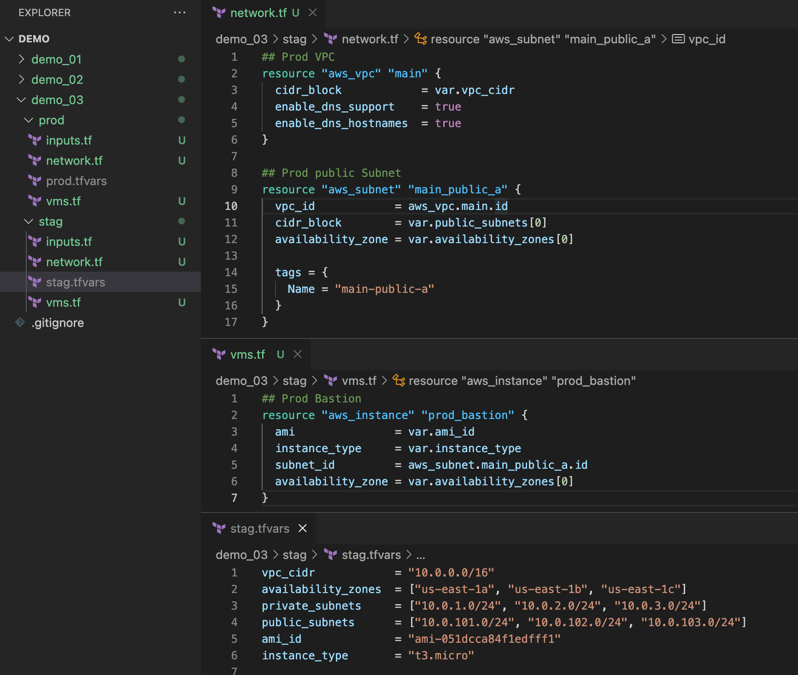
Now Sam can manage environment separately as we have separate state file per env.
he break down the single config file to multiple files.
he start using variables.
There are still room for improvement.

Slide 17
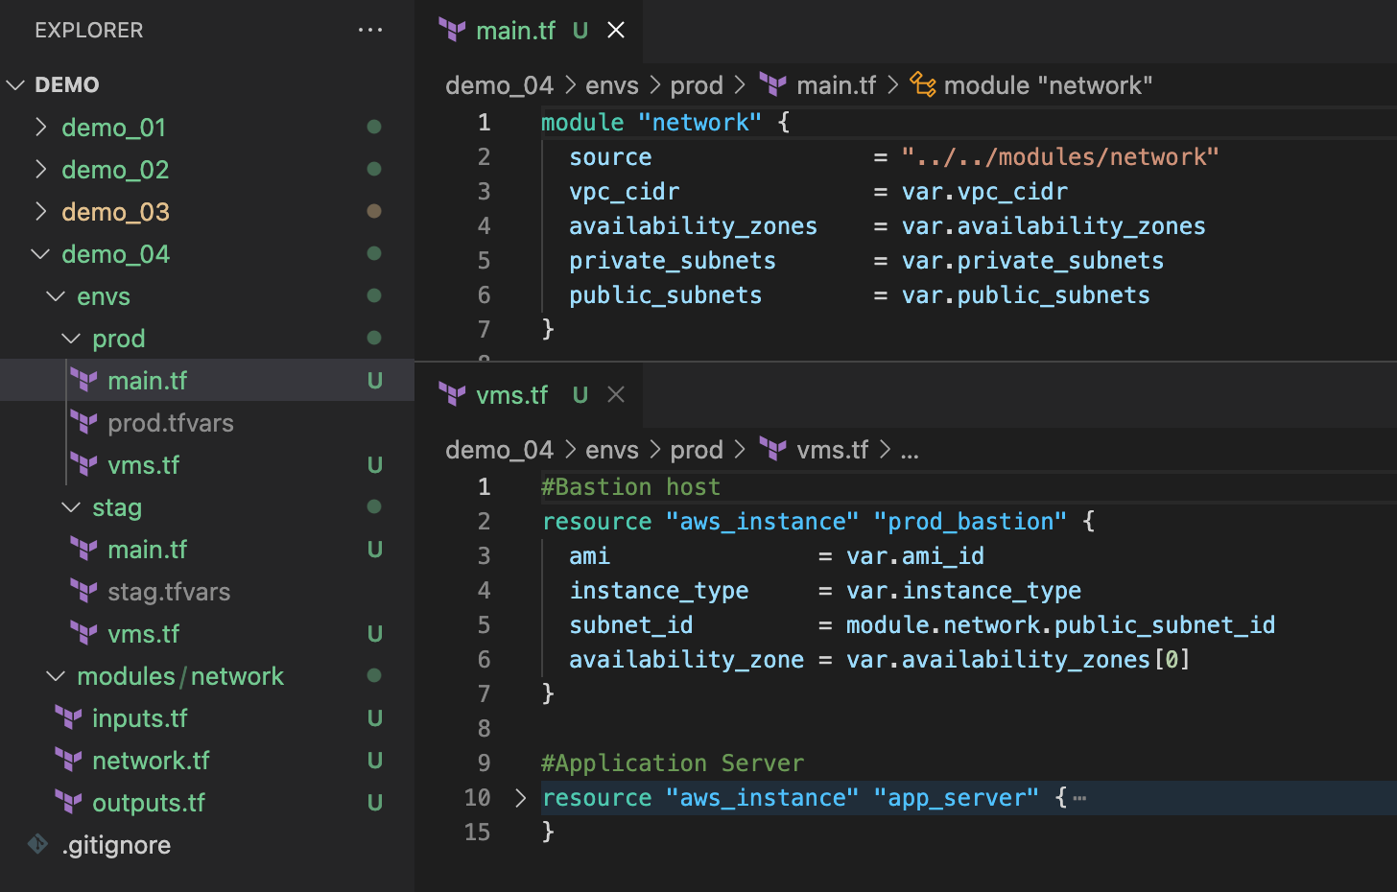
Sam moved all his network resources to network module.
Now he can reuse this module in each env.

Slide 18
Best Practices
Shared remote storage for state file.
Use State Locking to prevent corrupting your state.
Back-up state file regularly.
Treat your Iac code the same as your Application code.
Reuse code with Terraform modules.
Do not hardcode things use variables.
Use minimum required permission on service account associated with Terraform.
Read more : https://lkravi.medium.com/terraform-best-practices-fcec235e81fe

Slide 19
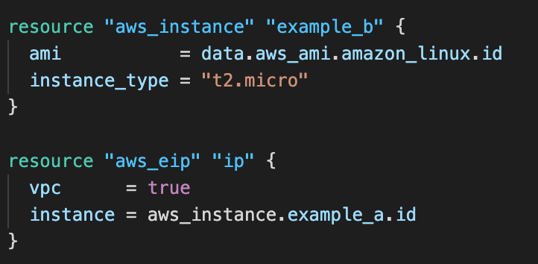
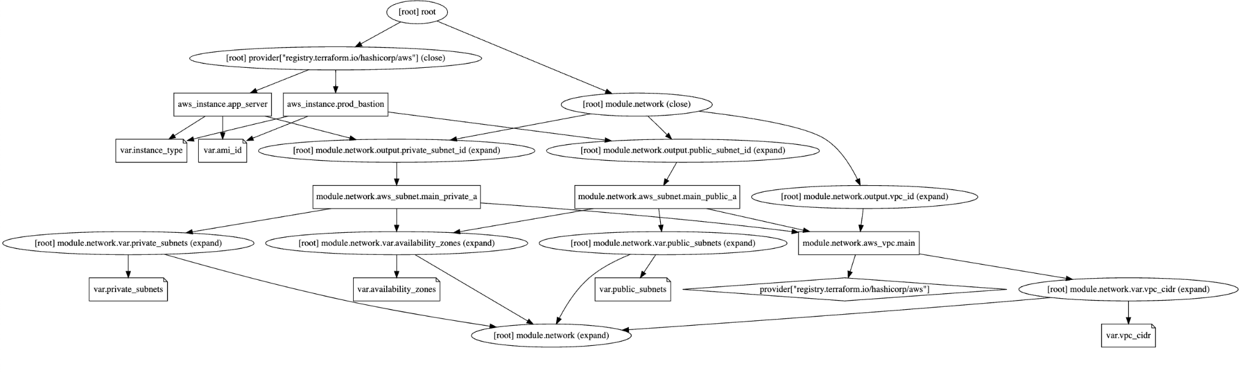
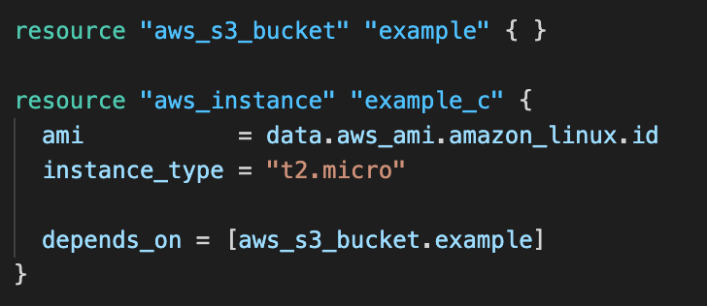
Useful Concepts
Implicit dependency
Implicit vs Explicit dependencies
Implicit dependencies, like their names suggest, are automatically detected by Terraform
Explicit dependencies are dependencies that are set up “manually” between resources, using the depends_on keyword
Explicit dependency
Notes:
terraform graph | dot -Tsvg > graph.svg

Slide 20
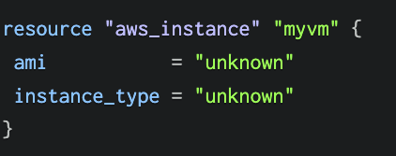

Useful Concepts
Importing Existing Infrastructure into Terraform
We can use import command to get the pre-existing cloud resources under the Terraform management
Define resource block first !
Import
Verify

Slide 21
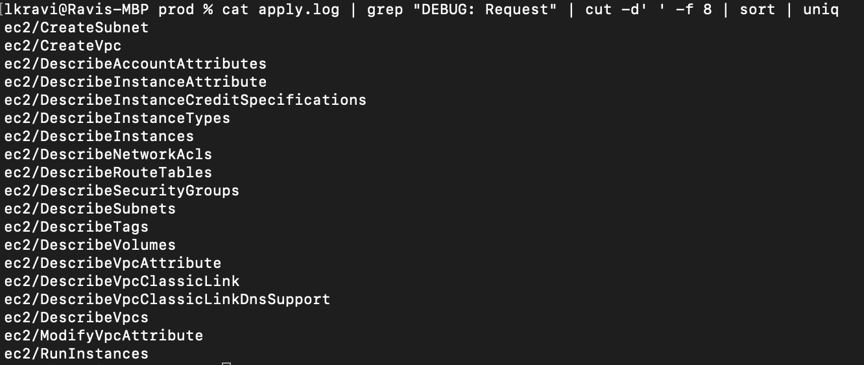
Troubleshooting
To enable logs you can use TF_LOG environment variable with any of the following log levels. TRACE, DEBUG, INFO, WARN, ERROR
Example:If you need to limit the permission scope for terraform SA, you can find out the exact API calls terraform making to the cloud provider.

Slide 22
Troubleshooting
Taint/Untaint resources
taint command can be used to mark resources as not fully functional. it will be deleted and re-created
terraform taint vm1.name — Taint a specified resource instance.
terraform untaint vm1.name — Untaint the already tainted resource instance.
Manipulate State file
terraform state list — Lists out all the resources that are tracked in the current state file.
terraform state show <resourcename> — Show the specified resource in the state file.
terraform state rm — Remove the specified instance from the state file. Useful when a resource has been manually deleted outside of Terraform.

