Slide 1
Chapter 3
Implementing Mean Reverting Strategies

Slide 2
Recap
Recall:
Mean Reversion
Belief that an asset will revert back to an equilibrium point
Drawn from inter/intraday data of stocks, ETFs vs. their components, currency pairs, futures calendar/intermarket spreads
Backwardation/contango with respect to futures contracts curves

Slide 3
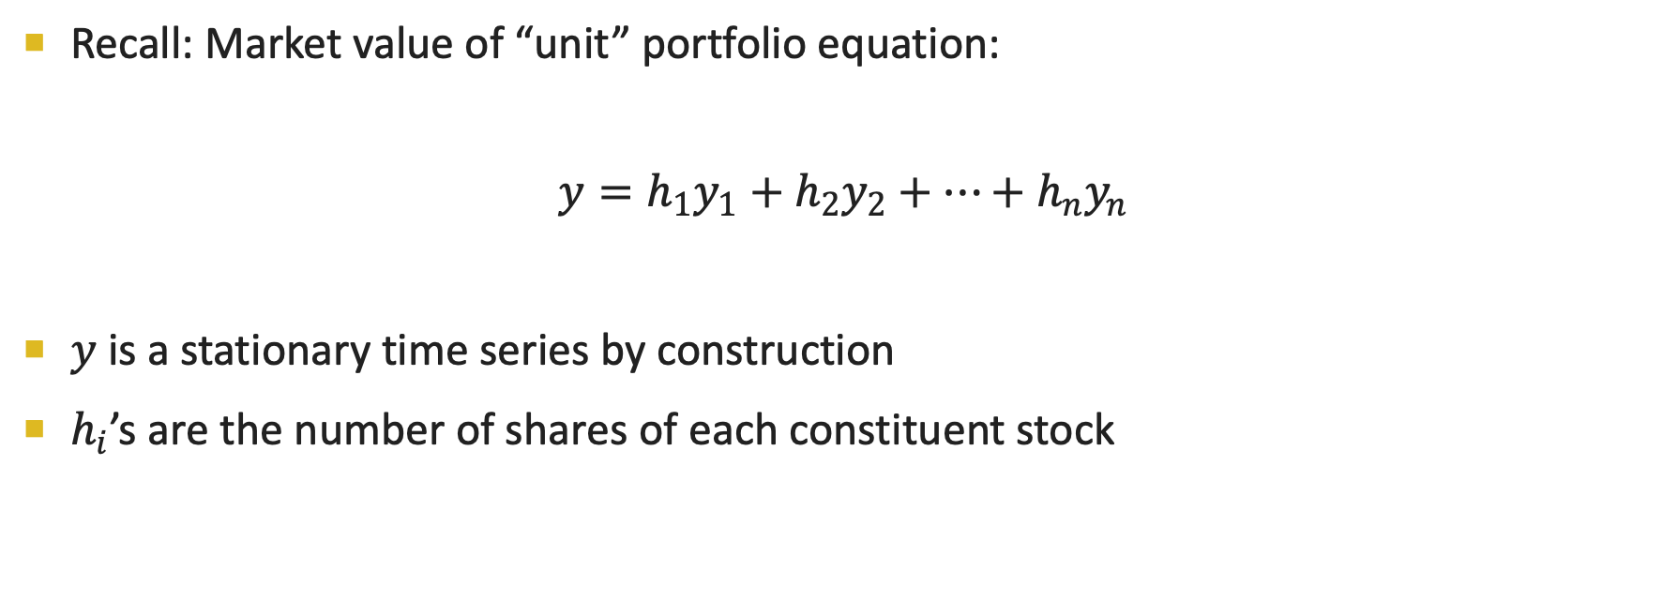
Trading Pairs using Price spreads
Recall: Market value of “unit” portfolio equation:
$$y=h_{1}y_{1}+h_{2}y_{2}+…+h_{n}y_{n}$$
$y$ is a stationary time series by construction
$h_{i}$’s are the number of shares of each constituent stock

Slide 4
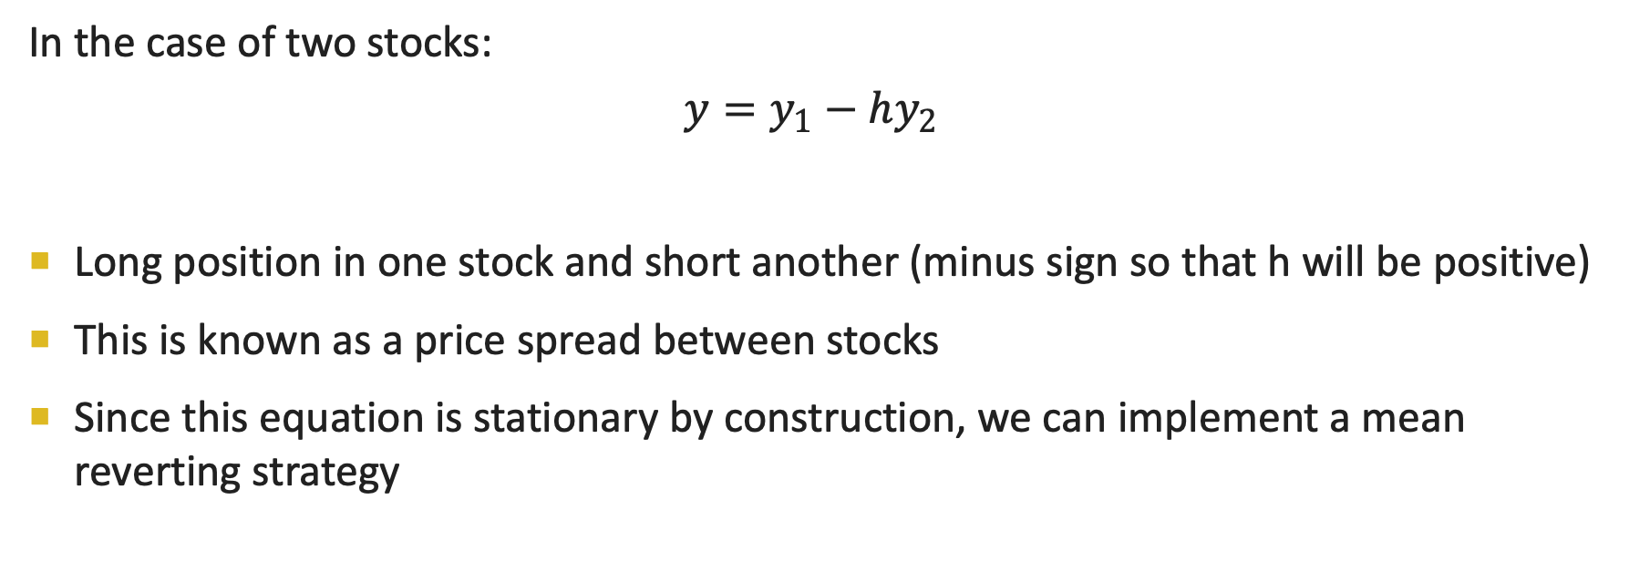
Trading using Price spreads
In the case of two stocks:
$$y=y_{1}−hy_{2}$$
Long position in one stock and short another (minus sign so that h will be positive)
This is known as a price spread between stocks
Since this equation is stationary by construction, we can implement a mean reverting strategy

Slide 5
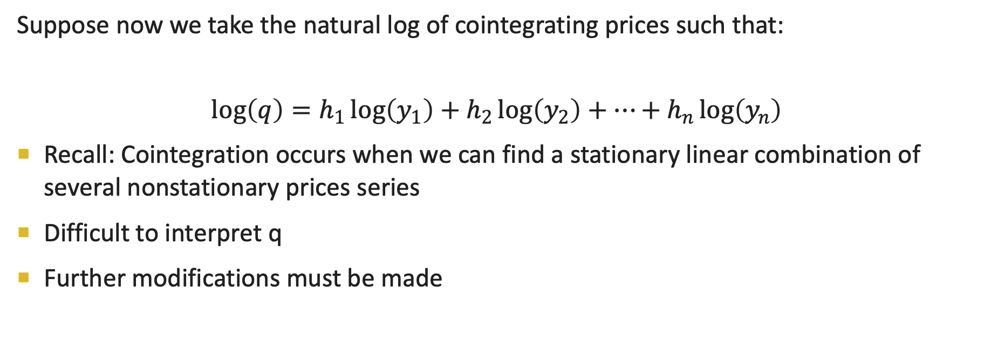
Trading with Log price spreads
Suppose now we take the natural log of cointegrating prices such that:
$$\log\left(q\right)=h_{1}\log\left(y_{1}\right)+h_{2}\log\left(y_{2}\right)+…+h_{n}\log\left(y_{n}\right)$$
Recall: Cointegration occurs when we can find a stationary linear combination of several nonstationary prices series
Difficult to interpret q
Further modifications must be made

Slide 6
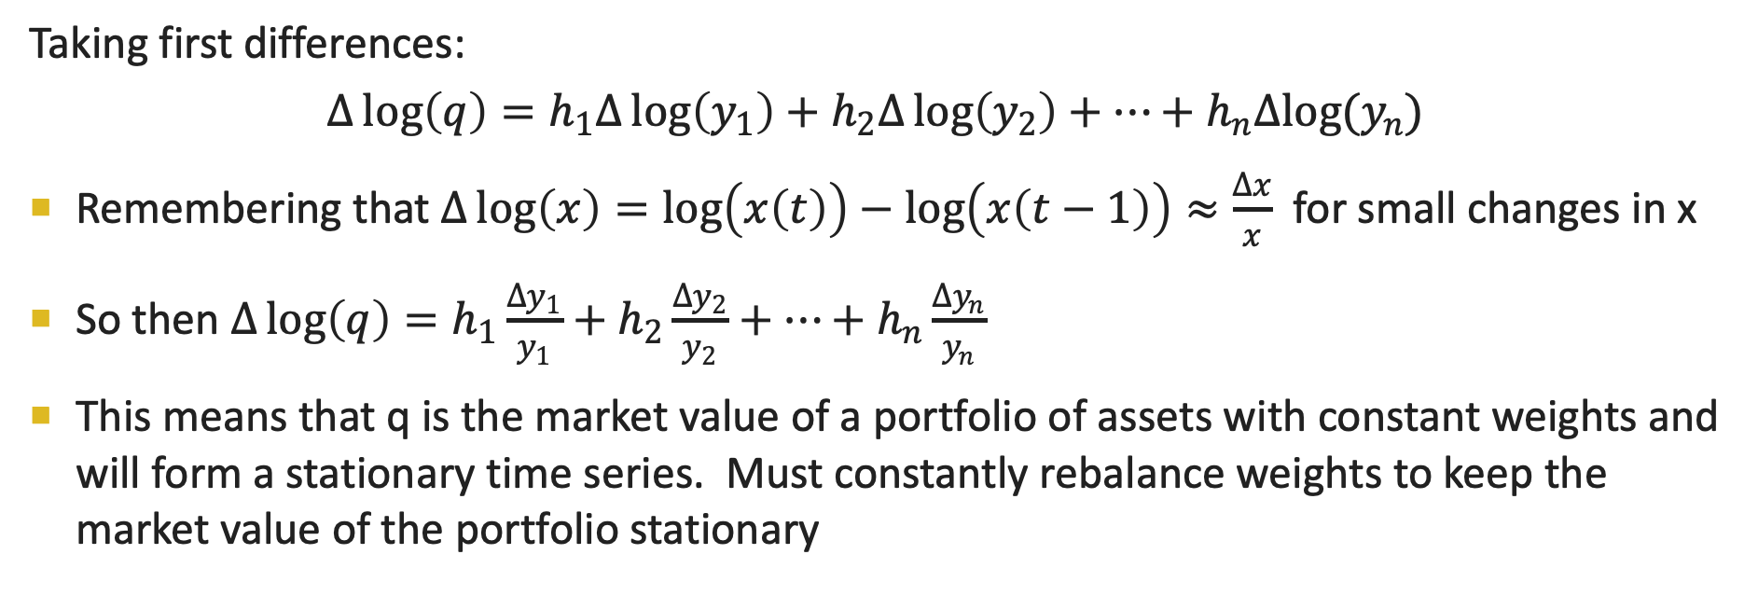
Trading with log spreads
Taking first differences:
$$Δ\log\left(q\right)=h_{1}Δ\log\left(y_{1}\right)+h_{2}Δ\log\left(y_{2}\right)+…+h_{n}Δlog(y_{n})$$
Remembering that $Δ\log\left(x\right)=\log\left(x\left(t\right)\right)−\log\left(x\left(t−1\right)\right)≈\frac{Δx}{x}$ for small changes in x
So then $∆\log\left(q\right)=h_{1}\frac{∆y_{1}}{y_{1}}+h_{2}\frac{∆y_{2}}{y_{2}}+…+h_{n}\frac{∆y_{n}}{y_{n}}$
This means that q is the market value of a portfolio of assets with constant weights and will form a stationary time series. Must constantly rebalance weights to keep the market value of the portfolio stationary

Slide 7
What does this all mean?
Mean reversion trading using price spreads is much simpler than log price spreads
Both can theoretically be justified if both price and log price series are cointegrating

Slide 8
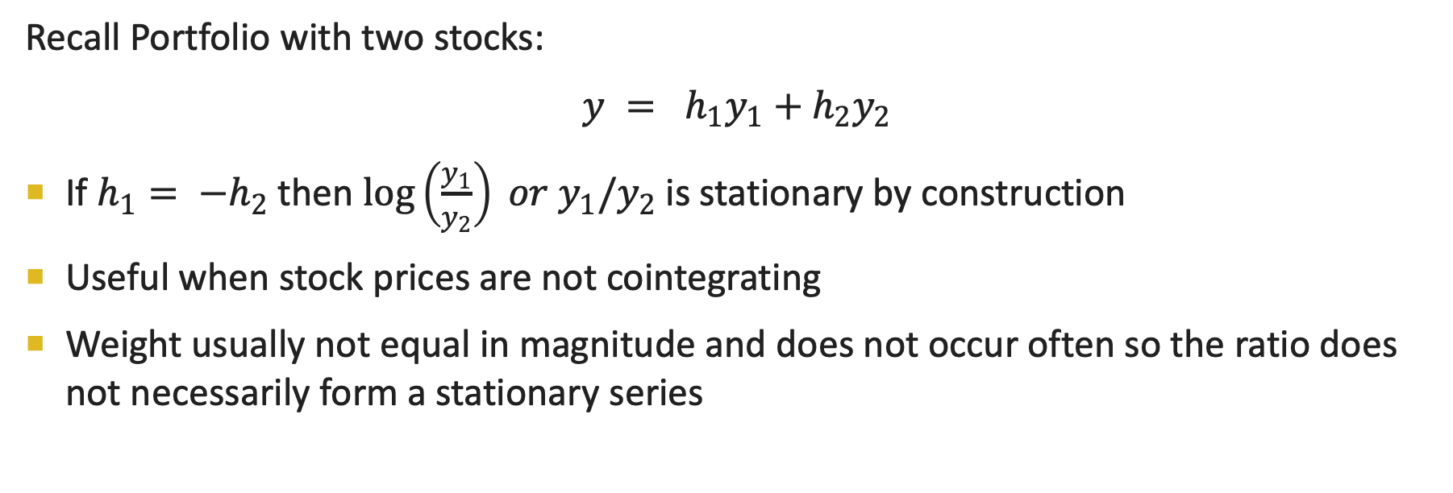
Trading with Ratios
Recall Portfolio with two stocks:
$y = h_{1}y_{1}+h_{2}y_{2}$
If $h_{1}= −h_{2}$ then $\log\left(\frac{y_{1}}{y_{2}}\right) or y_{1}/y_{2}$ is stationary by construction
Useful when stock prices are not cointegrating
Weight usually not equal in magnitude and does not occur often so the ratio does not necessarily form a stationary series

Slide 9
Example: Trading with Ratios
Suppose A=$10 and B=$5, after some time the price increases A=$100 and B=$50.
Assume A and B are not cointegrated, so a stationary series cannot be created
The spread has gone from 5 to 50 but the ratio remains to be 2 so a mean-reverting strategy based on ratio can be equally as effective.

Slide 10
Bollinger Bands
Enter market when price deviates by more than entryZscore standard deviations from the mean
entryZscore is a free parameter to be optimized in a trading set and standard deviation and mean are to be computed within a look back period
Exit market when price mean reverts to exitZscore standard deviations from the mean where entryZscore > exitZscore
Used to analyze market volatility
“Riding the Bands”

Slide 11
Scaling In
As the price of an asset falls and deviates further from its mean, the potential profit to be reaped from an eventual reversal also increases
Set a target price and invest in increments until the stock falls below that price
Continue to buy until the trade size is reached
Aim is to lower the average purchasing price
If stock price does not come back to target price we end up purchasing a losing stock

Slide 12
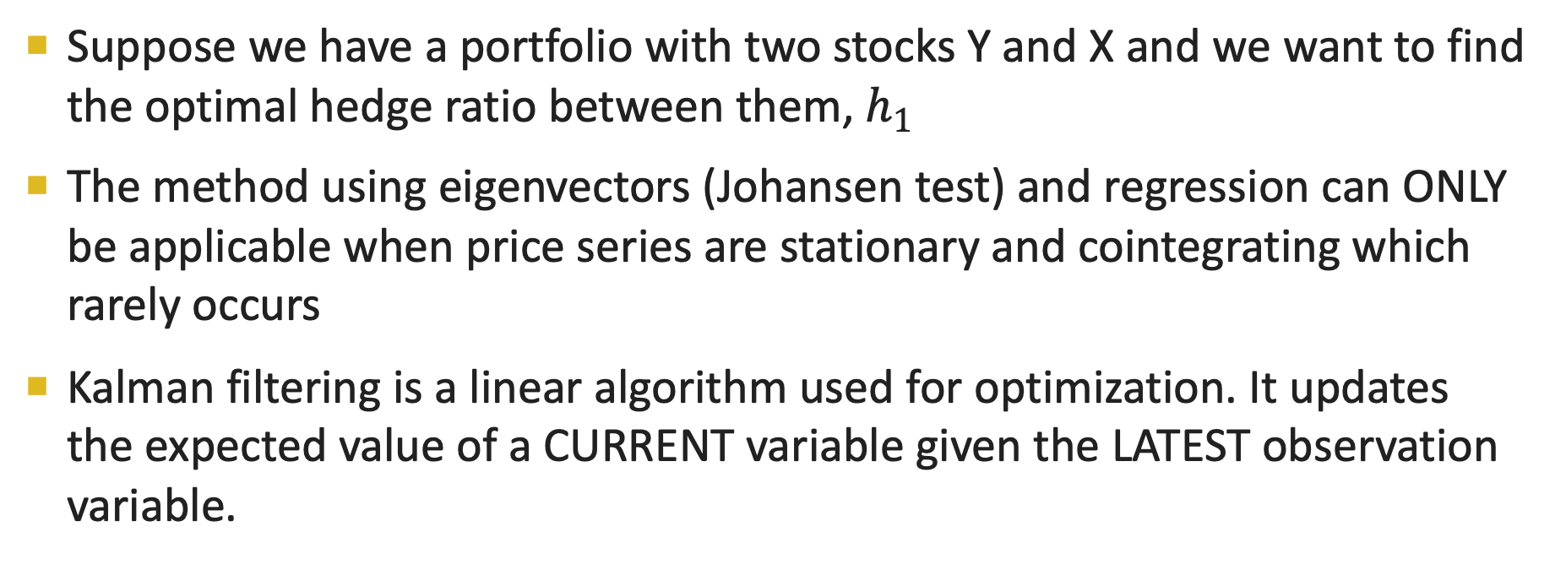
Wtf are Kalman filters?
Suppose we have a portfolio with two stocks Y and X and we want to find the optimal hedge ratio between them, $h_{1}$
The method using eigenvectors (Johansen test) and regression can ONLY be applicable when price series are stationary and cointegrating which rarely occurs
Kalman filtering is a linear algorithm used for optimization. It updates the expected value of a CURRENT variable given the LATEST observation variable.

Slide 13
Assumptions of Kalman filters
It is linear because it assumes the observable variable is a function of the hidden variable with noise
Assumes hidden variable is a function of itself at time t-1 with noise and the noise follows a normal distribution
Linear optimization

Slide 14
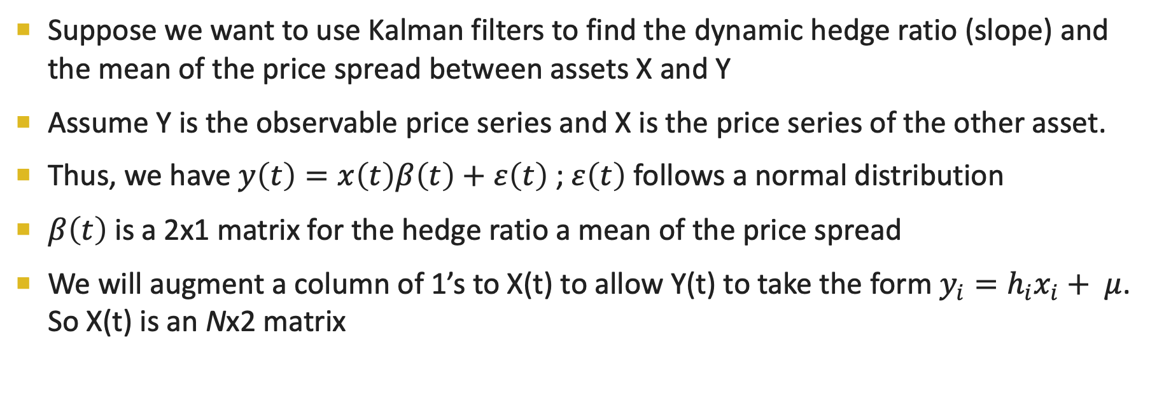
Applications of Kalman filters
Suppose we want to use Kalman filters to find the dynamic hedge ratio (slope) and the mean of the price spread between assets X and Y
Assume Y is the observable price series and X is the price series of the other asset.
Thus, we have $y\left(t\right)=x\left(t\right)β\left(t\right)+ε\left(t\right)$ ; $ε\left(t\right)$ follows a normal distribution
$β\left(t\right)$ is a 2x1 matrix for the hedge ratio a mean of the price spread
We will augment a column of 1’s to X(t) to allow Y(t) to take the form $y_{i}=h_{i}x_{i}+ μ$. So X(t) is an Nx2 matrix

Slide 15
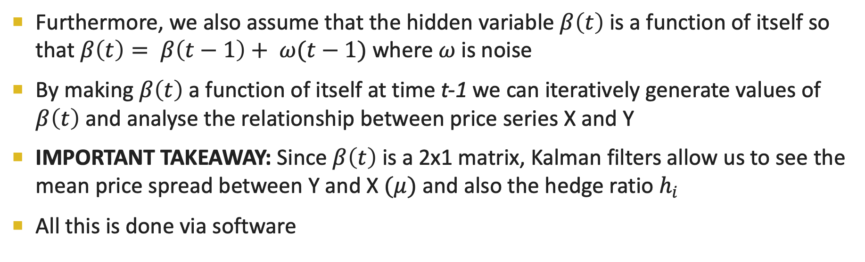
Applications of Kalman filters
Furthermore, we also assume that the hidden variable $β\left(t\right)$ is a function of itself so that $β\left(t\right)= β\left(t−1\right)+ ω(t−1)$ where $ω$ is noise
By making $β\left(t\right)$ a function of itself at time t-1 we can iteratively generate values of $β\left(t\right)$ and analyse the relationship between price series X and Y
IMPORTANT TAKEAWAY: Since $β\left(t\right)$ is a 2x1 matrix, Kalman filters allow us to see the mean price spread between Y and X $(μ)$ and also the hedge ratio $h_{i}$
All this is done via software

