Slide 1
Chapter 6
Interday momentum strategies
“The financial crisis of 2008-2009 ruined this momentum strategy” – Ernie Chan

Slide 2
CAUSES OF momentum
Persistence of Roll Returns (and their signs)
Slow Travel of new information
Forced sales or purchases of assets of various types of funds
Market Manipulation by high frequency Traders

Slide 3
Overview
Momentum in asset prices can be classified by 2 types:
Time Series Momentum
Past returns positively correlated with future returns
Cross - Sectional
Relative performance of a price series in relation to other price series
A price series with returns that outperformed other price series will likely keep doing so

Slide 4
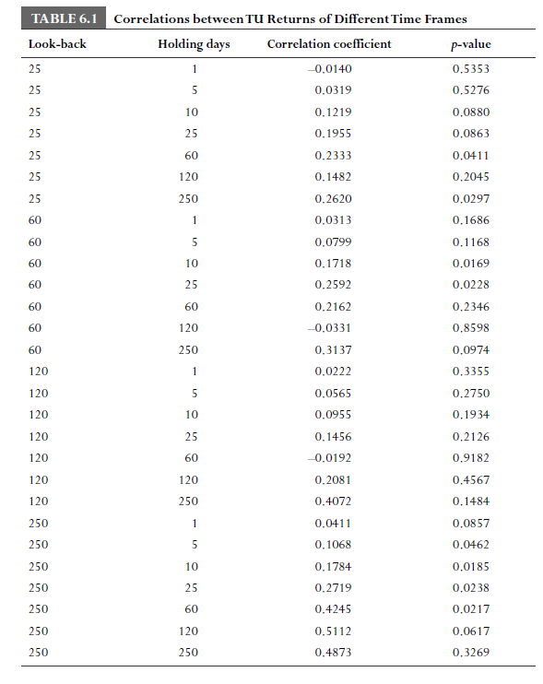
testing for Time Series Momentum
Calculate Correlation Coefficient
With different time lags you will see different values
Low p values, and holding times is good
High Correlation coefficient is good
Correlations between signs of past and future returns
Only shows correlation of the signs
Doesn’t show magnitude
Hurst Exponent and Variance test
Used to reject null hypothesis of random walks
Unable to test specific times

Slide 5
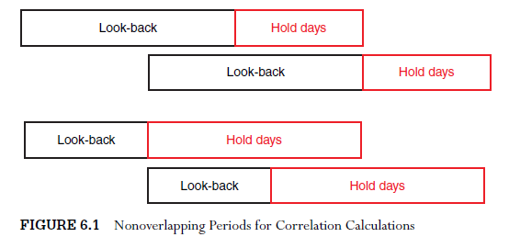
testing for Time Series Momentum
When testing for time series momentum we must not use overlapping data
If (lookback days > hold days) we must offset by hold days
If (hold days > lookback days) we must offset by lookback days

Slide 6
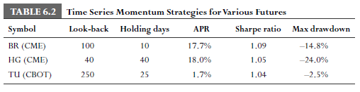
Why do many futures returns exhibit serial correlations?
Sometimes, combining mean-reverting and momentum strategies will work better than either strategy on it’s own
i.e, For CL: Buy at market close if the price is lower than that of 30 days ago an is higher than that of 40 days ago
The sign of roll returns does not vary often, futures stay in contango or backwardation for long periods of time
Spot returns very rapidly in sign and magnitude
Diversified Trends Indicator (DTI) is an index composed of 24 futures. It will long a future if it is above its EMA and short it if its below, with monthly rebalancing
Outperformed the S&P 500 prior to 2008, but now has poor performance

Slide 7
Time Series Strategies
Simple time series strategy
Buy (sell) the future if it has a positive (negative) 12 month return. Hold position for 1 month.
Can be modified to hold for 1 day, invest only 1/25 of the total capital
This strategy can be applied to many different futures. Each with a potentially different holding and look back period.
Lagged Roll Return
Long when roll return > some threshold
Short when roll return < some threshold
Exit otherwise
Alexander Filter
Buy when daily returns up at least x percent
Sell and short if price moves down x percent from a subsequent high
Other Buy Signals
Prices reach new N-day high
Price exceeds N-day moving average
Price exceeds upper Bollinger Band
Number of days up exceed number of days down in a moving period

Slide 8
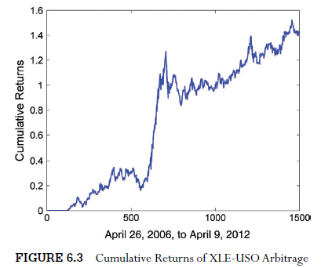
Extracting Roll returns Through Future vs Arbitrage trading
Future’s total returns = spot returns + roll returns
To extract roll return: buy the underlying asset and short the futures, if roll return is negative (contango). Vice verse for backwardation
Reason for this is to eliminate spot return which adds noise to a momentum strategy, yielding a shorter holding period and lower risk
In order to purchase the underlying, you have to find an ETF that holds that asset or companies producing that asset (ie XLE – energy sector etf) and will track the spot price
NOTE: Holding ETF’s incurs financing costs, and outside of precious metals, difficult to find ETF’s that hold the underlying asset, also futures have different closing times so use an ETF that holds futures (USO)
APR of 16%, Sharpe Ratio of 1

Slide 9
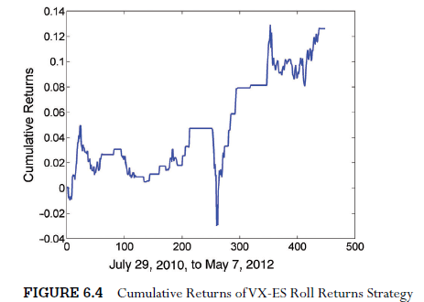
Volatility futures Versus equity index futures
Strategy
If the price of the front contract of VX is higher than that of VIX by 0.1 point (contango) times the number of trading days until settlement, short 0.3906 front contracts of VX and short 1 front contract of ES. Hold for one day.
If the price of the front contract of VX is lower than that of VIX by 0.1 point (backwardation) times the number of trading days until settlement, buy 0.3906 front contracts of VX and buy 1 front contract of ES. Hold for one day.
Notes:
VX is the future that tracks VIX index, volatility index, roll returns as low as -50 percent
No etf that replicates vix, find something with high correlation (anti correlation) with the spot return
ETF SPY fits the bill, ES (s and p e mini future) has insignificant roll return, same returns as underlying asset SPY, highly anticorrelated with vx

Slide 10
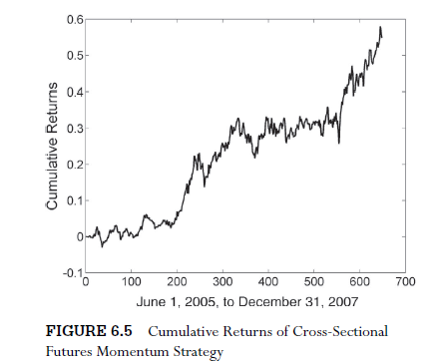
Cross-sectional Strategies
Third way to extract large roll returns is a cross- sectional strategy
Buy a portfolio of futures in backwardation and simultaneously short a portfolio of futures in contango
Strategy
Rank the 12 month return of a group of 52 physical commodities every day
Buy and hold the future with the highest return for the 1 month while short and hold the future with the lowest return for the same period
APR of 18%, Sharpe Ratio of 1.37
Notes:
Spot returns cancel each other out and you are left with roll returns
Strategy performed horribly with -33% apr from 2008 to 2009, financial crisis ruined this strategy but it recovered afterwards
This strategy works for everything under the sun, including stock indices, currencies, international stocks, and us stocks

Slide 11
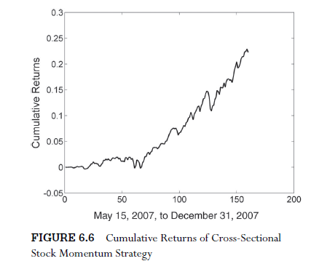
Cross-sectional Strategies
This strategy works for everything under the sun, including stock indices, currencies, international stocks, and us stocks
Instead of using lagged returns, can also rank by “factors”
Earnings growth, book-to price ratio, etc
Strategy
Buy and hold stocks within the top decile of 12-month lagged returns for a month, and vice versa for the bottom decile
APR of 37%, Sharpe Ratio of 4.1
Ruined by the financial crash, -30% from 2008-2009. Hasn’t fully recovered

Slide 12
News sentiment as a fundamental factor
Capture all news items on a company using programs
These programs assign "sentiment scores" to news articles that are indicative of its price impact on stocks
Collections of these sentiment scores from multiple articles was found to be predictive of that stocks future price
One strategy using sentiment scores is using RavenPack's sentiment index, buying a portfolio of stocks with positive change in sentiment score and shorting one with a negative change.
Some other vendors include, Recorded Future, thestocksonar.com, and Thomson Reuters News Analytics

Slide 13
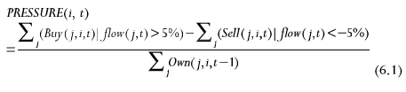
Mutual funds asset fire sale and forced purchases
Stocks held by poorly performing mutual funds facing redemptions experience negative returns
Fire sale depresses the stock prices causing further redemptions at those funds and other funds holding the same stocks
Vice versa is also true for funds performing well
Hence momentum in both directions for commonly held stocks can be ignited.
Measure the selling and buying pressure on a stock based on the percentage of funds holding them that experience redemptions
Pressure(i, t) is the factor for stock i at end of quarter t
Buy(j,i,t)=1 if fund j increased its holding in stock i during quarter t and if the fund experienced inflows greater than 5% of its net assets, ie (flow(j,t)>5% == True), and is 0 otherwise
Sell(j,i,t) is defined similarly but for decreases in holdings
Own(j,i,t-1) is the number of mutual funds holding stock i in the beginning of quarter t
Short stocks with highest selling pressure (lowest pressure ranking)
Buy stocks with highest pressure ranking

Slide 14
Pros and cons
Pros
Easier Risk Management
Diversify our risks across different asset classes and countries
Adding momentum strategies to a portfolio of mean reversion allows higher Sharpe ratios and lower drawbacks
Cons
Few independent signals, this leads to lower Sharpe ratios
Heavily impacted by market crashes
News driven momentum strategies are getting shorter time frames
(Information travels faster)

Slide 15
Key points
Time series momentum refers to the positive correlation of a price series past and future returns
Cross sectional momentum refers to the positive correlation of a price series past and future relative returns, in relation to that of other price series in a portfolio
Futures exhibit time series momentum mainly because of the persistence of the sign of roll returns
If you are able to find an instrument that cointegrates or correlates with the spot price or return of a commodity, you can extract the roll return of the commodity future by shorting the instrument during backwardation or buying during contango
Portfolios of futures or stocks often exhibit cross sectional momentum: a simple ranking algorithm based on returns would work
Profitable strategies on news sentiment momentum show that the slow diffusion of news is a cause for stock price momentum
The contagion of forced asset sales and purchases among mutual funds contributes to stock price momentum
Momentum models thrice on 'black swan' events and the positive kurtosis of the returns distribution curve

