Slide 1
Chp 5: Mean reversion of currencies and futures
Younis Soltan

Slide 2
Background Info
Currencies and futures are known for momentum trading
Ex. Of trade: USD/CAD trading at 1.33
USD = Base currency
CAD = Quote currency
Buying USDCAD means we are betting on USD strengthening and/or CAD weakening
Long on USD, short on CAD
P&L expressedin local currency denomination
Major and “exotic” currency pairs

Slide 3
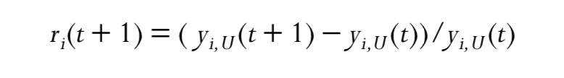
Trading Currency Cross Rates
Ex. Looking to trade AUD/CAD, can separately trade AUDUSD and USDCAD
Use the Johansen test to find out the best hedge ratio of capital, or capital weights, between AUD.USD versus CAD.USD (must have same quote currency to interpret eigenvector)
Buy 1 unit of CADUSD = Sell 1/y of USDCAD, y = quote
Here ri is the return of Bi.USD:
-
- yi,U(t) and yi,U(t + 1) are the quotes for Bi.USD at t and t + 1 respectively.This is because one unit of Bi.USD is worth yi,U in U.S. dollars.

Slide 4
Rollover Interests in Currency Trading
Cross-rate is the differential interest rate earned or paid if the cross-rate position is held overnight
If we are long a pair B.Q overnight, the interest differential is iB − iQ, where iB and iQ are the daily interest rates of currency B and Q, respectively. If iQ > iB, then this interest differential (get debited)
T + 2 day settlement system, if a position was held past the 5 p.m. ET close on day T, and day T + 3 is a weekend or holiday for either currency of the cross-rate, the rollover interest accrued on that position will be multiplied by one plus the number of days the market remains closed.
To calculate Sharpe ratio for any strategy, we need to consider financing costs if not taking intraday positions

Slide 5
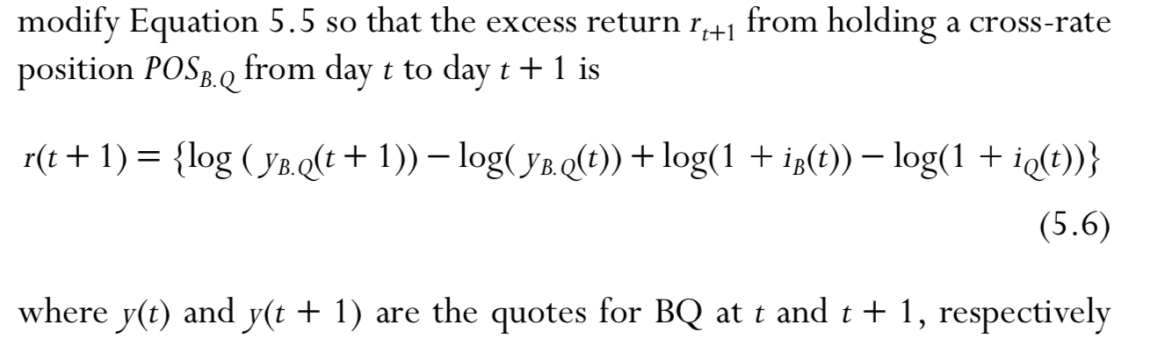
Continued
financing costs of zero in futures positions as they are just contracts, not assets that require cash to finance.
In the case of currency cross-rates, we can again set the financing cost to be zero, as long as we are careful to add the rollover interest to the percent change of the cross-rate

Slide 6
Trading Futures Calender Spread
Futures contracts with different expiration dates (or “maturities”) have different prices and returns
Pairing up futures con- tracts with different maturities creates what are known as calendar spreads
they do not generally mean-revert; we need to understand more about what drives the returns of futures in general.

Slide 7
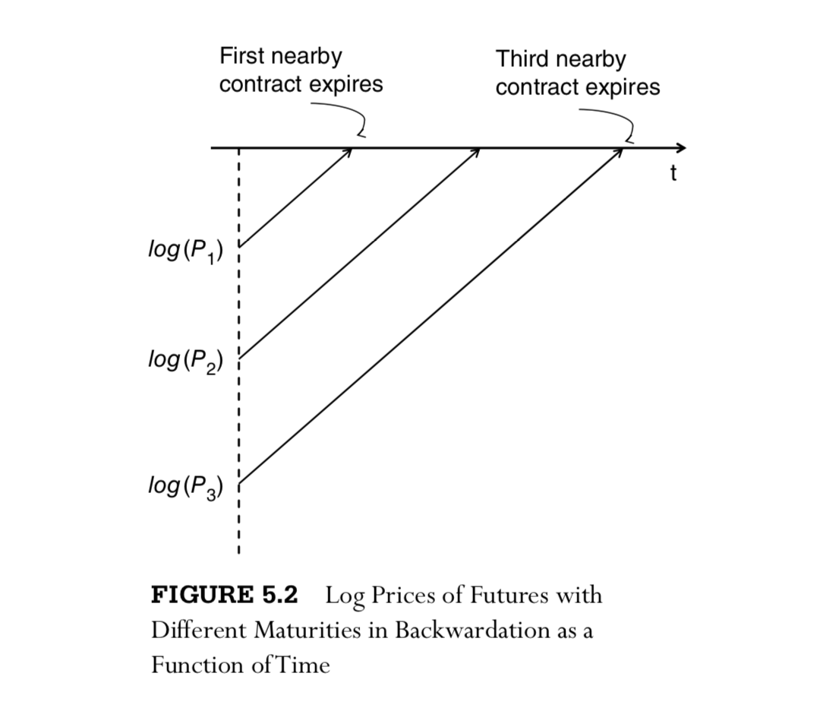
Roll Returns, Backwardation, and Contango
Futures position will have nonzero return even if the underlying spot price remains unchanged, since eventually all their prices have to converge toward that constant spot price – “roll return”
Loses this return if we roll forward to the next contract

Slide 8
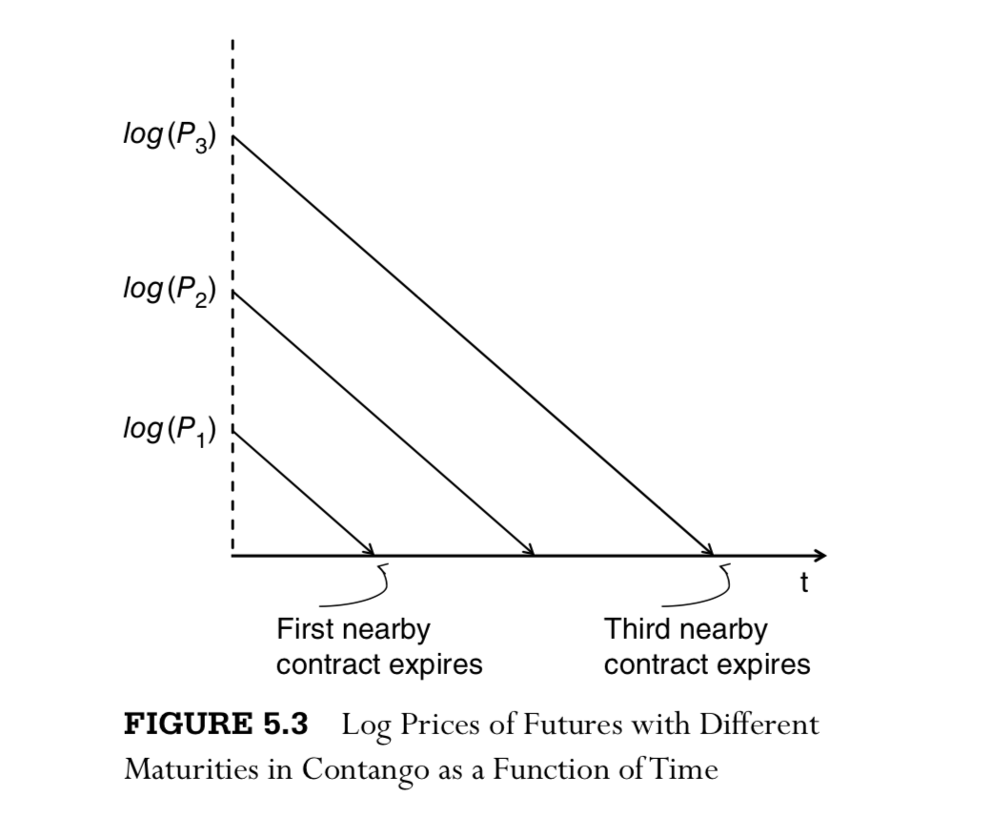
Continued
Near-expiration contracts have higher prices than the far contracts, then the roll returns will be positive; otherwise if the contracts are in Contango, then the roll returns will be negative

Slide 9


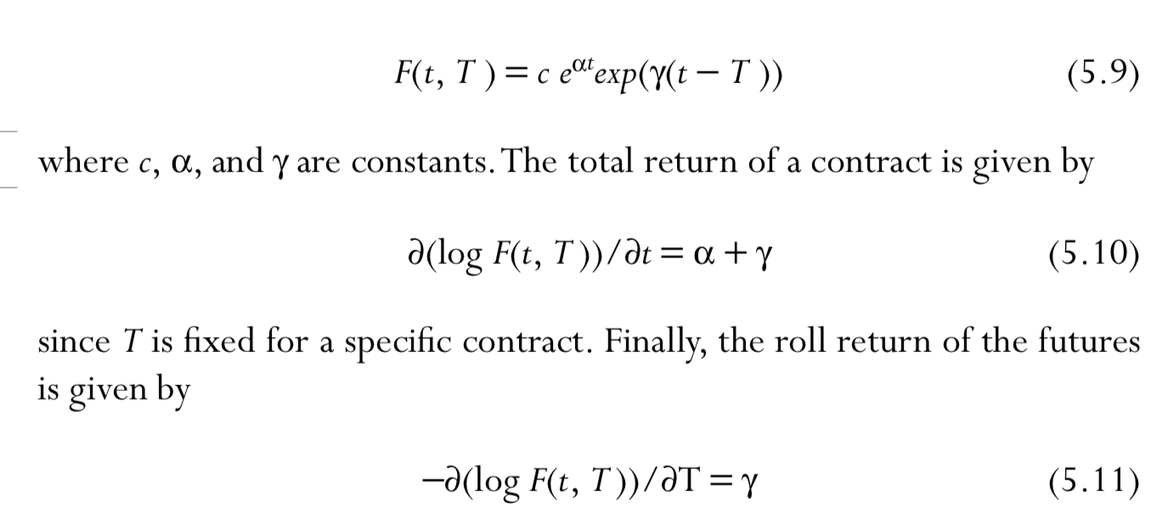
Continued
To calculate spot and roll returns – t= time, T = time to expiration, S(t) = spot price, roll return γ is constant over time
assume that the (compounded) spot return α is also constant:

Slide 10
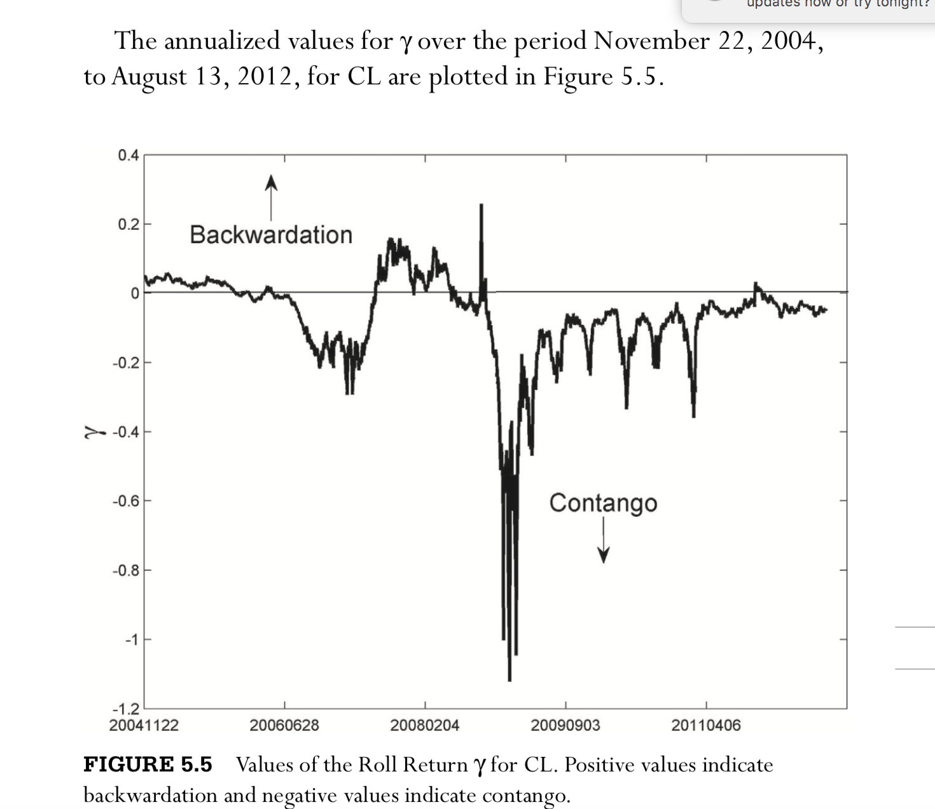
Example

Slide 11
Futures Intermarket Spreads
most obvious candidate for pair trading futures is intermarket spreads between markets that are closely related. Ex. energy complexes WTI crude oil CL, Brent crude oil BZ, unleaded gasoline RB, and heating oil HO,
well-known portfolio called the crack spread consisting of long three contracts of CL, short two contracts of RB, and short one contract of HO.
called the crack spread because we can obtain gasoline and heating oil by cracking the long hydrocarbon chains of crude oil molecules, and the 3:2:1 hedge ratios come about because three barrels of CL produces approximately two barrels of RB and one barrel of heating oil (usually a ready made basket)

Slide 12
