Slide 1
The Market for Gold
This presentation is for informational purposes only, and is not intended to serve as a buy or sell recommendation on any security, investment product or other financial product or service. Any views or opinions presented are solely those of the authors and do not necessarily represent those of the investment council.

Slide 2


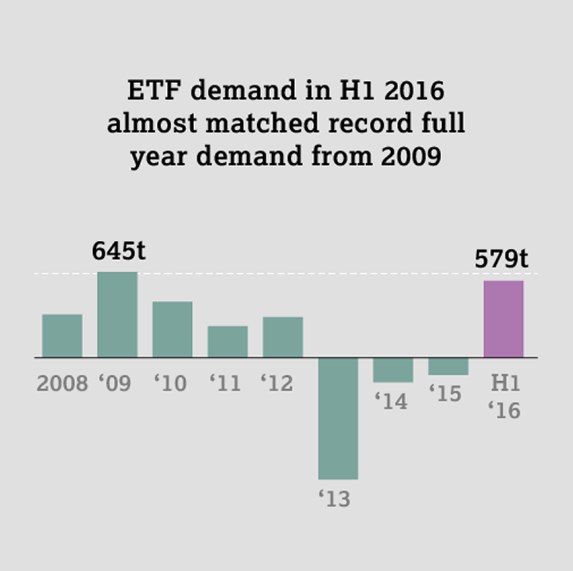
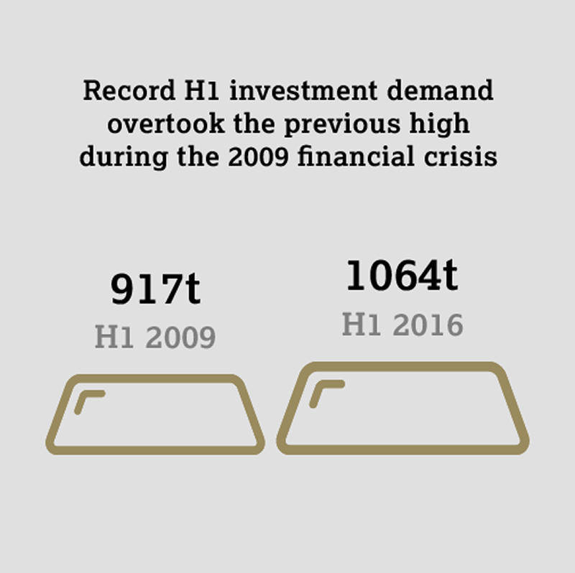
Overview
Gold is the most actively traded metal accounting for a daily volume of 1.5 million shares of the GLD ETF alone
Important to many cultures, as shown in the large demand in countries such as China and India
It can be used as a store of value, as an instrument for speculation, as well as a safe investment during times of uncertainty

Slide 3
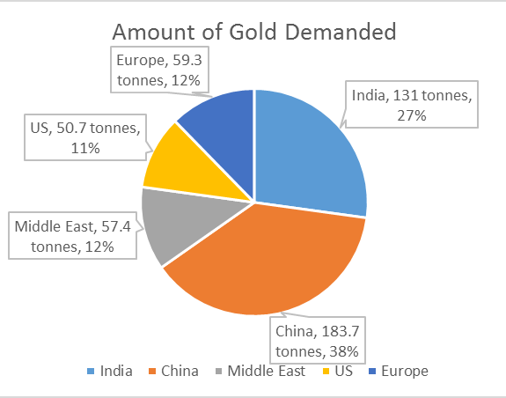
Demand and Supply
Demand-Side Dynamics
The largest demand for gold is in:
Jewelry—Gold is symbolically important in a variety of cultures, especially those in India and China
Investment—Investors turn to gold in economic uncertainty and downturns
Central Banks—Similarly, central banks hold gold as a store of value and securing their currency
Technology—Gold has many uses in technology, from catalytic converters to cancer treatment
Notes:
Electric power consumption (Demand)
Electric power consumption measures total electricity consumption by consumers, businesses and manufacturers, with manufacturers accounting for about half of total electricity consumption.
Strong demand for electricity fuels growth for this industry.
In 2015, electric power consumption is expected to increase, representing a potential opportunity for the industry.
Price of electric power
Industry operators either sell electricity to transmission and distribution utilities, or directly distribute electricity to end-users through their own utility business.
Regional governments regulate how much industry operators can charge for electricity. High electricity prices result in revenue and profit growth.
In 2015, the price of electric power is expected to increase; however, its moderate growth will pose a threat to the industry.
World price of natural gas
Natural gas is used to power electricity generators in some power plants. When the price of natural gas is low, gas-generated electricity becomes more competitive with hydroelectric power. As a result, demand for hydroelectric power and other renewable energy falls.
In 2015, the world price of natural gas is expected to decrease.
World price of steaming coal
Steaming coal is used to power electricity generators in coal power plants. When the price of steaming coal is low, coal-generated electricity becomes more competitive with hydroelectric power. As a result, demand for hydroelectric power and other renewable energy falls.
In 2015, the world price of steaming coal is expected to decrease.
Industrial capacity utilization
Industrial capacity utilization measures the ratio of current manufacturing output to total production capacity. When industrial capacity utilization increases, demand for electricity also grows because manufacturing is highly energy-intensive. This, in turn, leads to industry revenue growth.
In 2015, industrial capacity utilization is expected to increase.

Slide 4
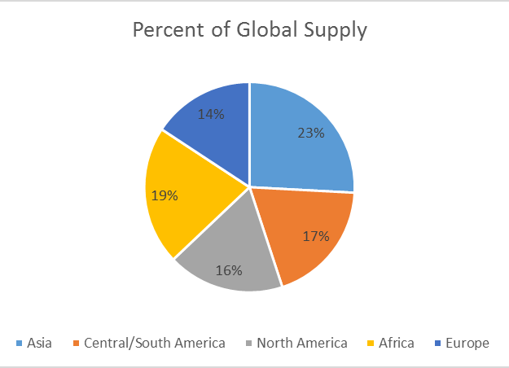
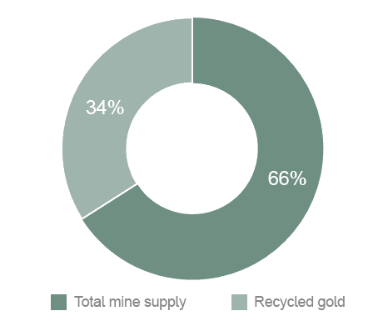
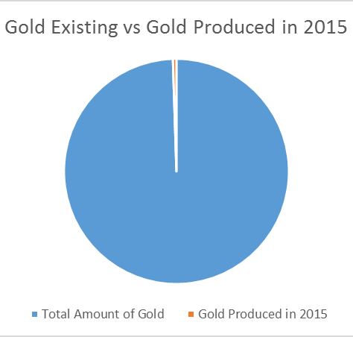
Demand and Supply
Supply-Side Dynamics
The supply of gold comes from three sources:
Mine Production—Gold produced from mines in many different countries as shown above
Producer Hedging—When gold is sold in the markets by producers who want to lock in a future price for their gold in the short term. This allows mining companies to sell metal ahead of their production schedules
Recycled Gold—Because gold is indestructible, it is recoverable as it can be melted down, re-refined, and reused. While hold mine production is relatively inelastic, the gold recycling industry provides an easily-traded supply of gold when it is needed, which helps stabilize the price of gold

Slide 5
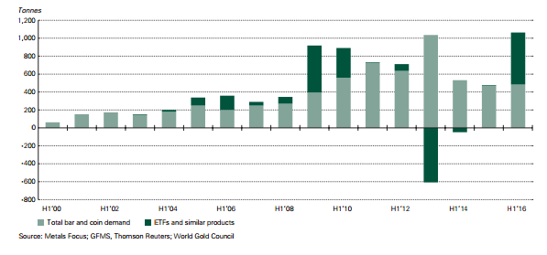
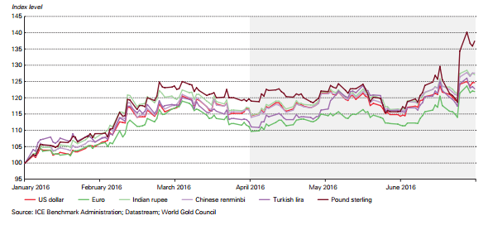
Trading
Macro Trends
The price of gold tends to follow investors’ uncertainty in economic conditions
Many of Europe’s central banks cutting key interest rates below zero, the Brexit referendum, and a divisive US election all contribute to an upswing in demand in the first half of 2016
The surge in gold has shown in the price expressed in GBP (+37%), Indian Rupees (+27%), Chinese Renminbi (+27%), and the Egyptian Pounds (+41%)

Slide 6
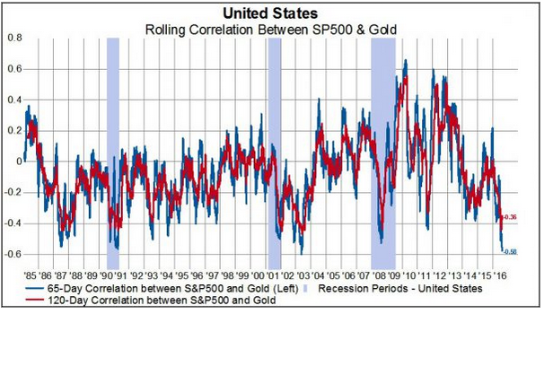
Trading
Macro Trends
Gold and the S&P 500 have reached the lowest negative correlation in 32 years (at -0.63).
Notes:
Electric power consumption (Demand)
Electric power consumption measures total electricity consumption by consumers, businesses and manufacturers, with manufacturers accounting for about half of total electricity consumption.
Strong demand for electricity fuels growth for this industry.
In 2015, electric power consumption is expected to increase, representing a potential opportunity for the industry.
Price of electric power
Industry operators either sell electricity to transmission and distribution utilities, or directly distribute electricity to end-users through their own utility business.
Regional governments regulate how much industry operators can charge for electricity. High electricity prices result in revenue and profit growth.
In 2015, the price of electric power is expected to increase; however, its moderate growth will pose a threat to the industry.
World price of natural gas
Natural gas is used to power electricity generators in some power plants. When the price of natural gas is low, gas-generated electricity becomes more competitive with hydroelectric power. As a result, demand for hydroelectric power and other renewable energy falls.
In 2015, the world price of natural gas is expected to decrease.
World price of steaming coal
Steaming coal is used to power electricity generators in coal power plants. When the price of steaming coal is low, coal-generated electricity becomes more competitive with hydroelectric power. As a result, demand for hydroelectric power and other renewable energy falls.
In 2015, the world price of steaming coal is expected to decrease.
Industrial capacity utilization
Industrial capacity utilization measures the ratio of current manufacturing output to total production capacity. When industrial capacity utilization increases, demand for electricity also grows because manufacturing is highly energy-intensive. This, in turn, leads to industry revenue growth.
In 2015, industrial capacity utilization is expected to increase.

Slide 7
Trading
Gold Contract Specifications
Ticker Symbol
GC (CME Globex)
Contract Size
100 troy ounces
Contract Trading
GCZ6 @ 1253.2
GC = Gold Contract
Z = Month (December)
8 = Year (2008)
1253.2 = Price/troy ounce
$1253.2 * 100 Troy Ounces = $125.320.00
Trading Hours
Sunday-Friday 6:00pm – 5:00pm with a 60-minute break each day beginning at 5:00pm
Notes:
Electric power consumption (Demand)
Electric power consumption measures total electricity consumption by consumers, businesses and manufacturers, with manufacturers accounting for about half of total electricity consumption.
Strong demand for electricity fuels growth for this industry.
In 2015, electric power consumption is expected to increase, representing a potential opportunity for the industry.
Price of electric power
Industry operators either sell electricity to transmission and distribution utilities, or directly distribute electricity to end-users through their own utility business.
Regional governments regulate how much industry operators can charge for electricity. High electricity prices result in revenue and profit growth.
In 2015, the price of electric power is expected to increase; however, its moderate growth will pose a threat to the industry.
World price of natural gas
Natural gas is used to power electricity generators in some power plants. When the price of natural gas is low, gas-generated electricity becomes more competitive with hydroelectric power. As a result, demand for hydroelectric power and other renewable energy falls.
In 2015, the world price of natural gas is expected to decrease.
World price of steaming coal
Steaming coal is used to power electricity generators in coal power plants. When the price of steaming coal is low, coal-generated electricity becomes more competitive with hydroelectric power. As a result, demand for hydroelectric power and other renewable energy falls.
In 2015, the world price of steaming coal is expected to decrease.
Industrial capacity utilization
Industrial capacity utilization measures the ratio of current manufacturing output to total production capacity. When industrial capacity utilization increases, demand for electricity also grows because manufacturing is highly energy-intensive. This, in turn, leads to industry revenue growth.
In 2015, industrial capacity utilization is expected to increase.

Slide 8
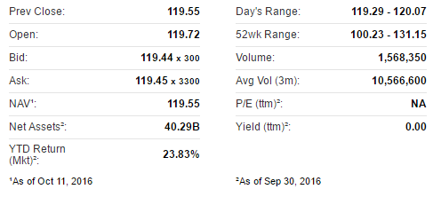

Trading
ETF Share Specifications
Ticker Symbol
GLD (NYSEArca)
GLD @ 119.51
GLD = SPDR Gold Shares ETF
Notes:
Electric power consumption (Demand)
Electric power consumption measures total electricity consumption by consumers, businesses and manufacturers, with manufacturers accounting for about half of total electricity consumption.
Strong demand for electricity fuels growth for this industry.
In 2015, electric power consumption is expected to increase, representing a potential opportunity for the industry.
Price of electric power
Industry operators either sell electricity to transmission and distribution utilities, or directly distribute electricity to end-users through their own utility business.
Regional governments regulate how much industry operators can charge for electricity. High electricity prices result in revenue and profit growth.
In 2015, the price of electric power is expected to increase; however, its moderate growth will pose a threat to the industry.
World price of natural gas
Natural gas is used to power electricity generators in some power plants. When the price of natural gas is low, gas-generated electricity becomes more competitive with hydroelectric power. As a result, demand for hydroelectric power and other renewable energy falls.
In 2015, the world price of natural gas is expected to decrease.
World price of steaming coal
Steaming coal is used to power electricity generators in coal power plants. When the price of steaming coal is low, coal-generated electricity becomes more competitive with hydroelectric power. As a result, demand for hydroelectric power and other renewable energy falls.
In 2015, the world price of steaming coal is expected to decrease.
Industrial capacity utilization
Industrial capacity utilization measures the ratio of current manufacturing output to total production capacity. When industrial capacity utilization increases, demand for electricity also grows because manufacturing is highly energy-intensive. This, in turn, leads to industry revenue growth.
In 2015, industrial capacity utilization is expected to increase.

Slide 9
Questions?

