Slide 1
10-k NLP Project progress update
Lucas krenn, hong kong machine learning (hkml)

Slide 2
Agenda
Motivation
Part 1: x Lessons for Developing Trading Strategies
Lesson 1:
Lesson 2:
Part II: Analysis of Strategies
Cosine Similarity

Slide 3
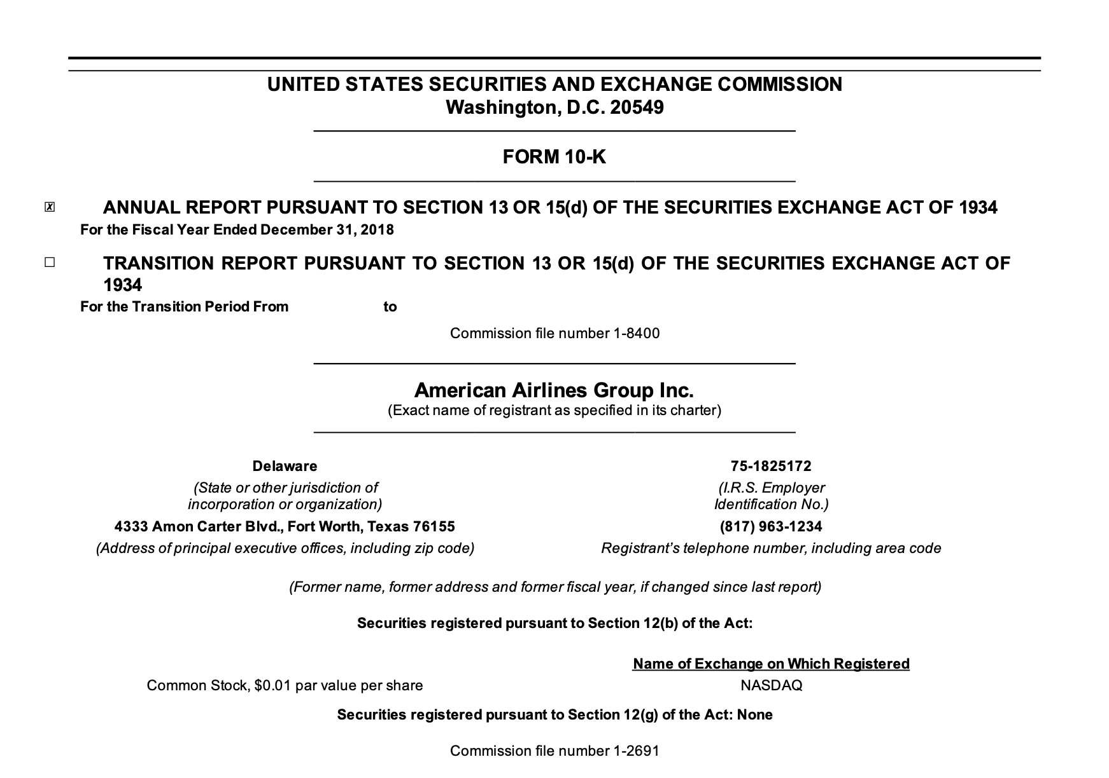
Motivation
Each year, publicly-listed American companies are asked by the SEC to provide investors with annual reports (Form 10-Ks)
Within these forms are information relating to the companies’ financial health, details outlining the performance over the past year, etc.
As with any data, these forms can be ‘squeezed’ for alpha in many ways
e.g. parsing and analyzing KPI results, parsing textual sentiment

Slide 4
Strategy pipeline
Have an idea
Create/obtain datasets
Use dataset to generate signal
Use signal to construct portfolios
Analyze Portfolios and Outcomes
SEC API
Bloomberg
Yahoo Finance
Gautier
Equal weight
Target historical volatility
Long/short
Parse 10-K documents to trade textual sentiment
Cosine Similarity
Loughran-McDonald
FinBERT
Sharpe
Turnover
Performance relative to benchmark

Slide 5
Part 1
Have an idea
Create/obtain datasets
Use dataset to generate signal
Use signal to construct portfolios
Analyze Portfolios and Outcomes
X Lessons for developing trading strategies

Slide 6

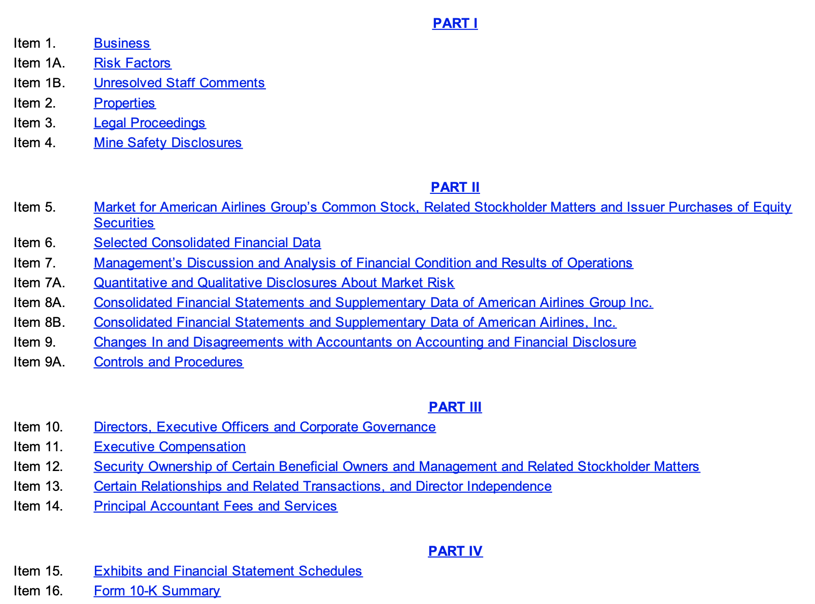
Initial analysis of 10-k
Before doing any sort of analysis of the data, I needed some priors to give me an idea of how these forms are formatted, the information they contain, and how they are divided
15 sections, each containing different information
Since we are looking to analyze sentiment, two sections in particular stand out:
Item 1A: Risk Factors
Item 7: Management’s Discussion & Analysis

Slide 7
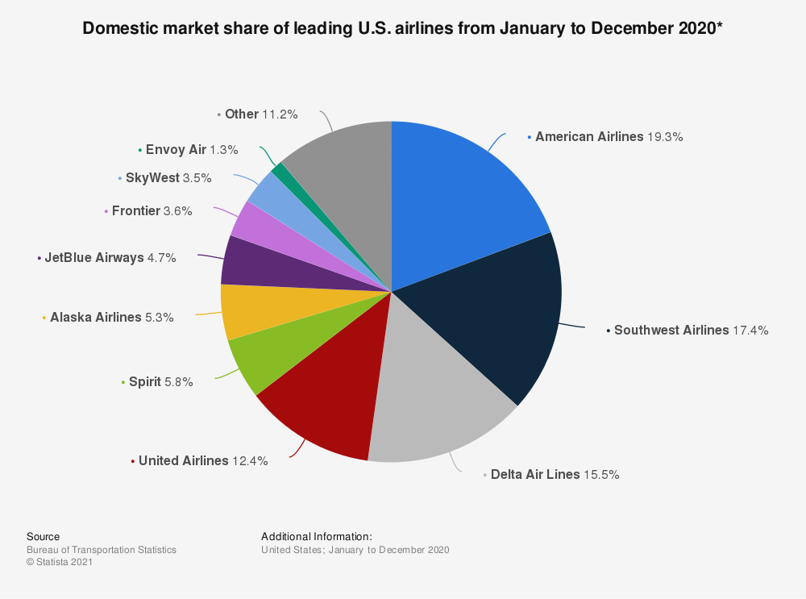
Lesson 1: Remain as general as possible
Since I wanted to flex my fundamental knowledge a bit, I figured I would immediately jump to only analyzing airlines; this was a mistake
There are only so many airlines that have been publicly traded, and price history data is hard to come by
After all this, I decided to start with a more broad universe and then work my way down, if need be
(Quiz: how many biases can you count just in this one idea?)

Slide 8
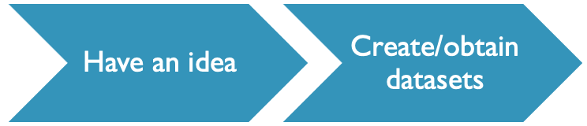

Lesson 2: Data can be hard to come by
While scraping 10-Ks is extremely easy using the SEC API, finding the necessary equity data is not so easy
Suppose we want all the stocks that have been listed in the S&P 500
Where can an amateur quant find a list of the historical constituents of an index?
Ultimately, I had to be given a dataset, since I could not come up with a valid list
Data vendors gatekeeping very basic stock data
me

Slide 9
Lesson 3: Sometimes simple is more effective
Once my universe was defined, I had to then pull the form data from the SEC, search the documents for each item, and parse the text for these items
This was much harder than it sounds; I tried manually writing a regexp that matched all conditions (how hard could it be?), clustering general regexp matches to see if there was a connection, using BeautifulSoup, …
Suppose I found a regexp that matched every case – how would I know which match is in the correct location?

Slide 10
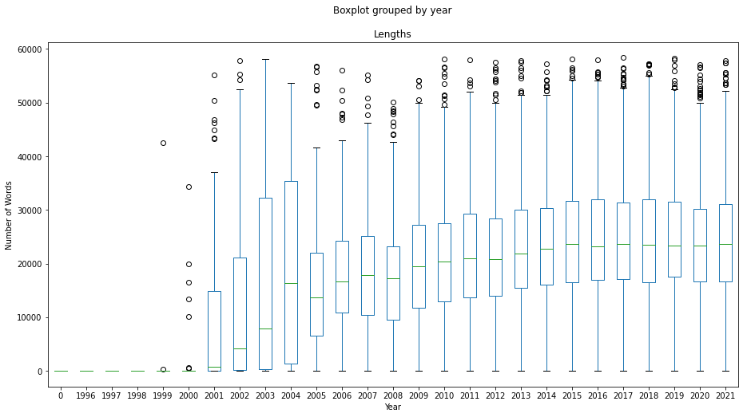
Lesson 3: Sometimes simple is more effective
I tried too hard to be fancy, and it turns out that a much simpler answer was much more effective:
By parsing only the text of the document, it is obvious that not many sentences will begin with e.g. Item 7: Management’s Discussion and Analysis, except for the beginning of the excerpt that we need, and in the table of contents

Slide 11
Another application of lesson 3
As I previously worked with a popular NLP sentiment model, FinBERT, I immediately tried to work with it
It turned out that each sentence took approximately 0.75 seconds for FinBERT to analyze
Two seconds * x sentences * y documents per company * 876 companies blows up very fast!
If a simpler model has absolutely no potential, then chances are something fancy like FinBERT will not as well.

Slide 12
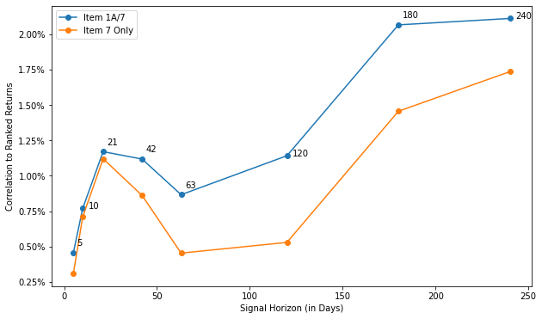
Another application of lesson 1
Recall that we had selected Items 1A and 7 to analyze
Indeed, computational power was part of the reason why, but why else?
Assumptions were imposed and our superset of outcomes shrank because of it
Data suggests that perhaps leaving out information is not a good idea

Slide 13
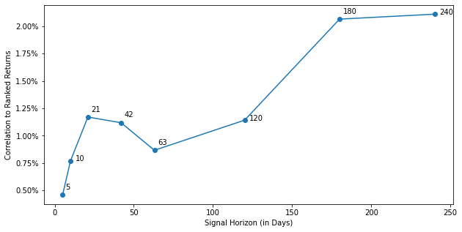
Lesson 3: patience is important
Since each form comes out once a year, it is important that we rebalance our portfolio very infrequently
Rebalancing too fast means that you will be paying lots of unnecessary transaction costs
Furthermore, the data shows that we need to wait before realizing some alpha!

Slide 14
Part ii
Analysis of strategies

Slide 15
Analysis of portfolio results

