Slide 1
Generating Music with Deep Learning
Advanced Topics in Machine Learning
Group project by:
Benjamin Ellenberger, Nicolas Deperrois, Laura Kriener

Slide 2
State of the Art
Google - Magenta Project
- Transformer networks + attention
- Harmonization
- AI Drum machine
- ...
OpenAI - MuseNet
- GPT2-Architecture
- Large-scale transformer network
- 1 week training time
In general:
- Very complicated network architectures
- Very computationally intensive

Slide 3
Central question for our project:
How much can you do with how little?

Slide 4
Challenges
Questions you need to address before you can even start:
- Melody? Rhythm? Harmony?
- How to feed music into a network? Spectrum? Pitches? Intervals?
- What kind of music?
- What filetype?
- How do you evaluate?

Slide 5
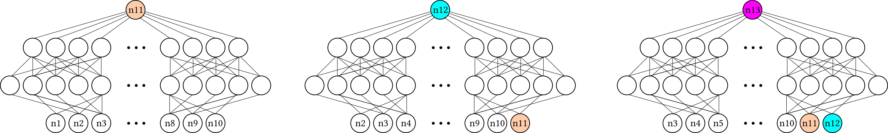
Feed-Forward – How to generate?

Slide 6
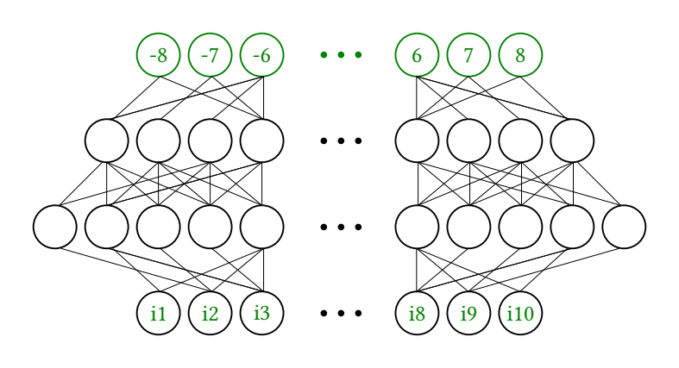
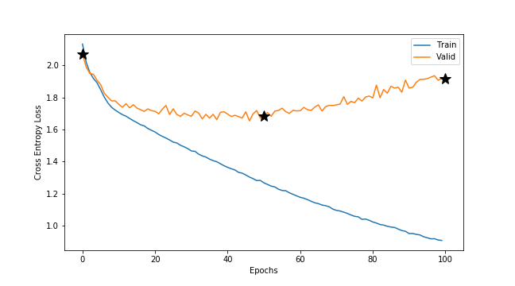
Feed-Forward - Improved

Slide 7
Feed-Forward - Improved

Slide 8
Feed-Forward - Improved

Slide 9
Feed-Forward - Improved

Slide 10
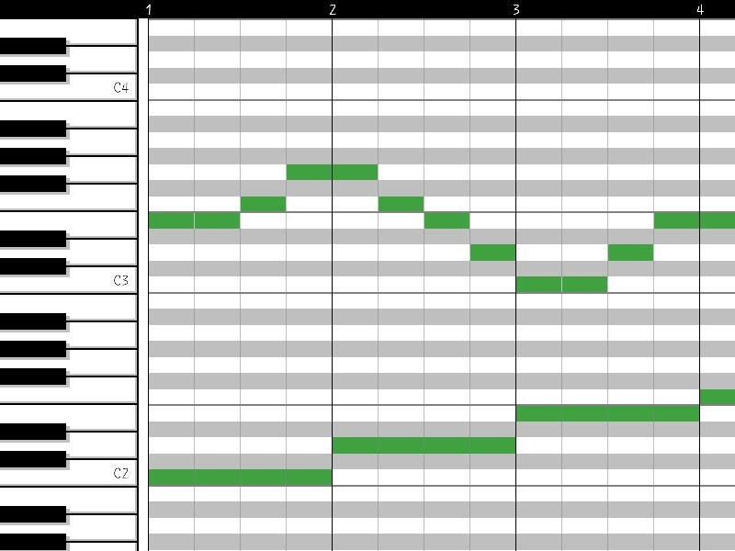
LSTMs – Including Rhythm
Use of pianoroll representations

Slide 11
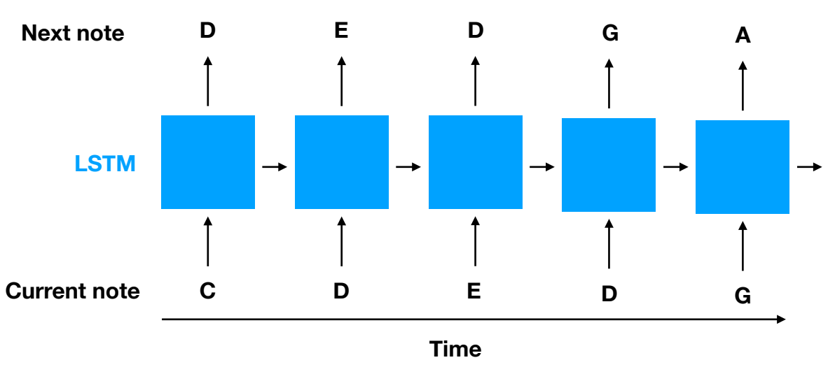
LSTMs – single voice generation
Note-to-note as char-to-char text generation

Slide 12
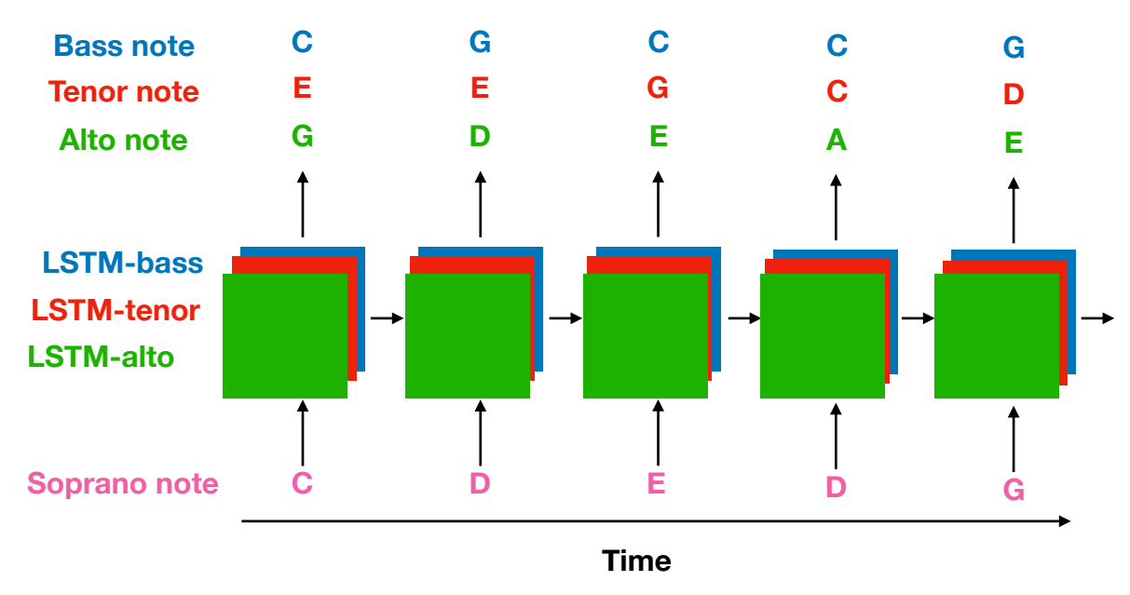
LSTMs – harmonization

Slide 13
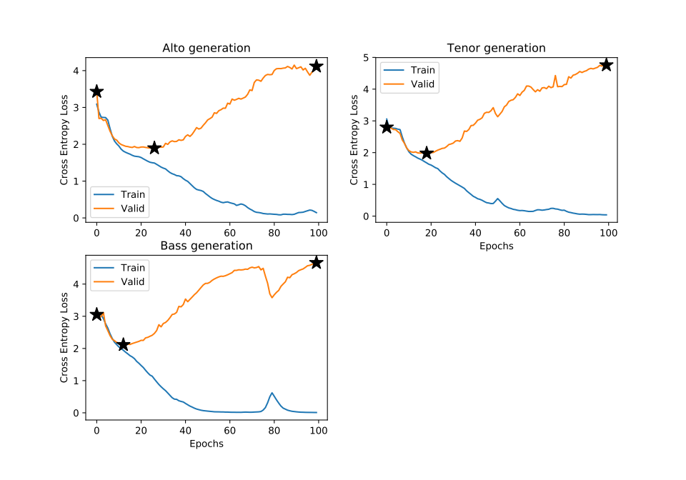
LSTMs - Harmonization

Slide 14
LSTMs – harmonization
No training

Slide 15
LSTMs – harmonization
End of training

Slide 16
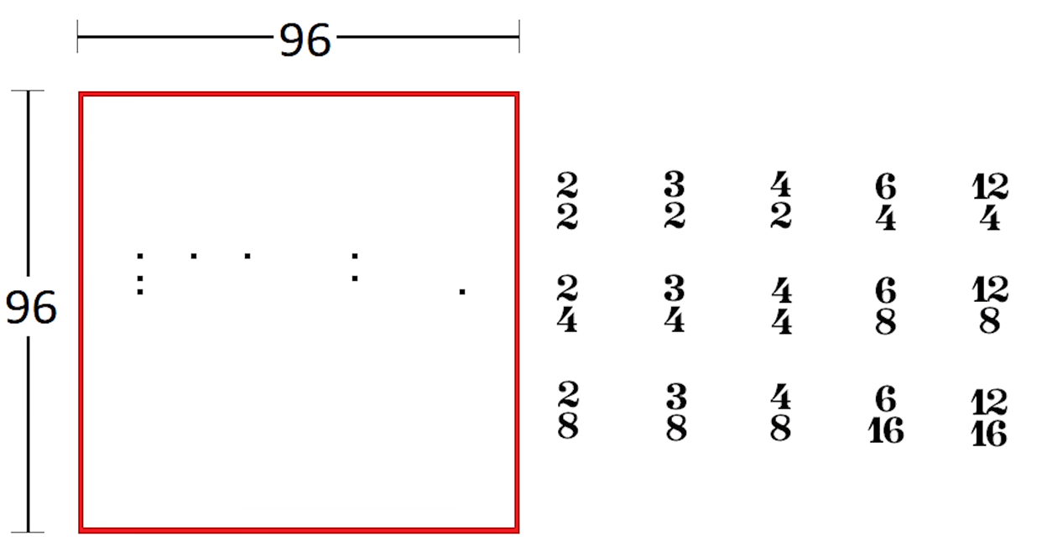
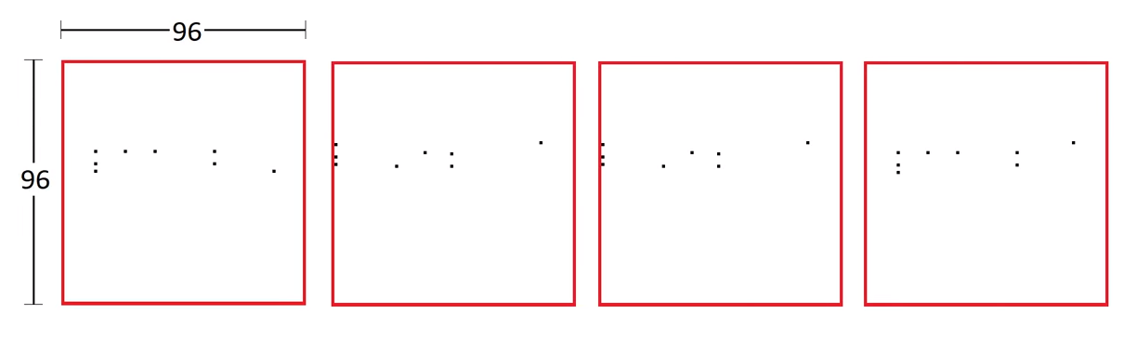
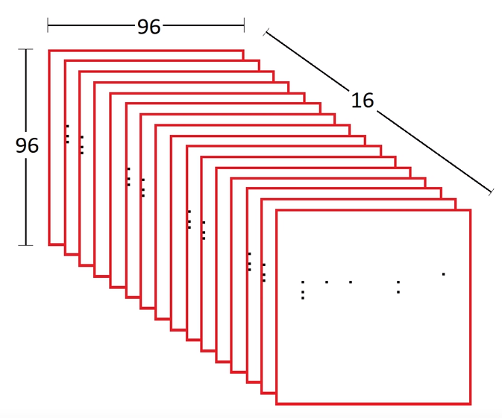
Autoencoders – Encoding pianorolls

Slide 17
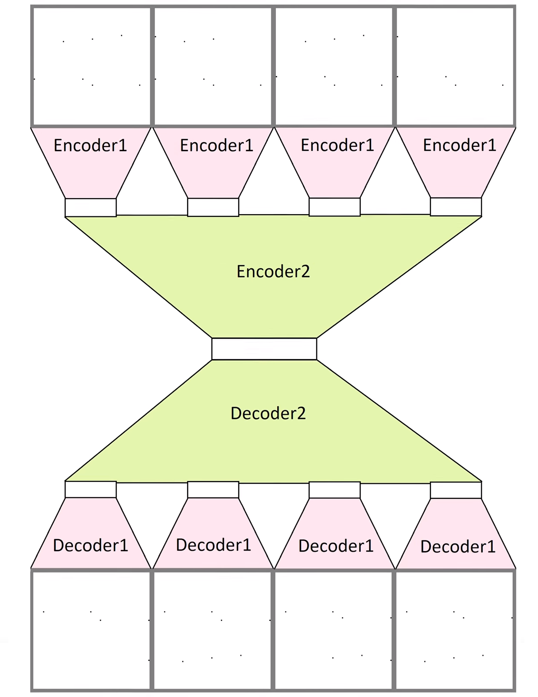
Autoencoders – cont.
Weight sharing
Slice latent space: 200 dims
Central latent space: 120 dims

Slide 18
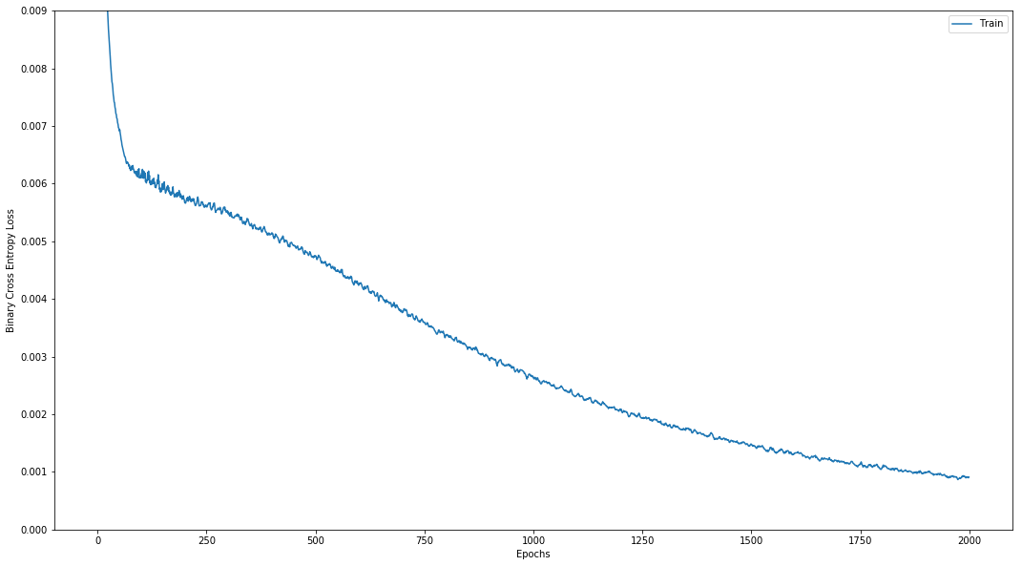
Autoencoder - Training

Slide 19
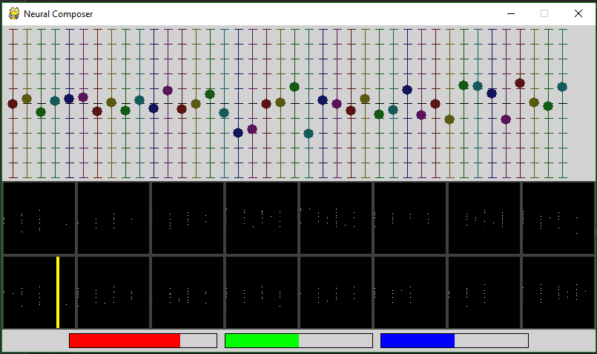
Autoencoders – Generate interactively

Slide 20
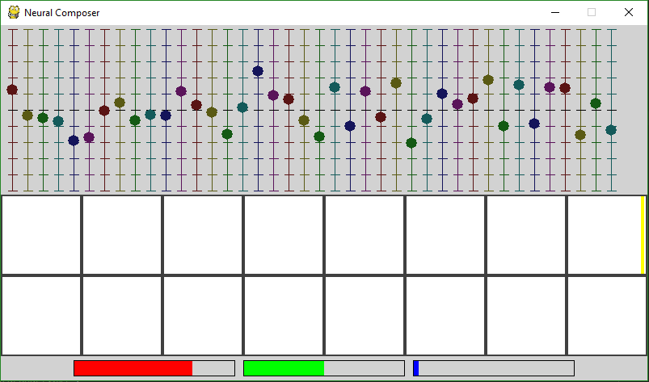
Autoencoders - Samples
Untrained AE

Slide 21
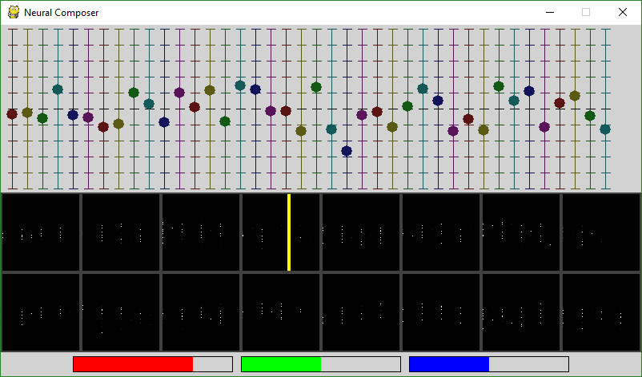
Autoencoders - Samples
Trained AE

Slide 22
Autoencoders - Samples
Trained AE

Slide 23
Conclusions

