Slide 1
FlashAttention-2 for Autoregressive Inference
Integrated Systems Laboratory (ETH Zürich)
Lars Kröger lkroeger@ethz.ch
Supervisors:
Luca Colagrande colluca@iis.ee.ethz.ch
Lorenzo Leone lleone@iis.ee.ethz.ch

Slide 2
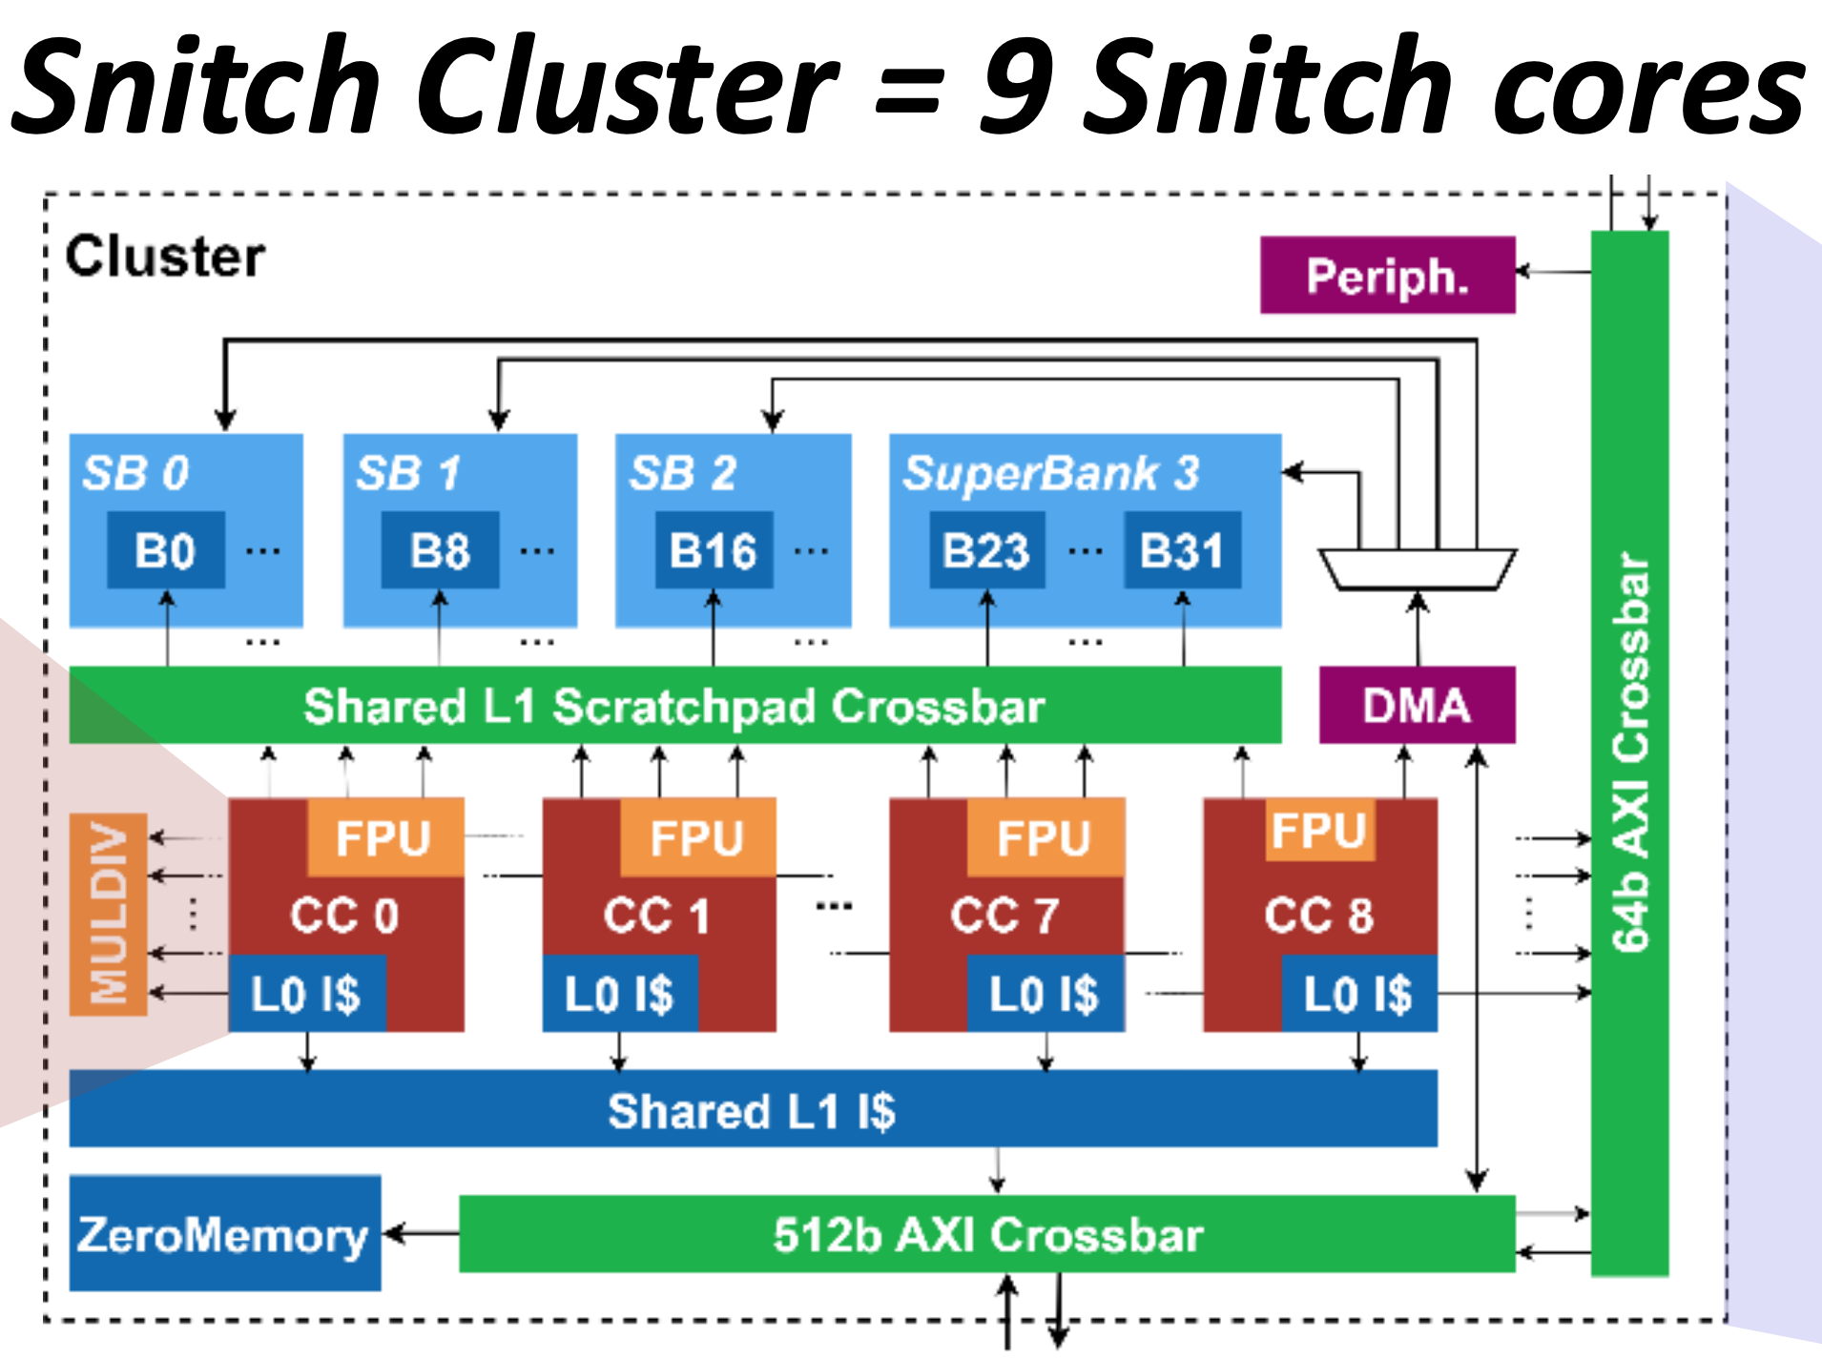
Why Optimize FlashAttention-2 for Autoregressive Decode?
The mechanism behind LLM text generation
Single new query against long context
  Different Computional Structure
Can FlashAttention be specialized for autoregressive decode to exploit the Snitch cluster?
  When does DMA/NoC bandwidth become the bottleneck?

Slide 3
Autoregressive Decode - QKV projection
Autoregressive Inference
Large GEMM to project K, V, Q
  Token Embedding of Dimension d
  Sequence length S
One new token per decoding step
Reuse cached K and V from previous tokens
GEMM –> GEMV

Slide 4
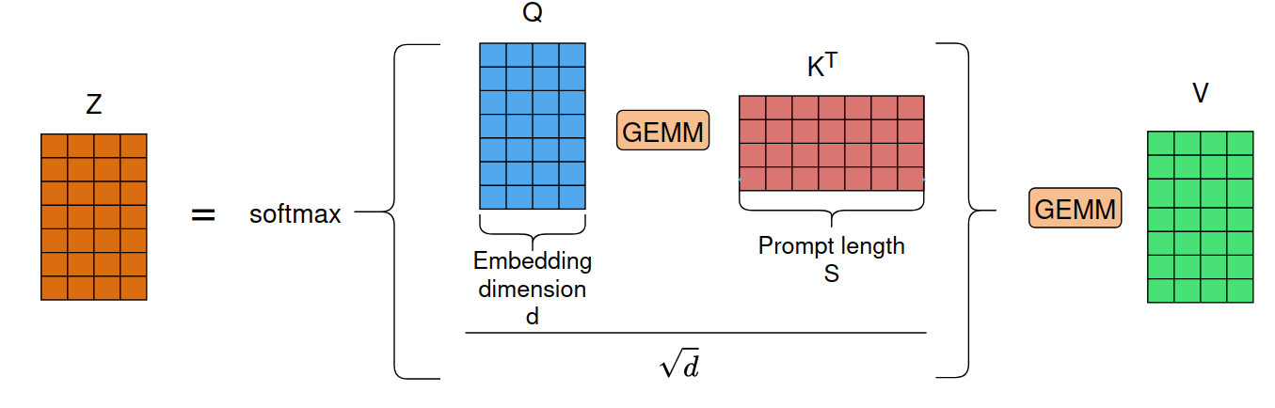
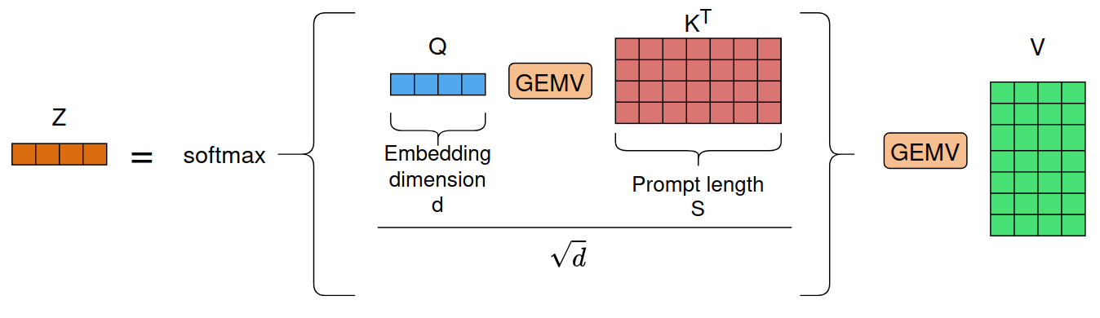
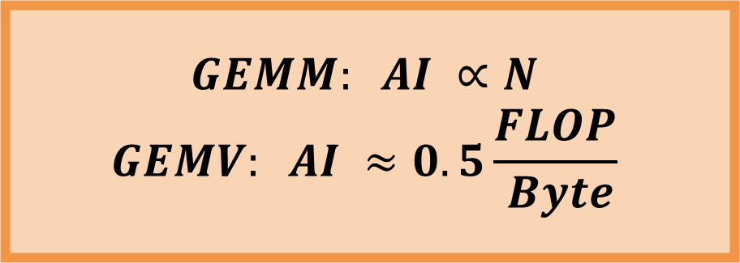
Attention
$$GEMM: AI ∝N$$
$$GEMV: AI ≈0.5\frac{FLOP}{ Byte}$$
Autoregressive Inference
Full-sequence attention features large GEMM
We query just the new token against K and V
GEMM –> GEMV
Hypothesis:
After optimizations, we will be memory-bound
Optimize Kernel for new Regime

Slide 5
Why autoregressive decoding changes attention
GEMMs collapse to GEMVs
  GEMM: 1/6*N FLOP/Byte
  GEMV: (1*8Byte)/2FLOP = 4 Byte/FLOP*
  Low arithmetic intensity shifts the bottleneck toward memory/NoC bandwidth
Goal: optimize FlashAttention for this regime and test wider NoC links
* For Large Matrices

Slide 6
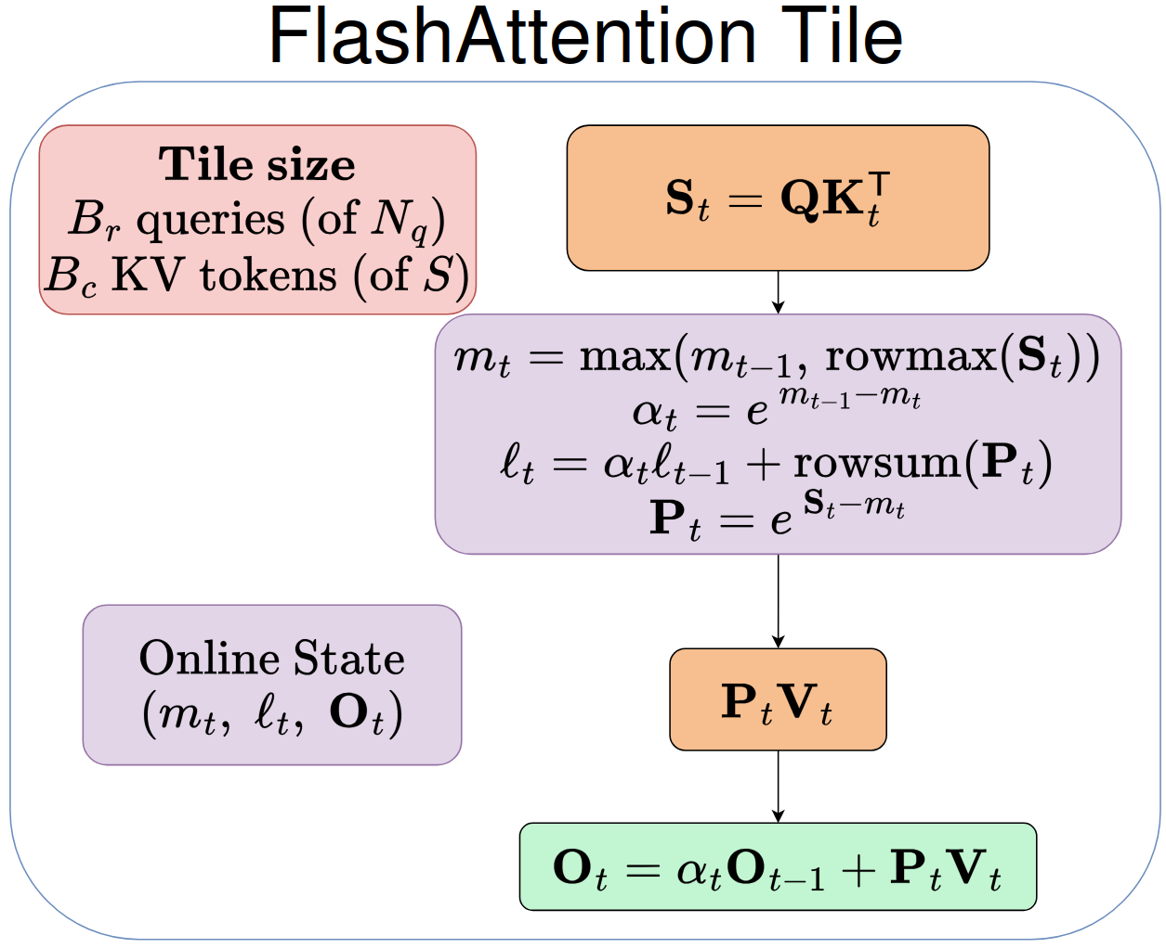
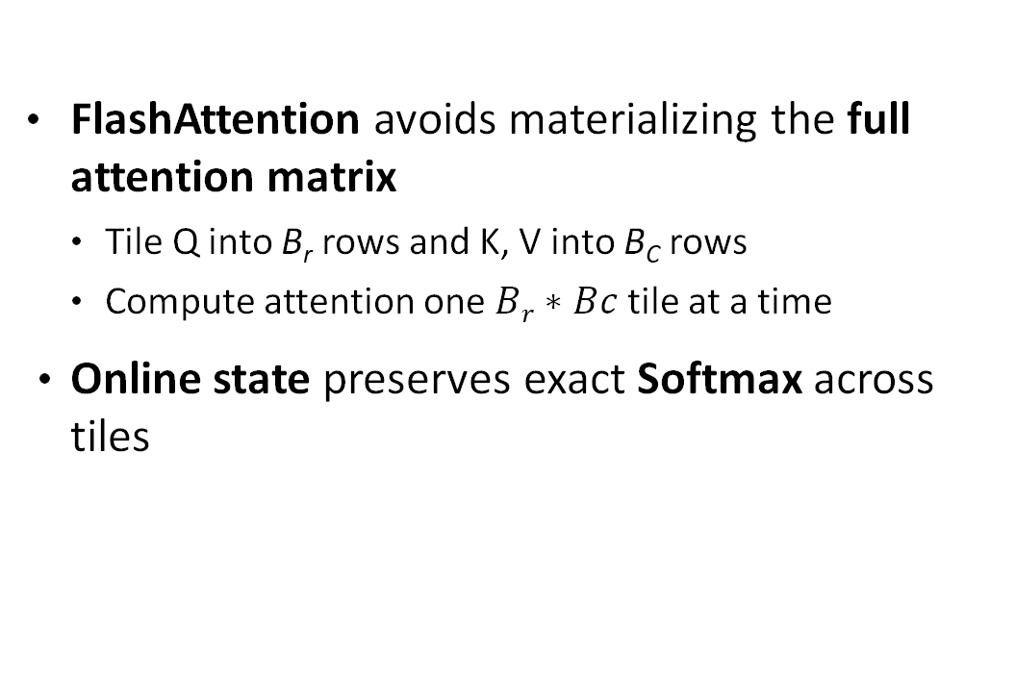
FlashAttention-2
Existing kernel: B_{r}>1 → GEMMs
Decode: B_{r}=1 → two GEMVs + vector Softmax
FlashAttention avoids materializing the full attention matrix
  Tile Q into B_{r} rows and K, V into B_{C} rows
  Compute attention one $Br∗Bc$ tile at a time
Online state preserves exact Softmax across tiles

Slide 7
Optimization 1 — K*q: Decode-specialized GEMV
Kq: parallelize across K rows
  Unroll the dot product over d with independent accumulators
  Fuse the local maximum into the GEMV
p^{T}V: parallelize across output dimensions
  Compute adjacent outputs together
  Reuse each p_{i} across multiple V elements
Common datapath for both GEMVs
  SSR streaming + FREP
  2-way FP32 SIMD
  Multi-accumulator unrolling to hide FMA latency
Exploit the dimension that remains parallel after GEMM → GEMV

Slide 8
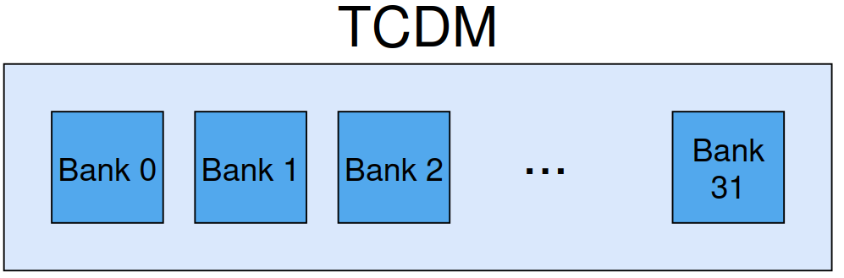
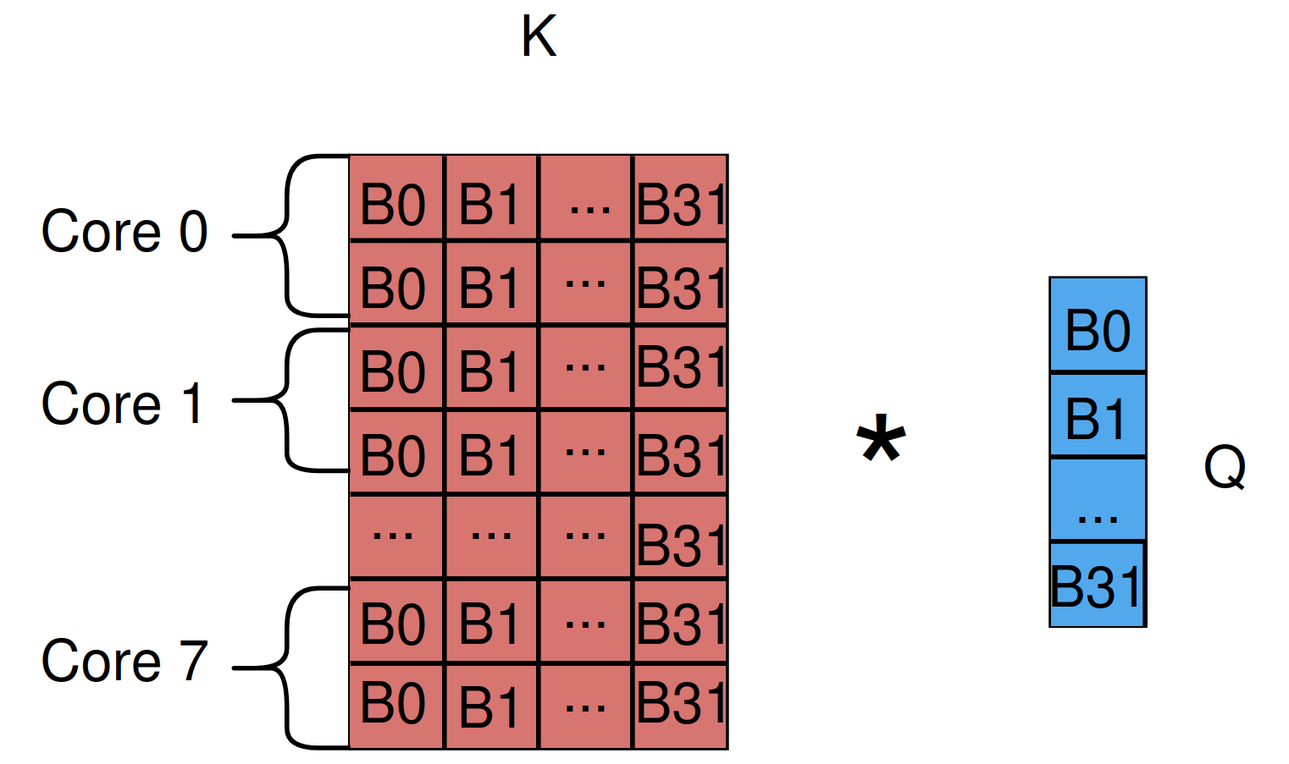
Optimization 1 — K*q: Decode-specialized GEMV
Parallelize across rows of K
  8 cores compute independent rows
SSR/FREP + FP32 SIMD
  Unrolling with independent Accumulators
Fuse local maxium into GEMV
  Tree reduction in the end saves cycles later
Most common head dimensions are 64 and 128 [1]
  FP32 rows are exact multiples of the 256-B TCDM bank period
  TCDM Bank Conflicts
B_{c}=d=64
Cycle 0
Cycle 1
[1] Y. Xu et al., “SparkAttention: High-Performance Multi-Head Attention for Large Models on Volta GPU Architecture,” arXiv:2502.12784, 2025

Slide 9
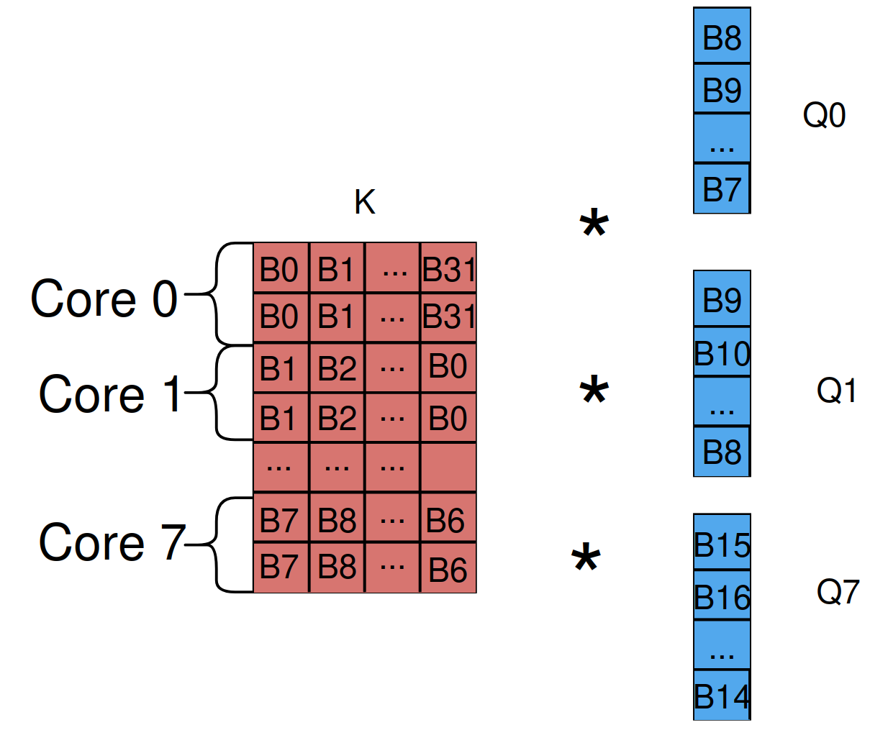
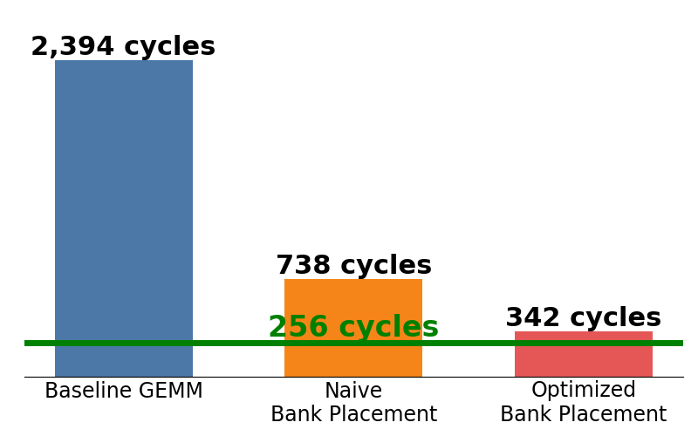
Optimization 2 – Bank-aware TCDM placement
IDEA
Partition K · Replicate Q · Skew by 1 bank/core
Scalar expf now dominates runtime!
Cycle 1
For p^{T}V we parallelize over output dimension d
The access pattern is already bank-friendly
Cycle 0
7x speedup with 8 cores
2.2x Speedup Through Bank Placement
Lower Bound:
# of vfmac.s

Slide 10
Optimization 2 — Vectorized Online Softmax
Scalar expf dominates runtime!
Range-reduced exponential: LUT + polynomial approximation
  LUT + constants staged in TCDM
SSR/FREP pipeline processes independent exponentials in parallel
Fuse Softmax Pₜ and rescaling factor αₜ into one vector call
Pad to vector granularity
  no scalar expf fallback

Slide 11
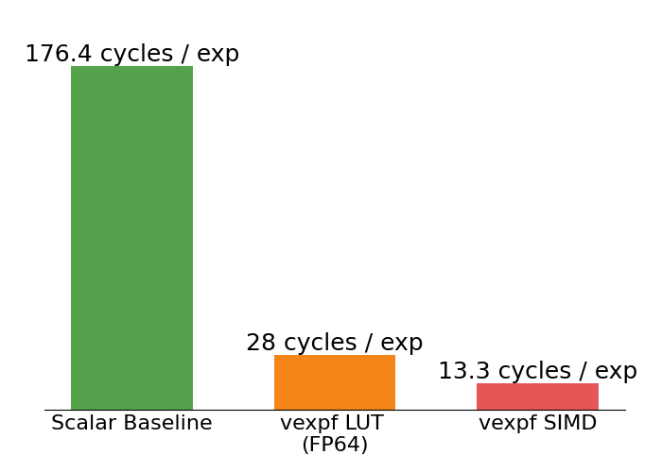
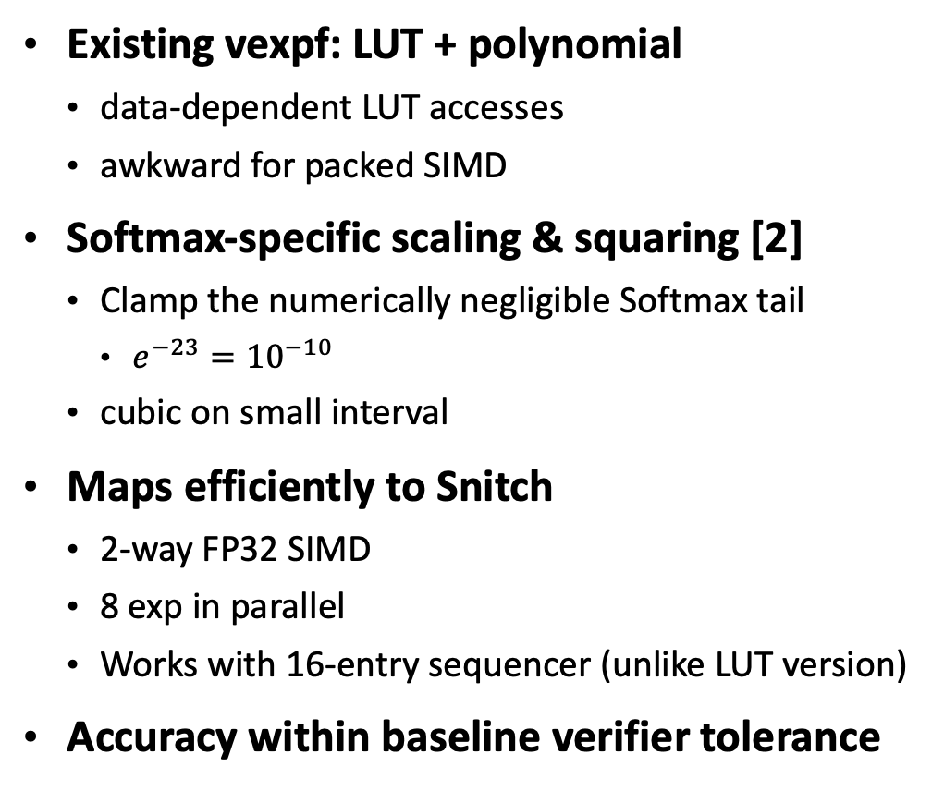
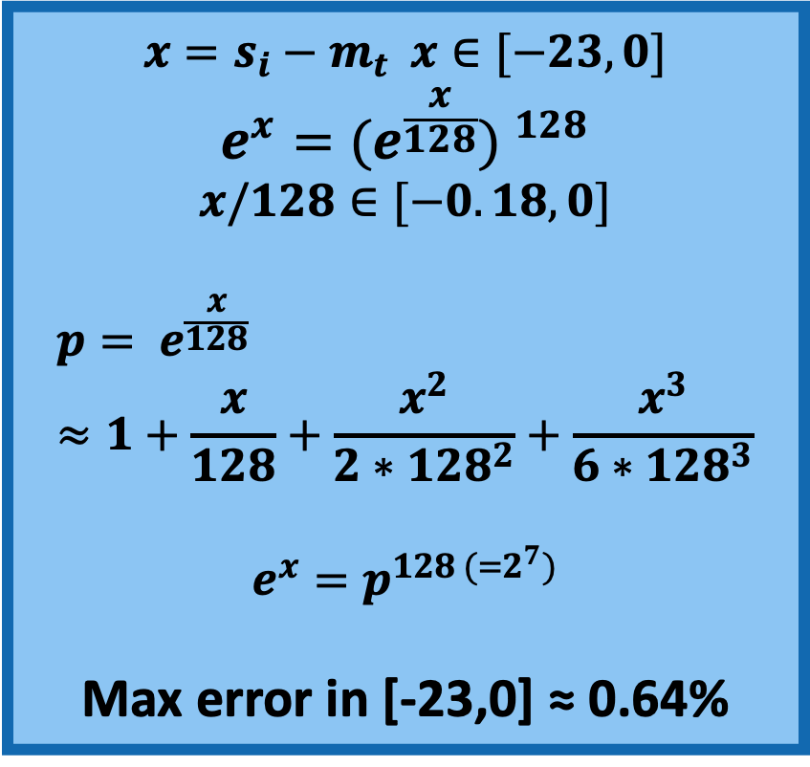
Optimization 3 — Vectorized Online Softmax
Existing vexpf: LUT + polynomial
  data-dependent LUT accesses
  awkward for packed SIMD
Softmax-specific scaling & squaring [2]
  Clamp the numerically negligible Softmax tail
    $e^{−23}={10}^{−10}$
  cubic on small interval
Maps efficiently to Snitch
  2-way FP32 SIMD
  8 exp in parallel
  Works with 16-entry sequencer (unlike LUT version)
Accuracy within baseline verifier tolerance
$$x=s_{i}−m_{t} x∈[−23,0]$$
$$e^{x}=({e^{\frac{x}{128}}) }^{128}$$
$$x/128∈[−0.18,0]$$
$${p= e}^{\frac{x}{128}}≈1+\frac{x}{128}+\frac{x^{2}}{2∗{128}^{2}}+\frac{x^{3}}{6∗{128}^{3}}$$
$$e^{x}=p^{128 (=2^{7})}$$
Max error in [-23,0] ≈ 0.64%
13.3x
[2] J. Sastre et al., “New Scaling-Squaring Taylor Algorithms for Computing the Matrix Exponential,” SIAM J. Sci. Comput., 37(1), A439–A455, 2015.

Slide 12
Optimization 3 — Overlap K/V Transfer with Compute
Keep two K/V tile buffers in TCDM
  Classical Double-Buffering
Use AXI Burst-Aligned placement for DMA transfers
Current FlashAttention serializes DMA and Compute

Slide 13
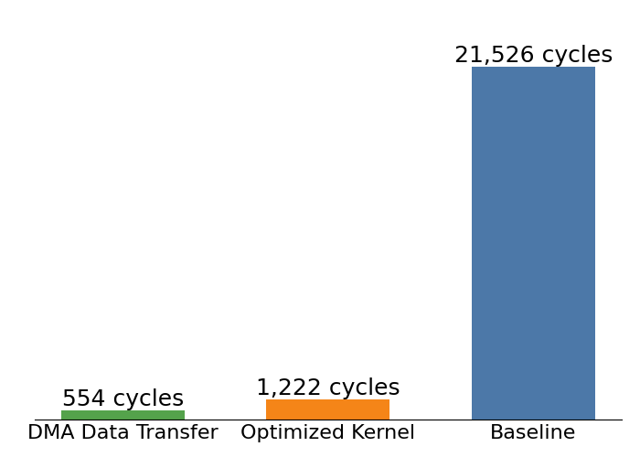
Single-Cluster Results: Decode-Specialized FlashAttention
Single-cluster benchmark: d=64, B_{c}= 64, FP32
  Double-buffered K/V tiles
  Full 512-bit NoC/DMA bandwidth available to one cluster
Baseline: existing GEMM-based FlashAttention-2 kernel
  Compared against our decode-specialized GEMV implementation
Decode specialization: 17.6× compute speedup
Compute 2.2x longer than data movement

Slide 14
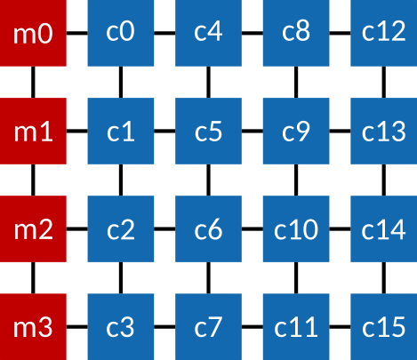
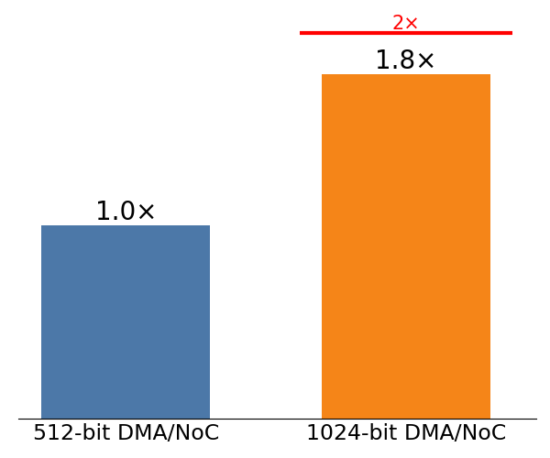
Memory Boundness
Working with tile-based Gwaihir SoC
  4x4 compute tile array + 4 L2 memory tiles
  Open source NoC: FlooNoC^{[3]} , configured to 512 Bit Link width
We can extend NoC and DMA data width, as done in previous semester project
With our optimizations, FlashAttention-2 becomes memory-bound!
  1.8x speedup with 1024-bit DMA!

