Slide 1
VI-69: Tech Titans: Best Practices for Building a Bridge to Unlock the Power of Vision APIs
Michael Dobler
Deltek, Inc.

Slide 2
Agenda
Overview
Finding and Connecting to the Vision API Web Service
Available Methods and Schemas
Reading Data from Vision
Writing Data to Vision
Parsing XML Data
Using the API Repository classes
Tips & Tricks

Slide 3
Overview

Slide 4
What Is the Vision API
It’s a Web Service
Available on premise and in the cloud (depending on licensing)
Installed by default
Allows you to read from and write to any Info Center record (including User Defined Info Centers)
Allows you to create and post journals, timesheet, expenses, etc…
Applies Vision’s security model and business logic
No direct access to the database necessary

Slide 5
Finding and Connecting to the Vision API Web Service

Slide 6
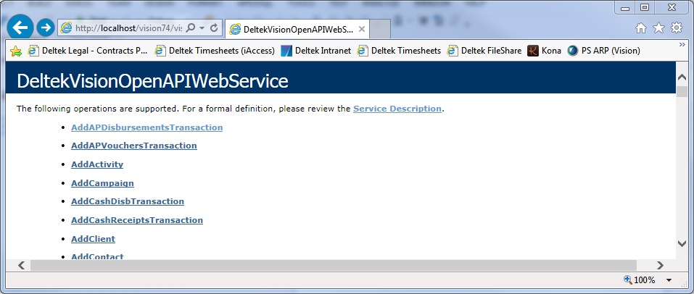
How to access it from a browser
Like any other Web Service, the “Deltek Vision Open API Web Service” can be accessed through a standard browser
Will show a list of available methods of this web service
Standard location: http://<your vision application location>/visionWS.asmx
Depending on your settings you must connect to a secure site (https://)
Default browser address (on Vision server): http://localhost/vision/visionWS.asmx

Slide 7
Use it in Visual Studio
Open Visual Studio 2015 and create a project (a WPF Application in our sample)
In the Solution Explorer, right-click the project and select “Add” > “Service Reference…”
In the Address enter your location of the asmx file followed by “?WSDL” and click “GO”
Sample: http://localhost/vision/visionWS.asmx?WSDL
In the Services list, open “DeltekVisionOpenAPIWebService” and select “DeltekVisionOpenAPIWebServiceSoap”
Give it a specific Namespace (“VisionAPI”)
Visual Studio will now add a couple of automatically created classes to the project that can call these web service methods

Slide 8
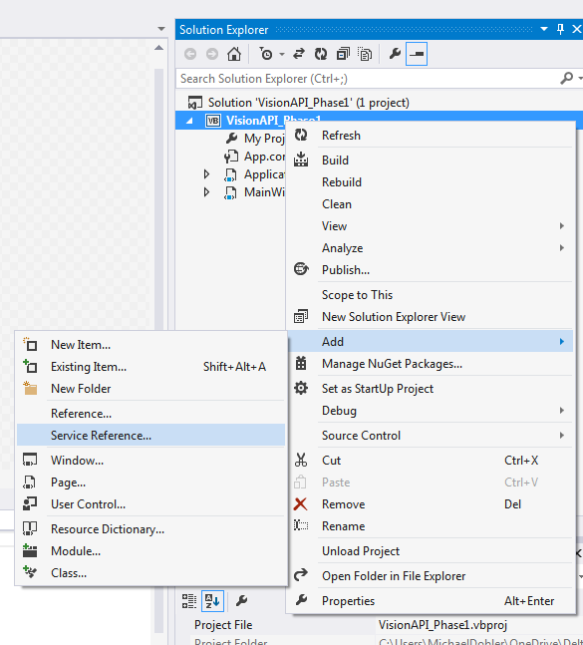
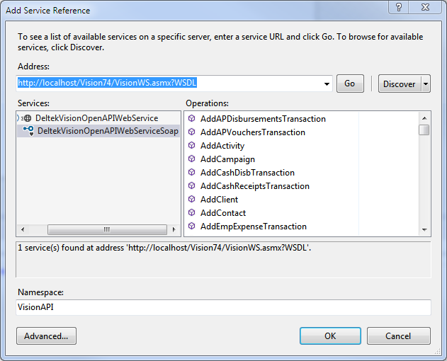

Slide 9
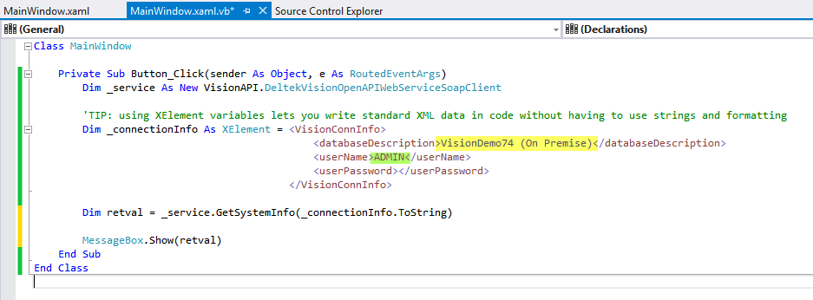
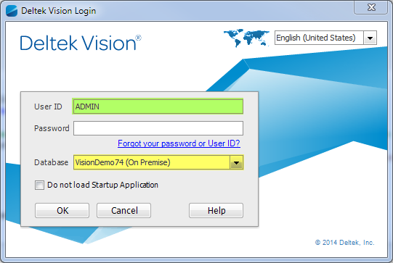
Test Connection
Add a button to the MainWindow and label it “Test Connection”
In the Button_Click method instantiate the service and call the GetSystemInfo method.
Provide the correct connection info (an XML string)

Slide 10
Connection Information
The web service will always ask for a connection info. This is an XML string in the following format: <VisionConnInfo> <databaseDescription>Weblink Database Name</databaseDescription> <userName>Vision User Name</userName> <userPassword>Vision User Password</userPassword> </VisionConnInfo>
Once a connection has been established and a method returned a session ID to the program you can use that session id for subsequent calls: <VisionConnInfo> <SessionID>Session ID returned by the previous call</SessionID> </VisionConnInfo>

Slide 11
Available Methods and Schemas

Slide 12
Methods and Schema Information
You can find a list of available methods
A) in the PDF documentation “DeltekVisionXtend7xWebServicesAPI.pdf” (the x stands for the Vision version)
B) in the list displayed by the browser if you go to http://<your vision server>/vision/vision WS.asmx
C) in the Visual Studio Object Browser when you go to your new Namespace “VisionAPI”
The schema definitions for reading and writing data with the API can be found on your application server here: C:\Program Files (x86)\Deltek\Vision\Web\xsd
Each info center has a corresponding …_Schema.xsd file that can be opened in Visual Studio and checked for specific elements

Slide 13
Specific vs. Generic methods
You can always choose specific read/write methods vs generic methods. With the generic methods you will have to pass an XML construct containing the InfoCenter information but these do give you more control over the returned data. We suggest to use the generic methods by default
Writing Data
SendDataToDeltekVision (generic): can insert or update all info centers
SendDataToDeltekVisionWithReturn (generic): This method provides the same functionality as SendDataToDeltekVision but also returns snapshots of the records after the updates
Add[InfoCenter] (specific): adds a record to the specific info center
Update[InfoCenter] (specific): updates a record in the specific info center

Slide 14
Specific vs. Generic methods
Deleting Data
DeleteRecords (generic): This deletes records from any number of tables and/or Info Centers.
Delete[InfoCenter] (specific): deletes a record from the specific info center
Reading Data
GetRecordsByKey (generic): retrieves records by a primary key
GetRecordsByQuery (generic): retrieves records based on a SQL select statement
GetUDICByKey (generic): retrieves UDIC records by a primary key
GetUDICByQuery (generic): retrieves records by a query
Get[InfoCenter]ByKey (specific): retrieves records from this info center by key
Get[InfoCenter]ByQuery (specific): retrieves records from this info center by query

Slide 15
Reading Data from Vision

Slide 16
Sample “VisionAPI_Phase 2”
Simple WPF application that searches for a project name portion and a list box that will display the results as a list of Project Number/Project Name pairs
Add these items to the window
Label “Search For”
Textbox txtSearchString
Button “Find”
ListBox lstResults
Implement the Button_Click method and set up the service and connection string as before

Slide 17
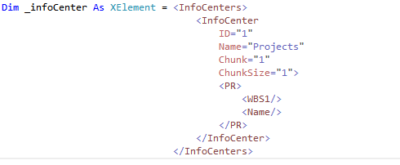
Initialize Service
Set up Connection Info
Set Up Info Center structure
Limit the returned data to 1 record per request and set it to the first record
Limit the returned Project Info to Number and Name only
Set up the Query
User <%= %> to inject data into XML

Slide 18
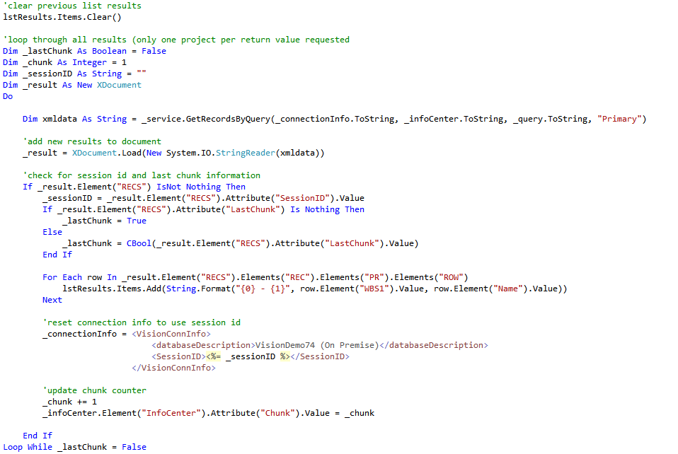
Clear List
Start Loop
Call API
Render string as XDocument
Look for the Session ID and Last Chunk Flag
Loop through all rows and add an item to the list
Reset connection to use SessionID
Update Chunk Counter

Slide 19
Writing Data to Vision

Slide 20
Sample “VisionAPI_Phase 3”
Extends the “VisionAPI_Phase 2” application
Adds the WBS2, WBS3, SubLevel fields to the InfoCenter definition → SubLevel is needed for a proper Update process later
Allows for the Project Name to be modified
Uses a similar data XML as returned by the read process for the SendDataToDeltekVision method call
Must reference the correct schema: <RECS xmlns="http://deltek.vision.com/XMLSchema">
Must define a transaction type (insert/update): <ROW tranType="UPDATE">
Must supply a minimum number of fields in the correct sequence (as listed in schema)!

Slide 21
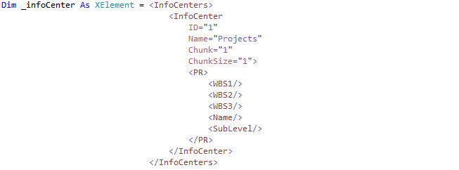
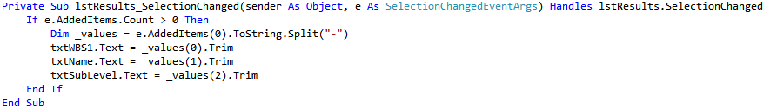
Extend Table Definition to Include SubLevel field
Add SubLevel to List Output
Split out info so that the end user can update name

Slide 22
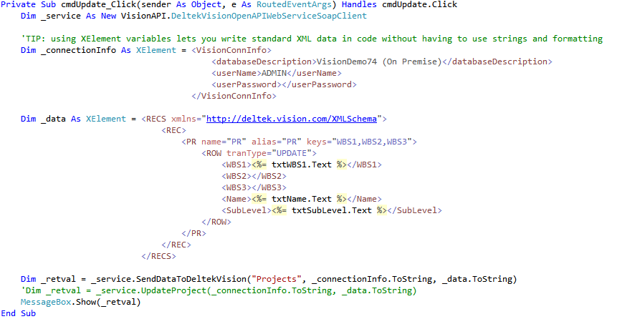
Set Connection Info
Create Record (including namespace reference)
Write back to Vision

Slide 23
Parsing XML Data

Slide 24
How to read XML Data
There are many technologies to that. My preference: Lync for XML (XDocument/XElement)
Create XDocument from returned XML string:
Dim xmldata As String = _service.GetRecordsByQuery(…)
Dim _myXDocument As XDocument = XDocument.Load(New System.IO.StringReader(xmldata))
Query child nodes with .Element(s) and .Attribute(s)
You can traverse down a complete XML graph by combining multiple elements:
.Element(“RECS”): return the first child of a previous XML level that is named RECS
.Element(“RECS”).Elements(“REC”).Elements(“PR”).Elements(“ROW”): return all ROW elements in all PR elements of all REC elements in the first RECS node

Slide 25
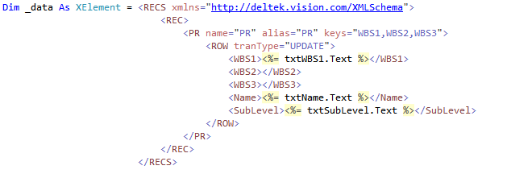
How to write XML Data
Lync for XML allows you to write XML expression in your source code
Using <%= … %> allows you to insert any value into the XML expression
You can write elements and attributes without having to concatenate strings

Slide 26
Using the API Repository Classes

Slide 27
The VisionAPIRepository Project
A project with a set of classes that make interaction with the Vision API a bit easier
Helper functions to return the correct connection info XML, info center XML
Repository functions that return the requested records either as a .net Dataset or an XDocument.
Error Handling
Methods to connect to the service through http or https
The VisionAPIRepository class can be extended for specific functionality

Slide 28
Preparing your solution
Remove any existing Service Reference to the VISION API from your original project
Add the VisionAPIRepository to your solution
Add a reference to the VisionAPIRepository in your project
Add the Binding information to your App.Config file(see next slide)
Replace previous code with new class method calls

Slide 29
<system.serviceModel>
<bindings>
<basicHttpBinding>
<binding name="DeltekVisionOpenAPIWebServiceSoap" openTimeout="00:02:00" sendTimeout="00:02:00" maxReceivedMessageSize="5242880">
<readerQuotas maxDepth="32" maxStringContentLength="5242880" maxArrayLength="16384" maxBytesPerRead="4096" maxNameTableCharCount="16384"/>
<security mode="None"/>
</binding>
<binding name="DeltekVisionOpenAPIWebServiceSoapSSL" openTimeout="00:02:00" sendTimeout="00:02:00" maxReceivedMessageSize="524288">
<security mode="Transport">
<transport clientCredentialType="None" proxyCredentialType="None" realm=""/>
<message clientCredentialType="Certificate" algorithmSuite="Default"/>
</security>
</binding>
</basicHttpBinding>
</bindings>
<client>
<endpoint address="http://localhost/Vision/VisionWS.asmx"
binding="basicHttpBinding"
bindingConfiguration="DeltekVisionOpenAPIWebServiceSoap"
contract="VisionAPI.DeltekVisionOpenAPIWebServiceSoap"
name="DeltekVisionOpenAPIWebServiceSoap"/>
<endpoint address="https://localhost/Vision/VisionWS.asmx"
binding="basicHttpBinding"
bindingConfiguration="DeltekVisionOpenAPIWebServiceSoapSSL"
contract="VisionAPI.DeltekVisionOpenAPIWebServiceSoap"
name="DeltekVisionOpenAPIWebServiceSoapSSL"/>
</client>
</system.serviceModel>

Slide 30

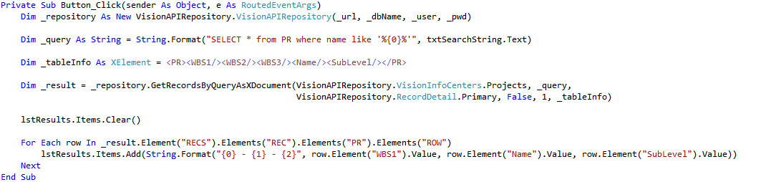
Define Connection Info globally or as a Setting
Initiate repository
Call repository method

Slide 31
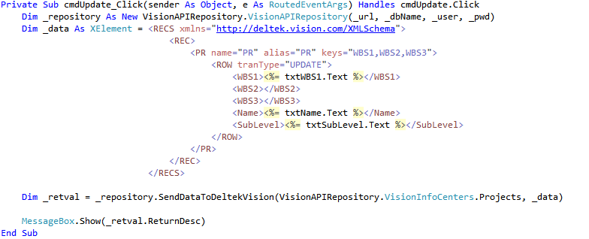
Initiate repository
Call repository method

Slide 32
Tips & Tricks

Slide 33
Tips & Tricks
Create a specific user in Vision for API access only and make sure the user has the correct access rights
Turning on https can be tricky
Always (!!!) follow the sequence of fields in the schema when you create data records
If the generic method will not work no matter what you do, try the specific method for that call
Be careful with returning ALL data. You might run into issues where the returned message is too big. Increase maxReceivedMessageSize and maxStringContentLength in your App.Config

Slide 34
Additional Resources

Slide 35
Links and Downloads
You can find all source code on GitHub here: https://github.com/mdobler/Insight2015/tree/master/VI69
All demos use the VisionDemo74 database (can be downloaded from the Deltek support site; http://support.Deltek.com )
I am available at the “Ask The Expert” sessions
Email me: Mike Dobler ( michaeldobler@Deltek.com )

Slide 36
Questions?

