Slide 1



Central Processing Unit
Noida Institute of Engineering and Technology, Greater
Noida
Unit: 3
COMPUTER SYSTEM
ORGANIZATION (AMCA-0104)
Dr. RAJ KUMAR GOEL
MCA-I SEM
Dr. RAJ KUMAR GOEL
AMCA-0104
UNIT-3
1
1/21/2022

Slide 2

Hardwired control unit
➢ Micro programmed control unit
➢ Hardwired control unit
➢ General register organization
➢ Stack organization
➢ Instruction types, formats
➢ instruction cycles and sub cycles (Fetch, decode, execute)
➢ execution of a complete instruction
➢ Addressing Modes
➢ Reduced Instruction set computer
➢ Complex Instruction set Computer
Dr. RAJ KUMAR GOEL
UNIT-3

Slide 3

Course Objective
➢ Discuss the basic concepts and structure of computers.
➢ Understand concepts of fetching and storing words from/to memory.
➢ Explain different steps of execution of a complete instruction.
➢ To discuss about hardwired and Microprogrammed control unit.
Dr. RAJ KUMAR GOEL
UNIT-3

Slide 4

Course Outcome
➢ Classify and compute the performance of machines.
➢ Understand how to implement memory read and write operations.
➢ Relate to arithmetic for ALU implementation.
➢ Understand the basics of hardwired and micro-programmed control
of the CPU.
➢ Learn about the concept of execution of a complete instruction.
Dr. RAJ KUMAR GOEL
UNIT-3

Slide 5

Prerequisite and Recap
➢ Before learning the concepts of Basic Electronics and Computer Organization, you should have a basic knowledge of functional units of a computer system.
➢ The knowledge of mathematics.
➢ The knowledge of English language upto a satisfactory level.
➢ In the last unit we have discussed about Memory, Register and
Register transfer
Dr. RAJ KUMAR GOEL
UNIT-3

Slide 6

Topic
➢ Hardwired and Micro programmed control unit
Dr. RAJ KUMAR GOEL
UNIT-3

Slide 7
Topic objective
To discuss about Hardwired and Microprogrammed control unit.
Dr. RAJ KUMAR GOEL
UNIT-3

Slide 8

Microprogrammed control (CO3)
A control unit whose binary control variables are stored in memory is called a Microprogrammed control unit .
Each word in control memory contains within it a microinstruction . The microinstruction specifies one or more microoperations for the system. A sequence of microinstructions constitutes a Microprogram.
ROM words are made permanent during the hardware production of the unit. The content of the word in ROM at a given address specifies a microinstruction.
1/21/2022
Dr. RAJ KUMAR GOEL
AMCA-0104
UNIT-3
8

Slide 9
Microprogrammed control (CO3)
When the control signals are generated by hardware using conventional logic design techniques, the control unit is said to be hardwired. Microprogramming is a second alternative for designing the control unit of a digital computer. The principle of microprogramming is an elegant and systematic method for controlling the micro operation sequence in a digital computer.
1/21/2022
Dr. RAJ KUMAR GOEL
AMCA-0104
UNIT-3
9

Slide 10
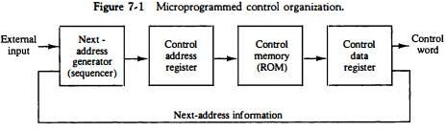
Microprogrammed Control Unit (CO3)
• A memory that is part of a control unit is referred to as a control memory. The general configuration of a micro-programmed control unit is demonstrated in the below figure.
• The control memory is assumed to be a ROM, within which all
control information is permanently stored.
• The control unit which generates control signals according to microprogram rather than using hardware is called a Microprogrammed Control Unit
Dr. RAJ KUMAR GOEL
UNIT-3

Slide 11
Microprogrammed Control Unit (CO3)
• The control memory address register specifies the address of the microinstruction, and the control data register holds the microinstruction read from memory.
• The microinstruction contains a control word that specifies one or more microoperations for the data processor. Once these operations are executed, the control must determine the next address.
• The location of the next microinstruction may be the one next in sequence, or it may be located somewhere else in the control memory.
• The next address generator is sometimes called a micro-program sequencer, as it determines the address sequence that is read from control memory.
Dr. RAJ KUMAR GOEL
UNIT-3

Slide 12
Microprogrammed Control Unit (CO3)
• Basic function of micro-program sequencer are:-
➢ Incrementing the control address register by one.
➢ Loading an address from control memory into the control address register
➢ Transferring an external address.
➢ Loading an initial address to start the control operation.
Dr. RAJ KUMAR GOEL
UNIT-3

Slide 13

Advantages of Microprogrammed Control Unit
(CO3)
• There are the following advantages of microprogrammed control are as follows −
➢ It can more systematic design of the control unit.
➢ It is simpler to debug and change.
➢ It can retain the underlying structure of the control function.
➢ It can make the design of the control unit much simpler. Hence, it is inexpensive and less error-prone.
➢ It can orderly and systematic design process.
➢ It is used to control functions implemented in software and not hardware.
➢ It is more flexible.
➢ It is used to complex function is carried out easily.
Dr. RAJ KUMAR GOEL
UNIT-3

Slide 14

Disadvantages of Microprogrammed Control Unit
(CO3)
• There are the following disadvantages of microprogrammed control are as follows −
➢ Adaptability is obtained at more cost.
➢ It is slower than a hardwired control unit.
Dr. RAJ KUMAR GOEL
UNIT-3

Slide 15

Microinstruction (CO3)
• An instruction that control the data flow and sequencing in a processor at a more fundamental level than machine instruction is known as microinstruction.
• A microinstruction is an instruction in a micro-program.
• For example , moving a bit from one register to another . It takes several microinstruction to carry out one machine instruction.
• Each word in microinstructions microprogram.
the control memory contains within it is a
and a sequence of microinstruction constitutes a
Dr. RAJ KUMAR GOEL
UNIT-3

Slide 16
Microinstruction (CO3)
• The microinstruction format for the control memory is shown in Figure.
The 20 bits of the microinstruction are divided into four functional parts.
• The three fields F1, F2, and F3 specify microoperations for the computer. The CD field selects status bit conditions. The BR field specifies the type of branch to be used. The AD field contains a branch address.
• The address field is seven bits wide, since the control memory has 128 =
2⁷ words.
• F1,F2, and F3 are microoperation fields.
• CD is conditions for branching
• BR is Branch field
• AD is address field
Figure Microinstruction code format (20 bits).
F1(3 bit) | F2( 3 bit) | F3(3 bit) | CD(2) | BR(2) | AD(7)
Dr. RAJ KUMAR GOEL
UNIT-3

Slide 17
Microinstruction (CO3)
• The microinstruction format for the control memory is shown in Figure. The 20 bits of the microinstruction are divided into four functional parts.
• The three fields F1, F2, and F3 specify microoperations for the computer. The CD field selects status bit conditions. The BR field specifies the type of branch to be used. The AD field contains a branch address.
• The address field is seven bits wide, since the control memory has
128 = 2⁷ words.
F1(3 bit) | F2( 3 bit) | F3(3 bit) | CD(2) | BR(2) | AD(7)
Figure 24.1 Microinstruction code format (20 bits).
Dr. RAJ KUMAR GOEL
UNIT-3

Slide 18
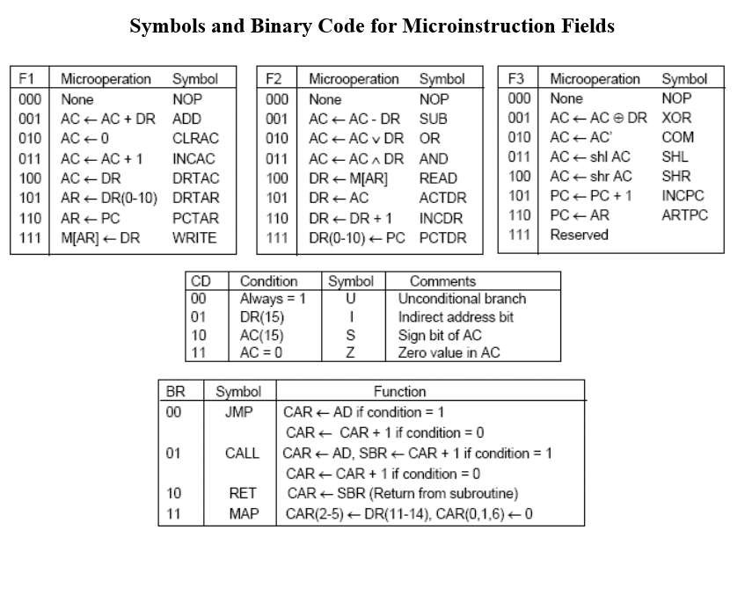
Microinstruction (CO3)
Dr. RAJ KUMAR GOEL
UNIT-3

Slide 19

Microprogram Sequencer
Microprogram Sequencer The basic components
of a
microprogrammed control unit are: -
1. The control memory.
2. The circuits that select the next address. The address selection part is called a Microprogram Sequencer. The purpose of the microprogram sequencer is to present an address to the control memory so that a microinstruction may be read and executed.
The next-address logic of the sequencer determines the specific address source to be loaded into the control address register (CAR). The choice of the address source is guided by the next-address information bits that the sequencer receives from the present microinstruction.
Dr. RAJ KUMAR GOEL
UNIT-3

Slide 20
Microprogram Sequencer
Microprogram Sequencer The basic components
of a
microprogrammed control unit are: -
1. The control memory.
2. The circuits that select the next address.
The address selection part is called a Microprogram Sequencer. The purpose of the microprogram sequencer is to present an address to the control memory so that a microinstruction may be read and executed.
The next-address logic of the sequencer determines the specific address source to be loaded into the control address register (CAR). The choice of the address source is guided by the next-address information bits that the sequencer receives from the present microinstruction.
Dr. RAJ KUMAR GOEL
UNIT-3

Slide 21
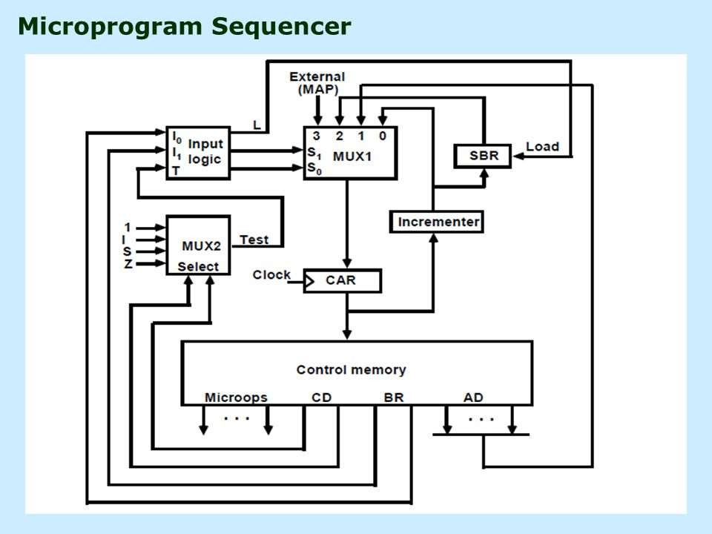
Microprogram Sequencer
Dr. RAJ KUMAR GOEL
UNIT-3

Slide 22
Microprogram Sequencer
Figure shows the block diagram of the microprogram sequencer. The control memory is included in the diagram to show the interaction between the sequencer and the memory attached to it.
1. There are two multiplexers in the circuit. a. The first multiplexer symbolized by MUX1 selects an address from one of four sources and transfer it into a control address register CAR. The output from CAR provides the address for a given word in the control memory.
2. he second multiplexer symbolized by MUX2 tests the value of selected status bit and the result of the test is applied to an input logic circuits.
Dr. RAJ KUMAR GOEL
UNIT-3

Slide 23
Microprogram Sequencer
The four inputs to MUX1 come from: -
1. The incremented content of CAR which is applied to one of the multiplexer inputs and to the subroutine register (SBR).
2. The address field of the present microinstruction.
3. The outputs of SBR.
4. The external source that maps the instruction.
Dr. RAJ KUMAR GOEL
UNIT-3

Slide 24
Microprogram Sequencer
The input logic circuit.
The condition field (CD) of the microinstruction selects one of the status bits in the second multiplexer (MUX1).
If the bit selected is equal to 1, the T (test) variable is equal to 1; otherwise, it is equal to 0.
The T value together with the two bits from the branch field (BR) goes to an input logic circuit.
he input logic in a particular sequencer will determine the type of operations that are available in the unit. Typical sequencer operations are: increment, branch or jump, call and return from subroutine, load an external address, push or pop the stack, and other address sequencing operations.
Dr. RAJ KUMAR GOEL
UNIT-3

Slide 25

Daily Quiz
The input logic circuit in figure 8.7 has three inputs, I0, I1, and T, and three outputs, S0, S1, and L. Variables S0 and S1 select one of the source addresses for CAR. Variable L enables the load input in SBR. The binary values of the two selection variables determine the path in the multiplexer.
For example, with S1S0 = 10, multiplexer input number 2 is selected and establishes a transfer path from SBR to CAR.
Dr. RAJ KUMAR GOEL
UNIT-3

Slide 26

Tutorial
Using Table 1, give the 9-bit microoperation field for the following microoperations:
a. AC ← AC + 1, DR ← DR + 1
b. PC ← PC + 1, DR ← M [AR]
c. c. DR ← AC, AC ← DR
Using Table 1, convert the following symbolic microoperations to
register transfer statements and to binary.
a. READ, INCPC
b. ACTDR, DRTAC
c. ARTPC, DRTAC, WRITE
Dr. RAJ KUMAR GOEL
UNIT-3

Slide 27
Tutorial
Using Table 1, give the 9-bit microoperation field for the following microoperations:
a. AC ← AC + 1, DR ← DR + 1
b. PC ← PC + 1, DR ← M [AR]
c. c. DR ← AC, AC ← DR
Dr. RAJ KUMAR GOEL
UNIT-3

Slide 28
Tutorial
Using Table 1, give the 9-bit microoperation field for the following microoperations:
a. AC ← AC + 1, DR ← DR + 1
b. PC ← PC + 1, DR ← M [AR]
c. c. DR ← AC, AC ← DR
Using Table 1, convert the following symbolic microoperations to
register transfer statements and to binary.
a. READ, INCPC
b. ACTDR, DRTAC
c. ARTPC, DRTAC, WRITE
Dr. RAJ KUMAR GOEL
UNIT-3

Slide 29
Tutorial
Using Table 1, give the 9-bit microoperation field for the following microoperations:
a. AC ← AC + 1, DR ← DR + 1
b. PC ← PC + 1, DR ← M [AR]
c. c. DR ← AC, AC ← DR
Using Table 1, convert the following symbolic microoperations to
register transfer statements and to binary.
a. READ, INCPC
b. ACTDR, DRTAC
c. ARTPC, DRTAC, WRITE
Dr. RAJ KUMAR GOEL
UNIT-3

Slide 30
Daily Quiz
1. Differentiate between hardwired and Microprogrammed control organization.
2. What do you mean by Microinstruction. Explain with format.
Dr. RAJ KUMAR GOEL
UNIT-3

Slide 31
Hardwired control unit
1. The Hardwired Control organization involves the control logic to be
implemented with gates, flip-flops, decoders, and other digital circuits.
2. it requires changes in the wiring among the various components if the design has to be changed or modified.
Dr. RAJ KUMAR GOEL
UNIT-3

Slide 32
Hardwired control unit
1. The Hardwired Control organization involves the control logic to be implemented with gates, flip-flops, decoders, and other digital circuits.
2. The instruction register is divided into 3 parts. The I bit, operation code and an address part.
3. First 12 bit (0-11) to specify an address, next 3 bit specify the operation code (op-code) and the last bit specify the addressing mode.
4. First 12 bit (0-11) bit are applied to the control logic gates.
5. the operation code (op-code) bit are decoded with a 3x8 decoder.
6. The 8 output from a decoder goes to control logic gates to perform specific operation.
7. Last 15 bit is transferred to flip flop and designated by I.
Dr. RAJ KUMAR GOEL
UNIT-3

Slide 33
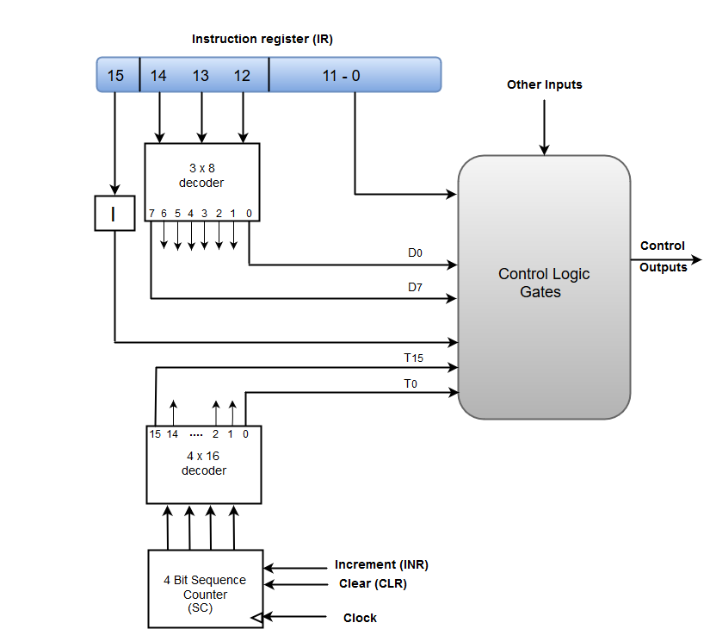
Hardwired control unit
Dr. RAJ KUMAR GOEL
UNIT-3

Slide 34

Topic
A Hard-wired Control consists of two decoders, a sequence counter, and a number of logic gates.
An instruction fetched from the memory unit is placed in the instruction register (IR).
The component of an instruction register includes; I bit, the operation code, and bits 0 through 11.
The operation code in bits 12 through 14 are coded with a 3 x 8 decoder.
Dr. RAJ KUMAR GOEL
UNIT-3

Slide 35
Topic
A Hard-wired Control consists of two decoders, a sequence counter, and a number of logic gates.
An instruction fetched from the memory unit is placed in the instruction register (IR).
The component of an instruction register includes; I bit, the operation code, and bits 0 through 11.
The operation code in bits 12 through 14 are coded with a 3 x 8 decoder.
Dr. RAJ KUMAR GOEL
UNIT-3

Slide 36
Topic
The outputs of the decoder are designated by the symbols D0 through D7.
The operation code at bit 15 is transferred to a flip-flop designated by the symbol I.
The operation codes from Bits 0 through 11 are applied to the control logic gates.
The Sequence counter (SC) can count in binary from 0 through 15.
The counter output is decoded into 16 timing pulses T₀ through T₁₅.
I=0 direct address mode, I=1 Indirect address mode
Dr. RAJ KUMAR GOEL
UNIT-3

Slide 37
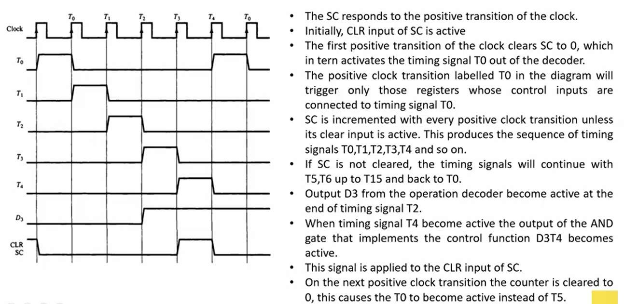
Topic
Dr. RAJ KUMAR GOEL
UNIT-3

Slide 38
Topic
➢ This organization is very complicated if we have a large control
unit.
Dr. RAJ KUMAR GOEL
UNIT-3

Slide 39

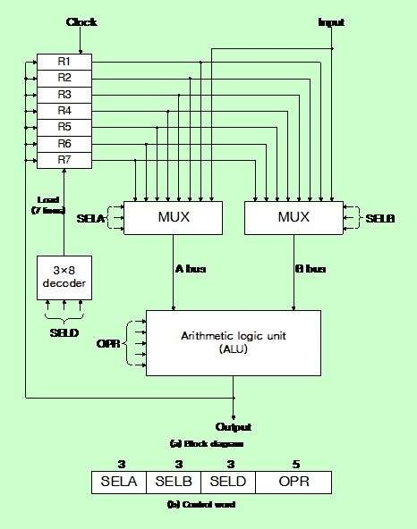
General register organization (CO3)
Figure : General Register Organization.
Dr. RAJ KUMAR GOEL
UNIT-3

Slide 40
General register organization (CO3)
➢ A bus organization for seven CPU registers is shown in Fig
➢ When a large number of registers are included in the CPU, it is most efficient to connect them through a common bus system.
➢ The registers communicate with
each other not only for direct data
transfers, but performing microoperations.
also
while various
➢ Hence it is necessary to provide a common unit that can perform all the arithmetic, logic, and shift microoperations in the processor.
Figure : General Register Organization.
Dr. RAJ KUMAR GOEL
UNIT-3

Slide 41
General register organization (CO3)
The control unit that operates the CPU bus system directs the information flow through the registers and ALU by selecting the various components in the system. For example, to perform the operation:
𝑅1 ← 𝑅2 + 𝑅3
The control must provide binary selection variables to the following selector inputs:
1. MUX A selector (SELA): to place the content of R2 into bus A.
2. MUX B selector (SELB): to place the content of R3 into bus B.
3. ALU operation selector (OPR): to provide the arithmetic addition A + B.
4. Decoder destination selector (SELD): to transfer the content of the output bus into Rl.
1/21/2022
Dr. RAJ KUMAR GOEL
AMCA-0104
UNIT-3

Slide 42
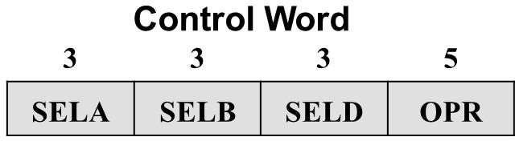
General register organization (CO3)
There are 14 binary selection inputs in the unit, and their combined value control word specifies a control word. The three bits of SELA select a source register for the A input of the ALU. The three bits of SELB select a register for the B input of the ALU. The three bits of SELD select a destination register using the decoder and its seven load outputs. The five bits of OPR select one of the operations in the ALU.
1/21/2022
Dr. RAJ KUMAR GOEL
AMCA-0104
UNIT-3

Slide 43
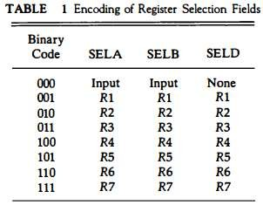
General register organization (CO3)
1/21/2022
Dr. RAJ KUMAR GOEL
AMCA-0104
UNIT-3

Slide 44
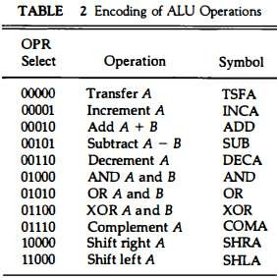
General register organization (CO3)
1/21/2022
Dr. RAJ KUMAR GOEL
AMCA-0104
UNIT-3

Slide 45
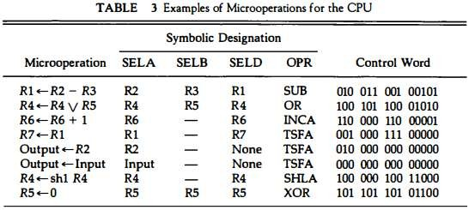
General register organization (CO3)
1/21/2022
Dr. RAJ KUMAR GOEL
AMCA-0104
UNIT-3

Slide 46
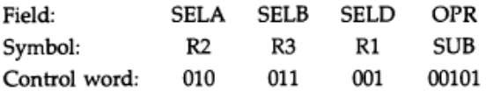
General register organization (CO3)
➢ For example, the subtract microoperation given by the statement: 𝑅1 ← 𝑅2 − 𝑅3 The binary control word for the subtract microoperation is 010 011 001 00101 and is obtained as follows
1/21/2022
Dr. RAJ KUMAR GOEL
AMCA-0104
UNIT-3

Slide 47

Stack organization (CO3)
➢ A useful feature that is included in the CPU of most computers is a
stack or last-in, first-out (LIFO) list.
➢ A stack is a storage device that stores information in such a manner
that the item stored last is the first item retrieved.
➢ The operation of a stack can be compared to a stack of trays. The last
tray placed on top of the stack is the first to be taken off.
➢ The stack in digital computers is essentially a memory unit with an address register that can count only (after an initial value is loaded into it).
1/21/2022
Dr. RAJ KUMAR GOEL
AMCA-0104
UNIT-3

Slide 48
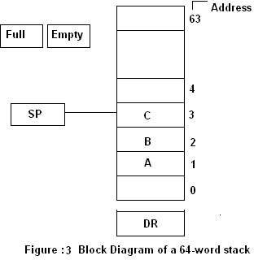
Stack organization (Register Stack) (CO3)
➢ A stack can be placed in a portion of a large memory or it can be organized as a collection of a finite number of memory words or registers.
➢ Figure shows the organization of a 64-word register stack.
➢ The stack pointer register SP contains a binary number whose value is equal to the address of the word that is currently on top of the stack.
Dr. RAJ KUMAR GOEL
UNIT-3

Slide 49
Stack organization (Register Stack) (CO3)
➢ The two operations of a stack are the insertion and deletion of items. The operation of insertion is called push because it can be thought of as the result of pushing a new item on top. The operation of deletion is called pop because it can be thought of as the result of removing one item so that the stack pops up.
Dr. RAJ KUMAR GOEL
UNIT-3

Slide 50
Stack organization (Register Stack) (CO3)
➢ The two operations of a stack are the insertion and deletion of items. The operation of insertion is called push because it can be thought of as the result of pushing a new item on top. The operation of deletion is called pop because it can be thought of as the result of removing one item so that the stack pops up.
Dr. RAJ KUMAR GOEL
UNIT-3

Slide 51

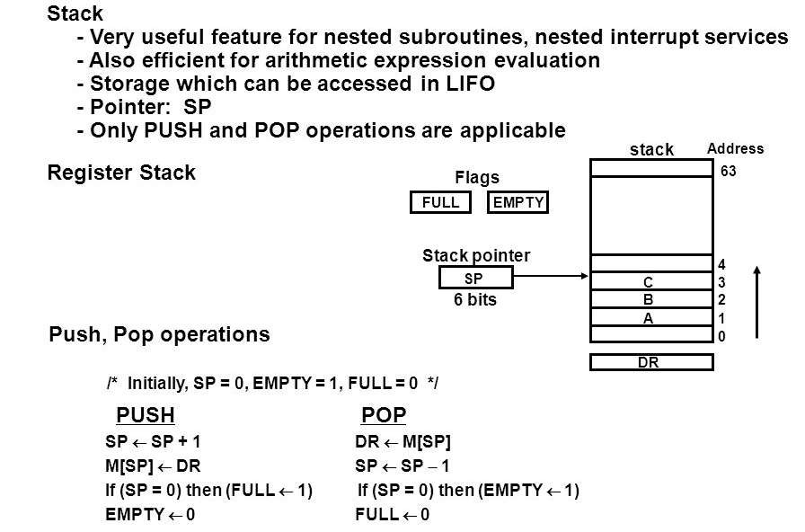
Stack organization (CO3)
Dr. RAJ KUMAR GOEL
UNIT-3

Slide 52
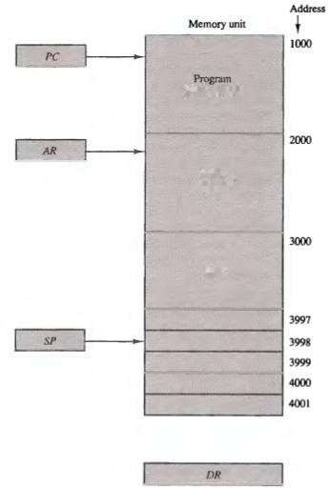
Stack organization (CO3)
➢ Memory Stack
➢ A stack can exist as a stand-alone unit as in Register stack or can be implemented in
➢ a random-access memory attached to
a CPU.
➢ A new item is inserted with the push
operation as follows:
SP ←SP – 1 ; M[SP] ←DR
➢ A new item is deleted with a pop
operation as follows:
DR ←M[SP]; SP ←SP + 1
Dr. RAJ KUMAR GOEL
UNIT-3

Slide 53
Daily Quiz
1. Let SP = 000000 in the stack of Register stack. How many items are there in the stack if:
a. FULL = 1 and EMTY = 0?
b. FULL = 0 and EMTY = 1?
Dr. RAJ KUMAR GOEL
UNIT-3

