Slide 1



MEMORY MANAGEMENT
Noida Institute of Engineering and Technology, Greater
Noida
Unit: 4
COMPUTER SYSTEM
ORGANIZATION (AMCA-0104)
Dr. RAJ KUMAR GOEL
MCA-I SEM
Dr. RAJ KUMAR GOEL
AMCA-0104
UNIT-4
1
2/9/2022

Slide 2

Content
➢ Memory Hierarchy
➢ Main Memory (RAM and ROM chips)
➢ Auxiliary Memory and Associative memory
➢ Cache Memory
➢ Memory Mapping:
➢ Associative mapping
➢ Direct mapping
➢ Set associative mapping.
➢ 2D and 2.5D memory organization
2/9/2022
Dr. RAJ KUMAR GOEL
AMCA-0104
UNIT-4

Slide 3

Course Objective
➢ Discuss the basic functionality of processor and processor
organization.
➢ Understand concepts of Instruction formats, data transfer and
manipulation with program control instructions.
➢ Explain the concepts of input – output organization and direct
memory access.
2/9/2022
Dr. RAJ KUMAR GOEL
AMCA-0104
UNIT-4

Slide 4

COs
CO1:
Master the logic gates, etc.
number
systems including computer arithmetic,
techniques
Boolean algebra and minimization
CO2:
Be familiar with the construction of buses by using different digital components.
CO3: Be familiar with the control unit, hardwired and
Microprogrammed for the processor
CO4: Be familiar with the memory hierarchy and memory
subsystem.
CO5: Be familiar with the input-output organization, multi core and
multithreading processors.
2/9/2022
Dr. RAJ KUMAR GOEL
AMCA-0104
UNIT-4

Slide 5

POs
PO1:Computational Knowledge: Develop knowledge of computing fundamentals, computing specialization, mathematics and domain knowledge for solving real world problems.
PO2:Problem Analysis: Identify formulate review research literature and analyze complex problems reaching substantial conclusions using first fundamental principles of mathematics, computing science and relevant domain discipline.
PO3:Design /Development of Solutions: Ability to design and evaluate system, components or processes for complex computing problems that meets specified needs with appropriate consideration for the public health and safety and cultural societal and environmental consideration.
PO4:Conduct investigations of complex Computing problems: Use research-based knowledge and research methods including design of experiments, analysis and interpretation of data, and synthesis of the information to provide valid conclusions.
PO5: Modern Tool Usage: Create, select, adapt and apply appropriate techniques, resources, and modern computing tools including prediction and modeling to complex computing activities, with an understanding of the limitations.
PO6:Professional Ethics: Understand and commit to professional ethics and cyber
regulations, responsibilities, and norms of professional computing practices.
2/9/2022
Dr. RAJ KUMAR GOEL
RCA-403
UNIT-4
5

Slide 6

Pos Cont..
PO7:Life-long Learning: Recognize
the need, and have the ability, to engage in
independent learning for continual preparation and development as a computing
professional for broadest content of technological change.
PO8:Project management and finance: Demonstrate knowledge and understanding of the computing and management principles and apply these to one’s own work, as a member and leader in a team, to manage projects and in multidisciplinary environments.
PO9:Communication Efficacy: Communicate effectively with the computing community, and with society at large, about complex computing activities by being able to comprehend and write effective reports, design documentation, make effective presentations, and give and understand clear instructions.
PO10:Societal and Environmental Concern: Understand and assess societal, environmental, health, safety, legal, and cultural issues within local and global contexts, and the consequential responsibilities relevant to professional computing practices.
PO11:Individual and Team Work: Function effectively as an individual and as a member
or leader in diverse teams and in multidisciplinary environments.
PO12: Innovation and Entrepreneurship: Identify a timely opportunity and using innovation to pursue that opportunity to create value and wealth for the betterment of the individual and society at large.
•
2/9/2022
Dr. RAJ KUMAR GOEL
RCA-403
UNIT-4
6

Slide 7

CO-PO Mapping
Mapping of COs and POs
POs | PO1 | PO2 | PO3 | PO4 | PO5 | PO6 | PO7 | P8 | PO9 | PO 10 | PO 11 | PO 12
COs
CO1 | 3 | 3 | 2 | 2 | 2 |  |  | 3 | 3
CO2 | 3 | 3 | 2 | 3 | 2 |  |  | 3 | 3
CO3 | 3 | 2 | 3 | 3 | 3 |  |  | 3 | 3
CO4 | 2 | 3 | 3 | 2 | 3 |  |  | 3 | 3
CO5 | 3 | 2 | 3 | 3 | 3 |  |  | 3 | 3
1 – Week
2- Moderate
3 – Strong
2/9/2022
Dr. RAJ KUMAR GOEL
AMCA-0104
UNIT-4
7

Slide 8

Prerequisite and Recap
➢ Before learning the concepts of Basic Electronics and Computer Organization, you should have a basic knowledge of functional units of a computer system.
➢ The knowledge of mathematics at least upto 10th standard.
➢ The knowledge of English language upto a satisfactory level.
➢ In the last unit we have discussed about how to build control unit of a CPU by using either the concept of hardwired organization or Microprogrammed control organization.
2/9/2022
Dr. RAJ KUMAR GOEL
UNIT-4

Slide 9

Topic
➢ Memory Hierarchy
2/9/2022
Dr. RAJ KUMAR GOEL
UNIT-4

Slide 10

Topic Objective
➢ To explain about different
of memories and their
interconnection to form a memory
types
hierarchy
2/9/2022
Dr. RAJ KUMAR GOEL
UNIT-4

Slide 11

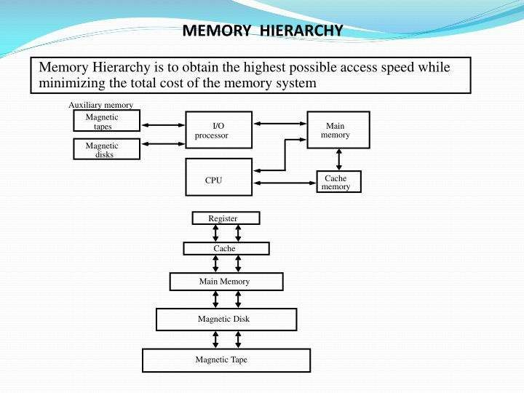
Memory Hierarchy (CO4)
2/9/2022
Dr. RAJ KUMAR GOEL
AMCA-0104
UNIT-4

Slide 12

Memory Hierarchy Cont.. (CO4)
Memory Hierarchy
– Memory hierarchy in a computer system :
• Main Memory : memory unit that communicates directly with the CPU
(RAM)
• Auxiliary Memory : device that provide backup storage (Disk Drives)
• Cache Memory : special very-high-speed memory to increase the processing
speed (Cache RAM)
Auxiliary memory
Magnetic tapes
I/O processor
Main memory
Magnetic disks
CPU
Cache memory
– Multiprogramming
• enable the CPU to process a number of independent program concurrently
– Memory Management System :
• supervise the flow of information between auxiliary memory and main memory
2/9/2022
Dr. RAJ KUMAR GOEL
AMCA-0104
UNIT-4

Slide 13

Memory Hierarchy (CO4)
➢ Main Memory
Bootstrap Loader
A program whose function is to start the computer software operating when power is turned on.
RAM and ROM Chips
Typical RAM chip :
128 X 8 RAM : 2⁷ = 128 (7 bit address lines)
Typical ROM chip :
512 X 8 ROM : 2⁹ = 512 (9 bit address lines)
2/9/2022
Dr. RAJ KUMAR GOEL
AMCA-0104
UNIT-4

Slide 14

Daily Quiz
➢ Define All.
- Cache Memory
- Inclusion property
- Magnetic tape
- Unit of transfer
- Secondary memory
- Primary memory
2/9/2022
Dr. RAJ KUMAR GOEL
AMCA-0104
UNIT-4

Slide 15

Recap
➢ Memory hierarchy and its significance
2/9/2022
Dr. RAJ KUMAR GOEL
AMCA-0104
UNIT-4

Slide 16
Topic
➢ RAM and ROM chips
Dr. RAJ KUMAR GOEL
UNIT-4

Slide 17
Topic Objective
➢ To discuss about the structure of RAM and ROM chips
Dr. RAJ KUMAR GOEL
UNIT-4

Slide 18

RAM CHIP (CO4)
Chip select 1
CS1
CS2 RD
Chip select 2
Read
128×8
RAM
8 bit data bus
Write
WR
AD7
7 bit address
(a) Block diagram
CS1 CS2 RD WR |  |  |  | Memory function | State of data bus
0 | 0 | × | × | Inhibit | High-impedance
0 | 1 | × | × | Inhibit | High-impedance
1 | 0 | 0 | 0 | Inhibit | High-impedance
1 | 0 | 0 | 1 | Write | Input data to RAM
1 | 0 | 1 | × | Read | Output data from RAM
1 | 1 | × | × | Inhibit | High-impedance
(b) Function table
2/9/2022
Dr. RAJ KUMAR GOEL
AMCA-0104
UNIT-4

Slide 19
RAM CHIP (CO4)
• The block diagram of a RAM chip is shown in Fig. The capacity of the memory is 128 words of eight bits (one byte) per word.
• This requires a 7-bit address and an 8-bit bidirectional data bus.
• The read and write inputs species the memory operation and the two chips select (CS) control inputs are for enabling the chip only when it is selected by the microprocessor.
• The RD and WR signals control the memory operation as well as the bus buffers associated with the bidirectional data bus .
2/9/2022
Dr. RAJ KUMAR GOEL
AMCA-0104
UNIT-4

Slide 20
RAM CHIP (CO4)
• A ROM chip is organized externally in a similar manner. However, since a ROM can only read, the data bus can only be in an output mode.
• The nine address lines in the ROM chip specify any one of the 512 bytes stored in it.
• The two chip select inputs must be CS1 = 1 and CS2 = 0 for the unit to operate. Otherwise, the data bus is in a high-impedance state.
• There is no need for a read or write control because the unit can only read. Thus when the chip is enabled by the two select inputs, the byte selected by the address lines appears on the data bus.
2/9/2022
Dr. RAJ KUMAR GOEL
AMCA-0104
UNIT-4

Slide 21

ROM CHIP (CO4)
Chip select 1 CS1
Chip select 2 CS2
512×8
ROM
8 bit data bus
9 bit address AD9
2/9/2022
Dr. RAJ KUMAR GOEL
AMCA-0104
UNIT-4

Slide 22

Memory Address Map(CO4)
• Memory Address Map
• The designer of a computer system must calculate the amount of memory required for the particular application and assign it to either RAM or ROM.
• The interconnection between memory and processor is then established from knowledge of the size of memory needed and the type of RAM and ROM chips available.
• The addressing of memory can be established by means of a table that specifies the memory address assigned to each chip. The table, called a memory address map, is a pictorial representation of assigned address space for each chip in the system.
2/9/2022
Dr. RAJ KUMAR GOEL
AMCA-0104
UNIT-4

Slide 23
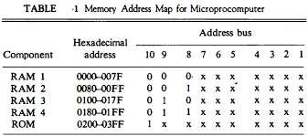
Memory Address Map(CO4)
2/9/2022
Dr. RAJ KUMAR GOEL
AMCA-0104
UNIT-4

Slide 24

Memory Connection to CPU (CO4)
– Memory Address Map
• Memory Configuration : 512 bytes
RAM + 512 bytes ROM
– 1 x 512 byte ROM + 4 x 128 bytes RAM
• Memory Address Map :
– Address line 9 8
Address bus CPU
16 - 11 10 9 8 7 - 1 RD WR
Data bus
Decoder 3 2 1 0
CS1
CS2 RD WR AD7
128×8
RAM 1
Data
» RAM 1
» RAM 1
» RAM 1
» RAM 1
– Address line
» ROM
0 0 : 0000 - 007F
0 1 : 0080 - 00FF
1 0 : 0100 - 017F
1 1 : 0180 - 01FF
10
CS1
CS2
RD
128×8
RAM 2
Data
WR
AD7
CS1 CS2
1 : 0200 - 03FF
• Memory Connection to CPU :
– 2 x 4 Decoder : RAM select (CS1)
– Address line 10
» RAM select : CS2
» ROM select : CS2 의 Invert
– 참고
» RD : ROM
OE(Output Enable)
RD
128×8
RAM 3
Data
WR
AD7
CS1
CS2 RD WR AD7
128×8
RAM 4
Data
CS1
CS2
1-7
8
128×8
ROM
Data
9
AD9
2/9/2022
Dr. RAJ KUMAR GOEL
AMCA-0104
UNIT-4

Slide 25


Memory Connection to CPU (CO4)
Address bus
10 9 8
CPU
16 - 11
7 - 1
RD WR
Data bus
Decoder 3 2 1 0
CS1 | 128×8 _{Data} RAM 1
CS2 RD WR AD7
CS1 | 128×8 _{Data} RAM 2
CS2 RD WR AD7
CS1 | 128×8 _{Data} RAM 3
CS2 RD WR AD7
CS1 | 128×8 _{Data} RAM 4
CS2 RD WR AD7
CS1
CS2
1-7
8
128×8
ROM
Data
9
AD9
Dr. RAJ KUMAR GOEL
UNIT-4

Slide 26

Memory Connection to CPU (CO4)
➢ RAM and ROM chips are connected to a CPU through the data and address buses.
➢ The low-order lines in the address bus select the byte within the chips and other lines in the address bus select a particular chip through its chip select inputs.
➢ This configuration gives a memory capacity of 512 bytes of RAM and 512 bytes of ROM.
➢ Each RAM receives the seven low-order bits of the address bus to select one of 128 possible bytes.
➢ The particular RAM chip selected is determined from lines 8 and 9 in the address bus.
Dr. RAJ KUMAR GOEL
UNIT-4

Slide 27
Memory Connection to CPU (CO4)
➢ This is done through a 2 x 4 decoder whose outputs go to the CS1 inputs in each RAM chip.
➢ when address lines 8 and 9 are equal to 00, the first RAM chip is selected. When 01, the second RAM chip is selected, and so on.
➢ The RD and WR outputs from the microprocessor are applied to the inputs of each RAM chip.
➢ Address bus lines 1 to 9 are applied to the input address of ROM without going through the decoder.
➢ This assigns addresses 0 to 511 to RAM and 512 to 1023 to ROM.
➢ The data bus of the ROM has only an output capability, whereas the data bus connected to the RAMs can transfer information in both directions .
Dr. RAJ KUMAR GOEL
UNIT-4

Slide 28

Daily Quiz
➢ Use a suitable example and explain about Data lines and Address lines.
➢ Explain about memory connection to CPU.
Dr. RAJ KUMAR GOEL
UNIT-4

Slide 29

Recap
➢ RAM and ROM chips
Dr. RAJ KUMAR GOEL
UNIT-4

Slide 30
Topic
➢ Auxiliary and Associative Memory
Dr. RAJ KUMAR GOEL
UNIT-4

Slide 31
Topic Objective
➢ To explain about auxiliary memory devices and Associative memories
Dr. RAJ KUMAR GOEL
UNIT-4

Slide 32

Auxiliary Memory
➢ The storage devices that provide backup storage is called auxiliary memory.
➢ To understand fully the physical mechanism of auxiliary memory devices one must have a knowledge of magnetics, electronics, and electromechanical systems.
➢ They are used for storing system programs, large data files and other backup information.
Dr. RAJ KUMAR GOEL
UNIT-4

Slide 33

Auxiliary Memory (CO4)
➢Auxiliary Memory
Tracks
text
Read/Write head
– Magnetic Disk : FDD, HDD
– Magnetic Tape : Backup or Program
– Optical Disk : CDR, ODD, DVD
➢Associative Memory
– Content Addressable Memory (CAM)
➢A memory unit accessed by content
➢Block Diagram :
Sector
A Register
K Register
101 111100
111 000000
Argument
Key (Mask)
Word 1 | 100 111100 | M = 0
Word 2 | 101 000011 | M = 1
M = 1
2/9/2022
Dr. RAJ KUMAR GOEL
AMCA-0104
UNIT-4
33

Slide 34

Associative Memory (CO4)
➢ The time required to find an item stored in memory can be reduced considerably if stored data can be identified for access by the content of the data itself rather than by an address.
➢ A memory unit accessed by content is called an associative memory or content addressable memory (CAM).
2/9/2022
Dr. RAJ KUMAR GOEL
AMCA-0104
UNIT-4
34

Slide 35
Associative Memory (CO4)
Argument register (A)
Key register (K)
Match register
M
Input
Associative memory array and logic
Read
Write
m words
n bits per word
Output
2/9/2022
Dr. RAJ KUMAR GOEL
AMCA-0104
UNIT-4

Slide 36


Associative Memory (CO4)
A 1
A j
An
K 1
K j
K n
Word 1
C 11
C 1j
C 1n
M1
Word i
C i1
C ij
C in
M i
Word m
Cm1
C mj
Cmn
Mm
Bit 1
Bit j
Bit n
2/9/2022
Dr. RAJ KUMAR GOEL
AMCA-0104
UNIT-4

Slide 37
Daily Quiz
➢ Elaborate how the Associative memory page table accommodates the page numbers and corresponding block numbers using suitable diagram.
➢ Describe the functionality of Argument register and key register
using a suitable example.
➢ Differentiate between Magnetic tape and Magnetic disk.
Dr. RAJ KUMAR GOEL
UNIT-4

Slide 38
Topic
➢ Cache Memory Mapping
Dr. RAJ KUMAR GOEL
UNIT-4

Slide 39

Questions
1.
a) How many 128 × 8 RAM chips are needed to provide a memory capacity of 2048 bytes?
b) How many lines of the address bus must be used to access 2048 byte of memory? How many of these lines will be common to all chips?
c) How many lines must be decoded for chip select? Specify the size of the decoders?
Dr. RAJ KUMAR GOEL
UNIT-4

Slide 40
Questions
2. A microprocessor uses RAM chips of 1024 X 1 capacity.
a) how many chips are needed and how should their address line be connected to provide a memory capacity of 1024 bytes?
b) how many chips are needed to provide a memory capacity of 16K bytes? Explain in words how the chips are to be connected to the address bus.
Dr. RAJ KUMAR GOEL
UNIT-4

Slide 41
Questions
3. Extend the memory system of given example Fig. to 4096 bytes of RAM and 4096 bytes of ROM. List the memory-address map and indicate what size decoders are needed.
Dr. RAJ KUMAR GOEL
UNIT-4

Slide 42
Topic Objective
➢ To explain about different mapping techniques of cache memory
Dr. RAJ KUMAR GOEL
UNIT-4

Slide 43

Cache Memory (CO4)
➢ Cache Memory
– Locality of Reference
• the references to memory tend to be confined within a few localized areas in memory
– Cache Memory : a fast small memory
• keeping the most frequently accessed instructions and data in the fast cache memory
– Cache
• cache size : 256 K byte (512 K byte)
• mapping method : 1) associative, 2) direct, 3) set-associative
• replace algorithm : 1) LRU, 2) LFU, 3) FIFO
• write policy : 1) write-through, 2) write-back
– Hit Ratio
• the ratio of the number of hits divided by the total CPU references (hits + misses) to memory
– hit : the CPU finds the word in the cache
– miss : the word is not found in cache (CPU must read from main memory)
• : cache memory access time = 100 ns, main memory access time =
1000 ns, hit ratio = 0.9
Dr. RAJ KUMAR GOEL
UNIT-4

Slide 44

Cache Mapping (CO4)
– Mapping
➢The transformation of data from main memory to cache
memory
– 1) Associative mapping
– 2) Direct mapping
– 3) Set-associative mapping
– Example of cache memory :
main memory : 32 K x 12 bit word (15 bit address lines) cache memory : 512 x 12 bit word
– CPU sends a 15-bit address to cache
» Hit : CPU accepts the 12-bit data from cache
» Miss : CPU reads the data from main memory (then data
is written to cache)
Dr. RAJ KUMAR GOEL
UNIT-4

Slide 45

Associative Mapping (CO4)
➢ Associative mapping :
➢ The fastest and most flexible cache organization uses an associative memory. The associative memory stores both the address and content (data) of the memory word. This permits any location in cache to store any word from main memory.
➢ A cpu address of 15 bits is placed in the argument register and the associative memory is searched for a matching address. If the address is found, the corresponding 12 bit data is read and sent to the cpu.
➢ If no match occurs, the main memory is accessed for the word. The address-data pair is then transferred to the associative cache memory. If the cache is full, an address-data pair must be displaced.
Dr. RAJ KUMAR GOEL
UNIT-4

Slide 46

Associative mapping cache(all no.s in octal)
Main memory 32K×12
CPU
Cache memory 512×12
CPU address(15 bits)
Argument register
Address | Data
0 1 0 0 0 | 3 4 5 0
0 2 7 7 7 | 6 7 1 0
2 2 3 4 5 | 1 2 3 4
Dr. RAJ KUMAR GOEL
UNIT-4

Slide 47

Direct Mapping (CO4)
Direct Mapping
➢ Associative memories are expensive compared to random-access memories because of the added logic associated with each cell.
➢The CPU address of 15 bits is divided into two fields. The nine least significant bits constitute the index field and the remaining six bits form the tag field.
➢main memory needs an address that includes both the tag and the index bits.
➢The number of bits in the index field is equal to the number of address bits required to access the cache memory.
Dr. RAJ KUMAR GOEL
UNIT-4

Slide 48
Direct Mapping (CO4)
₂k
➢ In the general case, there are words in cache
memory and 2^{n} words in main memory.
➢The n-bit memory address is divided into two fields:
➢k bits for the index field and n - k bits for the tag field.
➢Each word in cache consists of the data word and its associated tag.
➢ When a new word is first brought into the cache, the tag bits are stored alongside the data bits.
Dr. RAJ KUMAR GOEL
UNIT-4

Slide 49
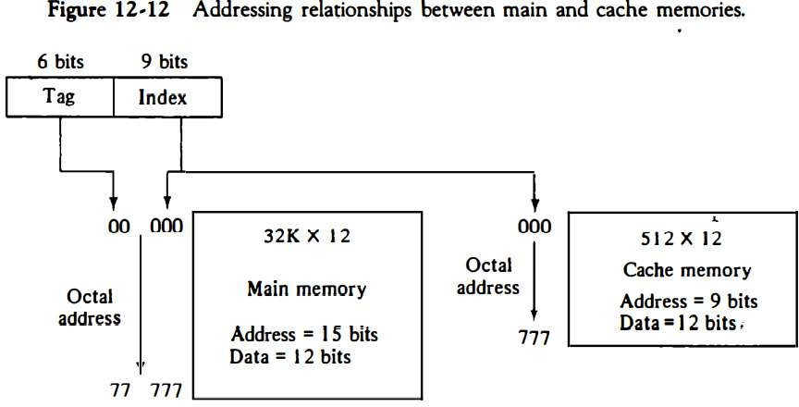
Direct Mapping (CO4)
➢When the CPU generates a memory request, the index field is used for the address to access the cache.
Dr. RAJ KUMAR GOEL
UNIT-4

Slide 50

Direct mapping cache (CO4)
6 bits Tag
9 bits Index
Tag (6 bit)
00 - 63
Index (9 bit)
000 - 511
00 000
32K×12
Main memory
Address = 15 bits Data = 12 bits
000
512×12
Cache memory
Address = 9 bits Data = 12 bits
Octal address
Hex Address
1FF
3F 1FF
Dr. RAJ KUMAR GOEL
UNIT-4

Slide 51

Direct mapping cache organization :
Memory address
000000
Index address
000
Memory data
Tag
Data
1 2 2 0
2 3 4 0
3 4 5 0
4 5 6 0
5 6 7 0
6 7 1 0
00 | 1 2 2 0
02 | 6 7 1 0
00777
01000
01777
777
02000
(b) Cache memory
02777
(a) Main memory
Dr. RAJ KUMAR GOEL
UNIT-4

Slide 52

Direct mapping cache organization :
Direct mapping cache with block size of 8 words :
Index Tag
Data
6
6
3
000 007 | 0 1 0 1 | 3 4 5 0 6 5 7 8
010 017
Tag | Block | Word
Block 0
Index
• 64 block x 8 word = 512 cache words size
Block 1
770 | 0 2
777 | 0 2 | 6 7 1 0
Block 63
Dr. RAJ KUMAR GOEL
UNIT-4

Slide 53

Direct mapping
➢ tag field of the CPU address is compared with the tag in the word read from the cache.
➢ If the two tags match, there is a hit and the desired data word is in cache. If there is no match, there is a miss and the required word is read from main memory.
➢ It is then stored in the cache together with the new tag, replacing the previous value.
2/9/2022
Dr. RAJ KUMAR GOEL
AMCA-0104
UNIT-4

Slide 54
Direct mapping
➢ The word at address zero is presently stored in the cache (index = 000, tag = 00, data = 1220).
➢ Suppose that the CPU now wants to access the word at
address 02000.
➢ The index address is 000, so it is used to access the cache. The two tags are then compared. The cache tag is 00 but the address tag is 02, which does not produce a match.
➢ Therefore, the main memory is accessed and the data word 5670 is transferred to the CPU. The cache word at index address 000 is then replaced with a tag of 02 and data of 5670.
2/9/2022
Dr. RAJ KUMAR GOEL
AMCA-0104
UNIT-4

Slide 55
Daily Quiz
➢ A digital computer has a memory unit of 64K X 16 and a cache memory of 1K words. The cache uses direct mapping with a block size of four words.
- How many bits are there in the tag, index, block and word fields of the address format?
- How many bits are there in each word of cache, and how are
they divided into functions? Include a valid bit?
- How man blocks can the cache accommodate?
2/9/2022
Dr. RAJ KUMAR GOEL
AMCA-0104
UNIT-4

Slide 56
Topic
➢ 2D and 2.5D memory organization
Dr. RAJ KUMAR GOEL
UNIT-4

Slide 57
Topic Objective
➢ Explanation about 2 dimensional and 2.5 dimensional memory
organization and their use and significance in computer system
Dr. RAJ KUMAR GOEL
UNIT-4

Slide 58
2D and 2.5D Memory organization (CO4)
➢ Internal structure of Memory either RAM or ROM is made of memory cells which contains a memory bit. Basically group of 8 bits makes a word.
➢ Now the memory is formed in multidimensional array of rows and columns. In which each cell stores a bit and a complete row contains a word.
➢ A memory simply can be divided in this below form.
2^{n} = N
➢ Where, n is the no. of address lines and N is the total memory in
bytes.
There will be 2^{n} words.
Dr. RAJ KUMAR GOEL
UNIT-4

Slide 59
2D and 2.5D Memory organization (CO4)
2D Memory organization
Basically in 2D organization memory is divides in the form of rows
and columns.
➢ Each row contains a word now in this memory organization there
is a decoder.
➢ A decoder is a combinational circuit which contains n input lines
and 2^{n} output lines.
➢ One of the output line will select the row which address is
contained in the MAR.
➢ And the word which is represented by the row that will get
selected and either read or write through the data lines.
2/9/2022
Dr. RAJ KUMAR GOEL
AMCA-0104
UNIT-4

Slide 60
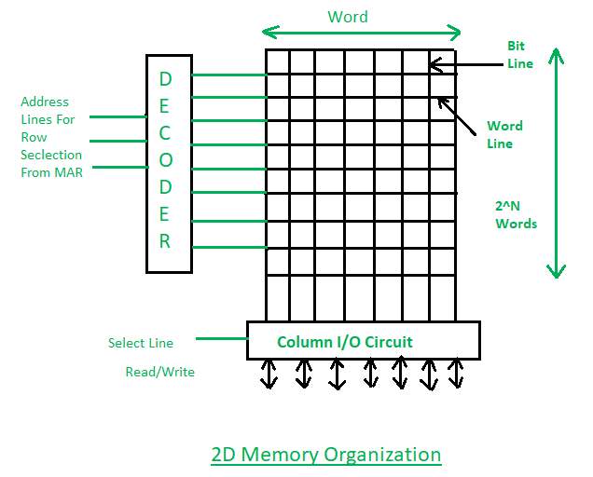
2D and 2.5D Memory organization (CO4)
2/9/2022
Dr. RAJ KUMAR GOEL
AMCA-0104
UNIT-4

Slide 61
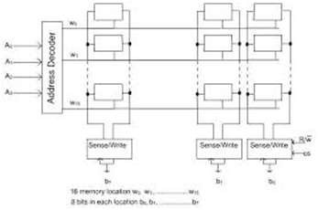
2/9/2022
Dr. RAJ KUMAR GOEL
UNIT-4
AMCA-0104
61

Slide 62
2D and 2.5D Memory organization (CO4)
➢ 2.5D Memory Organization The memory organization shown for
RAMs and ROMs above suffers from a problem of scale:
➢ it works fine when the number of words in the memory is relatively small but quickly mushrooms as the memory is scaled up or increased in size.
➢ This happens because the number of word select wires is an exponential function of the size of the address.
➢ Suppose that the MAR is 10 bits wide, which means there are 1024
words in the memory.
➢ The decoder will need to output 1024 separate lines.
➢ While this is not necessarily terrible, increasing the MAR to 15 bits means there will be 32,768 wires, and 20 bits would be over a million.
2/9/2022
Dr. RAJ KUMAR GOEL
AMCA-0104
UNIT-4

Slide 63
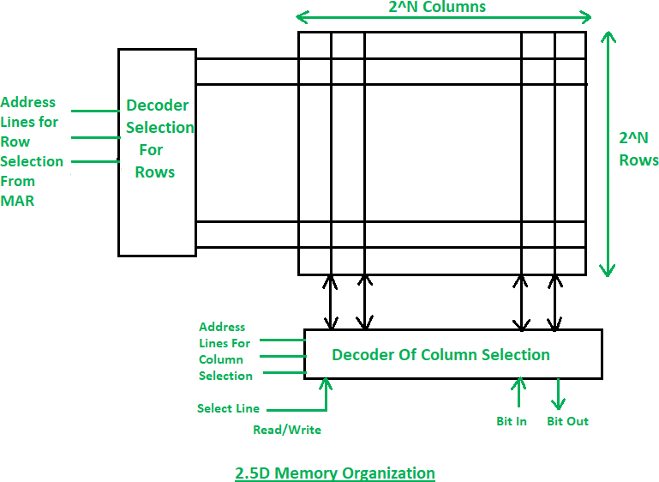
2D and 2.5D Memory organization (CO4)
2/9/2022
Dr. RAJ KUMAR GOEL
AMCA-0104
UNIT-4

Slide 64
Daily Quiz
➢ What are the similarities and differences between 2D and 2.5D
memory organization.
➢ Specify the use of these memory organizations.
2/9/2022
Dr. RAJ KUMAR GOEL
AMCA-0104
UNIT-4

Slide 65

Weekly Assignment
Q-1. Define All.
Cache Memory Inclusion property Magnetic tape Unit of transfer Coherence
Q-2. Define Memory hierarchy with suitable diagram.
Q-3. A digital computer has a memory unit of 64K X 16 and a cache memory of 1K words. The cache uses direct mapping wit h a block size of four words.
Q-4. How many bits are there in the tag, index, block and word fields of
the address format?
Q-5. How many bits are there in each word of cache, and how are they
divided into functions? Include a valid bit?
Q-6. How man blocks can the cache accommodate?
2/9/2022
Dr. RAJ KUMAR GOEL
AMCA-0104
UNIT-4

Slide 66


Faculty Video Links, YouTube & NPTEL Video Links and Online Courses Details
➢ YouTube/other Video Links
➢ https://www.webopedia.com/quick_ref/computer- architecture-study-guide.html
➢ https://www.youtube.com/watch?v=RAeXWjPMRV M
➢ https://www.youtube.com/watch?v=HKmWvlrrN3M
➢ https://www.youtube.com/watch?v=DHhcnjEKEFo
Dr. RAJ KUMAR GOEL
UNIT-4

Slide 67

Old Question Papers
➢ http://www.aktuonline.com/papers/mca-1-sem-computer- organization-and-architecture-AMCA-0104-2018-19.html
➢ http://www.aktuonline.com/papers/mca-1-sem-computer- organization-and-architecture-AMCA-0104-2017-18.html
➢ http://www.aktuonline.com/papers/mca-1-sem-computer-
organization-and-architecture-AMCA-0104-2016-17.html
Dr. RAJ KUMAR GOEL
UNIT-4

Slide 68
Expected Questions for University Exam
1. Show how a 9-bit microoperation field in a microinstruction can be divided into subfields to specify 46 microoperations. How many microoperations can be specified in one microinstruction?
2. A computer has 16 registers, an ALU with 32 operations, and a
shifter with eight operations, all connected to a common bus system.
a. Formulate a control word for a microoperation.
b. Specify the number of bits in each field of the control word and
give a
general encoding scheme.
c. Show the bits of the control word that specify the microoperation
R4←R5 + R6.
Dr. RAJ KUMAR GOEL
UNIT-4

Slide 69
Expected Questions for University Exam Cont.
3. The logical address space in a computer system consists of 128 segments. Each segment can have upto 32 pages of 4K words in each. Physical memory consists of 4K blocks of 4K words in each. Formulate the logical and physical address formats.
4. What do you mean by locality of reference? Explain with suitable example.
5. Define ROM memories and also explain 2D and D memory
organization.
Dr. RAJ KUMAR GOEL
UNIT-4

Slide 70

Summary
➢ The control variables at any given time can be represented by a string of 1’s and 0’s called a control word.
➢ A control unit whose binary control variables are stored in memory is called a Microprogrammed control unit.
➢ Each word in control memory contains within it a microinstruction.
➢ The next address generator is sometimes called a Microprogram sequencer.
➢ There are three types of instructions in our basic computer these are
➢ - Register reference instructions
➢ - Input- Output instructions
➢ - Memory reference instructions
➢ The timing signals are denoted by t_{i} where i = 0,1,2,… and
generated by a master clock generator.
➢ The master clock generator is build by using digital hardware.
Dr. RAJ KUMAR GOEL
UNIT-4

Slide 71


References
1. Logic and Digital Design, Morris Mano and Kimicharels 4th
Edition, Prentice Hall.
2. Computer System Architecture, M.Mano(PHI)
3. Computer Organization, Vravice, Zaky&Hamacher (TMH
Publication)
4. Structured Computer Organization, Tannenbaum(PHI)
5. Computer Organization, Stallings(PHI)
6. Computer Organization, John P.Hayes (McGraw Hill)
2/9/2022
Dr. RAJ KUMAR GOEL
AMCA-0104
UNIT-4
71

