Slide 1

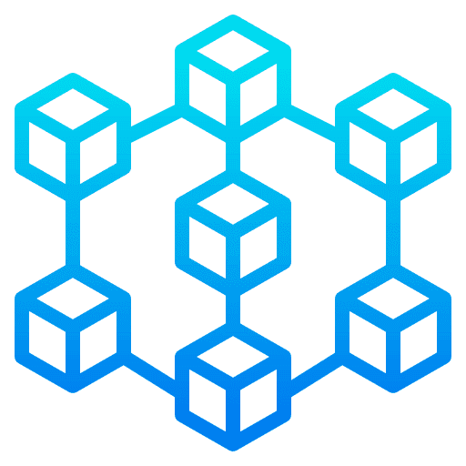
6 August 2022
Blockchain Overview AND IMPLEMENTATION

Slide 2

Blockchain overview
Blockchain – Agenda
Blockchain Overview
What is Blockchain?
What does Blockchain bring?
Blockchain Value additions and enablers
Different types of Blockchain
How do you choose the Blockchain type?
How does Blockchain work?
Building blocks of Blockchain
Architectural layers of Blockchain
Evolution of Blockchain
How do you choose Blockchain platform?
Factors changing estimation values
Skills needed to develop Blockchain application
What do developers develop?
Gartner Hype
Blockchain future
Blockchain use cases heatmap
Simple use case
Blockchain Implementation
Phases for South African Supplier Chain Network
Why Hyperledger Fabric?
Hyperledger Fabric Benefits
Hyperledger Various Views
Sample Transaction Flow
Phase 1
Identity Management and KYC
Identity Management Blockchain Interface
Identity Management Sequence Diagram
Identity Management - Zero Knowledge Proof (ZPK)
Identity Management Files Process Structure
Identity Management Application Layer Structure
dApp Chat System for Suppliers
Certification Standards
Phase 2
After login Business Flow for End Users
After login Use Case for the Business Workflow
Use Case for Developer End to End Workflow
Dashboard Screen after Login Success
On Clicking PIE Chart

Slide 3
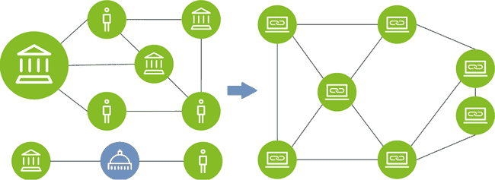
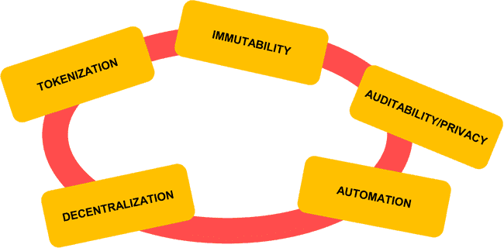
Blockchain overview
Blockchain - What is it?
Blockchain – What is it?
Aka DLT (Distributed Ledger Technology)
Rudimentary shared accounting system
Technologically, it is :
Distributed database – public ledger
you can insert, select data,
but can’t update or delete data
Distributed computer – digital contracts
Based on peer-to-peer or sharding technology, cryptology and API
Typical System
Blockchain System
Central authorities transfer actual value between two parties
Multiple intermediaries required to facilitate of assets and create trust
Distributed nodes that maintain a shared source of information
Trust enabled by cryptographic algorithm

Slide 4
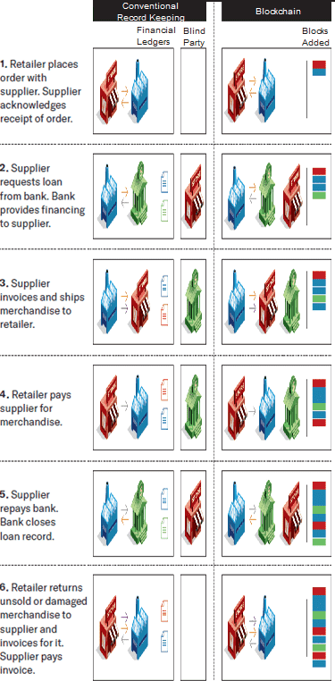
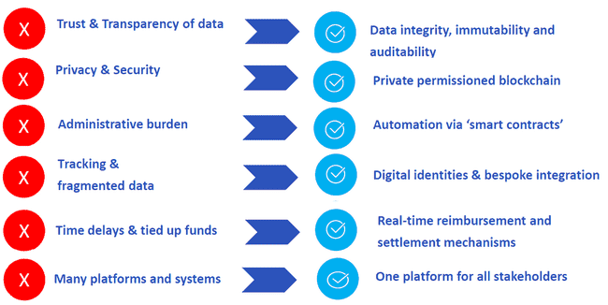
Blockchain overview
Blockchain - What does Blockchain bring?
Blockchain – What does Blockchain bring?

Slide 5
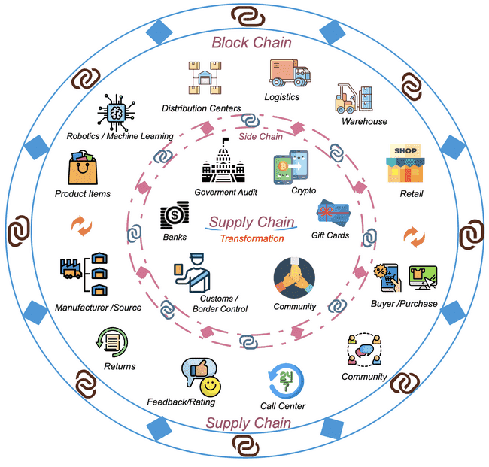
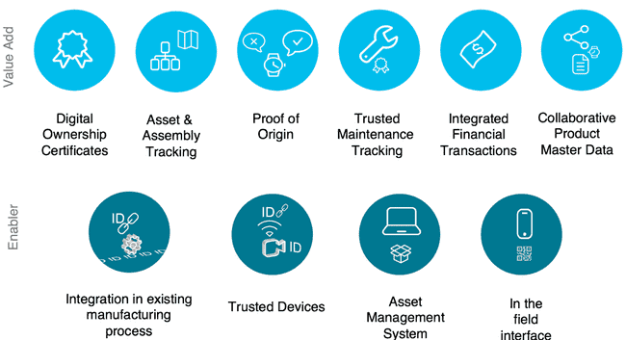
Blockchain overview
Blockchain – Value Additions and Enablers
Blockchain – Value Additions and Enablers

Slide 6
Blockchain overview
Blockchain – Different Types
Blockchain – Different Types
Types and Properties | Public (permissionless) | Private (permissioned) | Hybrid (combination) | Consortium (shared permissioned)
ADVANTAGES | + Independence + Transparency + Trust | + Access control + Performance | + Access control + Performance + Scalability | + Access control + Scalability + Security
DISADVANTAGES | - Performance - Scalability - Security | - Trust - Auditability | - Transparency - Upgrading | - Transparency
USE CASES | = Cryptocurrency = Document validation | = Supply chain = Asset ownership | = Medical records = Real estate | = Banking = Research = Supply chain

Slide 7
Blockchain overview
Blockchain – Choose a Type
Blockchain – Choose a Type
Need for a shared common database?
Multiple parties involved?
Involved parties have conflicting
Interests / trust issues?
Rules governing system access differ
between participants?
Parties can/want to avoid a trusted
third party?
Can Transactions be De- centralizable?
Need for an objective immutable log?
Need for public access?
Are transactions public?
1
Yes
2
Yes
3
Yes
4
Yes
5
Yes
6
Yes
7
Yes
8
Yes
9
Yes
No
No
No
No
No
No
No
No
No
11
Inter Organization
Engage privates or privates and public?
10
Where is consensus determined?
Privates and Public
Privates Only
Intra Organization
Blockchain not required
Consortium Blockchain
Hybrid
Blockchain
Permissioned Private Blockchain
Permission less Public Blockchain
11 Steps Decision Tree

Slide 8
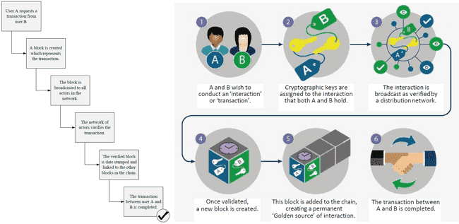
Blockchain overview
Blockchain – How does Blockchain work?
Blockchain – How does Blockchain work?

Slide 9
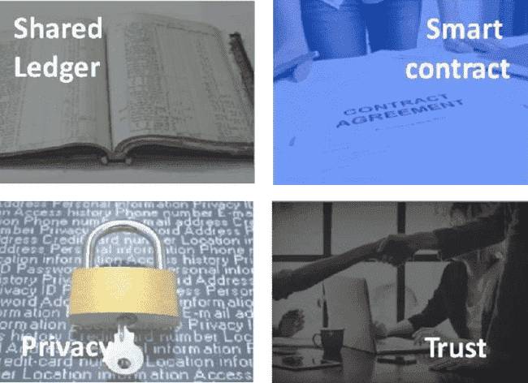
Blockchain overview
Blockchain – Building Blocks
Blockchain – Building Blocks
Append-only distributed system of record shared across business network
Shared between participants
Participants have own copy through replication
Permissioned, so participants see only appropriate transactions
Business terms embedded in transaction database & executed with transactions
Verifiable, signed
Encoded in programming language
Analogous to a stored procedure call on a database
Ensuring appropriate visibility; transactions are secure, authenticated & verifiable
Cryptography central to these processes
Access permission controlled via certification management
Transactions are endorsed by relevant participants
Endorsed transactions are added to the ledger with appropriate confidentiality
Assets have a verifiable audit trail
Transactions cannot be modified, inserted or deleted

Slide 10
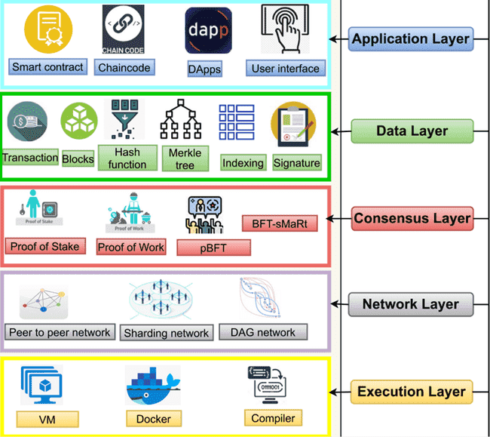
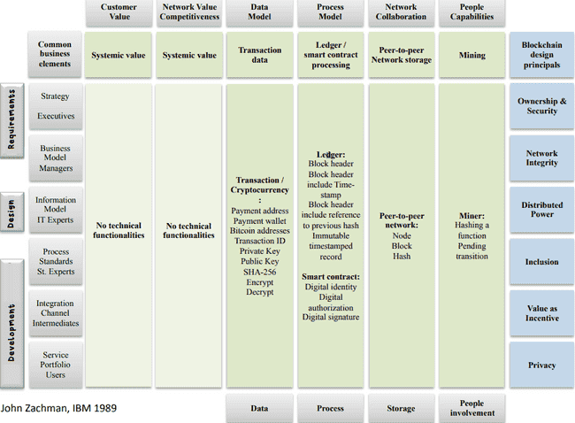
Blockchain overview
Blockchain – Architecture OSI View and Zachman View
Blockchain – Architecture OSI View and Zachman View

Slide 11













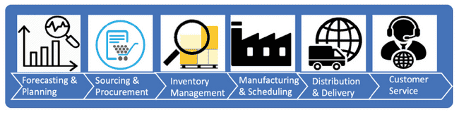



Blockchain overview
Blockchain – Business Architecture
Blockchain – Business Architecture
SUPPLY CHAIN APPLICATIONS
Inland Transportation
PLANNING/
OPTIMIZATION
INVENTORY
MANAGMENT
TRACK &
TRACE
CONTROL
TOWER
Shippers / Beneficial Cargo Owner
PROOBLEM
RESOLUTION
TRANSACTION
INSIGHTS (O2C, P2P)
eINVOICE/ COMPLIANCE
Customs Brokers
BUSINESS NETWORK
SUPPLIER
MANAGEMENT
Supply Chain Visibility Systems
ORDER
MANAGEMENT
AI
MACHNINE
LEARNING
DATA
SCIENCE
SUPPLIER
PROVENANCE
Customs Systems
Trade Associations
ORDER/FULFILLMENT
MANAGEMENT
BLOCKCHAIN
DATA
MANAGEMENT
CONNECTIVITY
Supply Chain / Transportation Management Systems
STORE
REPLENISHMENT
SUPPLIER
REGISTRY
Terminal Operating Systems
TRANSPORTATION MANAGEMENT
WAREHOUSE
REPLENISHMENT
TRANSPORTATION
MANAGEMENT
SYSTEM
ENTERPRISE
RESOURCE
PLANNING
Freight Forwarders / 3PLs
IoT
Authorities
Port Community Systems
Financial / Insurance Services

Slide 12
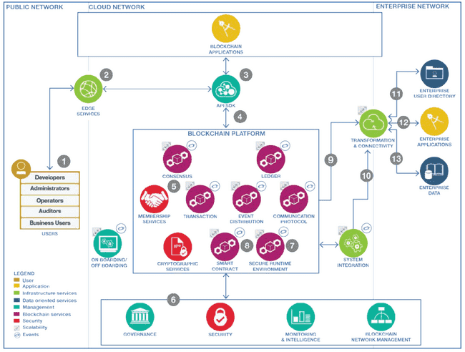
Blockchain overview
Blockchain – Workflow Architecture from Developers View
Blockchain – Workflow Architecture from Developers View

Slide 13
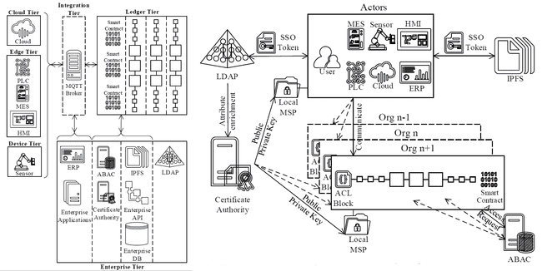
Blockchain overview
Blockchain – Technical Architecture from Components View
Blockchain – Technical Architecture from Components View

Slide 14
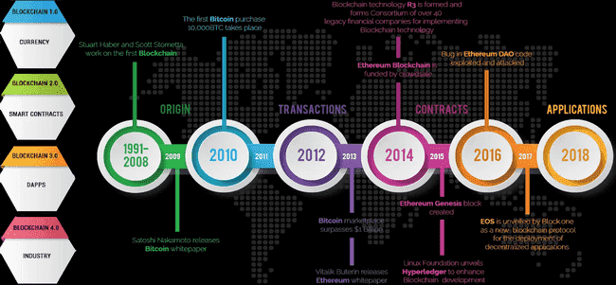
Blockchain overview
Blockchain – Evolution
Blockchain – Evolution

Slide 15
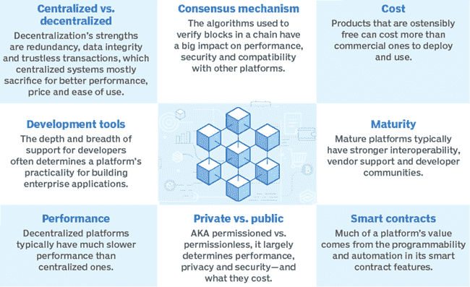
Blockchain overview
Blockchain – Platforms Selection Checklist
Blockchain – Platforms Selection Checklist
Whether a platform is open (that is, a public Blockchain) or closed (a private Blockchain) and how that affects speed and security. Anyone can join a public Blockchain, which can make it easier to set up for small-business users, such as farmers. The downside is that open Blockchains are not as fast. Many of the Blockchain code bases can be modified to be either open or closed.
Consensus mechanism, such as PoW, PoS or Byzantine fault tolerance. PoW is the older mechanism used in Bitcoin and Ethereum. The others are newer and less proven but faster and more efficient.
Ledger technology and how it records the transactions. This relates to how the Blockchain keeps track of information. Popular approaches include an account model and UTXO. An account model records the balance, whereas the UTXO model is analogous to cash with serial numbers in your wallet. The account model is used in the Blockchain platforms Ethereum, Stellar, Tron and EOSIO. IBM Blockchain, Hyperledger Fabric and Hyperledger Sawtooth use UTXO.
Intended smart contract functions for capturing business logic on the Blockchain. Popular programming languages include Ethereum Solidity, Web Assembly and Digital Asset Modeling Language.

Slide 16
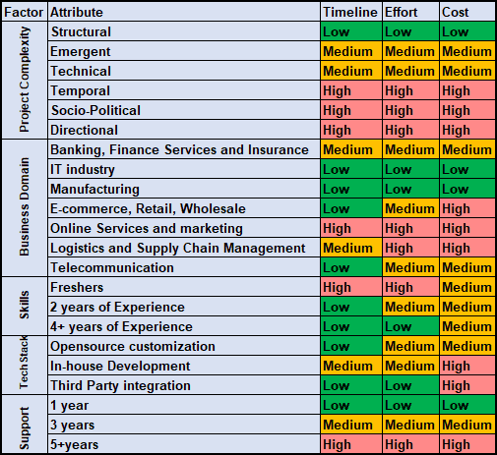

Blockchain overview
Blockchain – 5 Estimation Factors
Blockchain – 5 Estimation Factors
Project Complexity
Business Domain
Skill set & Expertise
Support & Maintenance
Technical Stack

Slide 17
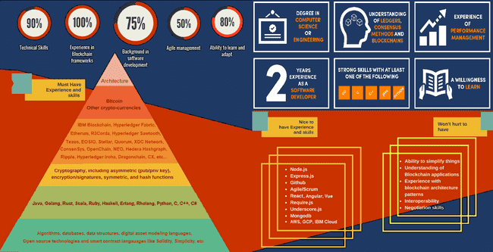
Blockchain overview
Blockchain – 8 Skills Needed
Blockchain – 8 Skills Needed
Blockchain Architecture
Smart Contract Development
Cryptography
Web Development
Data Structures
OOPS
Understand Standards and Eco systems
Interoperability skills to integrate any systems

Slide 18

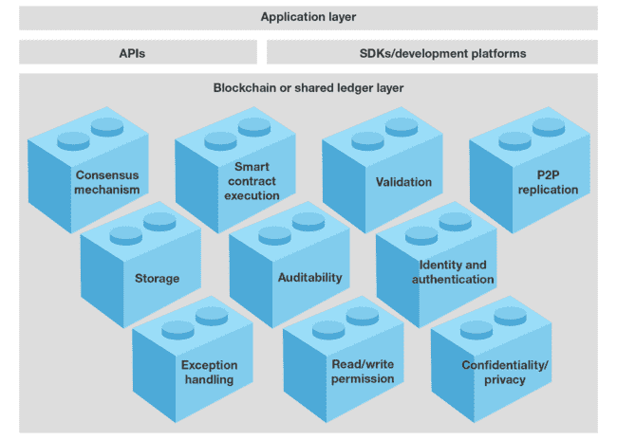
Blockchain overview
Blockchain – What developer does?
Blockchain – What developer does?
Blockchain
developer
develops
Application
D
Accesses
SDK
develops
Invokes/queries
Smart Contract
emits
event
‘get’
‘put, ‘delete’
emits
cached state, history, tx
block
…
txn
txn
txn
txn
Blockchain
Ledger
Peer

Slide 19
Blockchain overview
Blockchain – What developer does?
Blockchain – What developer does?
IDENTITY
Pluggable, Membership, Privacy and Auditability of transactions.
LEDGER | TRANSACTIONS
Distributed transactional ledger whose state is updated by consensus of stakeholders
SMART-CONTRACT
“Programmable Ledger”, provide ability to run business logic against the blockchain (aka smart contract)
APIs, Events, SDKs
Multi-language native SDKs allow developers to write DLT apps
APIs, Events, SDKs
IDENTITY
LEDGER
TRANSACTIONS
SMART CONTRACT
Distributed Ledger Technology Services
Membership Services
Consensus Services
Chain-code
Services
Distributed Ledger
Ordering Service
Secure
Container
Enrollment
Attributes
Network Protocol
Endorsement
Validation
Secure
Registry
Security and Crypto Services

Slide 20
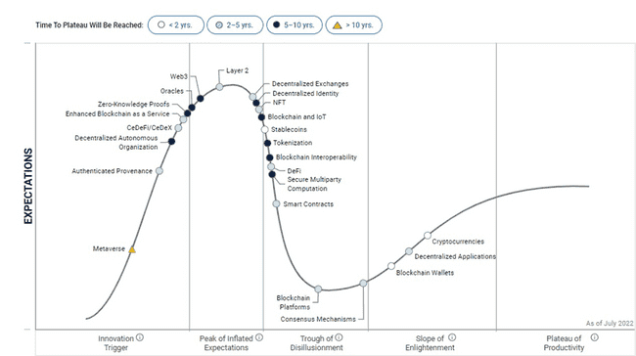
Blockchain overview
Blockchain –Gartner Hype chart
Blockchain –Gartner Hype chart

Slide 21
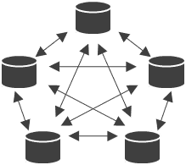
Blockchain overview
Blockchain – Future Vision
Blockchain – Future Vision
[Current Short-term – 2 years]
[Mid-term – 3 to 5 years]
[Long-term – 10 years]
Combination of IoT, Blockchain and AI
Blockchain, a guarantee to control AI
Blockchain, a new architecture for a new AI
IoT
AI
New AI
AI
AI
AI
Blockchain
Blockchain
Blockchain
AI
AI
Providing this two-way real-time interoperability between the real economy and the financial system will be disruptive
The Blockchain consensus might be a way to keep potential malicious AIs under control
The Blockchain technology might open the way to a new type of AI by getting closer to the real neuronal behavior

Slide 22
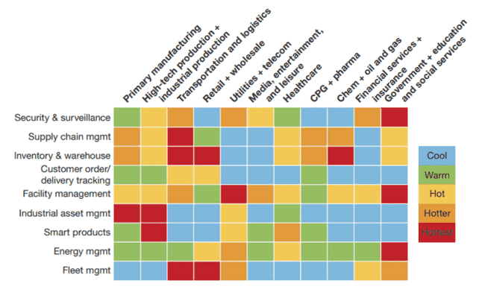
Blockchain overview
Blockchain – Use cases Heatmap
Blockchain – Use cases Heatmap

Slide 23

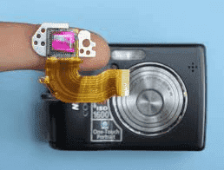
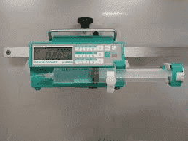

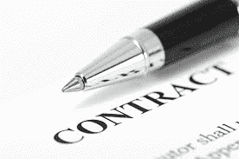

Blockchain overview
Blockchain – Simple Use case
Blockchain – Simple Use case
Hey, I want a cup of herbal tea, should I use a Blockchain ?
With AI, can I get a correct herbal tea based on my health conditions without my initiation ?
Trusted IoT identification
Conditions
(time, temperature, stress level…)
Collaborative SupplyChain organisation

Slide 24
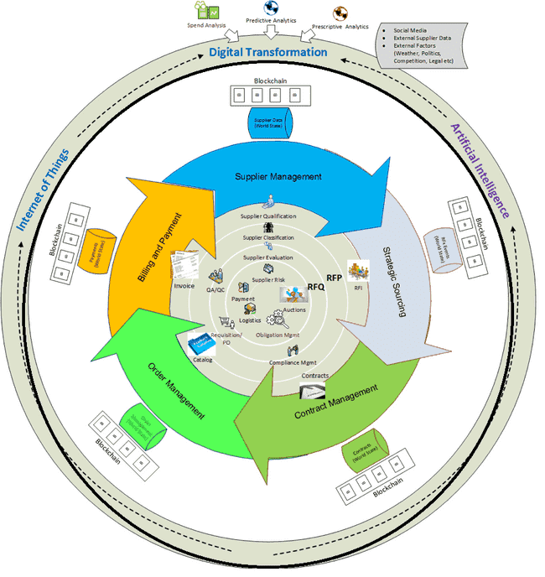
Blockchain IMPLEMENTATION
Phases for South African Supplier Chain Network
Phases
Phase 1:
Identity Management for Suppliers Network
Chat System for Suppliers Network
Certify the System for South Africa Network
Phase 2:
End to End Workflow for Suppliers Network Services

Slide 25
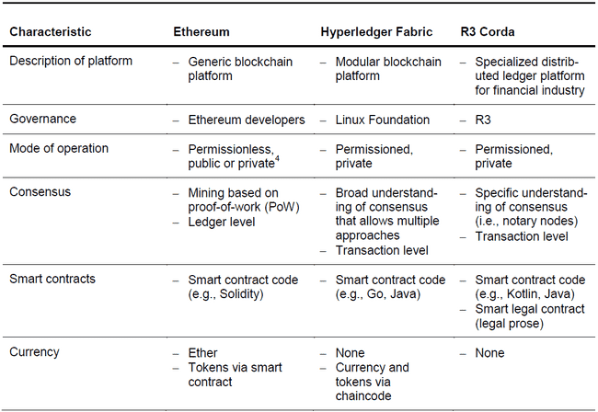
Blockchain IMPLEMENTATION
Why Hyperledger Fabric?
Why Hyperledger Fabric?

Slide 26

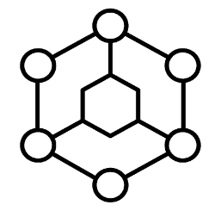
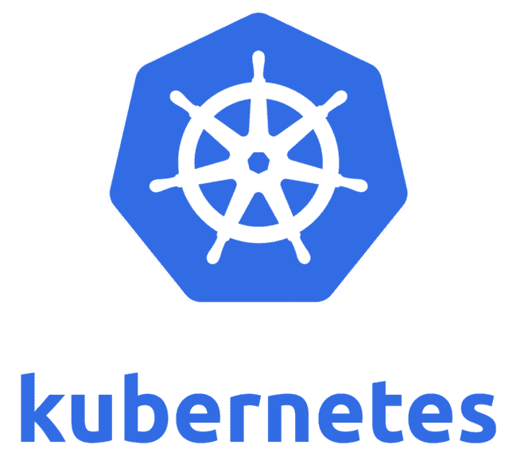


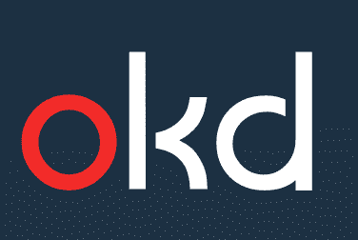






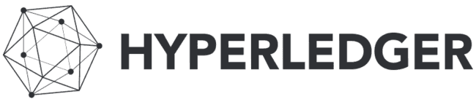
Blockchain IMPLEMENTATION
Hyperledger Fabric Benefits
Hyperledger Fabric Benefits
Developer
tools
Operator
tools
Ecosystem
Tap into our diverse ecosystem to develop strategic partnerships and create your competitive advantage
Container virtualization & orchestration
Services
Solutions
Solve critical industry challenges by building and joining new business networks and applications
…
Block chain Service and Monitoring
on prem
Collaborate with services teams from ideation all the way to production
Blockchain Platform
Build and operate blockchain networks in heterogeneous environments
Multi-cloud deployment
Advanced tooling
Create & manage smart contracts, applications & networks
Open technology
Hyperledger Fabric,
Containers, Kubernetes
Deploy anywhere
Comprehensive cloud &
on-premises options
A founding, premier member of Hyperledger, IBM is committed to open source, standards & governance

Slide 27
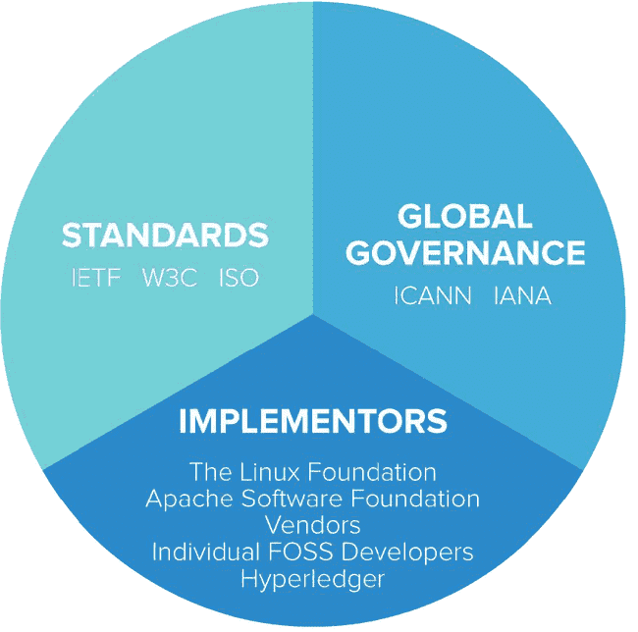
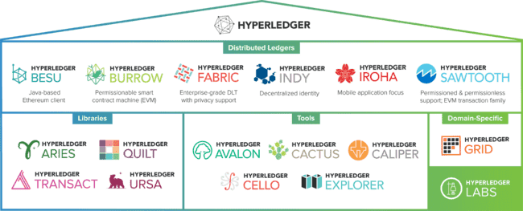
Blockchain IMPLEMENTATION
Hyperledger End user components view
Hyperledger End user components view

Slide 28



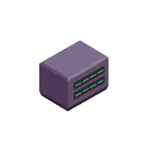

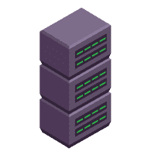
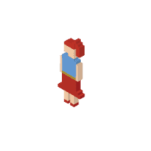
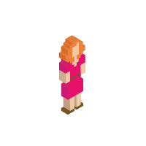

Blockchain IMPLEMENTATION
Hyperledger Developer view
Hyperledger Developer view
Cello
Network Setup
DevOps UI
Composer
Network Teardown
Composer
Software Development Kit
JSON Data Model
JS Chaincode
Node.js
Python
JSON Role-based ACL
Java
Go
ID Registry
Burrow
Fabric
Fabric [Apple]
Endorser
Chain code
State DB
Couch
Trans
Chain
Quilt (benchmark performance)
Chain code editor
Consenter
Fabric
[Seagate]
Fabric
[WD]
Explorer (interactive gui)
Committer
Chain code
State DB
Couch
Trans
Chain
Chain code
State DB
Couch
Trans
Chain
Caliper (ledger interoperability)

Slide 29
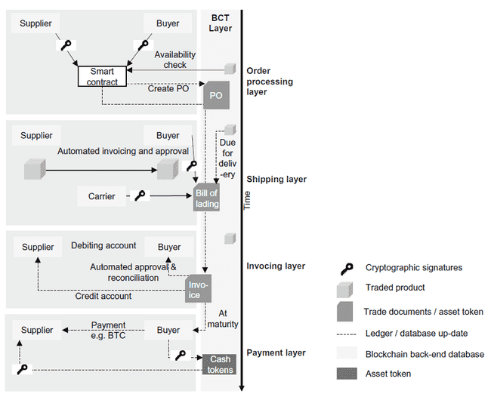
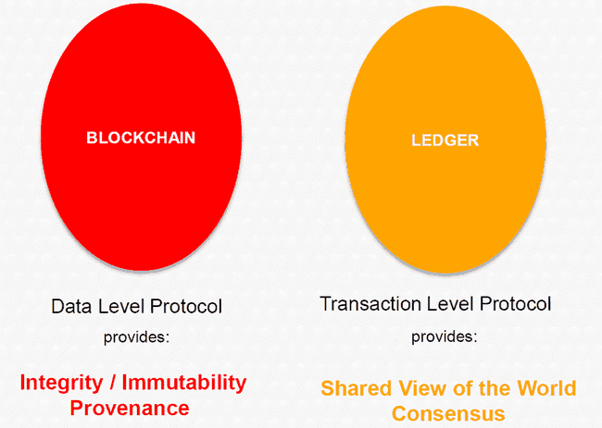
Blockchain IMPLEMENTATION
Sample Transaction Flow
Sample Transaction Flow

Slide 30
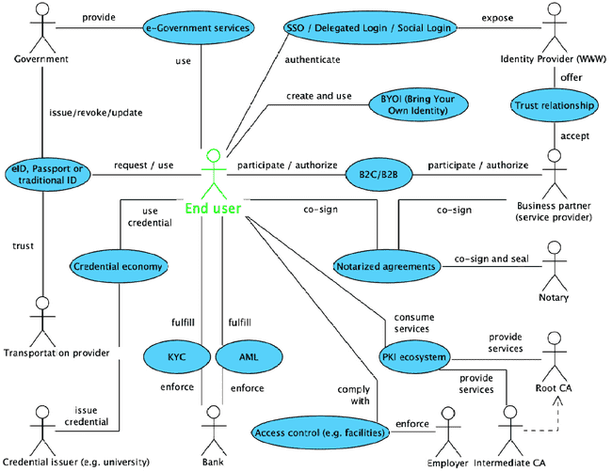
Blockchain IMPLEMENTATION
Phase 1 – Identity Management and KYC
Phase 1 - Identity Management and KYC

Slide 31
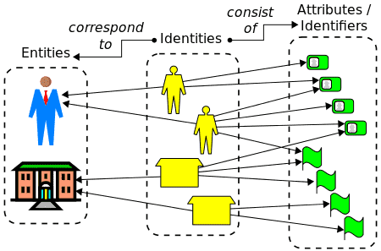
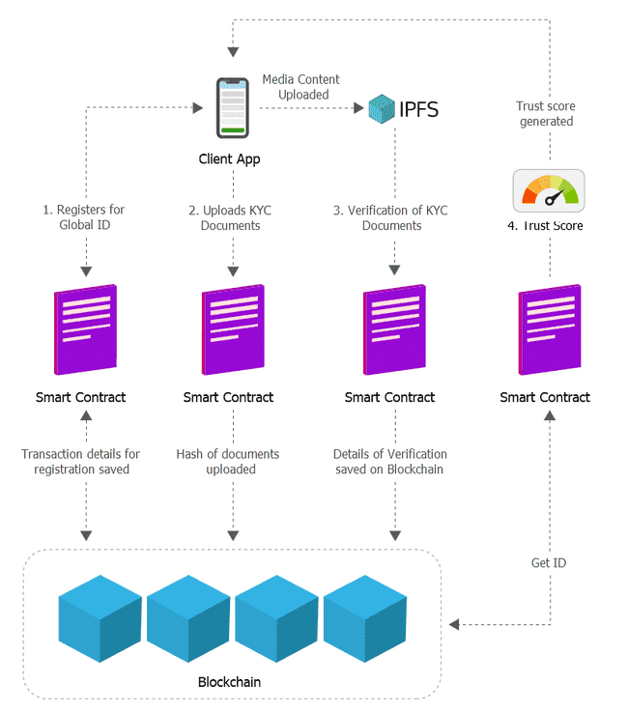
Blockchain IMPLEMENTATION
Phase 1 - Identity Management Blockchain Interface
Phase 1 - Identity Management Blockchain Interface
1.Issuer
2.Individual or corporation
3.Verifier
Signs
credential
Identity Trust Fabric (Blockchain)

Slide 32
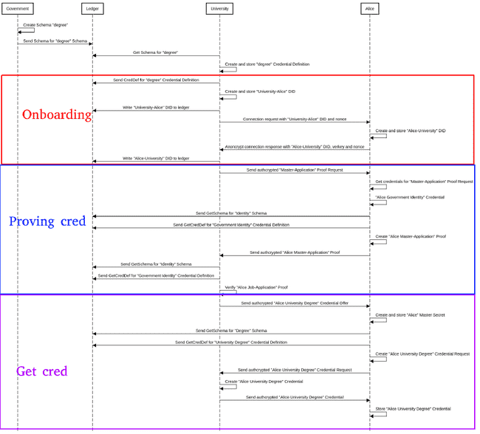
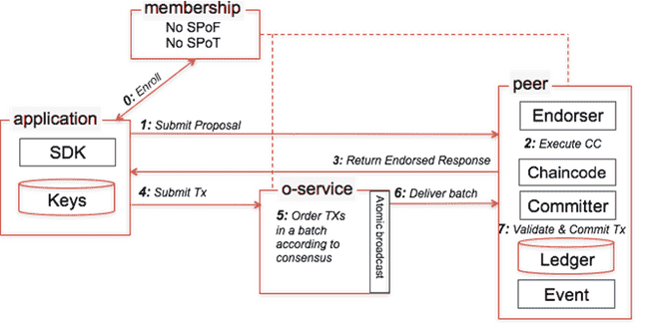


Blockchain IMPLEMENTATION
Phase 1 - Identity Management Sequence Diagram
Phase 1 - Identity Management Sequence Diagram
Membership Service Provider
Ecert
Fabric-CA
Indy URSA Aries
Tcert
Root
Certificate Authority
cluster DB
LDAP
HSM

Slide 33
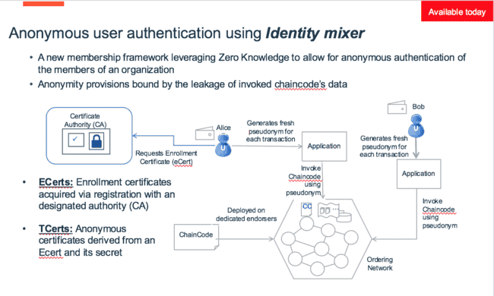
Blockchain IMPLEMENTATION
Phase 1 - Identity Management - Zero Knowledge Proof (ZPK)
Phase 1 - Identity Management - Zero Knowledge Proof (ZPK)

Slide 34
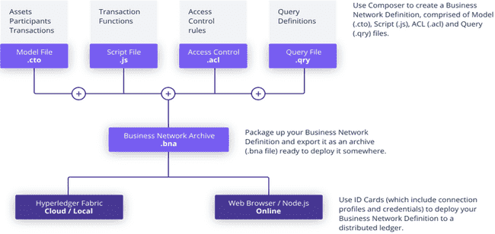
Blockchain IMPLEMENTATION
Phase 1 - Identity Management Files Process Structure
Phase 1 - Identity Management Files Process Structure

Slide 35

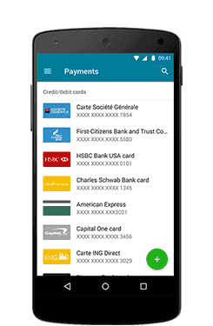





Blockchain IMPLEMENTATION
Phase 1 - Identity Management Application Layer Structure
Phase 1 - Identity Management Application Layer Structure
Layer Four: Rules
Context Specific Identity System
Verifiable Credential
Human Trust
Layer Three:
Exchange
Contextual Message Protocols
Proof
DID
VCX
Holder
ABC
XYZ
Issuer
Trust
Verifier
Layer Two: Agent-to-Agent Protocol
Connection
Identity Metasystem
Agent + Wallet
Agent + Wallet
Cryptographic Trust
DIDs
Layer One: Ledgers
Public Blockchain

Slide 36
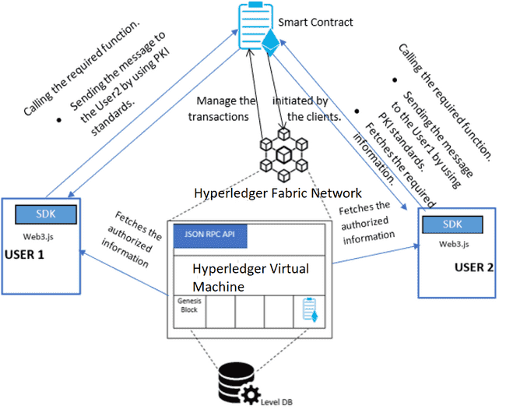
Blockchain IMPLEMENTATION
Phase 1 – dApp Chat System for Suppliers
Phase 1 – dApp Chat System for Suppliers

Slide 37
Blockchain IMPLEMENTATION
Phase 1 – Certification Standards
Phase 1 – Certification Standards
Standard | Title
ISO/IEC 27000 | Overview and vocabulary
ISO/IEC 27001 | Information security management systems – Requirements
ISO/IEC 27002 | Code of practice for information security controls
ISO/IEC 27003 | Information security management system -guidance
ISO/IEC 27004 | Information security management Monitoring, measurement, analysis and evaluation
Standard | Title
ISO/IEC 29190 | Privacy capability assessment model
ISO/IEC 24760-3 | A framework for identity management – Part 3: Practice
ISO/IEC 29146 | A framework for access management
ITU-T X.1085 | ISO/IEC 17922 | Tele biometric authentication framework using biometric hardware security module
ISO/IEC 29003 | Identity proofing
ISO/IEC 29134 | Privacy impact assessment – Guidelines
ITU-T X.gpim | ISO/IEC 29151 | Code of practice for personally identifiable information protection
ISO/IEC 20889 | Privacy enhancing data de-identification techniques

Slide 38
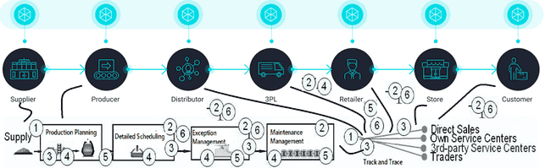
Blockchain IMPLEMENTATION
Phase 2 - After login Business Flow for End Users
Phase 2 - After login Business Flow for End Users
1. Production Planning and Procurement Management, 2. Financial Transactions Management, 3. Detailed Scheduling and Project Monitoring, 4. Exception Management and Performance Management, 5. Maintenance Management and Inventory Management, 6. Track and Trace Logistics along with Returns Management as Exception Management

Slide 39
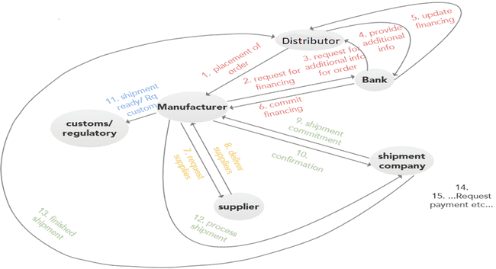
Blockchain IMPLEMENTATION
Phase 2 - After login Use Case for the Business Workflow
Phase 2 - After login Use Case for the Business Workflow

Slide 40

Blockchain IMPLEMENTATION
Phase 2 - Use Case for Developer End to End Workflow
Phase 2 - Use Case for Developer End to End Workflow

Slide 41

Blockchain IMPLEMENTATION
Phase 2 - Dashboard Screen after Login Success
Phase 2 - Dashboard Screen after Login Success

Slide 42

Blockchain IMPLEMENTATION
Phase 2 - On Clicking PIE Chart
Phase 2 - On Clicking PIE Chart

Slide 43

Thank you!
S. Lakshmanaraj
Lakshmanaraj.Sankaralingam@ideastoimpacts.com
https://www.linkedin.com/in/lakshmanarajsankaralingam/
“Accelerating the future of work thereby,
Distributing the future evenly”
www.ideastoimpacts.com

