Slide 1
Motivation

Slide 2
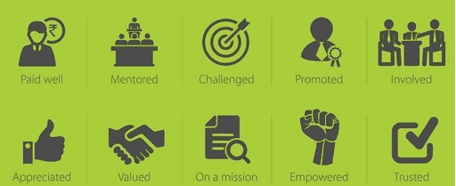
Motivation - Definition
The heart of motivation is to give team what they really want most from work. The more you are able to provide what they want more than job satisfaction, the more you should expect what you really want, namely: productivity, quality, and service. You don’t need the carrot or the stick; It’s not money that motivates; You get the best by giving the best.
As Per Kaizen, Top 5 reasons for extreme job satisfaction are: Achievement, Recognition, The Work Itself, Responsibility, and Advancement.
These help team to achieve goals; gain a positive perspective; create the power to change; build self-esteem and capability, manage their own development and help others with theirs; balance Life of Work in Spirit with Family, Health and Friends.
To Accomplish these 5 reasons, Implement 5 Strategies to Improve 8 Positive Potentials by exploring 10 principles to act upon and Find to measure and increase 30 Energy levels of team

Slide 3
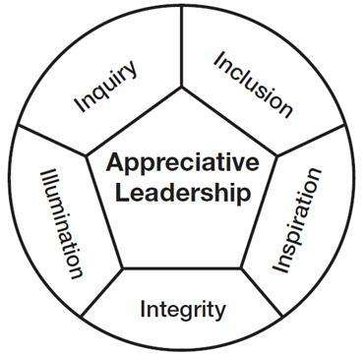
Motivation – 5 Strategies of I
Inquiry - Ask positively powerful questions to Motivate and Enhance Trust
Illumination - Bring out best of people and situations keeping end in mind
Inclusion - Engage with people to coauthor future and company growth
Inspiration – Awaken creative spirit and all breakthroughs begin with belief in your self
Integrity - Make choices for good of whole adding values and You can't be all things to all people but illustrating “Coming together is a beginning. Keeping together is progress. Working together is success”

Slide 4
Motivation – Improving 8 Positive Potentials
Strengths Exhibition - Success breeds success. Study strengths, capabilities and high performance patterns. Passionate environment/Provide opportunity to Show untapped talent to attain independence.
Targets or Commitment to Record History Creation or Past Success History Retention – Telling team that going to create a history or to retain the Past Success History is a source of positive possibility. Share stories of success from the past to continue or show how we progress to reach record breaking.
Cynicism Cultivation and Status Recognition - Great Vision has no place for cynicism. But Behind every cynical statement, there is a dream wanting to be realized. Ask about the dream; listen for it and reflect it including needs of recognizing position and brings out elevating organization value, brand and growth.
Big Emotions Validation and Fear Elimination - Emotions Validation releases emotions and creates a clearing for ideas. Listen with compassion; affirm and reflect feelings. In case of fear, illustrate fear is nothing but False Evidence Appearing Real and Act to increase the hope by eliminating reasons of fear.
Ideas Innovation Encouragement Thanking and Edgy Ideas Dealings - If Idea brings values, Encourage it. Respect your subordinate more than your superiors. If Ideas lives on the edge, It is never the norm. Seek out and playfully consider unlikely or disliked ideas with reasoning or a need for postponement.
Openness to Connectivity and Freedom To Act and Response - New connections create new opportunities. Reach out and get to know new people. Providing a personal touch and Being helpful to team and showing to be part of removing first concerns for others and then to individuals will not only motivate but also will help you when you need.
Input Positive Opposition and Persistence of Open Minded Flexibility - Unity is harmony among differences. Seek out people with whom you disagree. Respectfully seek a new “mash” of ideas that resonates with all, Act neutral, Agree which are values with a praise else without showing disagreement, create a healthy debate environment to encourage to find alternatives.
Novelty and Proficiency Level Elevation and Moving to Future with Mission - It is seed of learning. Regularly, asking to try new things, try new ways of doing things, reflect upon new ideas, will not only motivate, but also will bring new ideas and Increase Proficiency of each person.
To improve Motivation given below are 10 principles to follow.

Slide 5
Motivation - Principles
1. Happy Work-Force = Happy Customers : Increase Happiness
Provide a great environment to work in and look after your staff the way you expect them to look after your customers. Get Happiness Index from each team and make steps to increase their happiness value not only in terms of Work, but also personal things through personal touch. Some few points below may auto-increase happiness:
Increase individuals’ accountability for their work by removing some controls
Give people responsibility for a complete process or unit of work
Make information directly available to employees rather than sending it through their managers first.
Enable people to take on new, more difficult tasks they haven’t handled before
Assign individuals specialized tasks that allow them to become experts
Provide what they need in terms of training (soft skills as well as technical knowledge) and genuine support with positive messages where appropriate and constructive feedback of development is needed
Ask team with “How do you think I can be more productive?” Sure, you may end up doing more. But if everyone did this, we would all end up better off. Even if you don't get any ideas boosting efficiency or issues impacting environment, your questioning will open the way toward a more cooperative work life

Slide 6
Motivation - Principles
2. Everyone Has Motivation : Understand, Feel, Build Trust to increase it
Everyone is motivated on some level. They may want more status, higher pay, better working conditions, and flexible benefits. But Research says, it is not because of them, only by fulfilling items those motivate your team by asking them not in an annual survey feedback but in regular feedbacks, attitude surveys, and informal conversations. Find level of their motivation and move them to next level on an ongoing basis to measure attitude at ‘key moments of truth’ of each member on what they want most from their jobs; You don’t have to be perfect; “Best” doesn’t mean same thing to everyone; Ask for cheese-you might get moon.
i) Differentiate Each
Understand the differences of real, longer-term motivators and short-term spurs
ii) Everyone is not Like You
Trying to motivate others by focusing on what motivates you is wrong. It differs from person to person
iii) Find Out What Your People Want From Work
More interesting work, efficient direction, opportunity to see the end result of their work, greater participation, recognition, challenge, career growth
iv) Decide on an Action involving team
Since recognize that you don't have all the answers, Having listened to team, take steps to alter policies and attitudes after consulting fully with team

Slide 7
Motivation - Principles
2. Everyone Has Motivation
v) Let Me Understand You
a) Take time to Show Sincere Interest in your team as your family
Understand what your team are passionate about in their lives. What are their special passions? What are their personal needs? What brings them joy or pain? What are their short-range and long-range goals? What is in it not for them? Once you understand the answers to these questions, you can move them to a new level of motivation, because you cared enough to ask the questions and show interest in their success. Once you understand your employee’s needs and goals, they will take more interest in understanding and achieving your goals.
b) Listen to both sides of the team
During conflicts understand both the parties and exchange the positive things about each other, at the same time, convert the negatives to positives. Finally obtain a commitment from them this will increase your probability of success.
c) Listening to your team
You do not need to agree with everything they are thinking but you do need to understand why they feel this way. Understand what problems/worries they are encountering, what opportunities they see, what is important to them.

Slide 8
Motivation - Principles
2. Everyone Has Motivation
v) Let Me Understand You
d) Selling your idea
Instead of selling your idea first to team, first understand their pain points and then convert your ideas, how those could help them to erode pains and increase their pleasures. Thus they will buy in to your way and you can sell your idea
e) Listen Without Judgment
You need to understand other person's perception of the situation in order to help them to develop a strategy that works for them. Listening is about understanding how the other person feels - beyond merely the words that they say.
f) Some one is Difficult to understand or motivate
While it's true that not everyone has the same motivational triggers and some cannot be motivated, But there is an approach, 'seeking to understand‘ is generally a better first step than 'seeking to be understood'. The reality is that motivating some individuals does involve an investment of time.
g) Apply Stress Management
Team will rise and do more to tough challenges by applying stress, but you should aware of the elastic has a limit to elongate, else it would break. Extreme pressure kills inspired performance. You need to know what capacity and their feeling before deciding

Slide 9
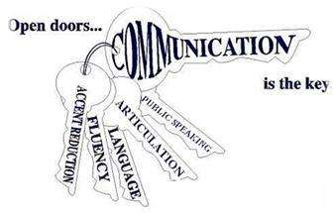
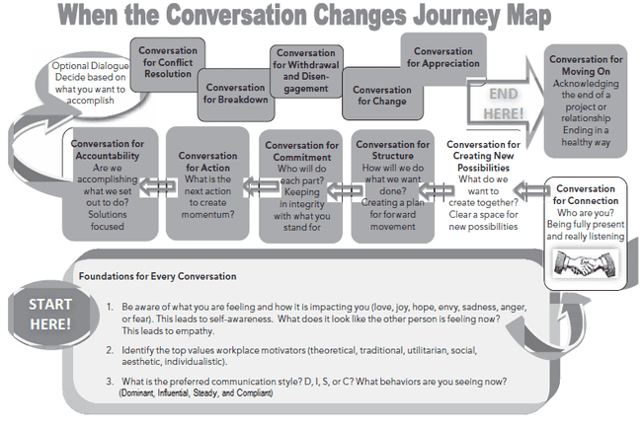
Motivation - Principles
2. Everyone Has Motivation
v) Let Me Understand You
h) Take Extra Care in Conversation
1. Utilitarian
Wanting things to be useful and productive, seeking financial well-being; possibly using money or points to keep score; . Return on investment
2. Aesthetic
Wanting things to feel good, look good, or sound pleasing; artistic, creative, subjective.
3. Theoretical
Wanting the answers, facts, data, and truth and sharing knowledge.
4. Traditional
Wanting instructions or procedures so that life can be lived or work can be done correctly.
5. Social
Wanting to make a difference for others, wanting to solve people issues, such as hate, poverty, homelessness, hunger, and political issues
6. Individualistic
Wanting to be at the table when decisions are made, seeking to be an expert whose voice matters, winning and leading in a world-class way.

Slide 10
Motivation - Principles
2. Everyone Has Motivation
v) Let Me Understand You
h) Take Extra Care in Conversation
Four communication styles namely Dominant, Influential, Steady, and Compliant have its own cluster of predictable behaviors and how to involve, collaborate and avoid with them are given below.
High Dominant Style
Behavior:
• Likes challenges and a fast pace
• Wants to control the agenda
• Is good at handling problems and challenges
• Relies on gut instinct
• Is very active and can be perceived by the other styles as being aggressive in getting results
• Goes directly at conflict or problems with no fear
• Will take risks that other styles would not consider
• Is quick to challenge others and likes a back-and-forth debate (may be seen by other styles as argumentative)
• Loves to win
• Does not like repetitive work and dislikes not being able to make decisions
• Fears being taken advantage of
• Likes to initiate change for self and others
• Reduces stress by working out, engaging in competitive physical activity
• Needs to learn humility
• Makes quick decisions (will say yes or no quickly)
Involvement:
• Luxury options
• Professionalism
• Power to make decisions
• Status symbols
• Customized solutions
Collaborate:
• “We can make this happen if we decide today . . .”
• “The results we are aiming for . . .”
• “We can be the best or the first at this if we . . .”
• “The bottom-line benefits are . . .”
• “Let’s take action on this now . . .”
• “Let’s pick up the pace on this . . .”
Avoid:
• Getting thrown off if the person seems confrontational. Instead, come into the conversation with the same candid up-front energy, and he or she will respect you.
• Moving slowly or insisting on talking about every detail.
• Walking on eggshells, afraid the person will explode—High Dominants might express their feelings with intensity, but stay with them through the conversation and they will be able to let it go quicker than other styles let go of issues.

Slide 11
Motivation - Principles
2. Everyone Has Motivation
v) Let Me Understand You
h) Take Extra Care in Conversation
High Influence Style
Behavior:
• Likes to interact and persuade others to his or her point of view
• Is good at including others, interacting with others, selling ideas
• Is outgoing and social
• Trusts others easily
• Is very enthusiastic and optimistic and does not want to focus on topics that bring him or her down
• Is a creative problem solver, especially involving people
• Is great at networking
• Is fun loving and impulsive
• Can be perceived by other styles as insincere because he or she is so friendly to everyone
• Does not like pessimism, negativity, or skepticism
• Fears not being liked
• May not notice changes going on around him or her
• Reduces stress by going to a social event, talking with people he or she likes
• Needs to learn self-discipline
• Makes quick, impulsive decisions and will appreciate creative new possibilities
Involvement:
• Showy, flashy, new trends
• Fun
• Creativity
• Attention
• Social standing
Collaborate:
• “I’m excited we are going to . . .”
• “Imagine this . . .”
• “So many people will . . .”
• “I feel so happy about . . .”
• “You’ll win the chairman’s club award if you . . .”
• “Wow, this is going to be fun . . .”
• “I love working with you because . . .”
• “This is great news! . . .”
Avoid:
• Using lots of facts, data, and logic to persuade.
• Getting frustrated when the person goes off on a tangent. Just bring him or her back to the conversation at hand.
• Expecting him or her to stick with detailed, complex, long-term projects (High Influencers need variety).

Slide 12
Motivation - Principles
2. Everyone Has Motivation
v) Let Me Understand You
h) Take Extra Care in Conversation
High Steady Style
Behavior:
• Likes security and steadiness
• Is good at creating the pace or process for self and others
• Likes to create short-term plans
• Prefers having clear directions and guidelines for work and activities
• Wants to know how things will be done step-by-step
• Is good at listening and is able to calm others
• Masks own emotions (other styles may find High Steadies hard to read emotionally)
• Has great patience and will stick it out through difficult times
• Needs own space
• Does not like lack of closure or inability to complete a task
• Fears loss of stability and conflict
• Gets overwhelmed with fast change, needs time to adjust to change
• Reduces stress by having alone downtime like yard work or a hot bath
• Needs to learn self-confidence
• Is a methodical decision maker
Involvement:
• Family activities
• Comfort
• Cozy, homey spaces
• Proven, tested assurances
• Safety
• Tradition
Collaborate:
• “Let’s take a few days and think this over before we make a decision.”
• “We have a solid reputation for service and reliability.”
• “Would you help me with . . . ?”
• “I promise I will . . .”
• “Take your time so you feel comfortable . . .”
• “We can make this happen on our own time schedule . . .”
Avoid:
• Pushing the person to make a decision quickly
• Expecting him or her to express disagreement directly or say no directly
• Getting to the big-picture concept in the first few minutes (it may take several conversations, but once High Steadies have the big-picture concept, they are able to stick with it longer than any other style)

Slide 13
Motivation - Principles
2. Everyone Has Motivation
v) Let Me Understand You
h) Take Extra Care in Conversation
High Compliance Style
Behavior:
• Likes accuracy and cautiousness
• Is good at creating policy and procedures and responding to rules set by others
• Can be perceived as too cautious by other styles
• May be overly critical of self and others
• Enjoys solving complex problems and thinking through details
• Analyzes and systematizes
• Has high expectations
• Expects others to follow the rules too
• Is troubled by risky situations and unscheduled events
• Does not like too much focus on emotions or feelings
• Fears criticism of work
• Will worry during times of change
• Reduces stress by having alone time to think
• Needs to learn to be more open verbally to share what is in his or her mind and heart
• Is a cautious decision maker
Involvement:
• Conservative ideals
• Proven records
• High-quality standards
• Formality
• Privacy
• Measurable value and results
Collaborate:
• “The research shows . . .”
• “Would you analyze the data?”
• “There is no risk in us exploring these three options first . . .”
• “The facts are . . .”
• “There is a 90-day guarantee . . .”
• “This has a proven track record . . .”
Avoid:
• Rushing the conversation, leaving little or no time for questions
• Asking for a personal opinion, gut reaction, or personal information
• Being emotional, random, or disorganized

Slide 14
Motivation - Principles
2. Everyone Has Motivation
v) Let Me Understand You
i) Find different types of Difficult Persons and Response accordingly
The Un-decider:
Behavior: Takes days to make a decision and then, after it's made, revisits it; when things fall apart, says, “It is not my Fault”
Response: Establish a deadline where the decision must be final, and a default decision that will hold true if no decision is made.
The Ultra-Competitor:
Behavior: Can't let it go until convinced that won--and, more importantly, that someone else has lost.
Response: Give awards or rewards based on team achievement--never on individual accomplishment.
The Drama Queen:
Behavior: Seems to draw energy from the drama, while draining energy from everyone else.
Response: Set up boundaries for the behavior that you won't tolerate. Eject from any meeting where behavior becomes obstructive.
The Iconoclast:
Behavior: Thrives on the negative attention that comes from dazzling authority figures, social protocols. Misses deadlines to prove not to follow rules
Response: Aiming him at right enemy. Oddly, these types often do well as "customer advocates" who can take on bureaucracy in order to see that customers get what they need.
The Droner:
Behavior: Ready to give you a presentation--and it's usually one you've heard before. Got a list of bullet point and no where leads to any conclusion and keep on discussing many other things
Response: Have an written agenda for every meeting and then stick to it.
The Social (Network) Butterfly:
Behavior: Convinced to remain online all day "building relationships" with all your customers, but doing nothing to assigned tasks
Response: Assign him measurable goals
The Procrastinator:
Behavior: Says yes to projects but fails to follow through. As deadlines approach, Goes on a mini vacation to "recuperate from the stress."
Response: Do micromanagement. Lay out frequent (even daily) milestones
The Creative Genius:
Behavior: Always talking about amazing stuff did in past and has equally amazing plans for future. Still, seldom seems to do anything.
Response: Give some lip service to greatness, then bring down to earth by getting to "consult" on each chunk after breaking tasks.
The Panic Button:
Behavior: Remains calm for day and weeks, but then when a problem has reached its inevitable conclusion, runs around like a decapitated chicken.
Response: Create an early warning system so that there are fewer surprises. And replace the regular coffee with the decaf on the day the bad news hits.

Slide 15
Motivation - Principles
2. Everyone Has Motivation
vi) Consider to Improve Relationship to increase Happiness Index
Foster inter-departmental communication and working, giving employees opportunities to share ideas and experiences
Encourage face-to-face communication where appropriate, so that colleagues have more worthwhile discussions than email alone allows
Encourage a culture where people can express feelings Learn to listen effectively and without judging, this will help you understand your colleagues better
Ensure no staff member is working in isolation but feels supported and involved in the business
Treat all team members with respect and be aware of cultural sensitivities
Provide opportunities for socializing outside of work e.g. family days. This will help employees relate to each other and may help with conflict resolution in the workplace
Discourage cliques. Although it is healthy for colleagues to form friendships, cliques can fuel office politics
A good corporate social responsibility plan will give staff the chance to work together on non work-related projects that also benefit the outside community
Communicate well and often, and ensure a supportive attitude
Put positive working relationships at the heart of your business culture by including it as a corporate value

Slide 16
Motivation - Principles
3. Show Positive Attitude : Set and Realign Expectations Periodically
Realign organization expectations and take into consideration the economic climate when setting targets and objectives. You stand in between inspiration and implementation. Even during challenges, Show enthusiasm and Positive Attitude.
Unites toward shared destiny - sharing information and ideas, empowering team and gaining trust
Show genuine caring and have a sense of humor
Lead, encourage, and guide staff - don't force them
Tell your staff what you think. Give valid reasons
Influence why doing the task is important to you, the organization, and for them
Don't make assumptions about what drives others
Don't assume others are like you
Don't force people into things that are supposedly good for them; But Strive for Excellence and not for Perfection
Don't neglect the need for inspiration; One is to Celebrate Success
Don't delegate work -- delegate responsibility
Express positive expectations and cheerful body languages; Stay cool under pressure
Expect the Best and your team will rise to that level as Team, not things are greatest resources
Establish a flexible climate of open communication based on trust, mutual respect, and commitment to a common purpose that enables teams to achieve better results more quickly and with less stress and wastages. Add value to team that adds to organization value
Have right capable person equipping with right tools, support and finally set realistic targets to achieve. If there are any gaps to explicit knowledge of Operation, Process, Architecture, Domain and Tacit knowledge, then Arrange training and investments to increase Proficiency, Productivity and Perfection. Wise man risks time and energy and not money.
Be an expert but Stay Humble and Be Courteous

Slide 17
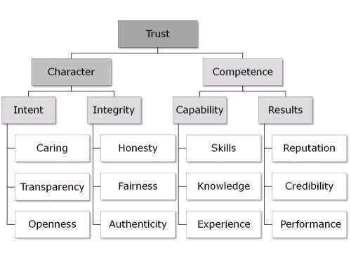
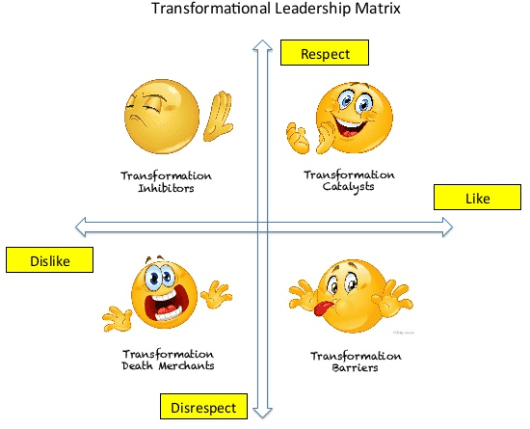
Motivation - Principles
3. Show Positive Attitude : Set and Realign Expectations Periodically

Slide 18
Motivation - Principles
4. Make Team Proud : Appreciate, Encourage and Let team feels
Napoleon Bonaparte once said, “A soldier will fight long and hard for a bit of colored ribbon.” Human nature dictates that no matter what job we do we all like to be rewarded or praised for doing it well.
Provide absolute clarity in “what success looks like”; all must be able to realize their goals and determine whether or not they are achieving them. Create an environment to decide reward before launch. If you've relied on bonuses or profit sharing in past; and they work; then, by all means, continue; But don’t create an expectation to be on a periodic basis, but a random rewards at proper time.
i) Be creative in determining rewards
ii) Public announcements
Reward team members and give an opportunity to explain triumph publicly
iii) Private feedbacks
Call team private to do a corrective action, preventive action, improvement areas.
Also Institute two-way performance reviews, so that how you are doing also will be known to improve yourself
iv) Higher Management Appreciations
Have your Director, President etc., give recognition to team by personally sending a note, recognizing them in an organizational or team meeting, or creating a “Hall or Wall of Fame”

Slide 19
Motivation - Principles
4. Make Team Proud
v) Give employee rewards your personal touch
Involve yourself in part of the recognition factor in rewarding. Customize to team's preferences, it will yield 8 to 14 times of value
vi) Small ‘quick fix’ prizes
No occasion is necessary. In fact, small surprises and tokens of your appreciation spread throughout the year help team in work life feel valued all year long. Give away little prizes as soon as they hit target. Every minute of day … precisely how is done and being rewarded for that performance. When they see positive and immediate consequences of what they do, they do it better; faster; more often.
vii) Group rewards
Group rewards may be appropriate, but don't undermine individual initiative. Make one-third based on the individual's tangible performance, and remaining two-thirds based on group accomplishment or vice versa
viii) Rewards to share with the family
Invite family also share like touring or movie etc
ix) Avoid de-motivation
Award should not hurt eligible performer or degrade any of team’s passion. Similarly be careful promoting people into management roles

Slide 20
Motivation - Principles
4. Make Team Proud
x) Minimum Needed
Say “Thank you.” to your colleagues, coworkers and teams how much you found admire, value and contribution any day of year. Thanks personally, timely, often and sincerely. Handwrite thank you notes, Send an email to everybody about a person.
Provide frequent positive performance feedback – at least weekly and also listen to staff. Stop by an individual’s workstation or office to talk informally, Show your genuine interest by asking your team about their family, their hobby, their weekend or a special event they attended. They feel valued and cared about.
Recognize, reward and promote based on performance. Know your team interests well enough to present a small gift occasionally. An appreciated gift, and the gesture of providing it, will light up your team day. Almost everyone appreciates food. Take team to lunch for a birthday, a special occasion or Create a fun tradition for a seasonal holiday or for no reason at all. Let your guest pick the restaurant. Provide Company logo merchandise such as shirts, hats, mugs, and jackets.
Demonstrate Support; Hang framed or unframed one on wall to make attention or to change their thinking. Whether your working culture is one that clamps down on mistakes and penalizes error or a more tolerant one that espouses mistakes as learning opportunities, your staff need to understand the kind and levels of support they can expect. Encourage new ideas and initiative.
Last, but not least, provide opportunity and ownership in their work. Give chances for training, cross-training and learning new skills. They want to participate on a special committee where their talents are noticed. They like to attend professional association meetings and represent your organization at civic and philanthropic events. Explain how employee fits into organization’s plans, Involve employees in decisions and Let them participate in new hire interviews. Give them a book related to their job. Finally Celebrate successes.

Slide 21
Motivation - Principles
5. Walk the Talk and Walk the Job : Show Consistency in behavior
Our teams model our behavior. If we are confident about a major change in the organization, our employees will follow our behavior. If we come in late and leave early, guess what will happen? Remember, even when you don’t think someone is watching…they are always watching. Set the example for others to follow.
Every day, find someone doing something well or bad and tell the person so. Make sure the interest you show is genuine without going overboard or appearing to watch over people's shoulders. If you have ideas as to how employees' work could be improved, don't shout them out, but help them to find their way instead. Earn respect by setting an example; it is not necessary to be able do everything better than your staff. Make it clear employees can expect, what levels of support
Educate teams to know the 'primary aim' of your company to align company goals to team goals
Eliminate obstacles stop performing to best effect or any recent changes that might have affected motivation
Boost that motivates and feeling empowered
Involve team in company development and create feeling listened to and heard with visible actions seen
Make sure company's internal image consistent is with its external one

Slide 22
Motivation - Principles
5. Walk the Talk and Walk the Job
When You Walk the Walk,
You Show What’s Really Most Important
You Show Who Comes First, You Show What Comes First
You Share the Struggle and the Risk
You Gain a Firsthand View and Show working towards goal with doesn’t matter who gets credit
You Express Every Moment Is an Opportunity to Teach, Train, and Lead
You Take Steps That Every Potential Follower Can Follow
You Make Change Desirable and Create win-win situation by showing Change equals growth, not pain
You Show Engaged, Happiness, No Fear and felling of Increasing in Status
You Manage Purpose of Team and not Team. But You Address team’s intrinsic Desires. You Improve Everything and Overcome barriers to performance by turning groups to become teams and Showing none of us is as smart or wise enough by self as combining all of us
You also show Management is a service, not a control
You Energize and Empower Team by showing My employees are my peers, not my children
You Align Constraints by showing Business is an ecosystem, not a battlefield
You Develop Competence, You show Technology offers empowerment, not automations
You Grow Structure with Work should be fun, not mere toil
You Inspire Belief and demonstrate A company is a community, not a machine
You earn Trust from Your team
By these, You Become a Leader even without Title, Position, or Formal Authority

Slide 23
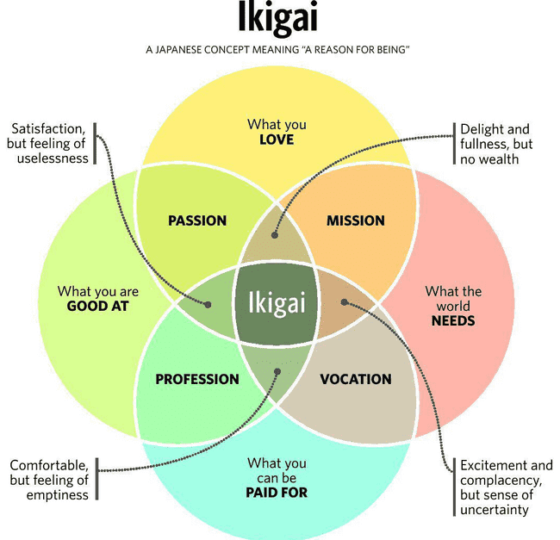
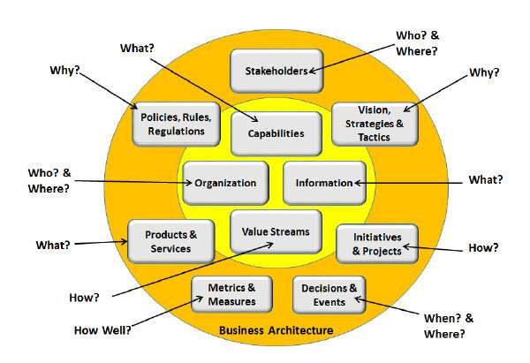
Motivation - Principles
6. Read the Needs : Provide what is needed
Understand where they are in the following circle and plan accordingly

Slide 24
Motivation - Principles
6. Read the Needs : Provide what is needed
Needs are similar to instincts and play a major role in motivating behavior. There are 4 deficiency needs (D-needs) and one growth / being needs (B-needs) in the following hierarchy.
i) Physiological Needs
Basic needs that are vital to survival, such as the need for water, food and sleep, Independence Being an individual
ii) Security Needs
Needs for Tranquility safety and security which includes a desire for steady employment, health insurance, safe neighborhoods and shelter from environment
iii) Social Needs
Needs for belonging, Romance, love and affection, Raising Family, Savings
iv) Esteem Needs
After first three needs have been satisfied, esteem needs include that reflect on self-esteem, personal worth, social recognition and accomplishment
v) Self-actualizing Needs
Concerned with personal growth, less concerned with opinions of others and interested fulfilling their potential, Power and need for influence

Slide 25
Motivation - Principles
6. Read the Needs : Provide 6 People Needed in Team’s Corner
You need others to help you, and you need to help others. With right team, you can make seemingly impossible practically inevitable. Following 6 type of people are needed to do so.
i) The Instigator : Voice of Inspiration
To keep person energized, and enthusiastic, Who pushes you, who makes you think. Who motivates you to get up and go, and try, and make things happen.
ii) The Cheerleader : Voice of Motivation
To keep person engaged, Who is a huge fan, a strong supporter, and a rabid evangelist for you and your work.
iii) The Doubter : Voice of Reason
To be as safe as you are successful, Who is devil’s advocate, who asks hard questions and sees problems before they arise.
iv) The Taskmaster : Voice of Progress
To make sure deadlines are met and goals are reached, who is loud and belligerent voice that demands you gets things done and is steward of momentum.
v) The Connector : Voice of cooperation and community
To reach people and places you can’t, who can help you find new avenues and new allies and breaks through roadblocks into finds ways to make magic happen.
vi) The Illustrator : Voice of Knowledge and Authority
To clarify, who is mentor, your hero, who you seek to emulate, your guiding entity, whose presence acts as a constant reminder that you, too, can do amazing things.

Slide 26
Motivation - Principles
6. Read the Needs : Understand and Treat Needed in Team’s Corner
Playfuls :
Enthusiastic, funny and loud; Extroverts speak before they think. Best at networking, socializing & having fun, the idea-people & very creative.
Powerfuls :
Assertive, decisive and productive; risk-takers who never give up on our goals.
Precises:
Meticulous. think before they talk. create structure, order and compliance.
Peacefuls:
Most calming of us all. easy-going, diplomatic and patient. hate conflict & do everything in their power to avoid confrontation. steady, comfortable in their own skin and grounded.
Give People What They Need
The Playfuls need attention, affection & approval.
The Powerfuls need credit, loyalty and appreciation.
The Precises need space, quiet and sensitivity.
The Peacefuls need respect, value and harmony.

Slide 27
Motivation - Principles
7. Manage Change : Consult team to do
Adopting Policies is one thing, implementing them is another. One of the most natural of human instincts is to resist change even when it is designed to be beneficial. The way change is introduced has its own power to motivate or de-motivate, and can often be the key to success or failure
Don’t give up when you try new things - new motivational ideas, especially which affect relationships and feelings - it is normal for things initially to get a little worse. Change can be a little unsettling at first. But keep the faith
Tell - instruct or deliver a monologue - you are ignoring your team's hopes, fears, and expectations;
Tell and sell - try to persuade people - even your most compelling reasons will not hold sway over the long term if you don't allow discussion;
Consult - it will be obvious if you have made up your mind beforehand; Look for real participation - sharing the problem solving and decision making with those who are to implement change - you can begin to expect commitment and ownership along with the adaptation and compromise that will occur naturally.
Consult, Inquire, Advise, Agree, Delegate, Empower, Encourage and then finally Enforce

Slide 28
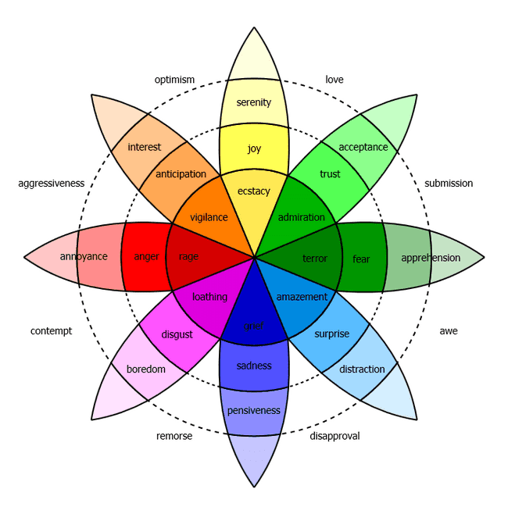
Motivation - Principles
7. Manage Change: Increase Productivity
FOCUS
Find Your Passion
Wield Your True Power
Motivate Employees to Contribute
Create Open Communication Channels
Find Stress-Reduction Initiatives
Decide Your Goals
Build Mastery
DISCIPLINE
Clearly define expectations and objectives. Work with them, not against them
Be loyal to the team, its mission and work from your strengths,
Celebrate all wins and learn from losses; Redefine Failure
Control Environment; Measure Efficiency, Effectiveness and Doing Right things Right.
Improve Enterprise Data Technology
Stop Re-Inventing the Wheel
Encourage Creative thinking
LEVERAGE
Leverage your Strength
Leverage your Energy
Leverage your Social networks
Leverage your Tools
Leverage through Synergy

Slide 29
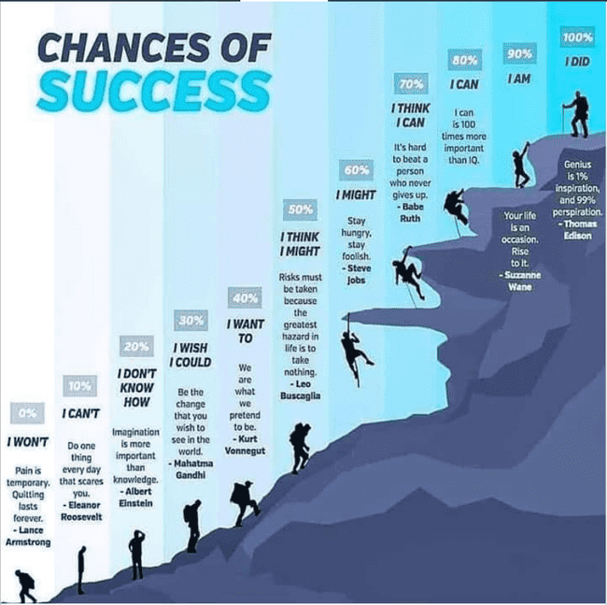
Motivation - Principles
7. Manage Change: Increase Productivity

Slide 30
Motivation - Principles
7. Manage Change: Increase Engagement, Diversity and Recognition
Inquire or Observe and Implement action to increase the following 10 points
I would recommend gloStream to a friend as a good place to work.
I am proud to tell others that I work for gloStream.
My job provides me with a sense of personal accomplishment.
I am willing to put in a great deal of effort beyond what is normally expected to help gloStream succeed.
I understand how my role in gloStream is related to gloStream overall goals, objectives and direction.
I understand how my unit/department contributes to the success of gloStream.
I have the appropriate amount of decision-making authority to do my job well. At gloStream employees are supported in taking appropriate work-related risks and empowers employees to make appropriate decisions that are in the best interests of the company and customers.
I find my immediate supervisor/manager on:
Consulting employees before making decisions that affect them
Acting in ways that support a diverse and inclusive environment
Encouraging/empowering people to take initiative in their work
gloStream provides me with opportunities to learn new skills and develop myself.
I find percentage of 50/30/20 rule for appreciation. i.e) 50 % come from Managers, 30 % come from Peers, 20 % come from Customers or External engagements
Notes:
Assured growth, Security and Appraisals, Saturday Off, Risk of contrary toward Going towards Cloud as well as stabilizing the product
Freedom to work is missing, Prioritization of work is not given to our choice, Break of Snacks has to be improved, Scrum masters going out has to be minimized, Fear in taking risks since we are conservative, Accountability & Responsibility in communication
Challenging or making to their best become less due to process
Goals of Organization and Personal goals
Don’t Give up, Keep pressurizing to get it done, Missing feedback from OM team or unable to convince us on prioritization
Common Module changes done are not communicated to all QA and developers
Common Module changes like only column addition, but not the purpose/summary is communicated
Frequent releases hampering growth
Demo to be given to every team members

Slide 31
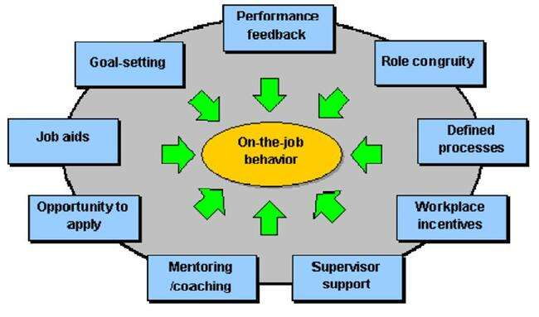
Motivation - Principles
8. Provide Feedback : Success of team is the Success of Organization
Metric 1: Flow State Percentage (Total Efforts - Interruption Efforts)/Total Efforts
Metric 2: The Anxiety-Boredom Continuum = (Interesting jobs Efforts / (Interesting jobs Efforts + boredom jobs Efforts)
Metric 3: Meeting Promoter Score = (No of Action items completed / No of Action items completed + No of Action items remaining)
Metric 4: Compound Weekly Learning Rate = Training Efforts / Total Efforts
Metric 5: Positive Feedback Ratio = No of Positives in the appraisal / (No of Positives in the appraisal + No Of Negatives in appraisal)
Notes:
12 Characteristics of Effective Metrics
Creating performance metrics is as much art as science. To guide you in your quest, here are 12 characteristics of effective performance metrics.
1. Strategic. To create effective performance metrics, you must start at the end point--with the goals, objectives or outcomes you want to achieve--and then work backwards. A good performance metric embodies a strategic objective. It is designed to help the organization monitor whether it is on track to achieve its goals. The sum of all performance metrics in organization (along with the objectives they support) tells the story of the organization’s strategy.
2. Simple. Performance metrics must be understandable. Employees must know what is being measured, how it is calculated, what the targets are, how incentives work, and, more importantly, what they can do to affect the outcome in a positive direction. Complex KPIs that consist of indexes, ratios, or multiple calculations are difficult to understand and, more importantly, not clearly actionable.
"We hold forums where we show field technicians how our repeat call metric works and how it might impact them. We then have the best technicians meet with others to discuss strategy and techniques that they use to positively influence the metric," says a director of customer management at an energy services provider.
3. Owned. Every performance metric needs an owner who is held accountable for its outcome. Some companies assign two or more owners to a metric to engender teamwork. Companies often embed these metrics into job descriptions and performance reviews. Without accountability, measures are meaningless.
4. Actionable. Metrics should be actionable. That is, if a metric trends downward, employees should know what corrective actions to take to improve performance. There is no purpose in measuring activity if users cannot change the outcome. Showing that sales are falling isn’t very actionable; showing that sales of a specific segment of customers is falling compared to others is more actionable.
Actionable metrics require employees who are empowered to take action. Managers must delegate sufficient authority to subordinates so they can make decisions on their own about how to address situations as they arise. This seems obvious, but many organizations hamstring workers by circumscribing the actions they can take to meet goals. Companies with hierarchical cultures often have difficulty here, especially when dealing with front-line workers whose actions they have historically scripted. These companies need to replace scripts with guidelines that give users more leeway to solve problems in their own novel ways.
5. Timely. Actionable metrics require timely data. Performance metrics must be updated frequently enough so the accountable individual or team can intervene to improve performance before it is too late. Some people argue that executives do not need actionable or timely information because they primarily make strategic decisions for which monthly updates are good enough. However, the most powerful change agent in an organization is a top executive armed with an actionable KPI.
6. Referenceable. For users to trust a performance metric, they must understand its origins. This means every metric should give users the option to view its metadata, including the name of the owner, the time the metric was last updated, how it was calculated, systems of origin, and so on. Most BI professionals have learned the hard way that if users don’t trust the data, they won’t use it. The same is true for performance metrics.
7. Accurate. It is difficult to create performance metrics that accurately measure an activity. Part of this stems from the underlying data, which often needs to be scanned for defects, standardized, deduped, and integrated before displaying to users. Poor systems data creates lousy performance metrics that users won’t trust. Garbage in, garbage out. Companies should avoid creating metrics when the condition of source data is suspect.
Accuracy is also hard to achieve because of the way metrics are calculated. For example, a company may see a jump in worker productivity, but the increase is due more to an uptick in inflation than internal performance improvements. This is because the company calculates worker productivity by dividing revenues by the total number of workers. Thus, a rise in the inflation rate, which artificially boosts revenues—which is the numerator in the metric—increases worker productivity even though workers did not become more efficient.
Also, it is easy to create metrics that do not accurately measure the intended objective. For example, many organizations struggle to find a metric to measure employee satisfaction or dissatisfaction. Some might ask users in surveys but it’s unclear whether employees will answer questions truthfully. Others might use the absenteeism rate but this might be skewed by employees who miss work to attend a funeral, care for sick family members, or stay home when daycare is unavailable.
8. Correlated. Performance metrics are designed to drive desired outcomes. Many organizations create performance metrics but never calculate the degree to which they influence the behaviors or outcomes they want. Companies must continually refresh performance metrics to ensure they drive the desired outcomes.
9. Game-proof. Organizations need to test all performance metrics to ensure that workers can’t circumvent them out of laziness or greed or go through the motions to make a red light turn green without making substantive changes. “Users always look for loopholes in your metrics,” says one BI manager. To prevent users from “fudging” customer satisfaction numbers, one company hires a market research firm to audit customer surveys.
10. Aligned. It’s important that performance metrics are aligned with corporate objectives and don’t unintentionally undermine each other, a phenomenon called “sub-optimization.” To align metrics, you need to devise them together in the context of an entire ecosystem designed to drive certain behaviors and avoid others.
11. Standardized. A big challenge in creating performance metrics is getting people to agree on the definitions of terms, such as sales, profits, or customer, that comprise most of the metrics. Standardizing terms is critical if organizations are going to distribute performance dashboards to different groups at multiple levels of the organization and roll up the results. Without standards, the organization risks spinning off multiple, inconsistent performance dashboards whose information cannot be easily reconciled.
12. Relevant. A performance metric has a natural life cycle. When first introduced, the performance metric energizes the workforce and performance improves. Over time, the metric loses its impact and must be refreshed, revised, or discarded.
"We usually see a tremendous upswing in performance when we first implement a scorecard application,” says a program manager at a major high tech company. “But after a while, performance trails off. In the end you can’t control people, so you have to continually reeducate them about the importance of the processes that the metrics are measuring or you have to change the processes."
Posted by Wayne W. Eckerson on April 19, 2010

Slide 32
Motivation - Principles
8. Provide Feedback
i) Don't keep team guessing
Don't keep team guessing how their development, progress, and accomplishments are shaping up. Offer comments with accuracy and care, keeping in mind next steps or future targets. People will respect what you expect if you inspect. What you count is what you get, so count the right things. Don’t confuse motion with progress.
You don’t need to spend a lot of money to make your team feels motivated but you must continue to celebrate success, coach people on specific challenges and address any difficult issues they face.
ii) Regular review sessions
In every role team wants to develop their skills to help them progress. All should have regular review sessions which help staff and employers to identify both areas of strength and skills gaps. At the end of each sessions, targets are set for the employee to work towards, helping them develop in their career.
iii) Motivation may take too much time
It is true that, sustainable motivation, commitment and focus is in the beginning more time consuming. A mature team should be virtually self-managing, leaving you free to concentrate on all the job-enhancing strategic aspects that you yourself need in order to keep motivated and developing.
iv) Your team has untapped talent
While giving feedback, don’t ignore that your team has untapped talent. By asking appropriate questions and creating an atmosphere to bring hidden talent, inspires team to motivate

Slide 33
Motivation - Principles
8. Provide Feedback
v) Let Feedback Fosters Team Feelings and Feels everyone Important
a) Feel competent
Make sure that people feel competent at what they are doing.
Give them work that challenges their abilities but that is still within their grasp
b) Feel accepted
Try to let people feel accepted by you and the group. Compliment them on their achievements (but only if you mean it).
c) Curiosity addressed
Make sure that their curiosity is addressed. Even though some activities can be boring, there should always be something new for them to investigate.
d) Honor satisfied
Give people a chance at satisfying their honor. You must allow teams to make their own rules, which team members will follow happily (or sometimes grudgingly).
e) Idealism (purpose) demonstrated
Infuse the business with some idealism (purpose). You’re not just there to make money. You’re also making a (small) contribution to make the world a better place. (Note: Be careful with this one. It is often abused by top management in an attempt to obfuscate its real purpose, which is simply to make money.)
.

Slide 34
Motivation - Principles
8. Provide Feedback
v) Let Feedback Fosters Team Feelings and Feels everyone Important
f) Independence (autonomy) given
Foster people’s independence (autonomy). Allow them to be different from other people, with their own tasks and responsibilities. Compliment them on their original and interesting hair style.
g) Rules(order) followed
Make sure that some level of order is maintained in the organization. People work better when they can rely on some (minimal) company rules and policies.
h) Power or influence created
Make sure that people have some power or influence over what’s happening around them. Listen to what they have to say and help them in making those things happen.
i) Social contacts (relatedness) collaborated
Create the right environment for social contacts to emerge. There’s usually no need to venture into the romance area, but friendships can easily arise, provided that managers take care of a fertile context.
j) Status appeared
Finally, it is important for people to feel that they have some status in the organization. They shouldn’t feel like dangling somewhere at the bottom of a big hierarchy.

Slide 35
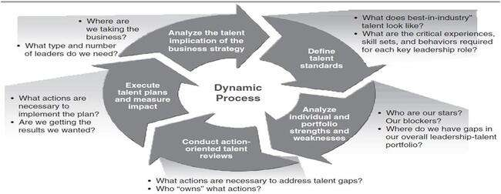
Motivation - Principles
8. Provide Feedback : Learning is a Continuous Process
Pride – Skills/Knowledge = Arrogance
Skills/Knowledge – Pride = Mediocre Work
Pride + Skills/Knowledge = The Best Work Each Time
Belief – Action = Fantasies
Action – Belief = Fool at Work
Belief + Action = Dreams Come True
Passion – Direction = Wasted Energy
Direction – Passion = Success Takes Far Longer, If Ever
Passion + Direction = Goals Galore

Slide 36
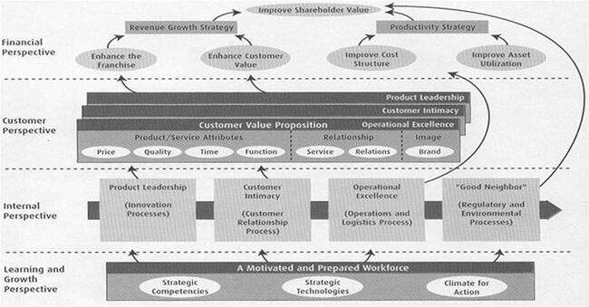
Motivation - Principles
8. Provide Feedback : Balanced Score card Strategy

Slide 37
Motivation - Principles
8. Provide Feedback : What is Balanced Score card ?
Financial
To succeed financially, how should we appear to our shareholders?
Objectives
Measures
Targets
Initiatives
Internal Business Process
Quality
Cost
Capability
Capacity
Knowledge
Skills
Identity
Motivation
VISION AND STRATEGY
Customer
To satisfy our shareholders and customers, what business processes must we excel at?
Objectives
Measures
Targets
Initiatives
To achieve our vision, how should we appear to our customers?
Objectives
Measures
Targets
Initiatives
Learning & Growth
To achieve our vision, how will we sustain our ability to change and improve?
Objectives
Measures
Targets
Initiatives

Slide 38
Motivation - Principles
9. Understand Learning Preferences : Do the needful accordingly
Change and review feedbacks involves learning and developing. But it is important to understand teams preferences learning with different styles, preferences, and approaches.
Activists: like to get involved in new experiences, problems, or opportunities. They're not too happy sitting back, observing, and being impartial;
Theorists: are comfortable with concepts and theory. They don't like being thrown in at the deep end without apparent purpose or reason;
Reflectors: like to take their time and think things through. They don't like being pressured into rushing from one thing to another;
Pragmatists: need a link between the subject matter and the job in hand. They learn best when they can test things out.
Accordingly group them, respond best to stimuli and suggestions that take account of the way they do things best. Learning is incomplete without opportunity to apply what has been learned

Slide 39
Motivation - Principles
10. Keep Environment / Atmosphere Fresh : Every matter Values
As obvious as it may sound, the key to motivation is to keep surrounding fresh.
i) Offer a nice clean working properly environment
ii) Provide team reach quicker and meet quicker
iii) Get the access right and easier
iv) Flow smooth communications and escalations
v) Sort out headaches and waiting delays
vi) Setup safe, comfortable and appealing
vii) Provide facility to recreate and energize
viii) Feel uninterrupted, but at the same time give rooms to humor at work like http://www.humorthatworks.com/how-to/101-ways-to-create-humor-at-work/
ix) Cultivate self-discipline
x) Introduce change in colour in the work space often
No one can motivate anyone to do anything. But We can create circumstances in which people motivate themselves.

Slide 40
Motivation - Work out to Measure Happiness Index by Personal touch
Act on Constraints to improve Happiness by heartiest feelings
Long term happiness
Ideas being listened to
Friendly, supportive colleagues
Working Conditions : Enjoyable work , Good boss or line manager, Good work/life balance , Varied work
Belief that we’re doing / I'm doing something worthwhile
Caring about the success of organization
Feeling that what we / I do makes a difference
Feeling important that contributing to the success of the organization
Being part of a successful team
Recognition for our / my achievements
Communicated well and often, and ensured a supportive attitude
Gaining Personal development and Lot of Benefits
Providing Opportunity for Openness
Team / Self Innovation
Respect
Job Security
Competitive salary, Pay, Benefits
Short term happiness
Feeling Psychologically Well-Being
Timely coinciding of Opportunity
Winnings or Elimination of losing
Increased Living Standard
Recovery from Illness or Debt
Got to Rule / Govern a team
Promotion
Getting additional family roles and members
Child / Family Achievement
Good atmosphere and surrounding
Exceeding any/all of 6 six senses Expectations
Finding Solution to a Problem
Notes:
Part I: Manager–Employee Relations
Do I maintain an open, trusting, and mutually respectful relationship with this employee?
Do I know this employee’s objectives and work with him or her toward these goals?
Do I know that this employee perceives his or her total rewards to be fair and receives recognition for achievements?
Do I understand why this employee works at gloStream and not at another firm?
Part II: Employee’s Work–Life Balance Satisfaction
Do I understand if the working environment fits with my employee’s personal and career needs?
Do I understand and support this employee to expand his or her interests or hobbies?
Do I know if this employee’s attitude, physical health, and overall status have been healthy for the past six months?
Part III: Employee’s Job–Interest Alignment
Do I know if the employee’s values are consistent with the organization’s values and culture?
Does this employee demonstrate passion and enthusiasm for his or her work?
Do I know how satisfied my employee is with aspects of the work situation (e.g., projects, training, coworkers)?
Part IV: Employee’s Career Goals
Do I know if the employee’s current work is aligned with his or her long-term goals?
Have I discussed different career choices with this employee?
Am I currently and actively working with this employee toward his or her career goals?
Have I had a discussion with this employee about ways to contribute to the company?
Do I proactively support this employee’s development through training and challenging learning opportunities?
#
Parameter
Average Score
( 1 to 10)
1
Are you happy with leadership team(Lakshmana, Pravin, Vinayak, Rohit)?
2
Are you happy with your reporting officer?
3
Am I properly utilized to the best of my capabilities?
4
Does organisation have good facilities for employees?
5
Do I have proper work-life balance w.r.t. work load Vs. available time ratio?
6
Am I properly heard when I have constraints or suggestions?
7
How much do I like my work and responsibilities?
8
Am I happy with my remuneration?
9
Do I like organization's work environment?
10
Am I learning at my work (Technical or non-technical)?
11
Am I allowed to be flexible to carry my responsibilities?
12
Do people maintain healthy relationship at work?
13
Do I have opportunity for growth?
14
Do I have respect to others and from others?
15
Does organization have good Process?
16
Do I get enough appreciation for what I am doing?
17
Do I have freedom to make mistakes and Learn from them?
18
Do I feel that I am part of success of organization?
19
Do you feel that the decisions made inclusive or forcibly to do?
20
Is there open culture to do innovation?
Overall satisfaction Index:
We value your suggestions and want to hear them. Please be frank about your opinions. * 1. How meaningful is your work? How meaningful is your work? Extremely meaningful Very meaningful Moderately meaningful Slightly meaningful Not at all meaningful * 2. How challenging is your job? How challenging is your job? Extremely challenging Very challenging Moderately challenging Slightly challenging Not at all challenging * 3. In a typical week, how often do you feel stressed at work? In a typical week, how often do you feel stressed at work? Extremely often Very often Moderately often Slightly often Not at all often * 4. How well do you believe you are paid for the work you do? How well do you believe you are paid for the work you do? Extremely well Very well Moderately well Slightly well Not at all well * 5. How much do you feel your opinions are valued by the company? How much do you feel your opinions are valued by the company? A great deal A lot A moderate amount A little None at all * 6. How realistic are the expectations of your supervisor? How realistic are the expectations of your supervisor? Extremely realistic Very realistic Moderately realistic Slightly realistic Not at all realistic * 7. How often do the tasks assigned to you by your supervisor help you grow professionally? How often do the tasks assigned to you by your supervisor help you grow professionally? Extremely often Very often Moderately often Slightly often Not at all often * 8. How many opportunities do you think, you have to get promoted in your current team/role? How many opportunities do you think, you have to get promoted in your current team/role? A great deal A lot A moderate amount A few None at all * 9. Are you supervised too much at work, supervised too little, or supervised about the right amount? Are you supervised too much at work, supervised too little, or supervised about the right amount? Much too much Somewhat too much Slightly too much About the right amount Slightly too little Somewhat too little Much too little * 10. Are you satisfied with your employee benefits? Are you satisfied with your employee benefits? Extremely satisfied Moderately satisfied Slightly satisfied Neither satisfied nor dissatisfied Slightly dissatisfied Moderately dissatisfied Extremely dissatisfied * 11. What benefits, if any, would you like to see added in the future? What benefits, if any, would you like to see added in the future? * 12. How proud are you of the gloStream brand/products? How proud are you of the gloStream brand/products? Extremely proud Very proud Moderately proud Slightly proud Not at all proud * 13. How do you feel working for gloStream as a 'whole' (taking into consideration management, co-workers, products, mission)? How do you feel working for gloStream as a 'whole' (taking into consideration management, co-workers, products, mission)? Like a great deal Like a moderate amount Like a little Neither like nor dislike Dislike a little Dislike a moderate amount Dislike a great deal * 14. Do you have a clear understanding of what is expected of you at work? Do you have a clear understanding of what is expected of you at work? Depends on the task/situation Sometimes Yes No * 15. What would be the one thing that would make you happier at gloStream? What would be the one thing that would make you happier at gloStream? A year supply of chocolate Increase in pay Increase in responsibilities Better benefits More paid time off More recognition for the work I do * 16. Do you have the equipment, tools and technology required to perform your job? Do you have the equipment, tools and technology required to perform your job? Yes No 17. If you answered 'no' to the above question, what tools/equipment do you need? If you answered 'no' to the above question, what tools/equipment do you need? * 18. Do you believe you have ALL of the skills and knowledge to perform your job at satisfactory level? Do you believe you have ALL of the skills and knowledge to perform your job at satisfactory level? Yes No 19. If you answered 'no' to the above question, what specific training do you need? If you answered 'no' to the above question, what specific training do you need? 20. If you answered 'no' to question #18, have you discussed this with your supervisor? If you answered 'no' to question #18, have you discussed this with your supervisor? Not applicable Yes No Planning on doing so * 21. Do you feel respected by your co-workers and supervisors? Do you feel respected by your co-workers and supervisors? Never respected Barely respected Very well respected Somewhat respected * 22. If you have an issue arise, do you find your supervisor to be available and responsive in a timely manner? If you have an issue arise, do you find your supervisor to be available and responsive in a timely manner? Yes, but not always in timely manner Sometimes Yes No * 23. Do you feel you that your supervisor gives you the recognition, appreciation and support that you deserve? Do you feel you that your supervisor gives you the recognition, appreciation and support that you deserve? Yes - consistently Rarely Often No * 24. What do you think of the 'layout' of the every morning meetings? What should be added/deleted/changed/improved? What do you think of the 'layout' of the every morning meetings? What should be added/deleted/changed/improved? * 25. If you have been hired in the last 12 months, how would you rate your 'new hire onboarding' experience? If you have been hired in the last 12 months, how would you rate your 'new hire onboarding' experience? N/A - I have been with the company for over a year Very satisfactory Satisfactory Unsatisfactory * 26. When you were hired, did you feel welcomed by your manager and co-workers the first week of your employment? When you were hired, did you feel welcomed by your manager and co-workers the first week of your employment? Yes No Sort of * 27. What was the most important thing that helped you when you first hired on? What was the most important thing that helped you when you first hired on? * 28. How would you rate overall 'gloTeam Spirit' of the company? How would you rate overall 'gloTeam Spirit' of the company? High/upbeat Low/stressed Average/OK * 29. What made you decide to join gloStream? What made you decide to join gloStream? gloPeople Friend working at gloStream Hated last job - anything would do better Product/company values/mission Exciting opportunity to grow with growing company Increase in pay from last employer * 30. What do you think gloStream can improve upon? What do you think gloStream can improve upon? * 31. How long have you been with gloStream? How long have you been with gloStream? Less than 12 months 1 - 2 years 3 years + * 32. What department/role are you in? What department/role are you in? Management Team Leaders/Scrum Masters Developer/Tester/Designer/Software Engineer Admin/Accounts/Logistics Customer Support & IT * 33. Do you see yourself continuing to grow with gloStream? Do you see yourself continuing to grow with gloStream? Yes No I don't know * 34. Please give any other feedback that you would like to share with management and thank you for completing this survey! Please feel free to include your name if you wish.

Slide 41
Motivation - Work out to Measure and Increase 30 energy levels Regularly
Find to Scale of 1 to 10 with each statement for each team and Increase
We see change as a new challenge and opportunity to grow
We feel hopeful and optimistic and don't have the Victimitis Virus
Our leaders are authentic and provide good examples to follow
We operate with a high degree of honesty and integrity
We give each other regular feedback on personal actions and behavior
We continually seek feedbacks and improvements on making job easier
We have deep passion and commitment to our cause
We take pride in, and joy from, our work
We don’t have obstacles stopping performing to best effect
We persist in the face of setbacks and failures
We are self-disciplined
Our work is meaningful and makes a difference
We regularly devote time to learning and improvement
Our leaders are highly effective coaches who help us develop
We don't use threats, intimidation, or punishments
Rewards are used to recognize and share success rather than as incentives to manipulate performance
Our leaders have strong verbal communication skills
Our team has many cooperative partnerships ,strong relationships and attitude of Teamwork divides task, multiplies success
We see motivation in every task
We frequently recognize, appreciate, and celebrate our small wins and significant successes
We move beyond our "reality rut" of current problems to focus on what could be
We know primary aim of our company - principles, priorities and mission
We have a strong and clear picture of our preferred future (vision)
We have 3 - 4 principles (core values) that guide our behavior (10 tags)
We take responsibility for our choices
Our goals are aligned to company goals
Our organization image is consistent with every customer as same as with internal team
We are involved in organization development
We have a strong sense of purpose
We feel empowered
Notes:
In order to achieve above Values, Individual needs to attain following Attitude:
I trust my intuition.
I welcome innovative ideas from employees
I feel comfortable asking employees' opinions and ideas on projects..
I am decisive. I do what I love and believe vision begin with end in mind
I Align team with the goals and vision of the company.
I believe the employee in the competence of management and their commitment to realize the goals and vision.
I Trust in their direct supervisor that he or she will support his or her people and help them to succeed.
I thrive on change and making effective.
I say no to 1000 things, but concentrate on what is necessary to take forward
If a person I am talking to seems ill-at-ease or intimidated, I will attempt to make him/her more comfortable (e.g. I will assume a different posture or tone of voice).
I state clearly the goals that everyone should be working towards.
I "roll with the punches" and adjust to changes in the business climate.
I am good at thinking "outside the box".
Once we have reached a goal, I set my sights on the next one for my organization.
I have a good sense of which employees/teams have the greatest potential in terms of helping the organization achieve its long-term objectives.
If one of my employees has an accident or makes a mistake, management must share some of the blame.
I believe in Whether or not a business is successful has a lot to do with chance.
Maintaining a good relationship with my employees is a top priority for me.
I feel that it is my job as manager/leader to ensure that each employee reaches his/her full potential.
I feel that I inspire my employees.
If I assign one of my tasks to someone else, I am not concerned that the person won't do as good of a job as I would. Managers/leaders must behave in a trustworthy manner to set an example for employees.
I demonstrate following things
a. Clarity of why you do what you do. To have this, you need a purpose, cause or belief that exists above and beyond the products or services you sell.
b. Discipline of how you do it. You must hold yourself and your people accountable to a defined set of guiding principles or values.
c. Consistency of what you do. Everything you say and do must prove what you believe. Every product that Apple made, all their marketing always communicated the same message: Think Different.
I Connect employees to the big picture. Helping an employee to understand a business's strategy and situation allows him or her to look and act beyond their role. When leaders at Radio Flyer, the Chicago-based maker of children's toys, wanted all 55 of its employees to better connect their individual efforts with the success of the company, they launched an initiative called "Connect-the-Dots" -- a three-part program geared toward educating employees about the business. One part consisted of an internal class, called "Wagon U 102: Driving Our Economic Engine," which discussed how the company defines and measures financial success. Radio Flyer executives also broadly communicated the five company objectives for the year along with related metrics for each department. Upward communication was jointly employed as each department reported its impact to the business back to fellow employees.
I Reward employees who go beyond "the norm." Nothing can quell people's desire to give extra than not feeling recognized. At Badger Mining Corp., a unique team approach ensures its 156 employees are rewarded for going above and beyond. Associates at this industrial mineral mining company belong to a "core" team, the one for which they were hired. In addition, they are encouraged to join cross functional teams, such as the "Retirement Plan Team," "Wellness Team" or "Safety Team." All teams are open to anyone interested in joining. Work on these teams becomes part of the performance evaluation process with employees gaining "extra credit" for joining and active participation.
I Make decisions and debates transparent. When employees have the full context about a decision and the options considered, they are more likely to support it regardless of whether they agree with it or not. At Bridgeway Capital Management, a Houston-based investment management firm that employs 33 people, leaders use an innovative meeting structure called "Fish-Bowl." The sessions are used to flesh out new proposals and educate staff on key decisions. A small group of employees sit in an inner circle to learn from one another on a controversial topic or idea. This group commits to "inquiry" on the subject as opposed to advocacy for or against the topic. Employees ask questions, explore the idea, flesh out any issues and learn about the subject. All remaining employees sit on the outside of the "fish bowl" and educate themselves on the idea while holding those on the inner circle accountable for listening, inquiring and being open and supportive to the new idea or issue. The result, they say, has been a quicker adoption of new and radical ideas.
I Collaborate on goals and decisions. A highly participative workplace yields better buy-in for decisions as people more fully support ideas they help create. Decision-making at Bridgeway often involves a combination of voting, consensus and/or delegating. For example, its human resources committee will design and recommend HR-related proposals, which will then go to the entire company for a vote. Depending on the magnitude of the decision, the vote will either be a super-majority vote (85 percent or more), a majority vote (50 percent or more) or a consensus driven decision in which objections are asked for but no formal vote is required. This shared decision-making extends to the company's annual goals as well. Using a unique process, all employees provide ideas for goals for the year. This list is then narrowed and ultimately voted upon by all employees, with each person having 100 points to vote for the top 10 goals. In the workplaces that have achieved a workforce of owner-minded employees, those workers often habitually step outside their role for the sake of the business's objectives. These cultures adapt faster to change and develop innovative ideas that lead to new product and market opportunities. And let's not forget they allow business owners to rest a little easier at night.
I DON'T get angry. "Getting angry is easy. Anyone can do that. But getting angry in the right way in the right amount at the right time, now that is hard." (Mark Twain) Anger does not belong in your managerial kit bag.
I DON'T be cold, distant, rude or unfriendly. Especially in difficult times, employees take cues from their immediate supervisors and need to hear from them. As such, your team will judge you by your action, moods, and behaviors, not by your intent.
I DON'T send mixed messages to your employees so that they never know where you stand. Keep your message simple, focused and prioritized. Too many messages and initiatives just confuse and alienate people.
I DON'T BS my team. This includes saying things that you don't believe in. This includes hiding information and just plain lying. By the time each of us is in our early 20's, we have all developed very well-tuned BS detectors.
I DON'T act more concerned about my own welfare than anything else. Your success will come through the success of your team."Self-serving detectors" are also very well-tuned in most employees.
I DON'T avoid taking responsibility for my actions. You are the boss. As such, you are accountable and the buck stops with you. You are trying to develop accountability throughout your company. So, lead by example.
I DON'T jump to conclusions without checking my facts first. A few years ago, I watched in horror as a colleague of mine started screaming at an employee of his who had missed an important meeting that morning. After several minutes, the employee responded: "I apologize and should have contacted you. But, I just got back from the hospital as my mother has been diagnosed with terminal cancer."
I DO what I say I am going to do when I am going to do it. There is no better way to communicate the message that you are accountable for your promises and that everyone in your company should be accountable as well.
I DO be responsive (return phone calls, emails). As a manager, your team can be considered to be your customer. You want your sales team to punctually respond back to customer requests, so you should do the same.
I DO publicly support your people. Your disagreements and disappointment with your employees can be communicated later and in private. Nothing appears so hollow as your attempt to blame your team for failures.
I DO admit my mistakes ... ...and take the blame for failures.
I DO recognize my team. "You can never underestimate the power of simple recognition for a job well done."
I DO ask and listen."The manager of the future will know how to ask rather than how to tell." (Peter Drucker) Some of the most dangerous words for a manager to ever say include: "But, you just don't understand…" "Because I said so…"
I DO smile and laugh. Have some fun. But, be genuine; programmed fun and faked laughter is worse than doing nothing. When appropriate, laugh at yourself; it will humanize you.
I understand the preferred communication style of the people I work closely with.
I connect with people on an emotional level when needed.
I share information about myself in order to deepen my connection with others.
I engage in conversations to create and explore new ideas and possibilities.
I brainstorm new ideas without judging or evaluating the idea too quickly.
I consider a variety of options and encourage others on my team to join me.
I develop clearly defined plans to meet my goals and objectives.
I verbalize to team members how we will accomplish a goal.
I have a system for tracking my progress on projects, goals, and initiatives.
When taking on new projects, I commit myself and demonstrate integrity by “walking my talk.”
I get team members engaged and committed to a common goal.
I know what I stand for, and the things I do are in line with that commitment.
I keep projects and tasks moving forward.
When momentum is not occurring, I check in with myself or my team to understand what action is needed to get back on track.
I am able to verbalize to team members what the next action is.
I am able to hold myself accountable.
I am able to hold others accountable.
I engage in conversations with others about the specific goals and expectations they are focused on.
When conflict arises, I have a conversation to address it in a timely, calm, and constructive fashion.
I do not fester in anger, bitterness, or resentment.
I am comfortable talking through differences in opinion and observations in order to resolve an issue.
When a situation seems to be in a repeat pattern or if things are not working, I have the conversations necessary to address the issue with the right people.
I catch myself when I am in circular thinking that is preventing me from reaching my goals.
When I am stuck or do not know what to do, I acknowledge it and ask the right people to help me through to the next step.
When a relationship is toxic or one-sided, I am able to have a conversation to disengage and withdraw.
When significant change is needed, I am able to describe the outcomes we are looking for.
I am self-aware and am able to navigate through my emotions surrounding a change situation.
When change has occurred, I am able to have a conversation to initiate or deal with the change.
When I sense a change is on the horizon, I am able to discuss proactively what items need to be considered in light of that future change.
I include other people appropriately so that they understand what is expected of them before, during, and after change initiatives
I regularly demonstrate my appreciation to others in ways that are tailored to them as individuals.
When others acknowledge me, I graciously accept their compliments.
I endorse others, and I am also well endorsed.
When a project is ending, I acknowledge the accomplishments.
When moving on from a team or organization, I leave on good terms and do not burn bridges.
When I or someone I know is leaving a team or an organization, I do something to acknowledge that a "chapter” is ending.
I Don’t assume but over-communicate
I stay calm but keep my team engaged
I know my obstacles and show team the progress of overcoming
I dole out credits instantaneously
I am authentic and at the same time I believe in my people with a strategy of Employees rarely quit companies. Instead, employees quit their managers or supervisors by leaving the company
I Create insanely different experiences
I allow myself to learn as well as mentor others to learn

Slide 42
Thank You

